Slide 1
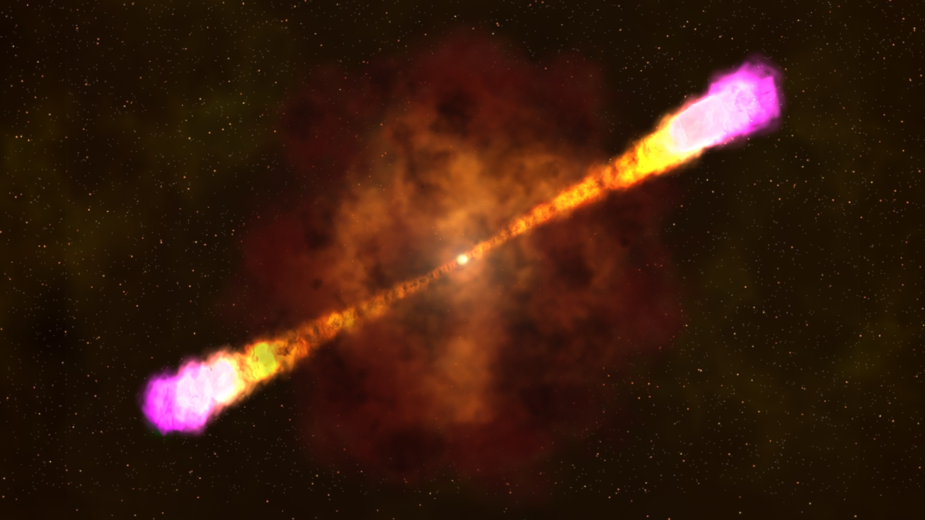
Exploring low-luminosity afterglows: automated optical follow-up of Swift GRBs with the Palomar-60 inch telescope
Aleksandra (Ola) Bochenek
(they/them)
PhD Student, Liverpool John Moores University
Supervisors: D. A. Perley, G. Lamb. C. Copperwheat

Slide 2
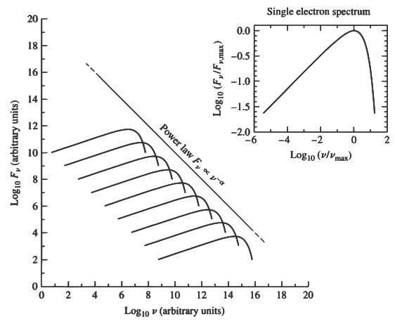
Gamma-Ray Bursts
Prompt (gamma) emission – due to ultra-relativistic shocks in the exploding material
Afterglow – relativistic forward shock interacting with circumburst material
synchrotron radiation
Carroll & Ostlie+2007
Notes:
The prompt emission is produced by the ultra relativistic shocks in the exploding material. And the afterglow is forward shock interacting with circumburst material, slowing the jet down and making it spread. The interaction produces synchrotron radiation, composed of individual spectra of electrons, which produces ideally is very nice power law decay.
relativistic charged particles are accelerated in magnetic fields

Slide 3
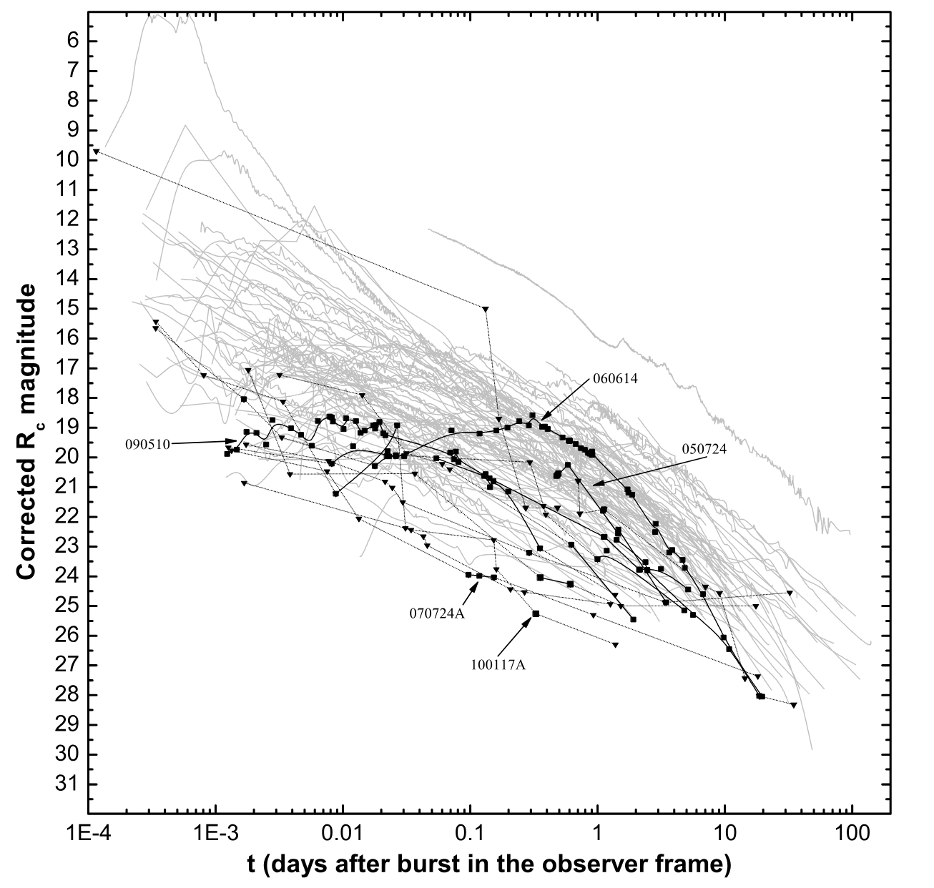
Gamma-Ray Bursts
Lots of samples and surveys done!
But - some jet population statistics needed, e.g.:
jet opening angles,
peak energies range,
very early afterglow behaviour,
luminosity distribution
what happens at low energies
orphan afterglows
… etc
New facilities detecting high-energy transients/afterglows (ZTF, EP, SVOM, LSST)
my project!
Kann+2011
Notes:
Of course there have been a lot of samples published, the ones that come to mind are Kann’s 2010, 2011 papers, and they have given a good overview of the general GRB population. But there’s still a lot of variables we don’t really understand, it’s difficult to minimise selection effects in the studies, so we don’t necessarily have really robust studies made with unbiased samples. So things that would be good to know, are, for example,
- early behaviour & low energies enabled by the sample
- want to see what we see and what we don’t see so that we can also constrain the orphan afterglows population
(ZTF, SVOM, EP, LSST - how do we know if what these facilities are seeing is "new"?) etc. What does the complete population look like?
Previous samples, e.g. Kann+2010, 2011, Gehrels 2008, etc
Optical automated follow-up samples from ROTSE, Liverpool Telescope
Constraining characteristics, e.g.
Opening angles: Ryan+2015, Wang+2020
Lorentz factors: … big list ?
kANN: The afterglow data was combined from multiple sources. It showed a weaker bimodal distribution of luminosity across merger and collapsar GRBs than was previously assumed, attributed in part to Swift's sensitivity to lower energies and improved capabilities in the follow-up of faint objects. It also showed that the scatter in luminosities is the same for Type I (merger-related, and typically short-duration) and Type II (collapse-related, and typically long-duration) GRBs.

Slide 4
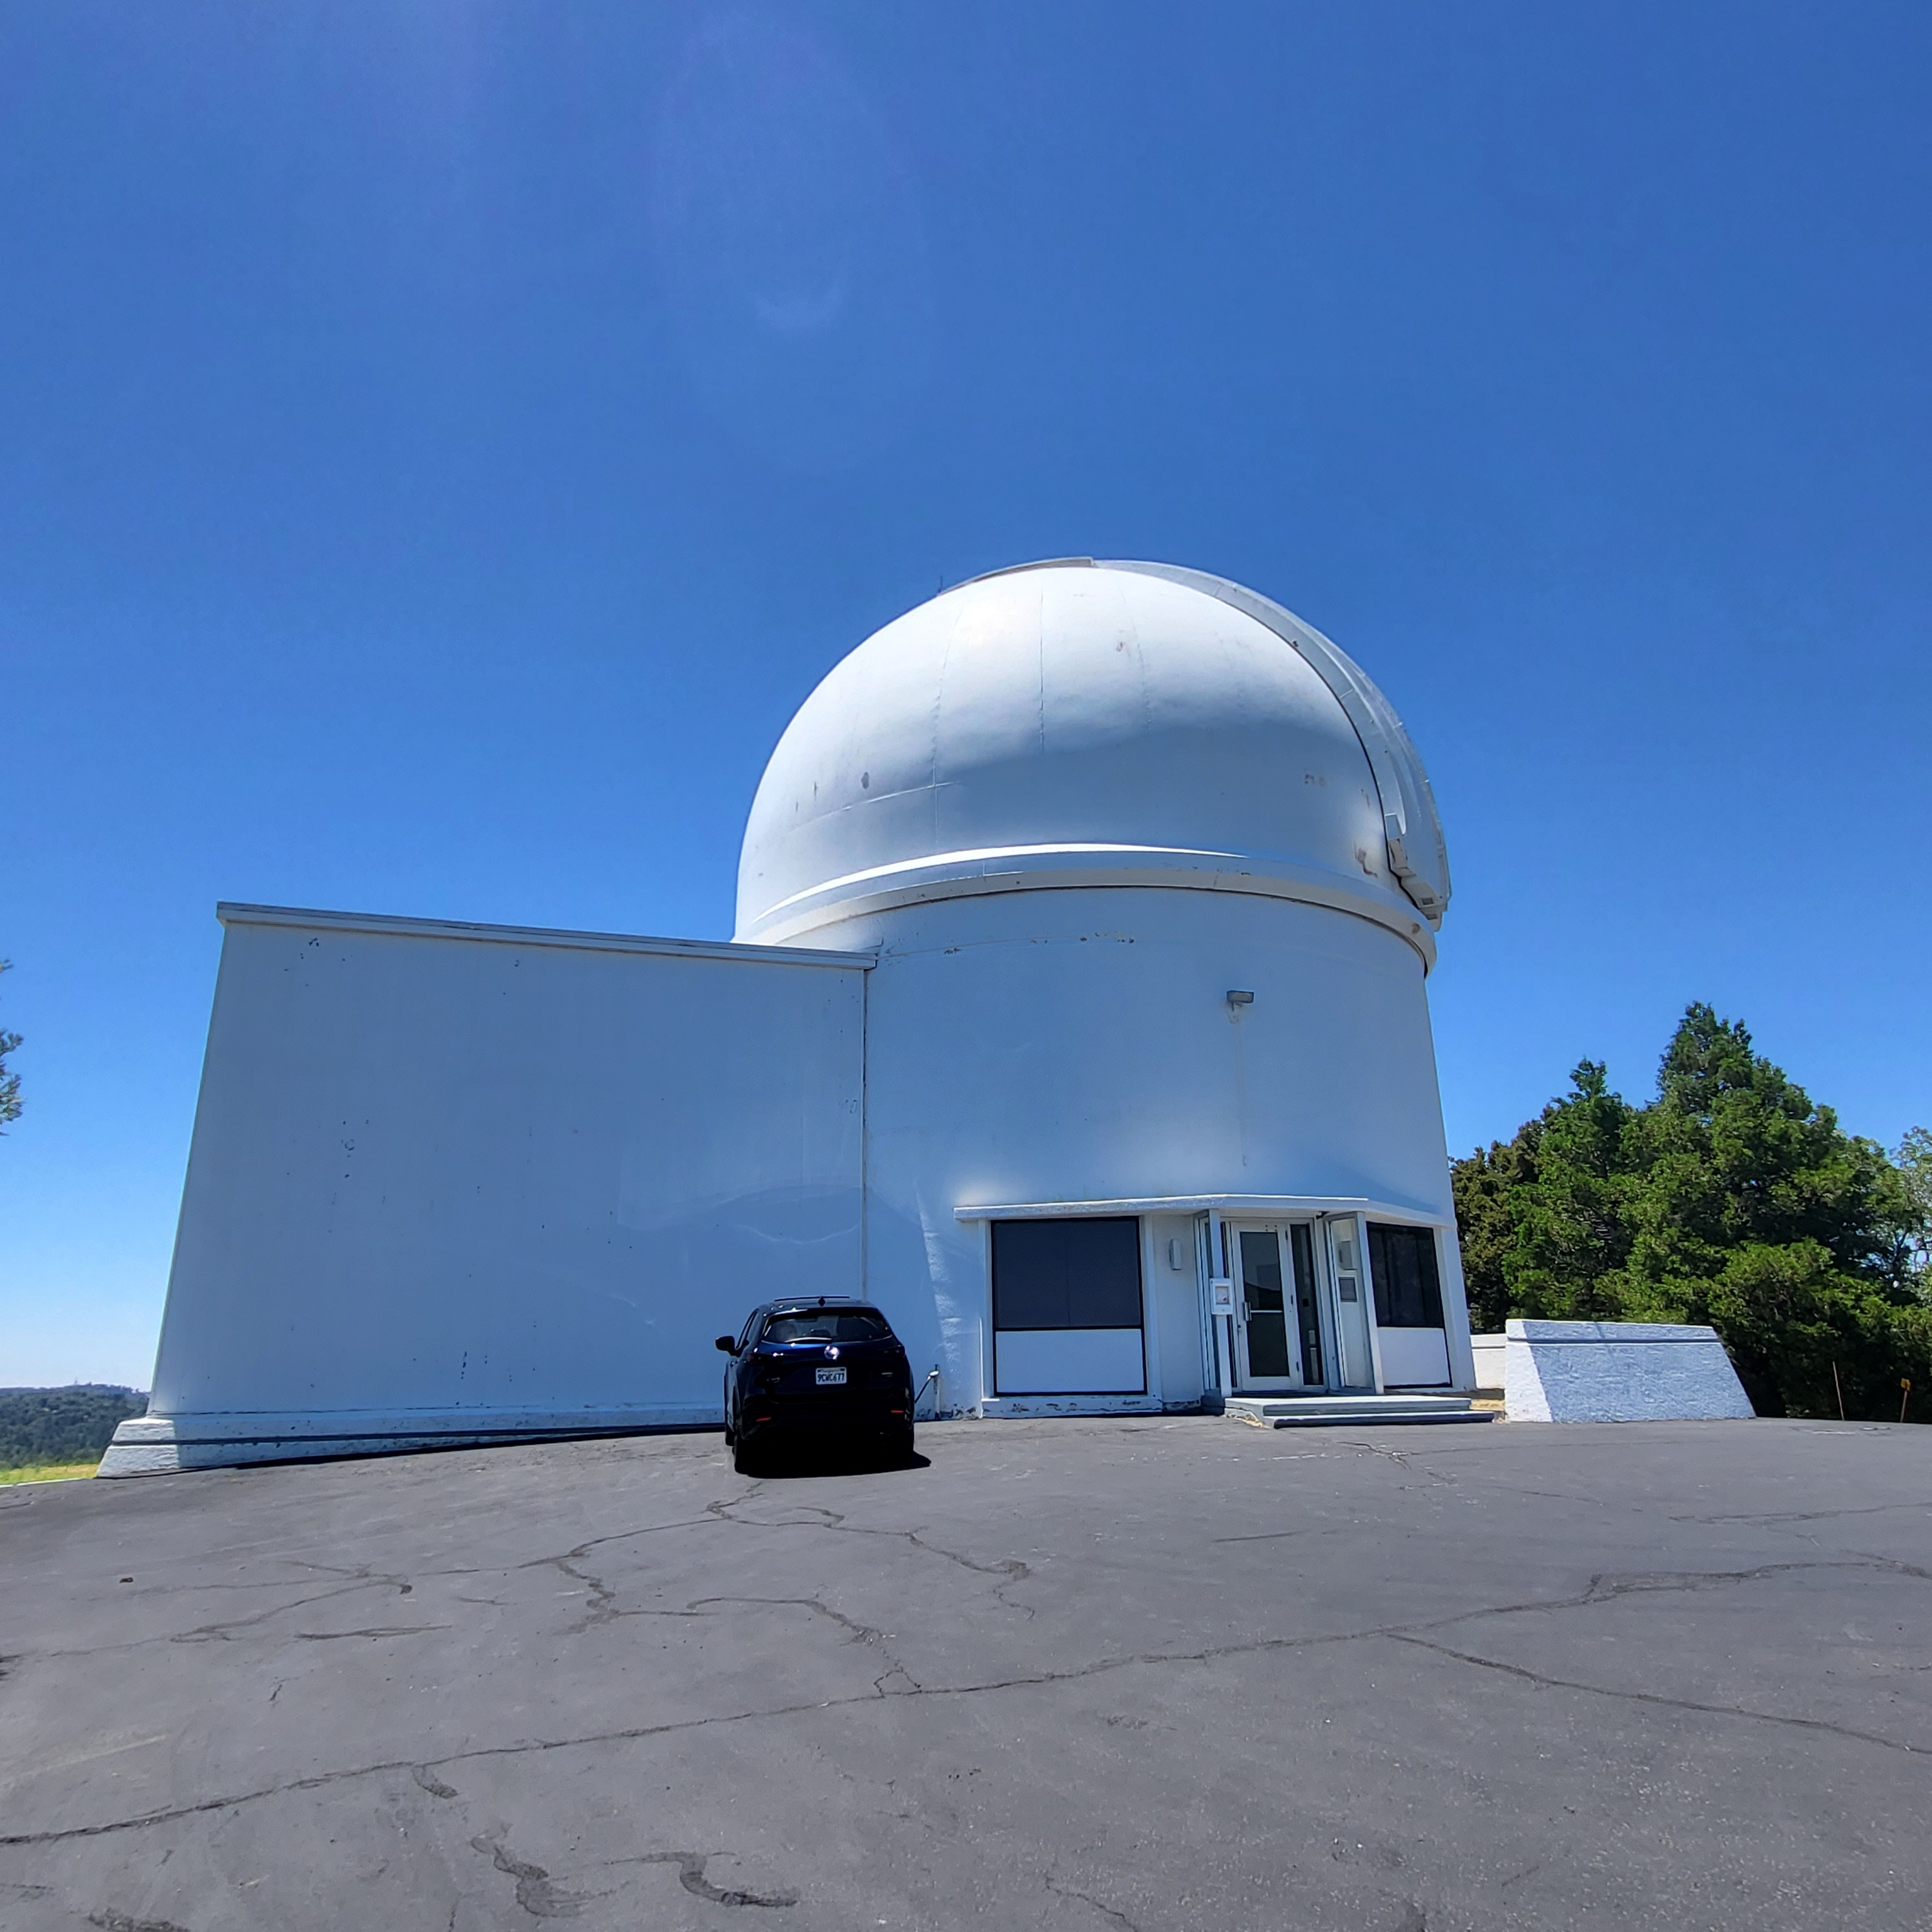
P60 – Palomar 60-inch telescope
Cenko+2006, Cenko+2009
Automatic, unbiased optical follow-up of Swift alerts in 2004 – 2016*
Minimum response time < 2 min
Sample of bursts observed within one hour
63% detection rate
Typical depth: r ~ 20 mag in a single 60s exposure
Imaging in the g, r, i and z filters
87 early observed GRBs
55 with a detection – 63%
40 with redshifts
36 with $≥$ 5 data points
full analysis of 41% of the sample
Notes:
- automatic, unbiased sample
- project led by Brad Cenko, and this work is expanding on that
- till 2016 because ZTF later
- min response 2 min, 63% detection rate, typical depth, red filters allowing us to see dustier grbs
- early within one hour of swift trigger, swift well localized, one hour gives decent lum distribution
But, even though we have been observing GRBs for decades now, we don’t actually have their characteristics super well constrained, like jet opening angles, or what is actually the distribution of peak energies, etc.

Slide 5
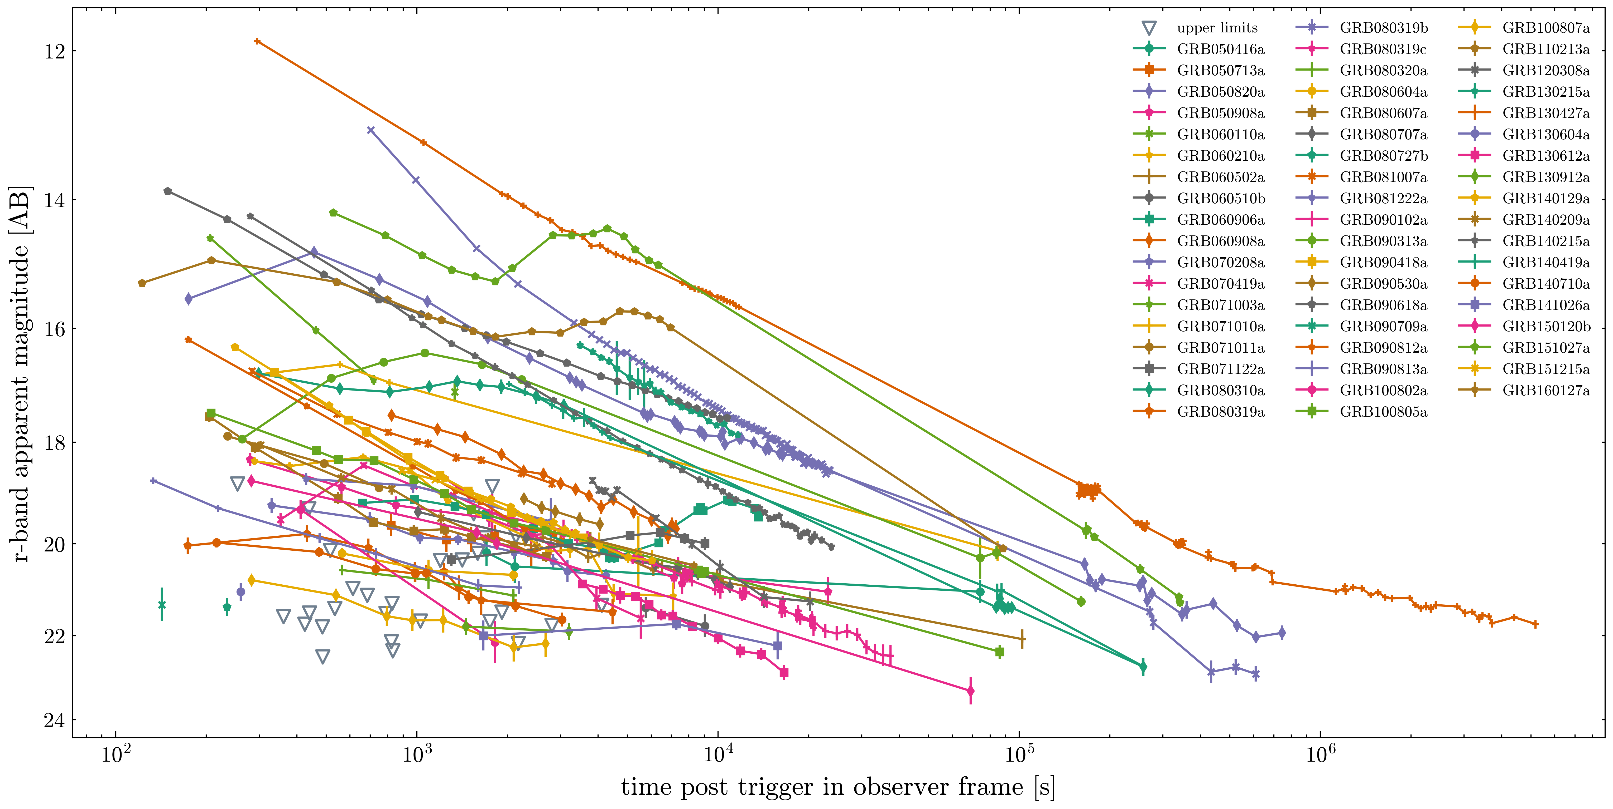
P60 GRBs
Notes:
Again, ~40% not detected within one hour, to the limit of around 22 mag,
The afterglows show lots of variability, love to see it
I’ve not made a slide on it because i don’t want to make it boring, but the bulk of the work was identifying those early afterglows and doing the photometry and triple checking everything. Fit with Cenko’s published part of sample but

Slide 6
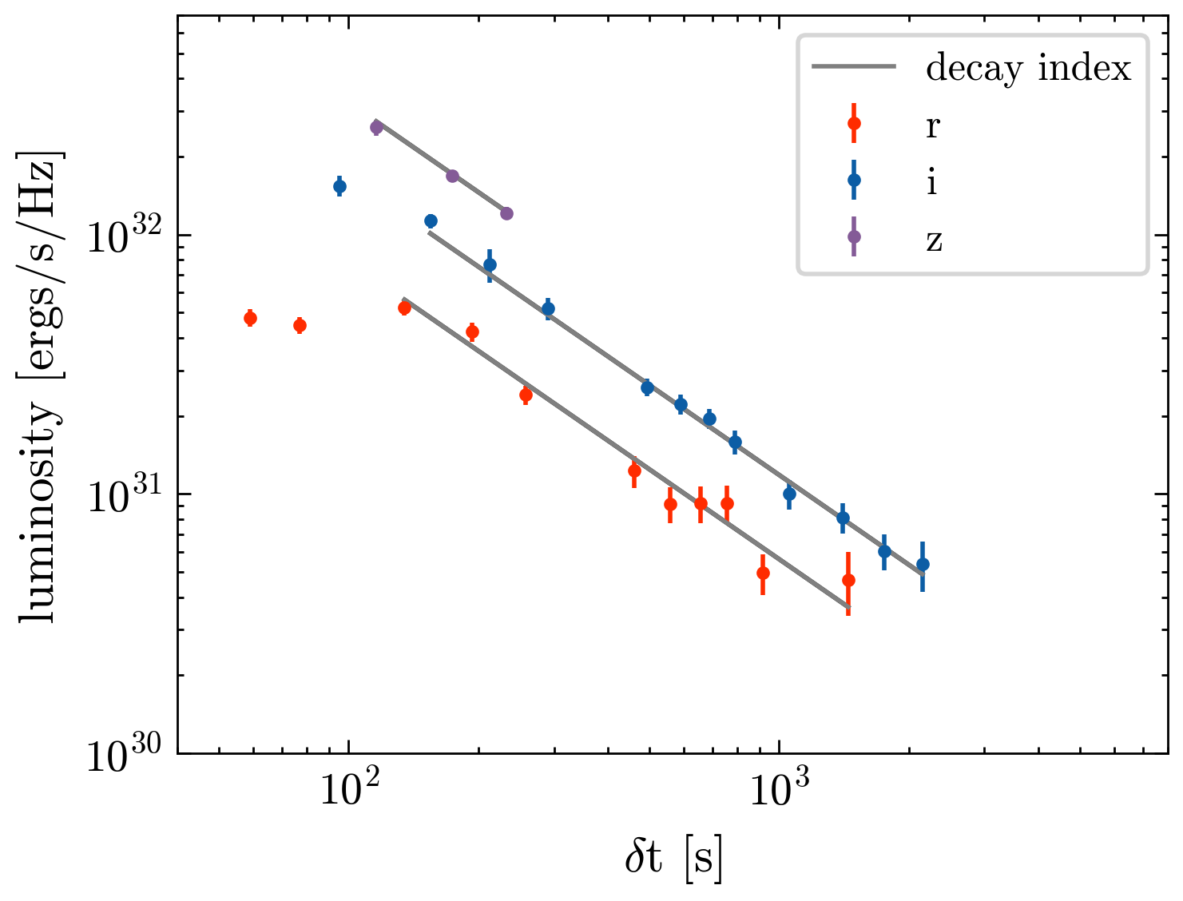
Decay and spectral indices
For events with redshifts, in rest frame, after all corrections:
Decay index $α$and spectral index $β$ at t = 0.1h, 0.28h (=1000s), 1h, 2h, …
Plane in log space approximated by
$$F∝t^{α}ν^{β} → log⁡(F)∝α\log\left(t\right)+β\log\left(ν\right)+c$$
GRB060210a
Notes:
Events with redshift were moved to rest frame, and i need to point out they were not corrected for host extinction. They were fit in both spectral and temporal directions at the same time as planes as logged planes to really get the most of the data to obtain their decay and spectral indices, which allowed us to get their luminosities out and basic characteristics without the need for modelling.

Slide 7
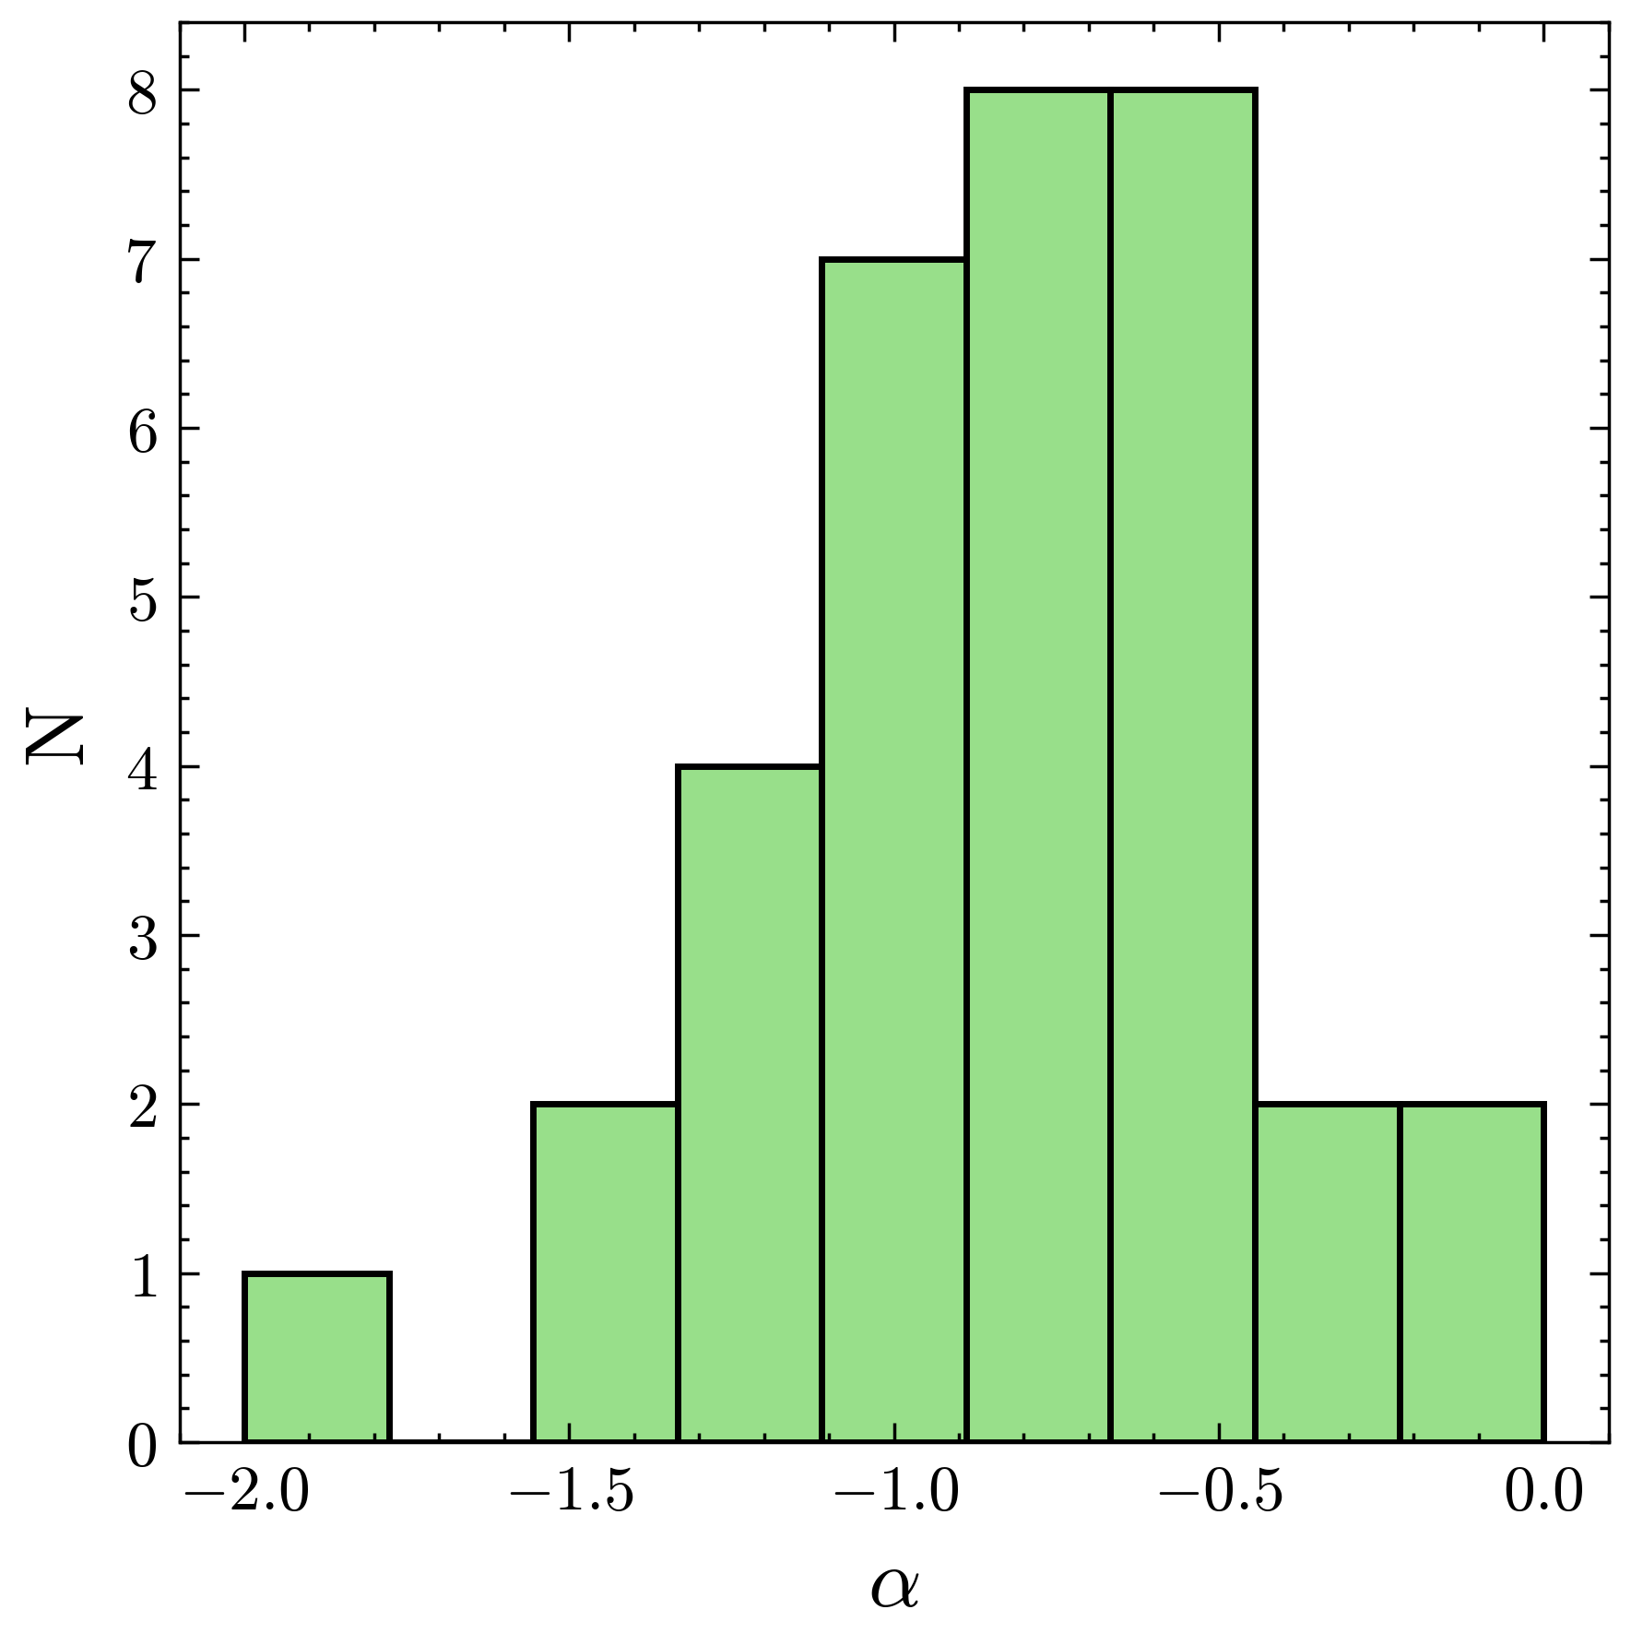
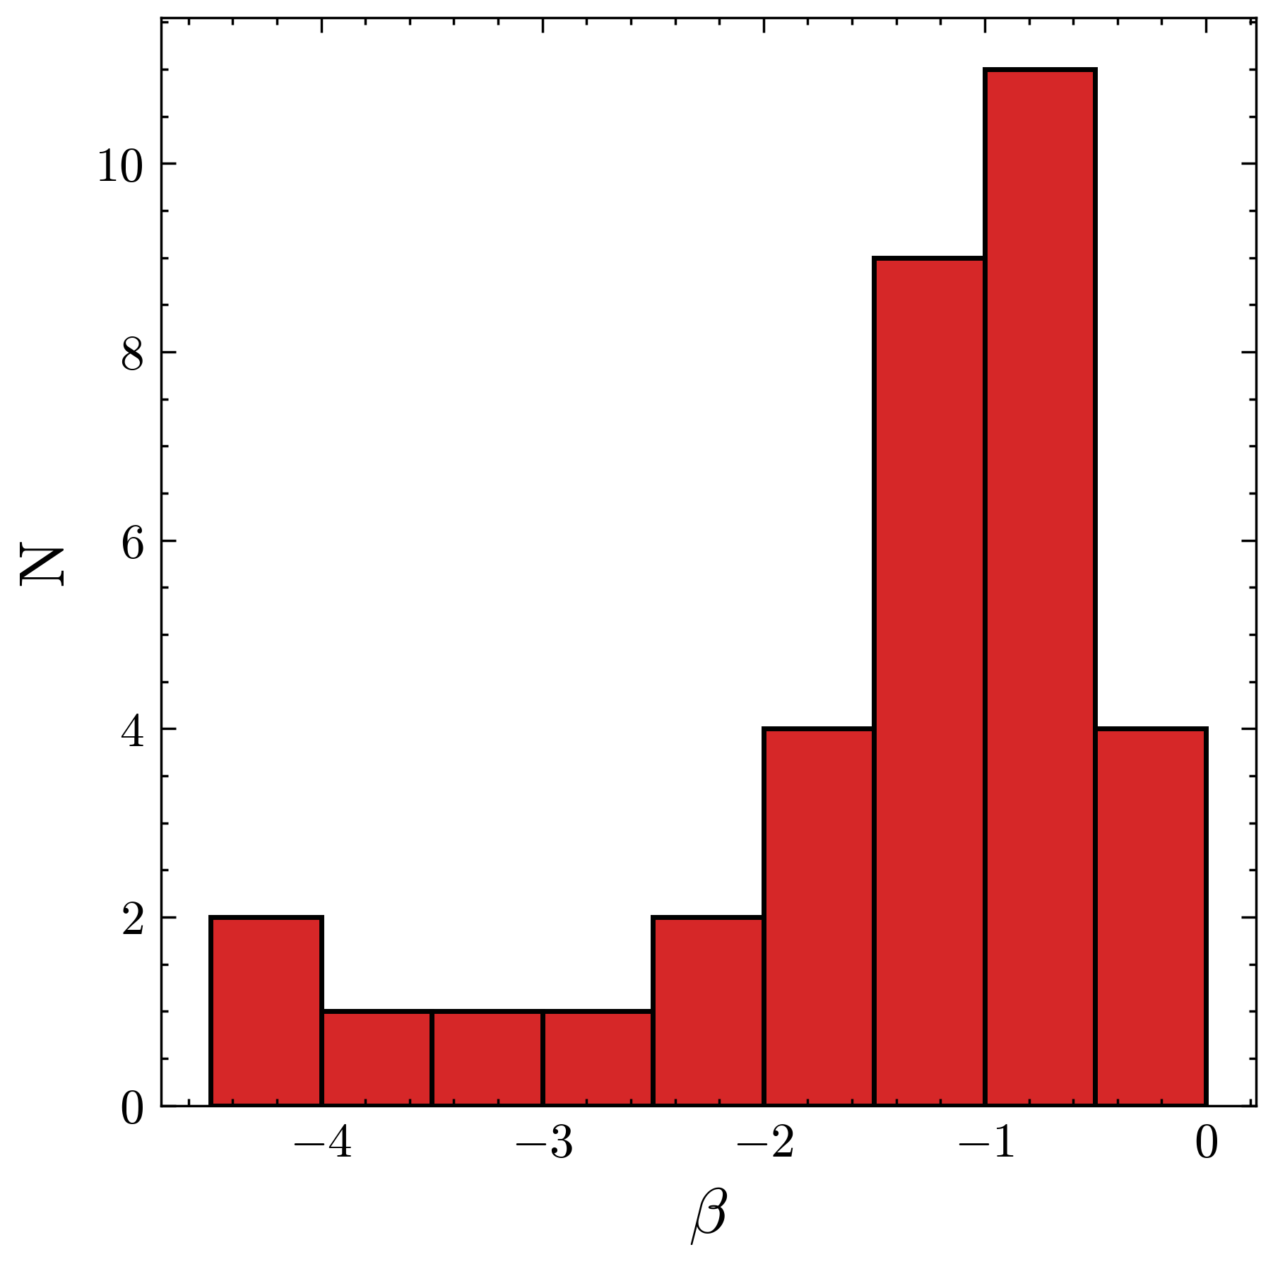
Decay and spectral indices at t = 1000s
Decay index $α$
Spectral index $β$
typical range
host extinction
~20% very dusty
Jet break at $α<−2$
Notes:
The decay index is less steep than some other samples, which makes sense because it's taken at a much earlier time. There isn’t anything at alpha less than -2 which makes sense again because that's associated with jet break.
The beta distribution is slightly more interesting and requires a little bit of explanation because, as I said before, we did not perform any host extension and because our coverage is in the redder bands, we do see the impact of host extinction. And so we have a peak around the typical range for spectral index, and the tail shows host extinction, and we can say that around 20% of GRBs in the sample are very dusty, although a lot more show some sort of curvature in colour space.
$α$ mean: -0.75 median: -0.81 stdev: 0.56
$β$ mean: -1.46 median: -1.09 stdev: 1.06

Slide 8
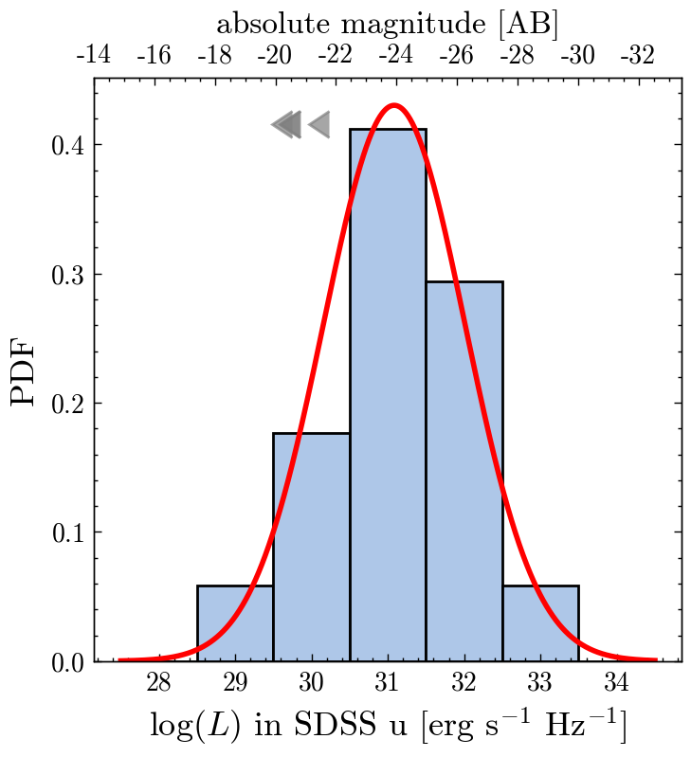
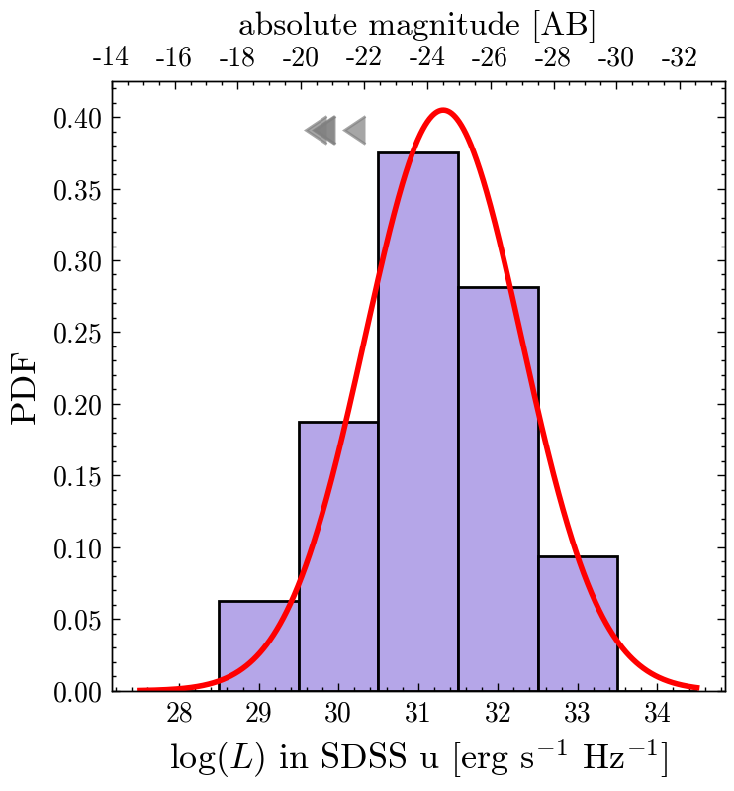
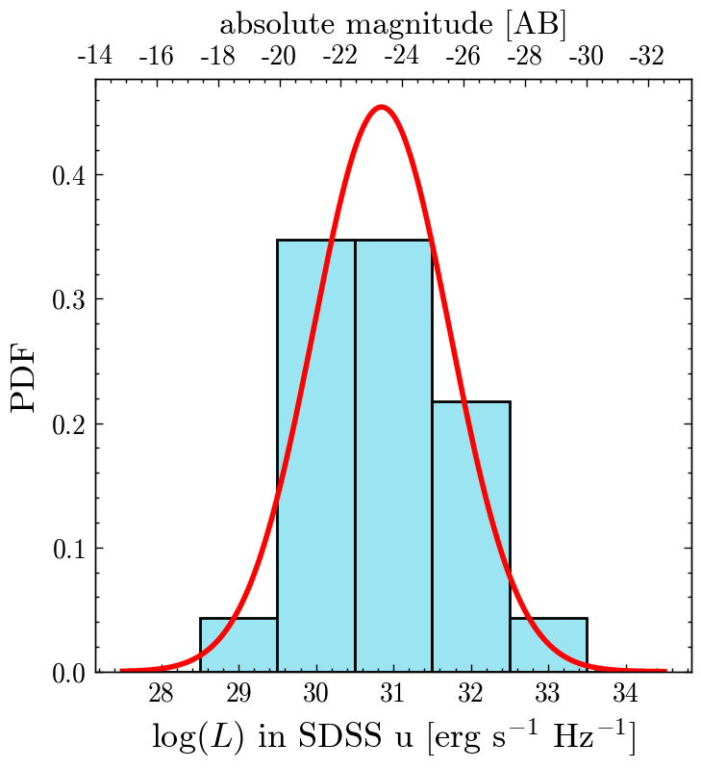
Luminosity
(in u-band in rest frame)
0.28h
1.27 x 10³¹ ergs s⁻¹ Hz⁻¹
0.1h
1h
7.0 x 10³⁰ ergs s⁻¹ Hz⁻¹
2.1 x 10³¹ ergs s⁻¹ Hz⁻¹
Notes:
Luminosity was calculated to be in the u band, which at redshift = 1 produces radiation that would be seen on Earth at around the r-band. And the luminosity has a normal distribution although one could say it there is potentially a bias towards lower luminosities. Luminosities derived at later time are a bit flater and actually show peak at a marginally higher luminosity, since there are now observational effects in place; the least luminous afterglows have faded, or the observation cycle are starting to finish.
For comparison, SN would usually have a peak around 20 mag, reaching very rarely 24-25 mag. so GRBs can be much brighter than that, in the first minutes of afterglow emission.
and we see that they have also a huge range of magnitudes.

Slide 9
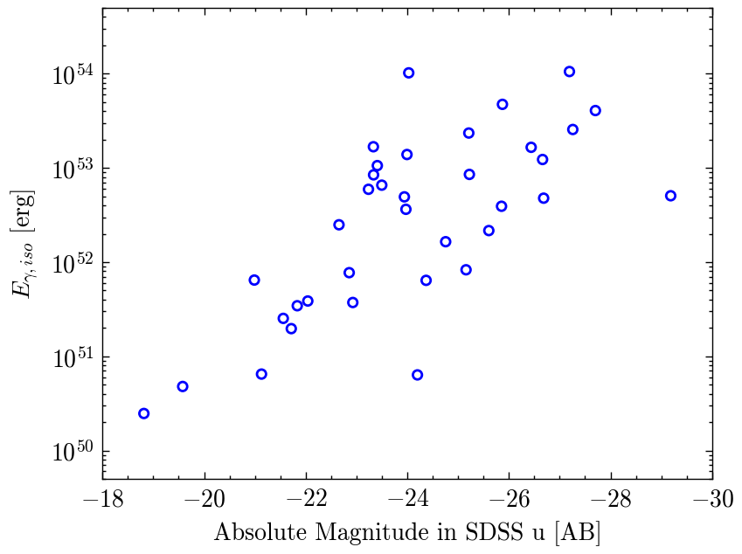
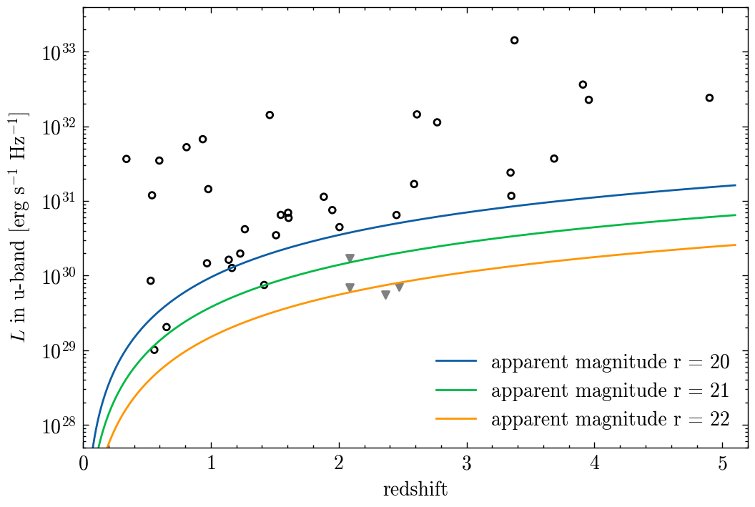
Luminosity
(at 0.28h = 1000s)
Notes:
The distribution of luminosity with redshift, shows exactly what it's supposed to show, P60 afterggows are set up as isotropically and then cut off with our observing limit. The shifting of wavelength with the redshift limits the detections.
Also a plot of the total isotropic gamma energy compared to the absolute magnitudes of the bursts, effectively showing that the more energetic bursts are brighter. Which makes sense, but there is some spread in that distribution as well.

Slide 10
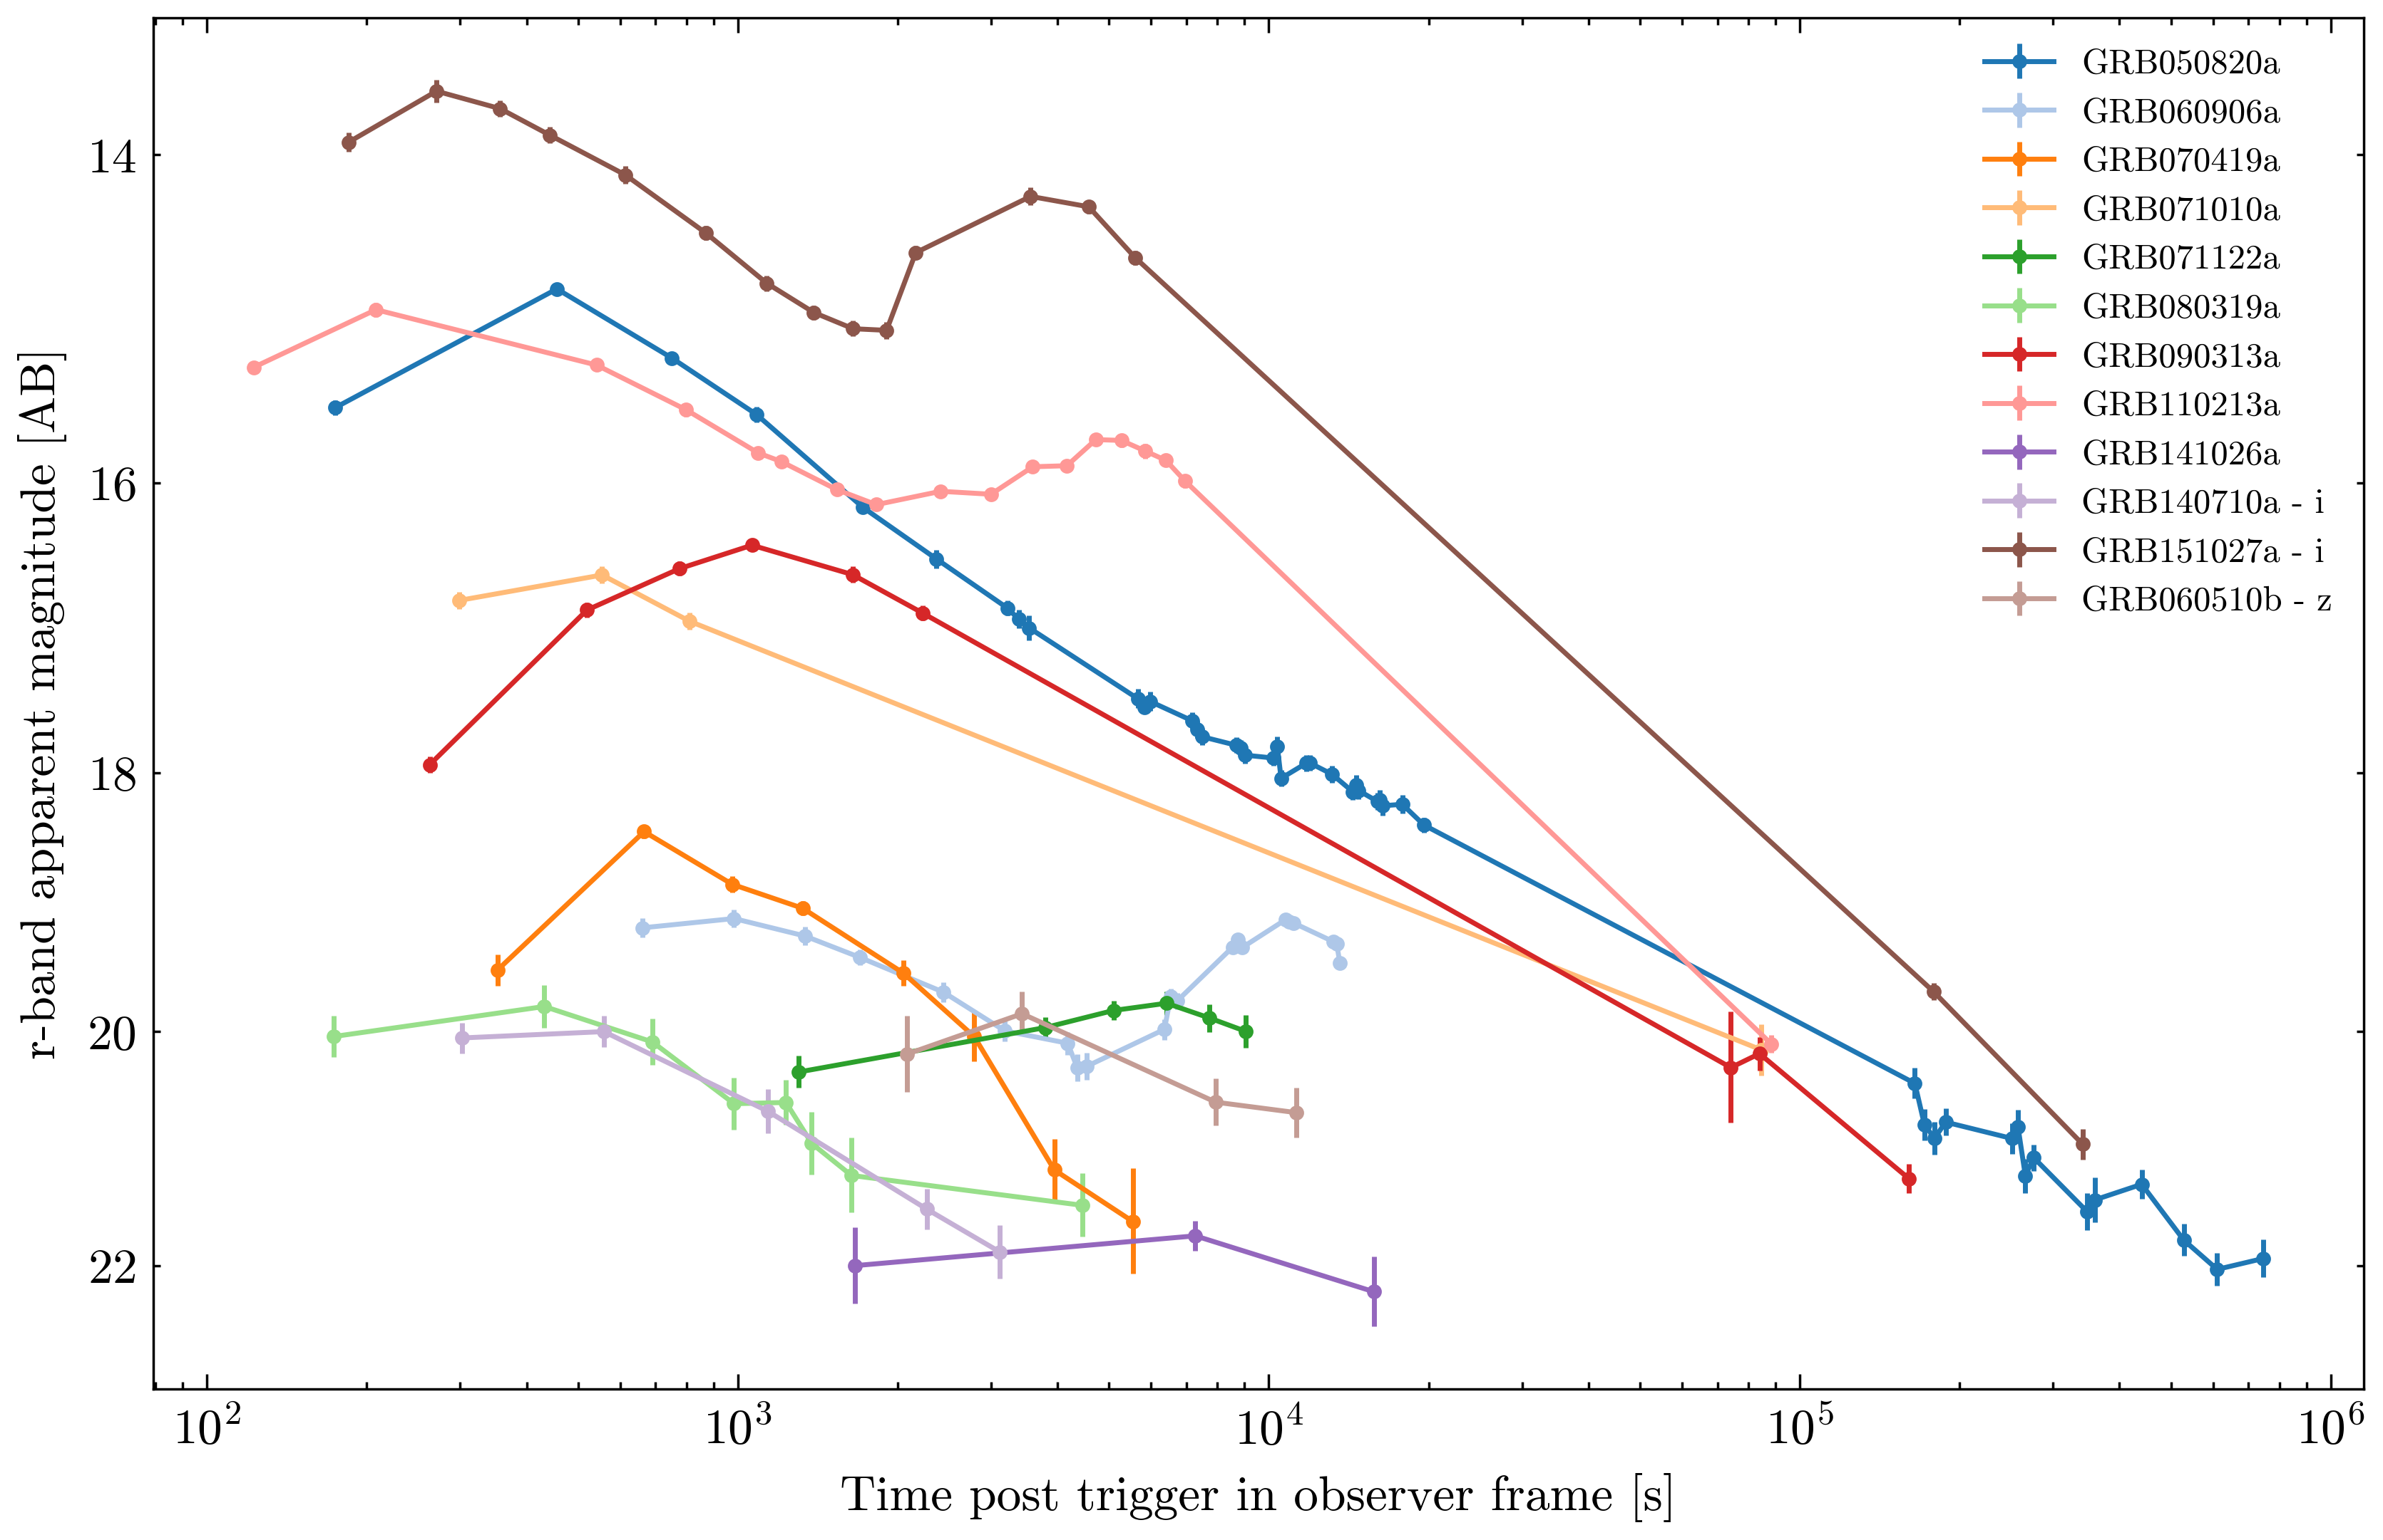
Constraining the afterglow rise
20% - afterglow rise or re-brightening?
Data showing X-ray flares or previous decay from other facilities for all but two afterglows
(and they have sparse and/or late data)
GRB090313a & GRB071010a
Notes:
several afterglows show some sort of rise at the beginning of the observations.
Put together with XRT data and reported observations from GCN, that were taken before the P60 observations, all the bursts but two are coincident with XRT X-ray flaring or have a previous decay and the rise we see is refreshed emission or re-brightening or flaring, rather than the initial optical rise. Only two afterglows don't have that but at the same time they are the only two that don't have early XRT coverage. So we can constrain the rise time of afterglows to 100 seconds post trigger pretty definitely.
Also: 17/55 w/ bumps/flares/re-brightenings in general

Slide 11
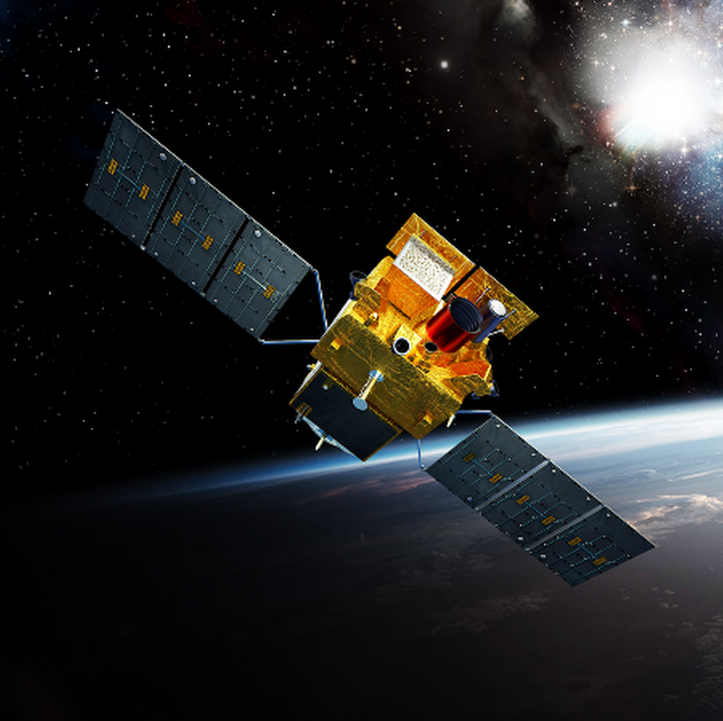
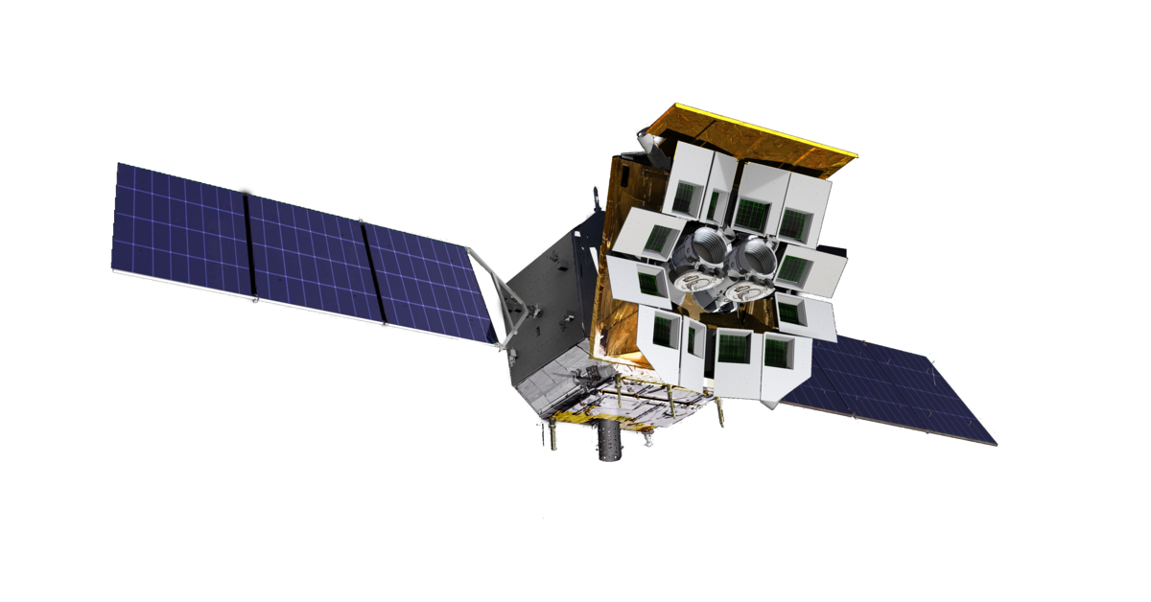
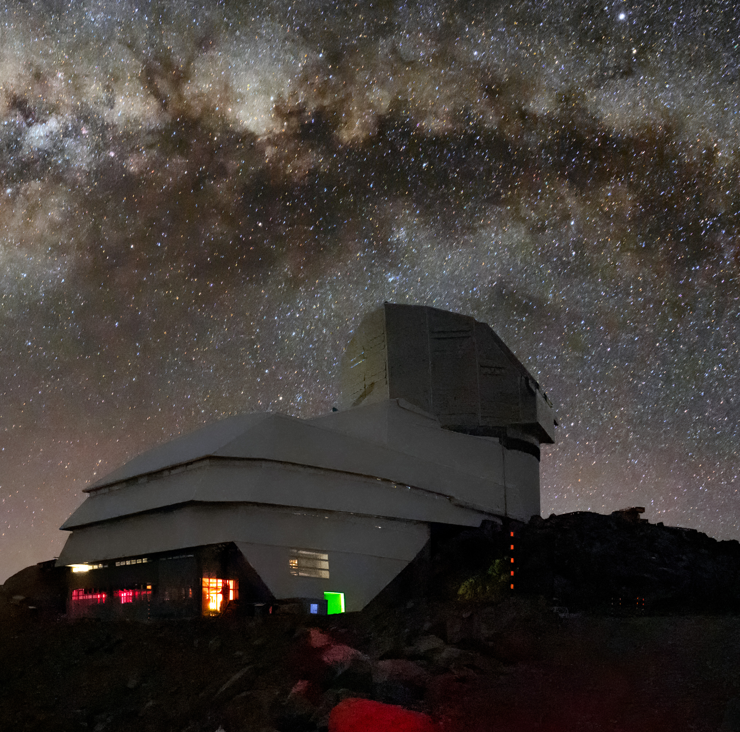
Extra: new science
SVOM
Gamma-ray
space observatory
- Wide instrument
range & dedicated
on-ground follow-up
EP
X-ray space observatory
Exploring new parameter space!
LSST
- deeper observations of
transients, incl. GRBs &
orphan afterglows
Notes:
having all this information from P60 will be helpful for understanding what we are seeing from EP and SVOM
especially in understanding exactly how expected or unexpected what they are seeing is.
And since SVOM has dedicated ground based follow-up, it will also be very interesting to see their results compared to Swift results.

Slide 12
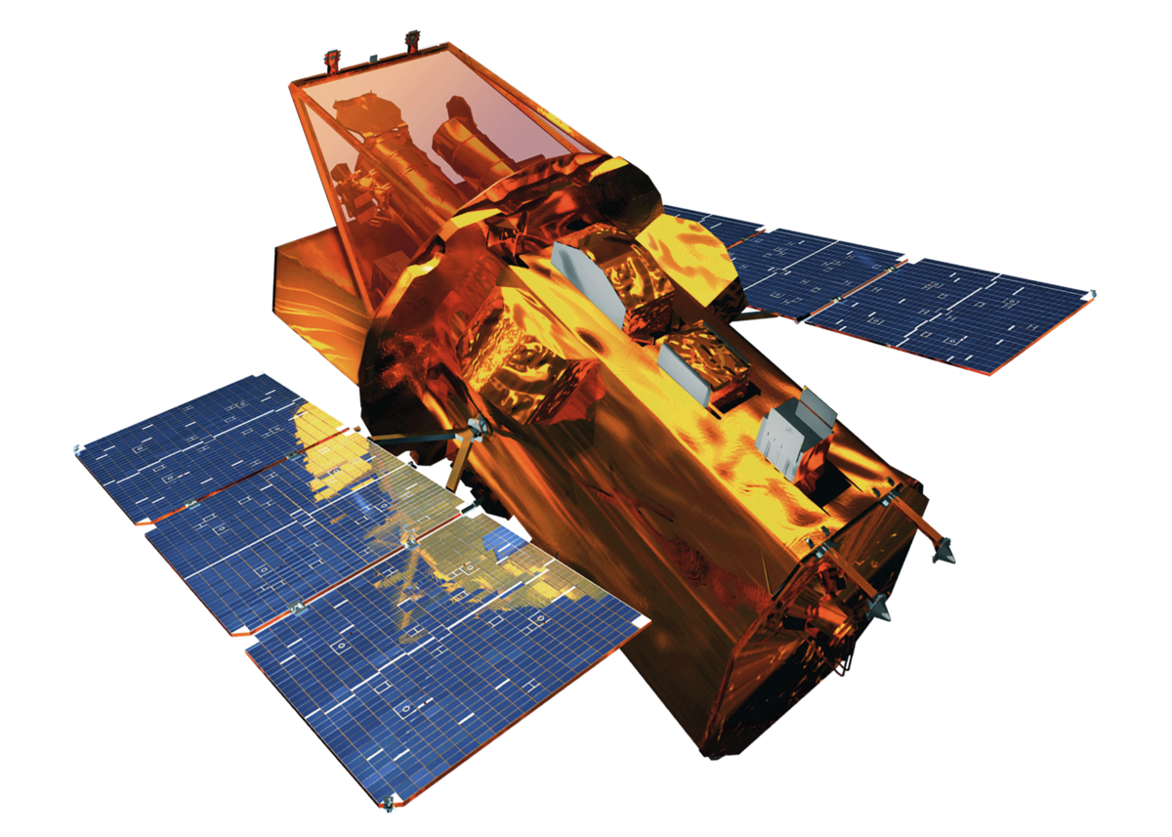
Summary
we can quantify what a typical afterglow looks like at very early times
63% detection rate within 1h post trigger
~ 20% very dusty afterglows
~ 20% with slow rises
lots of modelling in the future!
Notes:
The data will be published so look out for that

Slide 13
EXTRA

Slide 14
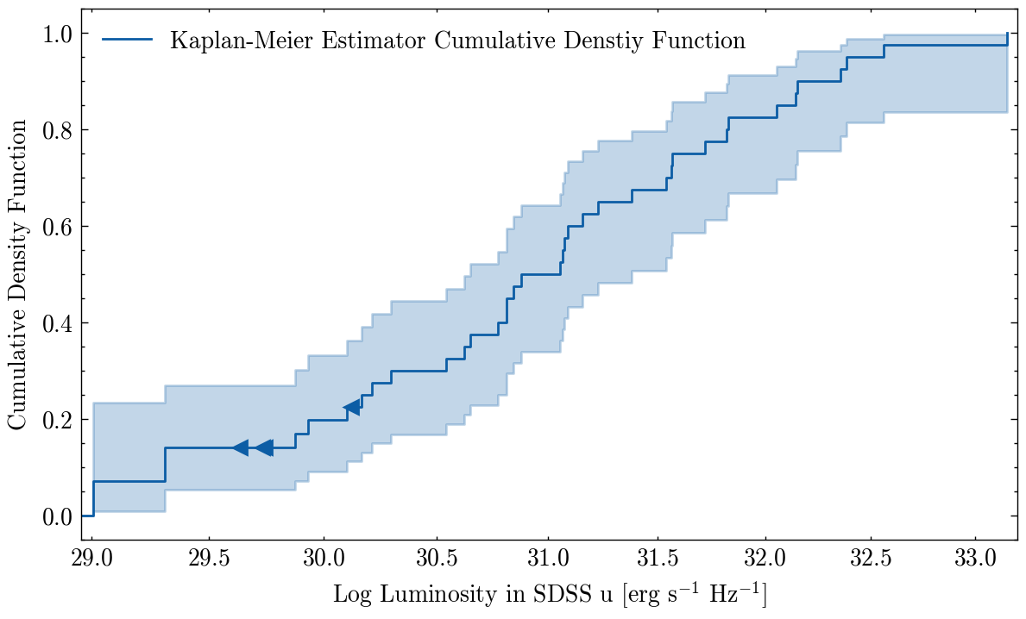
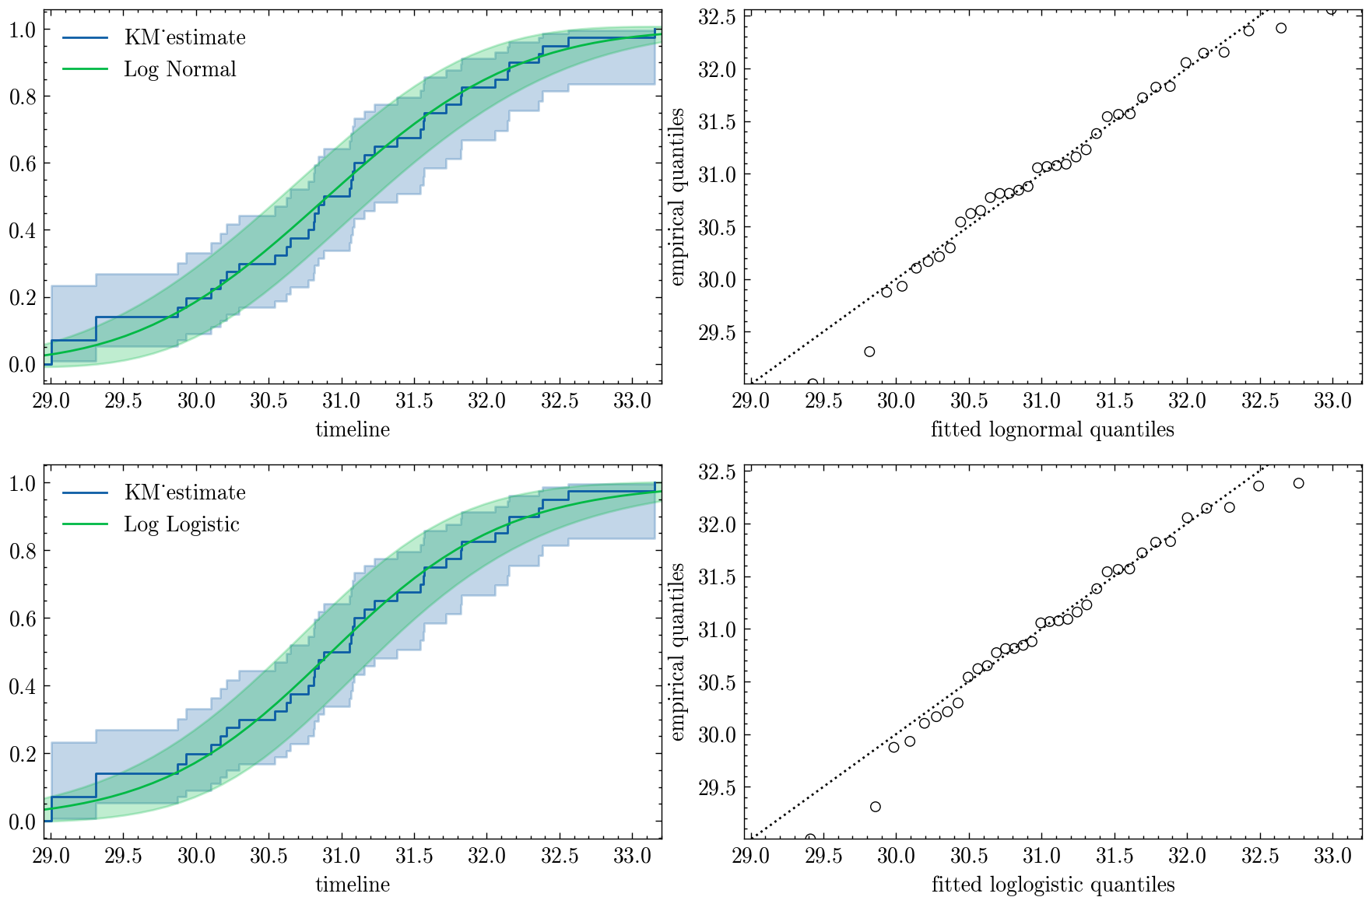
Luminosity
Empirical estimator – not dependent on prior model
Lognormal plot performs best
Notes:
Cumulative Distribution Function worked out with the Kaplan Meier estimator, which is an empirical estimator so it does not depend on any pre-defined models or functions, and it works very well when you have censored data, so data with upper limits. A few functions were fit to it and the normal distribution fits the best so far.

Slide 15
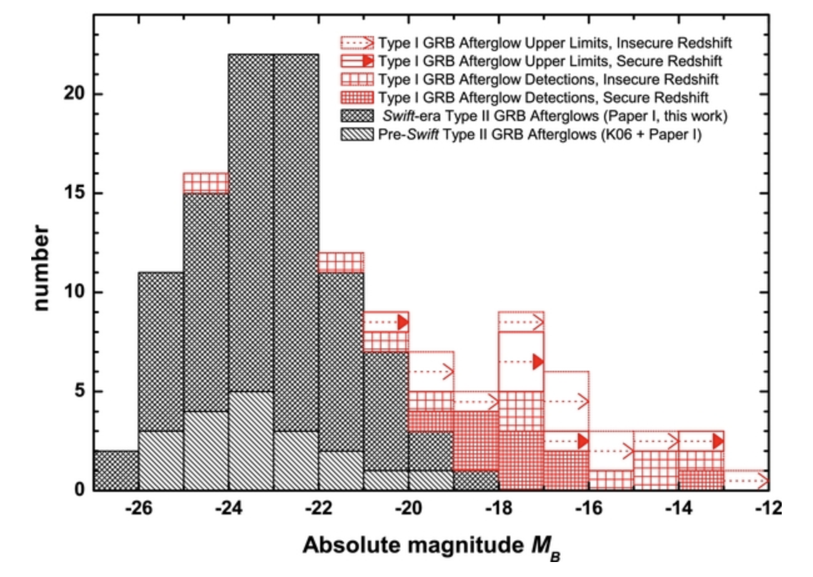
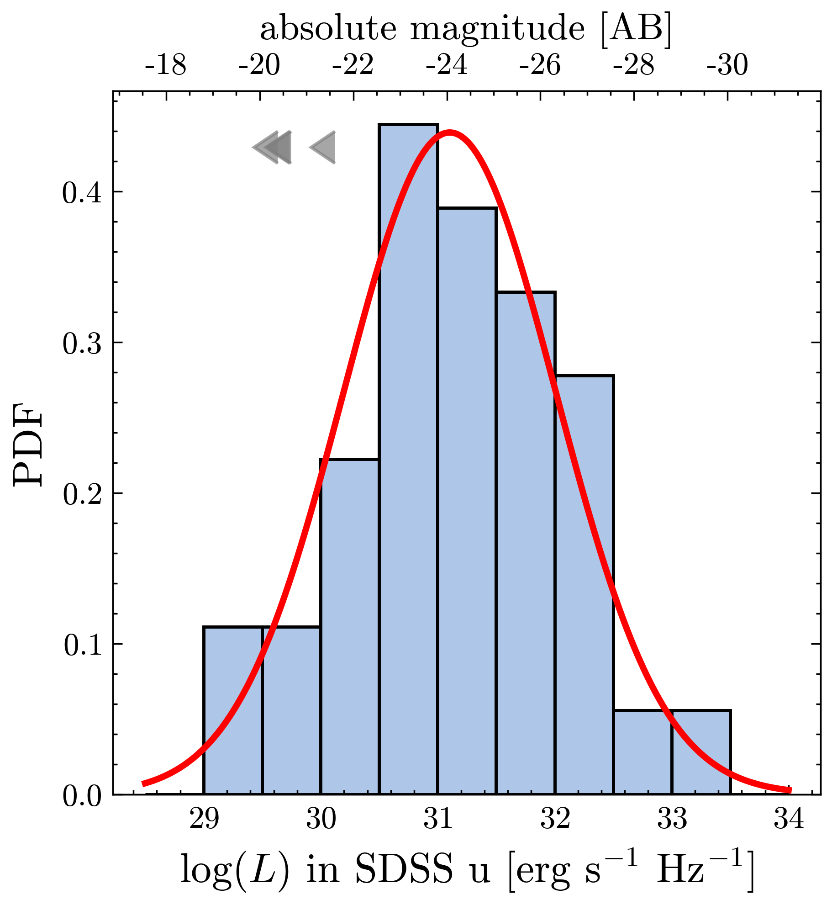
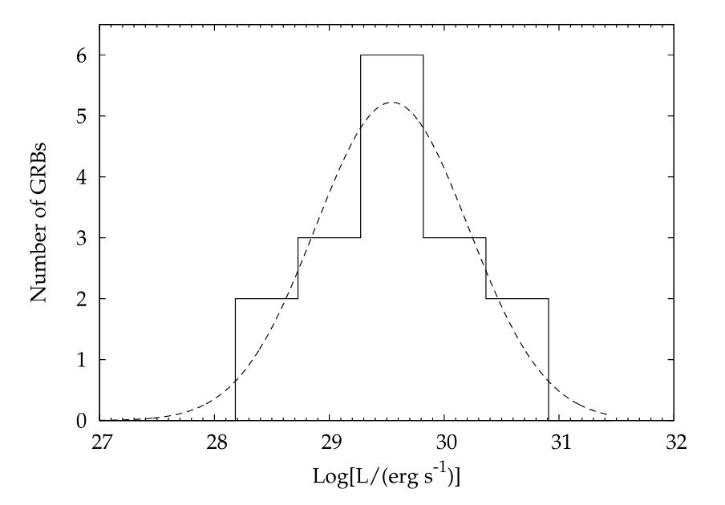
Extra: Luminosity
Kann+2011, at 1 day
Melandri+2008, at 12h

Slide 16
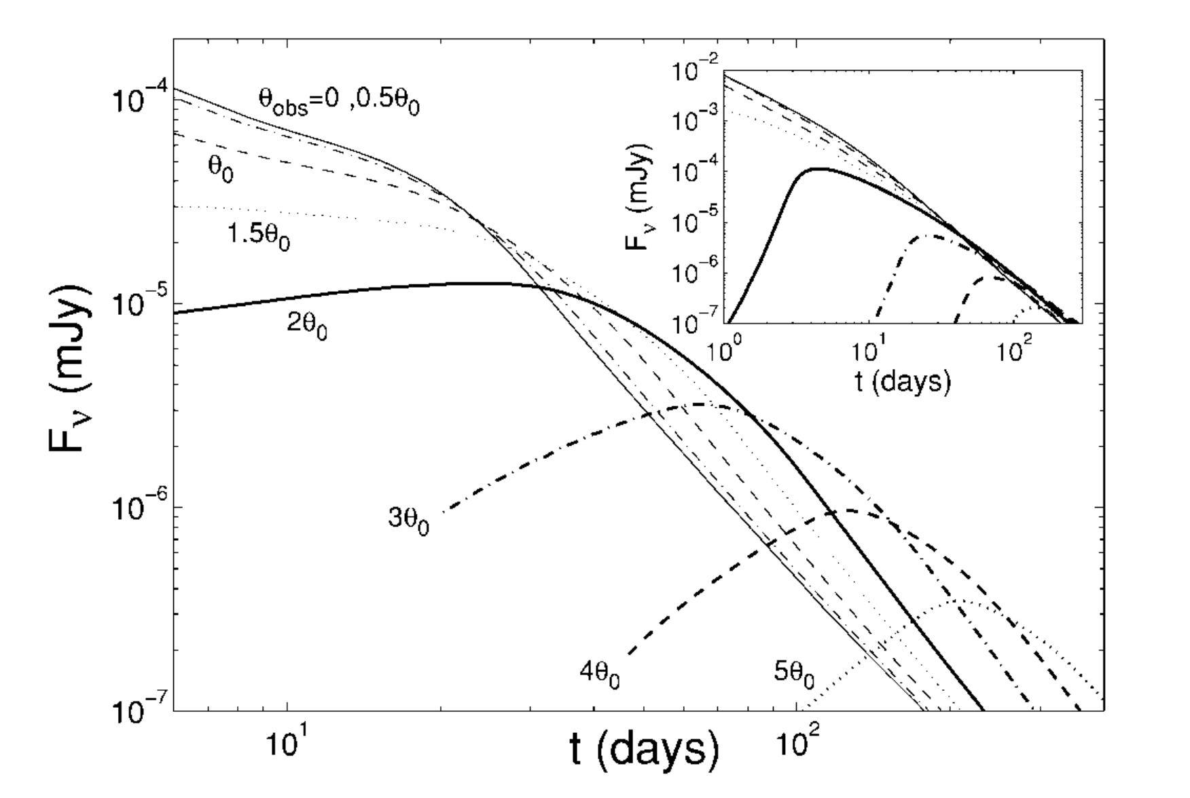
Orphan afterglows
Afterglows observed without corresponding prompt gamma emission
off-axis jets
dirty fireballs – on-axis jet but low initial Lorentz factor, e.g. $Γ$ ~ 20
Granot+02
16
Notes:
SO! Afterglows that are observed without corresponding prompt emission are called orphan afterglows! And they can be either off-axis jets, as explained before, or they can be also caused by something we call dirty fireballs. These are supposed to be on-axis jets, but the velocity of the ejected material is low enough , e.g. due to a presence of too many baryons, to suppress the production of high energy photons in the jet.
(due to the domination of pair-production )
And therefore they would have low initial Lorentz factors, like 20, or 40, compared to the GRBs 100-1000
And so we expect to see the orphan afterglows in all wavelengths, including in the optical, and due to geometric effects, we would see a rise of the afterglow on the order of hours or days, like shown here.

Slide 17
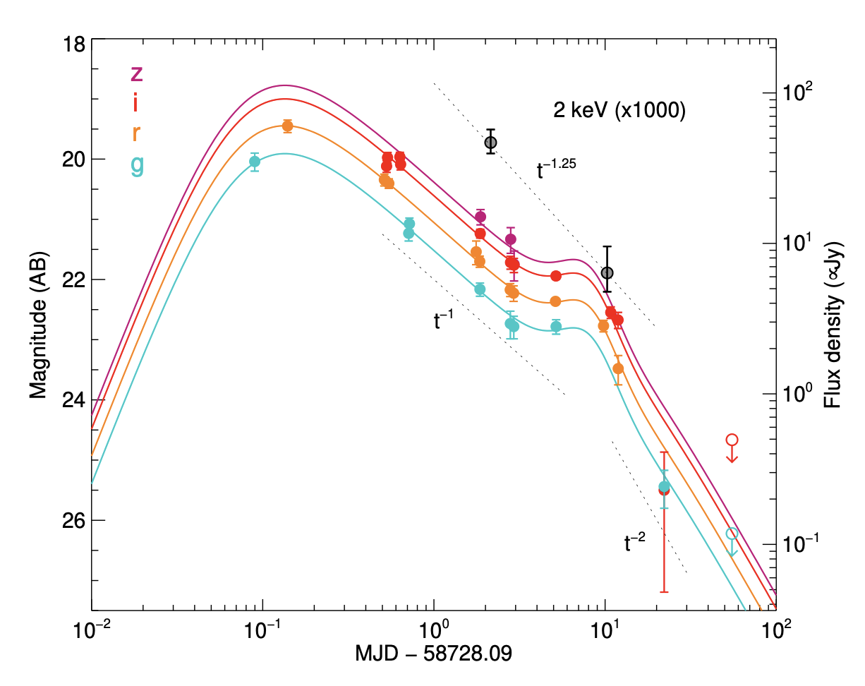
Orphan afterglows
Optical surveys, like ZTF!
We have around ~10 candidates, ~6 with redshift!
Modelling necessary to distinguish between off-axis or dirty fireball models.
AT2019pim, Perley+2025
(This one has the rise constrained by TESS, which was observing its location as it appeared)
17
Notes:
We do detect orphan afterglows! And while it is possible to find orphan afterglows in other wavelengths, optical surveys such as ZTF are incredibly important and give the best results.

Slide 18
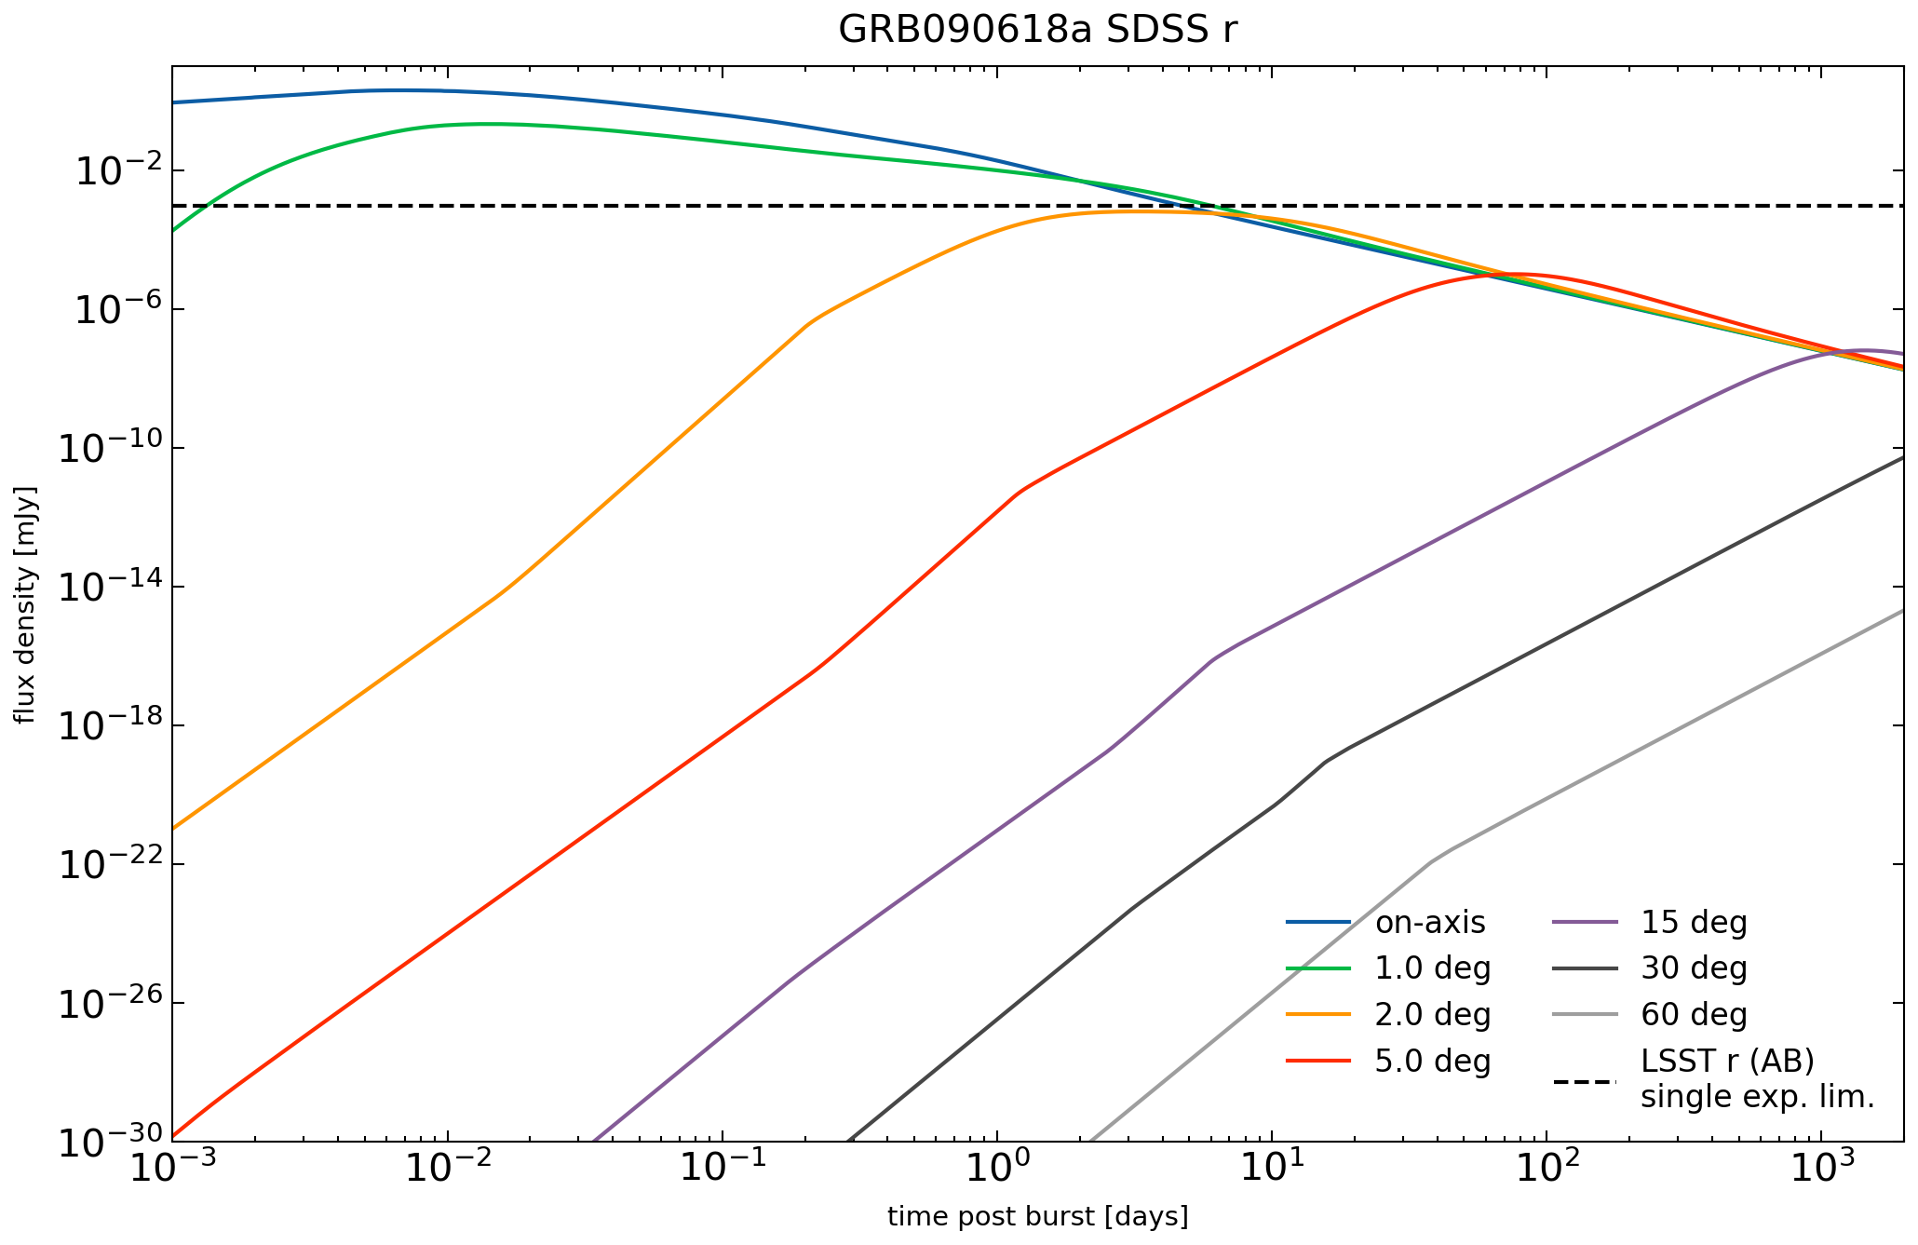
Orphan afterglows modelling
We expect most off-axis afterglows to be at a range of viewing angles, so they might rise on the scale of hours or days!
Exactly where the P60 sample is not looking!
A light curve of GRB090618a modelled in redback & plotted at different viewing angles
Notes:
Would be cool to have though!
(also this GRB just wasn’t very luminous in the first place)
Make sure to make these points earlier

Slide 19
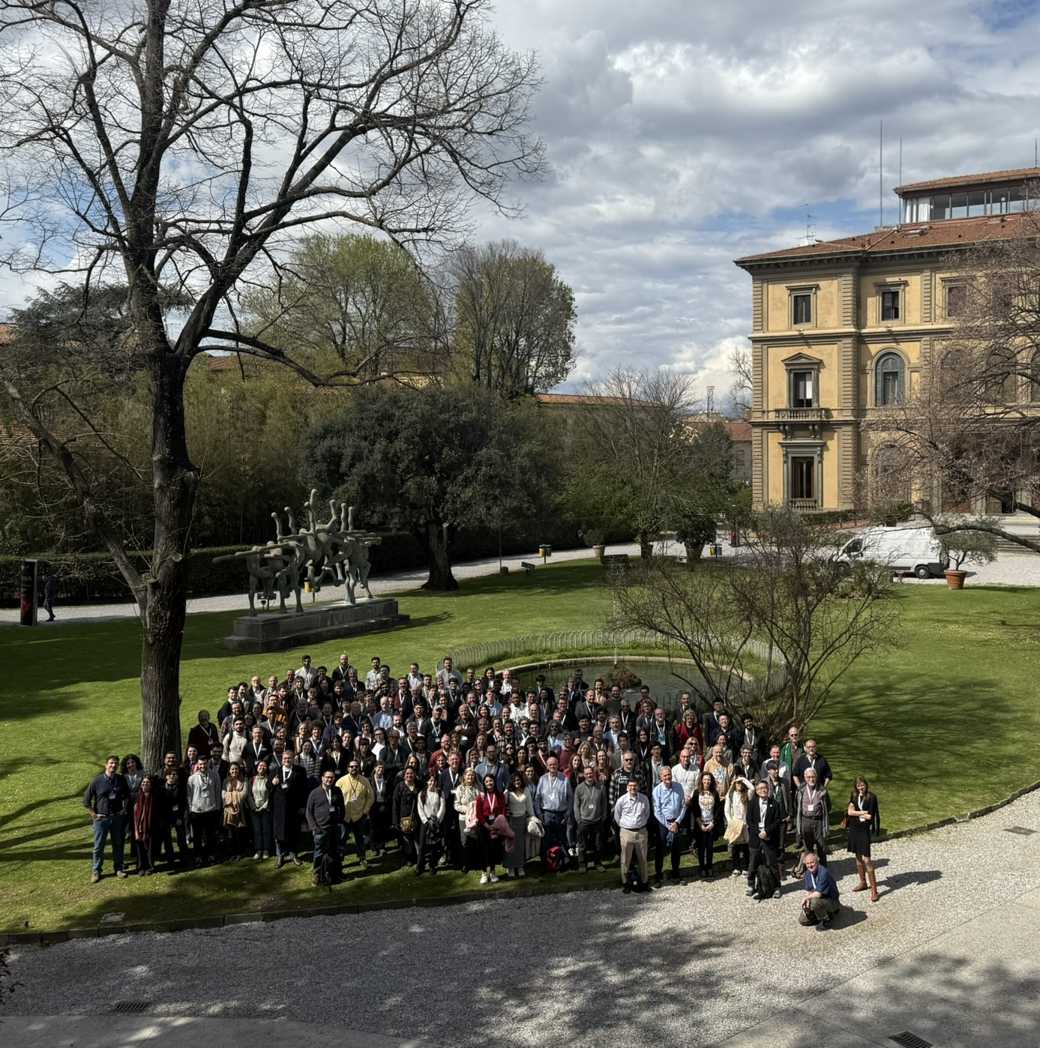
Swift mission
Launched in 2004,
started science operations in 2005
Instruments:
Burst Alert Telescope (BAT) – 15-150 keV
X-Ray Telescope (XRT) – 0.2-10 keV
Ultraviolet/Optical Telescope (UVOT) – UBV filters
Most importantly: good localization
20 years of Swift! 🎂
Notes:
Swift: good localization and follow-up in multiple wavelengths, so easy to follow-up with larger telescopes

Slide 20
Photometry
Technical stuff:
P60 data on IRSA
~ 200 GB of “early” data
Own photometry code with Astromatix software
Calibrated with Pan-STARRS 1 (or Sky Mapper at dec < -30 deg)
Cenko+2009 characterised the sample up to March 2008.
First test of my methods!
Sometimes significant differences due to different catalogs available (USNO-B vs PanSTARRS)
Notes:
(thank you PanSTARRS 🙏)
Single exposure image

Slide 21
On-axis
direction of prompt emission
afterglow opening angle
NASA/GSFC
- artist impression
Notes:
And the jets, due to them being jets, are very narrow, and have opening angles of typically a few degrees – double check that!!
And so we only see GRBs really when they are on-axis.
jet break,
at $Γ=\sim 1/Θ_{jet}$

Slide 22
Off-axis
direction of prompt emission
afterglow opening angle
NASA/GSFC
- artist impression
Notes:
UNLESS. There are moments when we can move off-axis, and either view the jet core off-axis, but still see prompt emission, technically, as was the case for the famous GRB170817a associated with the neutron star neutron star merger.
or we can miss the prompt emission completely, and just see the afterglow.
And so this project is slowly moving in the direction of working with those afterglows, but not yet!
jet break,
at $Γ=\sim 1/Θ_{jet}$

Slide 23
Mag corrections – no need
Milky Way dust extinction – corrections from Schlegel+98, recalibrated by Schlafly & Finkbeiner+11
K-correction – redshifts from Swift archive, K-correction following Hogg+02
Relativistic effects on duration and frequency
$L_{v_{e}}= \frac{4πD^{2}L}{1+z}F_{ν_{o}}$ , with $v_{e}=\left(1+z\right) v_{o}$
$$t_{r}= t_{o} / (1 + z)$$

