Slide 1
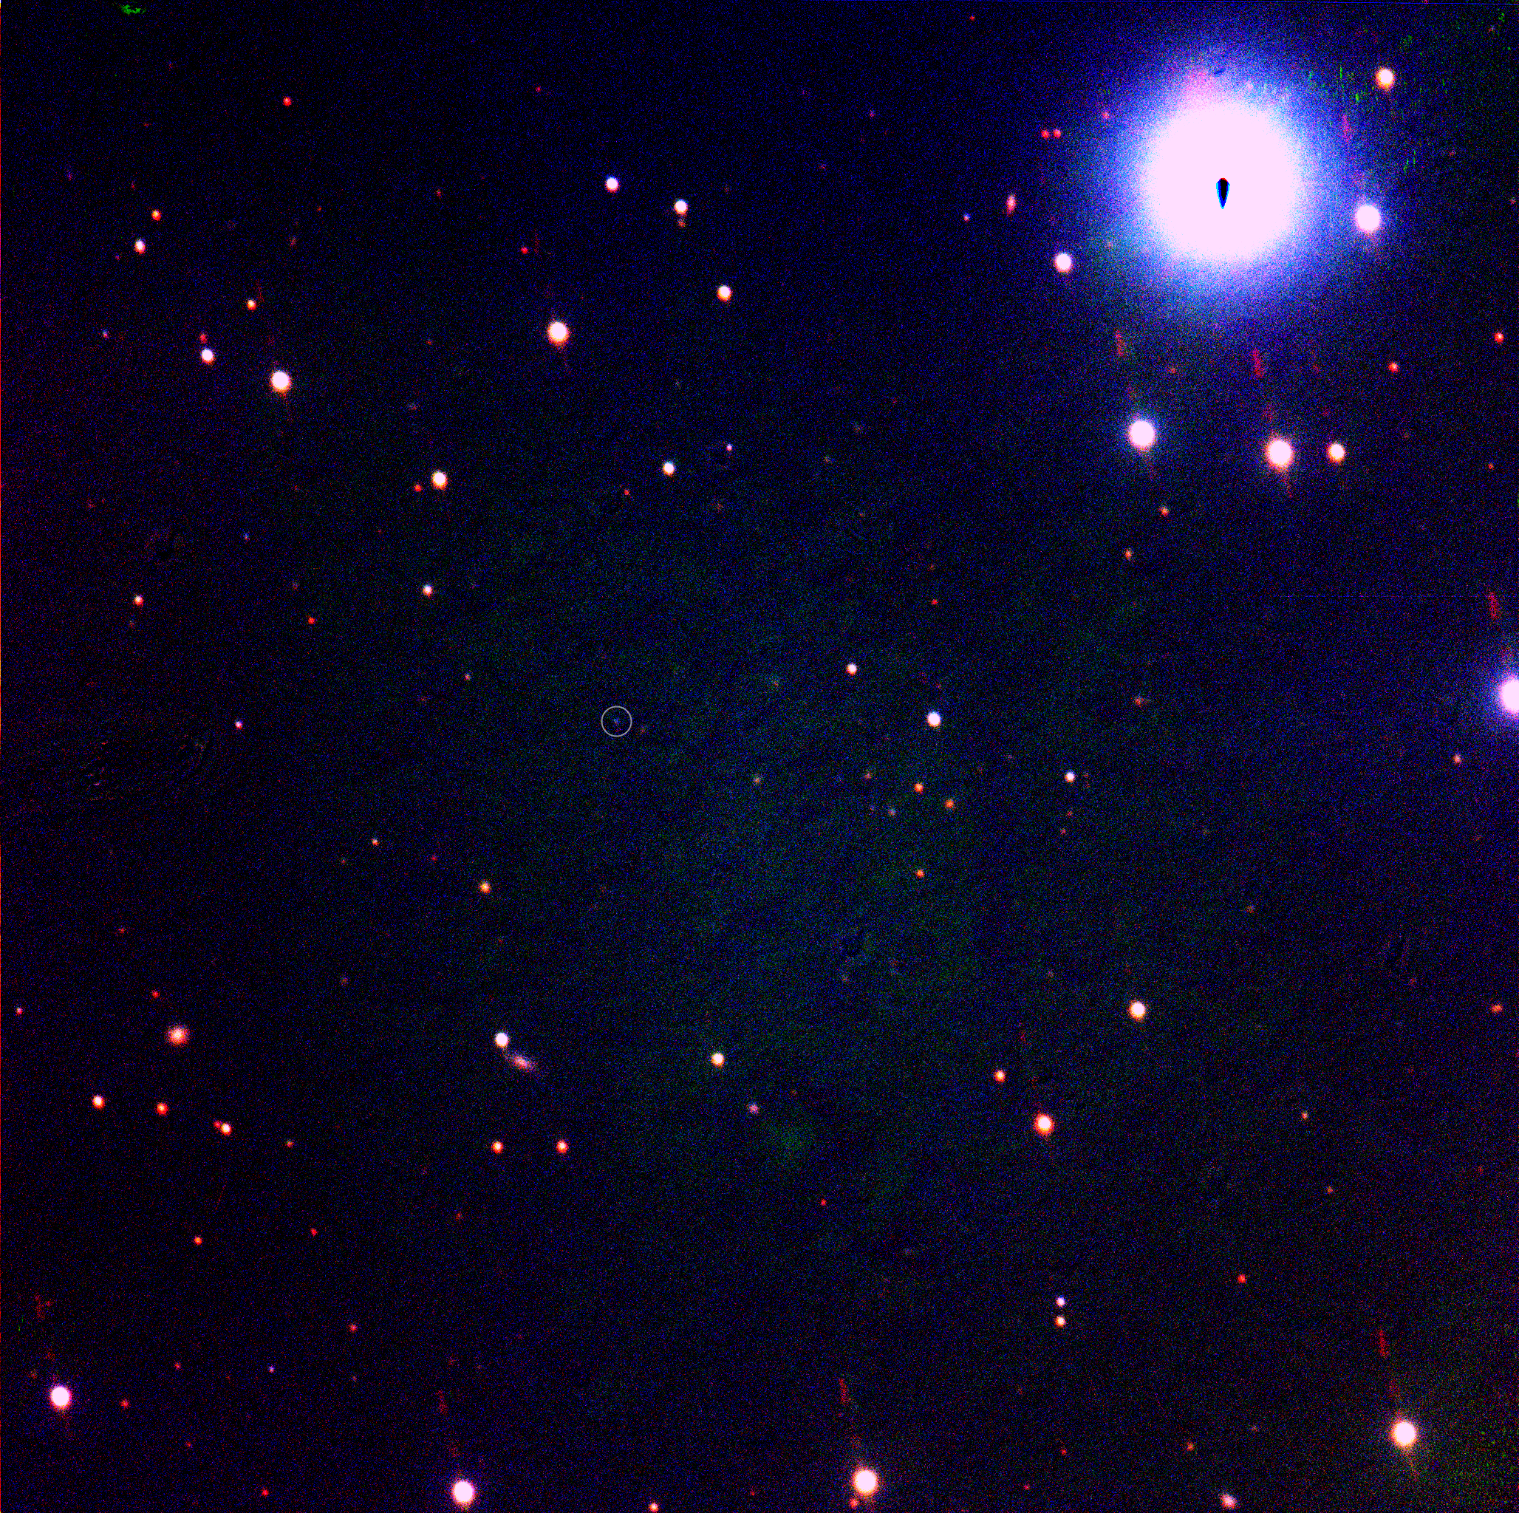
The kangaroo’s first hop: EP250108a / SN 2025kg
Rob Eyles-Ferris, Jillian Rastinejad + ~90 others

Slide 2
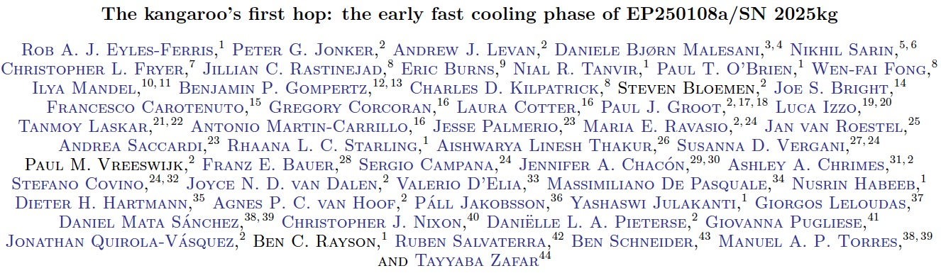
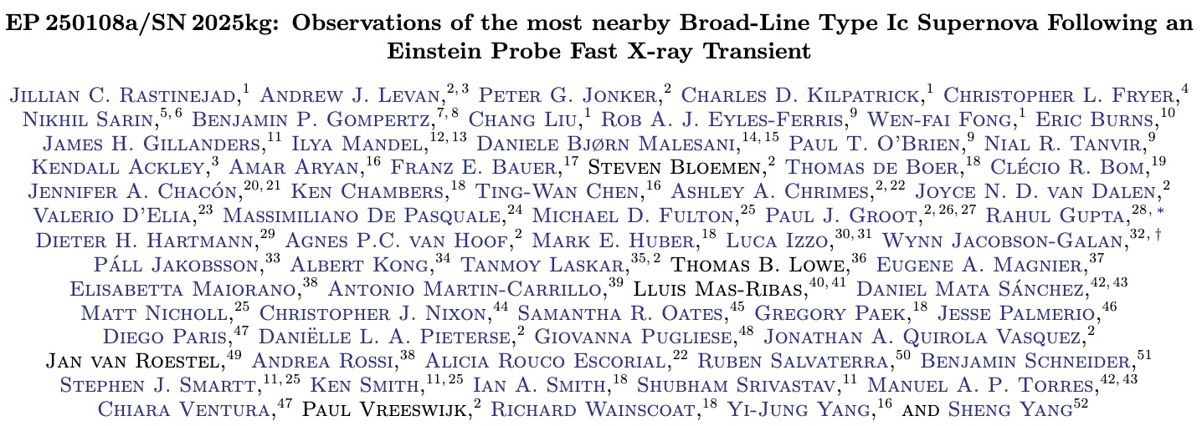

Slide 3
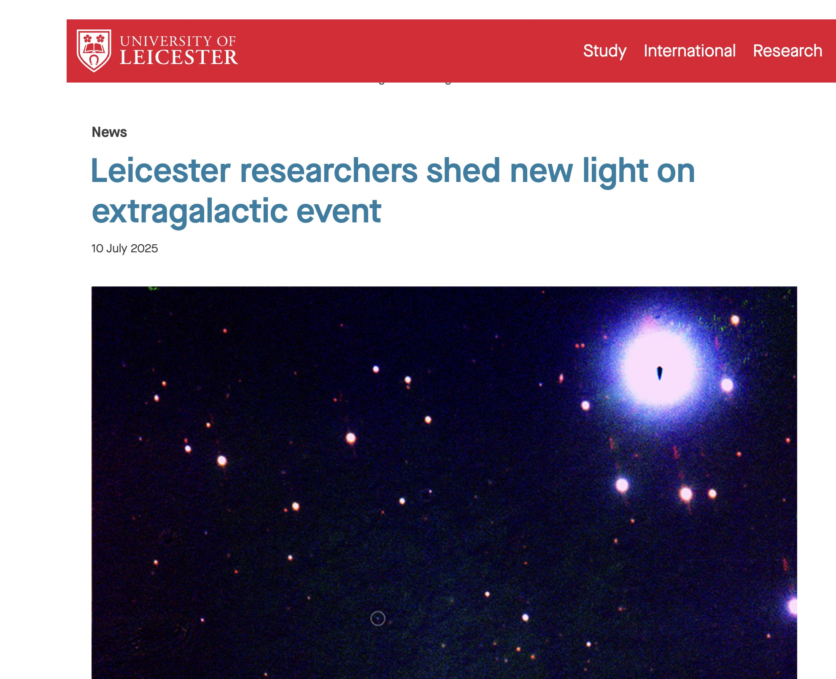
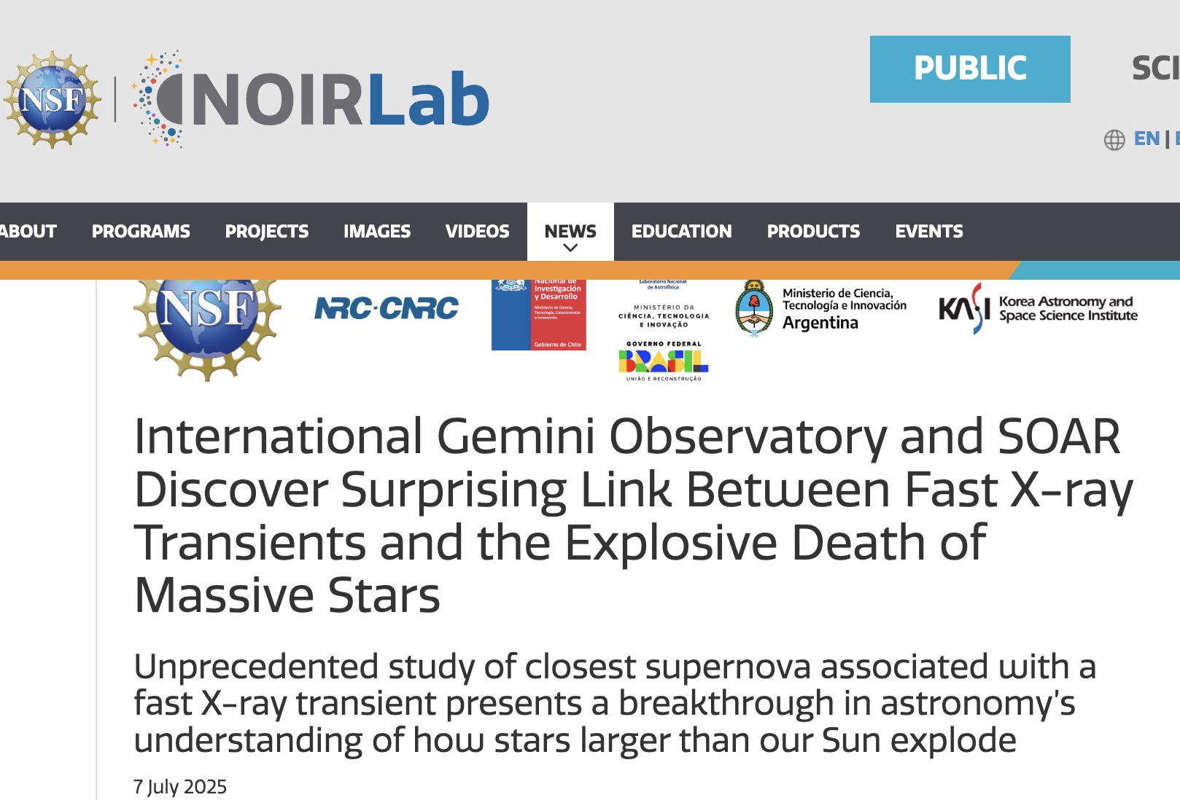
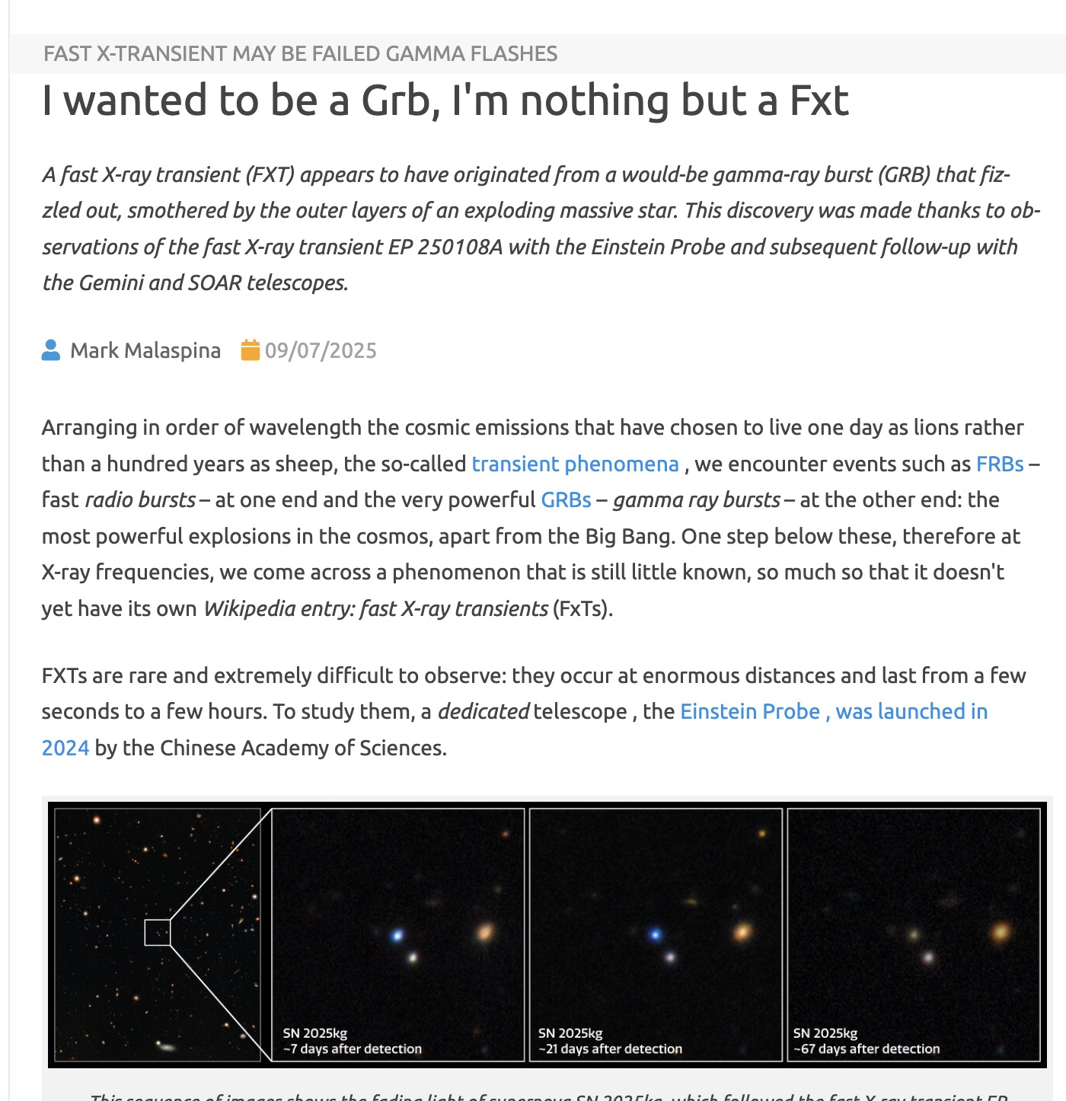
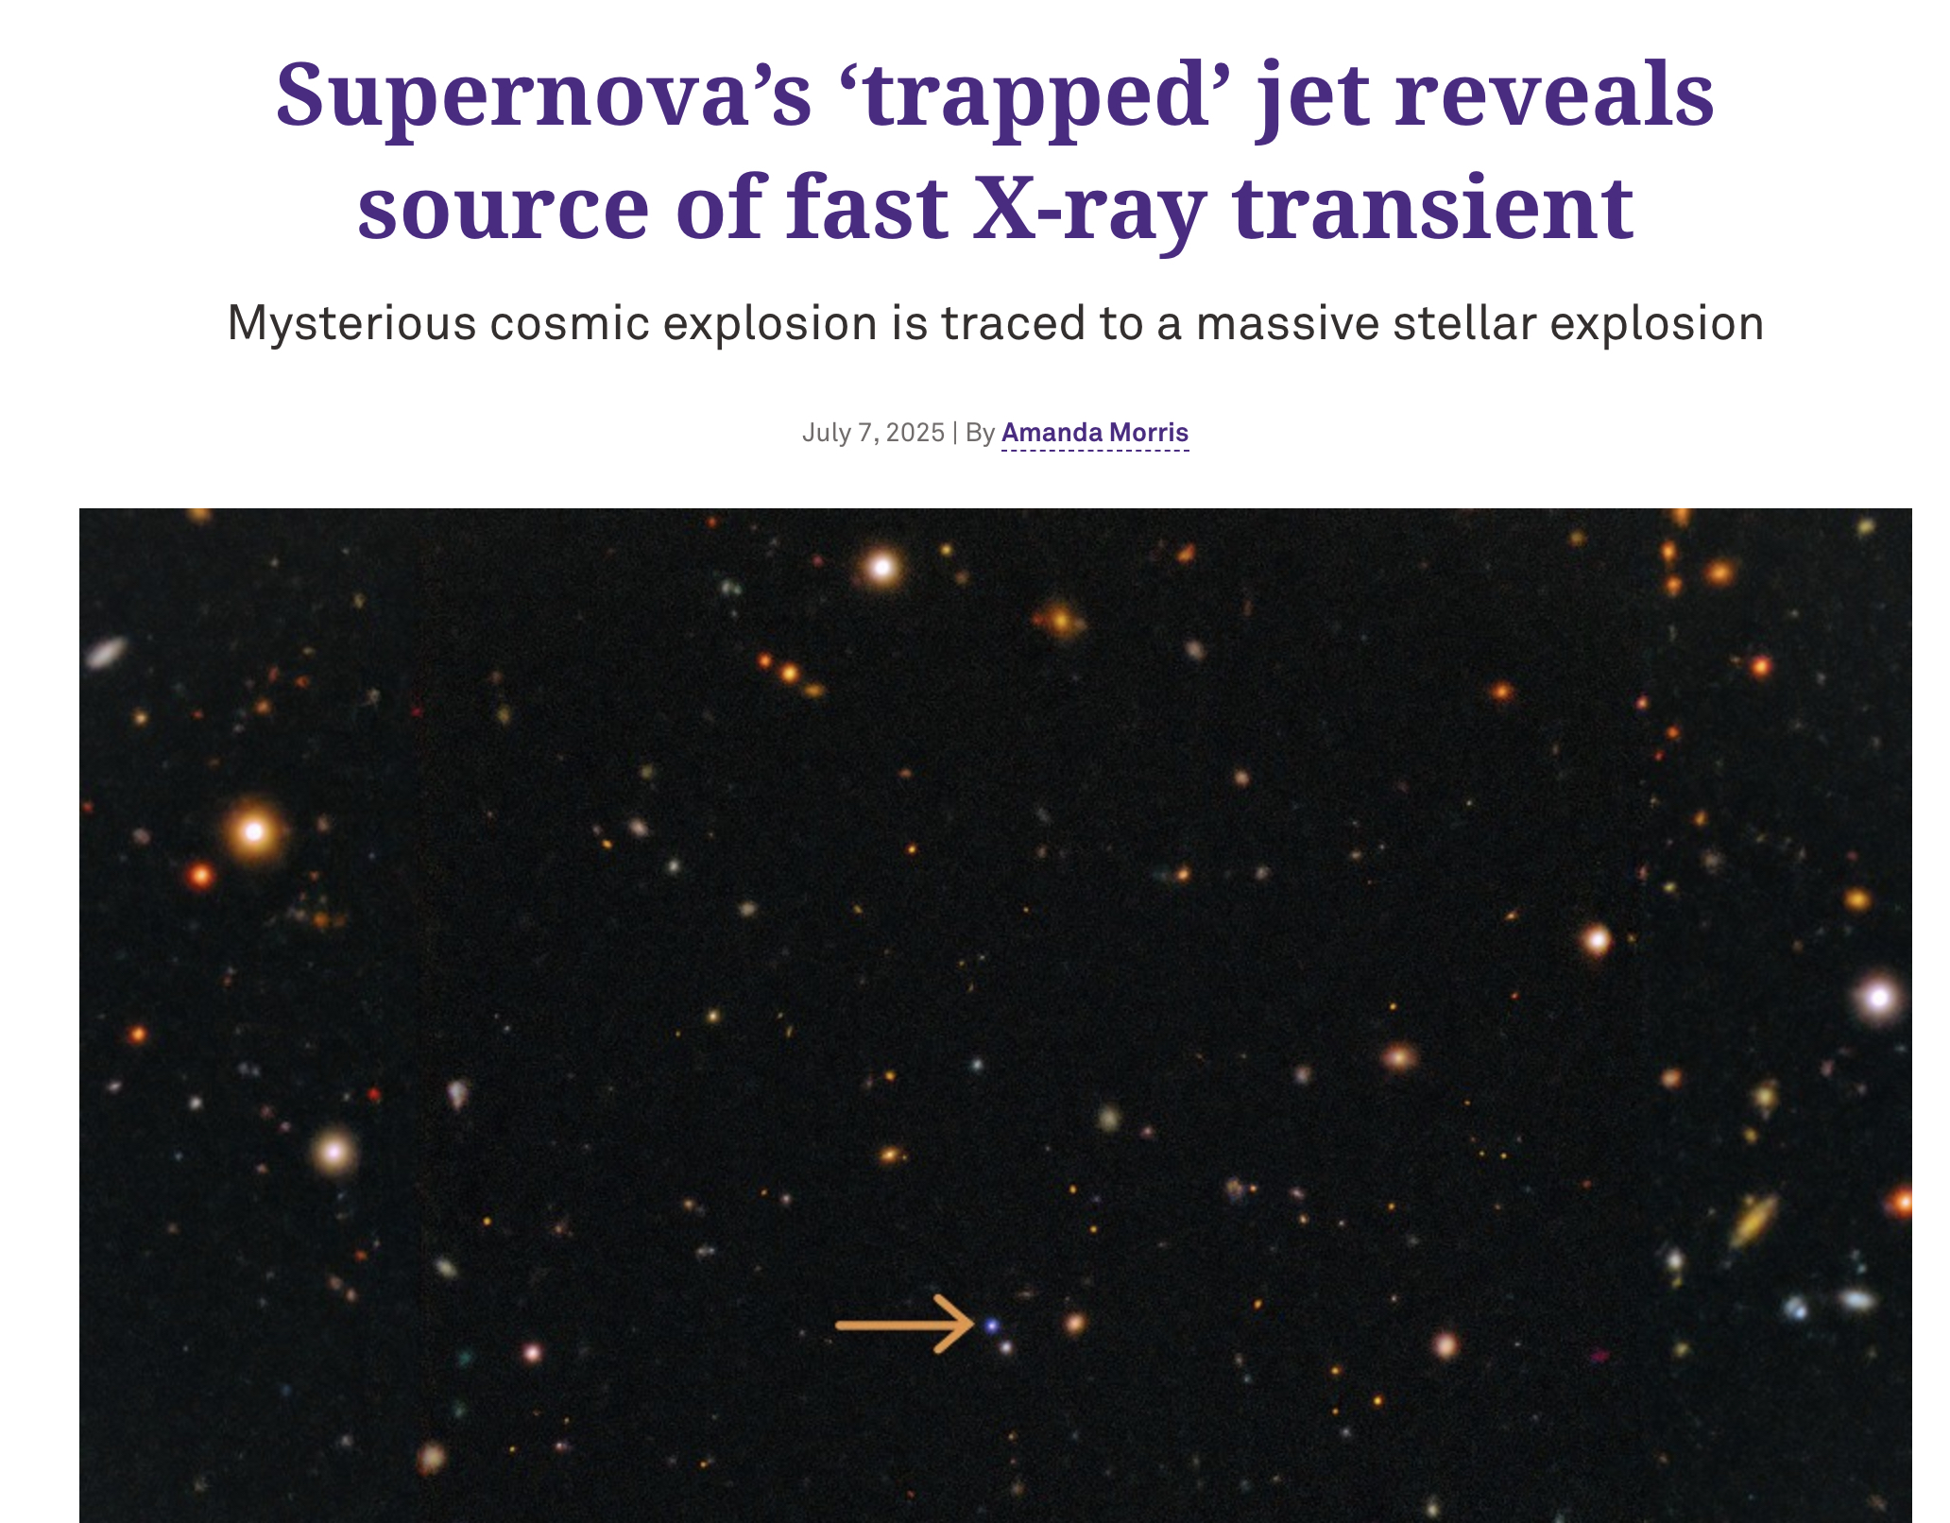

Slide 4
EP250108a / SN 2025kg
EP FXT detected 8th January 2025
  Unusually long (2500 s)
  Faded very quickly – no X-ray detections after WXT trigger
Optical counterpart discovered ~1.3 days later
  Blue thermal transient similar to LFBOTs hence ‘the kangaroo’
  Cooled and decayed
  Rose again as a Ic-BL supernova
z = 0.17641
  Nearest FXT-SN
As yet, no radio detection
Multiple papers already
  Srinivasaragavan et al. and Li et al. in addition to our papers

Slide 5
Phase I (<6 days)
Fast cooling
Eyles-Ferris et al.
Phase II (>6 days)
Ic-BL SN
Rastinejad et al.

Slide 6
Phase I
Fast cooling

Slide 8
Phase I properties
Very blue mostly featureless spectra
  2x10⁴ K
  Dropped to 10⁴ K over first four days
Fades steadily
  10⁴⁴ to 10⁴³ erg / s

Slide 9

Phase I properties
Can model the photometry as a simple expanding and cooling blackbody
Mildly relativistic expansion
Large radius
  Extrapolating back implies initial expansion velocity closer to $0.4−0.6 c$

Slide 10
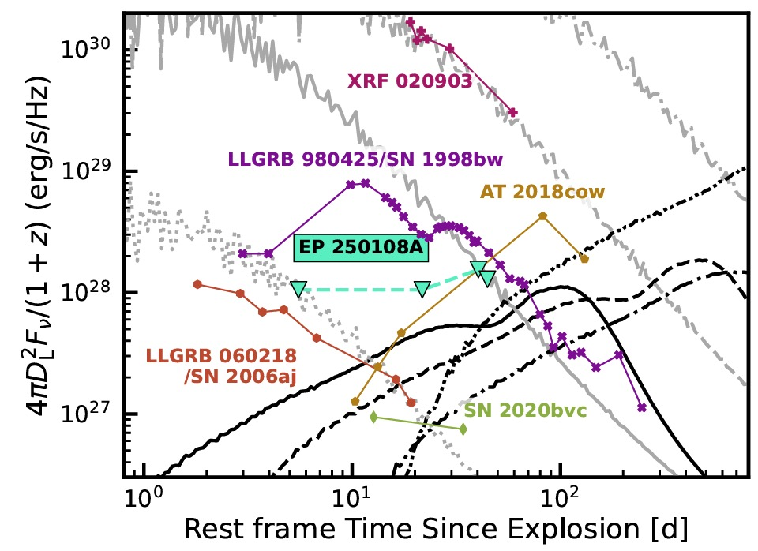
Similarities to past events
Srinivasaragavan et al.
Notes:
GRB 101225A and SN 2008D are the exceptions – ulGRB and Ib
SN 2024gsa is of course another EP FXT-SN

Slide 11
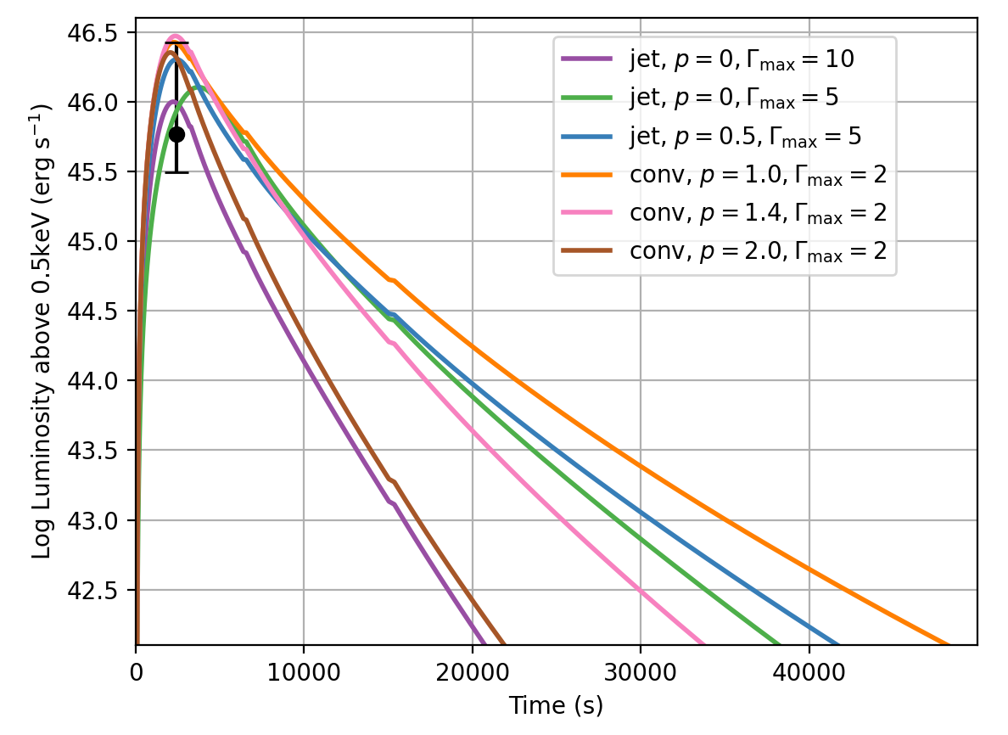
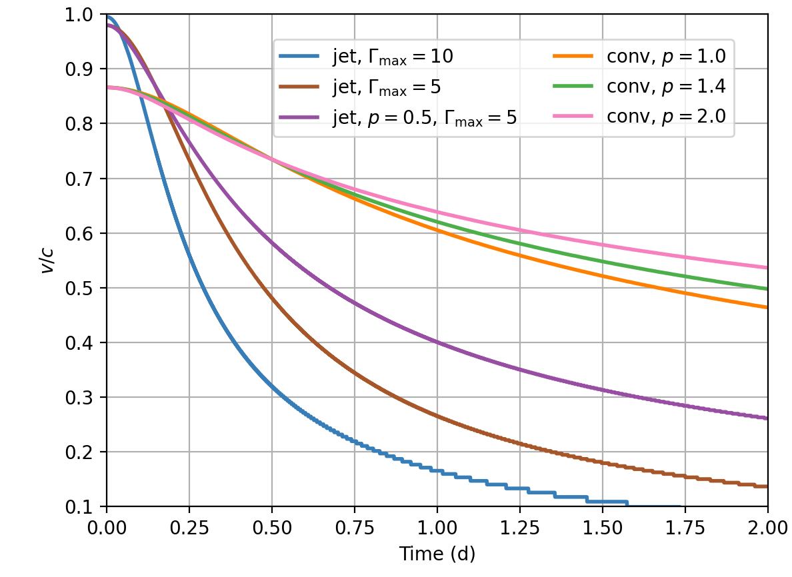
Origin of the X-rays
X-rays can be produced via jet driven or convective engine
Both models can reproduce the luminosity observed by WXT
  Jet driven consistent with cocoon models
  Convective engine requires extreme energies and masses
Ejecta decelerate through CSM
  High mass required by convective engine cannot reach velocities inferred by photometric modelling
  Low jet driven mass much more consistent

Slide 12
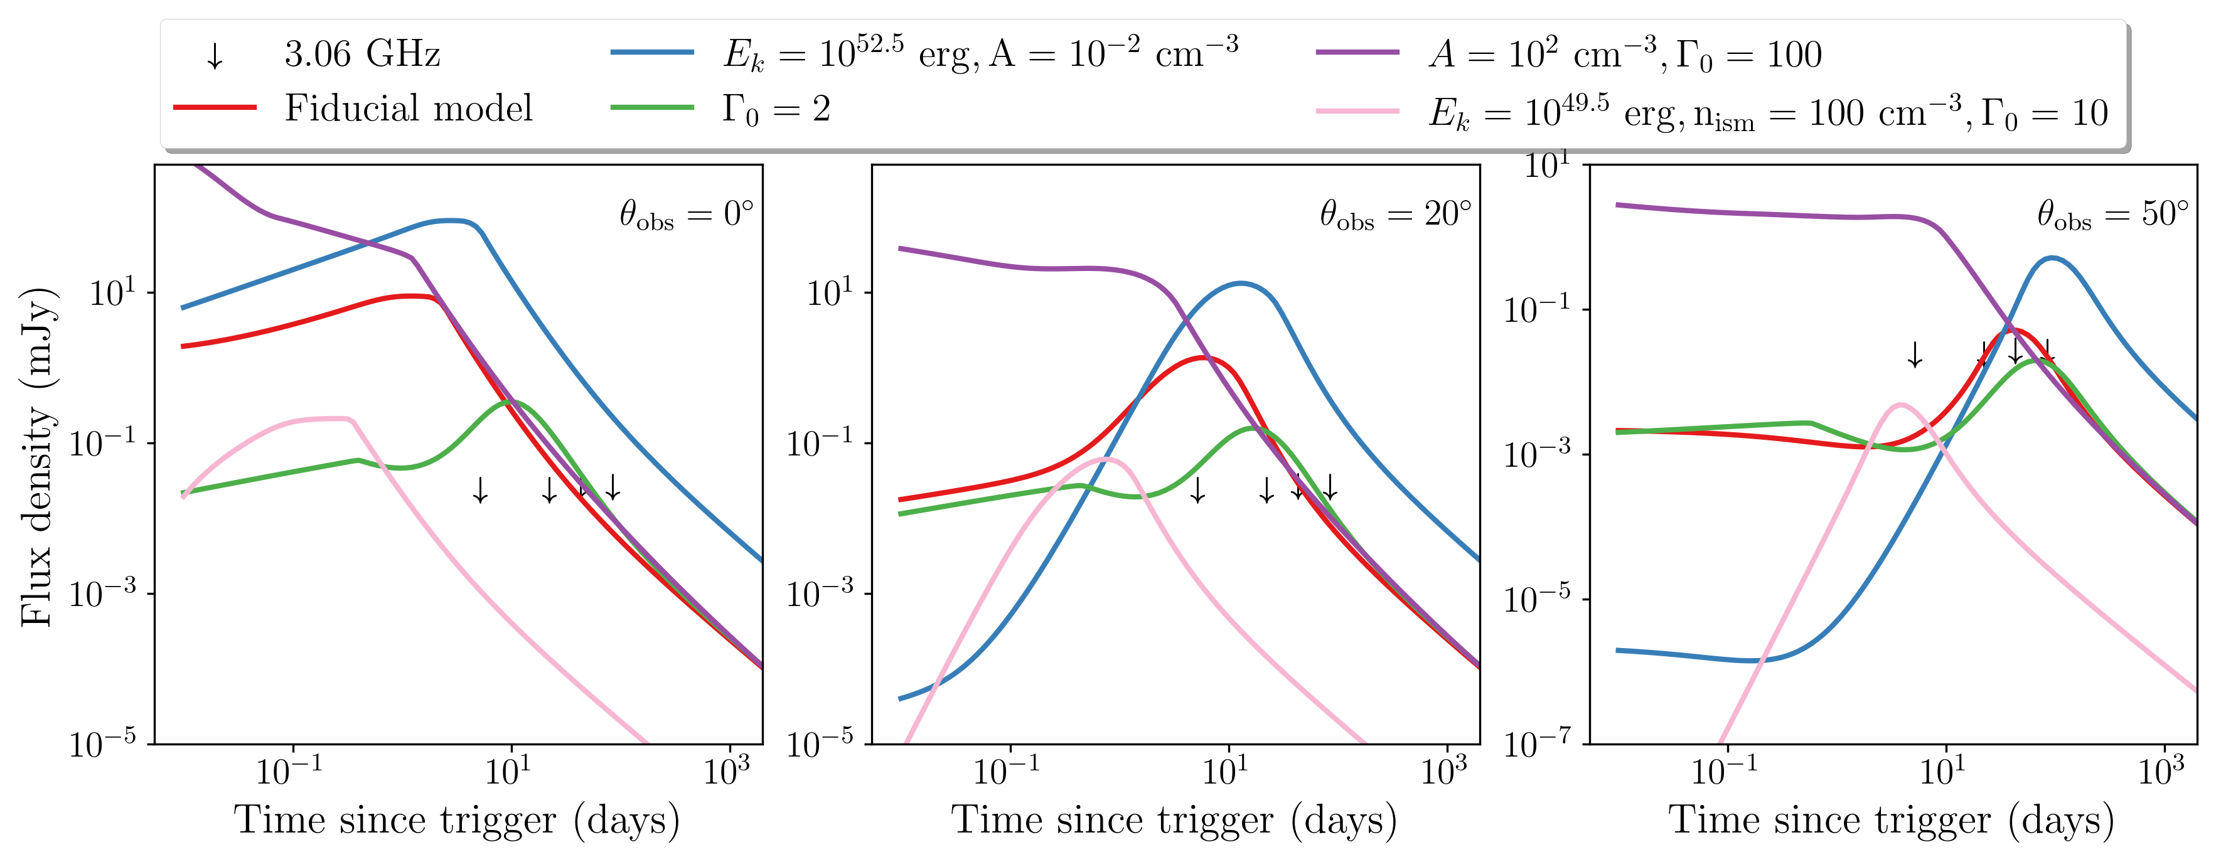
Radio constraints
The lack of radio detections can tell us more about the jet and any other relativistic ejecta
Limits rule out jets with energies >10⁵¹ erg and we are left with weak/failed jets
Cannot determine observing angle from current data

Slide 13

Origin of the optical emission
Cocoon model is consistent with the X-ray and radio observations
  ~0.04 – 0.15 $M_{⊙}$ of shocked ejecta
  Kinetic energy ~4 – 45 x10⁵⁰ erg
Successfully reproduces the optical light curve
CSM interactions could also produce optical but require specific CSM geometry

Slide 14
Phase I summary
FXT probably driven by jet
Jet fails to break out and forms a cocoon
Shocked cocoon produces the optical emission
Broadly consistent picture across the spectrum

Slide 15
Phase II
Ic-BL SN

Slide 16
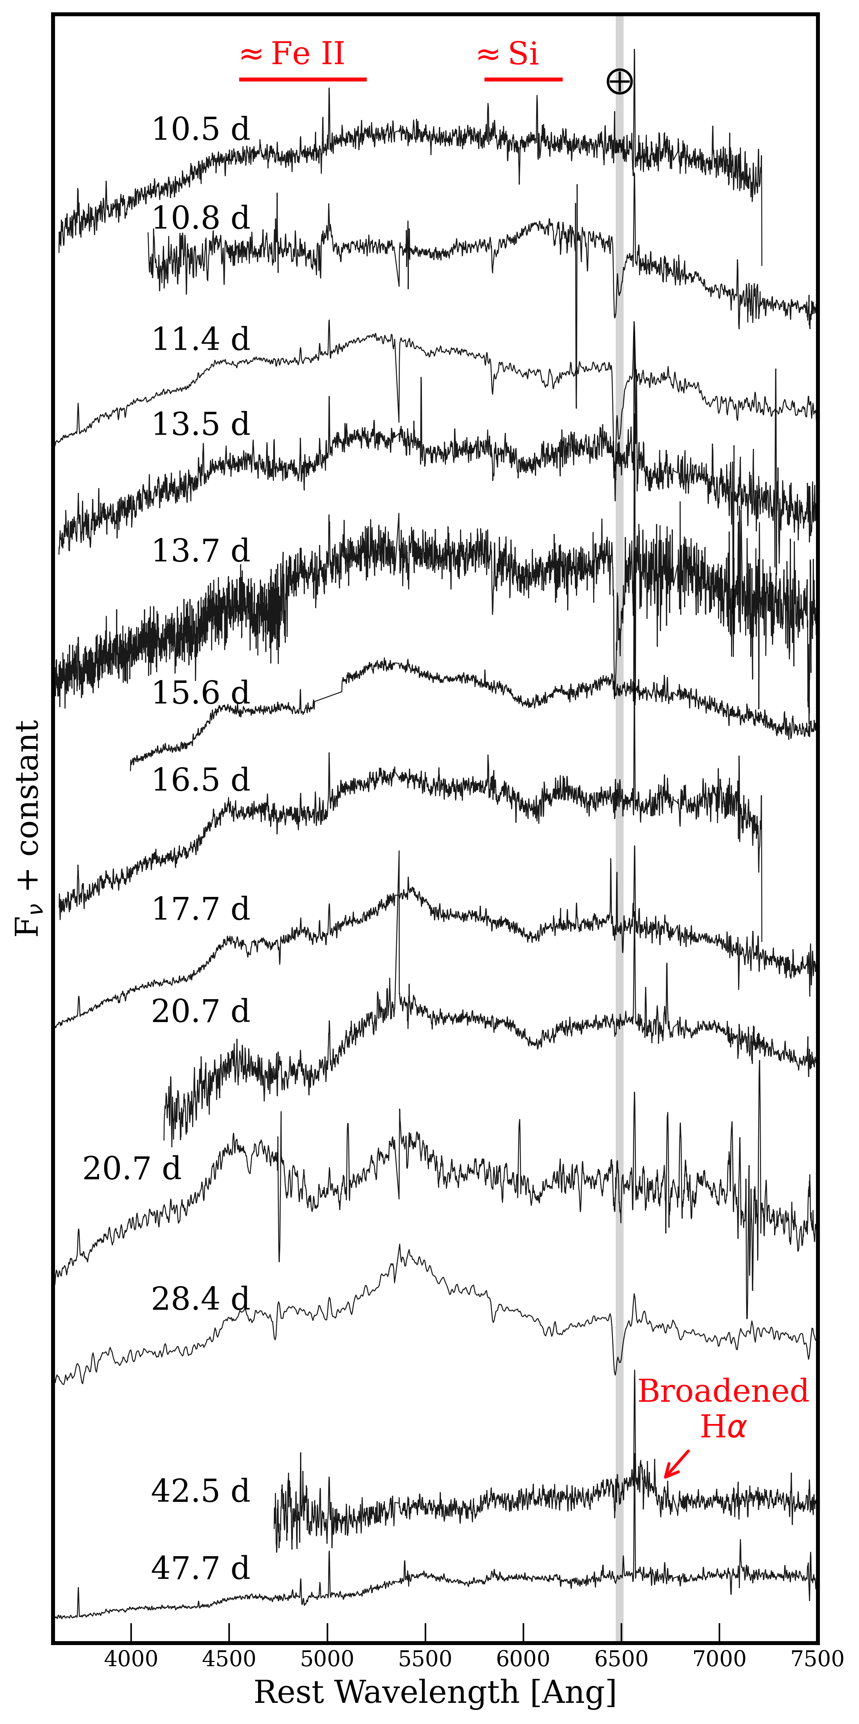
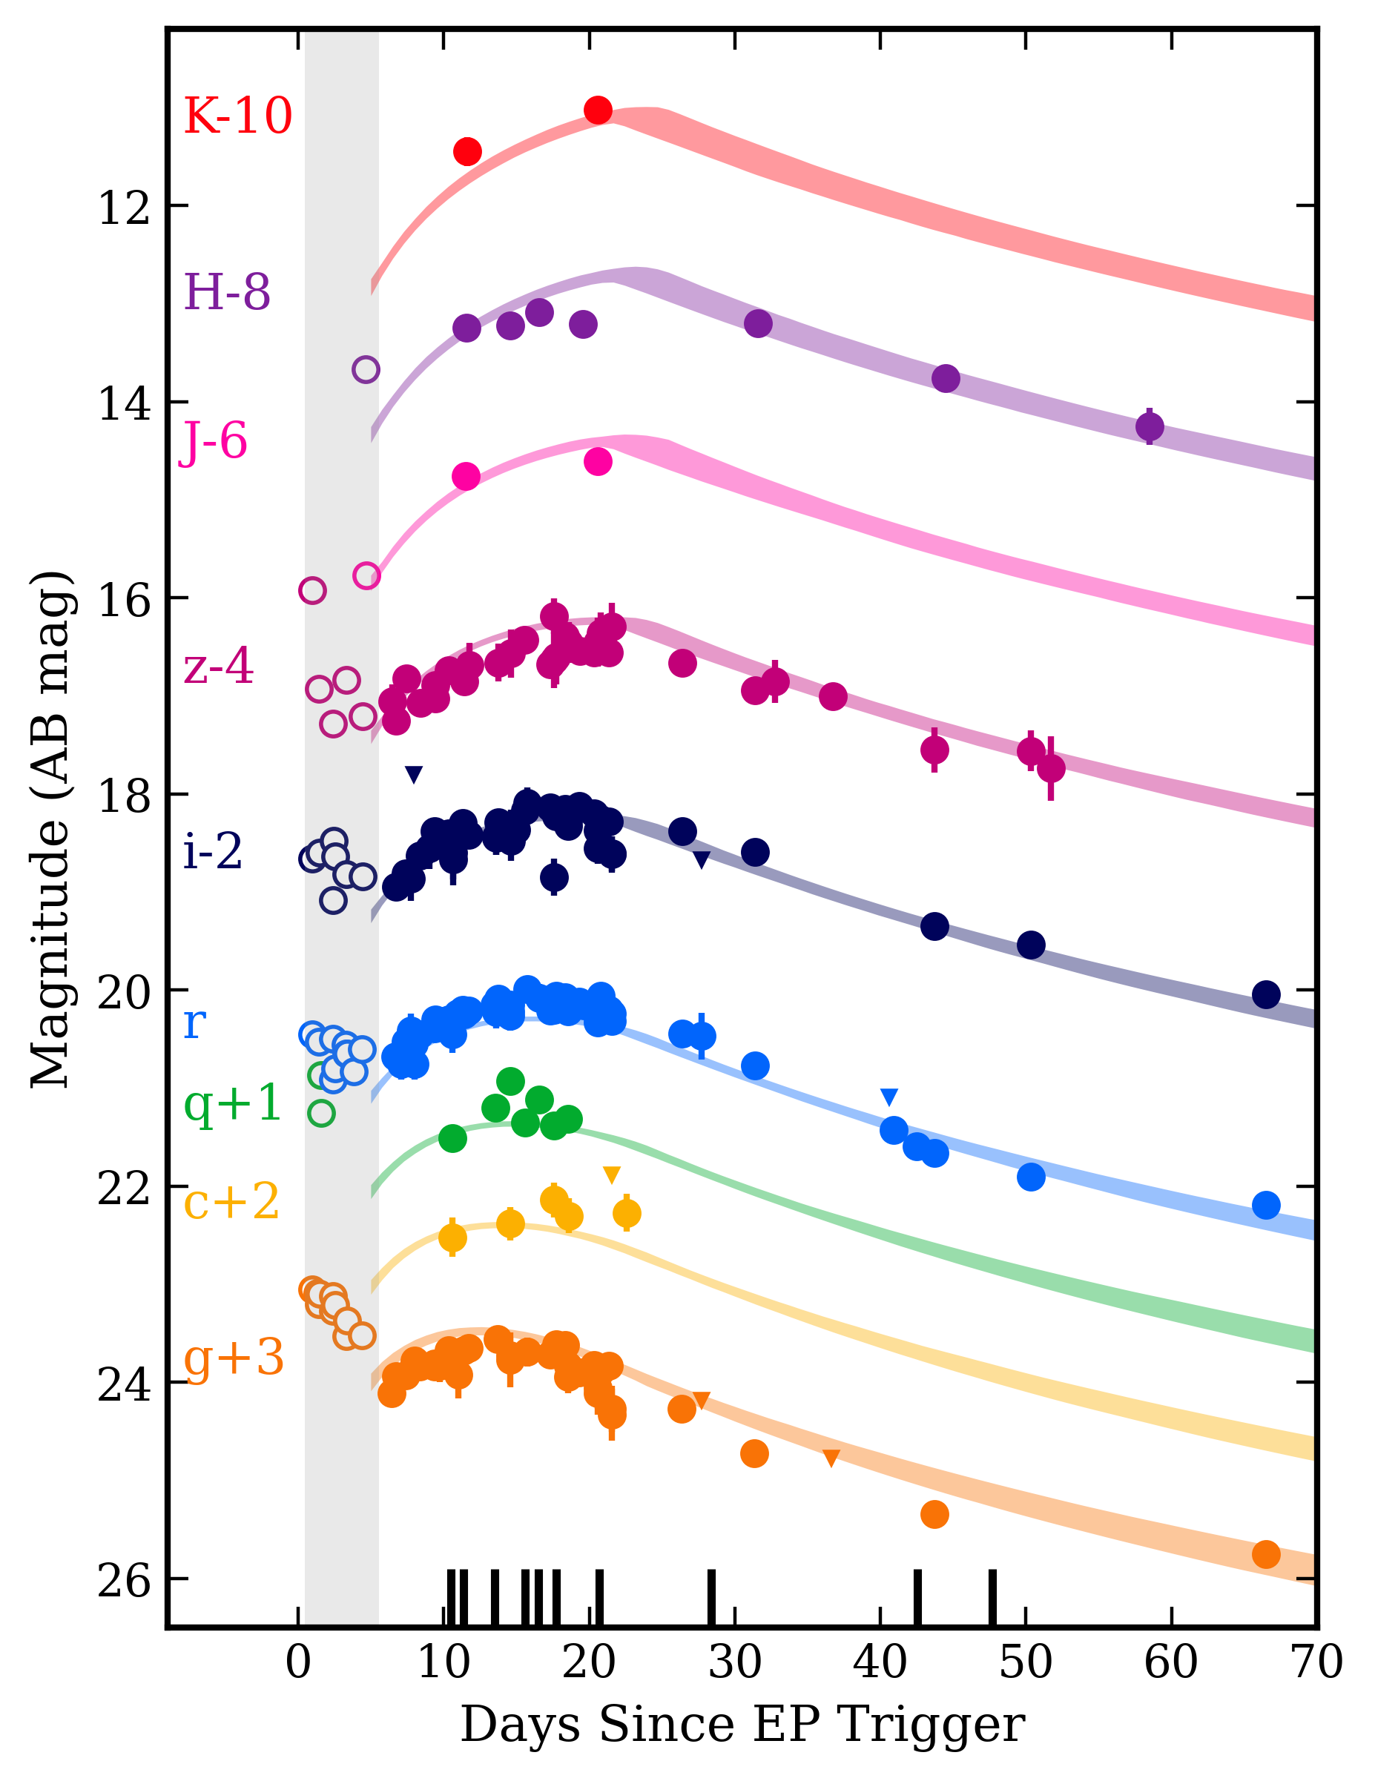
Phase II observations
Extensive observing campaign continued from phase I
  ~25 ks in g band alone
  13 spectra

Slide 17
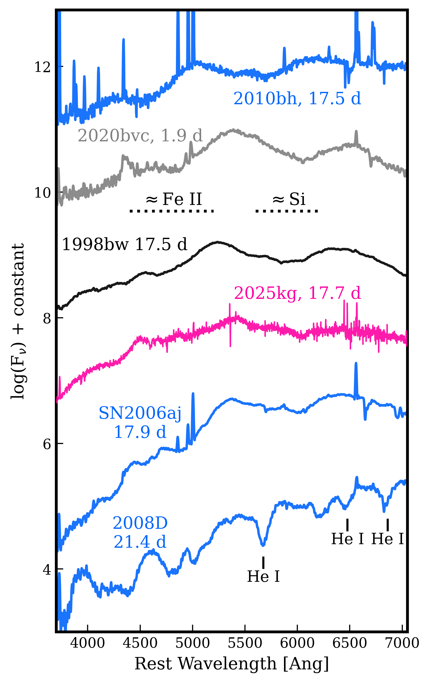
Supernova comparison
Ic-BL
  Distinct Fe II and Si broad lines
  Lack of He I absorption lines
Similar to SN1998bw, SN 2006aj and SN 2020bvc (again)

Slide 18
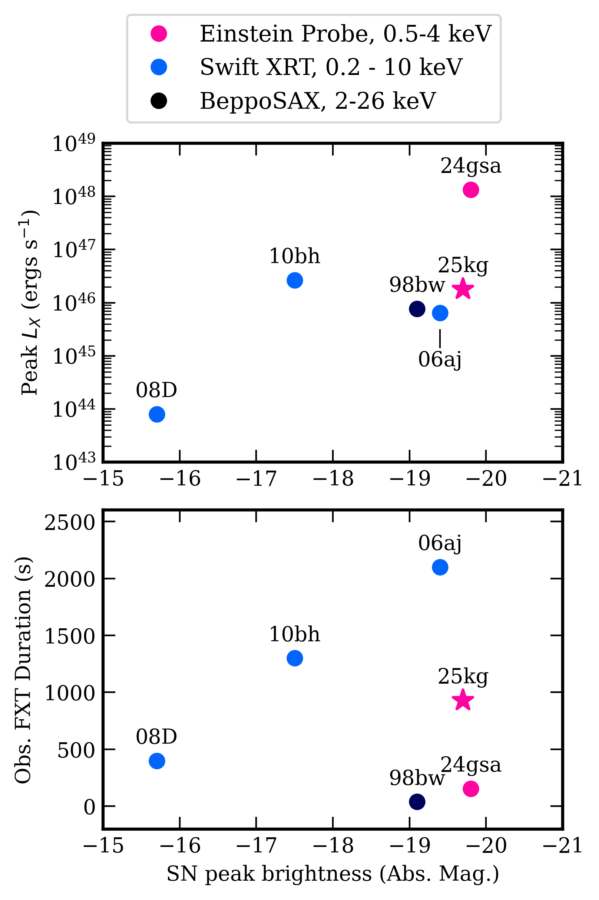
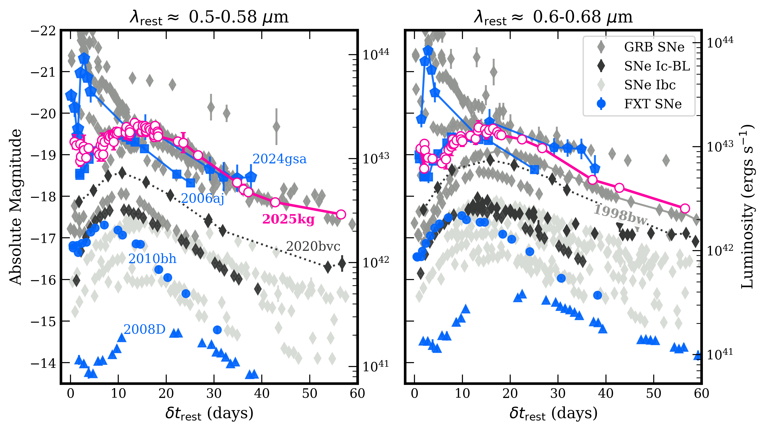
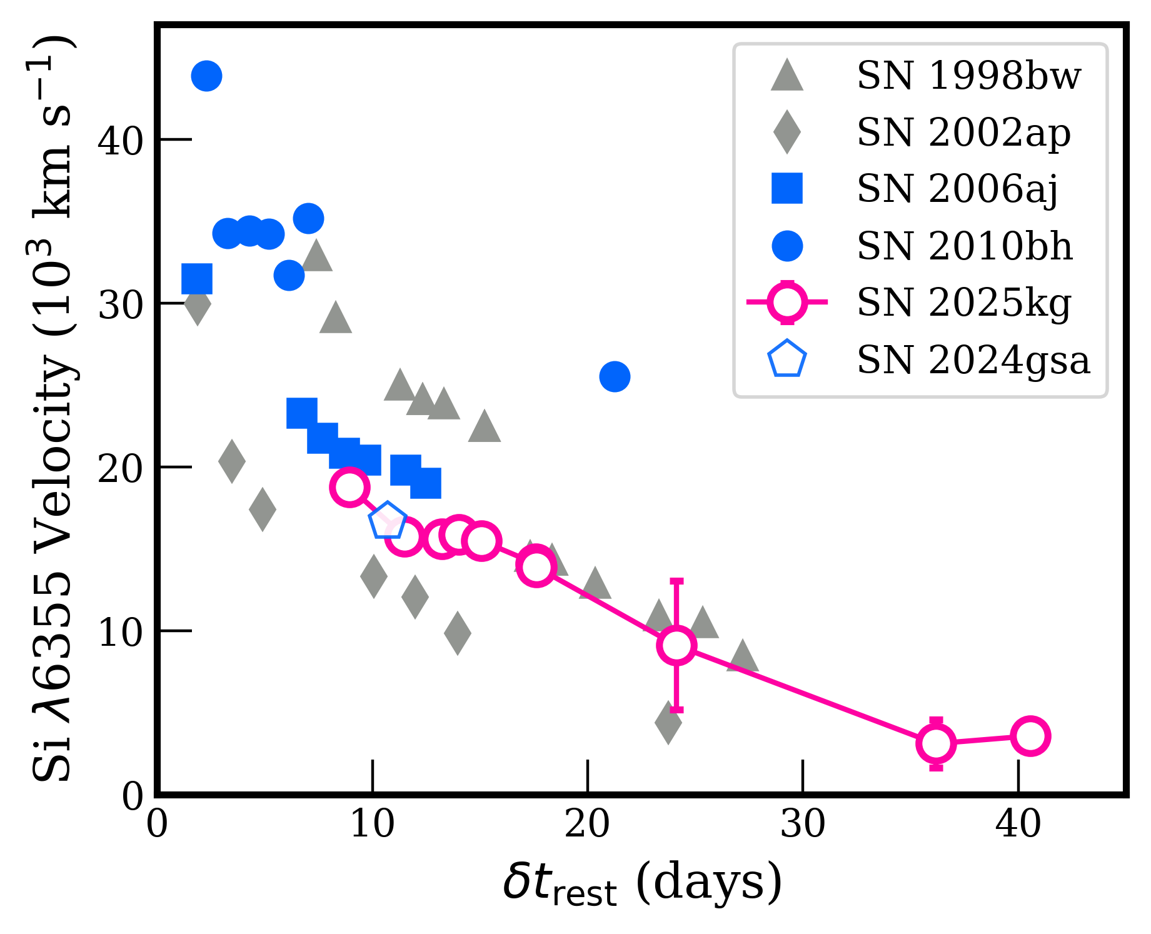
Supernova comparison
SN 2025kg is consistent with other FXT/GRB Sne
  Significantly more luminous than Ic SNe without high energy counterparts
  Comparable line velocities
  Appears to be correlation in X-ray/SN luminosity

Slide 19
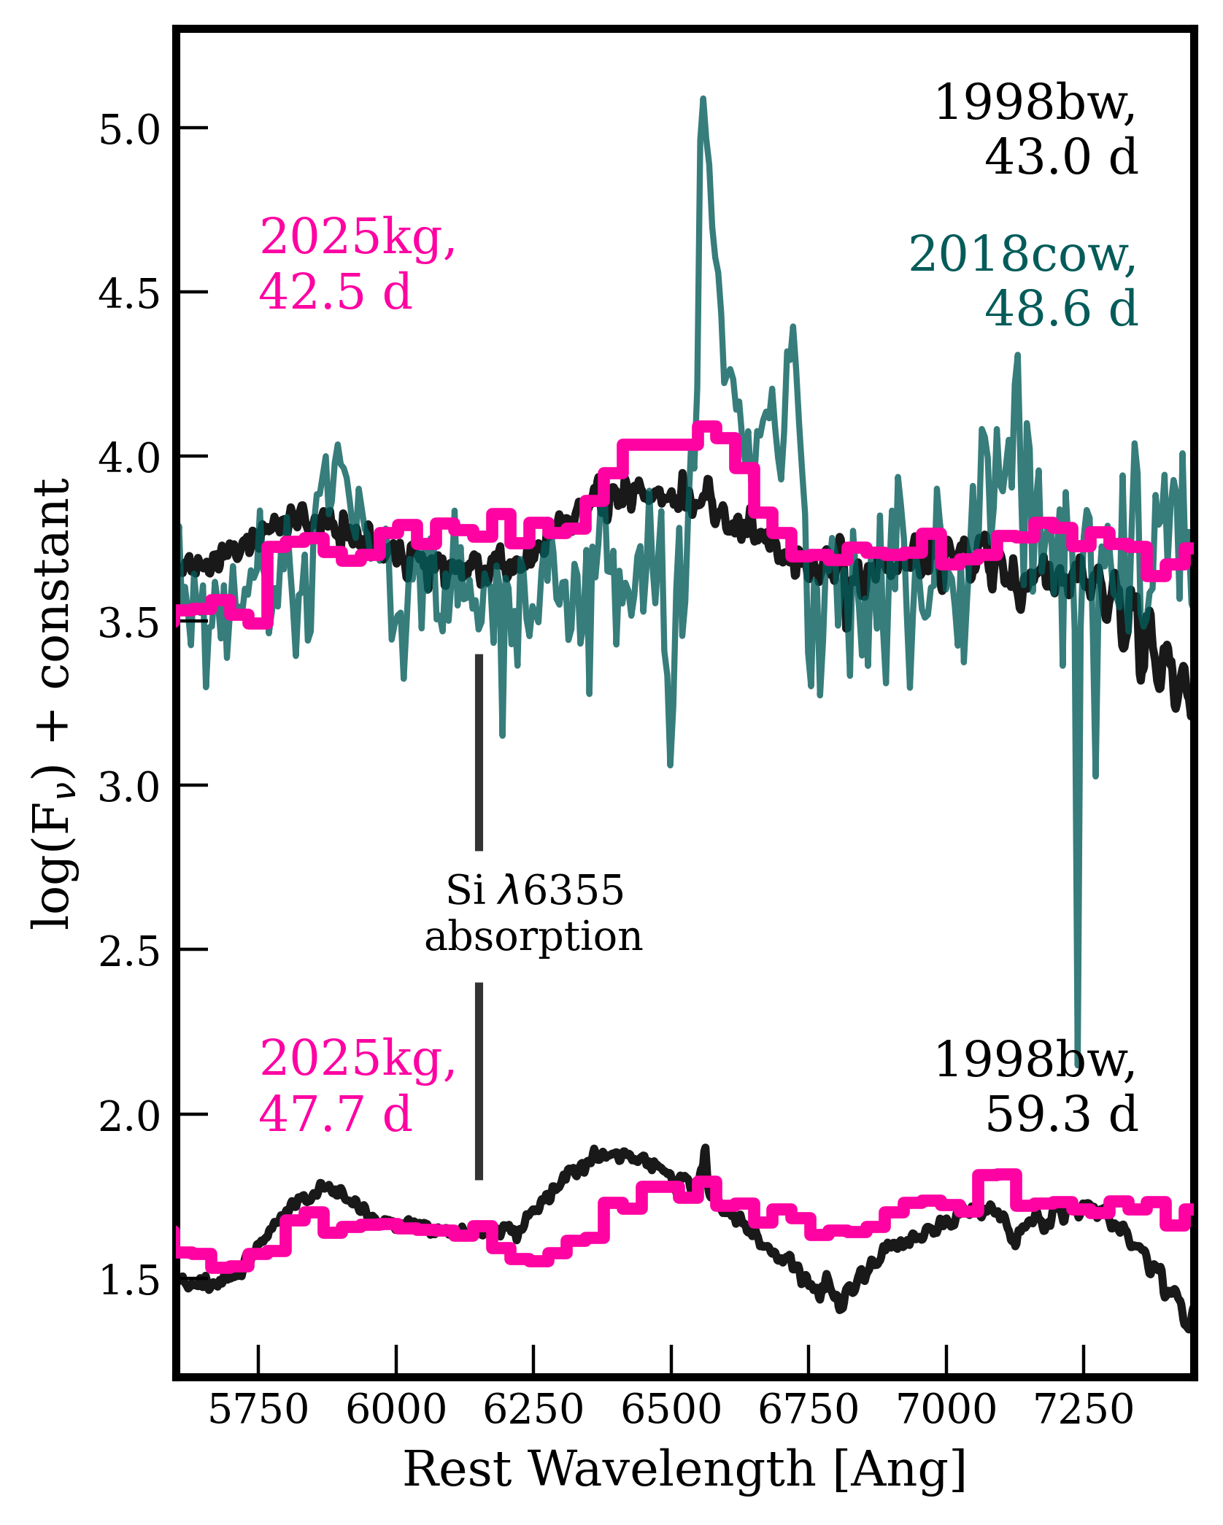
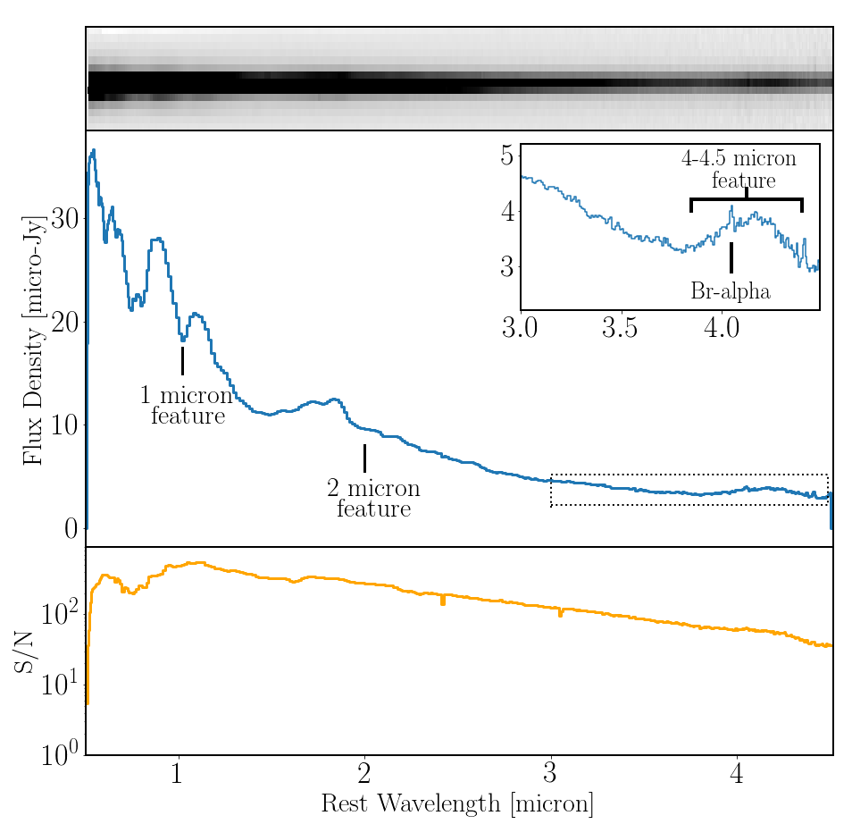
Spectral features
Many interesting spectral features
Broad Hα feature appears in spectrum at (and only at) 42.5 days
  Similar feature appears in AT 2018cow but not SN 1998bw
  Could be due to asymmetric mass loss in a common envelope phase
1 µm and 2 µm broad absorption features
  Suggests He presence
4.2 µm emission feature
  Difficult to explain, maybe nebular Fe lines?
Notes:
Broad Halpha: Possible explanations:
Interaction with extended H shell similar to AT 2018cow although that was more persistent
Signature of stellar companion similar to <5% of SN Ia.
Could be the result of assymmetric mass loss in a common envelope phase
1 µm and 2 µm:
Can be fitted with a combined He I λ1.0830, λ2.0581 µm and C I λ1.0693, λ2.1259 µm model
He dominates 2 µm feature, C I dominates 1 µm
He likely limited to <0.5 $M_{⊙}$ due to lack of optical He lines
Inconsistent with Phase I shock cooling inferences
Enhanced mixing or additional earlier wind mass loss is required
4.2 um feature:
Inconsistent with thermal emission from r-process
T ~ 700 K, blackbody radius ~2 x 10¹⁶ cm so too big
SN 1987A features a similar SiO overtone feature from dust
Much later timescale than here
Temperature likely still too high for dust to form
Nebular Fe lines
Requires regions of ejecta to become optically thin
Could possibly be achieved through high velocity ejecta as inferred in Phase I

Slide 20

Progenitor system
ZAMS mass of the progenitor can be inferred from ejecta and ⁵⁶Ni mass
  C/O core mass sum of ejecta mass, remnant (BH or NS) mass and accretion disk mass
  Gives ZAMS mass of 15 – 21 $M_{⊙}$ (NS remnant) or 19 – 30 $M_{⊙}$ (BH remnant)
He and H evidence suggests a binary or trinary system
  He shell from common envelope ejection
  H clumps from earlier asymmetric common envelope ejection or giant/supergiant tertiary

Slide 21
Rates of similar events
EP240414a/SN 2024gsa, EP250108a/SN 2025kg and EP250304a are all FXT-SNe
  Comparable properties to other events like XRF 060218/SN 2006aj and GRB 980425
  Suggests common link between FXTs and GRBs with SNe
Rate calculation suggest several tens Gpc⁻³ yr⁻¹
  Much higher rate than GRBs
  Substantially more common end to a star’s lifecycle

Slide 22
Conclusions

Slide 23



EP250108a/SN 2025kg is the most nearby FXT-SN
Two phases in the light curve
  Phase I: blue, thermal source from (probably) cocoon emission due to a trapped jet
  Phase II: Ic-BL SN similar to FXT- and GRB-SNe
Progenitor system is a 15 – 21 $M_{⊙}$ (NS remnant) or 19 – 30 $M_{⊙}$ (BH remnant) collapsar in a complex environment
  Evidence of mass loss and at least one companion
Eyles-Ferris et al.
Rastinejad et al.

