Slide 1
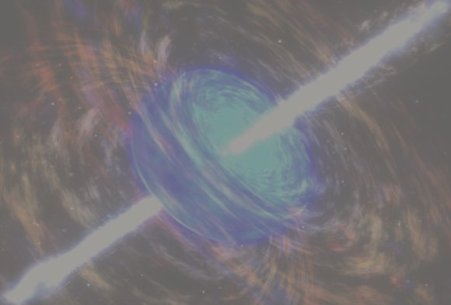
Extended Emission of Merger GRBs
from High Latitude Emission and Time Propagation Effects.
Isabelle Worssam
Dr Benjamin Gompertz
Dr Hendrik van Eerten
Image Credit: NASA

Slide 2
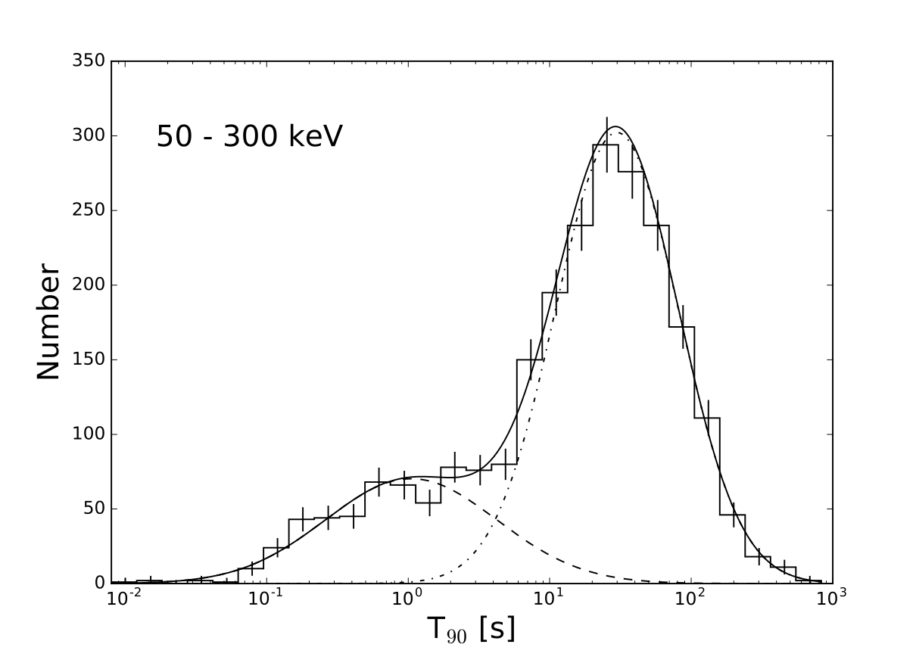
Two classes of GRBs
Short: T90 < 2s
- binary compact object mergers
Long: T90 > 2s
- collapsing massive stars
A. von Kienlin et al 2020 The fourth Fermi-GBM gamma-ray burst catalog: a decade of data

Slide 3
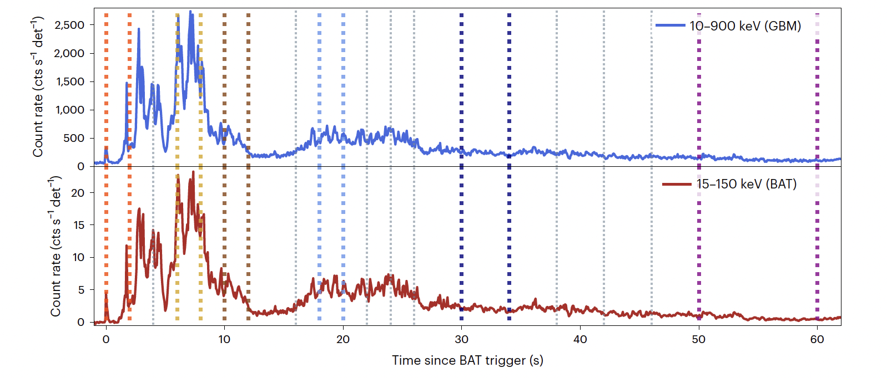
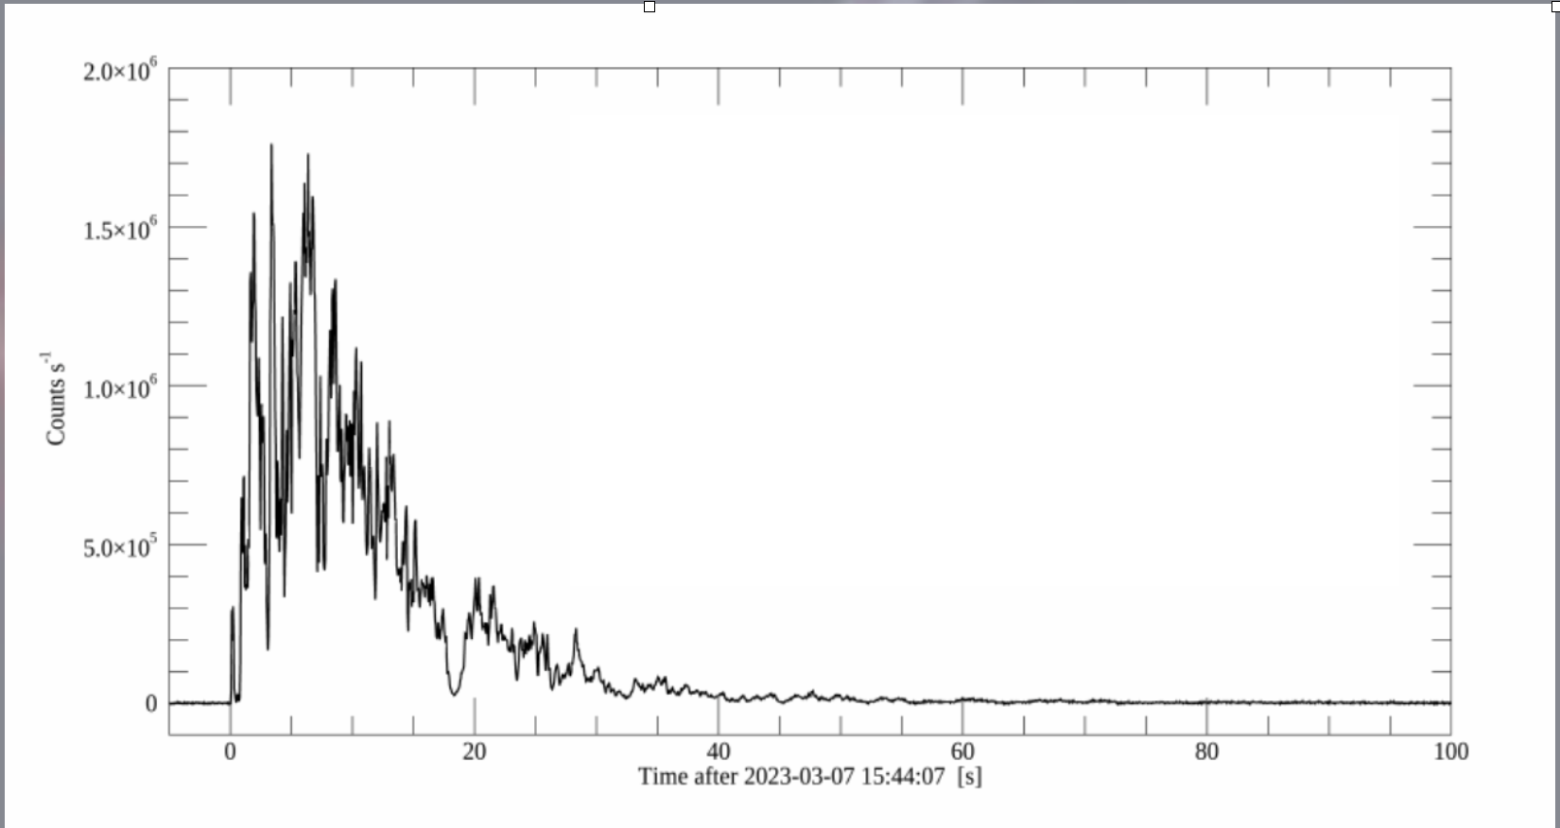
GRB 211211A
Ref: B. Gompertz 2022 Nat. Astron.
GRB 230307A
Ref: S. Mereghetti et al 2023 AstroJ
Notes:
Merger’s energy source is accretion disk (order seconds). How does this power long bursts!?

Slide 4
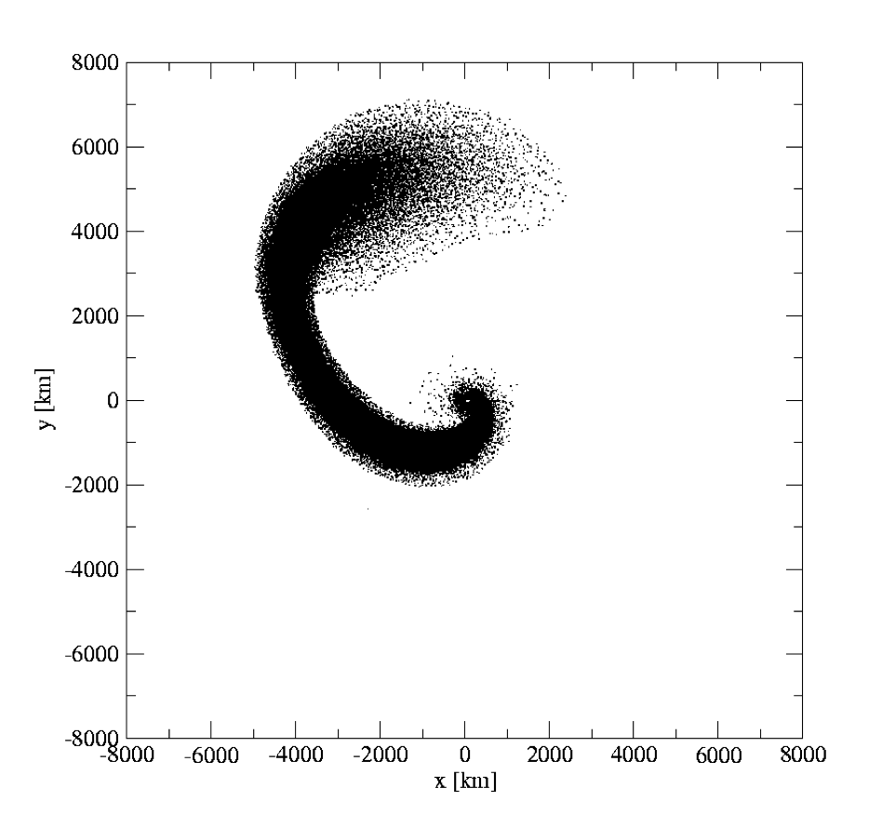
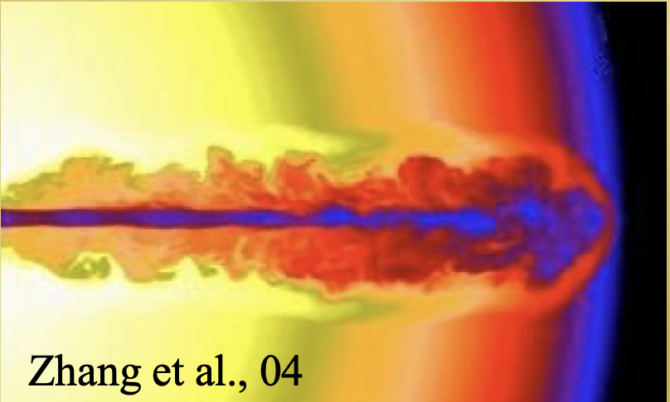
Proposed Solutions
Adaptions
Energy Injection
Magnetic Braking
Structured Jet
NS-BH mergers
Magnetar
Zhang et al 2004
Rosswog 2006
Notes:
What’s a problem with magnetic braking?
Put references I here!

Slide 5
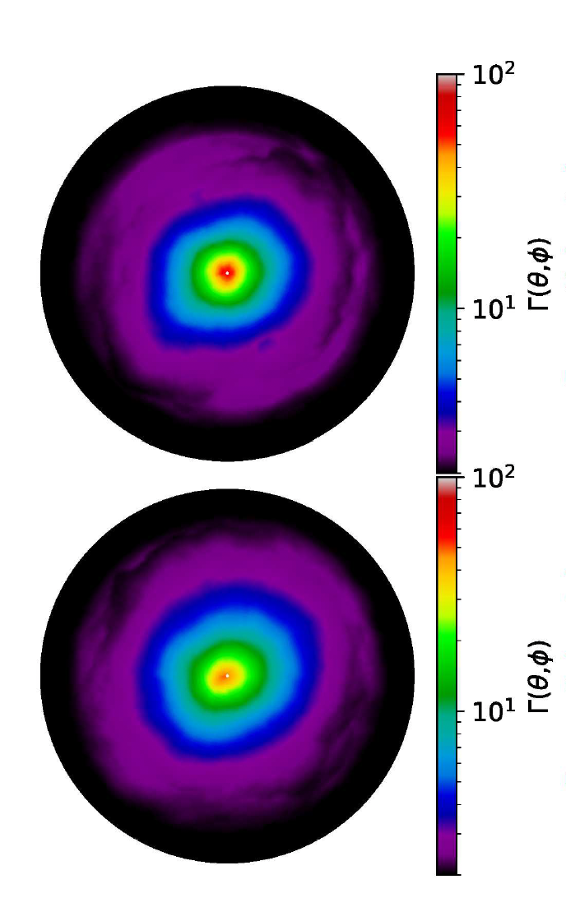
Proposed Solutions
Adaptions
Energy Injection
Magnetic Braking (Proga 2006)
Structured Jet
(Lamb 2022)
NS-BH mergers
(Rosswog 2006)
Magnetar
(Gompertz 2013)
Rosswog 2006
Lamb 2022
Notes:
Need to mention fallback accretion for NSBH otherwise it’s not energy injection

Slide 6
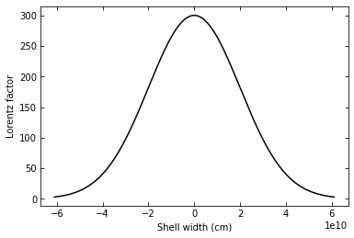
Shell Model
- Synchrotron Radiation
- Afterglow-like Model
Γ = 100
Γ = 30
Γ = 300
Radius
Prompt emission radius
Afterglow onset radius

Slide 7
High Latitude Emission
θ = 1 / Γ
Not to scale

Slide 8
High Latitude Emission
θ = 1 / Γ
tobs = γt’e(1 - βcosθ)
Not to scale

Slide 9
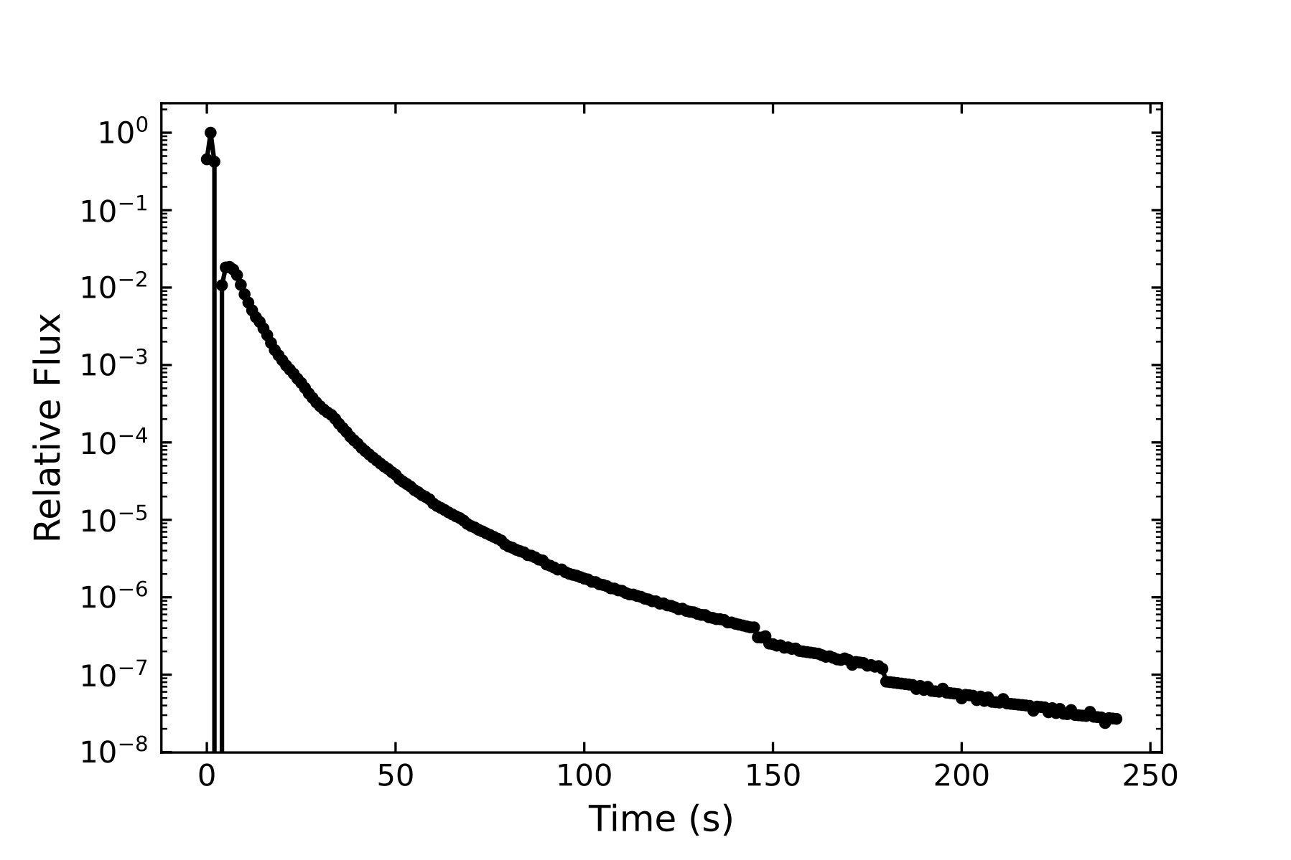
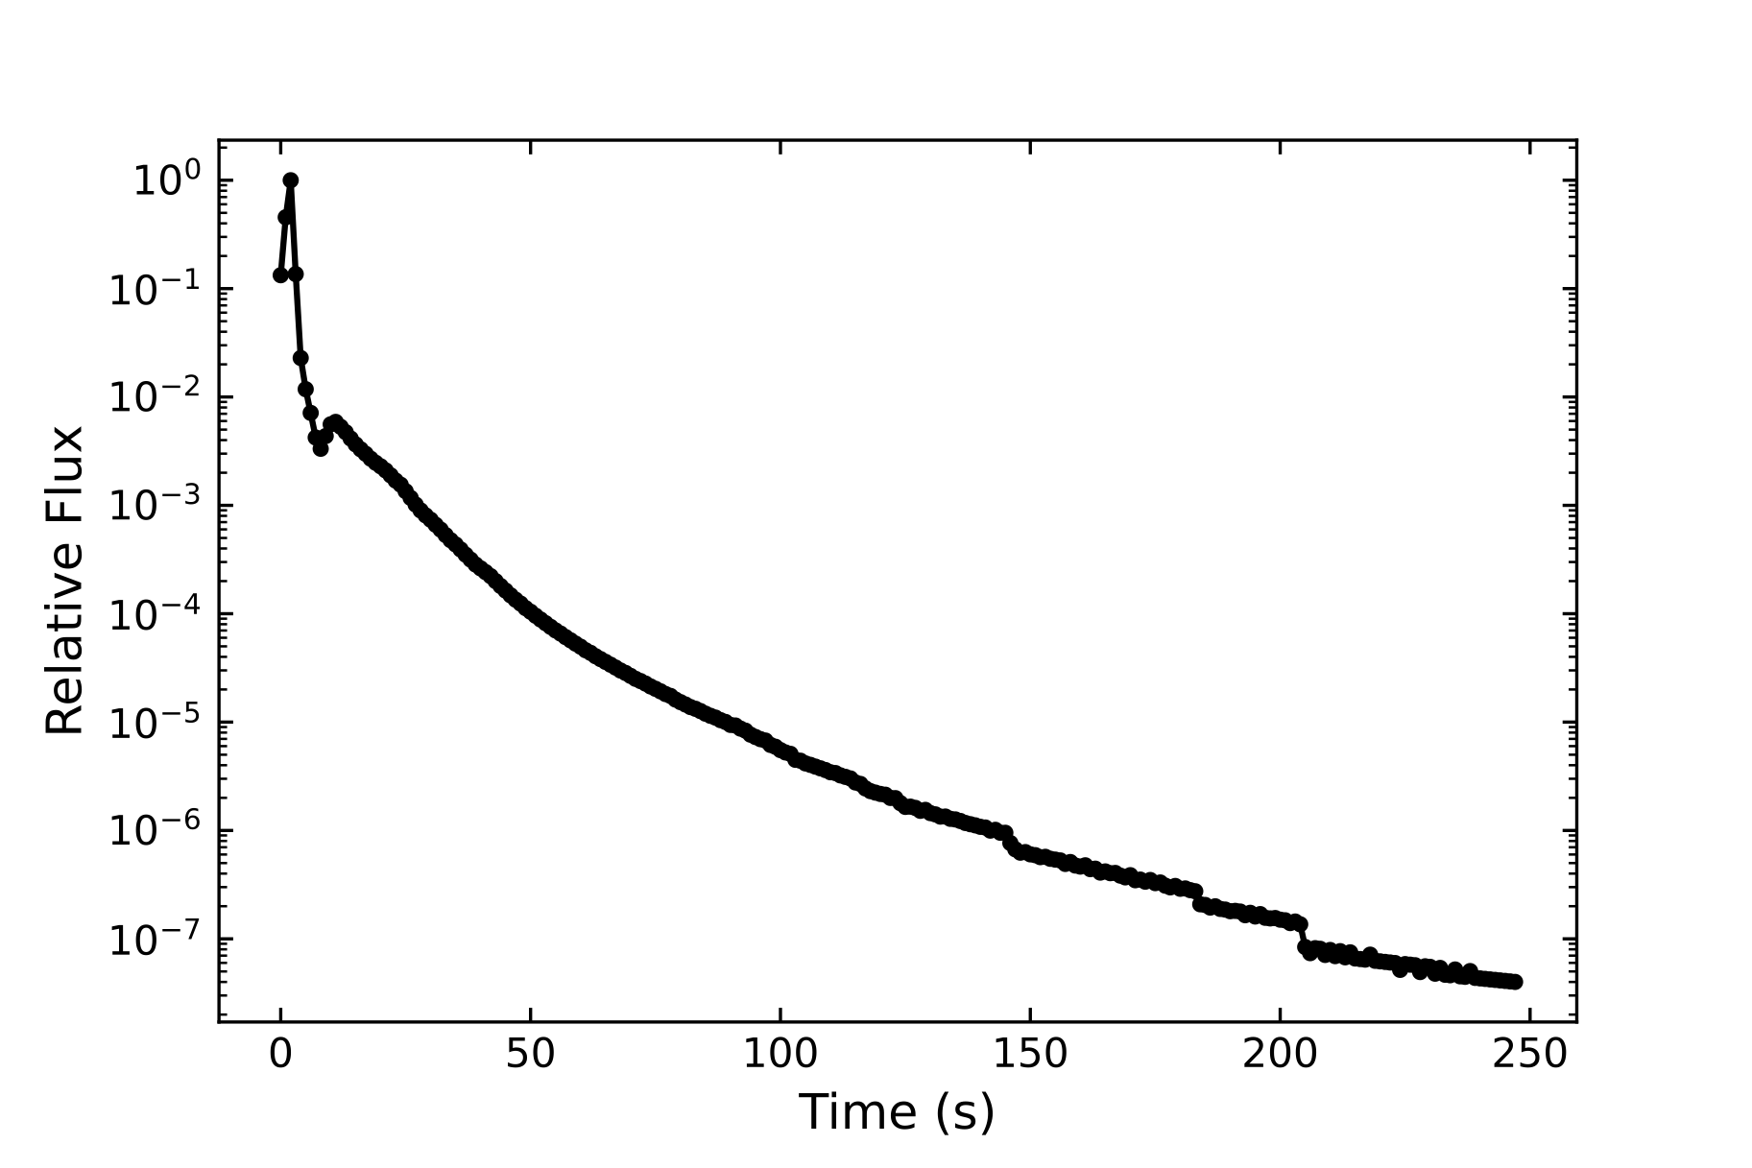

Slide 10
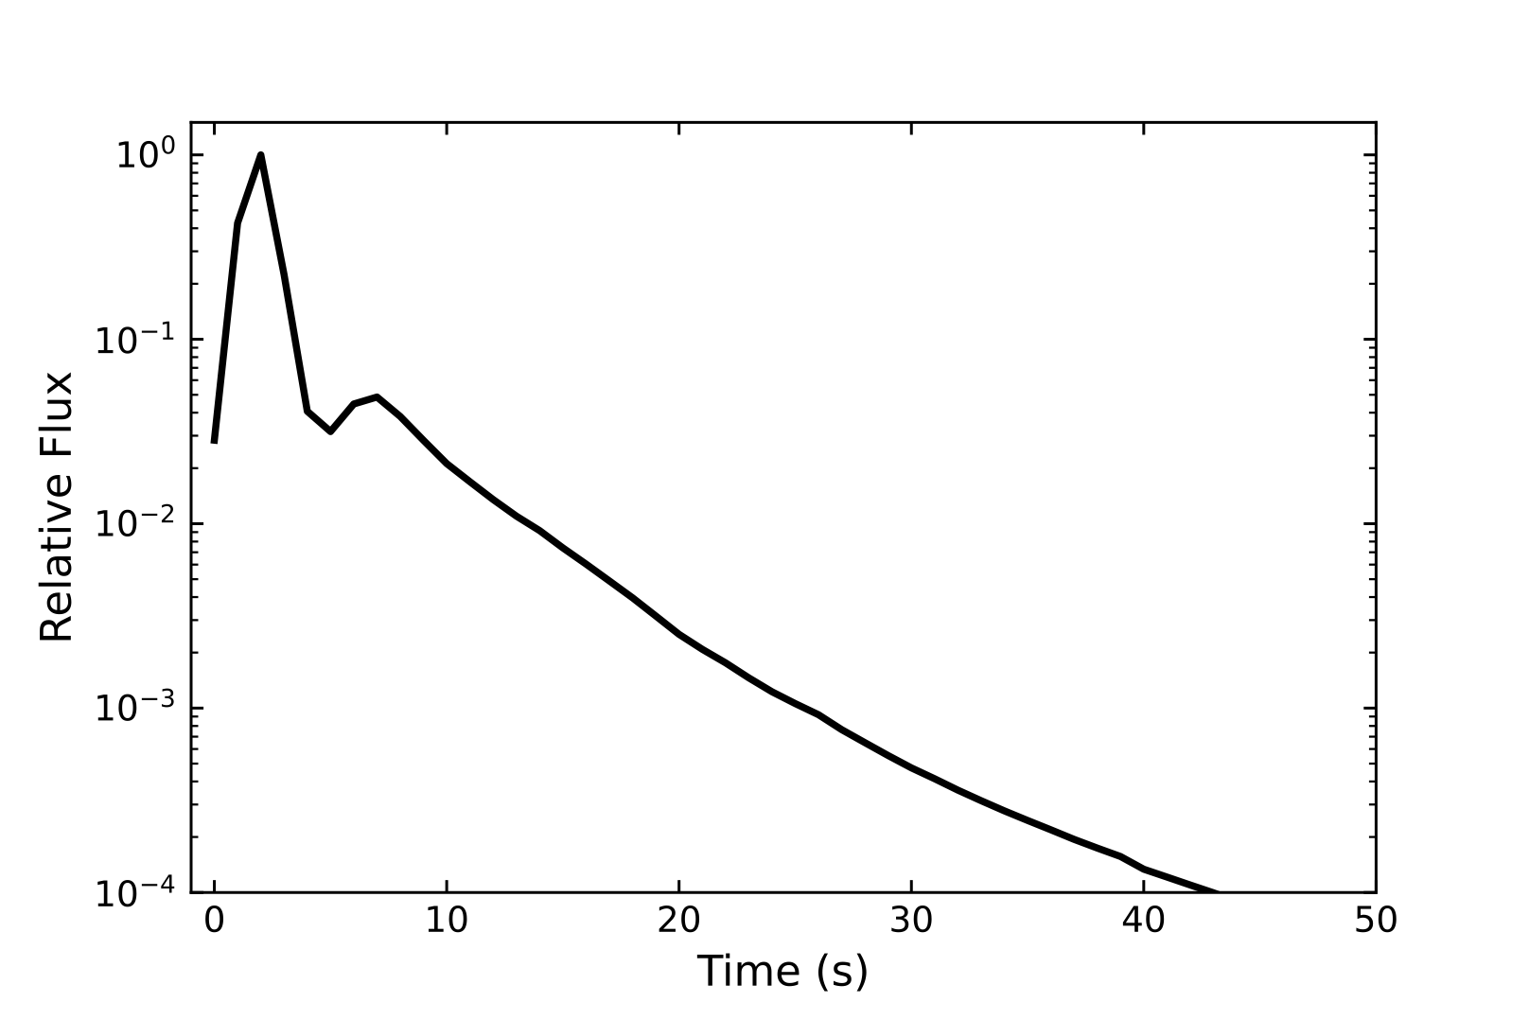
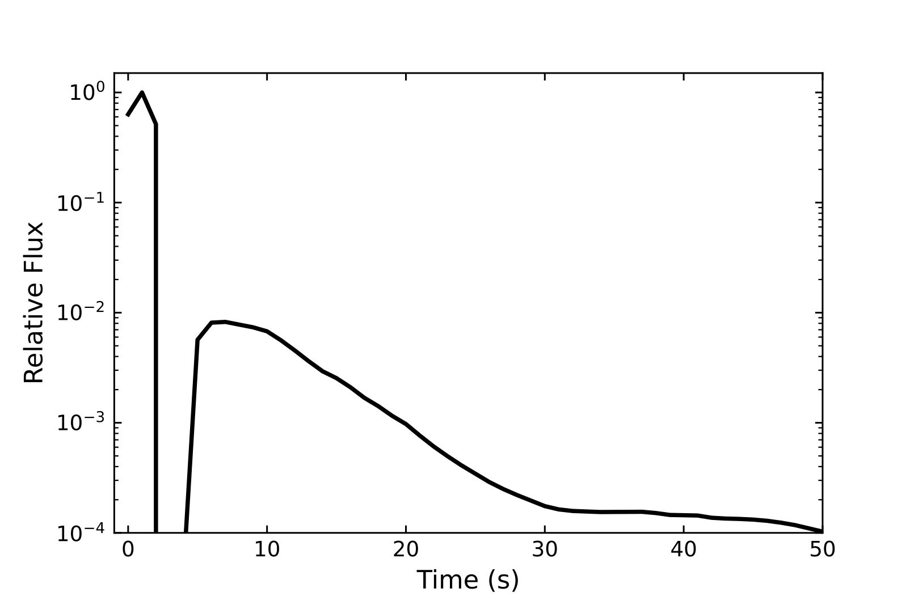
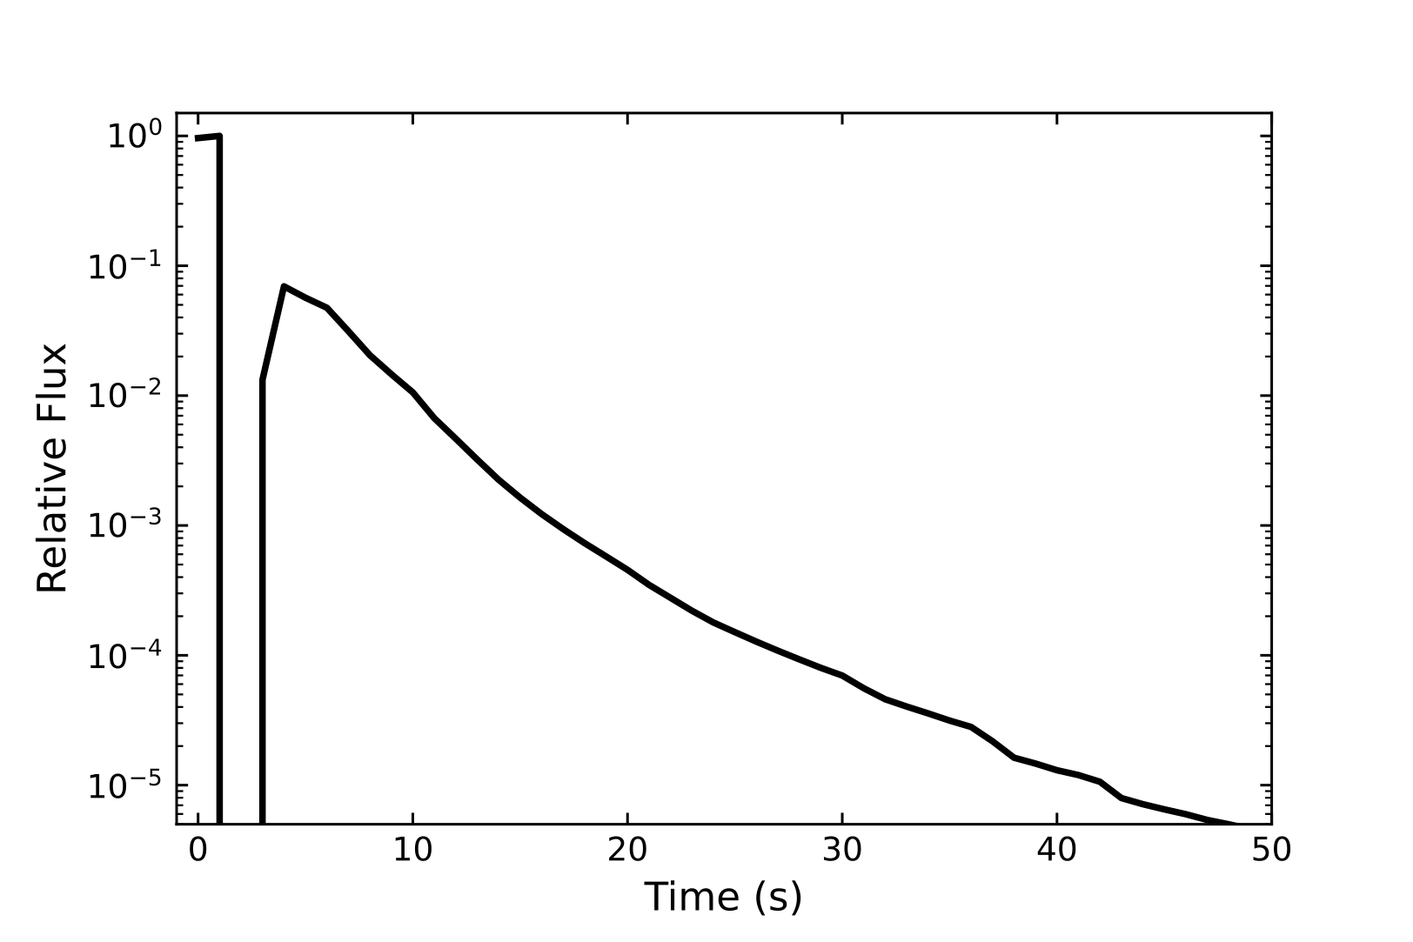
Γ = 500
Γ = 300
Γ = 500
Γ = 900
Notes:
500 one = [500-300], [90-10]

Slide 11
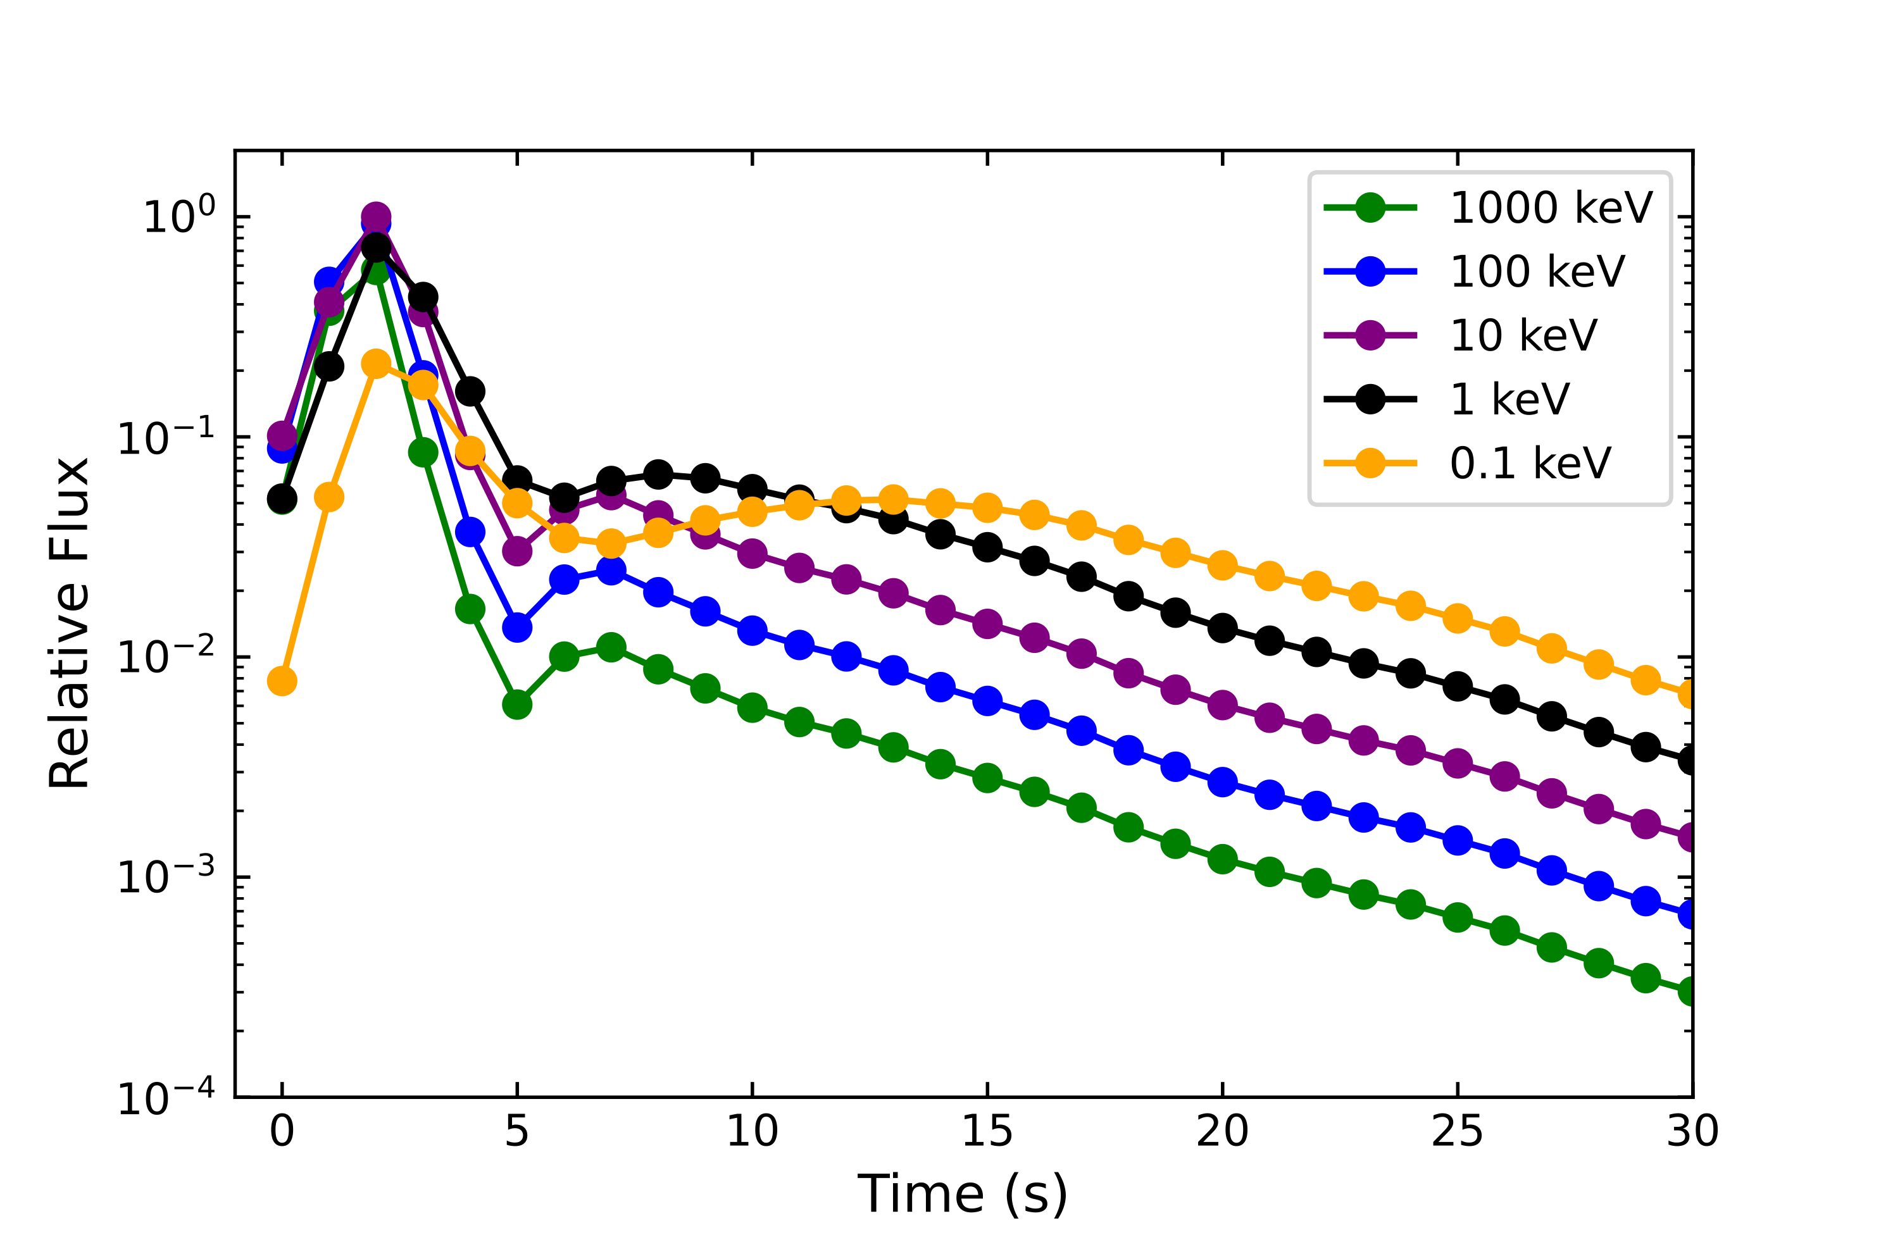

Slide 12
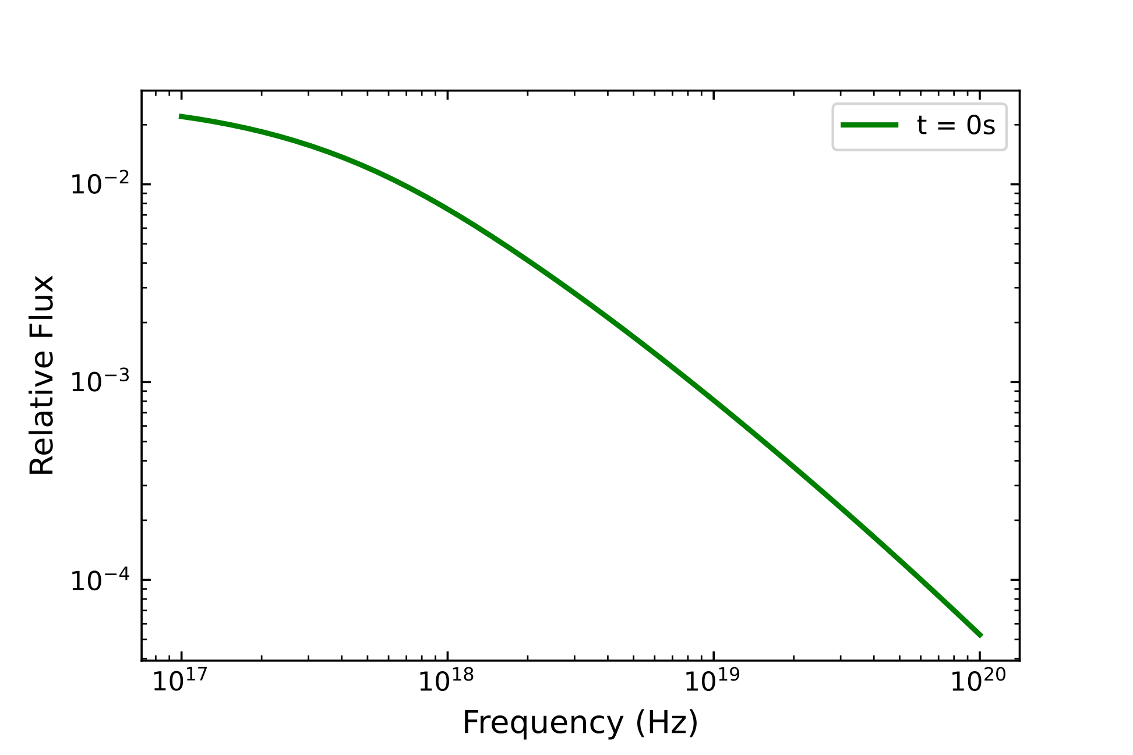
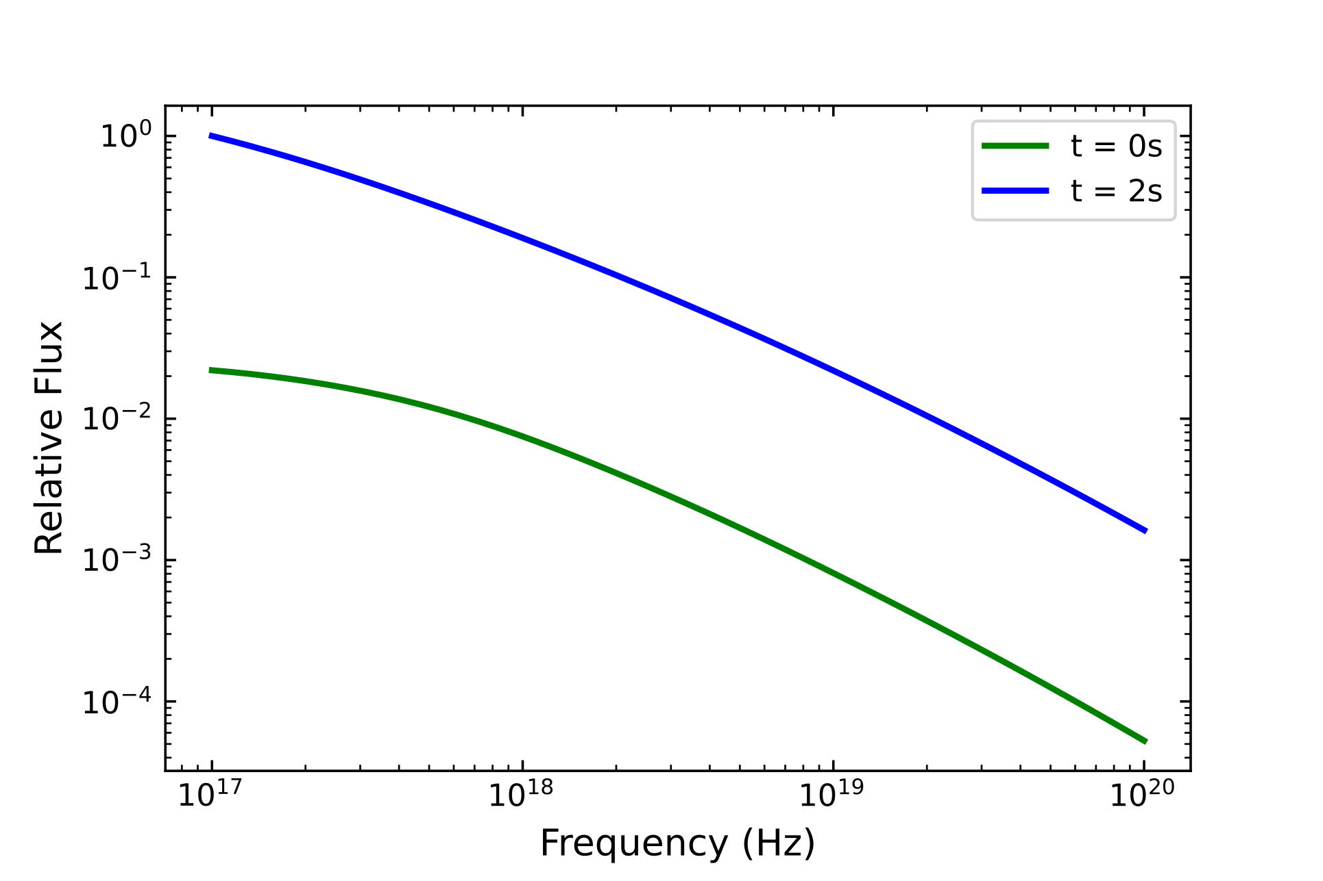
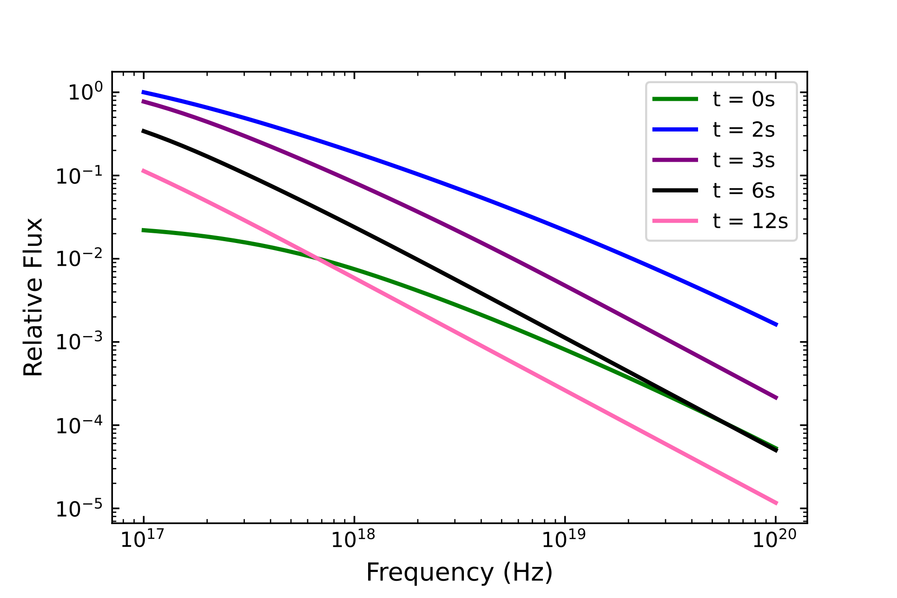
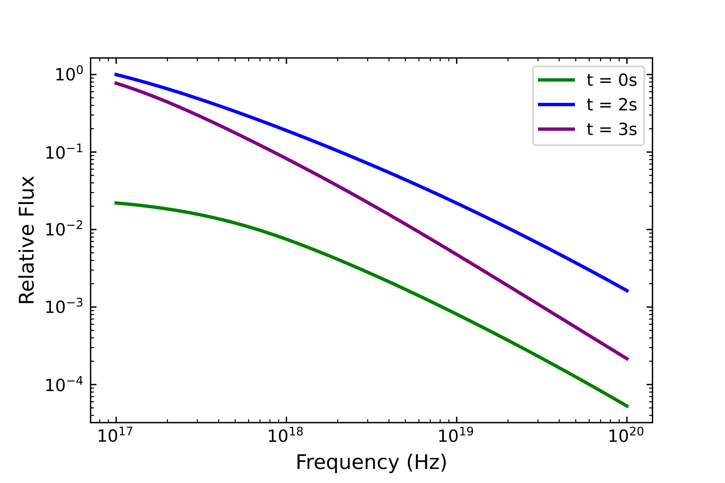
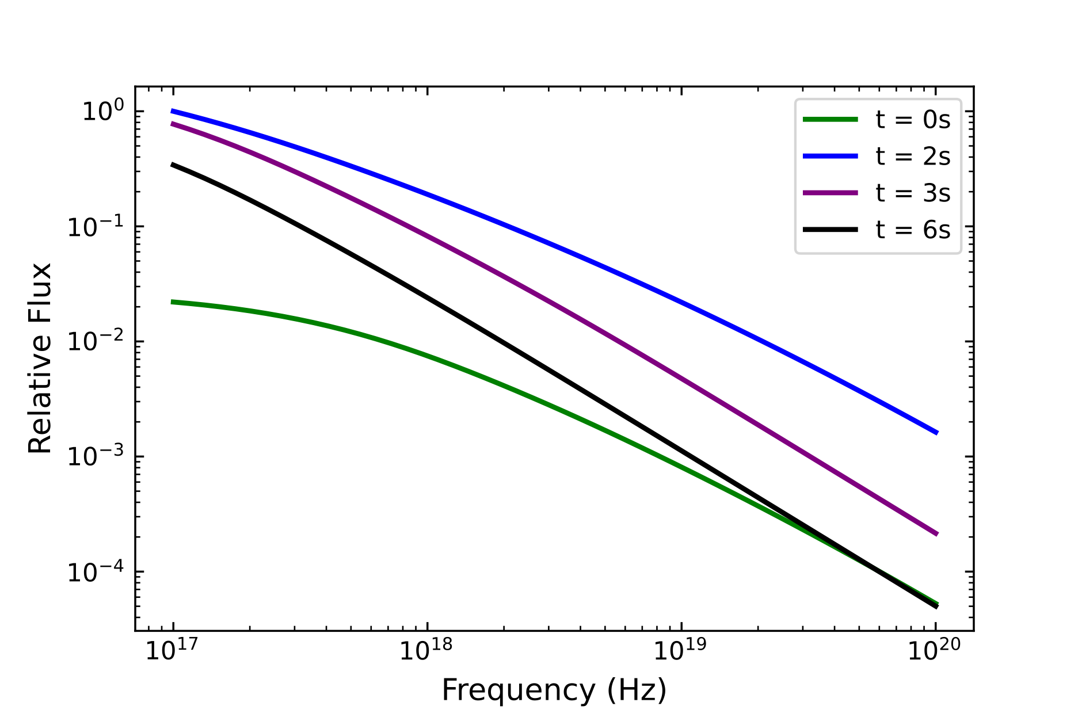
Ref: B. Gompertz 2022 Nat. Astron.
Notes:
Mention vFv = 211211A against F = our model

Slide 13
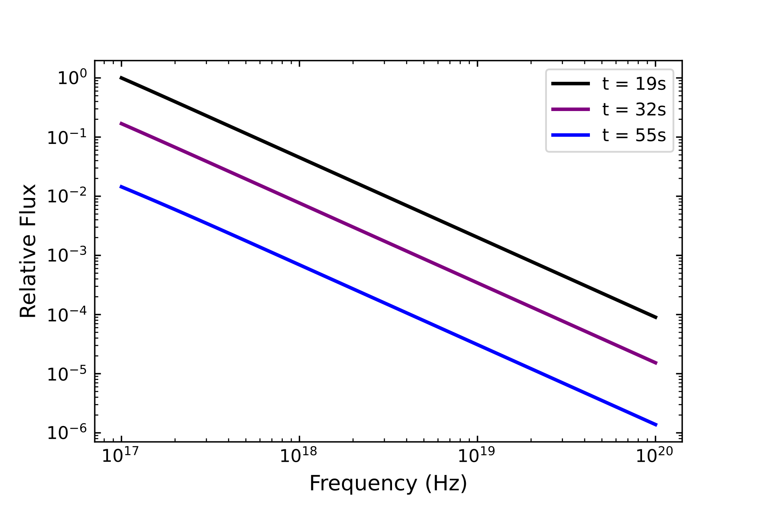
Ref: B. Gompertz 2022 Nat. Astron.

Slide 14
Conclusions
Shell model with time propagation and radius range up to afterglow onset
Extended emission-like lightcurves (IPC + plateau)
Spectral evolution doesn’t match observations (replace afterglow-like assumptions)

