Slide 1
Polarisation signals from non-axisymmetric Gamma-ray burst jets
Thomas Baxter
Graduate student
Supervisor: Shiho Kobayashi
NAM Durham - 2025
Thomas Baxter
aritbaxt@ljmu.ac.uk
Notes:
Afterglow Pol signals around the jet break.
How the integrated afterglow emission from the shocked ambient medium can be polarized, and how polarimetry allows us to probe the geometry and structure of GRB jets, including as hinted at by the title deviations from perfect symmetry
???And a core idea here is that GRBs are cosmological in origin and we have little hope of directly imaging their jets, so how then can we understand their shape and structure.

Slide 2
Linearly polarised emission from a fluid element of a relativistic blast wave
COMOVING
LAB
Notes:
In standard synchrotron shock model, the magnetic fields responsible for the afterglow emission are generated locally at the blast wave. Fields generated by collisionless relativistic shocks are expected to be tangled in the plane of the shock.
fluid element in the shocked ambient medium propagating radially at relativistic speeds, therefore shock normal direction is a physically distinct direction
distinct direction at each point of the blast wave surface
Each fluid element will emit most intensely in a cone of angular scale 1/Gamma around the shock normal direction
Effect is more pronounced at higher frequencies

Slide 3
Side view
Head on projection
Central jet axis
LOS
LOS
Notes:
Head on : two collimation scales

Slide 4
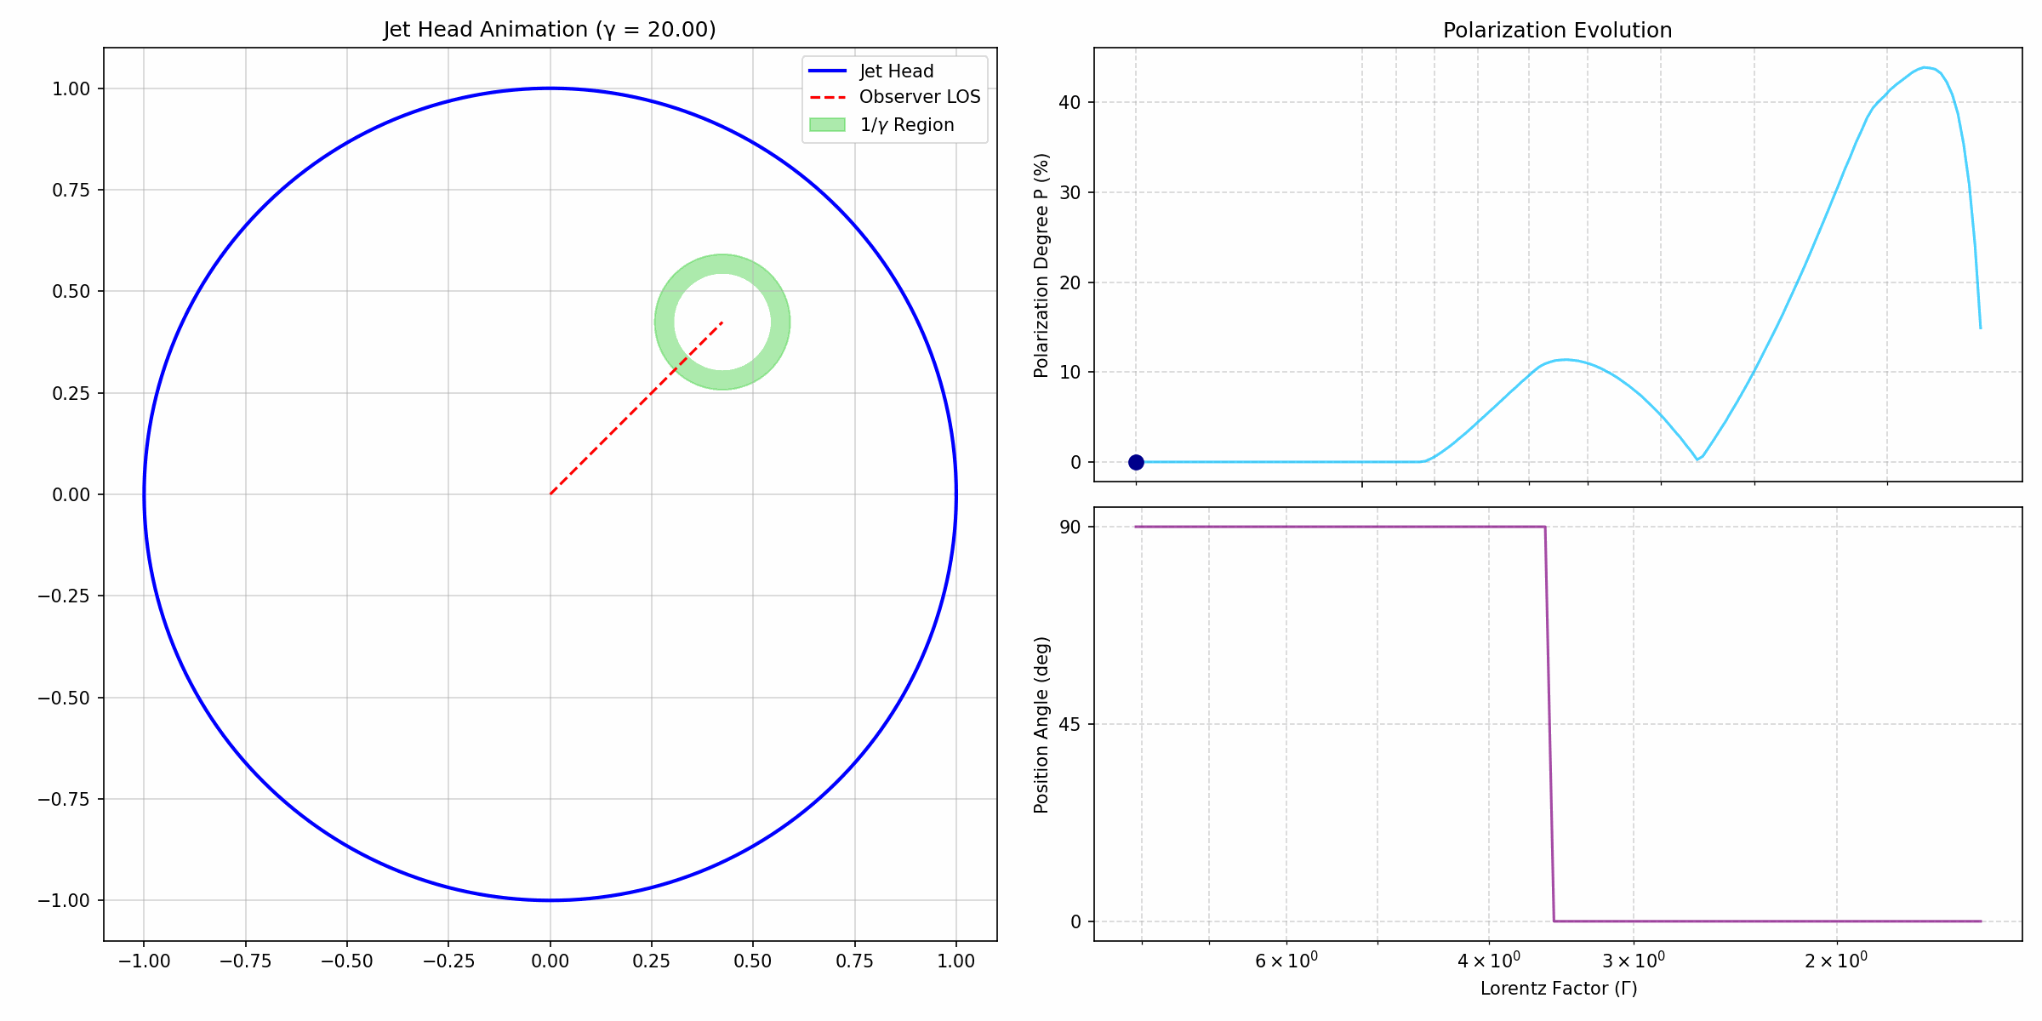
Polarisation signals from axisymmetric jets
Non-spreading top-hat jets with microscopic scale tangled fields (Ghisellini & Lazzati, 1999. Sari, et al. 1999)
Structured jets: Single peak and unchanging position angle (Rossi, et al. 2004 )
Notes:
Two polarisaiton peaks and rapid 90 degree position angle rotation, features are independent of viewing angle.

Slide 5
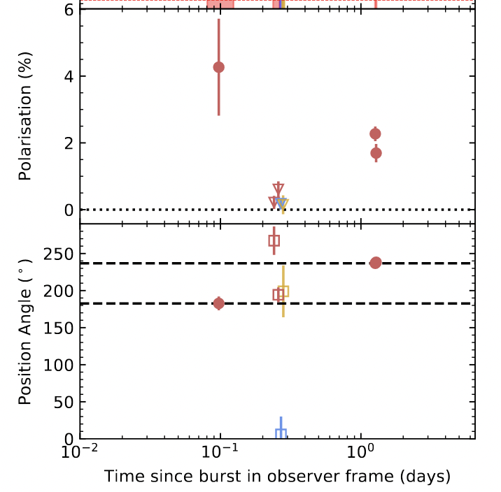
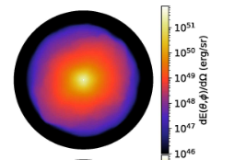
Jet morphology
GRB210610B
Δɸ = 54°
(Fernandez, et al. 2024)
(Lamb, et al 2022)
Notes:
Tophat ( cone ) is a reasonable zeroth order approximation but this simple model is being challenged by firstly
Obs non-standard position angle rotations.
This is shown even clearer by lamb, plot shows energy across a jets surface after interacting with the wind ejecta from a compact object merger. Aside from the extended structure outside the bright core, he found that sampling azimuthally gave dex difference in the light curve, essentially, the jets energy is not symmetric about the central axis
Now the question is, How would these devitations from axisymmetry manifest in the polarization data?

Slide 6
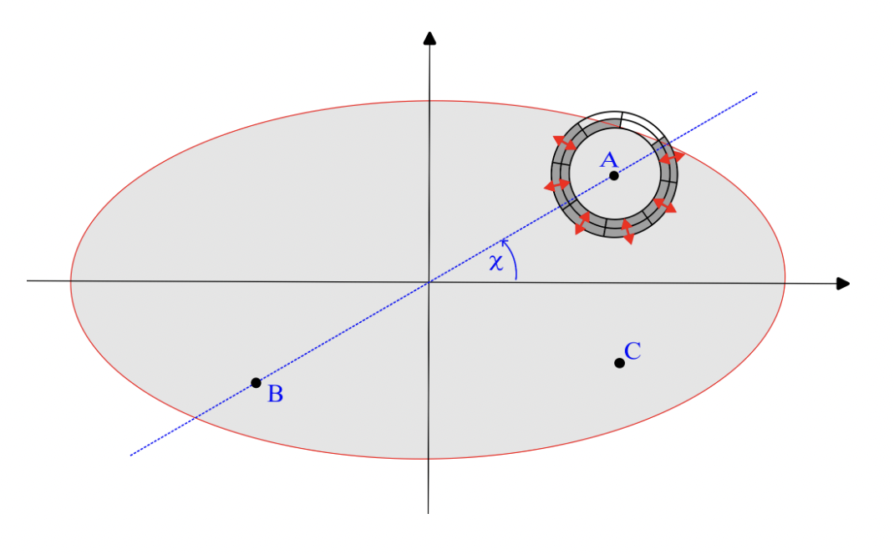
Notes:
Elliptical cross section, most natural generalisation
Azimuthal dependence ( chi ) as well as viewing angle, and quantify the jets deformation by eccentricity ( e )

Slide 7
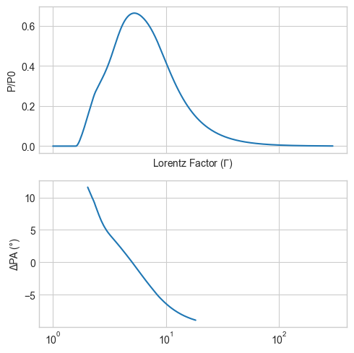
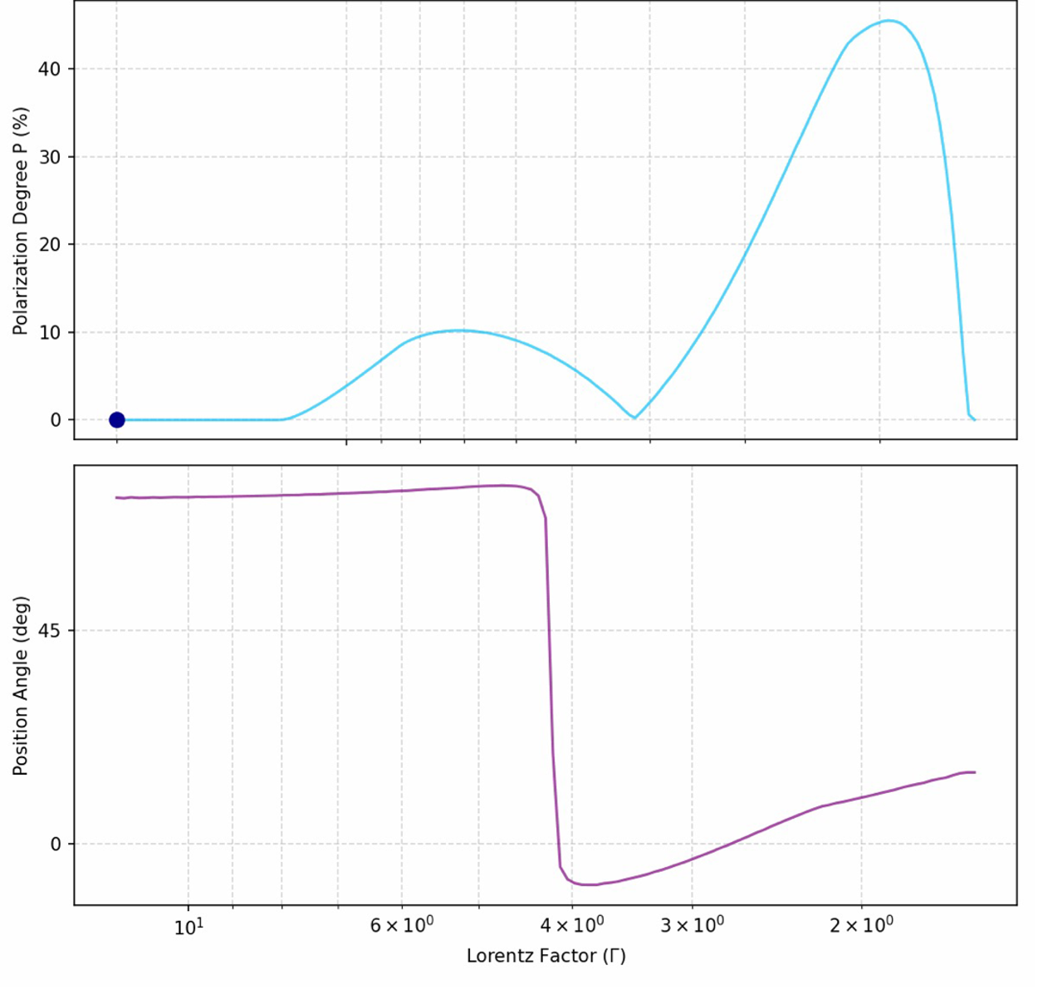


$$R_{pd}≈30$$
$${Δφ= 72}^{∘}$$
Structured non-axisymmetric jet
Non-axisymmetric top-hat jet
Notes:
- Extra degree of freedom, comparing polarization no longer instructive
uniformly sampling, extract these parameters in each case. trends in pol data and see what that can tell us about the geometry.

Slide 8
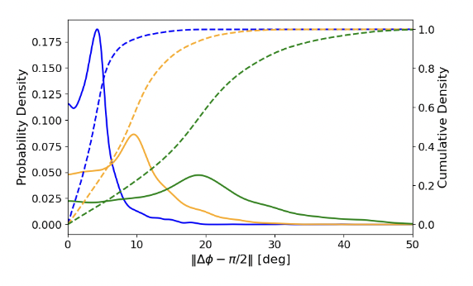
e = 0.15
e=0.3
e=0.45
Baxter & Kobayashi
2025
Notes:
- pronounced peak, axi close to 90 deg, regardless of how you view the jet the polarization signals look similar to that of an axisymmetric jet
- jet more deformed, most of the samples have PA rot that deviate significantly from 90 degrees, highlighting used to tell us about geometry

Slide 9
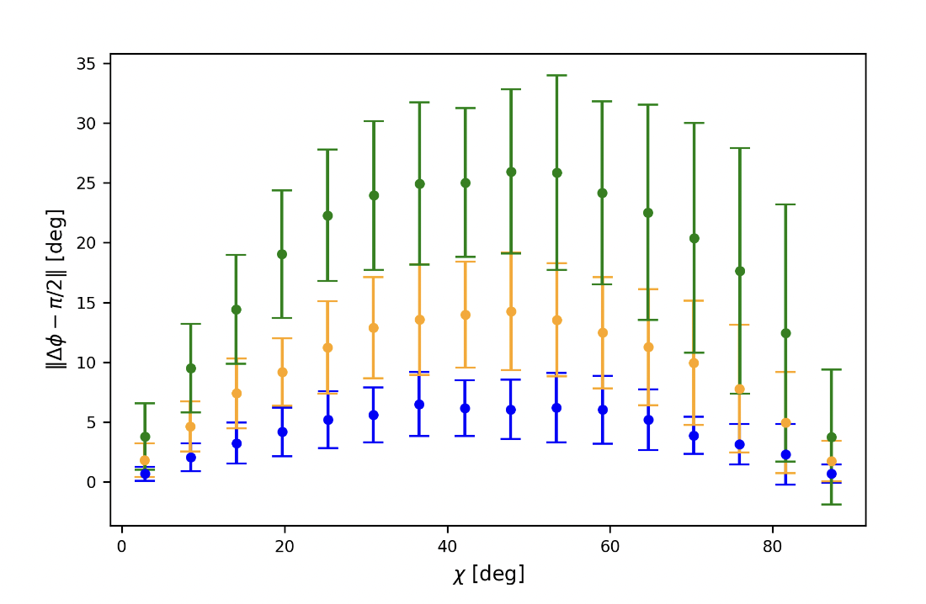


e = 0.15
e=0.3
$$χ={90}^{∘}$$
e=0.45
$$χ=0^{∘}$$
(B+K 2025)
Notes:
- binned the samples by azimuthal position of the LOS, shown green
- distribution of PA rotation values in a particular angular range
- near axis of symmetry, regardless of deformation, still distributed tightly around 90 degrees
- intermediate region is where the jet asymmetry is most pronounced in the polarisation data
- now tells us that pa rotations that deviate significantly form 90 degrees are likely from a jet that is highly non-axisymmetric

Slide 10

Summary
For non-axisymmetric top-hat jets, the polarisation position angle rotation between the two polarisation peaks around a jet break can deviate significantly from the 90° predicted by axisymmetric models.
The polarisation degree in such jets generally does not drop to zero between the peaks.
For structured, non-axisymmetric jets viewed in their outer regions, a single polarisation peak is expected, accompanied by a gradual evolution of the PPA, contrasting with the constant PPA predicted by axisymmetric models
Baxter, T., & Kobayashi, S., "Probing the axial symmetry of gamma-ray burst jets using afterglow polarimetry,"
Notes:
The acceleration and collimation processes of jets are not yet well understood. Our study offers a new type of information concerning the axisymmetry of jets. While it may not directly identify the underlying physical processes, it provides insights that are not accessible through other methods. This can place meaningful constraints on theoretical models and stimulate further investigation.

Slide 11













Light curves of non-axisymmetric jets
Photons emitted over
Solid angle:
$$Ω≈π\left(\frac{1}{Γ^{2}}\right)$$
$$θ_{j}$$
$$∼t^{−1}$$
Flux (arb)
$$∼t^{−\frac{7}{4}}$$
Blast wave dynamics in
ISM :
$Γ∝t^{−\frac{3}{8}}$
Time (arb)
$$θ_{j,1}$$
$$∼t^{−1}$$
Constraint on jet
Geometry:
$$\frac{t_{j,2}}{t_{j,1}}∼{\left(1−e^{2}\right)}^{4/3}$$
$$∼t^{−\frac{11}{8}}$$
$$θ_{j,2}$$
$$∼t^{−\frac{7}{4}}$$
$$t_{j,1}$$
$$t_{j,2}$$
Notes:
Solid angle grows by 1/gamma^2 until the beaming cone is ~ bigger than jet angle. At this point you lose emission from a portion emission stays being emitted over thetaj^2 as the blast wave continues to decelerate. This deficit picking up the 1/gamma^2 factor
Breaks will be smooth so angular scales would have to be quite different in order for them to be distinct.
- When the light curve breaks and the polarisation position rotates will be around the same time, looking into how these times are related for non-axisymmetric jets could be an interesting direction to go next

Slide 12
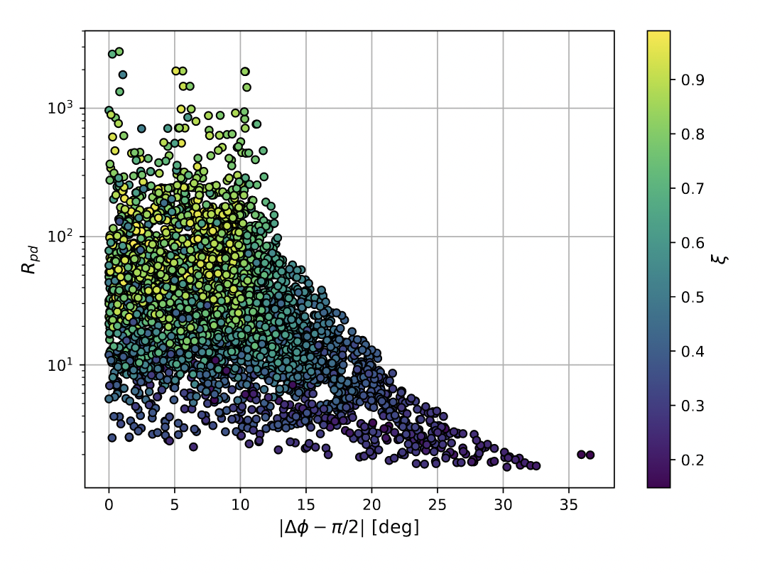

Slide 13
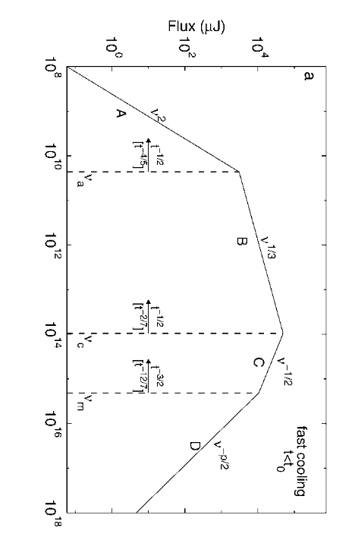
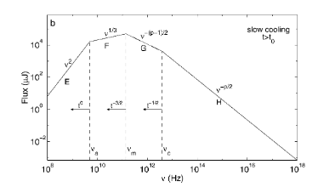
Spectrum of GRB afterglows
Sari 98

Slide 14
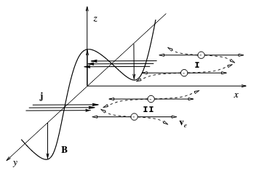
Two stream plasma instability
Medvdev&Loeb 1999
Notes:
Relativistic two-stream “Weibel” instability
Coherence length of plasma skin depth
Requires no seed field
Model relies on the fact that the same physical process is responsible for the generation of the fields and that, they are anisotropic, same fraction of magnetic energy and plasma skin depth uniform across the blast wave statistically

Slide 15
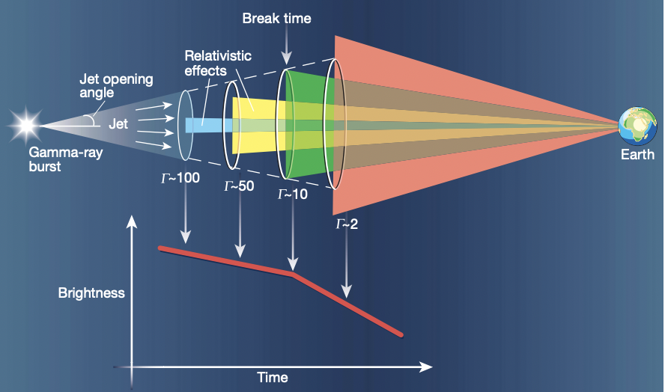
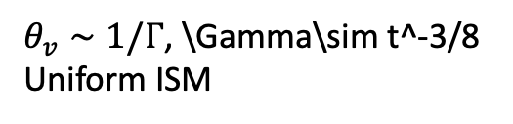
Jet break in afterglow light curves
Early times = spherical relativistic
blast
wave emission
Flux decline F~t^-1 for typical p=2 value
$θ_{v}∼1/Γ$, \Gamma\sim t^-3/8
Uniform ISM
Deficit in flux when the
viewing cone grows out of
the jet
Woolsey 2001

Slide 16
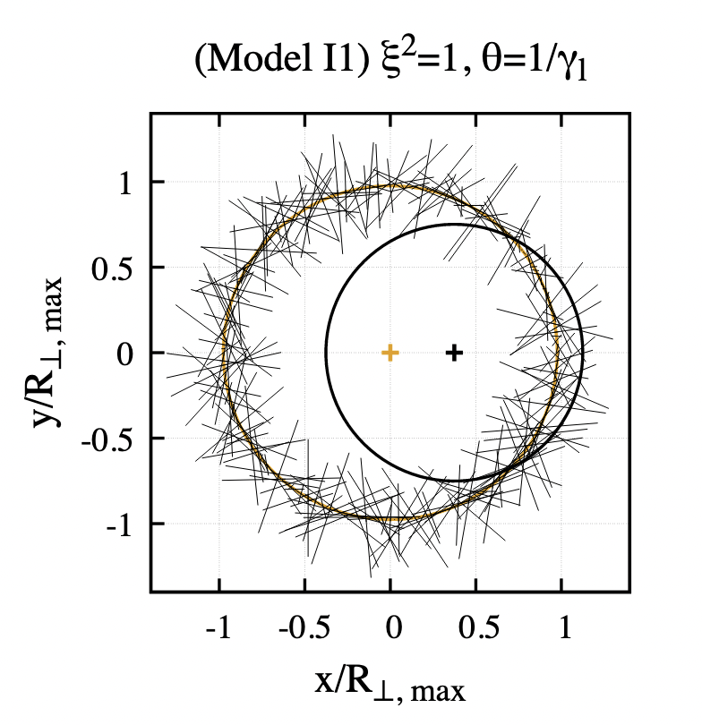
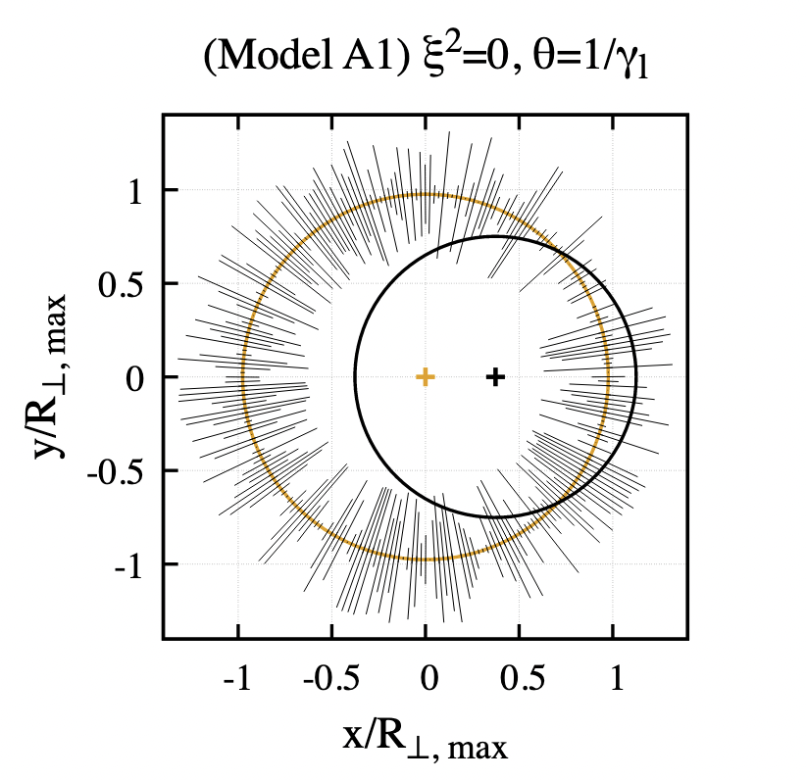
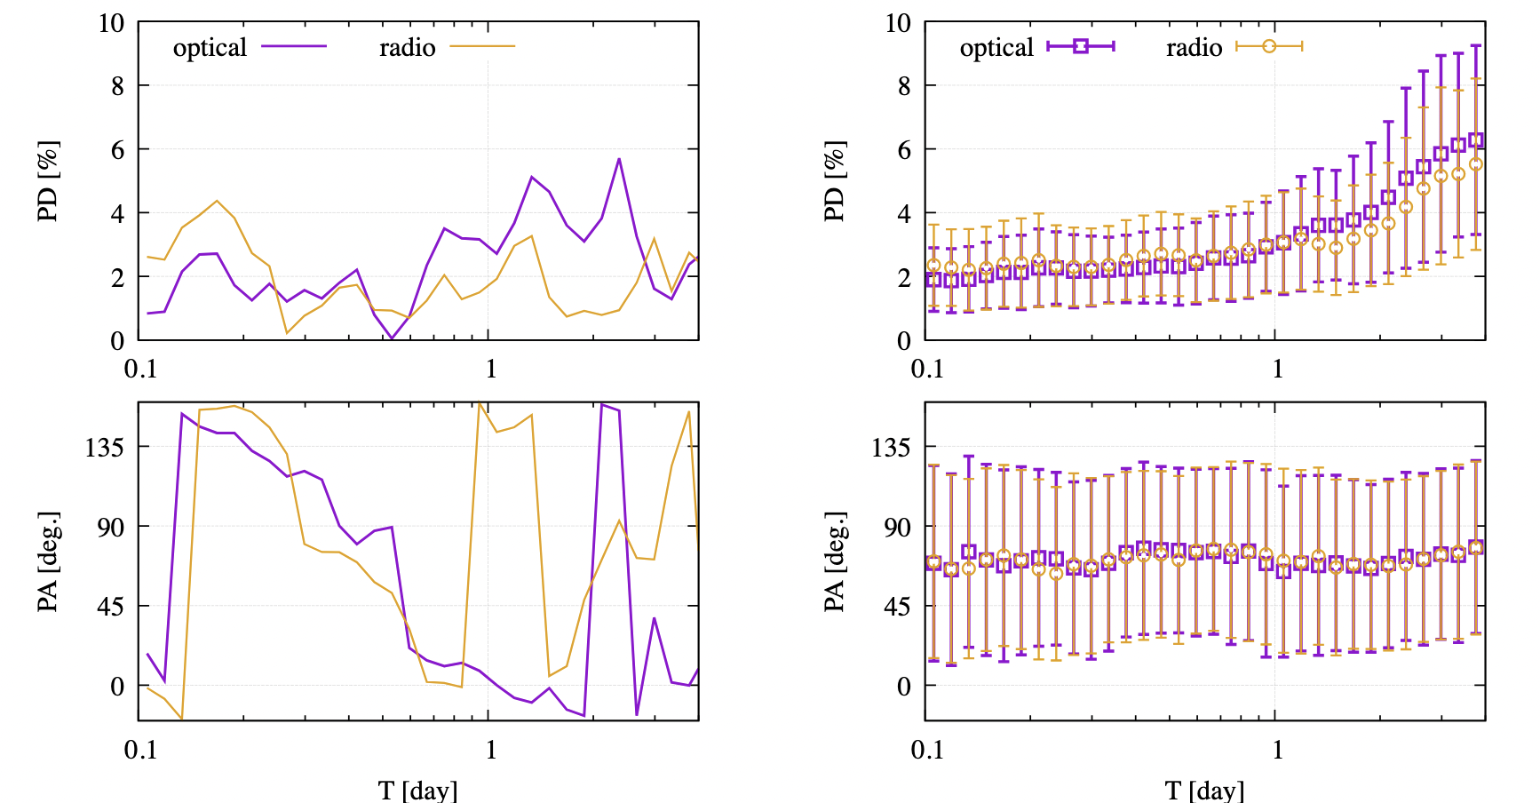
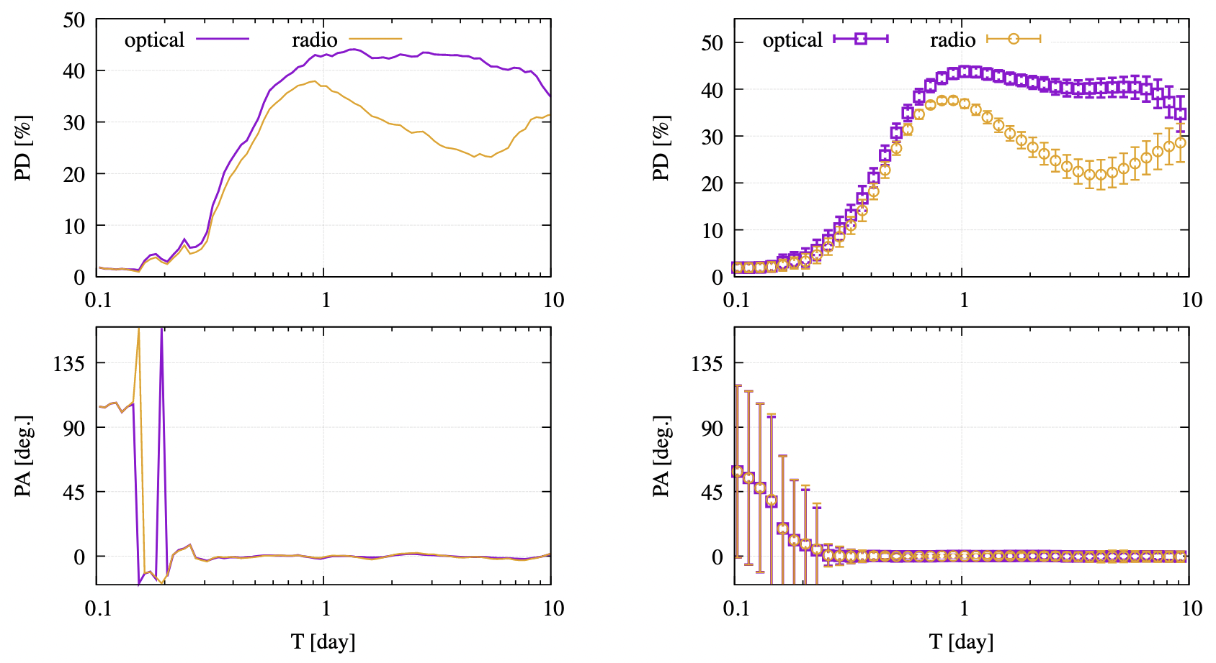
Kuwata et al 2023

Slide 17
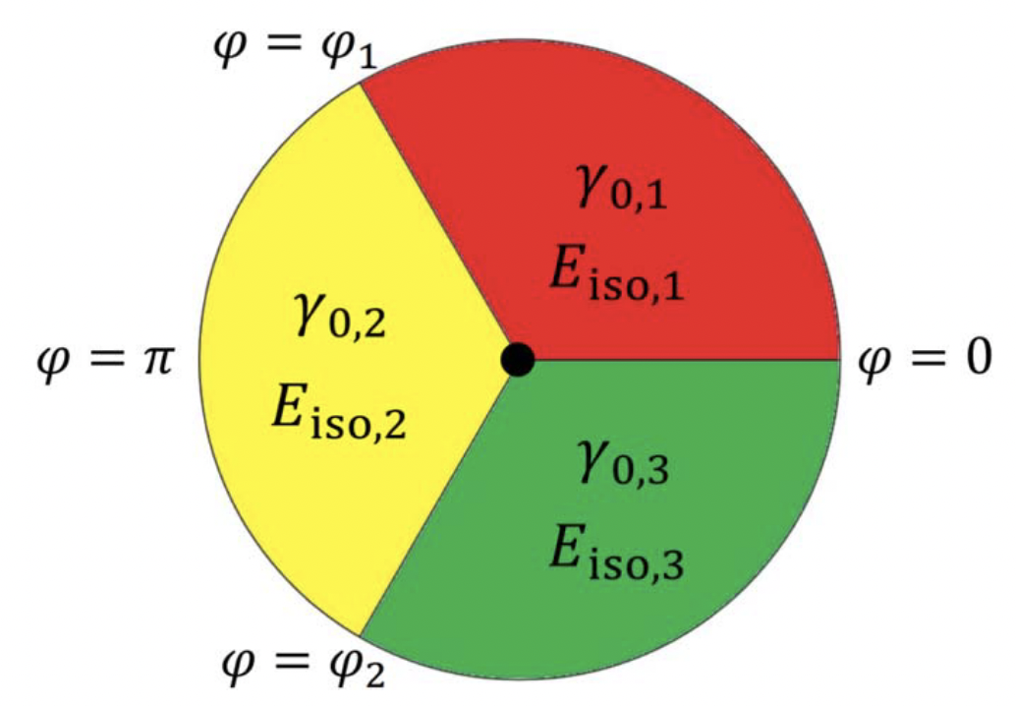
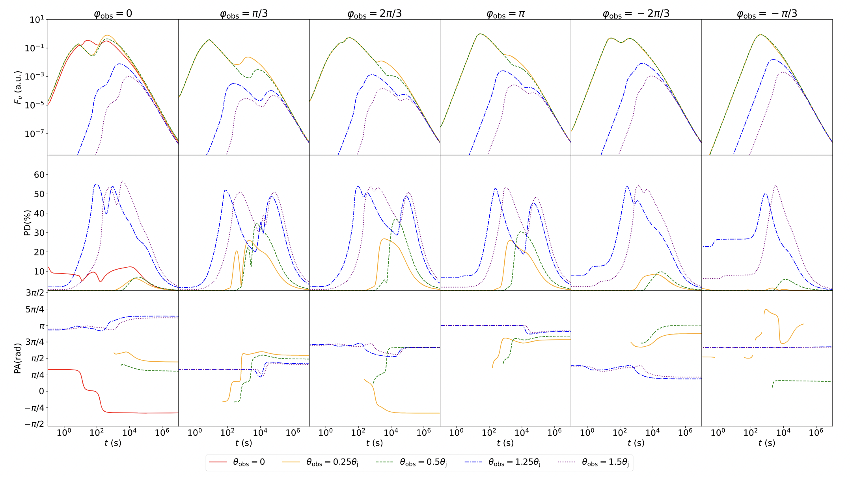
Li 2024

