Slide 1
IRIS Digital Research Infrastructure
Prof. Jonathan Hays, IRIS Science Director
ASTROCOMP, National Astronomy Meeting 2025
07/07/2025

Slide 2

eInfrastructure for Research and Innovation for STFC
IRIS is a federated cooperative community bringing together STFC computing interests
Formed bottom up by science communities and compute providers
Works closely with STFC but run by the community

Slide 3
IRIS Activities
Build infrastructure
Build community
Invest in computing hardware
Coordinate
Support training
Support digital asset creation
Making the case for investment

Slide 4





SCD RAL
GridPP
DiRAC
SCARF HPC cluster
STFC cloud
Imperial Cloud
CSD3 HPC cluster
LondonGrid
Arcus cloud
(coming soon… Durham Cloud)

Slide 5












Some of our supported activities…

Slide 6
IRIS Structure
Resource Scrutiny and Allocation Panel
Delivery Board
Technical Working Group
Resource Allocation
Strategy, Policy, Funding etc
Technical Coordination
Activities and Facilities
Other Partners
Providers

Slide 7
Funding
2017:
  £1.5m Capital : £1m hardware, 0.5m digital assets
2018:
  £16m (4M / year over 4 years, 11M Hardware, 5M Digital Assets for National Facilities
2020:
  Capital injections ~ £6m : 3M capital for IRIS, 2M for LSST (Rubin Observatory), 1M for SKA
2021:
  UKRI Digital Research Infrastructure funding ~ £2m
2022:
  STFC Capital funding £2.4m – anticipated recurrent over 3 years
  UKRI DRI funding – £3.5m additional funding in 22/23 + 23/24
  Additional capital supporting Astronomy programme £2.3m
2023:
  STFC Capital funding £2.4m
  UKRI DRI Phase 1b from 22/23 award - £400k
  UKRI DRI Phase 2 - £1.4m (£400k 23/24, £1m 24/25)
2024:
  STFC Capital funding £2.4m
  UKRI DRI Phase 2 - £1.2m
2025
  STFC Capital funding £2.4m (TBC)
  UKRI DRI - £1m

Slide 8
IRIS and its Community
Technical Working Group
  Weekly meetings
    Technical discussions – presentations, showcases etc
    Operations reports
  Regular ad-hoc workshops as and when needed
    Wide range of topics from identity management, cloud computing, GPU usage, machine learning etc
Targeted at the IRIS community but open to all

Slide 9



Invest in computing hardware
Science (Programmes)
HTC Computing for
Experimental PP (and others)
STFC
>50k cores
> 30 high-memory nodes
> 20PB Disk
~280 GPU compute
National Labs

Slide 10
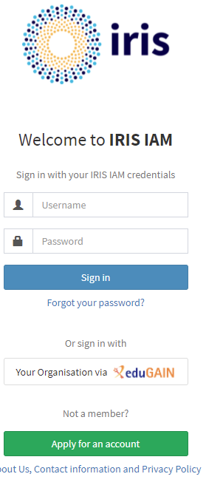
Build Infrastructure
Building capability
Examples include:
Identity management, access methods, data management, workflow management, Policy (security for example)
Community building, coordination, digital asset funding

Slide 11
Digital Asset Creation
Digital Assets
Essentially software (or similar) products (capitalizable) – with a defined end point or delivery of the asset
Additional track of funding “Other DA” programme available to full IRIS Community
Often infrastructure related but can also be closer to science
UKRI DRI funding also allows some non-capital projects
- can be used for R&D as well as asset production

Slide 12
Digital Asset Creation
Data management
  RUCIO (LHC) from development for non LHC usage – multi-VO support, token based authentication support, etc (LSST, DUNE, SKA)
  High performance data transfers for SKA – using FTS and RUCIO (leveraging hardware investment by ExCALIBUR)
Core infrastructure
  Security policy
  Information Security Management – supporting STFC SOC
  Accounting development – building on work at Tier 1
  VMDIRAC – workflow management building on DIRAC (LHCb) for non-LHC
  Tools and services portfolio
Digital Assets
Identity management - IRIS-IAM
  Working towards single-sign on
  Closely aligned with LSST and SKA work
  Integrated with the DiRAC Federation Project
Radio astronomy on-boarding
  eMERLIN, ALMA, and others
  Documentation, tutorials, community engagement
  Evaluation for IRIS integration
Algorithm Development
  Efficient random numbers on FPGAs
  Support for FAST-HEP toolkit

Slide 13
What IRIS is not…
IRIS is not a turn-key computing solution for your favourite project
IRIS has no direct resource funding for user support – some community support as “best effort”
Physical resources for groups who can make use of it – depending on size you need your own:
  Software frameworks
  Support staff
IRIS might not have the kind of hardware you need
If you think this might be for you – despite the caveats – contact your closest Delivery Board Member
https://www.iris.ac.uk/partners/deliveryboard/

Slide 14
Summary
IRIS is a federated cooperative community bringing together STFC (and beyond) computing interests
Bringing groups together
Building Infrastructure
Supporting Science
Lobbying for the future
https://www.iris.ac.uk/

