Slide 1
Euclid UK Science on IRIS (Euclid Cloud Cluster)
James Nightingale, on behalf of Euclid:UK

Slide 2
Euclid

Slide 3
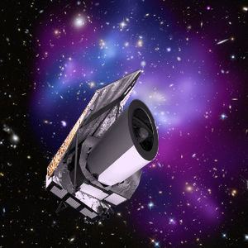
Euclid
European Space Telescope launched in 2023 to map the geometry of the dark Universe.
Wide-field optical & near-infrared imaging and spectroscopy of 15,000 square degrees.
Designed to constrain dark energy, dark matter, and cosmic structure formation with unprecedented precision.

Slide 4
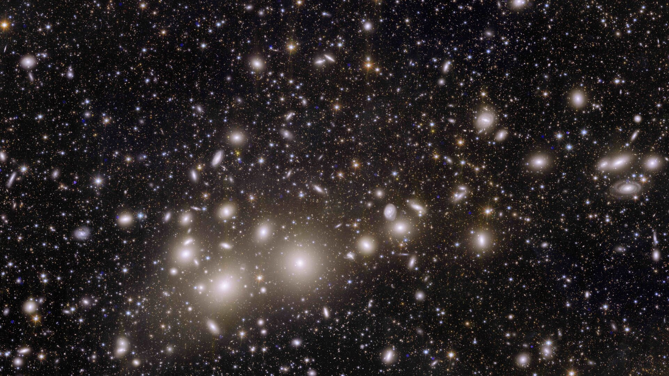

Slide 5
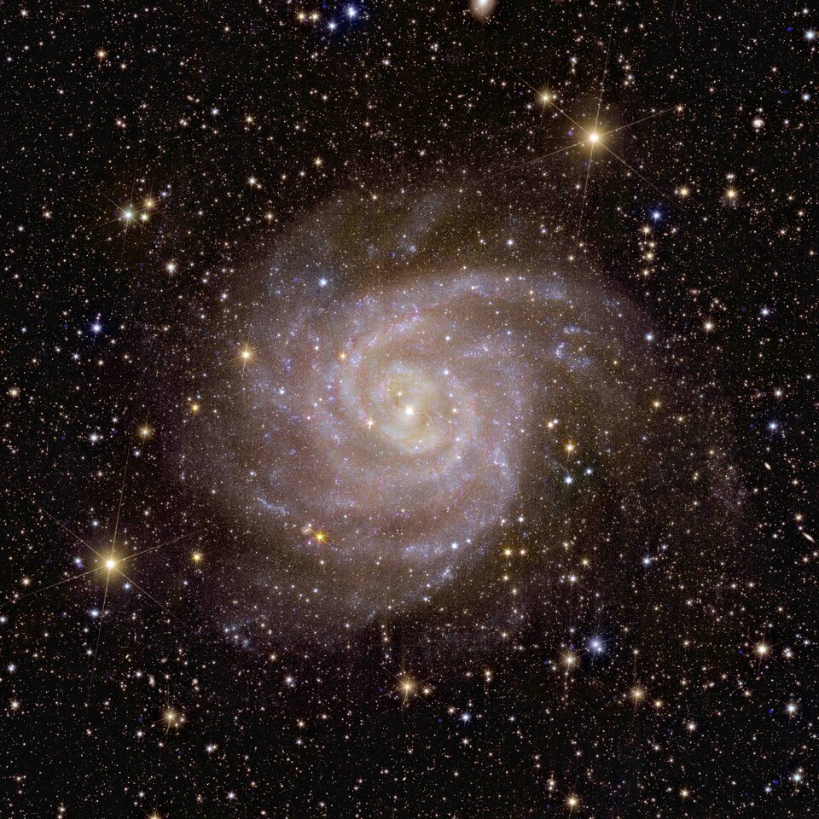
Euclid
The dynamic range of the images is unprecedented.
You can zoom in on individual galaxies are keep revealing more details.

Slide 6
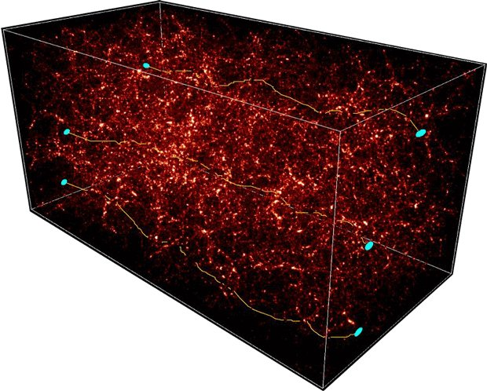
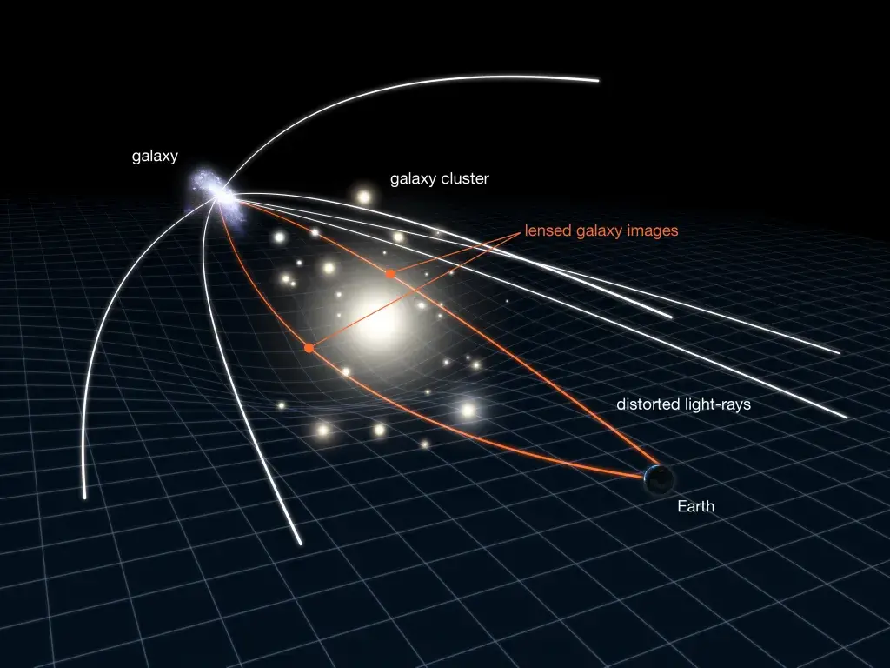
Weak Lensing

Slide 7
Shape Measurement

Slide 8
Euclid UK Computing

Slide 9
Euclid:UK Computing coordination
Yearly bid for UK computing resources through IRIS to enable Euclid science in the UK.
Joint SGS/SWG submission for 2025-2026 period went in November 2024, currently with allocation committee.
SWG request:
7.4M CPU hrs
54k GPU hrs
75TB cloud-based POSIX storage
Awarded similar resource allocations in previous years.

Slide 10
How to use IRIS (Euclid Cloud Cluster)
Our current allocation gives us access to 2 cloud clusters (“Slurm as a service”) located at RAL and Cambridge:
RAL: ~30 worker nodes, each with 60 cores and 246GB RAM.
Cambridge: ~30 worker nodes, each with 52 cores and 86GB RAM.
50TB shared disk space (not intended for long-term storage).
To access: contact Mark Holliman (our sysadmin, msh@roe.ac.uk) and cc either James Nightingale or myself.
User guide: available on the Euclid UK redmine page (thanks Matt Selwood and Sotiria Fotopoulou).

Slide 11
Science Uses
PSF: Calibrate the Point Spread Function for Weak Lensing Shape Measurement.
9 GPU years.
OU-SHE: Shape Measurement for Weak Lensing Science.
6000CPUyr / 200TB+ Storage.
Legacy Science:
5,000,000+ CPU Hours.
100,000+ GPU Hours.

Slide 12
Proprietary Analysis
PSF: Calibrate the Point Spread Function for Weak Lensing Shape Measurement.
9 GPU years.
OU-SHE: Shape Measurement for Weak Lensing Science.
6000CPUyr / 200TB+ Storage.
Legacy Science:
5,000,000+ CPU Hours.
100,000+ GPU Hours.

Slide 13
PSF

Slide 14
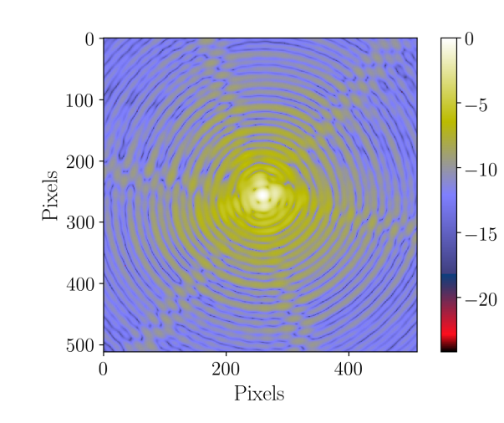
PSF Model
The PSF describes how a telescope blurs a point source of light.
It encapsulates all instrumental and atmospheric effects, including optics, detector response, and spacecraft jitter.
Accurate PSF modeling is critical for precise measurements in weak lensing and galaxy shape analysis.

Slide 15
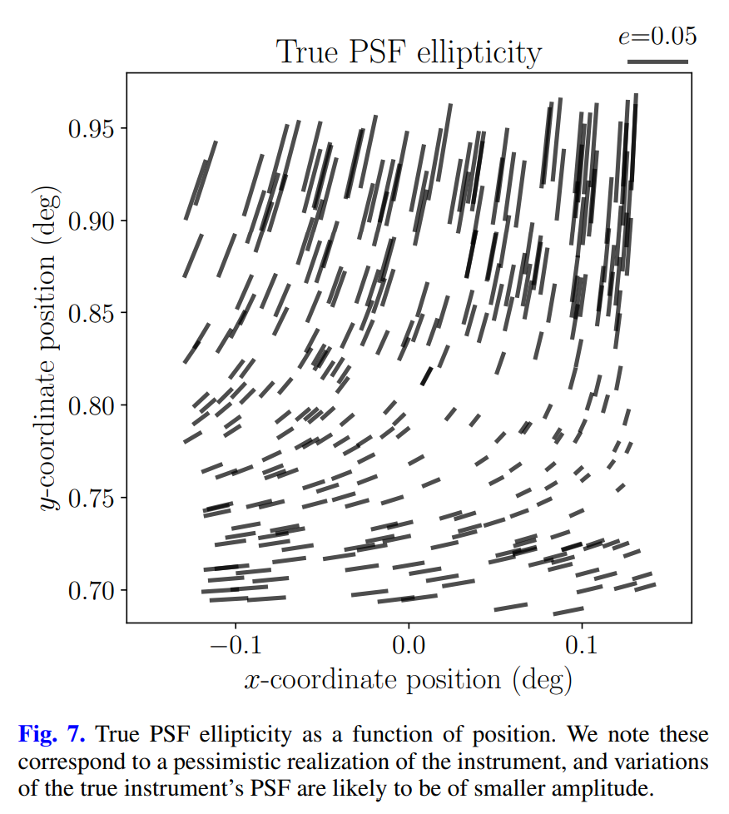
PSF Spatial Variation
For every Euclid CCD, PSF is estimated with variations over the CCD.
This process is repeated for the full 6 x 6 focal plane array of CCDs.

Slide 16
OU-SHE

Slide 17
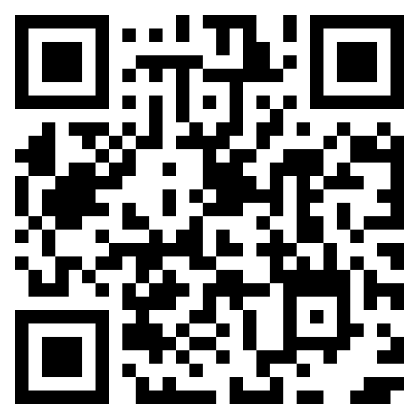
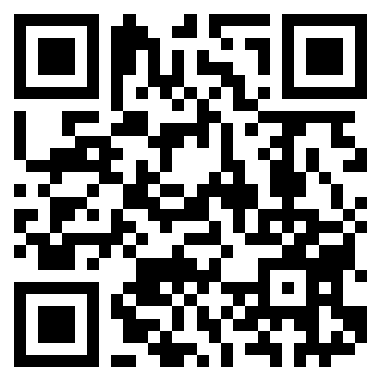
& 200+ more authors
Shapes, positions and morphological parameters
MCMC on a massive scale, 30 /arcmin^2 (mag<26), ~1.5 billion galaxies
Only 5 sec/galaxy/exposure/core; no fine tuning
Bias around 2x10⁻³; low sensitivity; calibrate if necessary
gitlab/LensMC
pip install lensmc
arXiv/2405.00669
A&A 691, A319 (2024)

Slide 18
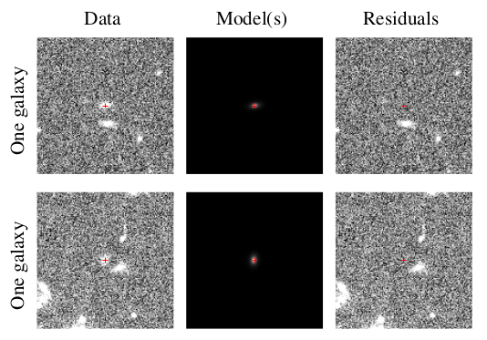
Shear Measurement
Can measure one galaxy…

Slide 19
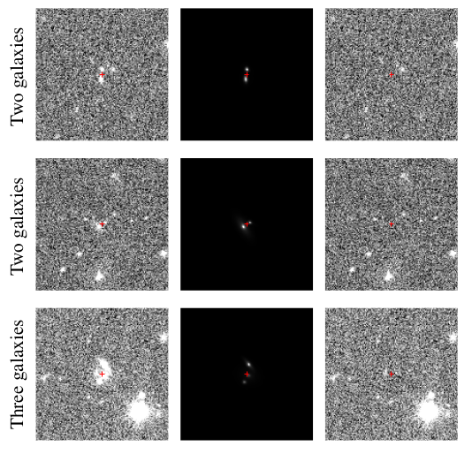
Shear Measurement
Can measure one, two, three, … galaxies, jointly
“Recognised blends” dominate shear bias in LSST/Rubin – subdominant in Euclid

Slide 20
Cosmology
The PSF and shape measurement are key ingredients to performing Stage IV weak lensing cosmology.
Apologies I could not show more details yet.
DR1 runs through to October 2026 so we’re just over a year away!

Slide 21
UK Resource Use

Slide 22
Legacy

Slide 23
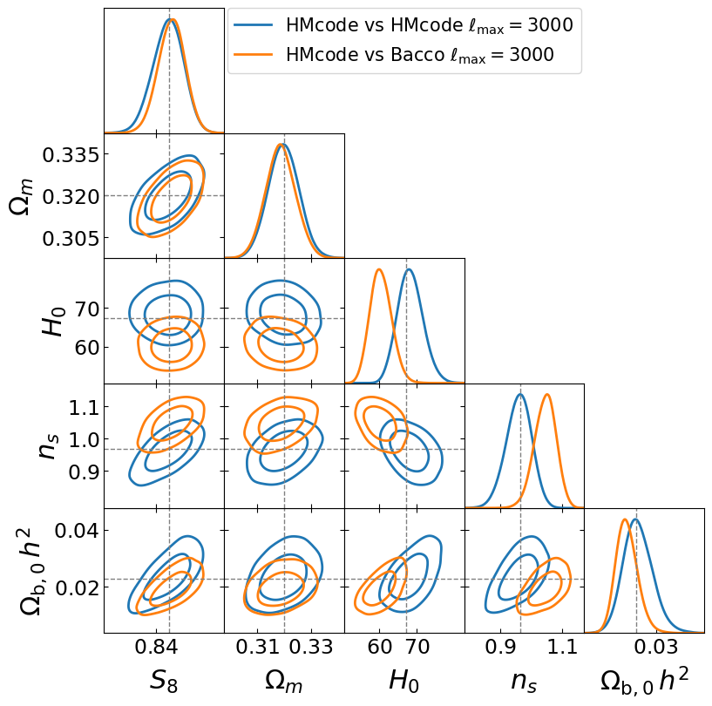
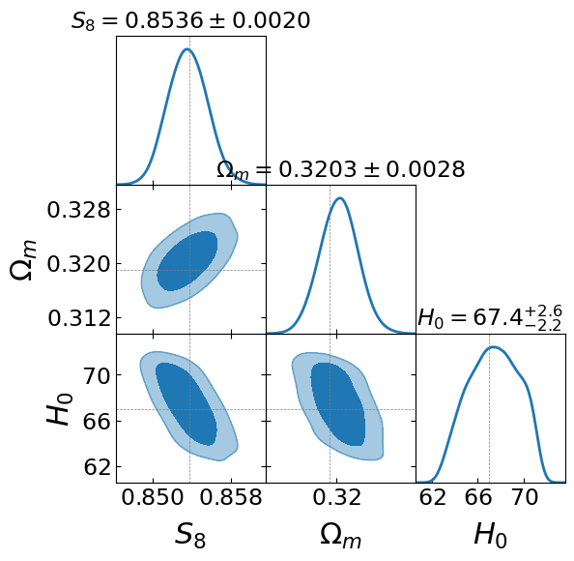
IRIS for cosmological parameter inference
IST:NL Nonlinear model testing: Ran over 100 MCMCs
Testing new CLOE: cloelib+cloelike

Slide 24
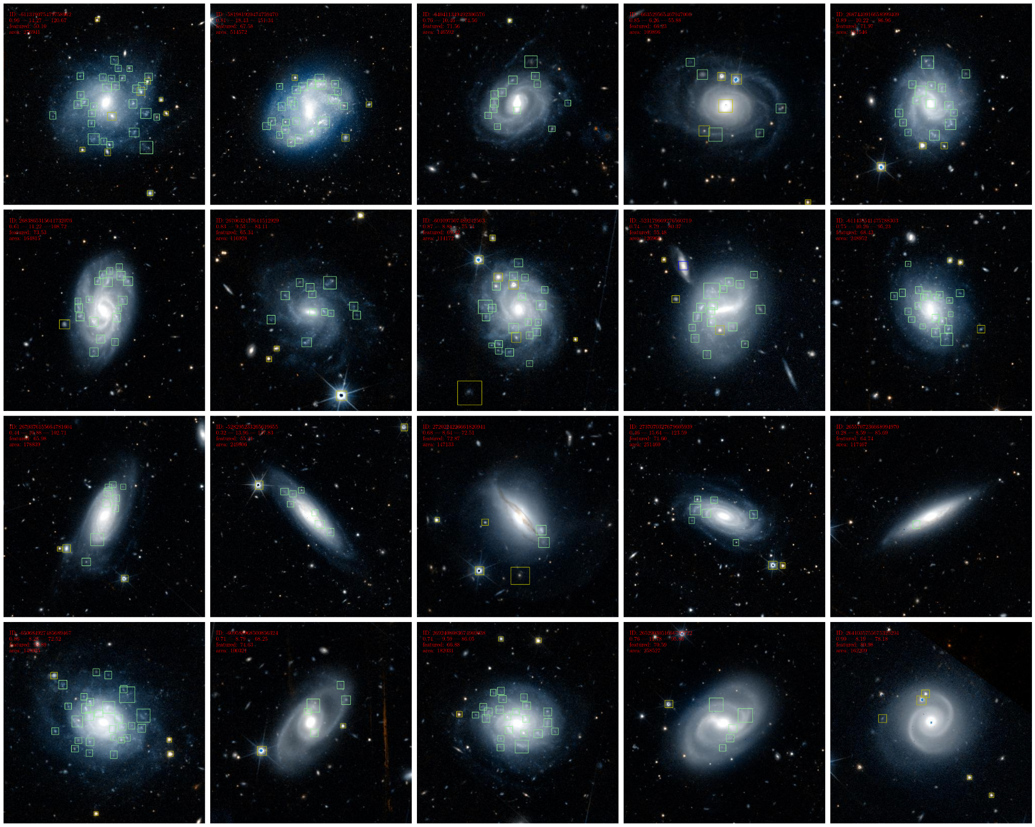
Clump Detection (Credit Jurgen Popp)
Training on object detection model for star-forming clumps in nearby galaxies
Training data: - For PoC: expert annotations on a small sample of ERO-galaxies (~500 galaxy images). - additional training data in preparation provided by a new Galaxy Zoo project (~5-10k galaxy images). - with bounding boxes not only for clumps but also contaminations (e.g. foreground stars, background galaxies). Model: - Multi-class DL-based object detector. - Faster R-CNN architecture pre-trained on SDSS and HSC images (Popp+2024, Popp+2025 (in prep.)) - Zoobot-classifier (Walmsley+2023) as feature extracting backbone. Execution: - Model training on GPU nodes. - Detection run on CPU nodes for value-added catalogue to the Euclid MER catalogue.

Slide 25
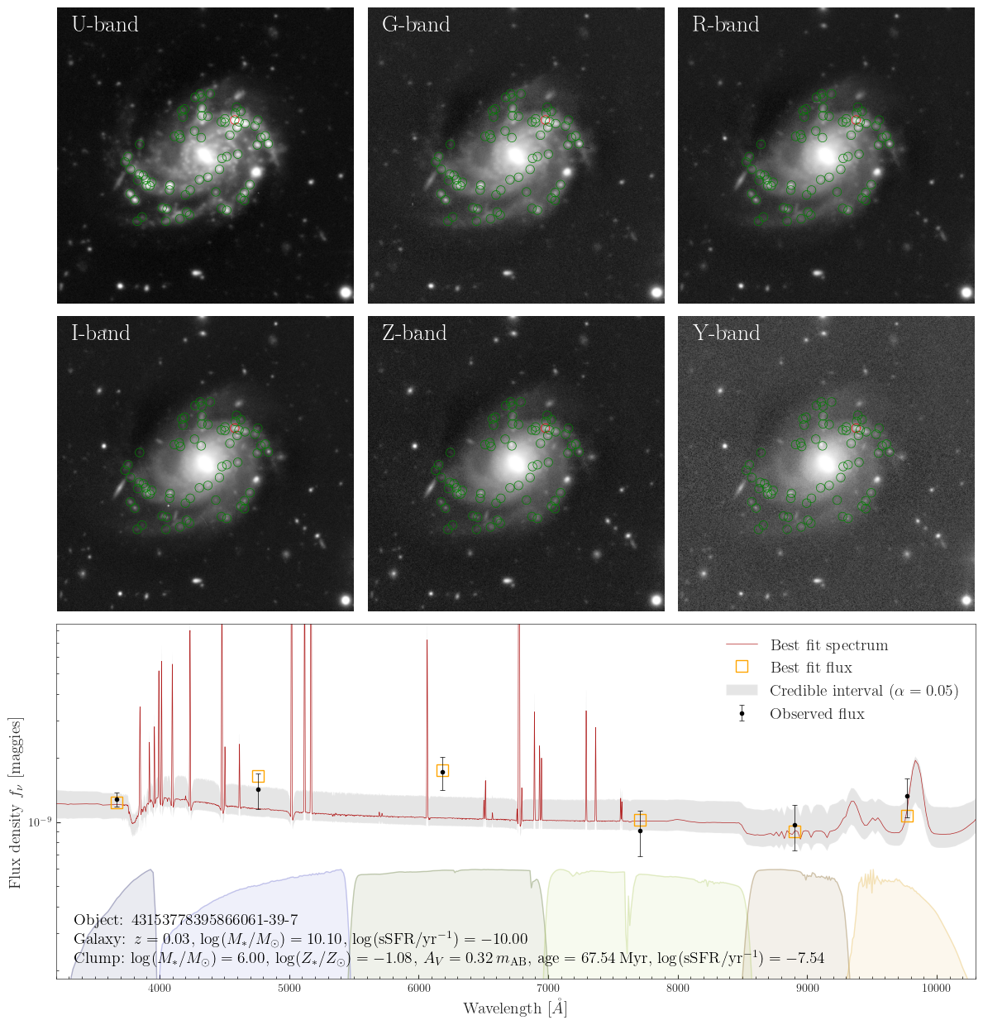
SED Fitting (Credit Jurgen Popp)
SED-fitting using Prospector in preparation for Euclid DR1
Data:
~30k objects with U- and GRIZY-photometry from CLAUDS and HSC SSP ~530k objects with GRIZY-photometry Models:
Four different SED models each with variations of SFH and priors for the main physical properties Execution:
Parallel jobs on 20 CPU nodes with 60 CPUs each

Slide 26
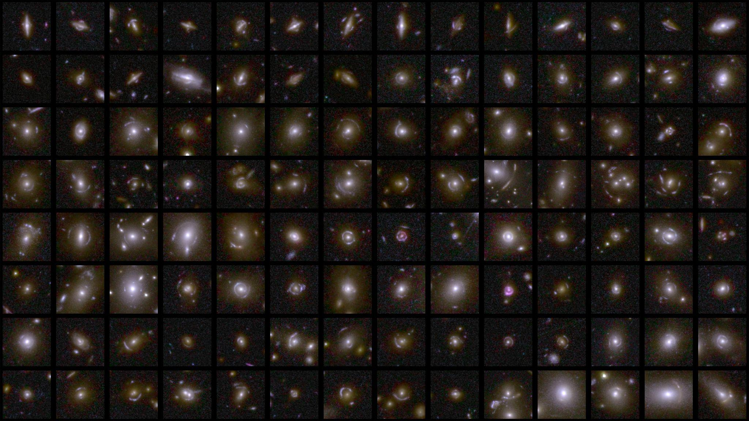
Strong Lensing (Euclid Team STAR Prize)
Discovered ~500 strong lenses in Q1 data.
On course to find over 100,000!
~1000 strong lenses known before Euclid launched.

Slide 27
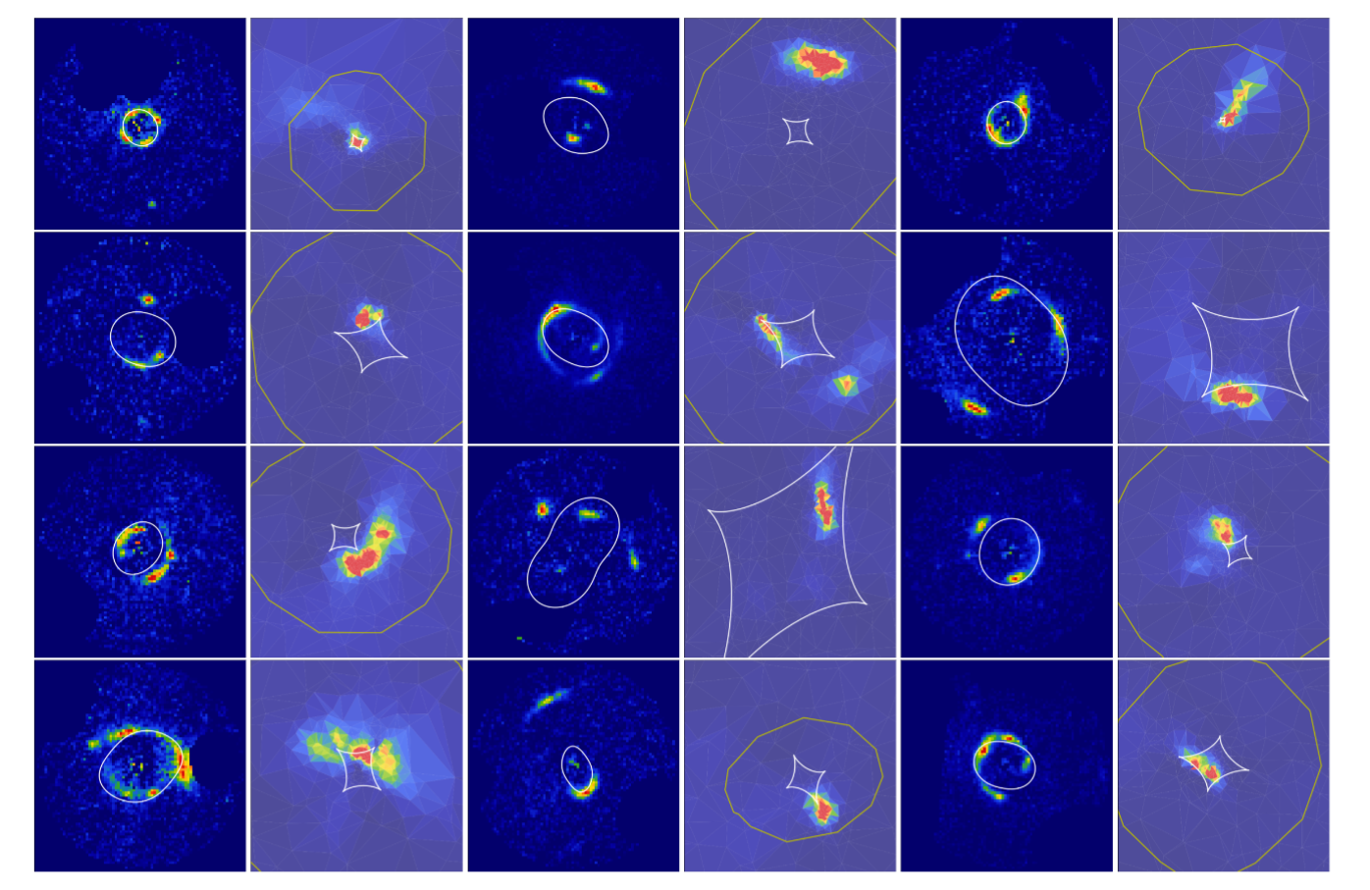
Strong Lensing Modeling (James Nightingale)
Lens modeling performed using PyAutoLens:
https://github.com/Jammy2211/PyAutoLens
Huge potential to further our understanding of galaxy formation, cosmology and the high redshift Universe.

