Slide 1
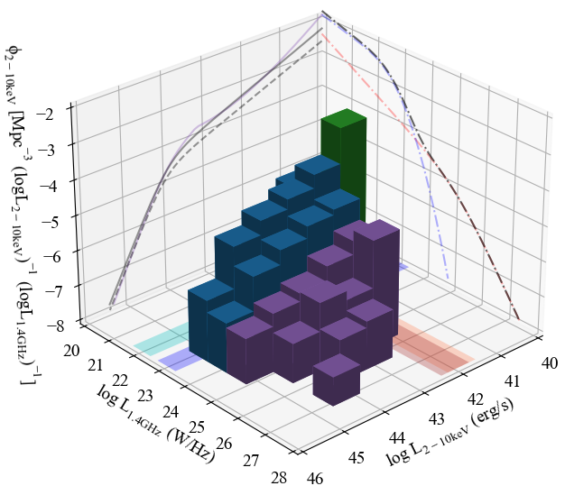

The broad relationship between X-ray and radio luminosities for AGN
Clara M. Pennock (Postdoc)
Contact: Clara.Pennock@ed.ac.uk

Slide 2
Exploring the X-ray--radio connection for AGN via measurements of the multi-dimensional luminosity function
Clara M. Pennock (Postdoc)
arXiv:

Slide 3
Radio AGN-galaxy dichotomy
Radiative-mode
Jet-mode
Radio emission
Radio emission
Dusty obscuring material
X-ray emission
Weak X-ray emission
Accretion disk
Truncated
thin disk
X-ray
Corona
Advection-dominated inner accretion flow
Black hole
Radio Jet
See Heckman & Best (2014)

Slide 4
Radio AGN-galaxy dichotomy

Slide 5
Radio AGN-galaxy dichotomy

Slide 6
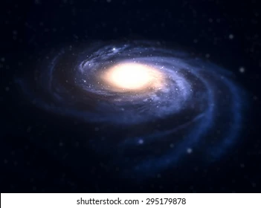
Radio/X-ray galaxy contamination
X-ray
  X-ray binaries
  Hot interstellar gas
Radio
  Supernova remnants
SF tends to be weaker than AGN emission

Slide 7
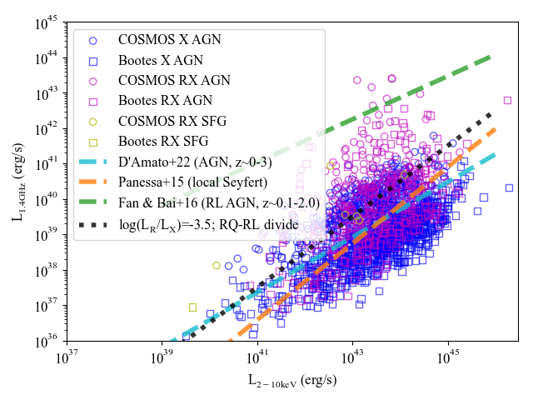
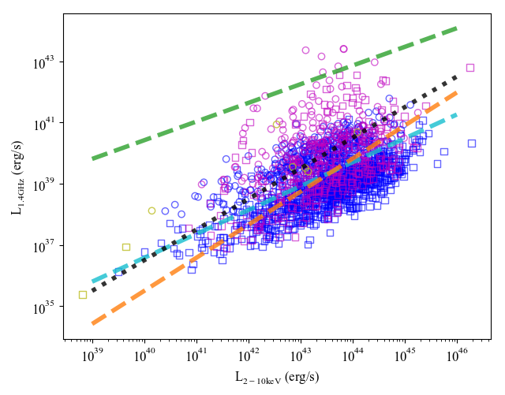
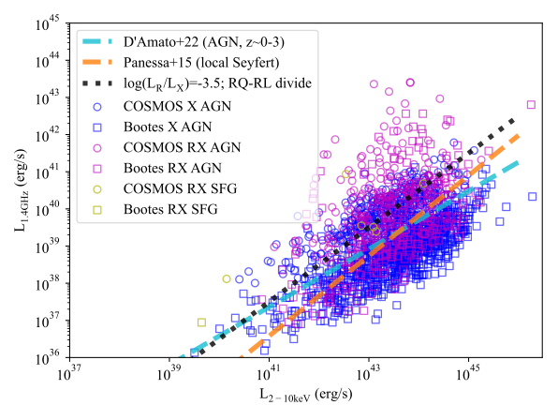
X-ray – Radio sample
Radio-X-ray AGN
1891 Radio-Xray sources from the Boötes and COSMOS fields with optical counterparts.
Is there a relation between X-ray and radio luminosity???
X-ray AGN

Slide 8
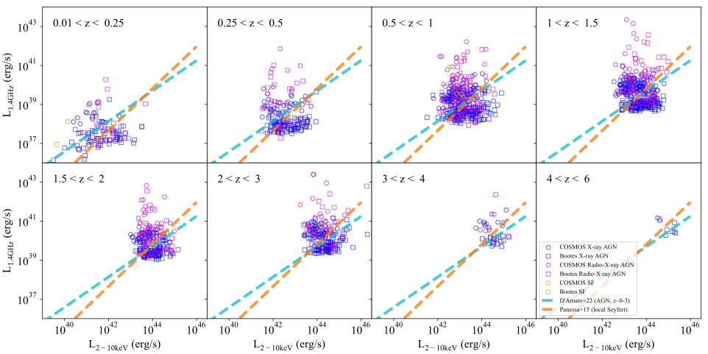
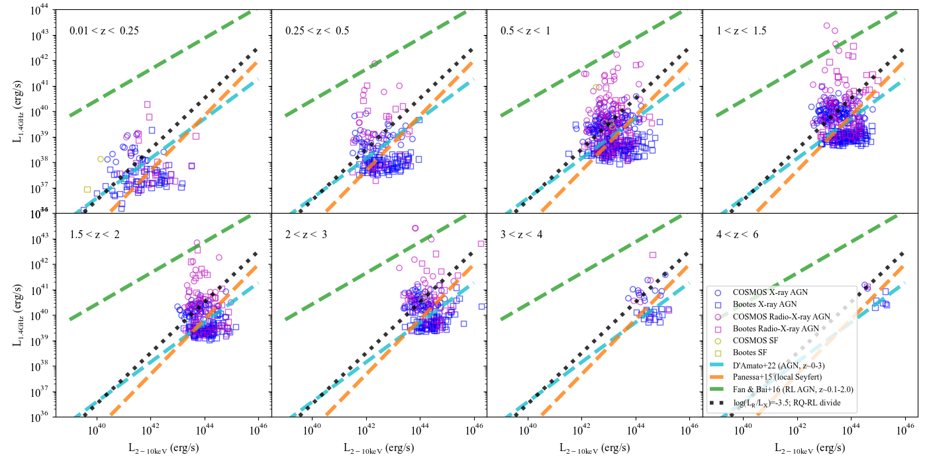
X-ray vs Radio Luminosity

Slide 9
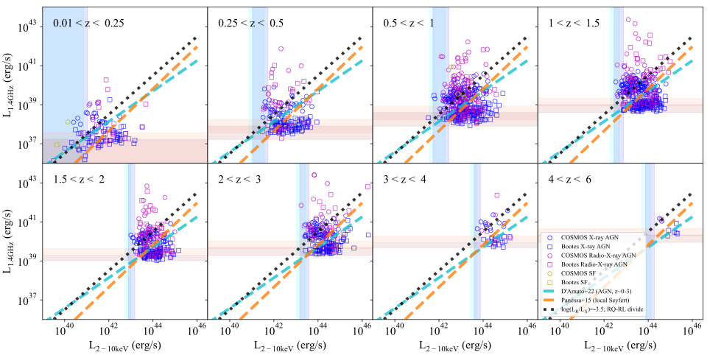
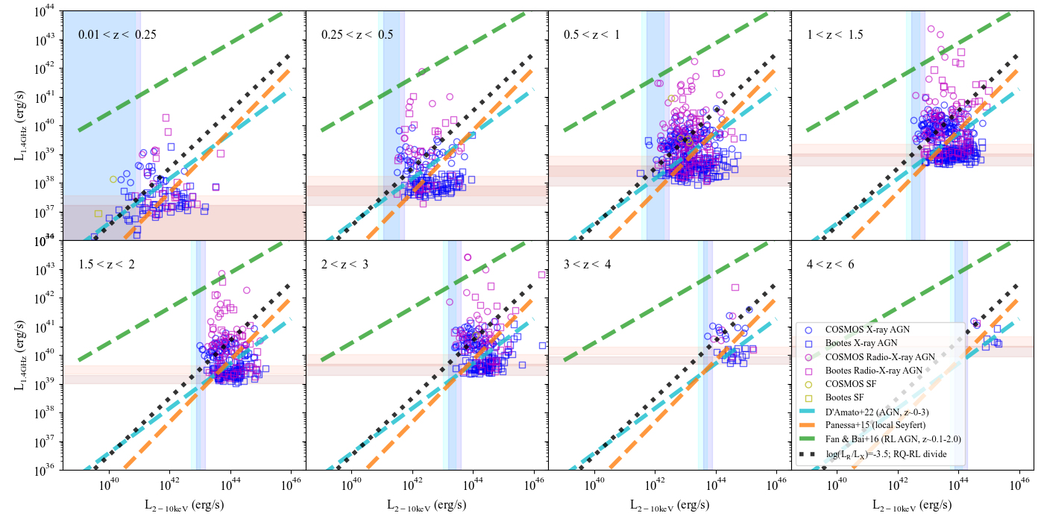
X-ray vs Radio Luminosity
X-ray survey limits
Radio survey limits

Slide 10
Multi-dimensional X-ray—Radio Luminosity Function (XRLF)

Slide 11

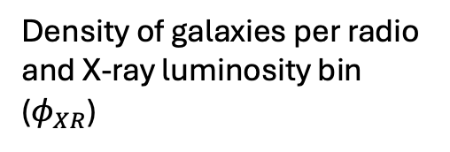

Multi-dimensional X-ray—Radio Luminosity Function (XRLF)
Density of galaxies per radio and X-ray luminosity bin ($φ_{XR}$)
X-ray luminosity ($L_{X}$)
Radio luminosity ($L_{R}$)

Slide 12
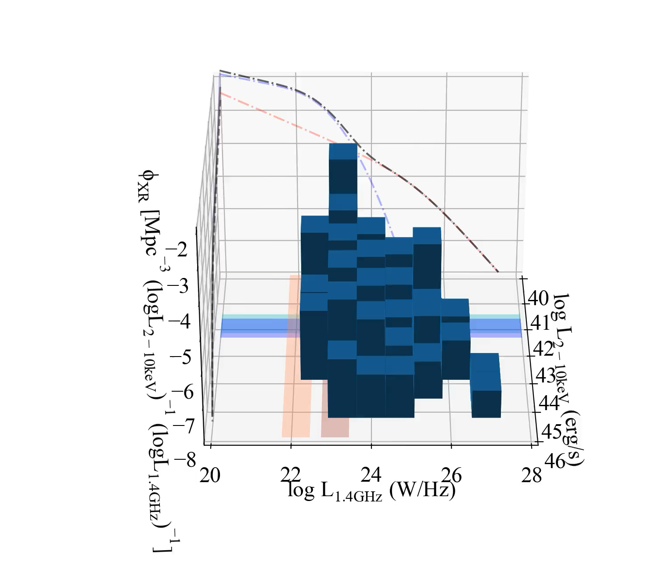
XRLF
X-ray survey limits
Radio survey limits
0.5<z<1

Slide 13
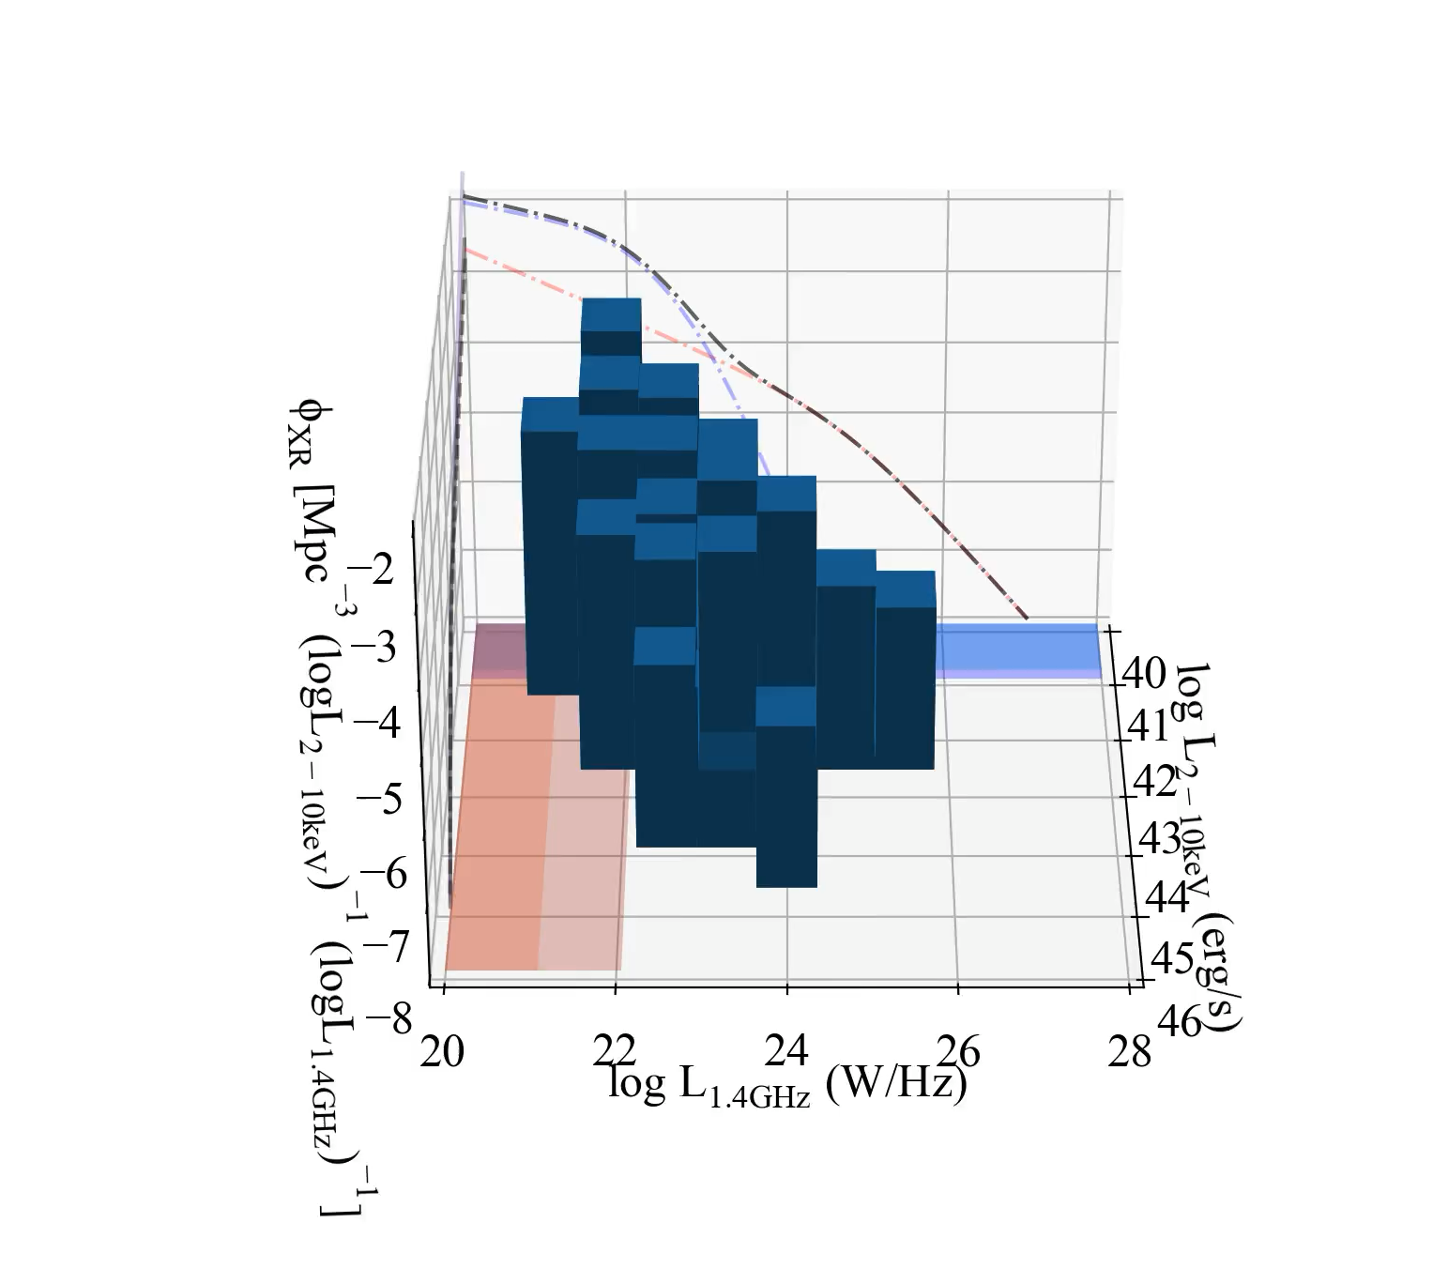
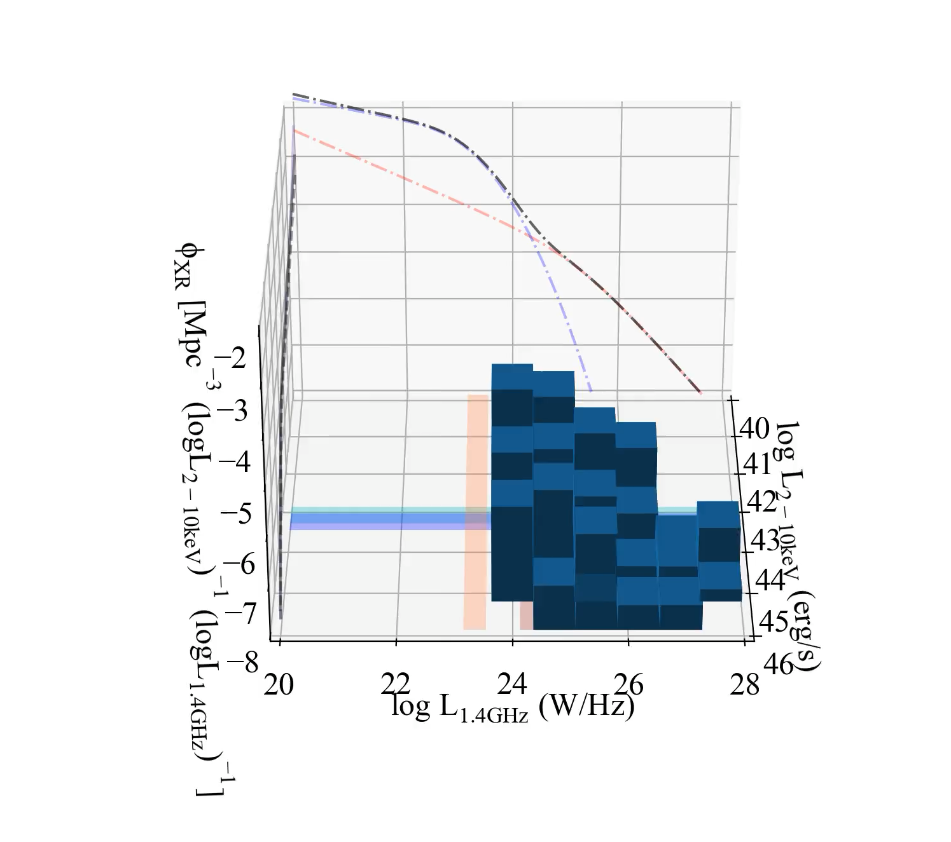
XRLF
Radio survey limits
X-ray survey limits
Broad continuous distribution
0.01<z<0.25
0.5<z<1
2<z<3

Slide 14
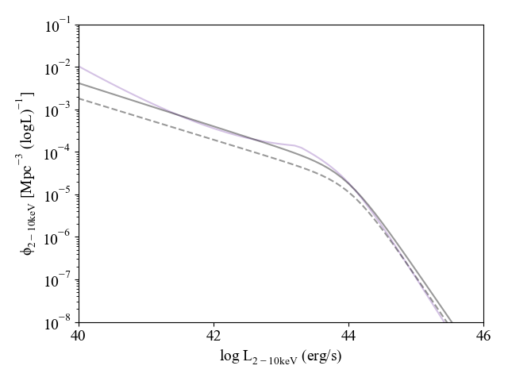
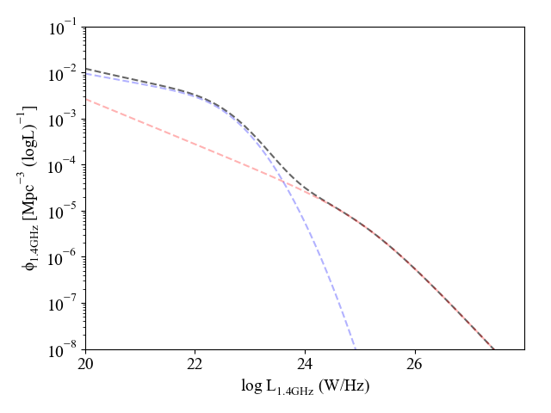
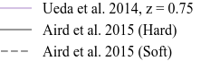
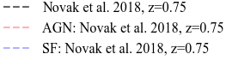


Separating the AGN from the SF
Log $L_{X}$ > 42
$$φ_{AGN}>φ_{SF}$$
SF
dominated
population
AGN
dominated
population
SF
dominated
population
AGN
dominated
population

Slide 15
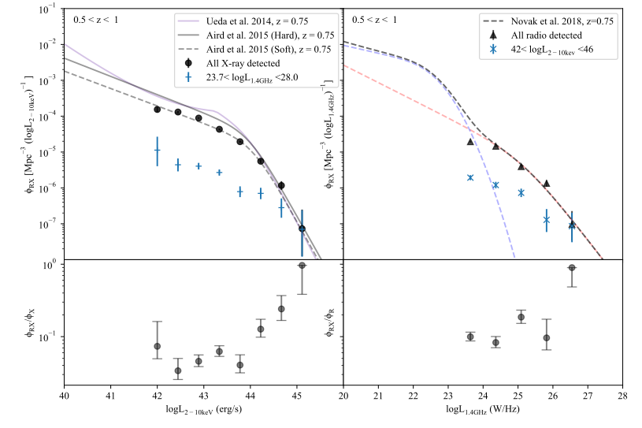
2D XRLF

Slide 16
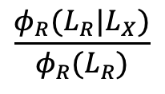
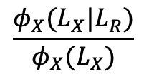
2D XRLF
Ratio of the XLF of the X-ray-radio AGN sample to the overall XLF
Ratio of the RLF of the X-ray-radio AGN sample to the overall RLF
X-ray—radio detected fraction
$$\frac{φ_{X}(L_{X}|L_{R})}{φ_{X}(L_{X})}$$
$$\frac{φ_{R}(L_{R}|L_{X})}{φ_{R}(L_{R})}$$

Slide 17
2D XRLF
X-ray luminosity increases
Fraction of radio bright sources increases
(and vice versa)

Slide 18


2D XRLF
X-ray luminosity increases
Fraction of radio bright sources increases
(and vice versa)
$$L_{∗}$$
$$L_{∗}$$

Slide 19
2D XRLF
As X-ray luminosity increases the fraction of radio bright sources increases, and vice versa.
$$L_{∗}$$
$$L_{∗}$$
X-ray luminosity increases
Fraction of radio bright sources increases
(and vice versa)

Slide 20
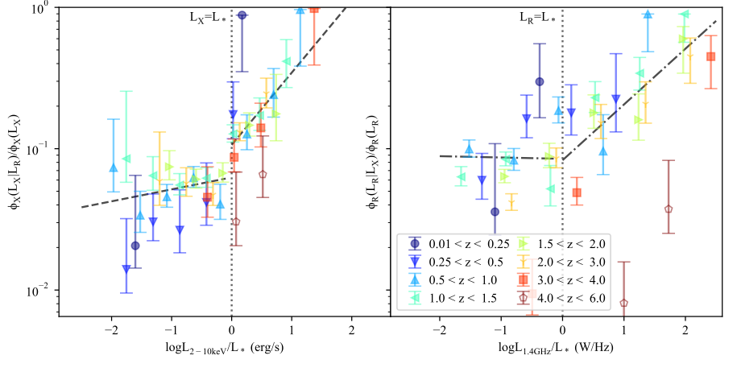
The X-ray—radio detected fraction

Slide 21
The X-ray—radio detected fraction
Most luminous accretion events are more likely to be associated with the production of a jet
Towards higher radio luminosities, you are more likely to have a radiatively efficient AGN

Slide 22
Summary
More likely radio source is X-ray detected
Overall, broad, continuous relationship between X-ray and radio luminosities across a luminosity function.
At the highest luminosities we are more likely to obtain a detection in both bands, though the source will not necessarily be bright in both bands.
Radio Luminosity
arXiv link: Coming Soon!
X-ray Luminosity
More likely X-ray source is radio detected
Thanks for listening!
Contact: Clara.Pennock@ed.ac.uk

Slide 23
Extra Slides

Slide 24
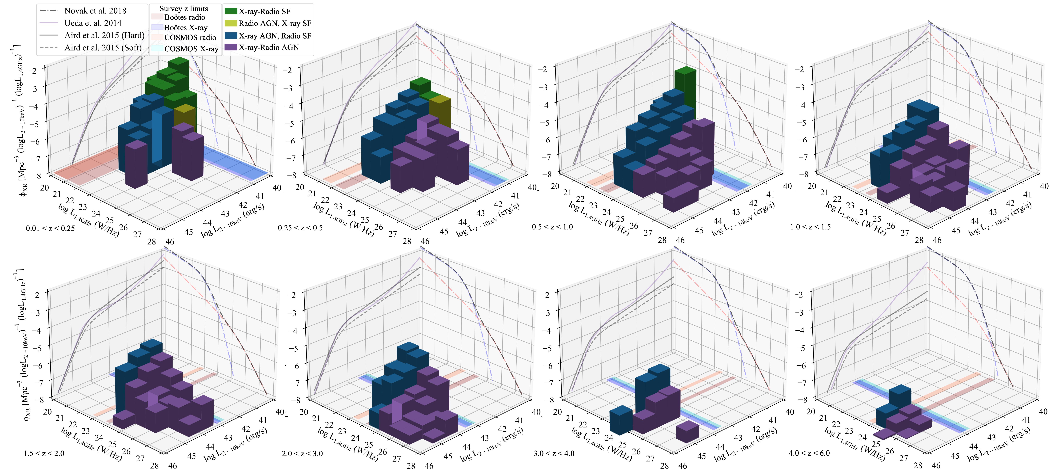

Slide 25
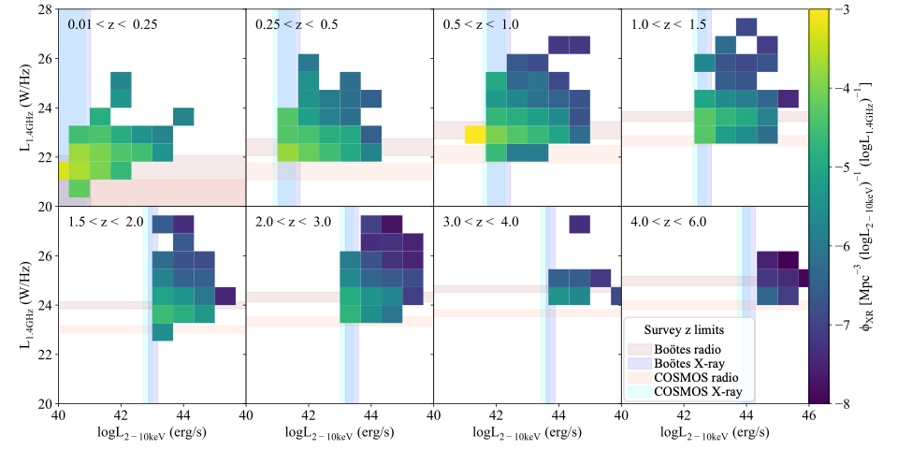

Slide 26
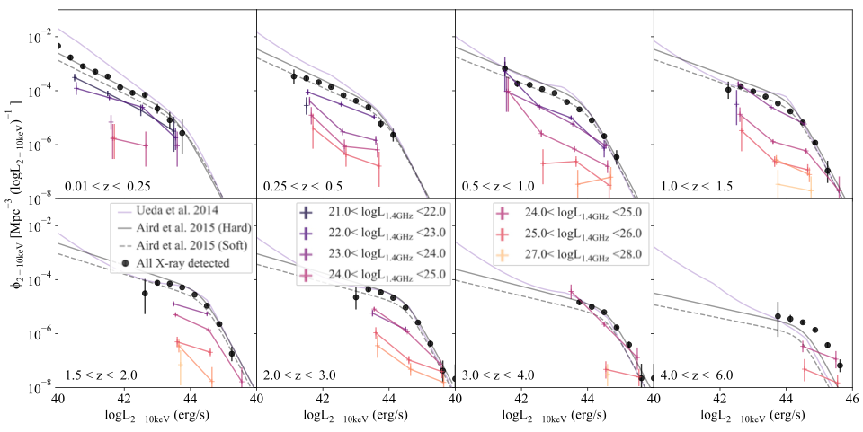
XLF – Radio detected
XLF of overall sample
XLF model
XLF of Radio detected sources

Slide 27
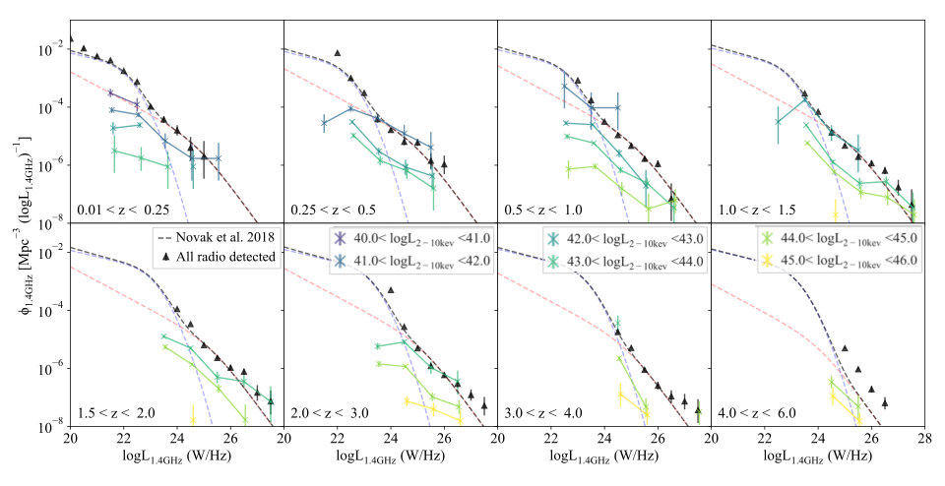
RLF - X-ray detected
RLF of overall sample
RLF model
RLF of X-ray detected sources

Slide 28
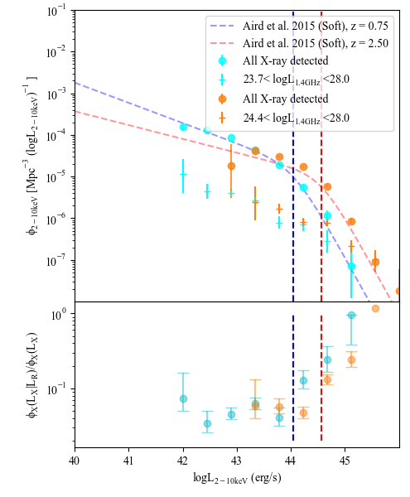


$$L_{∗}(z=0.75)$$
$$L_{∗}(z=2.50)$$

Slide 29
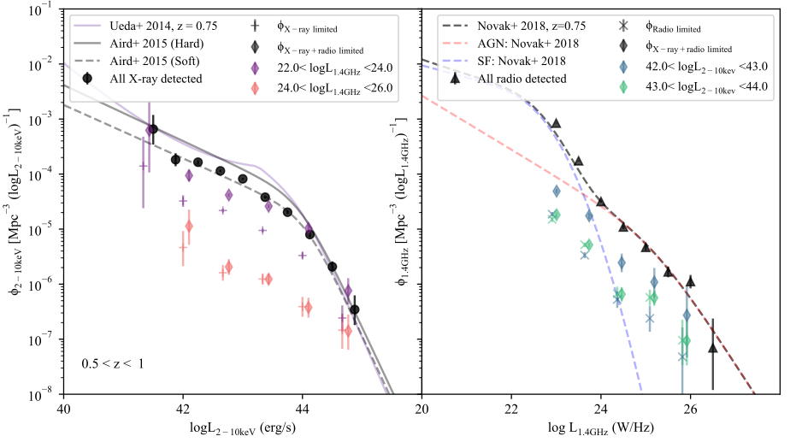
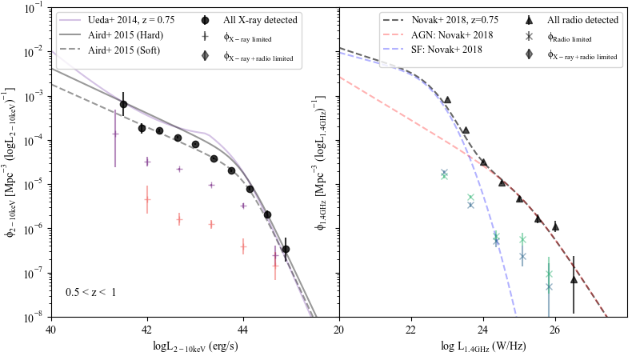
Page and Carrera method
Notes:
We used the Page and Carrera method to calculate the luminosity functions, and here is the XLF on the left and RLF on the right, where the black points indicate the full X-ray and radio samples, and the coloured points are the X-ray and radio detected sample, and the lines show various XLF and RLF models. This shows, for the X-ray and radio detected sample, space densities that are calculated per X-ray luminosity bin on the left and per radio luminosity bin on the right. But if we modify the Page and Carrera method to take into account both the X-ray and radio luminosity bin, and therefore the volume of space over which a source at a specific luminosity can be detected in both bands, we get this…

Slide 30
Page and Carrera method - modified
Notes:
Where the diamonds represent the now modified method. This shows that for the lower luminosity range, purple on left and blue on right, this brings the luminosity function up, as the volume over which the source can be detected is reduced when taking into account the lower luminosity of the other band.

Slide 31
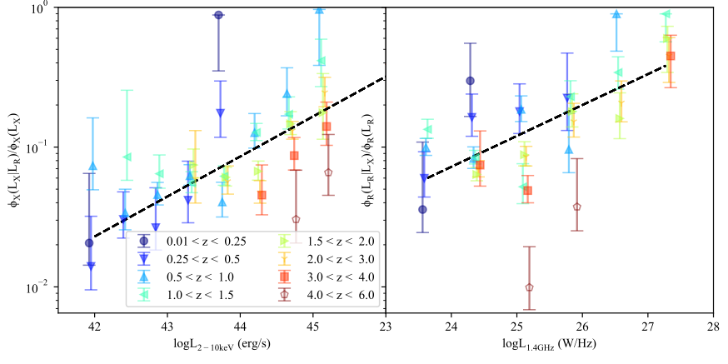
2D RXLF- fraction of overall populations
At a given X-ray luminosity a specific fraction of X-ray sources appear radio bright across redshift, and vice versa. As radio luminosity increases, the more likely a source as radiatively efficient.

Slide 32
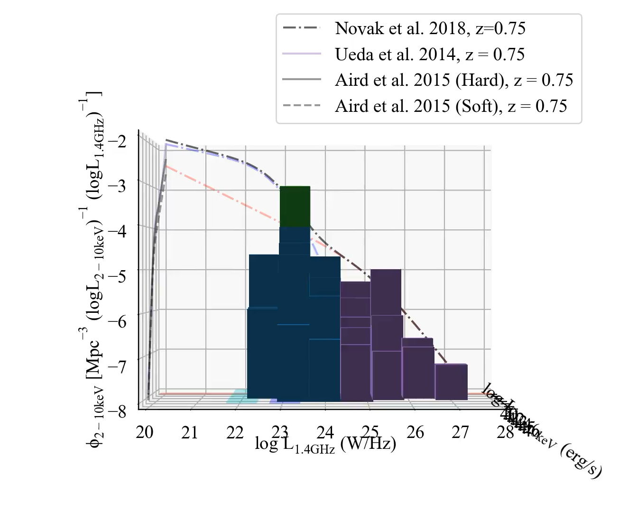
3D RXLF
X-ray-Radio SF
Radio AGN, X-ray SF
X-ray AGN, Radio SF
X-ray-Radio AGN
0.5<z<1
X-ray survey limits
Radio survey limits

Slide 33
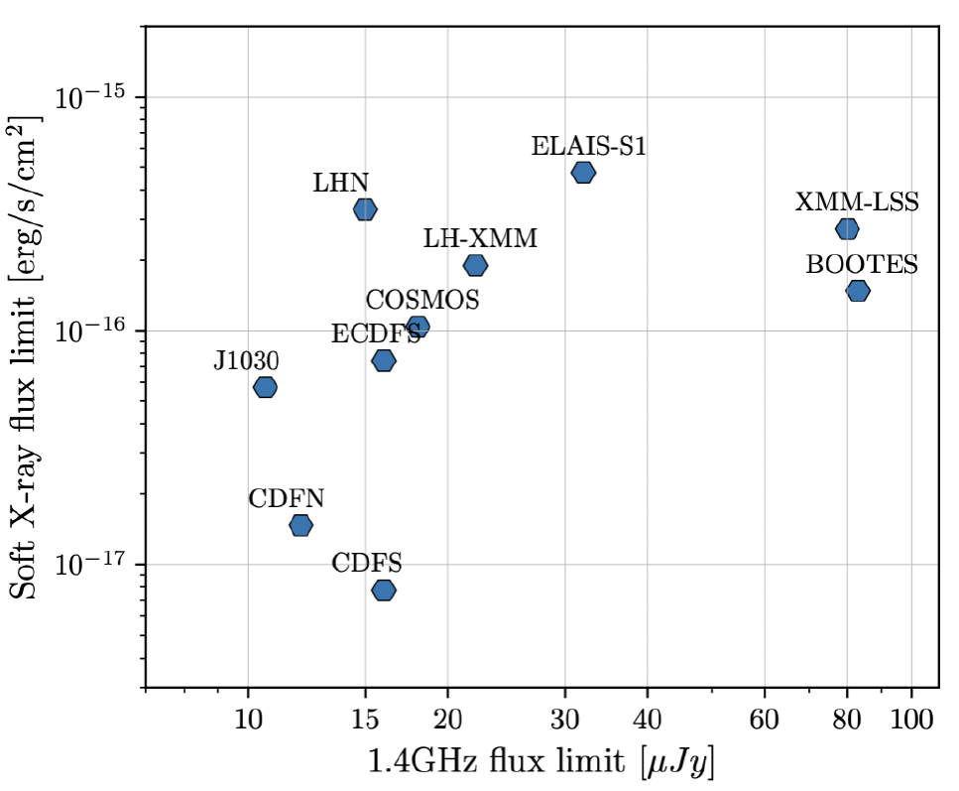
Survey Choice
Boötes – Shallower/Wider area
  X-ray – Chandra (0.5-7keV); Masini et al. (2020); 6891 sources
  Radio – LOFAR (144 MHz); Kondapally et al. (2021);18,766 sources
  Optical/IR – Duncan et al. (2021)
COSMOS – Deeper/Smaller Area
  X-ray – Chandra (0.5-7keV); Civano et al. (2016); 2888 sources
  Radio – VLA (3 GHz); Smolčić et al. (2017);10,830 sources
  Optical/IR – COSMOS; Weaver et al. (2022)

Slide 34

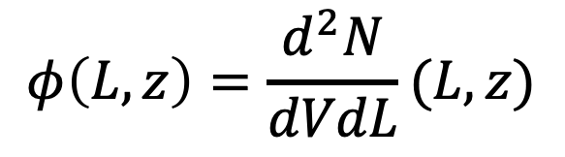


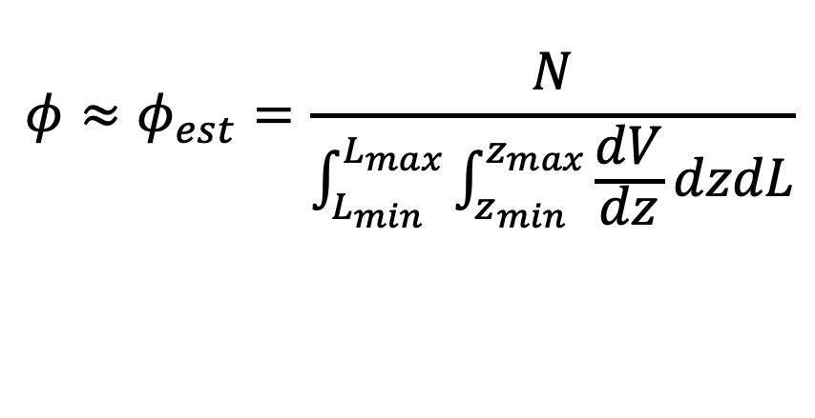
Luminosity functions
V
Page & Carrera (2000) method:
$$φ\left(L,z\right)=\frac{d^{2}N}{dVdL}(L,z)$$
$ΔV(Δ$z)
estimated as
$$φ≈φ_{est}=\frac{N}{\int_{L_{min}}^{L_{max}}{\int_{z_{min}}^{z_{max}}{\frac{dV}{dz}dzdL}}}$$
$Δ$L
L

Slide 35
Luminosity functions
V
Page & Carrera (2000) method:
Flux limit
$$φ\left(L,z\right)=\frac{d^{2}N}{dVdL}(L,z)$$
$ΔV(Δ$z)
estimated as
$$φ≈φ_{est}=\frac{N}{\int_{L_{min}}^{L_{max}}{\int_{z_{min}}^{z_{max}}{\frac{dV}{dz}dzdL}}}$$
$Δ$L
L

Slide 36
Luminosity functions
V
Page & Carrera (2000) method:
Flux limit
$$φ\left(L,z\right)=\frac{d^{2}N}{dVdL}(L,z)$$
$ΔV(Δ$z)
estimated as
$$φ≈φ_{est}=\frac{N}{\int_{L_{min}}^{L_{max}}{\int_{z_{min}}^{z_{max}}{\frac{dV}{dz}dzdL}}}$$
$Δ$L
L

Slide 37
Luminosity functions
V
Page & Carrera (2000) method:
Flux limit
$$φ\left(L,z\right)=\frac{d^{2}N}{dVdL}(L,z)$$
v
$ΔV(Δ$z)
estimated as
$$φ≈φ_{est}=\frac{N}{\int_{L_{min}}^{L_{max}}{\int_{z_{min}}^{z_{max}}{\frac{dV}{dz}dzdL}}}$$
$Δ$L
L

Slide 38
Luminosity functions
V
Page & Carrera (2000) method:
Flux limit
$$φ\left(L,z\right)=\frac{d^{2}N}{dVdL}(L,z)$$
v
$ΔV(Δ$z)
estimated as
$$φ≈φ_{est}=\frac{N}{\int_{L_{min}}^{L_{max}}{\int_{z_{min}}^{z_{max}}{\frac{dV}{dz}dzdL}}}$$
$Δ$L
L

Slide 39
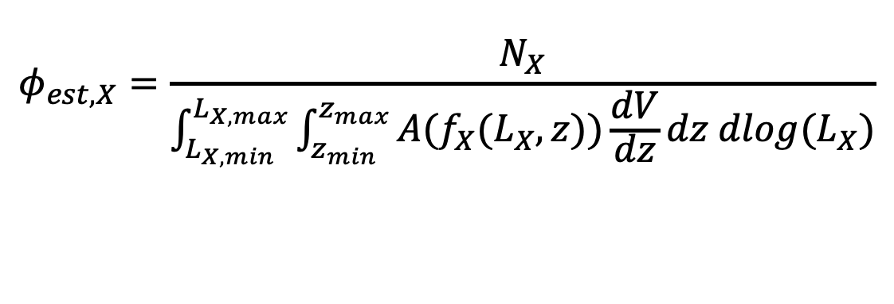

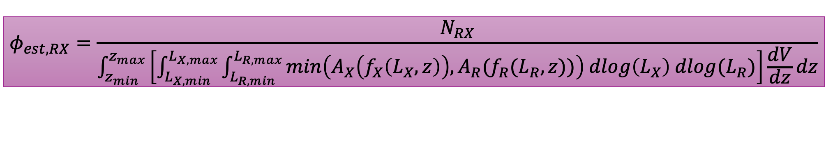
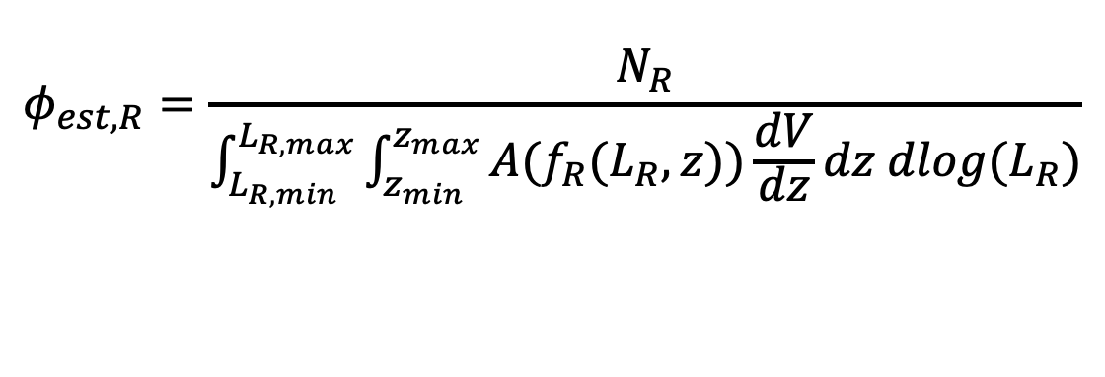
Radio X-ray Luminosity function
Currently have:
$$φ_{est, X}=\frac{N_{X}}{\int_{L_{X,min}}^{L_{X,max}}{\int_{z_{min}}^{z_{max}}{A(f_{X}(L_{X},z))\frac{dV}{dz}dz dlog(L_{X})}}}$$
Combine by taking the minimum observable volume for each X-ray-Radio luminosity bin
$$φ_{est, R}=\frac{N_{R}}{\int_{L_{R,min}}^{L_{R,max}}{\int_{z_{min}}^{z_{max}}{A(f_{R}(L_{R},z))\frac{dV}{dz}dz dlog(L_{R})}}}$$
$$φ_{est, RX}=\frac{N_{RX}}{\int_{z_{min}}^{z_{max}}{\left[\int_{L_{X,min}}^{L_{X,max}}{\int_{L_{R,min}}^{L_{R,max}}{min\left(A_{X}\left(f_{X}\left(L_{X},z\right)\right),A_{R}(f_{R}(L_{R},z))\right) dlog\left(L_{X}\right) dlog(L_{R})}}\right]\frac{dV}{dz}dz}}$$

Slide 40



Combined Radio X-ray Luminosity function
V
Flux limit
v
$ΔV(Δ$z)
$$ΔL_{X}$$
$$L_{X}$$

Slide 41


Combined Radio X-ray Luminosity function
V
V
Flux limit
Flux limit
$ΔV(Δ$z)
$ΔV(Δ$z)
$$ΔL_{X}$$
$$L_{X}$$
$$ΔL_{R}$$
$$L_{R}$$

Slide 42

Combined Radio X-ray Luminosity function
V
V
Flux limit
Flux limit
v
Take the minimum observable volume between the X-ray and radio luminosity bins
$ΔV(Δ$z)
$ΔV(Δ$z)
$$L_{R}$$
$$ΔL_{R}$$
$$L_{X}$$
$$ΔL_{X}$$

Slide 43
X-ray – Radio sample
Boötes: 1206 Radio-X-ray matches (with optical counterparts); ~18% of X-ray; ~7% of radio
COSMOS: 606 Radio-X-ray matches (with optical counterparts); ~21% of X-ray; ~6% of radio

