Slide 1


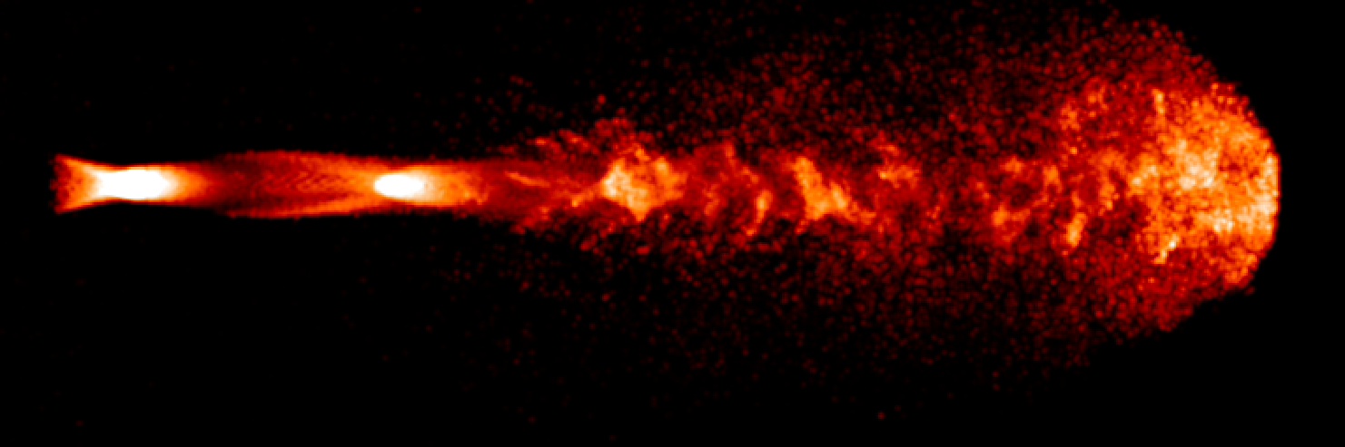
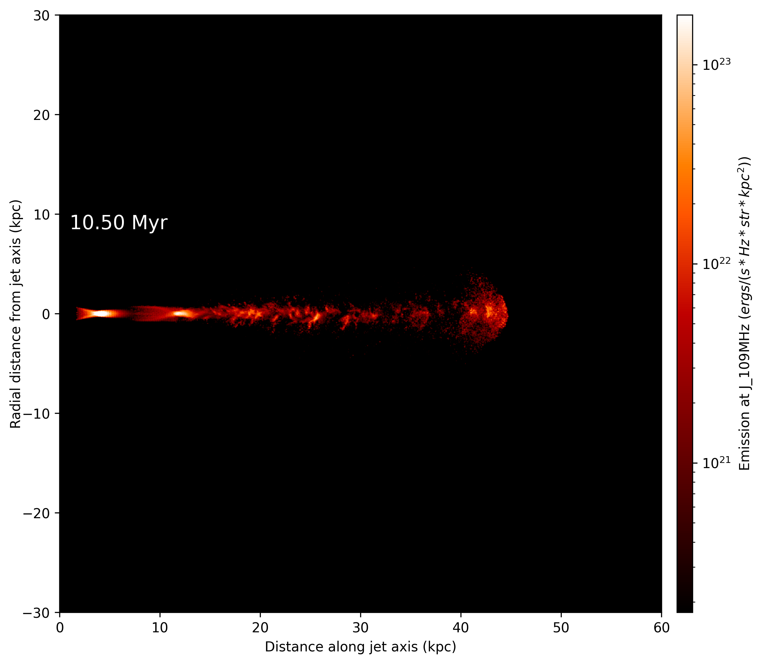
Simulated radio emissivity maps as a probe of fuelling and flickering in AGN jets
Emma Elley, James Matthews, Dipanjan Mukherjee, Bhargav Vaidya

Slide 2
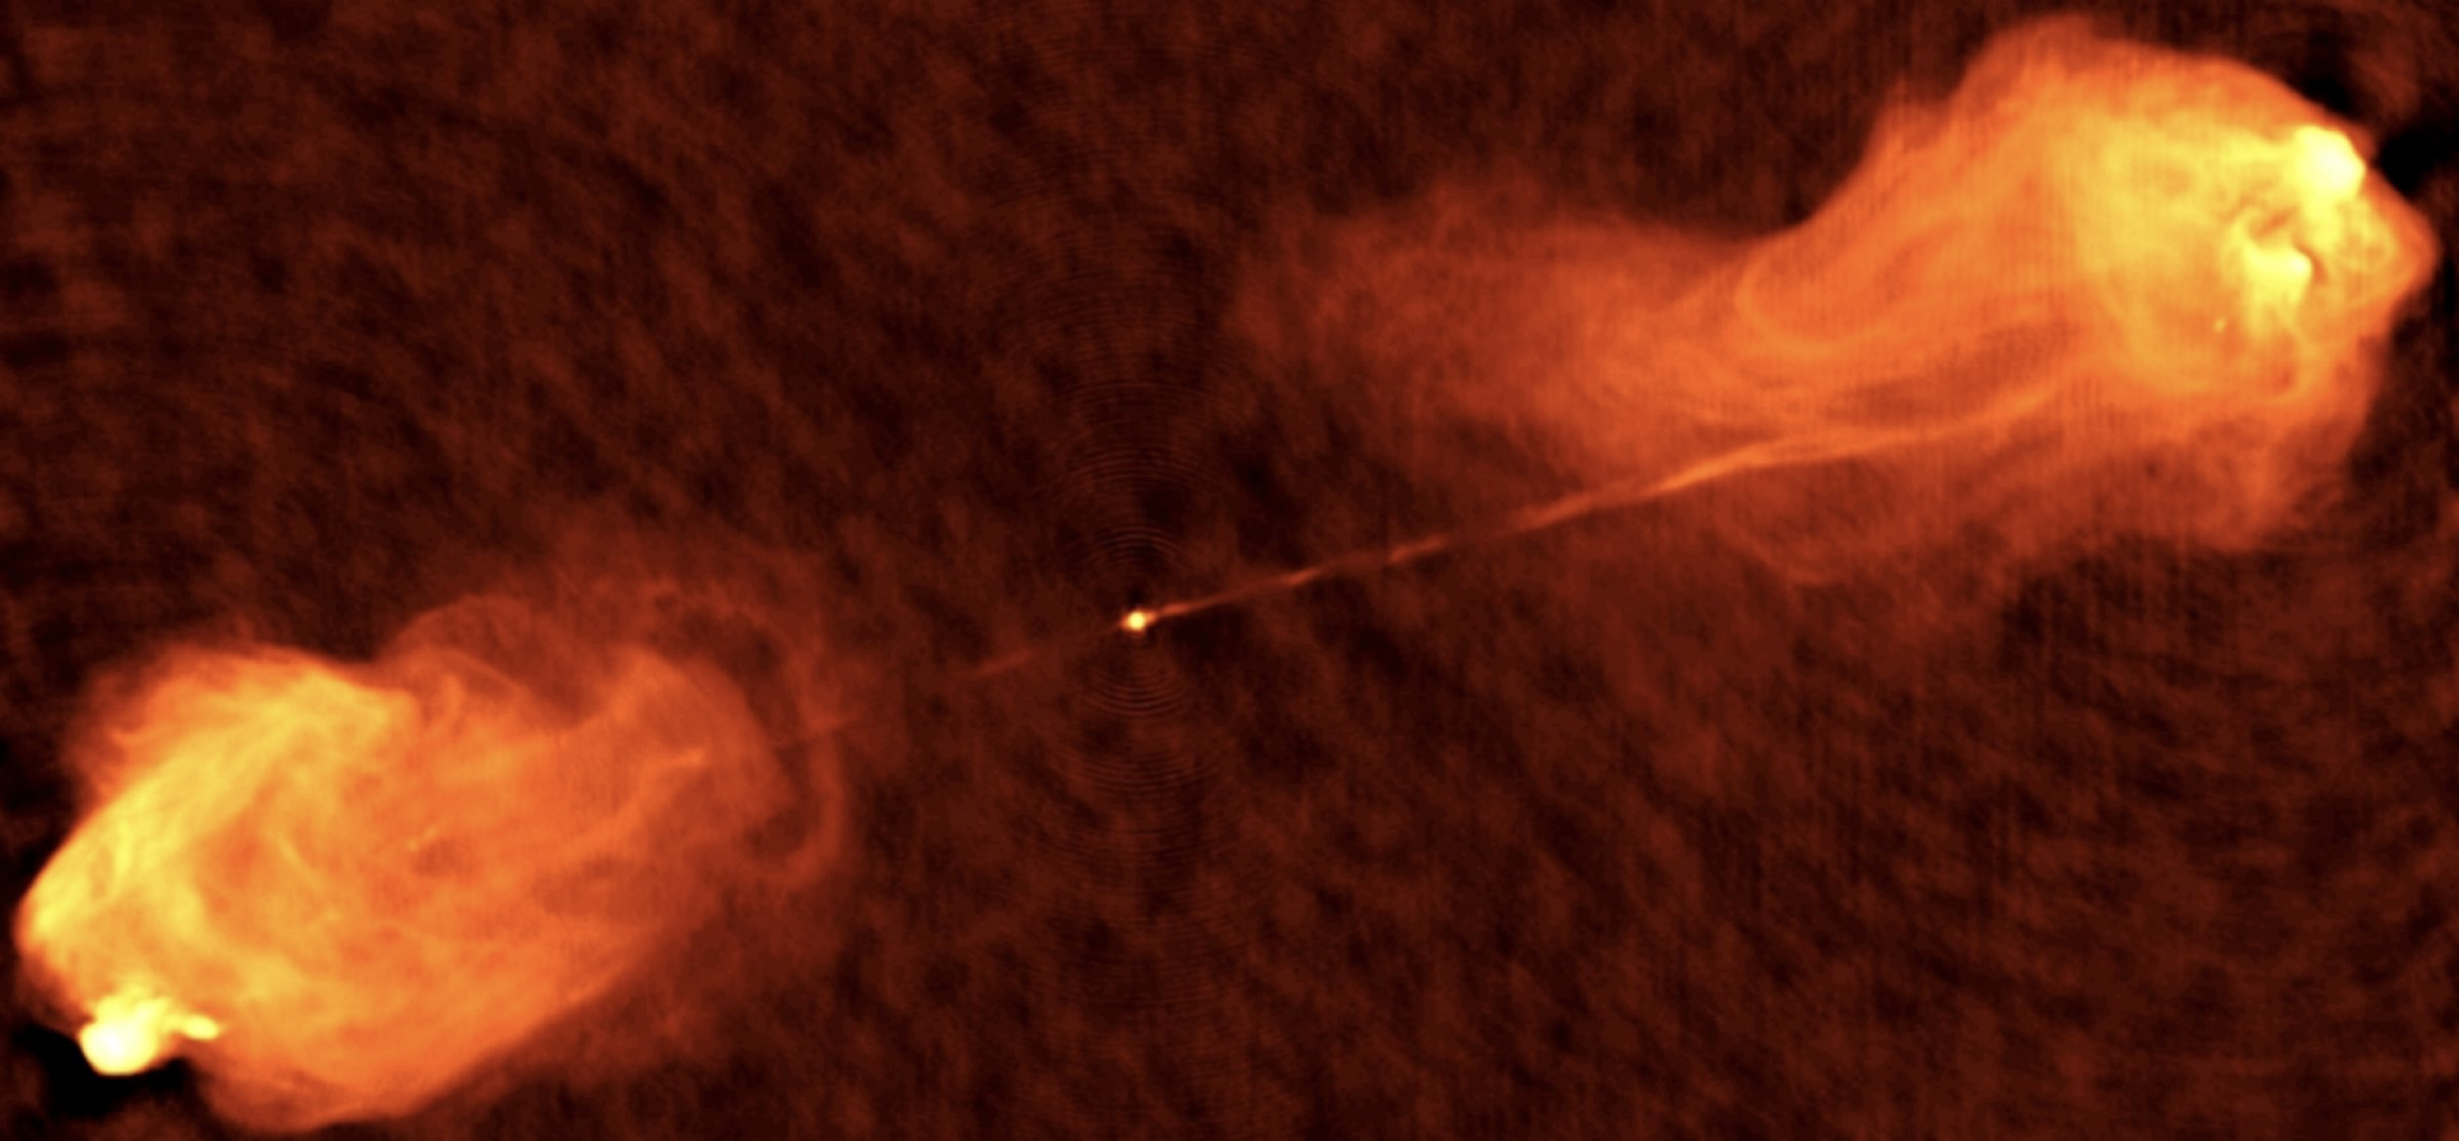
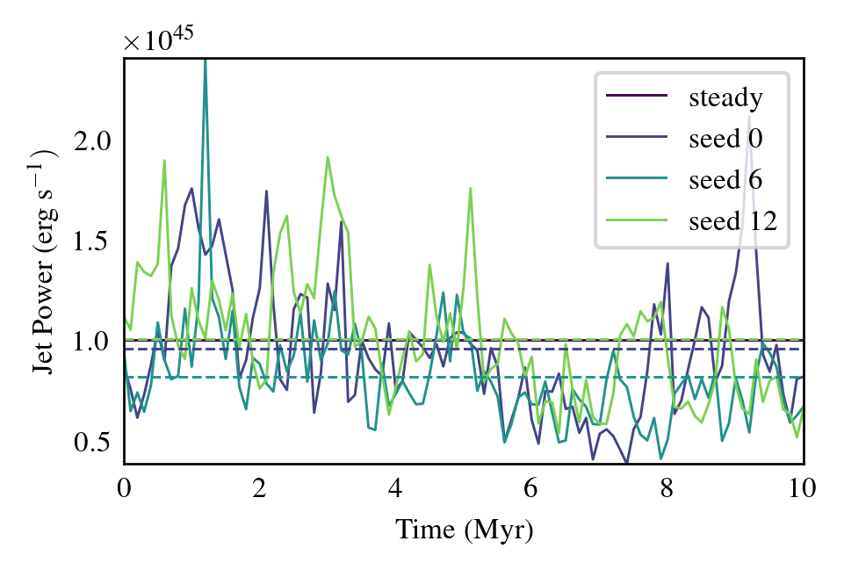
The
Fuelling histories of AGN jets
How does material reach the accretion disk?
Our noise profile is motivated by chaotic cold accretion (Gaspari et al., 2016)
Legacy Astronomical Images, “Cygnus A,” NRAO/AUI Archives, https://www.nrao.edu/archives/items/show/33386.
Emma Elley, University of Oxford

Slide 3
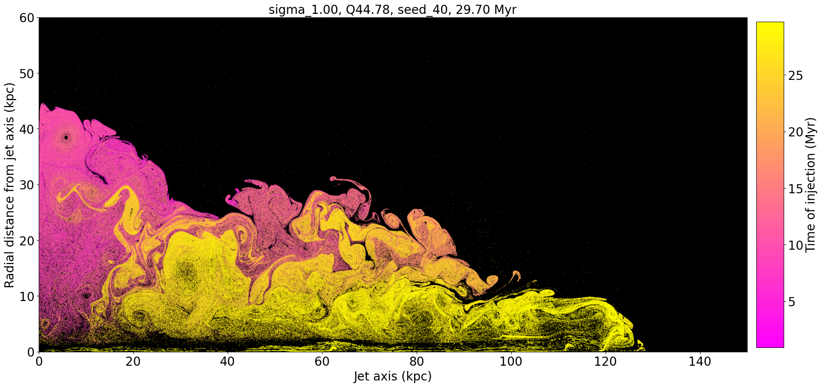
Lagrangian particles in an RHD simulation
Simulations run using 1 million core hour UKRI allocation on Isambard3
We use a novel approach to improve tracking of adiabatic cooling in high density contrast environments
PLUTO (Mignone et al., 2007)
Lagrangian Particle module (Mukherjee+ 2021 & Vaidya+ 2018)
Emma Elley, University of Oxford

Slide 4
RHD
How?
  Estimate magnetic fields from the internal energy density of the fluid
Why?
  Separate effects of:
    different magnetic field geometries
    variability
  Closer to observational approaches used in spectral ageing
    Focus on effects of mixing of new and old material
RMHD simulations planned with computational time allocated
Emma Elley, University of Oxford

Slide 5
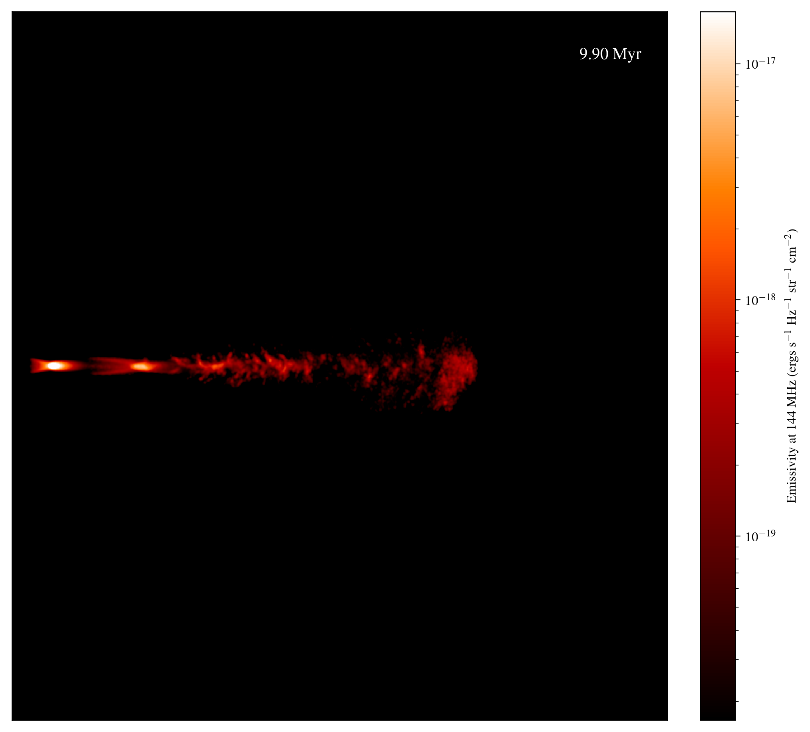
Steady jet
10⁴⁵ erg s⁻¹
Simulation domain 60 kpc³
Ribbed structures produced by the onset of Kelvin Helmholtz instabilities
Emma Elley, University of Oxford

Slide 6
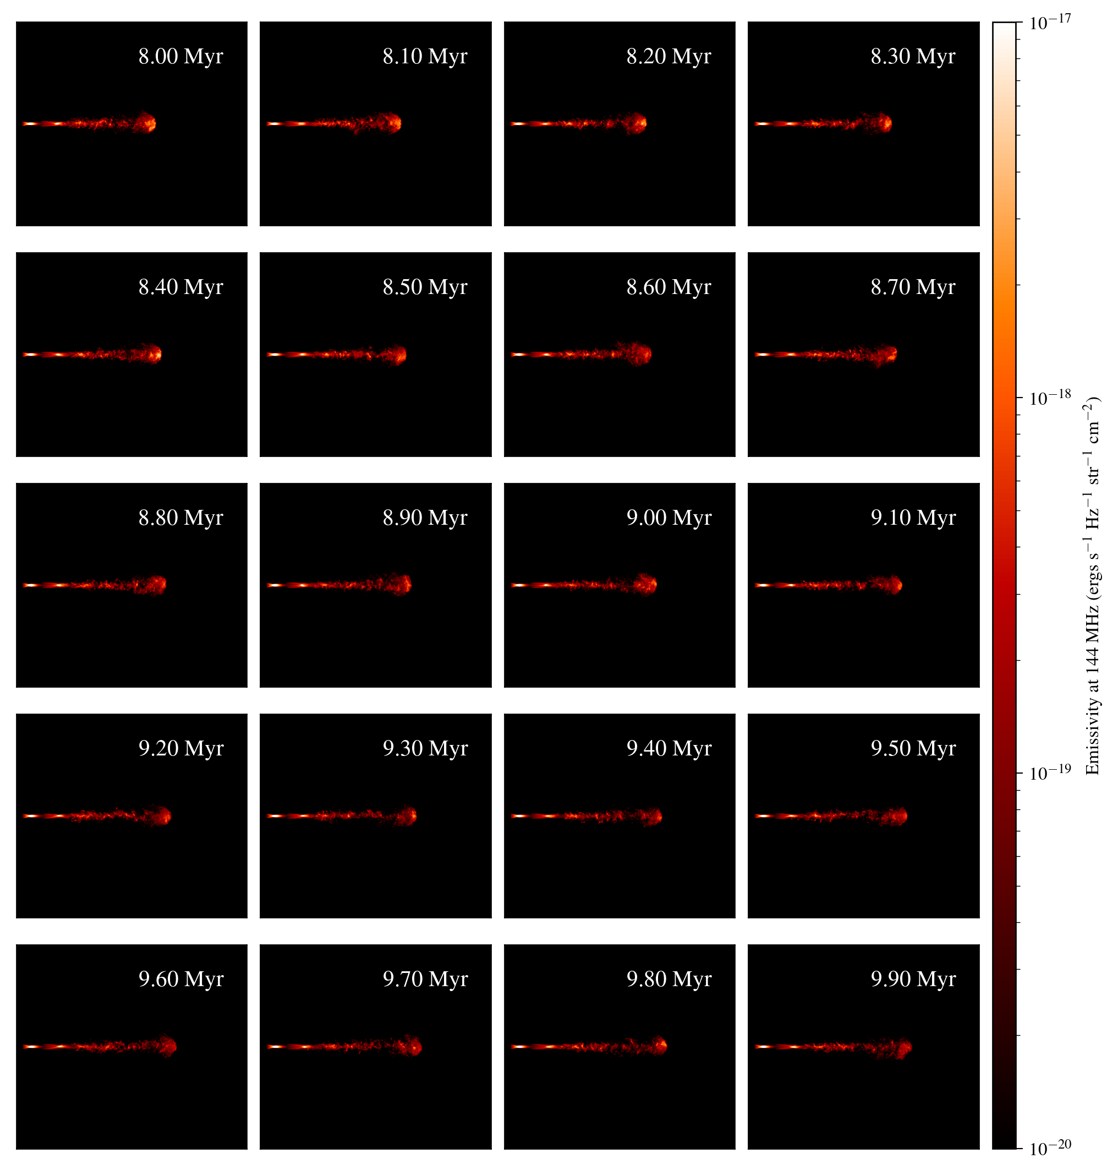
Steady jet: 8-10 Myr
Slight decrease in luminosity over time, particularly at hotspot
Steady first and second recollimation shocks, followed by a turbulent region
Emma Elley, University of Oxford

Slide 7
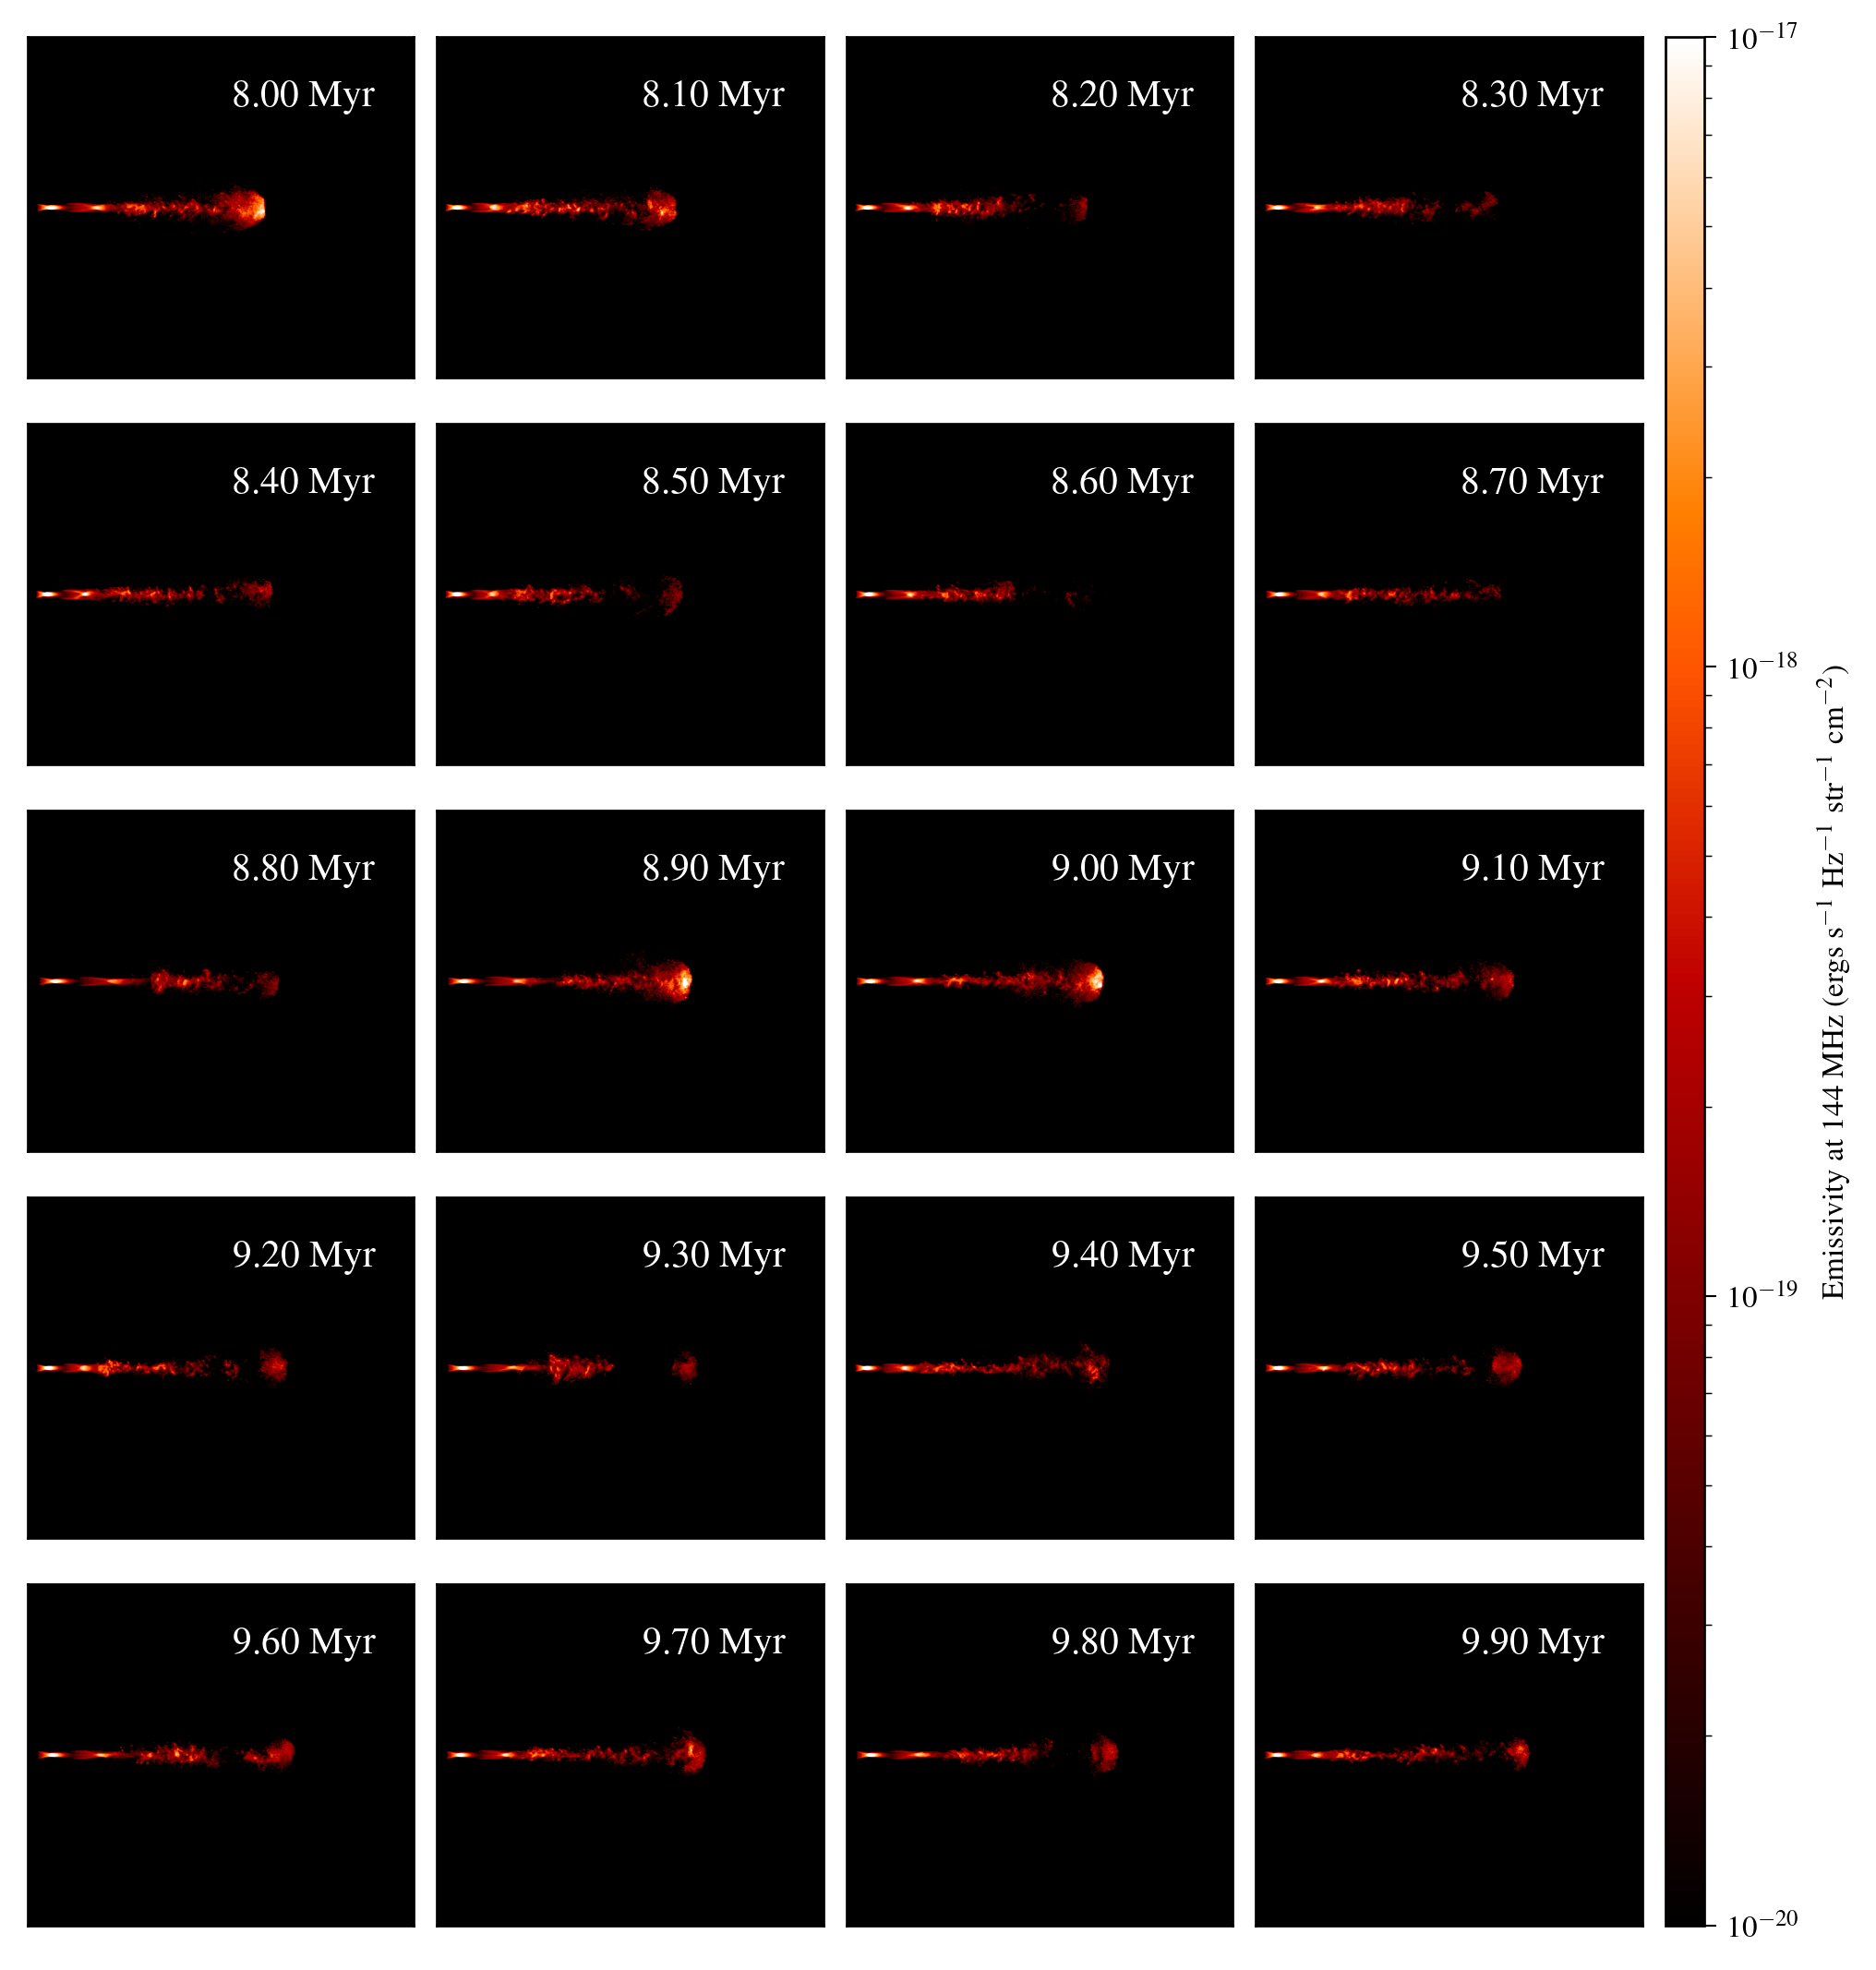
Variable jet: 8-10 Myr
Overall luminosity is much less dependent on time and size
Hotspot outshines both recollimation shocks at some times
Emma Elley, University of Oxford
Notes:
Seed 12

Slide 8
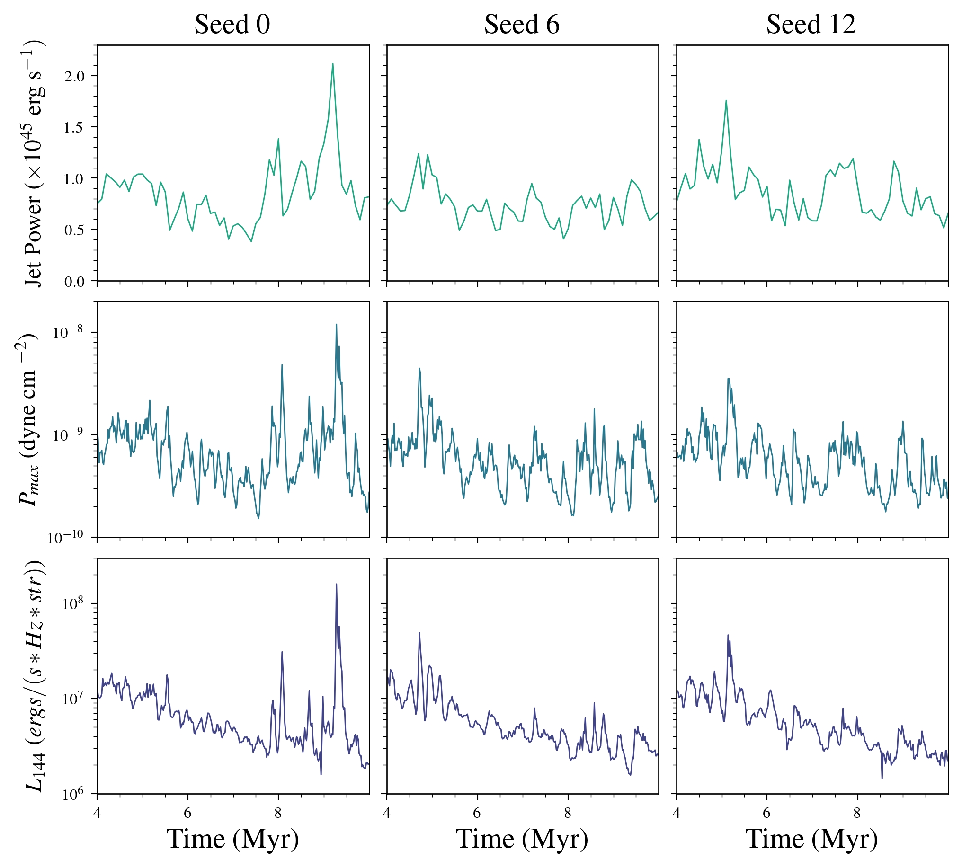
Variable jets
Radio luminosity at 144 MHz has a strong dependence on the jet power and maximum power in the hotspot
Trend for lower luminosities at later times, but significantly affected by hotspot variability
Emma Elley, University of Oxford

Slide 9
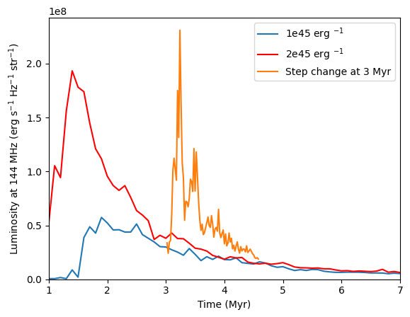
How can we understand these intermittent hotspots?
At late times both the high and low power jets have similar luminosities
A step change from the lower power to the higher power at 3 Myr leads to a sharp increase in luminosity, which slowly decays to match the steady jet luminosities
Emma Elley, University of Oxford

Slide 10
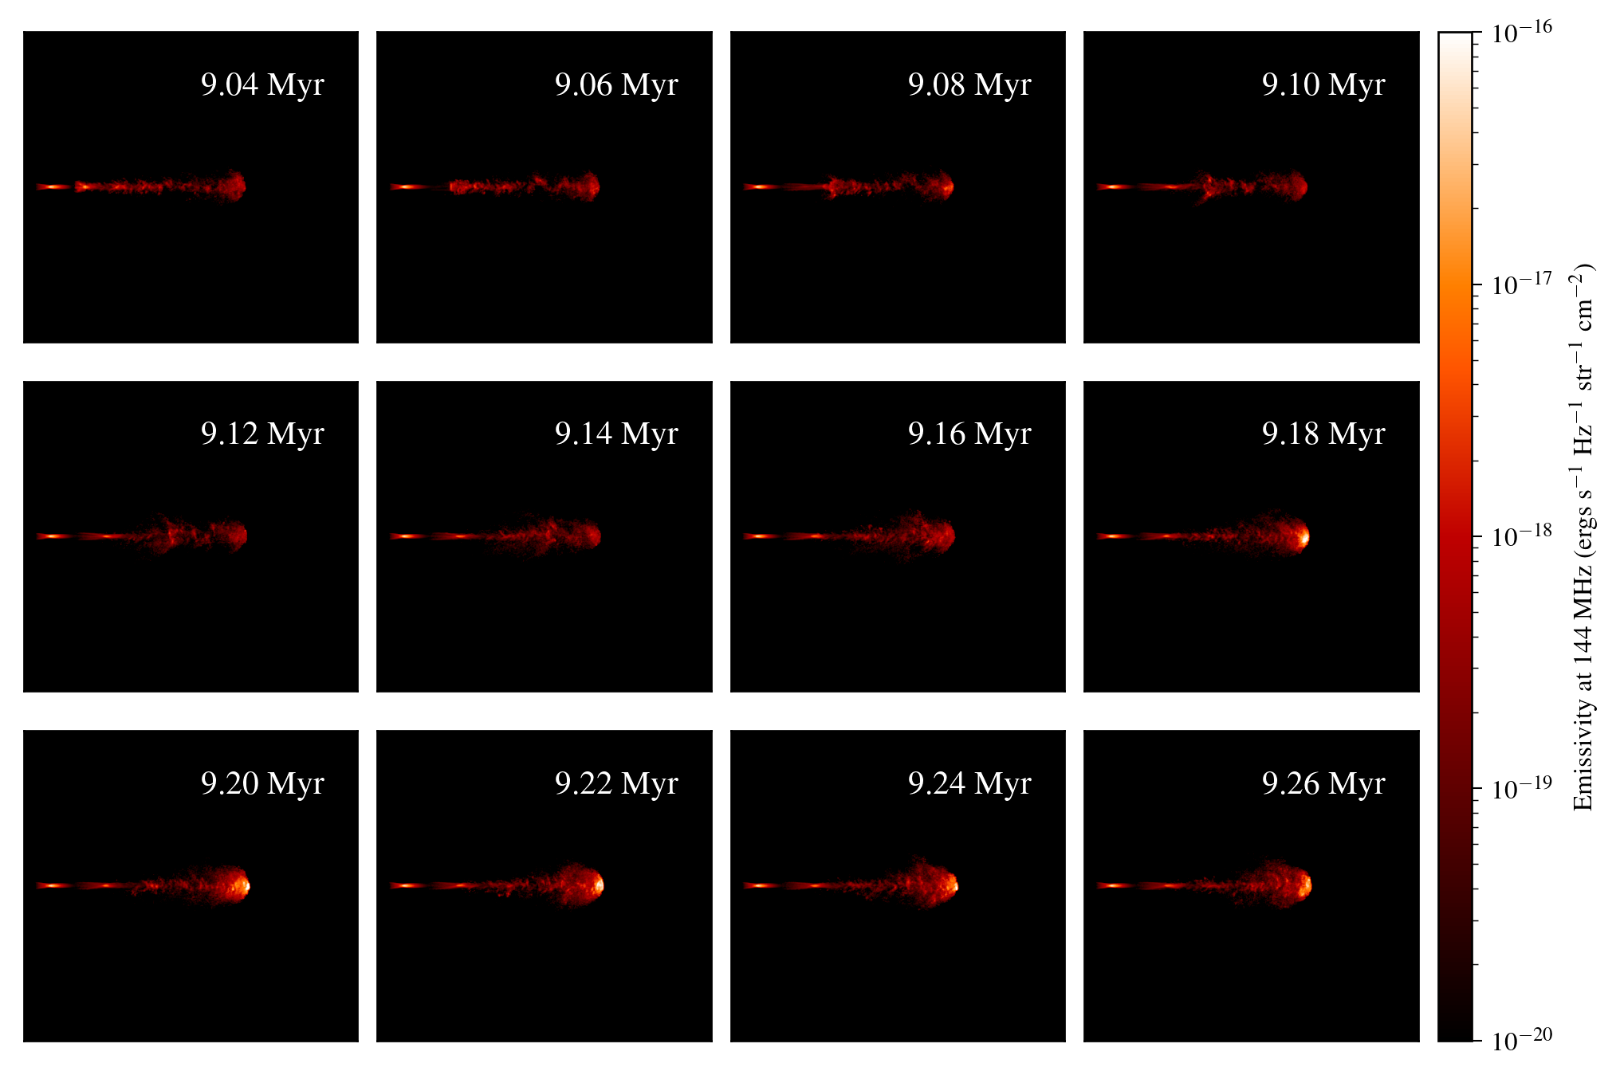
Emma Elley, University of Oxford

Slide 11
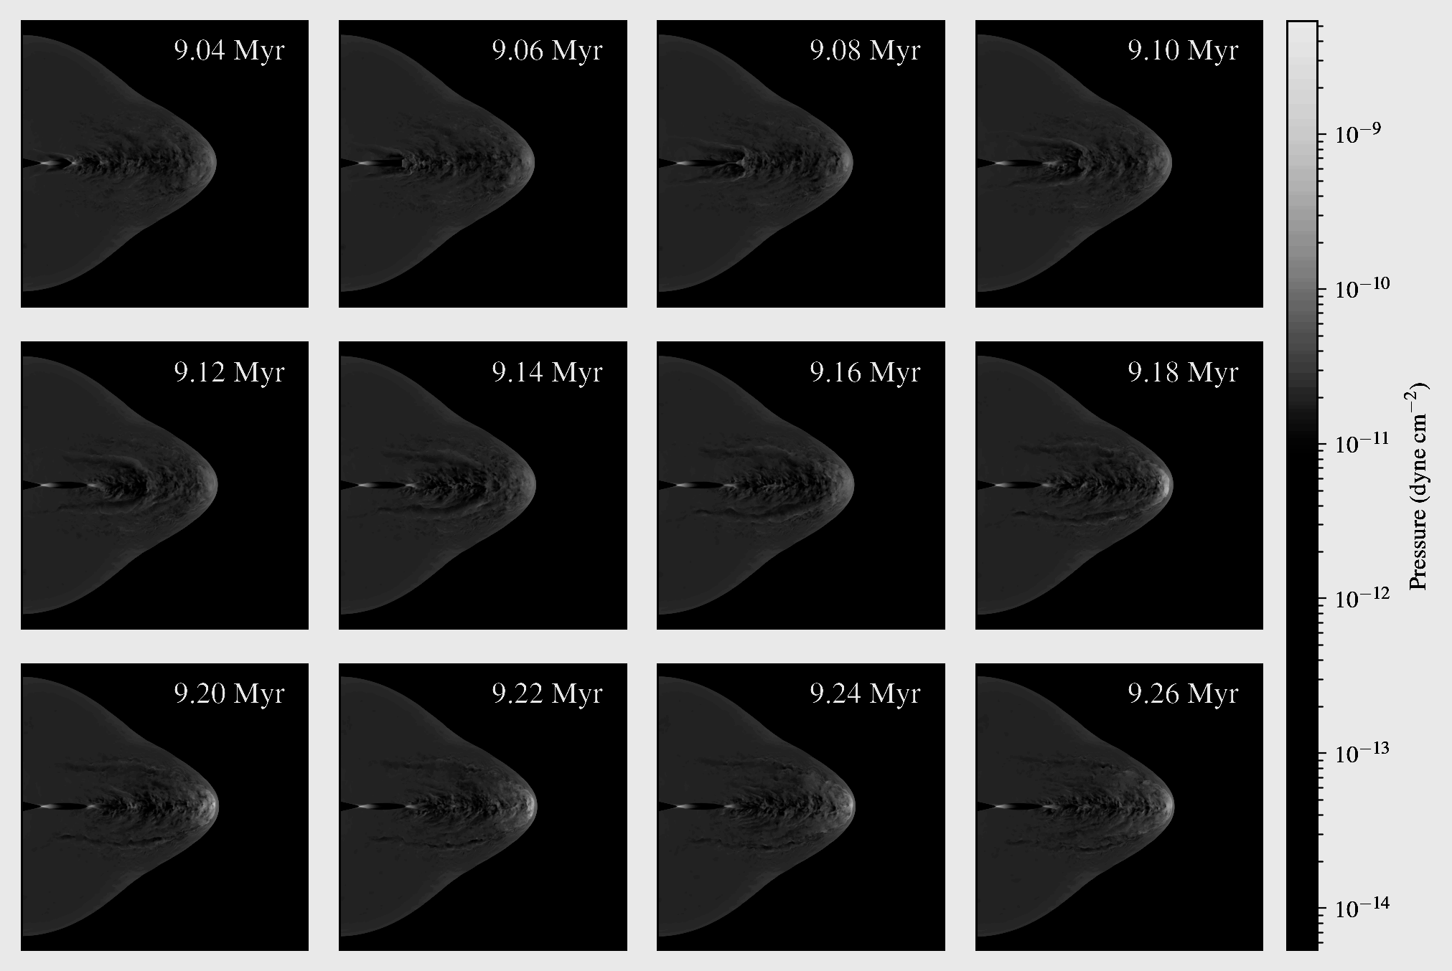
Emma Elley, University of Oxford

Slide 12
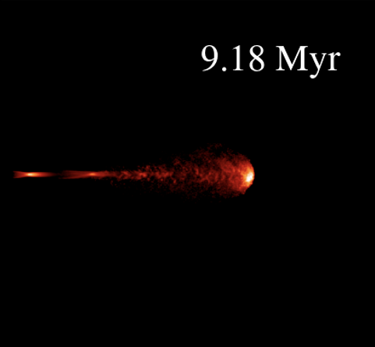

Implications for spectral ageing
We find increased rate of injection of energy into newly shocked material directly following high power periods
This suggests that sources may appear younger than they are if a constant rate of energy injection at a stable hotspot is assumed.
Emma Elley, University of Oxford

Slide 13
Conclusions
Increases in jet power can lead to dramatic increases in hotspot luminosity
Mechanism: travelling shock interacts with the pre-existing forward and reverse shock structure at the hotspot
Important implications for
  Spectral ageing
  Understanding the diversity of radio galaxy morphologies in observations
  Estimates of jet power
We have a paper on effects of variability on morphology in preparation
Please talk to me about:
  Radio observations of and emission mechanisms in jets (both AGN and XRB)
  Our methods/ hydrodynamics simulations in general
Emma Elley, University of Oxford

