Slide 1
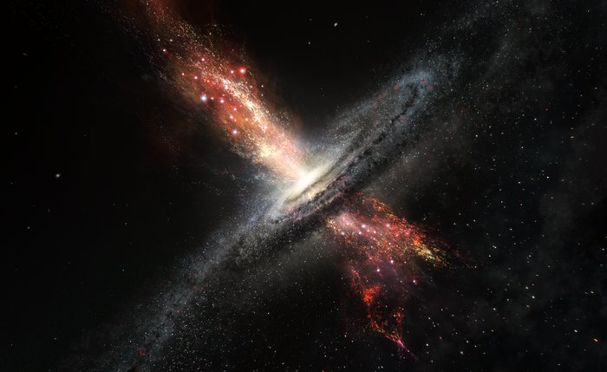


A striking signature of shocks in compact red quasars?
Ciera Sargent ・PhD Student ・Durham University
Supervisors: David Alexander & Claire Greenwell
Active Galactic Nuclei – from ISCO to CGM and from cosmic dawn to the present day, NAM, 9 July
Image Credit: ESO/M. Kornmesser

Slide 2
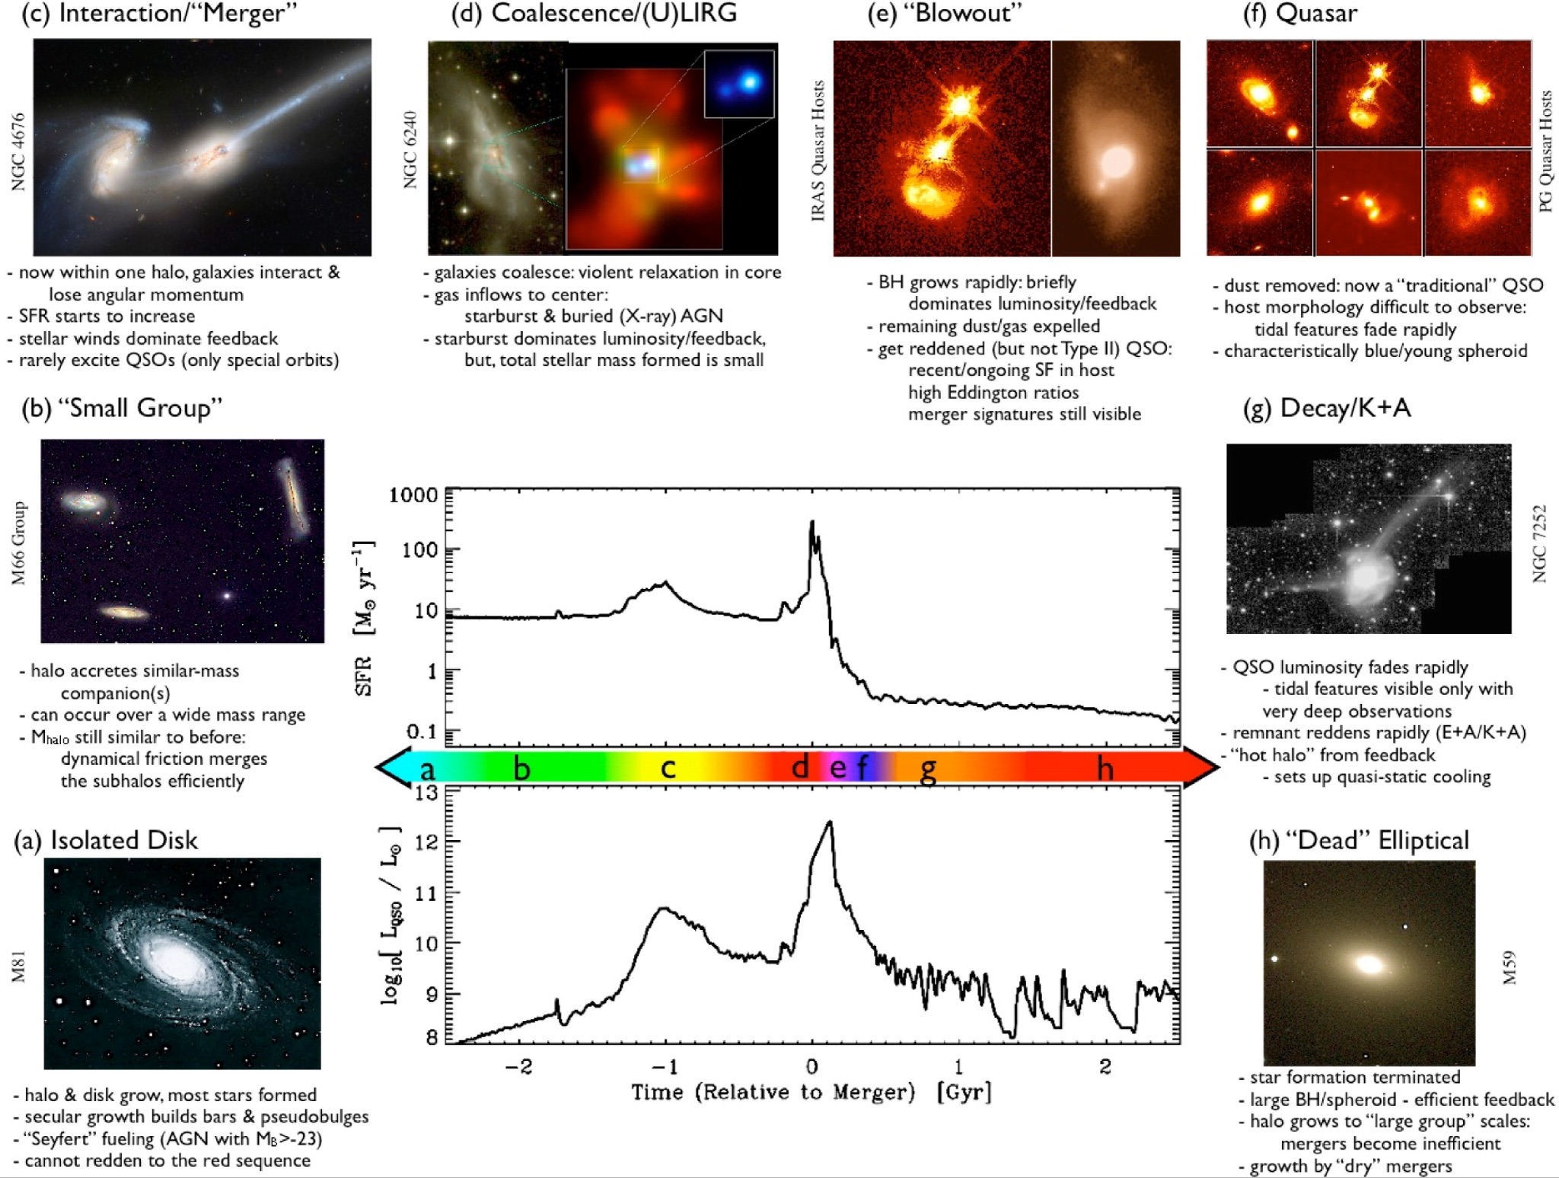
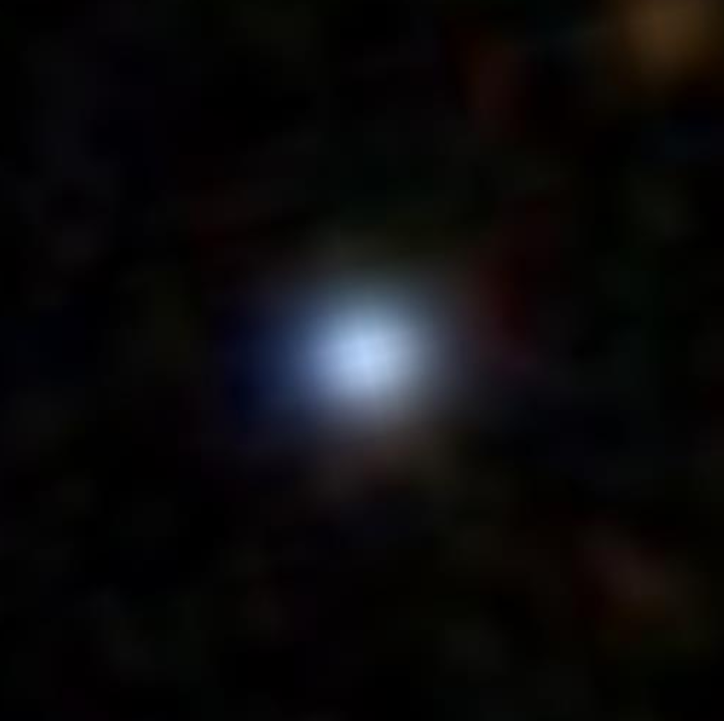
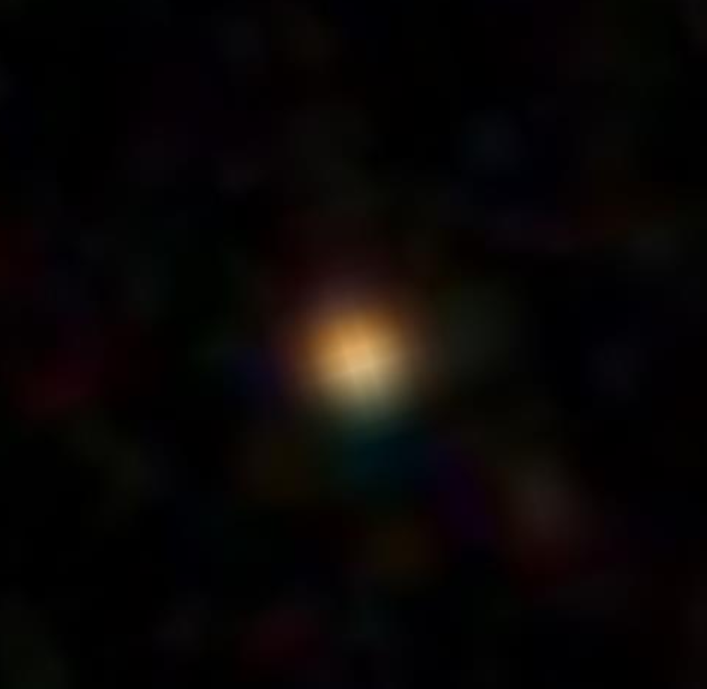
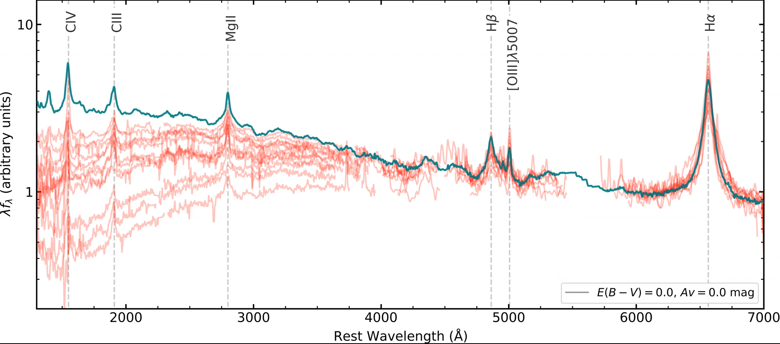
Why care about red quasars?
Galaxy simulations predict there is a transitional phase in the evolution of galaxies, also known as a “blow-out” phase
Hopkins+08
Optical images taken from SDSS
Fawcett+ 22
Majority of optical quasars are blue
~10% are red
light dust obscuration: E(B-V)<~0.5 & still observe broad lines
Ciera Sargent (ciera.l.sargent@durham.ac.uk) AGN NAM, 9 July 1/7

Slide 3
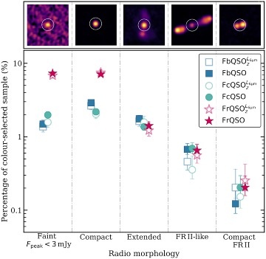
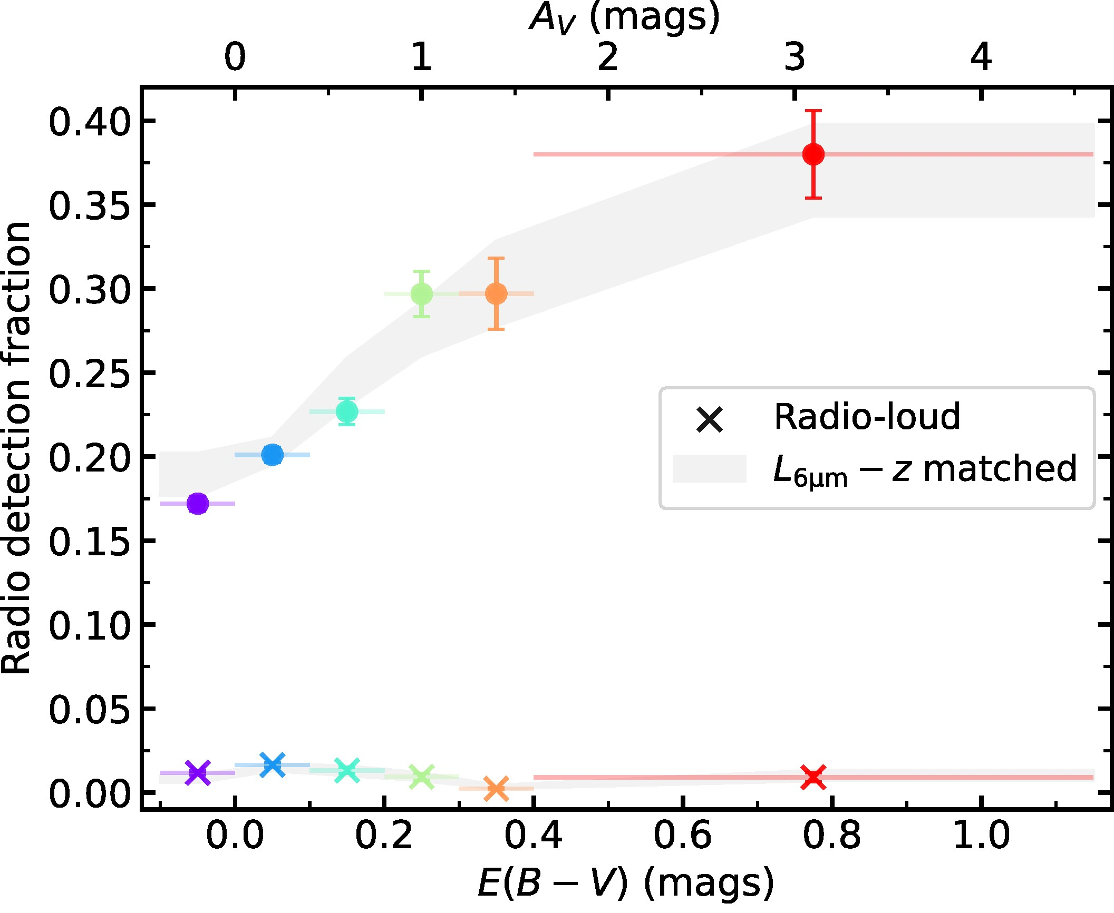
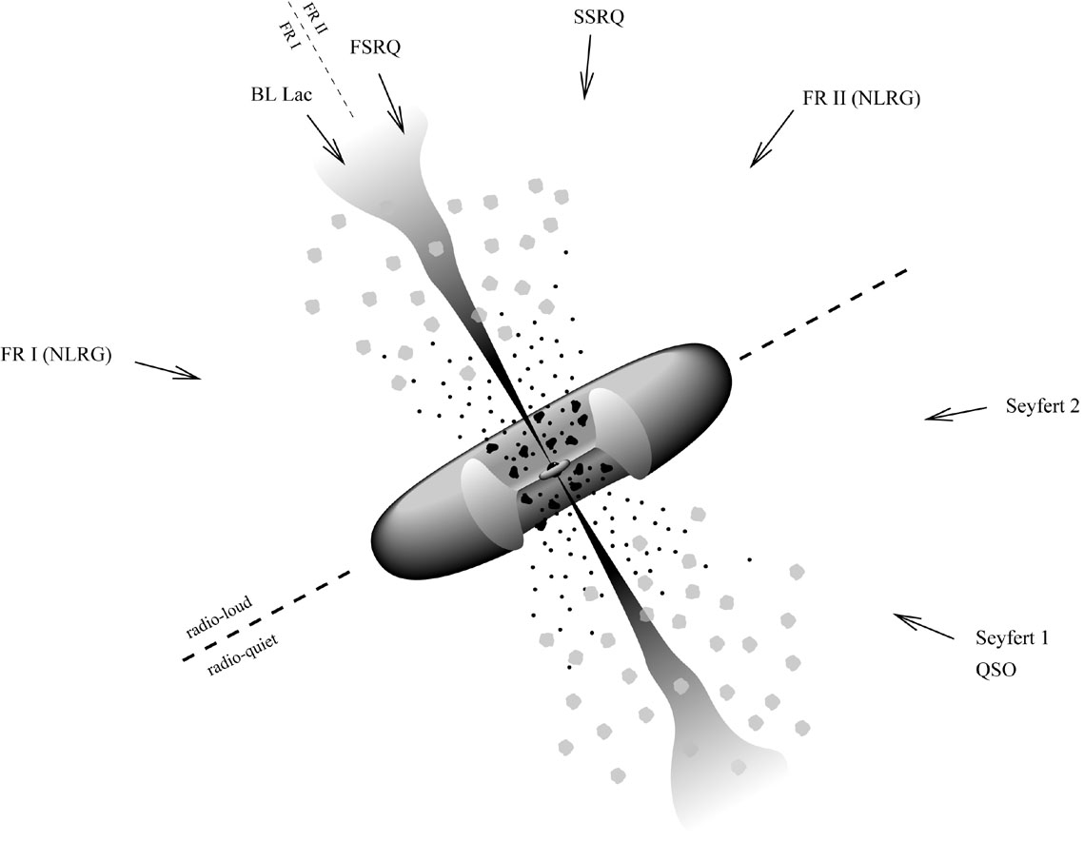

Dust-radio connection
Fawcett +23: Radio detection – opacity connection
Klindt +19
not explained by orientation!
Radio detection fraction
10% bluest g*-i*
Radio detection fraction (%)
middle 10% g*-i*
R = log(L_{144MHz} /L₆$μ$_{m})>-4.5
10% reddest g*-i*
E(B-V) (mags)
Dust-reddened quasars ~2-3 x more likely to be detected than typical blue quasars (eg. Klindt+19, Rosario+20, Fawcett+20,21)
predominantly due to radio-quiet/intermediate sources
Radio morphology
Excess detection rates driven by compact (<host galaxy scale) radio morphologies (eg. Fawcett+20, Rosario+21)
Ciera Sargent (ciera.l.sargent@durham.ac.uk) AGN NAM, 9 July 2/7

Slide 4
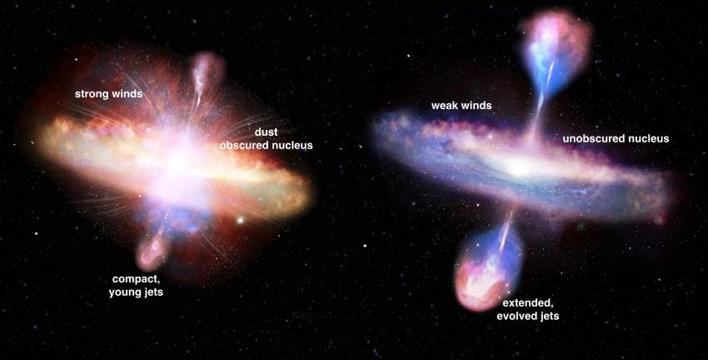
Dust-radio connection
Fawcett +23: Radio detection – opacity connection
Klindt +19
not explained by orientation!
What is causing this excess radio emission?
Shocks due to AGN driven winds?
Red quasar
Blue quasar
Radio detection fraction
10% bluest g*-i*
Radio detection fraction (%)
middle 10% g*-i*
Low power jets interacting with higher opacity ISM?
10% reddest g*-i*
E(B-V) (mags)
Dust-reddened quasars ~2-3 x more likely to be detected than typical blue quasars (eg. Klindt+19, Rosario+20, Fawcett+20,21)
predominantly due to radio-quiet/intermediate sources
Radio morphology
Excess detection rates driven by compact (<host galaxy scale) radio morphologies (eg. Fawcett+20, Rosario+21)
Ciera Sargent (ciera.l.sargent@durham.ac.uk) AGN NAM, 9 July 2/7

Slide 5
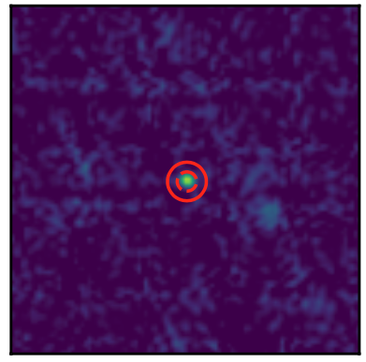
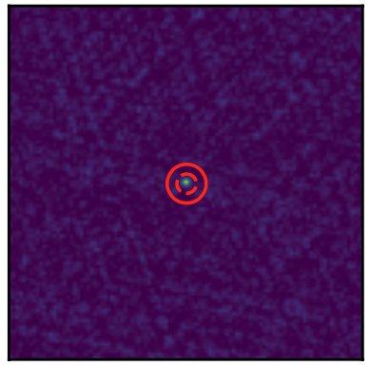
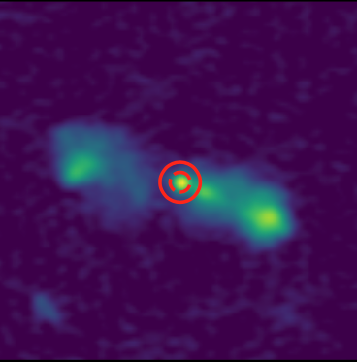

Radio morphologies at different frequencies
1.4 GHz (FIRST)
3 GHz (VLASS)
144 MHz (LoTSS)
Previous work: biggest differences among compact & faint radio morphologies
morphology classification usually in one frequency only (eg. Klindt+19, Rosario+20)
radio sources can look very different at different frequencies/resolutions/sensitivities
130 kpc
z= 0.59
Typical synchrotron power law: $S_{υ}∝ υ^{α}; α=−$0.7
Extended low frequency emission – previous episode of activity?
Radio spectral slopes – probe underlying radio emission mechanism
Turnover/inverted at low frequencies indicating absorption
Energy losses at high frequencies
Ciera Sargent (ciera.l.sargent@durham.ac.uk) AGN NAM, 9 July 3/7

Slide 6
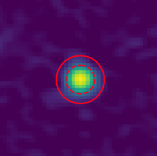
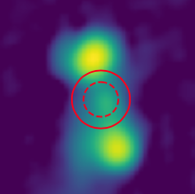

Red quasars more likely to remain compact at all frequencies
Visually inspected radio images of all sources > 3 mJy (632 red quasars, 1426 blue/control quasars) in each radio survey
Simple classification (each survey):
compact
not compact
FIRST compact quasars
130 kpc
z= 0.59
Red quasars detected 2-3x as often as blue
97% remain compact in VLASS (3GHz; < 8-20kpc)
+ LoTSS compact
= “truly compact”
+ LoTSS not compact
= “fake compact”
Ciera Sargent (ciera.l.sargent@durham.ac.uk) AGN NAM, 9 July 4/7

Slide 7
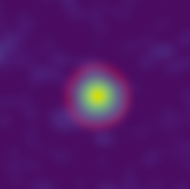
Red quasars more likely to remain compact at all frequencies
Visually inspected radio images of all sources > 3 mJy (632 red quasars, 1426 blue/control quasars) in each radio survey
Simple classification (each survey):
compact
not compact
FIRST compact quasars
130 kpc
z= 0.59
Red quasars detected 2-3x as often as blue
97% remain compact in VLASS (3GHz; < 8-20kpc)
= 83% of FIRST compact red quasars
= 73% of FIRST compact blue quasars
+ LoTSS compact
= “truly compact”
+ LoTSS not compact
= “fake compact”
Ciera Sargent (ciera.l.sargent@durham.ac.uk) AGN NAM, 9 July 4/7

Slide 8
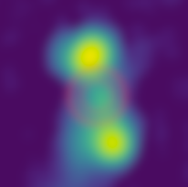
Red quasars more likely to remain compact at all frequencies
Visually inspected radio images of all sources > 3 mJy (632 red quasars, 1426 blue/control quasars) in each radio survey
Simple classification (each survey):
compact
not compact
FIRST compact quasars
130 kpc
z= 0.59
Red quasars detected 2-3x as often as blue
97% remain compact in VLASS (3GHz; < 8-20kpc)
= 83% of FIRST compact red quasars
= 73% of FIRST compact blue quasars
+ LoTSS compact
= “truly compact”
+ LoTSS not compact
= “fake compact”
red and blue quasars detected at similar rates
Ciera Sargent (ciera.l.sargent@durham.ac.uk) AGN NAM, 9 July 4/7

Slide 9
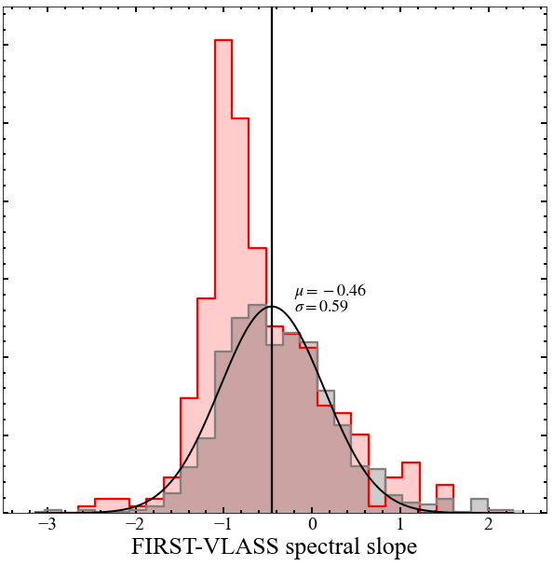
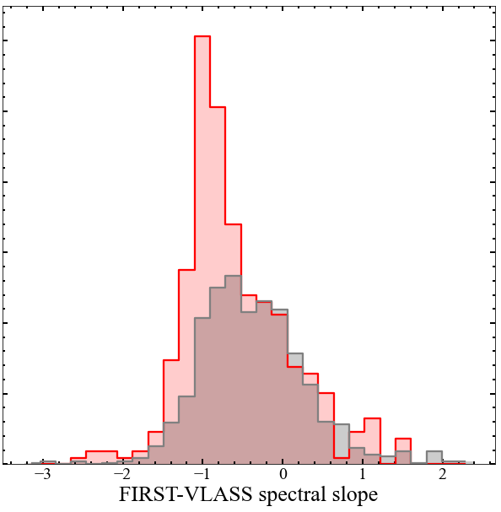
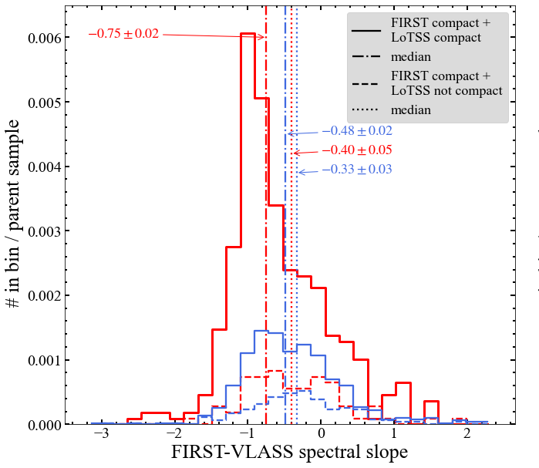
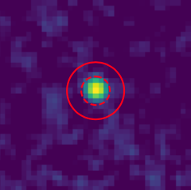
Steep radio spectral slopes in truly compact red quasars
1.4 GHz – 3 GHz spectral slope of truly compact vs. fake compact quasars
red quasar
+
truly compact
+
+
all other classifications: consistent distributions
Ciera Sargent (ciera.l.sargent@durham.ac.uk) AGN NAM, 9 July 5/7

Slide 10
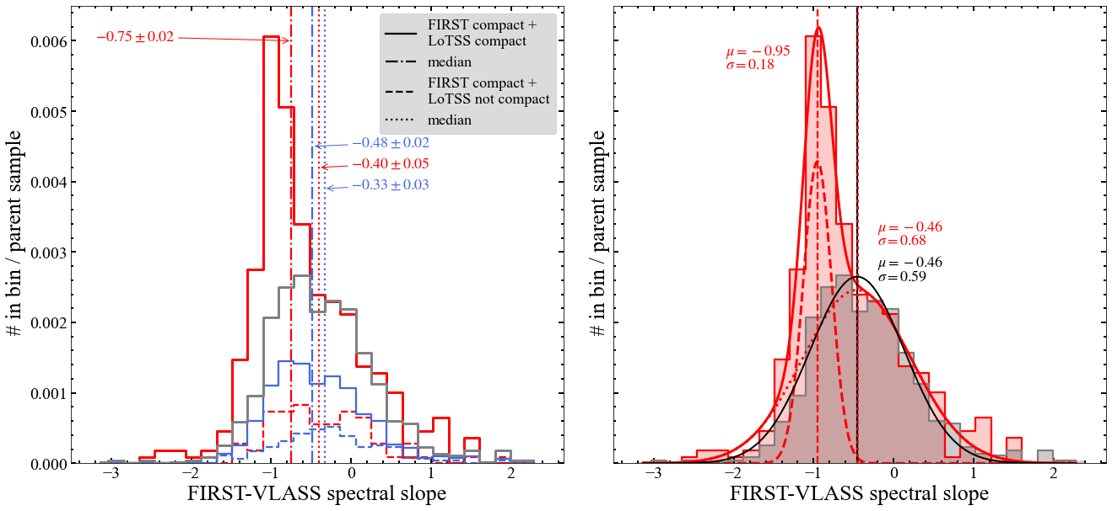
Steep radio spectral slopes in truly compact red quasars
1.4 GHz – 3 GHz spectral slope of truly compact vs. fake compact quasars
red quasar
+
truly compact
+
+
typical synchrotron slope ~ - 0.7
all other classifications: consistent distributions
fake compact red quasars have similar spectral slopes to typical (FIRST compact) blue quasars
Ciera Sargent (ciera.l.sargent@durham.ac.uk) AGN NAM, 9 July 5/7

Slide 11
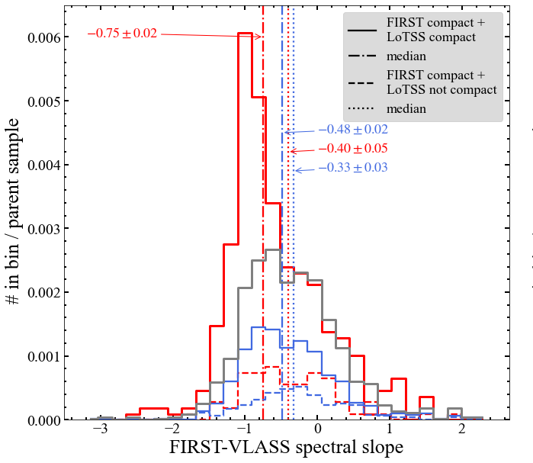
Steep radio spectral slopes in truly compact red quasars
1.4 GHz – 3 GHz spectral slope of truly compact vs. fake compact quasars
red quasar
+
truly compact
population of sources with steep slopes
+
+
typical synchrotron slope ~ - 0.7
all other classifications: consistent distributions
fake compact red quasars have similar spectral slopes to typical (FIRST compact) blue quasars
Truly compact red quasars contain a population of steep slope sources that drive the excess radio detection rates
makes up ~ 30% of all truly compact red quasars
are preferentially radio quiet/radio intermediate
Ciera Sargent (ciera.l.sargent@durham.ac.uk) AGN NAM, 9 July 5/7

Slide 12
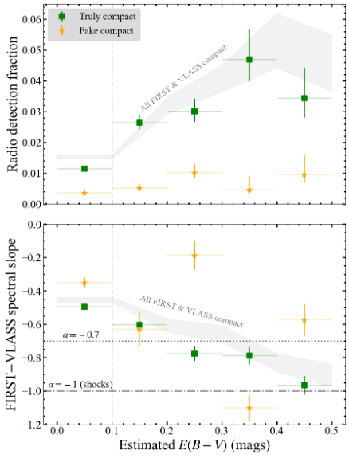
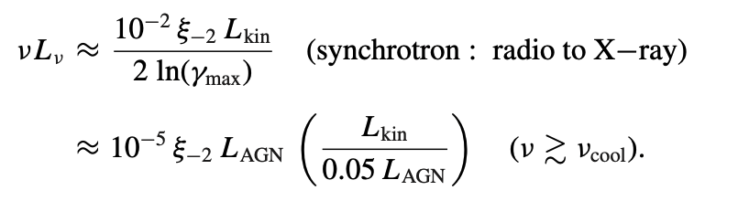
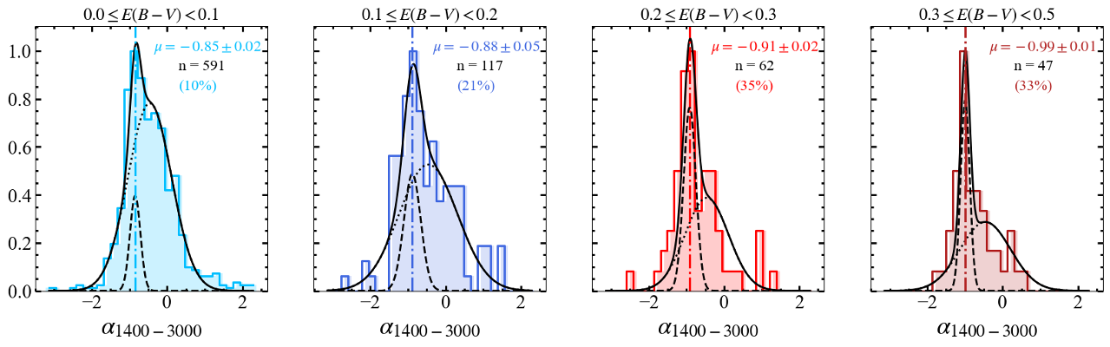
Radio-dust connection for truly compact quasars only
Fawcett+25: weak but significant trend of steepening radio spectral slope with E(B-V)
We can now split this into truly vs fake compact quasars:
Non-thermal emission from electrons accelerated by an AGN wind shock (Nims+15):
𝜈L_{𝜈} ~ constant → L_{𝜈} ∝ 𝜈⁻¹ ie. 𝛼 ≈ -1
Spectral slope steepens with E(B-V) for truly compact quasars only
Radio-detection rate also connected to E(B-V) for truly compact quasars only
Ciera Sargent (ciera.l.sargent@durham.ac.uk) AGN NAM, 9 July 6/7

Slide 13
Radio-dust connection for truly compact quasars only
Fawcett+25: weak but significant trend of steepening radio spectral slope with E(B-V)
We can now split this into truly vs fake compact quasars:
Non-thermal emission from electrons accelerated by an AGN wind shock (Nims+15):
𝜈L_{𝜈} ~ constant → L_{𝜈} ∝ 𝜈⁻¹ ie. 𝛼 ≈ -1
An increasing fraction of shock-dominated systems toward higher level of dust extinction?
Can’t rule out other mechanisms such as low-powered/compact jets
Future work: look for signatures of outflows/winds in steep-slope sources
Spectral slope steepens with E(B-V) for truly compact quasars only
Radio-detection rate also connected to E(B-V) for truly compact quasars only
Ciera Sargent (ciera.l.sargent@durham.ac.uk) AGN NAM, 9 July 6/7

Slide 14
Radio-dust connection for truly compact quasars only
Fawcett+23: radio-detection fraction increases with E(B-V)
Fawcett+25: weak but significant trend of steepening radio spectral slope with E(B-V)
We can now split this into truly vs fake compact quasars:
Radio-detection rate connected to E(B-V) for truly compact quasars only
Spectral slope steepens with E(B-V) for truly compact quasars only
What is the physical meaning for this correlation?
Ciera Sargent (ciera.l.sargent@durham.ac.uk) AGN NAM, 9 July 6/8

Slide 15
Radio-dust connection for truly compact quasars only
Fawcett+23: radio-detection fraction increases with E(B-V)
Fawcett+25: weak but significant trend of steepening radio spectral slope with E(B-V)
We can now split this into truly vs fake compact quasars:
Non-thermal emission from electrons accelerated by an AGN wind shock (Nims+15):
𝜈L_{𝜈} ~ constant → L_{𝜈} ∝ 𝜈⁻¹ ie. 𝛼 ≈ -1
An increasing fraction of shock-dominated systems toward higher E(B-V)?
Radio-detection rate connected to E(B-V) for truly compact quasars only
Spectral slope steepens with E(B-V) for truly compact quasars only
What is the physical meaning for this correlation?
Ciera Sargent (ciera.l.sargent@durham.ac.uk) AGN NAM, 9 July 6/8

Slide 16
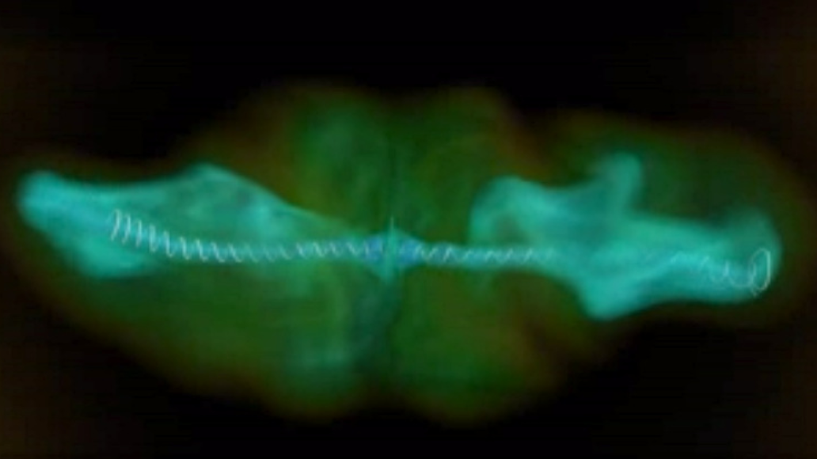
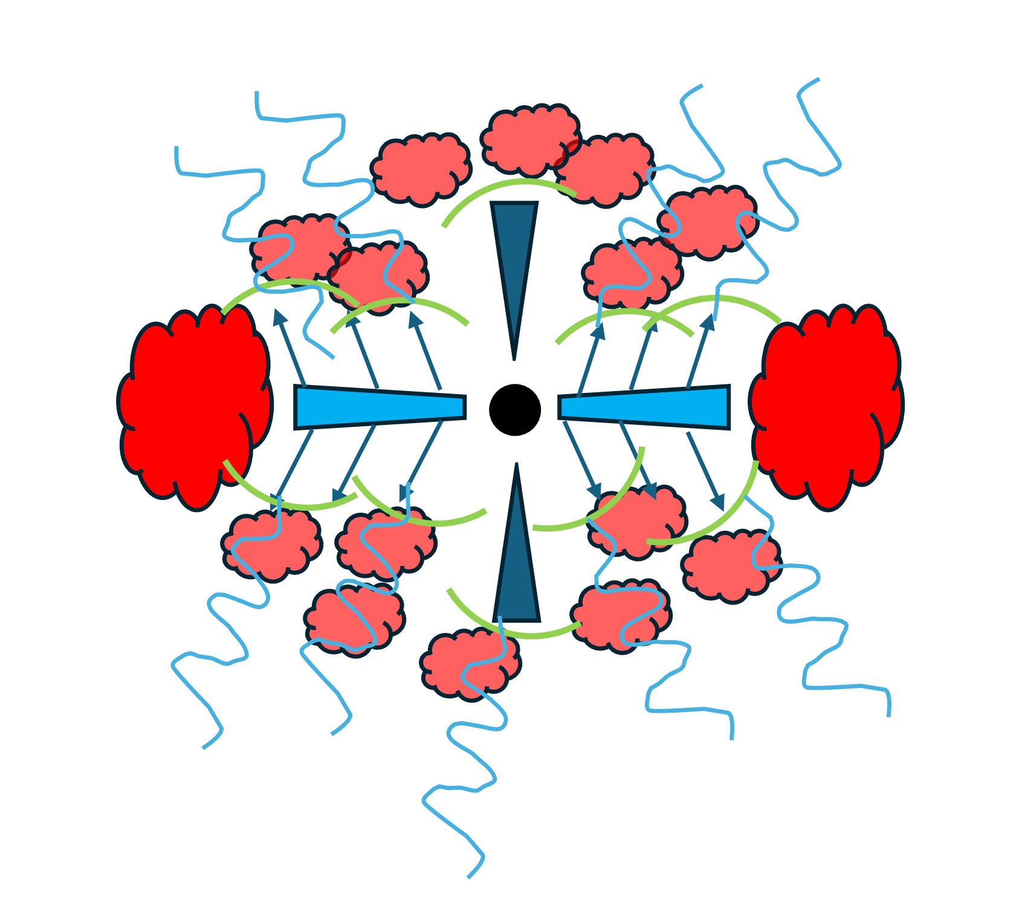
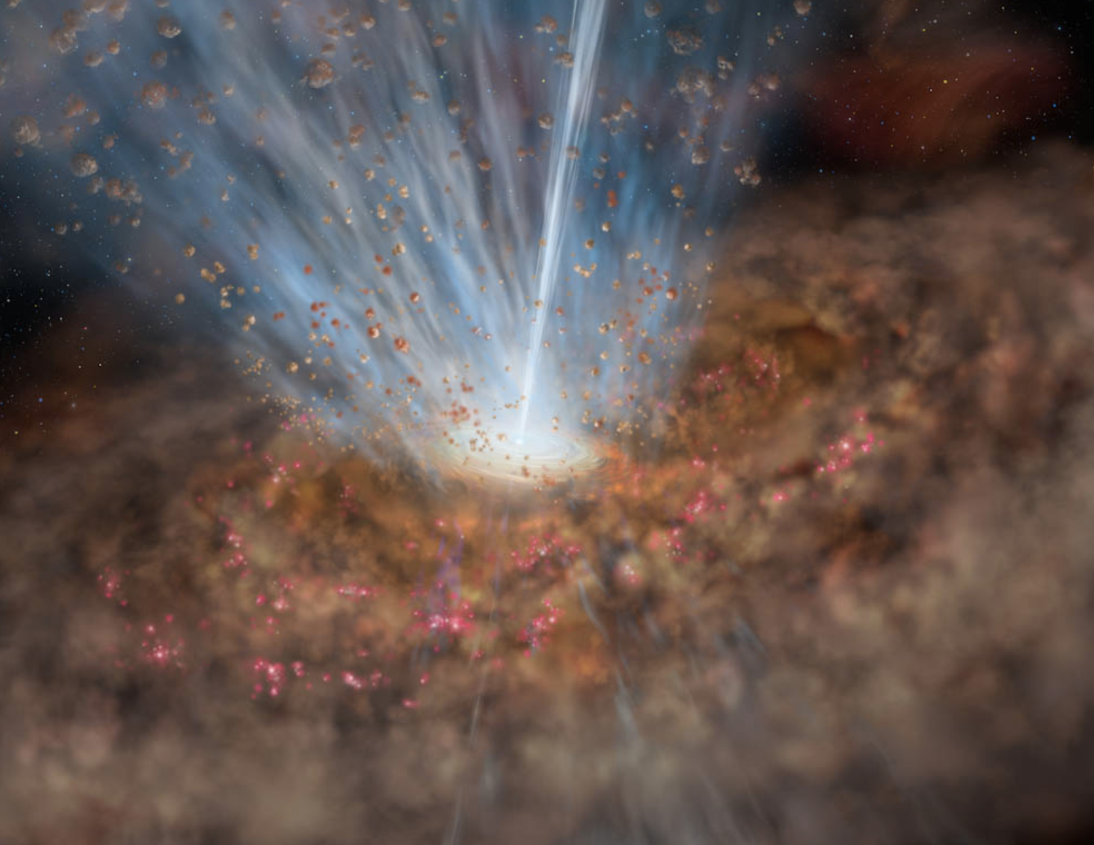
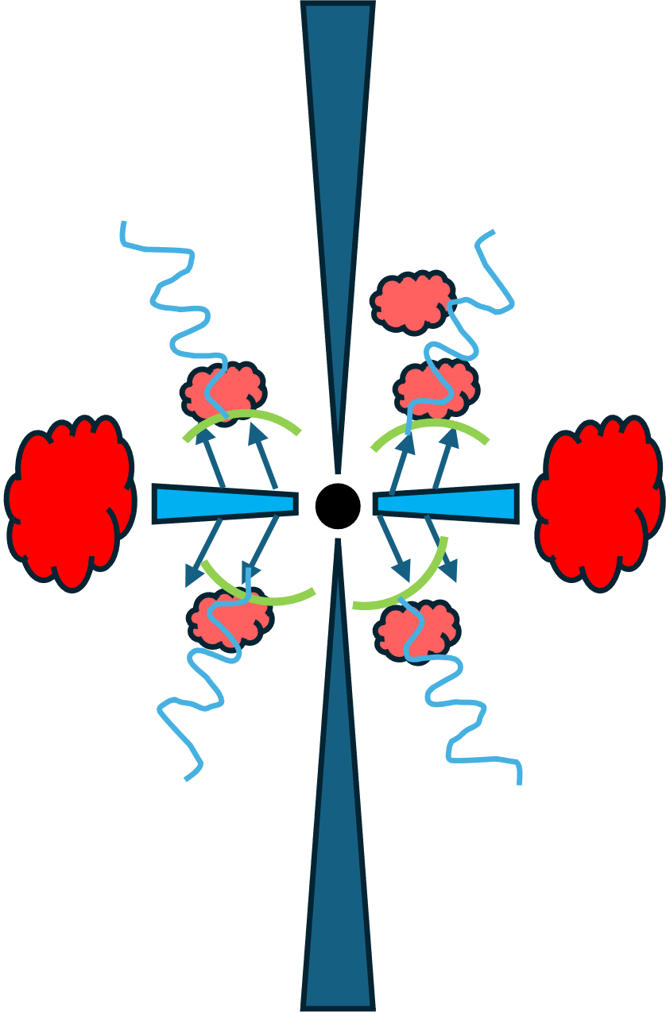
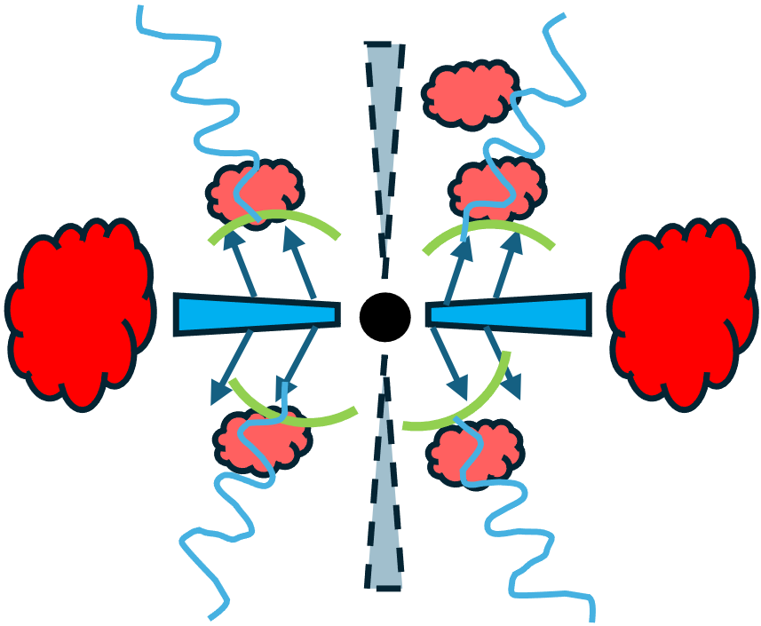
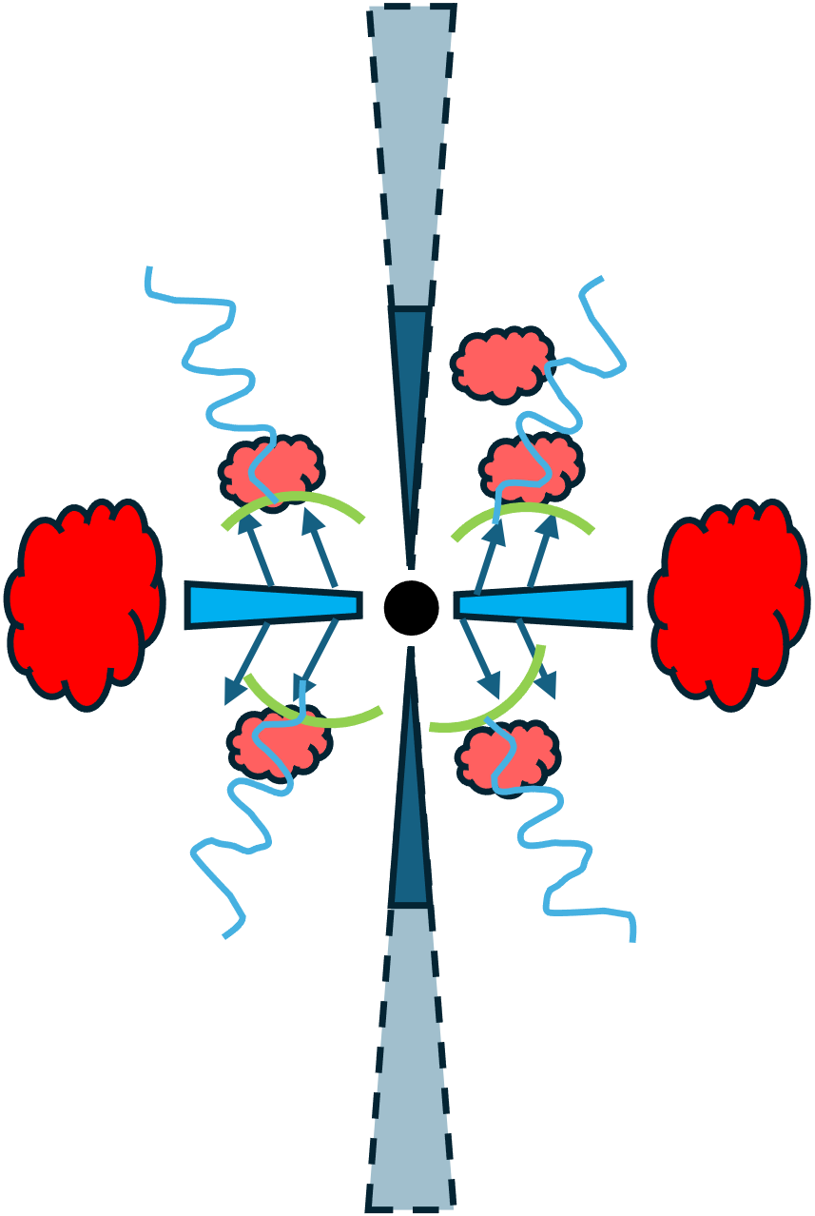
Red quasars as a dusty blow-out phase?
Tchekhovskoy & Bromberg (2016)
gas infall
– obscuration increasing
dusty blow-out phase
Radio jet-host galaxy interaction simulation
Winds shocking gas producing synchrotron emission?
unobscured/blue quasar
eg. Nims+ 2015
steep radio spectral slopes
some quasars likely red just due to orientation
extended radio emission
observed with typical distribution of radio spectral slopes
extended radio emission fades
extended radio emission fades
(high frequency faster)
= shocks
= radio emission
“fake compact” quasars
Ciera Sargent (ciera.l.sargent@durham.ac.uk) AGN NAM, 9 July 7/8

Slide 17
Summary
There is a connection between dust and radio spectral slopes/detection rates in quasars
The radio-dust connection in red quasars is mostly driven by systems with unresolved radio emission in both FIRST (1.4 GHz) and LoTSS (144 MHz)
These “truly compact” red quasars contain a population of sources with steep radio spectral slopes of α~-1
This is consistent with the prediction from AGN-wind shocks in the Nims+15 model
Consistent with a “dusty blow-out” phase?
Ciera Sargent (ciera.l.sargent@durham.ac.uk) AGN NAM, 9 July 7/7

Slide 18
Backup slides
Ciera Sargent (ciera.l.sargent@durham.ac.uk) AGN NAM, 9 July

Slide 19
Red quasars as a dusty blow-out phase?
Tchekhovskoy & Bromberg (2016)
gas infall
– obscuration increasing
dusty blow-out phase
Radio jet-host galaxy interaction simulation
Winds shocking gas producing synchrotron emission?
unobscured/blue quasar
eg. Nims+ 2015
steep radio spectral slopes
some quasars likely red just due to orientation
extended radio emission
observed with typical distribution of radio spectral slopes
extended radio emission fades
extended radio emission fades
(high frequency faster)
= shocks
= radio emission
“fake compact” quasars
Ciera Sargent (ciera.l.sargent@durham.ac.uk) AGN NAM, 9 July

Slide 20
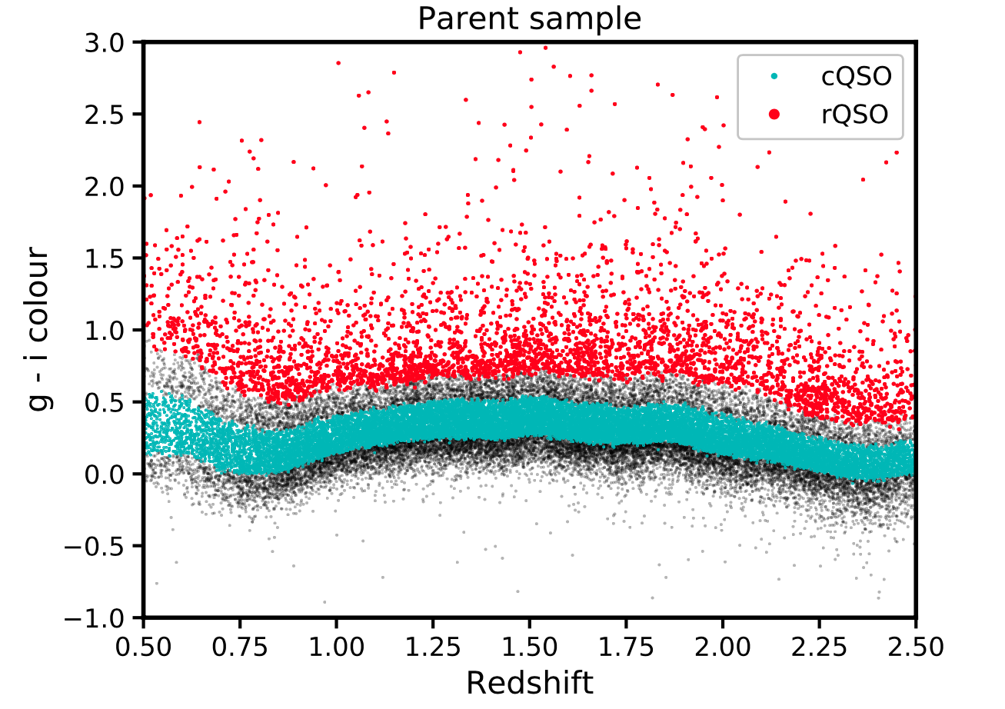
Red & control colour selection
SDSS optically selected red and blue/control quasars (0.2 < z < 2.4) from Fawcett+2022:
top 10% g*-i*
50% around median g*-i*
Ciera Sargent (ciera.l.sargent@durham.ac.uk) AGN NAM, 9 July

Slide 21
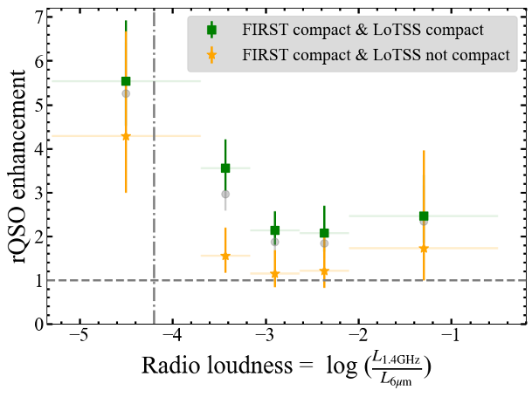
Radio loudness
Ciera Sargent (ciera.l.sargent@durham.ac.uk) AGN NAM, 9 July

Slide 22
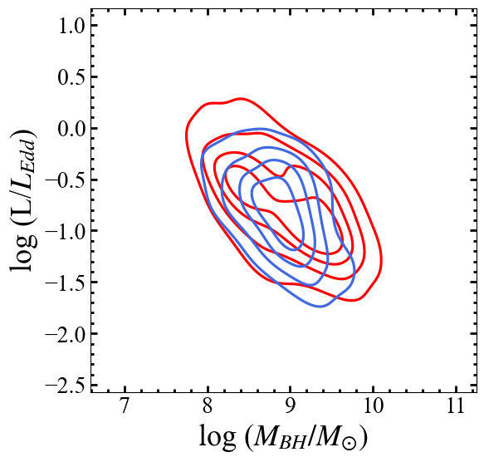
Differences in the central engines?
Preliminary
Eddington ratios - previous work finds mixed results for red quasars:
  no difference in L/Ledd (Calistro Rivera+2021),
  red quasars slightly lower L/Ledd (Fawcett+2022),
  higher L/Ledd (Urrutia+2012)
Rakshit+2020 BH mass and luminosity values – corrected for E(B-V)
no strong difference in L/Ledd
BH mass distributions different
truly compact only:
Ciera Sargent (ciera.l.sargent@durham.ac.uk) AGN NAM, 9 July

Slide 23
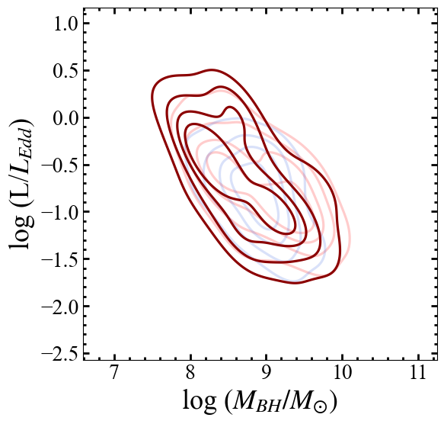
Differences in the central engines?
Preliminary
Eddington ratios - previous work finds mixed results for red quasars:
  no difference in L/Ledd (Calistro Rivera+2021),
  red quasars slightly lower L/Ledd (Fawcett+2022),
  higher L/Ledd (Urrutia+2012)
Rakshit+2020 BH mass and luminosity values – corrected for E(B-V)
no strong difference in L/Ledd
BH mass distributions different
Steep truly compact red quasars: less massive BHs and higher Eddington ratios?
truly compact only:
weighted – steep slopes
Ciera Sargent (ciera.l.sargent@durham.ac.uk) AGN NAM, 9 July

Slide 24
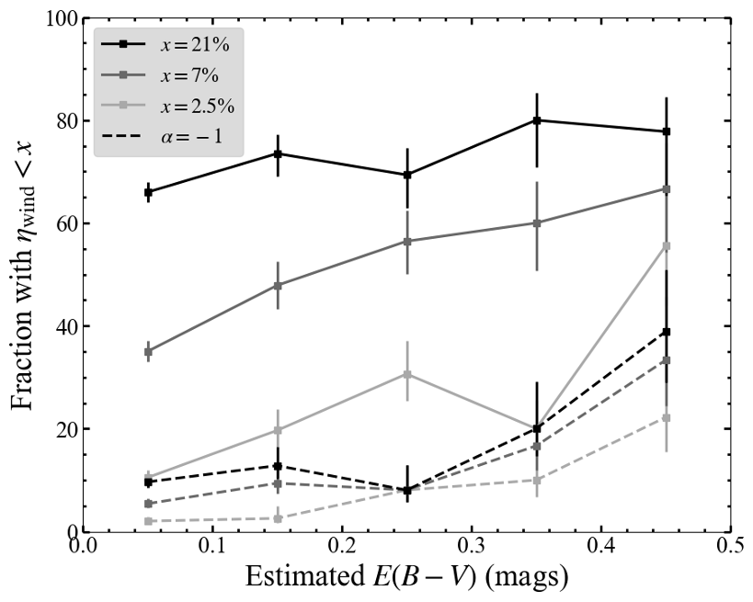
Wind efficiency parameter
Ciera Sargent (ciera.l.sargent@durham.ac.uk) NAM, 9 July

Slide 25
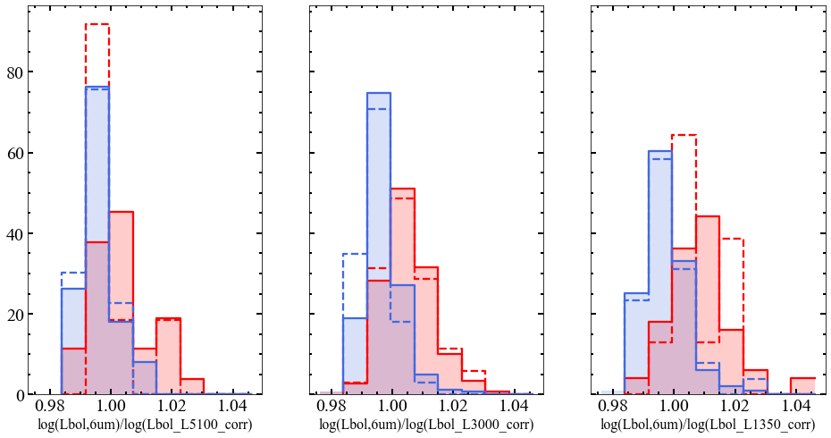
MIR excess
Ciera Sargent (ciera.l.sargent@durham.ac.uk) AGN NAM, 9 July

Slide 26
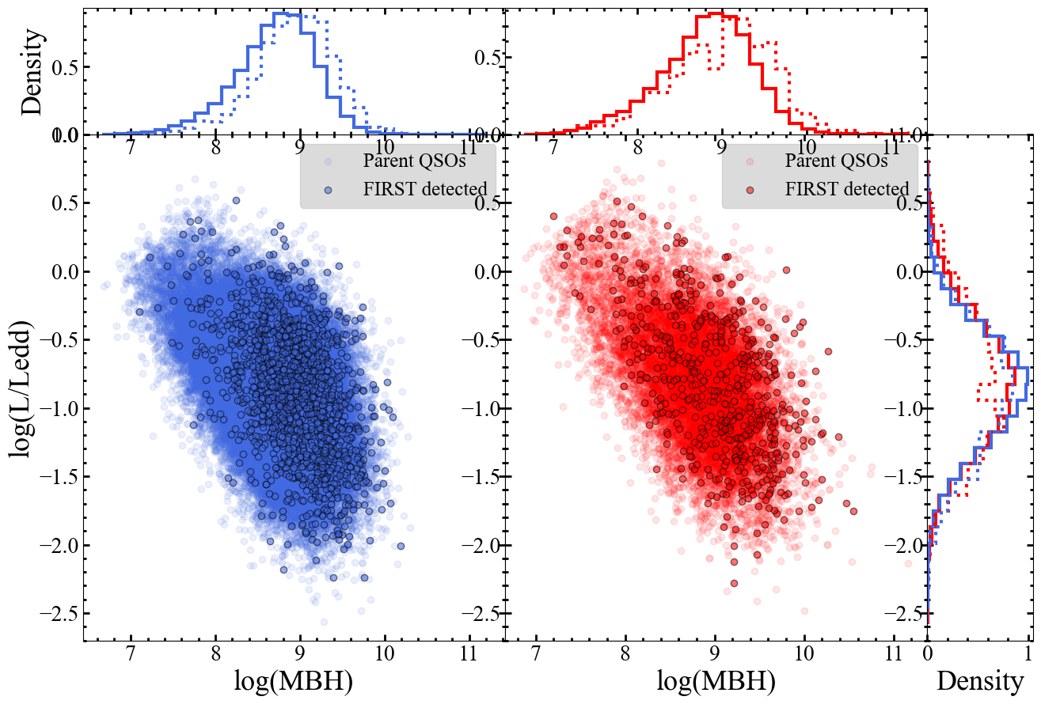
L/Ledd - MBH plane

Slide 27
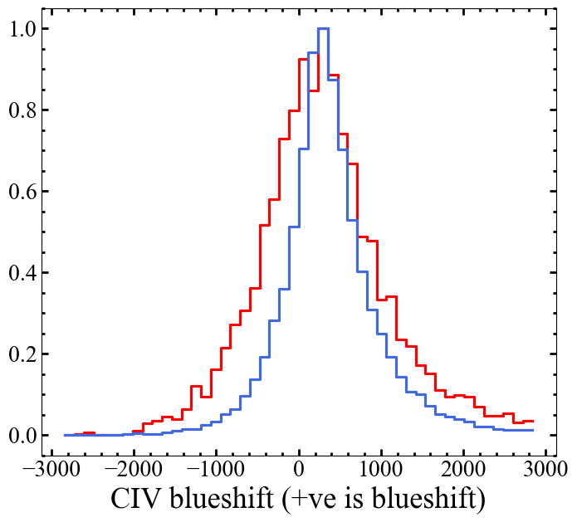
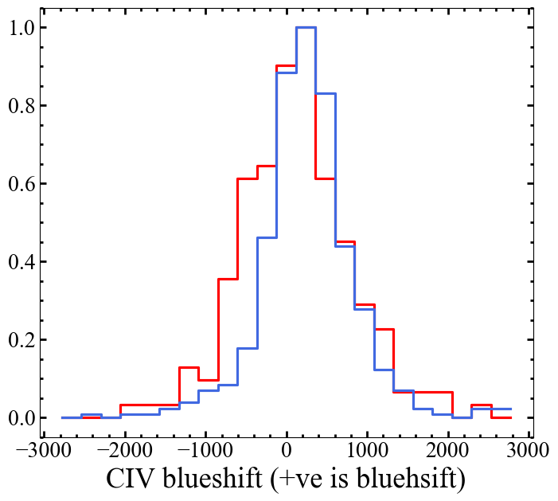
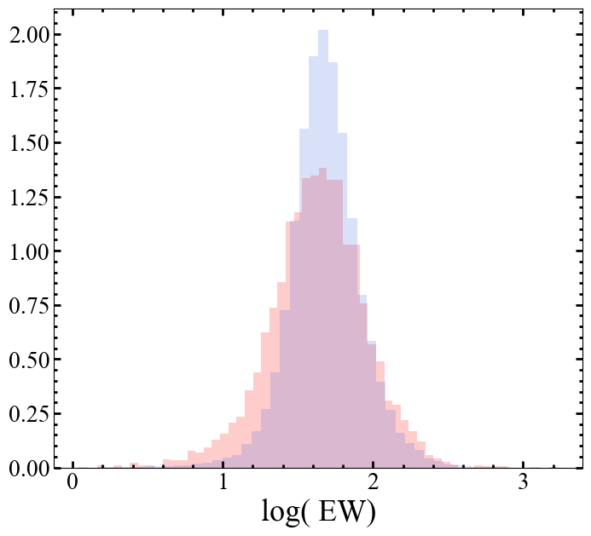
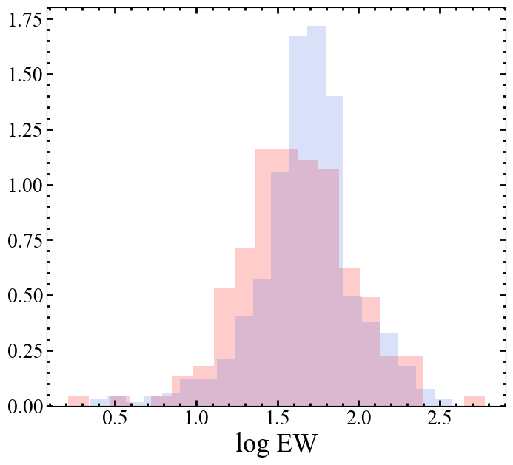
CIV blueshifts and EW (v. preliminary)
parent:
radio detected:

Slide 28
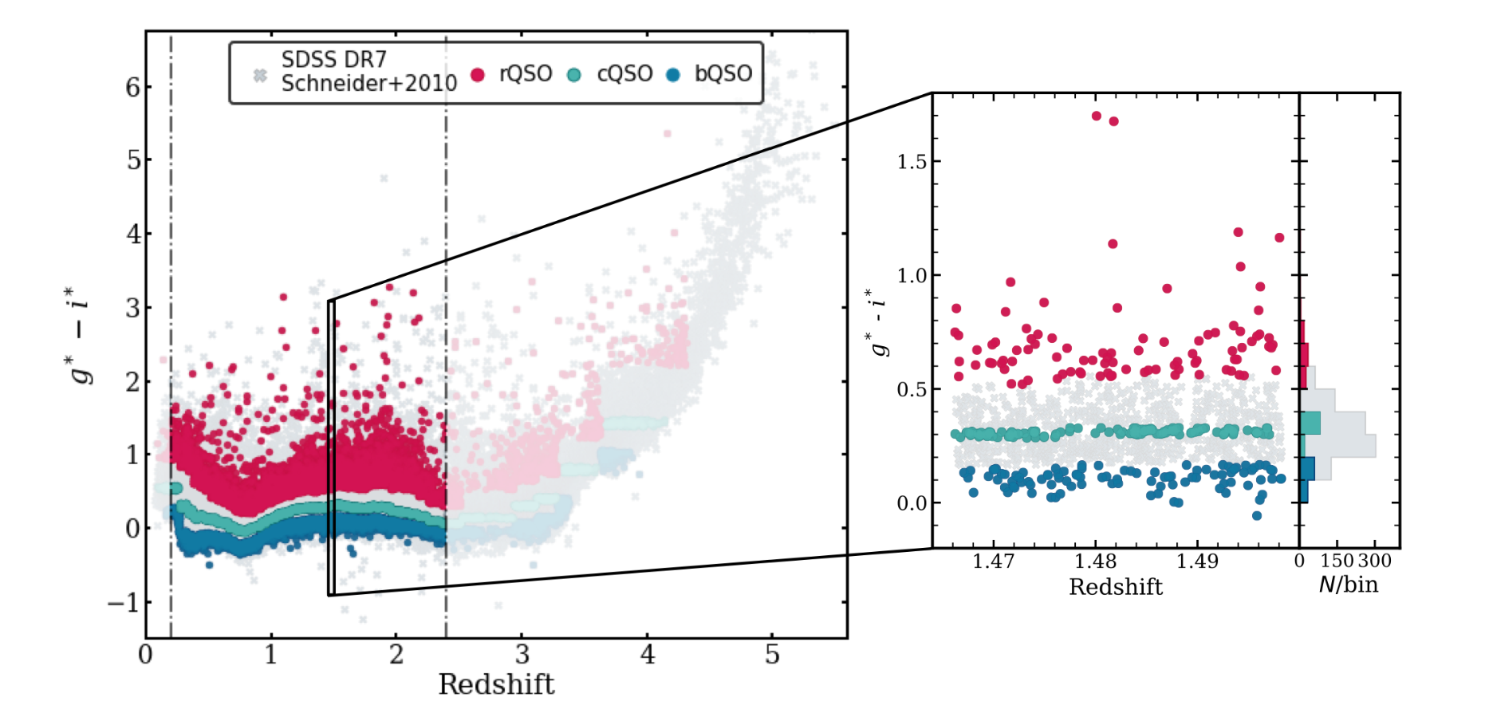
g*-i* selection
Klindt et. al (2019)

Slide 29
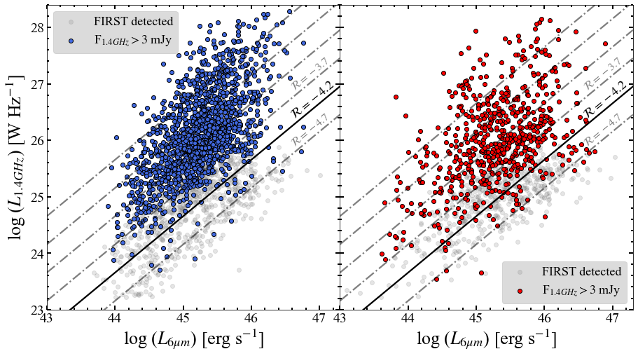
L6 vs lradio

Slide 30
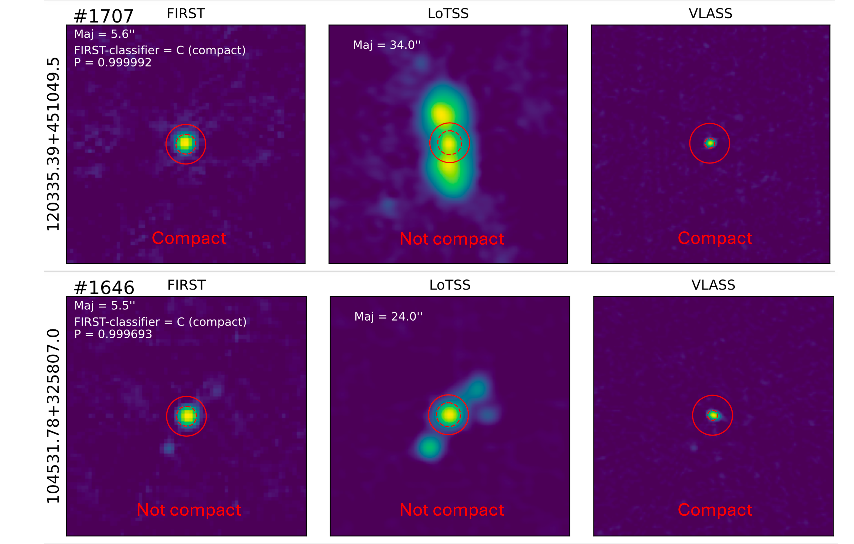
visual inspection

Slide 31
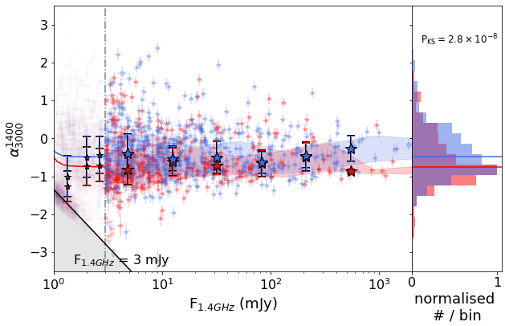
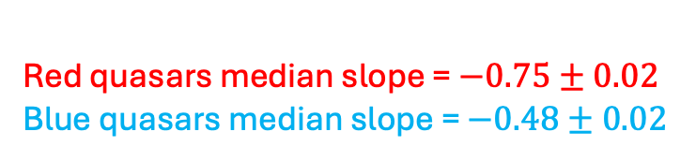
alpha vs flux
FIRST-VLASS:
Red quasars median slope = $−0.75±0.02$
Blue quasars median slope = $−0.48±0.02$

Slide 33
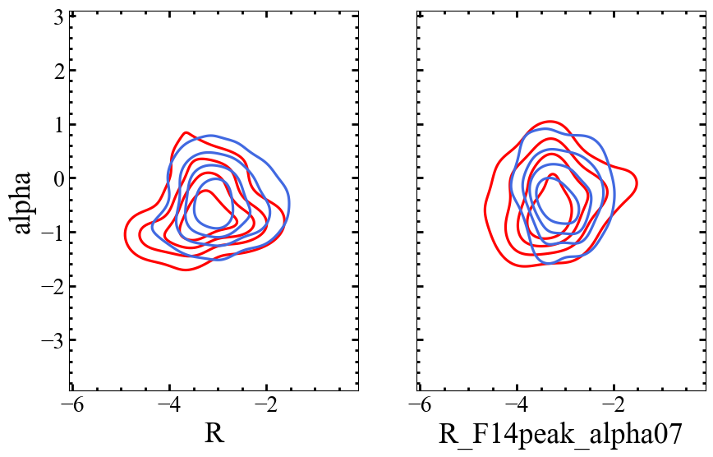
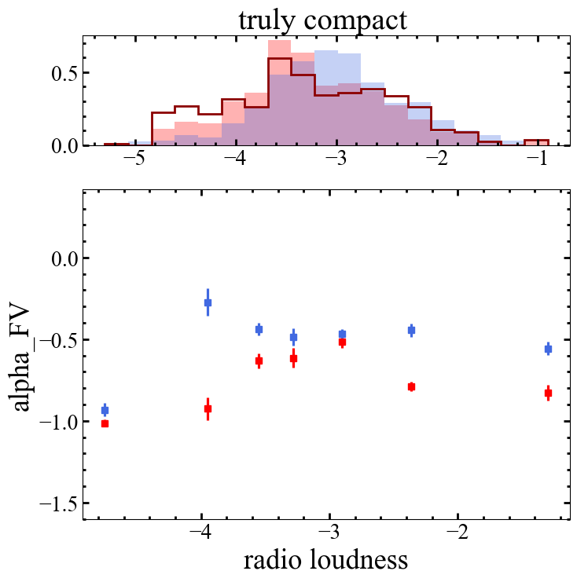
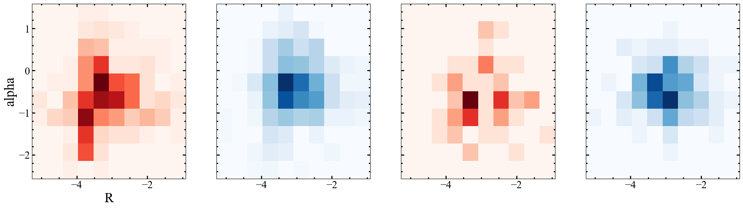
truly compact
fake compact
truly compact
truly compact
fake compact
fake compact

