Slide 1
AGN Wings: Unravelling the mystery of Cross-shaped X-ray emission
Tom Higginson, Belinda Wilkes, Andy Young, Mark Birkinshaw, Joanna Kuraszkiewicz, Vijay Mahatma & Jonathon Pierce

Slide 2

Jet Emission
Large scale (100s kpc) jets are usually observed in radio frequencies.
Radio emission is thought to be from Synchrotron of high energy electrons.
These electron energies can up-scatter photons both emitted by Synchrotron (SSC) and from the CMB (iC/CMB) [see Worrall, 09 for details].
At these electron energies, the up scattering can be seen at X-ray energies.
Email: thomas.higginson@bristol.ac.uk
NAM 2025

Slide 3

X-ray Observations of Radio Jets
Multiple Chandra observations have shown jets at X-ray energies e.g. PKS 0637-75 [Schwartz+2000]
Combining X-ray and Radio fluxes, can be used to find the magnetic field without relying on minimum energy assumptions
Results have shown B-field in jet related regions often knots and hot spots to be a factor of a few away from minimum energy.
To the right is an example of an iC/CMB dominated X-ray emission from a QSO jet with jet power: $6.8 × {10}^{47}$ erg s⁻¹
Example jet lobe for 3CR 14
Email: thomas.higginson@bristol.ac.uk
NAM 2025

Slide 4
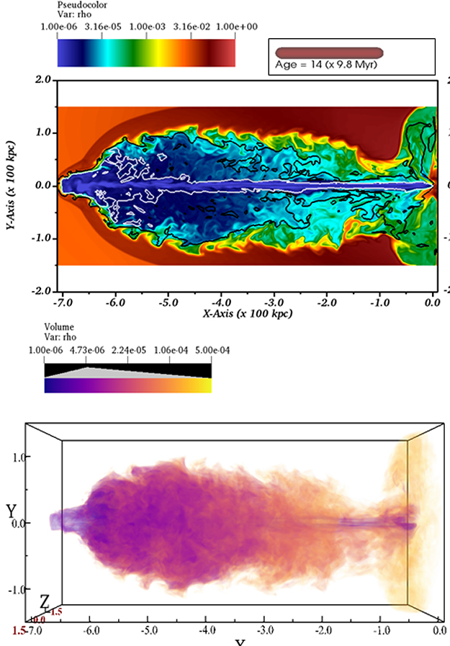
Evolution of AGN Wings
In radio observations hundreds of AGN have been observed to have emission along two separate axes, often appearing perpendicular [see Bera+20].
This emission, appearing Cross-shaped, has led to the categorisation of XRGs or sometimes ZRGs.
There are a few different mechanisms, which include:
  A merger or binary/dual AGN scenario [e.g. Merrit & Ekers, 02; Lal+19]
  A backflow model where plasma follows favourable pressure gradients to form wings [See Leahy & Williams, 1984; Gillone+16; Giri+25]
Giri+ 2025
Email: thomas.higginson@bristol.ac.uk
NAM 2025

Slide 5
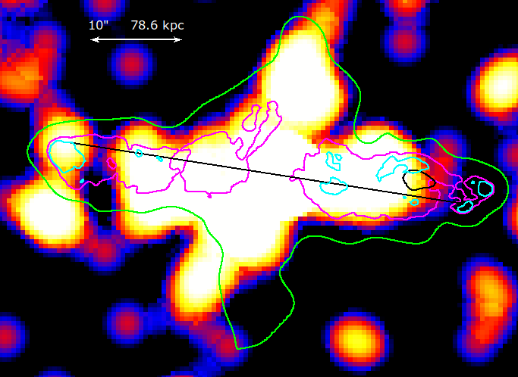
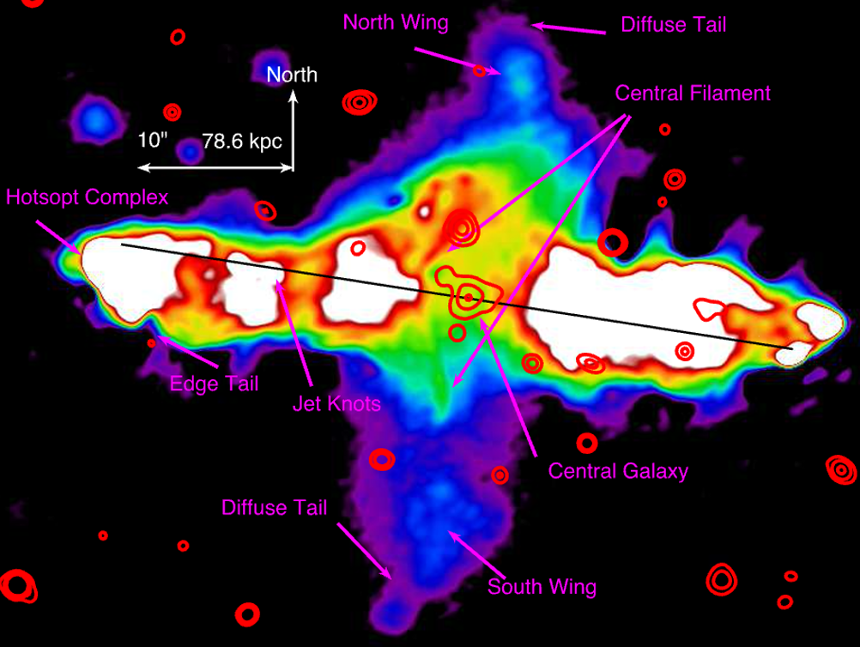

3C 34 (z=0.69)
LOFAR 144 mHz image with red HST optical contours
LOFAR resolution is 0.3”
Projected 380 kpc length
Large central filament $∼100 kpc$ feeding $\sim 125 kpc$ wings
Best model is plasma backflow [Mahatma+2023]
Mahatma+23 & Best+97
Email: thomas.higginson@bristol.ac.uk
NAM 2025

Slide 6
3C 34 (z=0.69)
Smoothed Chandra image with LOFAR Contours
Evidence of X-ray emission to match the LOFAR-observed Wings
X-ray emission along the jet axis
Email: thomas.higginson@bristol.ac.uk
NAM 2025

Slide 7
3C 34 (z=0.69)
Model gives a magnetic field discrepancy of a factor of 4
Consistent with general jet observations
Email: thomas.higginson@bristol.ac.uk
NAM 2025

Slide 8
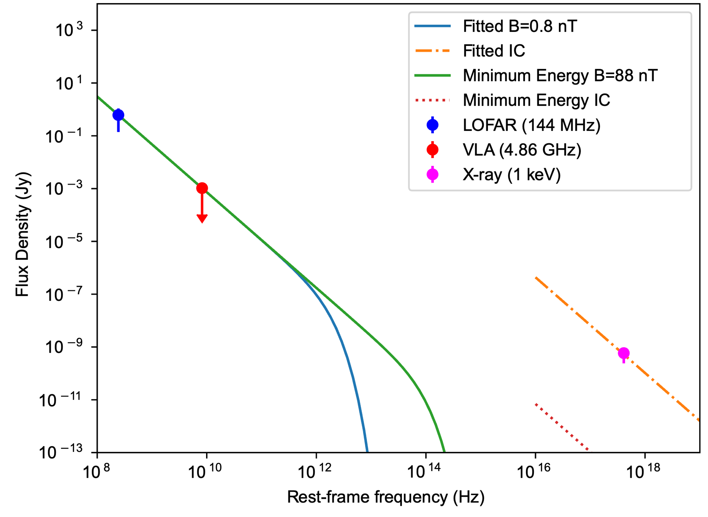
3C 34 (z=0.69)
Model gives a magnetic field discrepancy of a factor of about 100
Likely a thermal model is needed to explain a majority of the X-ray emission
Email: thomas.higginson@bristol.ac.uk
NAM 2025

Slide 9
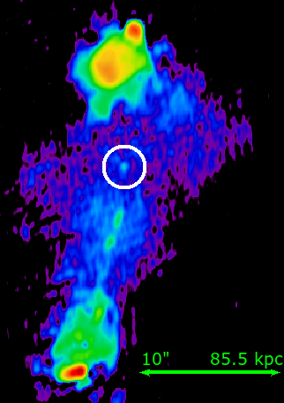
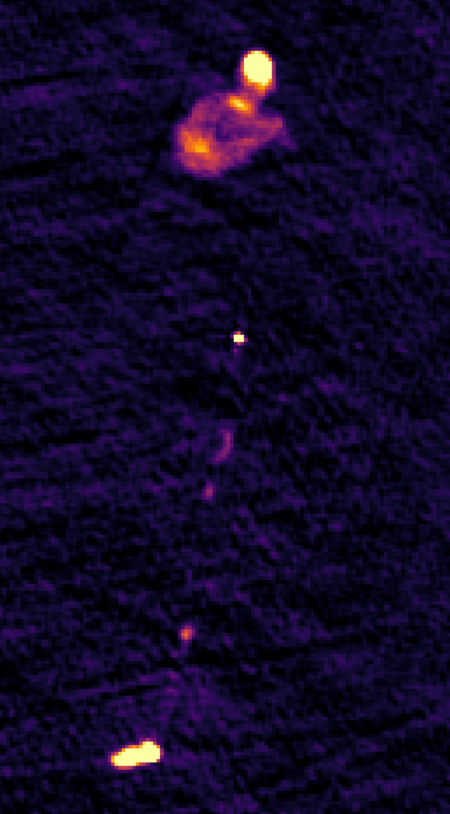
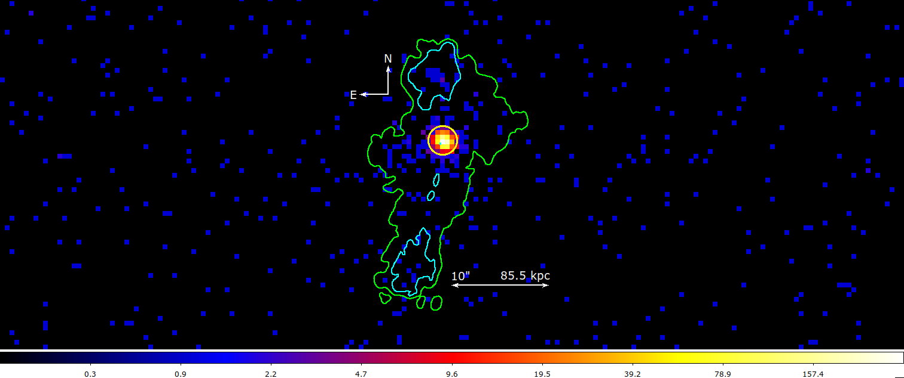

3C 14 (z=1.469)
Deprojected Jet length $∼$ 300 kpc.
Some jet knots seen along South jet and a leading-edge feature trailing the northern hot spot on the plane of the sky.
No clear evidence of emission perpendicular to the jet axis at 8.44 GHz.
VLA 8.44 GHz image of 3CR 14 from Bowden [Private Communication]
Email: thomas.higginson@bristol.ac.uk
NAM 2025

Slide 10

3C 14 (z=1.469)
Deprojected Jet length $∼$ 300 kpc.
Some jet knots seen along South jet and a leading-edge feature trailing the northern hot spot on the plane of the sky.
No clear evidence of emission perpendicular to the jet axis at 8.44 GHz.
Evidence of wings emerging perpendicular to the jet axis from LOFAR.
LOFAR 144 MHz image of QSO 3CR 14 with a 1.5” circle over the core to indicate the Chandra PSF size.
Email: thomas.higginson@bristol.ac.uk
NAM 2025

Slide 11

3C 14 (z=1.469)
Deprojected Jet length $∼$ 300 kpc.
Some jet knots seen along South jet and a leading-edge feature trailing the northern hot spot on the plane of the sky.
No clear evidence of emission perpendicular to the jet axis at 8.44 GHz.
Evidence of wings emerging perpendicular to the jet axis from LOFAR.
X-ray emission is seen faintly along the jet axis.
Stronger evidence of X-ray detection from the leading-edge feature from the north jet.
X-ray emission to the east of the core, significantly detected above the background and core PSF.
Chandra native pixel image of 3CR 14 with LOFAR contours in green and cyan. The Chandra 90% PSF is circled in yellow.
Email: thomas.higginson@bristol.ac.uk
NAM 2025

Slide 12
3C 14 (z=1.469)
Email: thomas.higginson@bristol.ac.uk
NAM 2025

Slide 13
3C 14 (z=1.469)
Email: thomas.higginson@bristol.ac.uk
NAM 2025

Slide 14
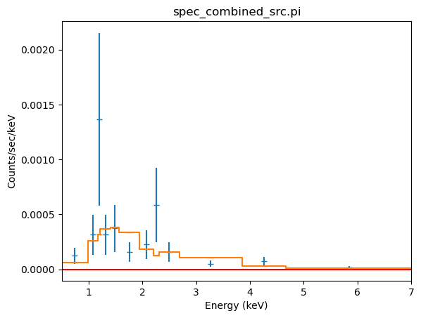
3C 14 (z=1.469)
Email: thomas.higginson@bristol.ac.uk
NAM 2025

Slide 15

Thermal Emission
Key Values:
Temperature: $5.7±2.7$ keV
Electron Density: $n_{e}=6.2±0.1$ cm⁻³
Thermal Pressure: $P_{T}=(1.1±0.5) ×{10}^{−9}$ erg cm⁻³.
Age: $\sim 50$ Myr
Email: thomas.higginson@bristol.ac.uk
NAM 2025

Slide 16
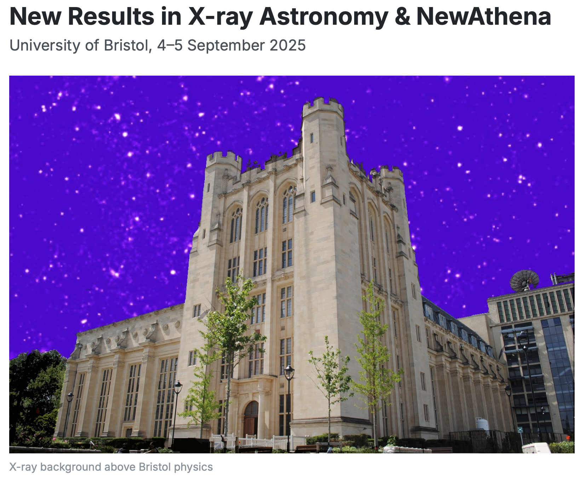

Summary
XRGs have different morphologies and origin histories
X-ray emission needs to be inspected carefully, even in regions outside of high-frequency radio emission
In the case of 3CR 14, Thermal emission dominates X-rays production in the LOFAR wing region
newresults2025@bristol.ac.uk
Email: thomas.higginson@bristol.ac.uk
NAM 2025

