Slide 1


Flipping the switch: what can we learn from the MIR emission of Changing-Look AGN?
Claire Greenwell, David Alexander, Wei-Jian Guo
Durham University
claire.l.greenwell@durham.ac.uk

Slide 2
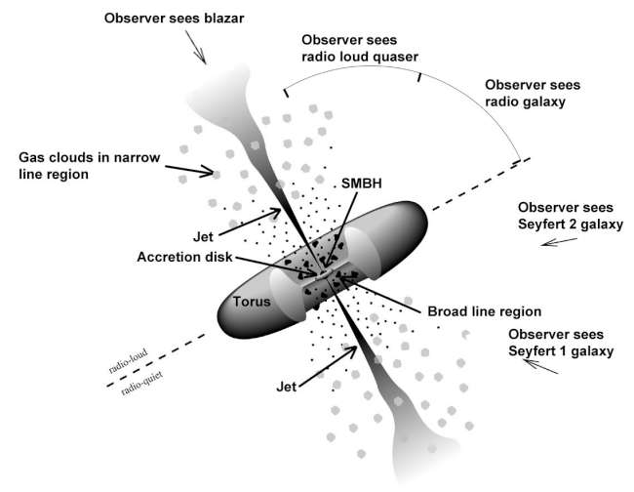
A “Normal” Active Galactic Nucleus
https://fermi.gsfc.nasa.gov/science/eteu/agn/
Claire Greenwell | NAM2025 | claire.l.greenwell@durham.ac.uk
1/19

Slide 3
A “Normal” Active Galactic Nucleus
https://fermi.gsfc.nasa.gov/science/eteu/agn/
Claire Greenwell | NAM2025 | claire.l.greenwell@durham.ac.uk
1/19

Slide 4
A “Normal” Active Galactic Nucleus
https://fermi.gsfc.nasa.gov/science/eteu/agn/
Claire Greenwell | NAM2025 | claire.l.greenwell@durham.ac.uk
1/19

Slide 5
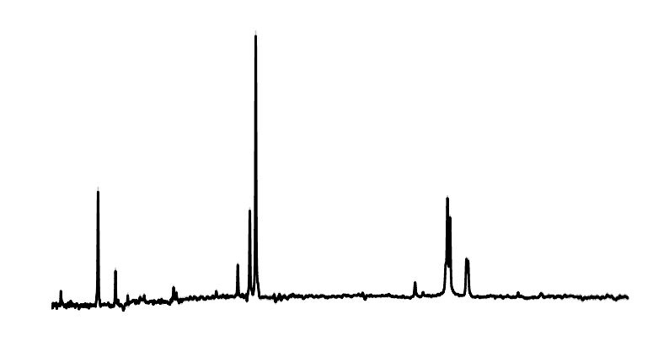
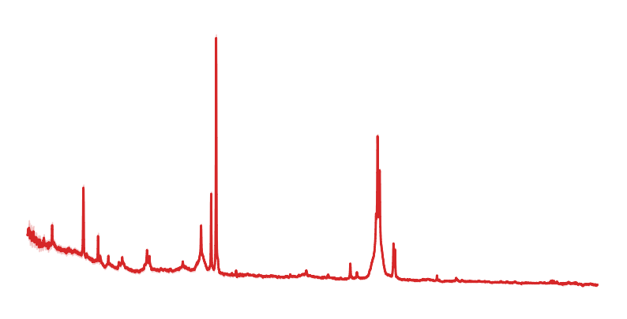
A “Normal” Active Galactic Nucleus
Narrow Balmer lines
Dim blue continuum
Broad Balmer lines
Bright blue continuum
https://fermi.gsfc.nasa.gov/science/eteu/agn/
Claire Greenwell | NAM2025 | claire.l.greenwell@durham.ac.uk
1/19

Slide 6
What we observe in Changing-Look AGN:
With repeated optical spectra taken years to decades apart:
Changes in broad emission lines from Type 1 to Type 2 or intermediate types (or the reverse)
  Doesn’t fit with an orientation only model!
Changes in continuum
From photometric data:
Unusual variability over time
Claire Greenwell | NAM2025 | claire.l.greenwell@durham.ac.uk
2/19
Notes:
What is a CLAGN?

Slide 7
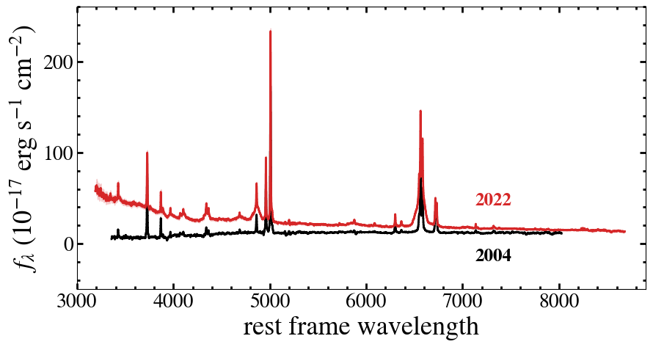
Claire Greenwell | NAM2025 | claire.l.greenwell@durham.ac.uk
3/19

Slide 8
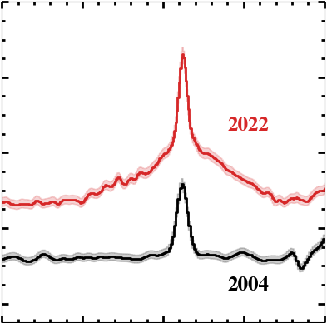
Claire Greenwell | NAM2025 | claire.l.greenwell@durham.ac.uk
3/19

Slide 9
What this could be:
Changes in accretion
or
Changes in obscuration
Claire Greenwell | NAM2025 | claire.l.greenwell@durham.ac.uk
4/19
Notes:
Selection in this project

Slide 10
In this talk: what do these look like in the mid infrared?
Reprocessed emission
Should be ~isotropic
Therefore should be orientation-neutral
https://fermi.gsfc.nasa.gov/science/eteu/agn/
Claire Greenwell | NAM2025 | claire.l.greenwell@durham.ac.uk
5/19

Slide 11
What this could be:
Change in MIR emission that lags optical
Changes in accretion
or
Changes in obscuration
Claire Greenwell | NAM2025 | claire.l.greenwell@durham.ac.uk
6/19
Notes:
Selection in this project

Slide 12
What this could be:
Changes in accretion
or
Changes in obscuration
No apparent change in MIR
Claire Greenwell | NAM2025 | claire.l.greenwell@durham.ac.uk
6/19
Notes:
Selection in this project

Slide 13
Sample used in this work
Based on comparison between SDSS and DESI spectra
See Guo et al. (2024) and Guo et al. (2025)
Selected on changes in broad optical emission lines only
Hα, Hβ, MgII
561 CLAGN (278 “turn-off”, 283 “turn-on”)
Claire Greenwell | NAM2025 | claire.l.greenwell@durham.ac.uk
7/19

Slide 14
The main advantages of this sample are:
(a) larger sample from single selection method than any other work
(b) parent sample of SAGN selected in the same way
=> we can do statistical comparisons
Claire Greenwell | NAM2025 | claire.l.greenwell@durham.ac.uk
8/19

Slide 15
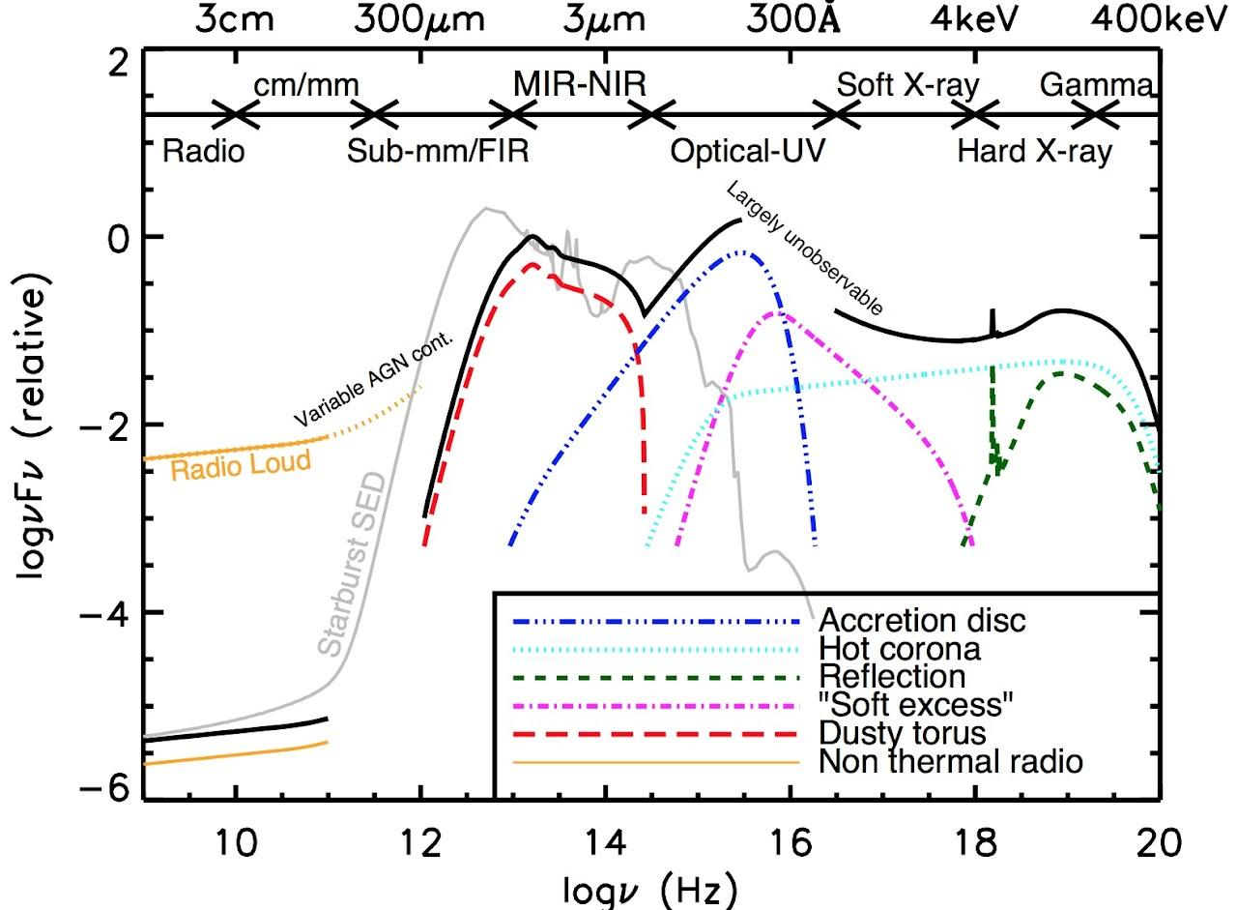
MIR in CLAGN
WISE W1 and W2 - 3.4 and 4.6 microns
Traces hot dust from torus (depending on redshift!)
Other papers have seen variation in CLAGN, even selecting by it in a couple of cases (e.g. Sheng+20, Wang+23)
MIR changes/flares are also seen in other objects e.g. TDEs, blazars
Restrict to z<1 (~⅔ of CLAGN sample)
MIR (3-5 μm)
Claire Greenwell | NAM2025 | claire.l.greenwell@durham.ac.uk
9/19

Slide 16
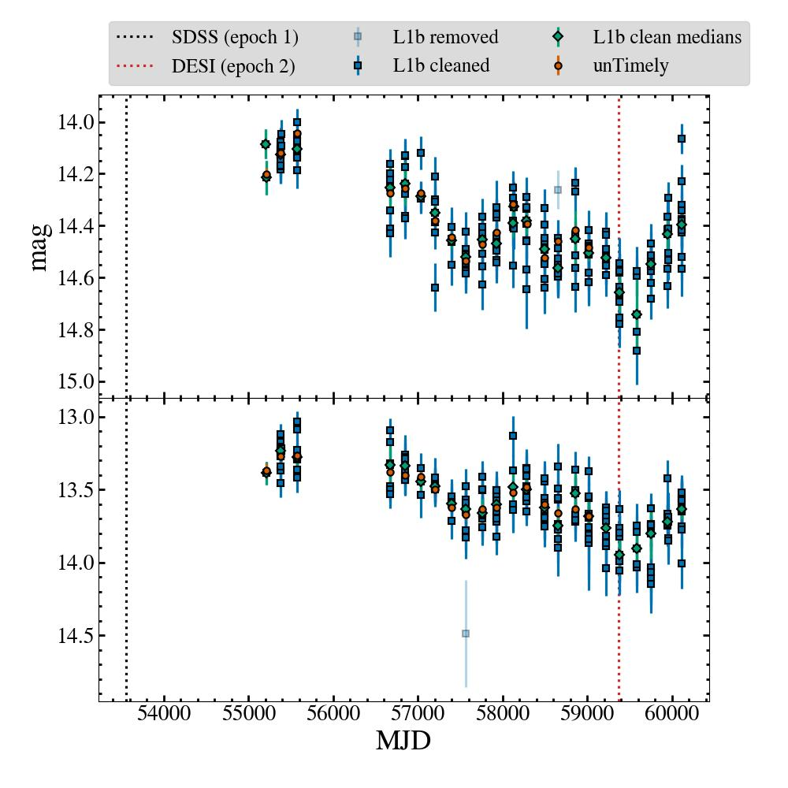
MIR light curves
Broad lines
No broad lines
We use WISE single exposure products (blue squares): several over a few days, then 6 months gap
Cleaned medians (green diamonds): median of each epoch (after some cleaning)
“unTimely” (orange diamonds): catalog from stacking and reprocessing of images
  Deeper data
  Only up to ~2020
  Mostly similar but can be wildly different for bright/extended sources
  See Meisner+22
Original WISE
NEOWISE Re-activation
~2005
~2024
Hibernation
Claire Greenwell | NAM2025 | claire.l.greenwell@durham.ac.uk
10/19

Slide 17
Quantifying Variability
We can do this in many ways
Each of which will probe a slightly different type of variability
E.g.:
  Biggest change within a period of time
  Type of variability (flares, continued increase/decrease)
Cadence is longer than normal short term AGN variability
We also want to be able to do this for the whole population algorithmically, with minimal visual inspection or classification
  Partly this is preparation for larger catalogues as DESI continues!
Claire Greenwell | NAM2025 | claire.l.greenwell@durham.ac.uk
11/19

Slide 18
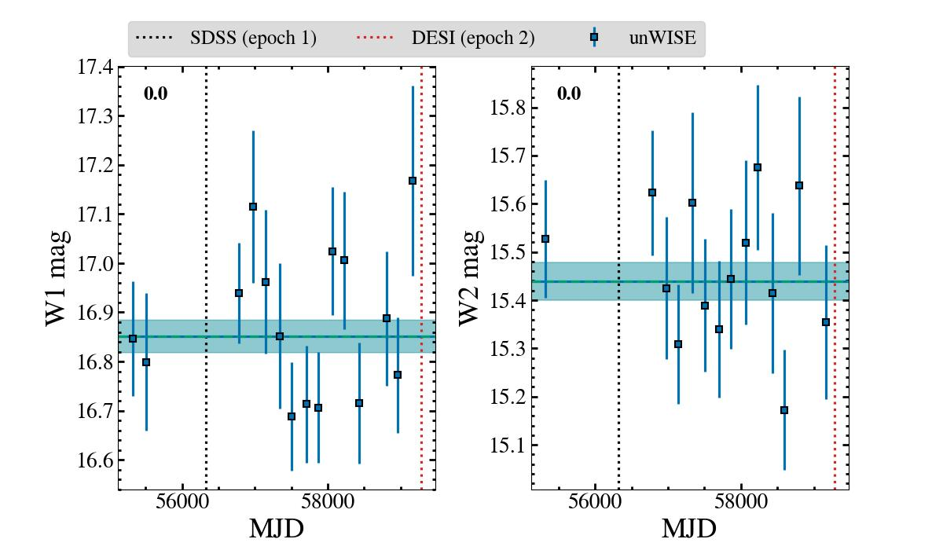
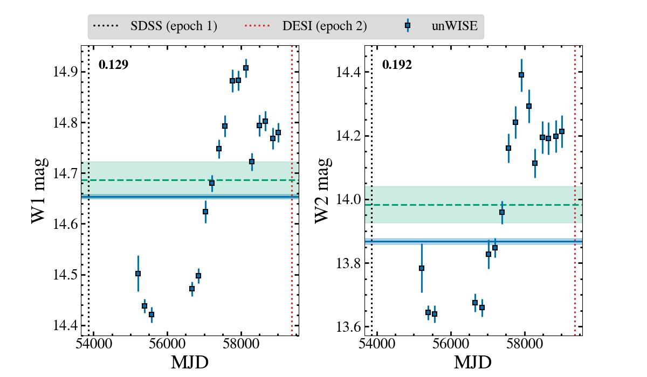
Intrinsic Variability
How inconsistent is the light curve with a constant flux?
-> fit with constant, then add intrinsic variability until it’s a good fit
Nothing added = constant MIR emission
Extra intrinsic variation needed
= variable source
Claire Greenwell | NAM2025 | claire.l.greenwell@durham.ac.uk
12/19

Slide 19
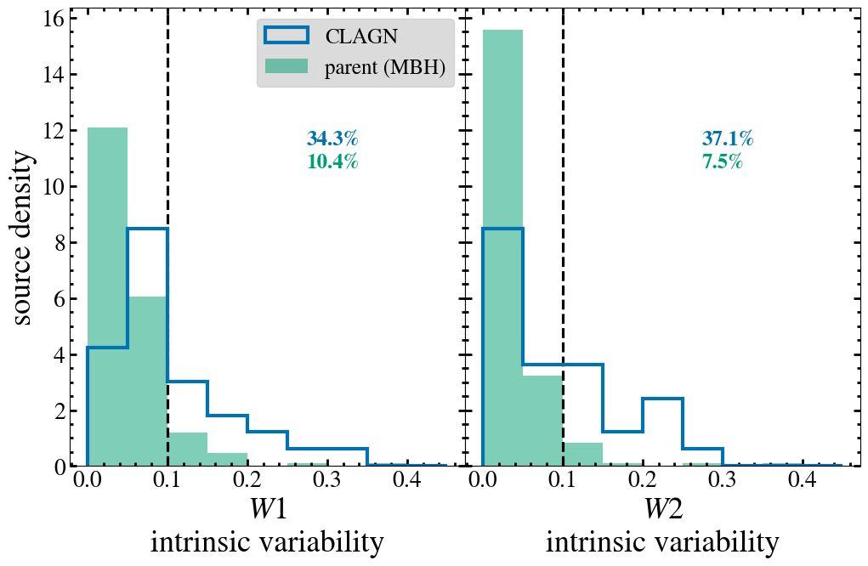
Intrinsic Variability
Claire Greenwell | NAM2025 | claire.l.greenwell@durham.ac.uk
13/19

Slide 20
Variability by Type
What different types of variability are we seeing?
-> fit with four models, progressively more complicated:
Constant, linear, single Gaussian
-> pick the simplest model that is consistent with a good fit
-> also if a more complicated model doesn’t provide significant improvement, revert to the simpler model
-> now we do know something about the type of variation and we can include uncertainties
Claire Greenwell | NAM2025 | claire.l.greenwell@durham.ac.uk
14/19

Slide 21
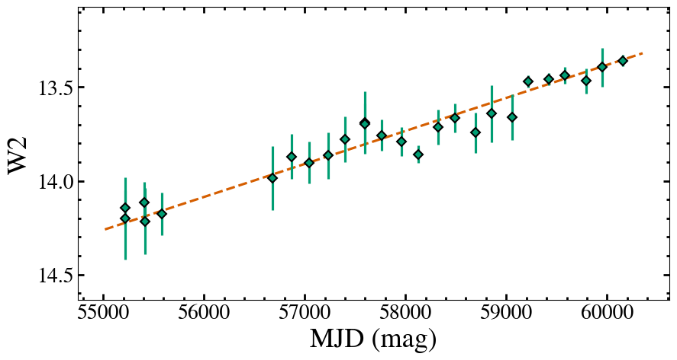
Variability by Type
Claire Greenwell | NAM2025 | claire.l.greenwell@durham.ac.uk
15/19

Slide 22
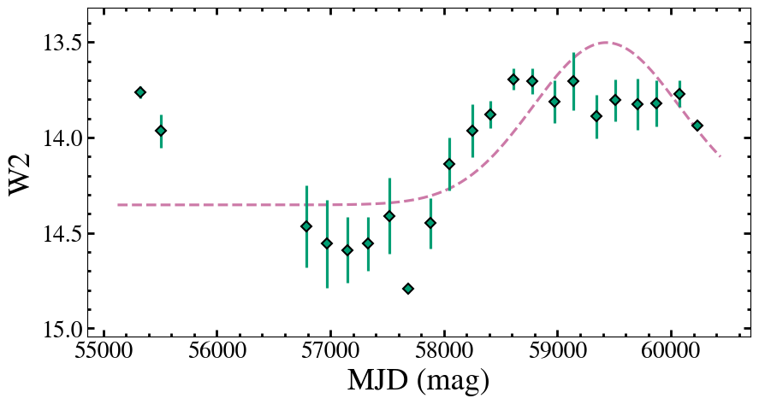
Variability by Type
Claire Greenwell | NAM2025 | claire.l.greenwell@durham.ac.uk
16/19

Slide 23
Variability by Type
Biggest differences:
More non-CLAGN showing no change than CLAGN
  W2: 26% vs 6%
More CLAGN showing decrease than non-CLAGN
  W2: 32% vs 14%
  Slightly more “turn-off” than “turn-on” CLAGN, but not enough to make this difference
  Possibly to do with the epoch we’re viewing MIR vs. optical spectra?
  Or maybe a statistical quirk because of the gap in data?
Claire Greenwell | NAM2025 | claire.l.greenwell@durham.ac.uk
17/19

Slide 24
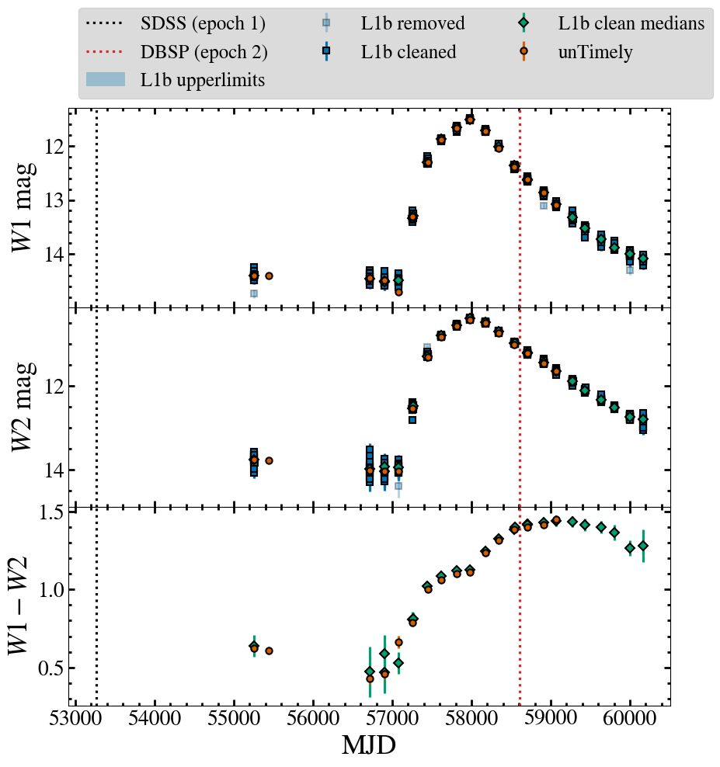
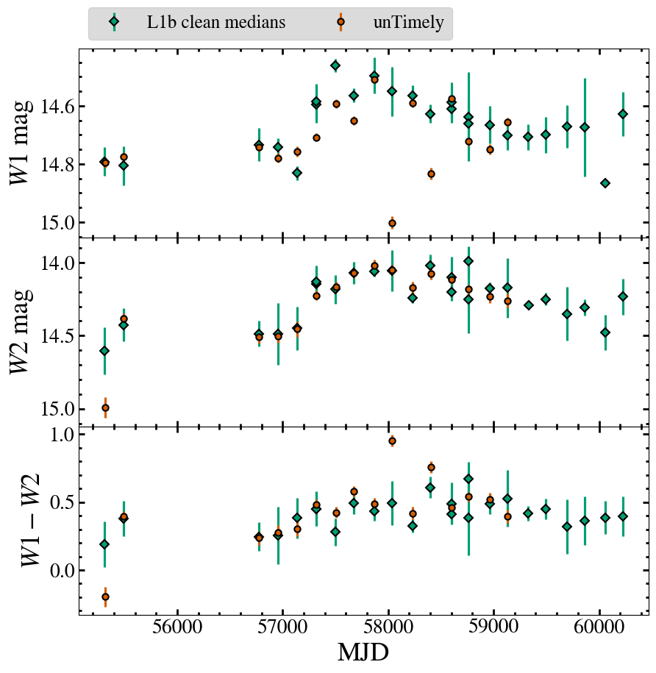
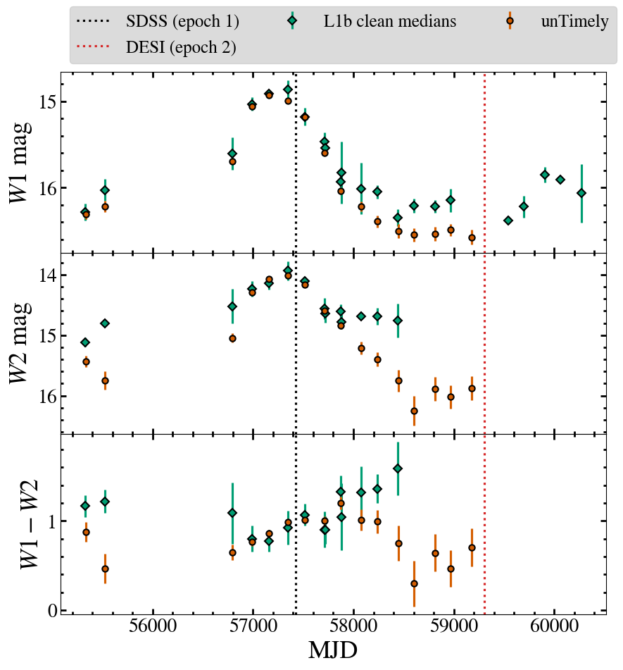
Other events
Yang+19 MIR flare: TDE(?) CLAGN (?)
Jiang+21 MIR flare: TDE(?) SN(???)
Guo+24/Greenwell(in prep.) CLAGN(??)
No difference in opt. spec.
No opt. spec. at all
Broad MgII disappears
18/19

Slide 25
Summary
Largest CLAGN sample to date allows for statistical population analysis of properties
MIR emission shows variability beyond non-CLAGN
  (however it’s measured)
Different measurements of variability do not always select the same sources
Assigning a type to the variability could help distinguish between different types of transient/transitional event in AGN
Claire Greenwell | NAM2025 | claire.l.greenwell@durham.ac.uk
19/19

Slide 26
Extra slides

Slide 27
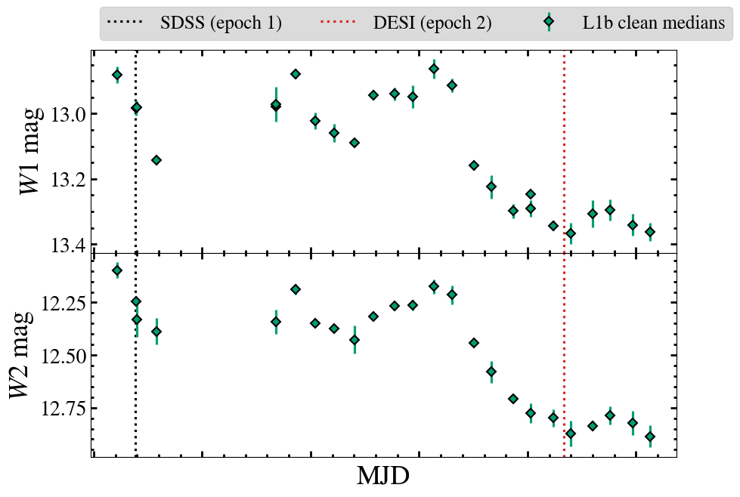
Variability Range
What is the range of magnitudes?
-> simply Δmag = faintest - brightest
-> higher value = more change in magnitude
-> inconsistent results for bright vs dim sources
Claire Greenwell | NAM2025 | claire.l.greenwell@durham.ac.uk

Slide 28
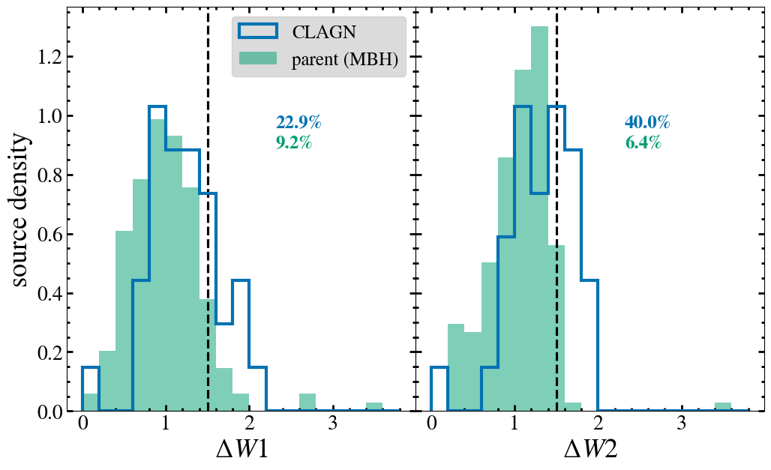
Variability Range
Claire Greenwell | NAM2025 | claire.l.greenwell@durham.ac.uk

Slide 29
Quantifying Variability
 | Variability Range | Intrinsic Variability | Variability by Type
Method | Δmag = faintest - brightest | it with constant, then add intrinsic variability until the reduced χ² is consistent with 1 | fit with four models, progressively more complicated: pick the simplest good fit
Type information? | None | None | Yes!
Uncertainties included? | No | Yes | Yes
W2 result | 40% CLAGN variable, 6% SAGN | 37% CLAGN variable, 8% SAGN | 94% CLAGN variable, 74% SAGN
Claire Greenwell | NAM2025 | claire.l.greenwell@durham.ac.uk

