Slide 1
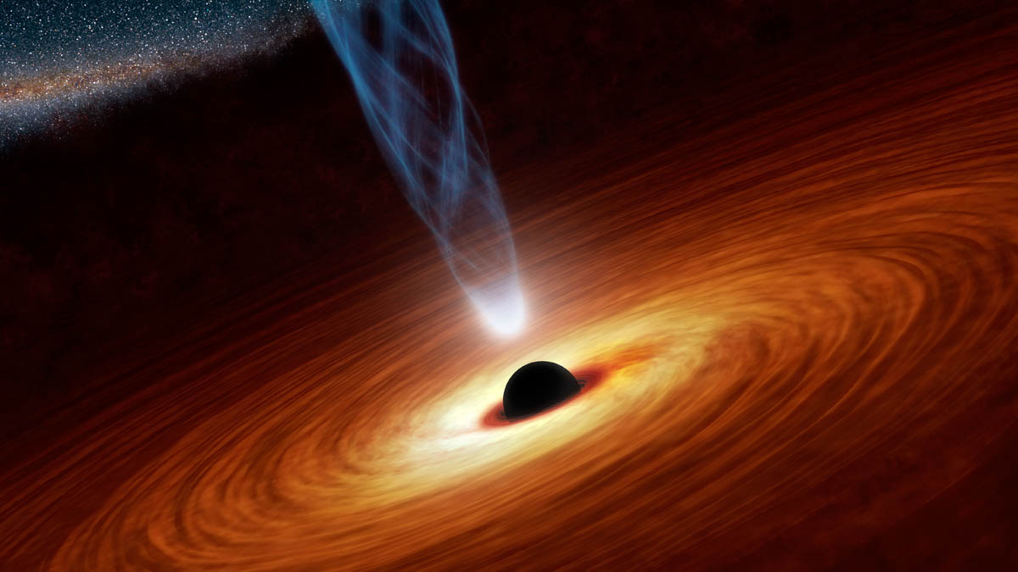


Black Holes and Accretion:
Observational Frontiers
The Broadband View of the Bare Seyfert PG1426+015: Relativistic Reflection, the Soft Excess
and the Importance of Oxygen
Dom Walton
NASA Postdoctoral Fellow
JPL/Caltech
Dom Walton
Centre for Astrophysics Research
University of Hertfordshire
++ A. Madathil-Pottayil, P. Kosec, J. Jiang, J. Garcia,
A. C. Fabian, C. Pinto, D. J. K. Buisson, M. L. Parker,
W. N. Alston, C. S. Reynolds

Slide 2
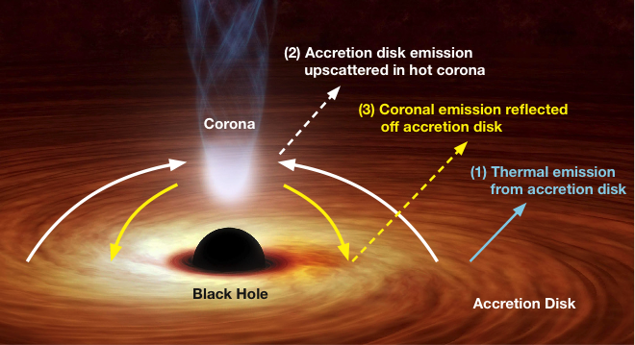
Relativistic Disc Reflection
Broad Fe K emission
High-energy continuum
Relativistic disc reflection carries information regarding both the spin of the black hole and the geometry of the ‘corona’
2

Slide 3
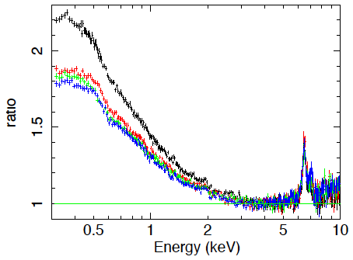
The Soft Excess
A ~smooth excess of emission seen in unobscured AGN below ~2 keV when the ~2-10 keV powerlaw continuum is extrapolated down in energy
Porquet+18
Ark 120
XMM
3

Slide 4
Relativistic Disc Reflection
Broad Fe K emission
High-energy continuum
Soft excess?
Relativistic disc reflection carries information regarding both the spin of the black hole and the geometry of the ‘corona’
4

Slide 5
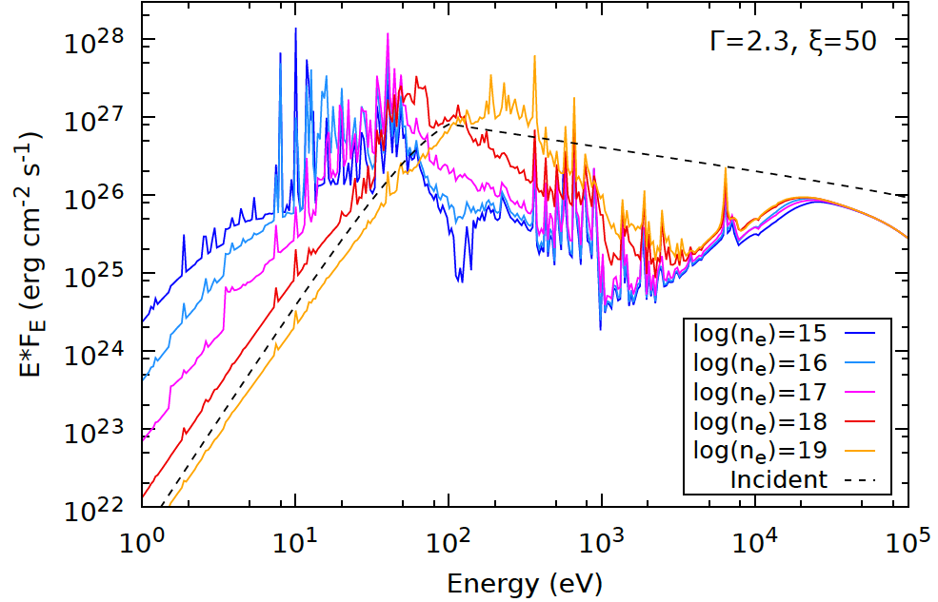


Variable Density Models
Wealth of low-energy emission lines, all of which will be subject to relativistic blurring
Models with densities $n_{e}>{10}^{16} {cm}^{−3}$ also increasingly shift the low-energy free-free emission in the reflection spectrum up into the observed bandpass
(> 0.3 keV)
Such densities are predicted by coupled disc-corona models for a wide range of $m_{BH}$, $\dot{m}$ parameter space (Svensson+94)
Garcia+16
$$n_{e}∝m_{BH}^{−1}{\dot{m}}^{−2}$$
[for radiation pressure]
5

Slide 6
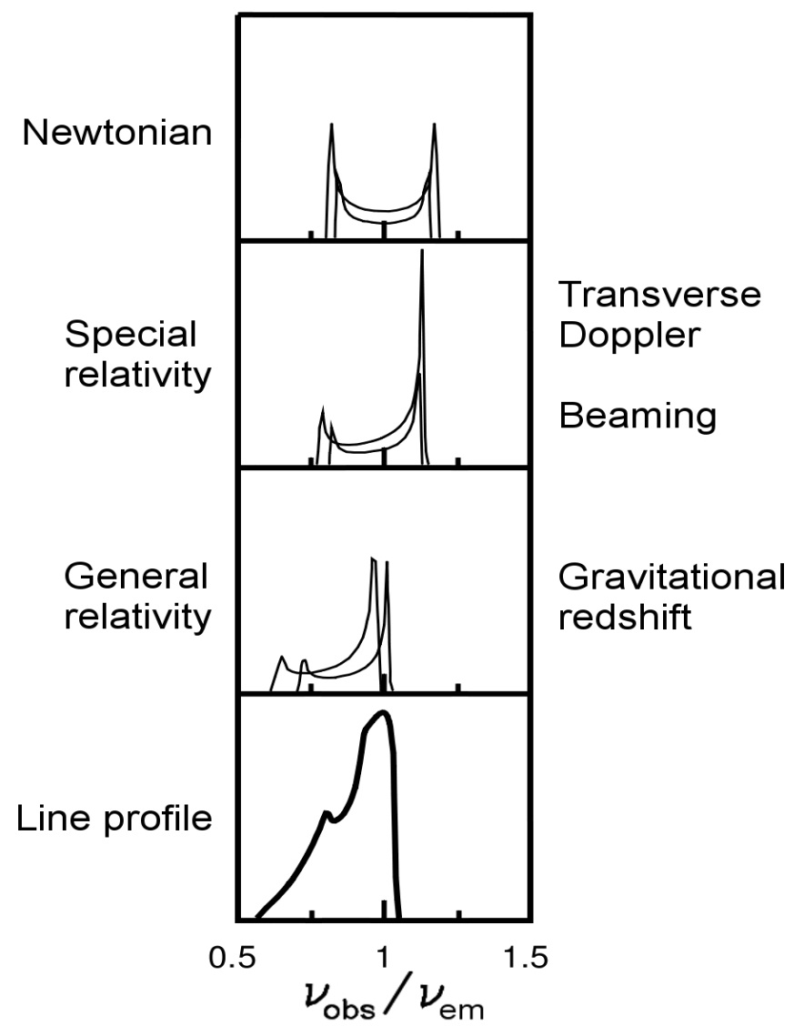
Variable Density Models
Wealth of low-energy emission lines, all of which will be subject to relativistic blurring
Models with densities $n_{e}>{10}^{16} {cm}^{−3}$ also increasingly shift the low-energy free-free emission in the reflection spectrum up into the observed bandpass
(> 0.3 keV)
Such densities are predicted by coupled disc-corona models for a wide range of $m_{BH}$, $\dot{m}$ parameter space (Svensson+94)
Garcia+16
$$n_{e}∝m_{BH}^{−1}{\dot{m}}^{−2}$$
[for radiation pressure]
Fabian+00
5

Slide 7
Variable Density Models
Wealth of low-energy emission lines, all of which will be subject to relativistic blurring
Models with densities $n_{e}>{10}^{16} {cm}^{−3}$ also increasingly shift the low-energy free-free emission in the reflection spectrum up into the observed bandpass
(> 0.3 keV)
Such densities are predicted by coupled disc-corona models for a wide range of $m_{BH}$, $\dot{m}$ parameter space (Svensson+94)
Adapted from
Jiang+19
$$n_{e}∝m_{BH}^{−1}{\dot{m}}^{−2}$$
[for radiation pressure]
5

Slide 8
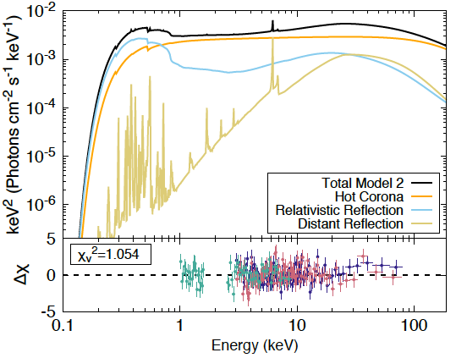
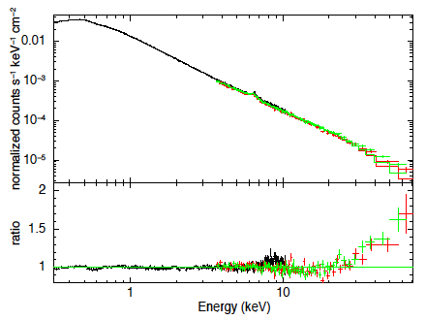

The Broadband View
Mrk509
Garcia+16a
Ark 120
Porquet+18
Broadband observations of ‘bare’ AGN (little/no absorption beyond Galactic $N_{H}$) offer the best opportunity to test the relativistic reflection scenario
Conflicting reports in the literature over whether relativistic reflection can successfully fit the broadband data in these cases, even in the era of high-density reflection models being available
6

Slide 9

PG1426+015
Walton+25
(subm.)
Coordinated XMM+NuSTAR observation of the bare Seyfert PG1426+015
Reverb. mapped mas of $\log\left[M_{BH}/M_{⊙}\right]={9.01}_{−0.16}^{+0.11}$ (Kaspi+00; Peterson+04), so is of particular interest for efforts to populate the SMBH spin-mass plane (Piotrowska+24)
Regardless of the origin of the soft excess, data show clear evidence for reflection from the inner accretion disc via a relativistically broadened iron line + Compton hump
7

Slide 10
PG1426+015
Walton+25
(subm.)
Coordinated XMM+NuSTAR observation of the bare Seyfert PG1426+015
Reverb. mapped mas of $\log\left[M_{BH}/M_{⊙}\right]={9.01}_{−0.16}^{+0.11}$ (Kaspi+00; Peterson+04), so is of particular interest for efforts to populate the SMBH spin-mass plane (Piotrowska+24)
Regardless of the origin of the soft excess, data show clear evidence for reflection from the inner accretion disc via a relativistically broadened iron line + Compton hump
7

Slide 11
PG1426+015 – Reflection Fits
Basic XILLVER-based reflection models fail to reproduce the broadband spectral shape; results in pivoting of the primary continuum to account for soft X-rays at the expense of fitting the highest energies, leaving apparent hard excesses.
In contrast, comparable REFLIONX-based reflection models are able to fit the broadband data successfully.
8

Slide 12
The Importance of Oxygen
A key difference between the two models is the strength of the OVIII emission at low energies
This is much stronger in XILLVER at high densities, and is strong enough to prevent the fits from moving too far into the
high-density regime (and thus from bringing in sufficient amounts of free-free emission to fit the soft excess here)
Cause of this discrepancy likely down to XILLVER not considering additional line opacity when the line itself becomes optically thick
Likely therefore that XILLVER currently overpredicts (some) soft emission lines
Raw
Common
smoothing
9

Slide 13
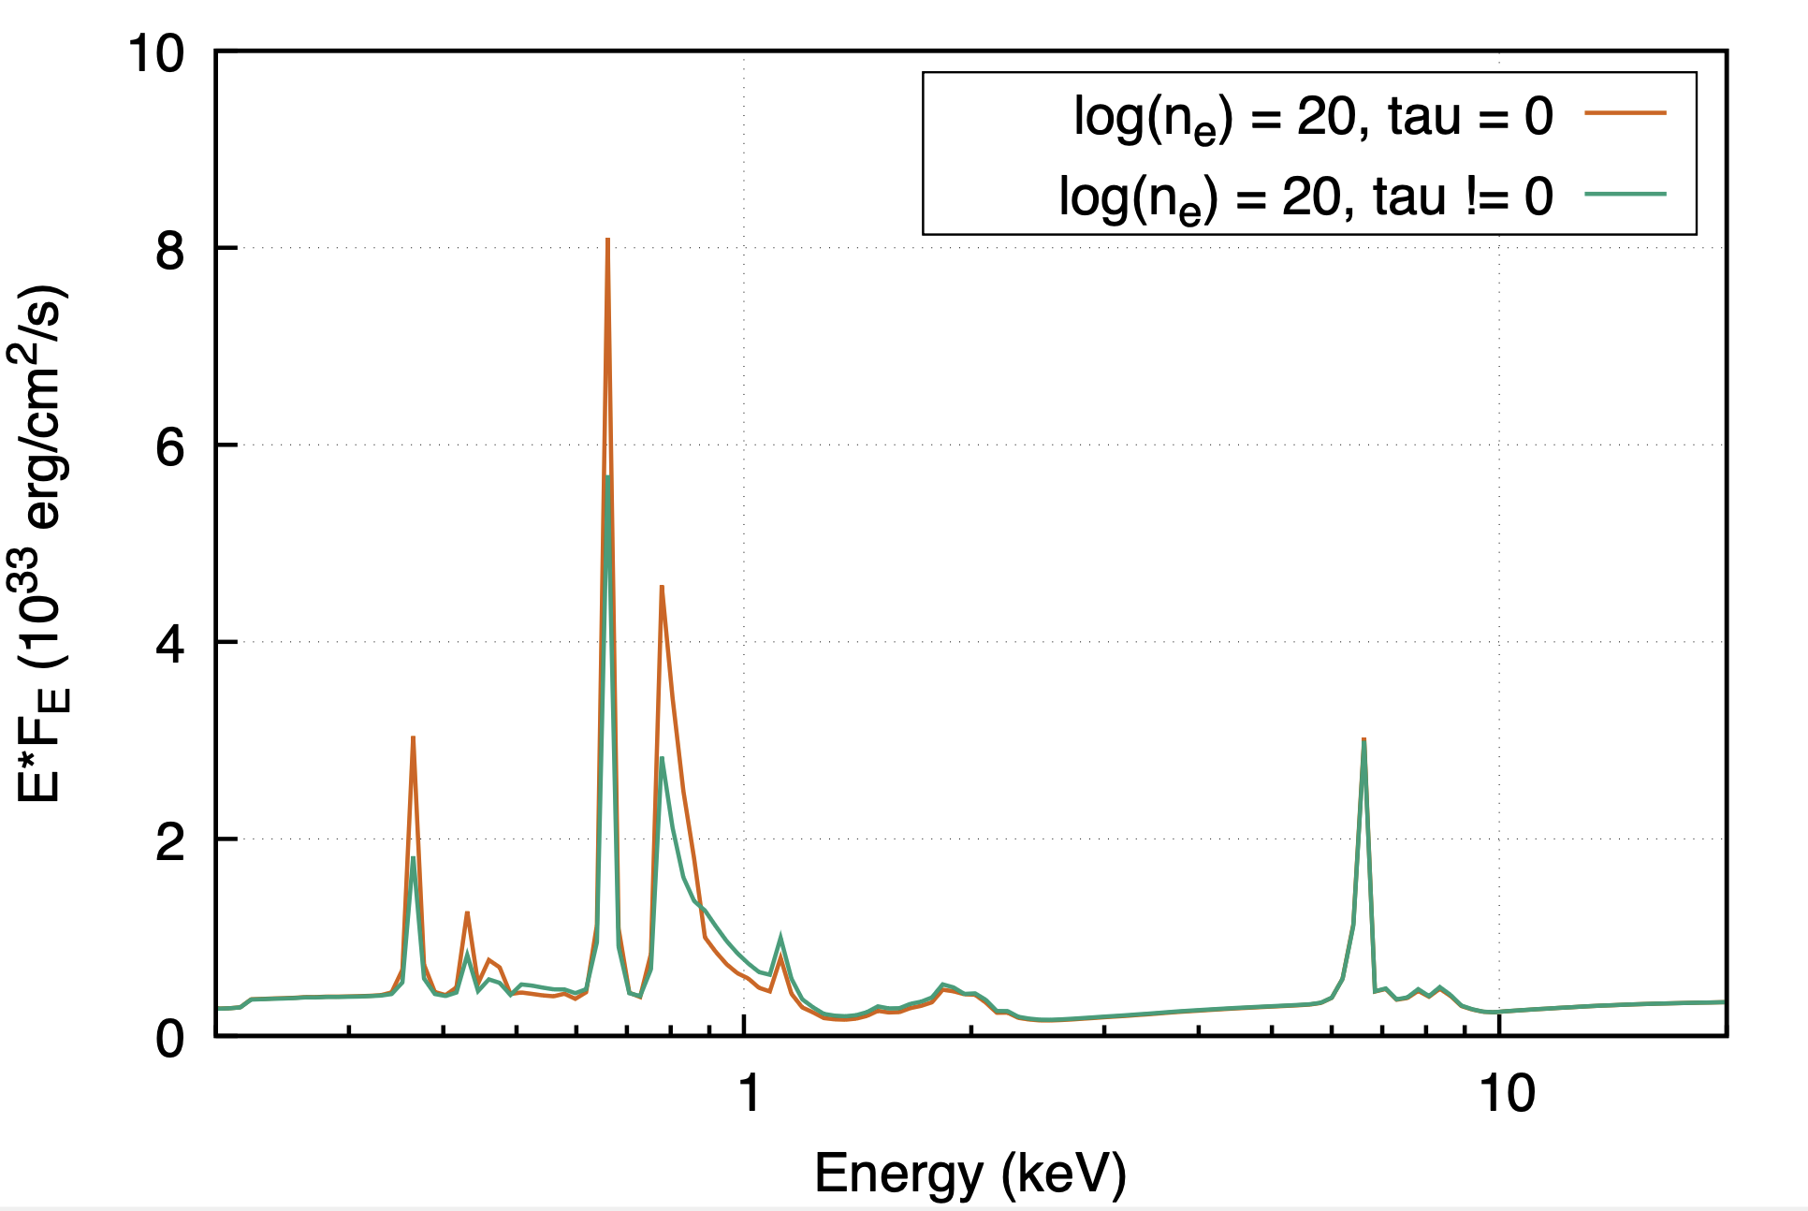
The Importance of Oxygen
A key difference between the two models is the strength of the OVIII emission at low energies
This is much stronger in XILLVER at high densities, and is strong enough to prevent the fits from moving too far into the
high-density regime (and thus from bringing in sufficient amounts of free-free emission to fit the soft excess here)
Cause of this discrepancy likely down to XILLVER not considering additional line opacity when the line itself becomes optically thick
Likely therefore that XILLVER currently overpredicts (some) soft emission lines
9

Slide 14

The Importance of Oxygen
Reducing the OVIII emission allows the XILLVER-based model to successfully fit the data
Also brings the fits into good agreement with the REFLIONX-based models in terms of the disc density; both imply
$$\log\left[n_{e}/{cm}^{−3}\right]\sim 18$$
Such a density is not unreasonable given the combination of $m$ and $\dot{m}$ relevant for PG1426+015 ($\dot{m} \sim 0.04$ here, giving $\log\left[m_{BH}{\dot{m}}^{2}\right]\sim 6.2$)
Broadband models provide preliminary spin constraints:
$a^{∗} \sim 0.77$ (REFLIONX)
$a^{∗} \sim 0.95$ (XILLVER)
XILLVER-based fit
Bkn po emissivity
OVIII reduced
10

Slide 15

In Summary…
Key Takeaway:
Relativistic reflection from the inner accretion disc is able to successfully account for the soft excess in the bare Seyfert PG1426+015, a key testbed for such models
In More Detail:
In the case of XILLVER-based reflection models, successful fits require a reduction of the OVIII emission at low energies. No such correction is required for successful fits with REFLIONX-based models.
There are good reasons to believe such reductions may be reasonable/ necessary for XILLVER (line opacity neglected)
When such reductions are allowed, XILLVER- and REFLIONX-based models show good agreement in e.g. the density inferred
for the disc ($\log\left[n_{e}/{cm}^{−3}\right]\sim 18$ for PG1426+015)
OVIII issue likely to be an important consideration when assessing whether relativistic reflection fits in other cases; needs further investigation (more observational work + model development)
11

Slide 17
Supplementary
Material

Slide 18

PG1426+015 – Density
Reducing the OVIII emission allows the XILLVER-based model to successfully fit the data
Also brings the fits into good agreement with the REFLIONX-based models in terms of the disc density; both imply
$$\log\left[n_{e}/{cm}^{−3}\right]\sim 18$$
Such a density is not unreasonable given the combination of $m$ and $\dot{m}$ relevant for PG1426+015 ($\dot{m} \sim 0.04$ here, giving $\log\left[m_{BH}{\dot{m}}^{2}\right]\sim 6.2$)
Contextual data from:
Jiang et al. 2019a,b, 2022
Mallick et al. 2018, 2022
Garcia et al. 2019
Walton et al. 2021
Xu et al. 2021
Wilkins et al. 2022
Madathil-Pottayil et al. 2024

Slide 19

PG1426+015 – Spin & Inclination
Broadband models provide preliminary spin constraints:
$a^{∗} \sim 0.77$ (REFLIONX)
$a^{∗} \sim 0.95$ (XILLVER)
Formal uncertainties do have some small overlap at the $3σ$ level
Hard X-ray data (>2 keV) not yet sufficient to place tight constraints on the spin regardless of the nature of the soft excess (can only say $a^{∗}≥−0.15$)
Constraints here are thus model dependent; some caution needed
All fits imply low inclinations of $i≤40°$, as broadly expected for an unobscured AGN based on the unified model
99%
95%
90%

Slide 20
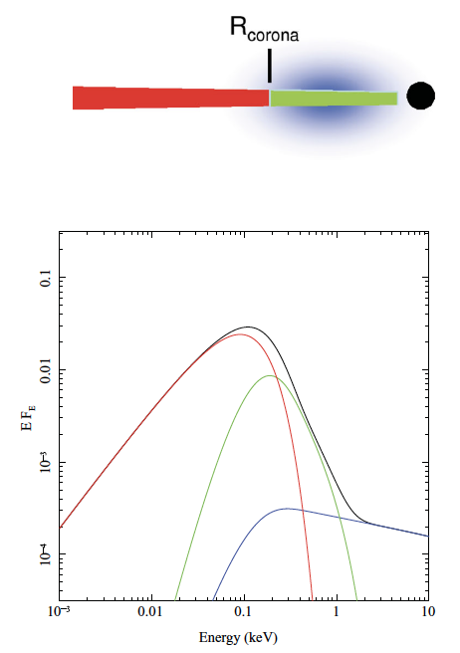
Main Alternative: Warm Corona
Leading alternative is the ‘warm corona’
Soft excess modelled as a second, cooler, optically-thick corona in addition to the ‘hot’ corona that produces the hard X-rays
Often interpreted as a slab shrouding the inner disc within the framework of a radially-stratified accretion flow; with decreasing radii:
Typically fits the data well, as the soft excess is a distinct emission component in the X-ray spectrum in this model (e.g. Petrucci+13; Porquet+18)
Able to successfully fit the data for PG1426+015 specifically (Mallick+25)
Done+12
Standard
disc
Warm
corona
Hot
corona
Notes:
Took 4 coordinated observations of SMBH in NGC1365 with XMM and NuSTAR
All show the broad iron emission and characteristic high-energy continuum, and independently find the BH in NGC1365 is rapidly rotating

Slide 21
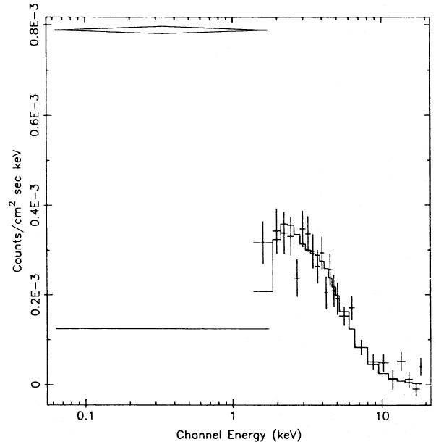
The Soft Excess
A ~smooth excess of emission seen in unobscured AGN below ~2 keV when the ~2-10 keV powerlaw continuum is extrapolated down in energy
Arnaud+85
Mrk 841
EXOSAT

Slide 22
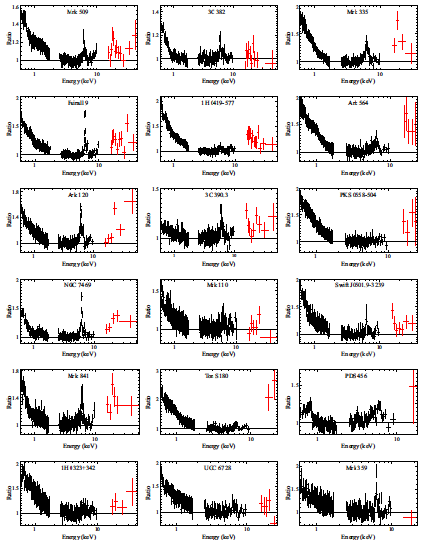
Suzaku sample of ‘bare’ AGN
Walton+13

Slide 23

Historical & Current Explanations
Accretion disc emission
Smeared ionised absorption
‘Warm’ thermal Comptonization
Relativistic reflection
Essentially debunked
Popular today

Slide 24
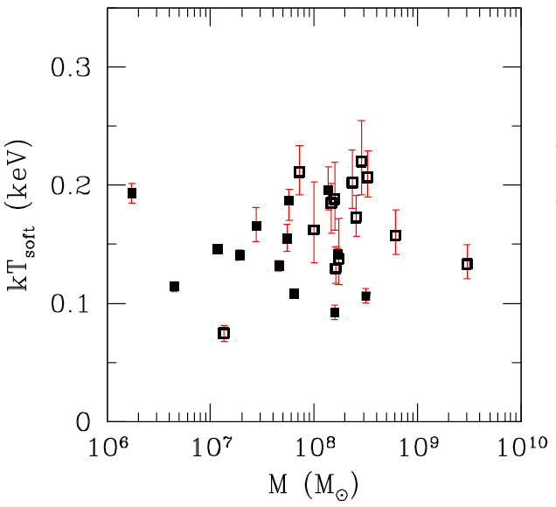
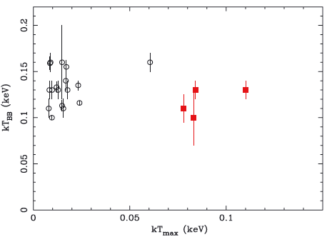
Constant Apparent Temperature
Gierlinski+04
Miniutti+09
Constant temperature not expected for blackbody emission (may support atomic origin…), and temperature too hot for typical AGN discs.
ACCRETION DISC IS GENERALLY EXCLUDED

Slide 25
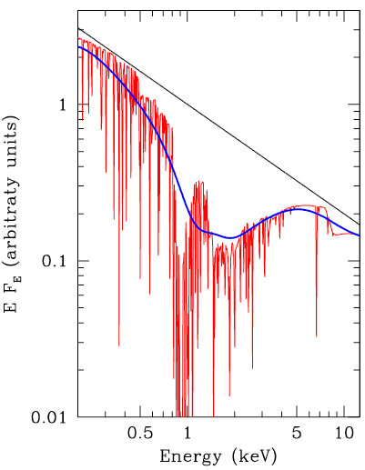
Smeared Absorption
Ionised absoption could produce a deficit in the ~1-5 keV range
If the absorption is velocity broadened (e.g. in a diverging outflow), this could appear as a smooth excess
Simulations show the absorption would need outflow velocities of ≥0.9c to produce the required broadening (Schurch+08)
SMEARED ABSORPTION IS GENERALLY EXCLUDED
Gierlinski+04

Slide 26
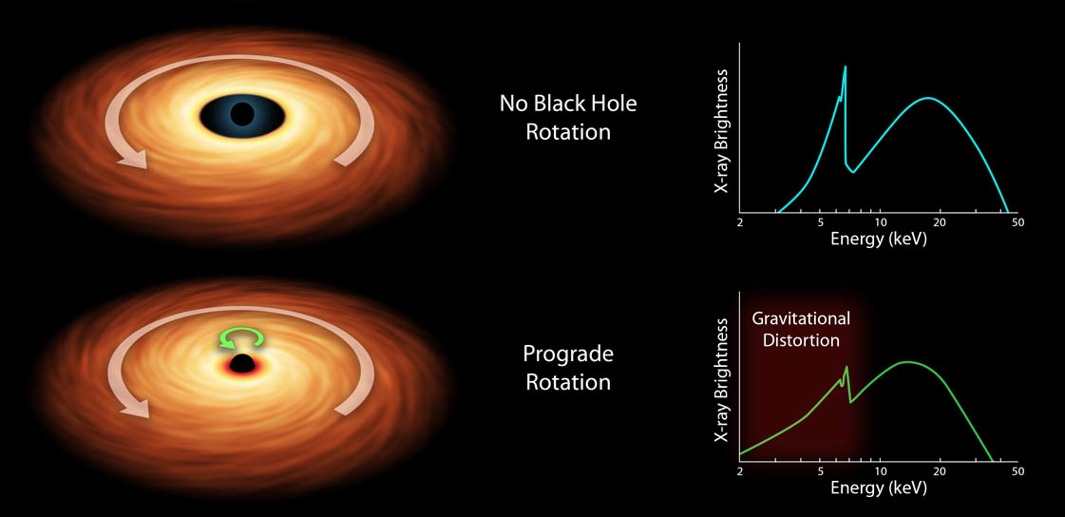
Relativistic Disc Reflection
Fe Kα
High-energy continuum
No black hole rotation
(a ~ 0)
Rapid black hole rotation
(a ~ 1)
Innermost Stable Circular Orbit (R_{ISCO}) BH spin (a)

Slide 27
Ionised Reflection
Original idea: in addition to the more prominent Fe K emission, reflection by ionised material produces a complex of low-energy emission lines (lighter elements, Iron L-shell) which are blurred together to produce a ~smooth excess below ~2 keV

Slide 28
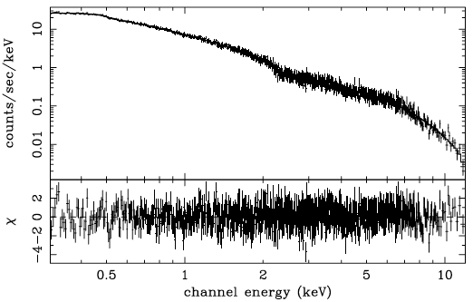
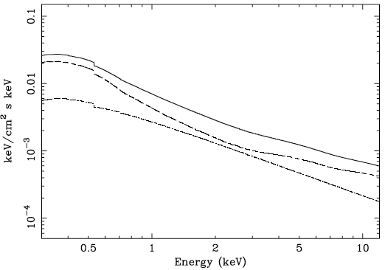
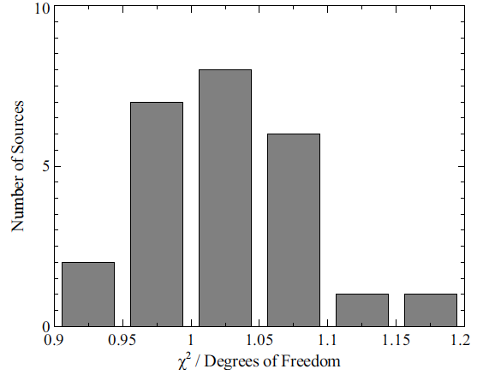
Reflection Fits
PG 1501+106
XMM, Crummy+06
Fits with a standard reflection-based model to a sample of 25 ‘bare’ AGN observed with Suzaku, covering
~0.6-30 keV on average
(Walton+13):

Slide 29
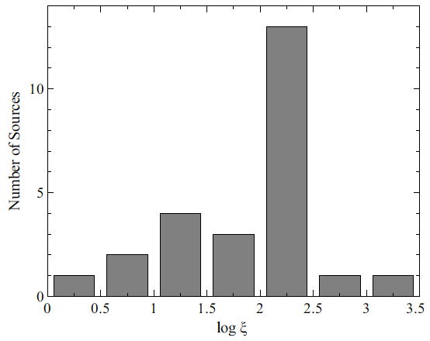
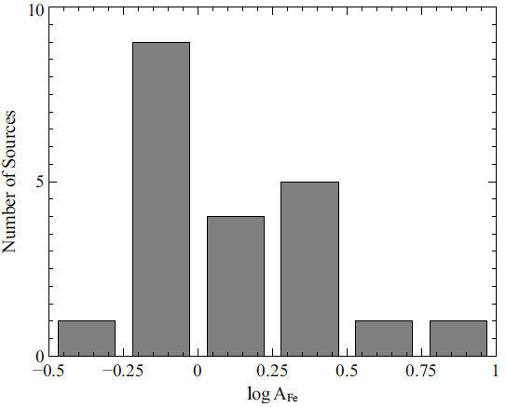
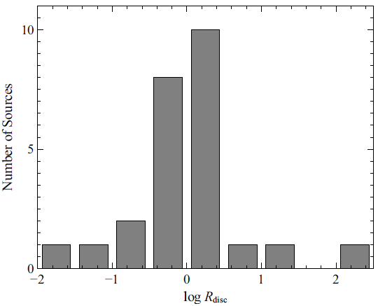

Typical Results and Implications
Results from Walton+13 sample of 25 ‘bare’ AGN observed with Suzaku:
Ionisation parameter typically ξ ~ 200, but broad range exhibited
Iron abundance peaks at A_{Fe} ~ 1, but some high abundances
Reflection fraction peaks at R_{disc} ~ 1 (roughly expected for a $2π$ disc), but some high values
Steep emissivity indices (q > 5) often required
[emissivity: ε(r) ∝ r ^{–q}; Newtonian expectation is q ~ 3]

Slide 30
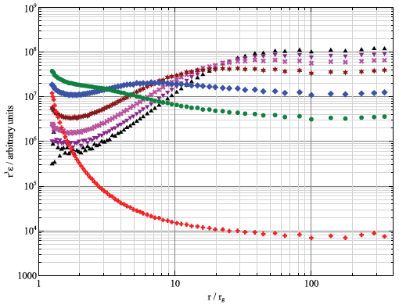
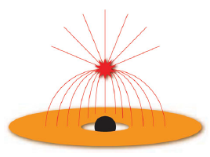
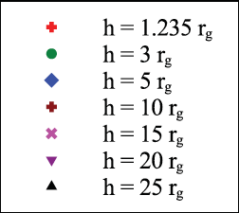
Steep Emissivity Indices
Gravitational lightbending (GR) can produce both steep emissivity indices (i.e. q > 3) and reflection-dominated spectra (i.e. R_{disc} > 1)
h
Wilkins+12
Requires the corona to be compact (~a few R_{G}), but this is broadly similar to microlensing results in strongly lensed quasars (see G. Chartas talk)
Also suggested that steep emissivities could be related to radial ionisation gradients (which have not typically been treated; Kammoun+19, Ingram+19)

Slide 31
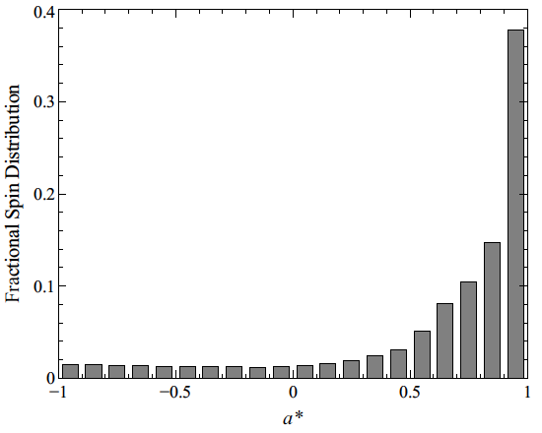
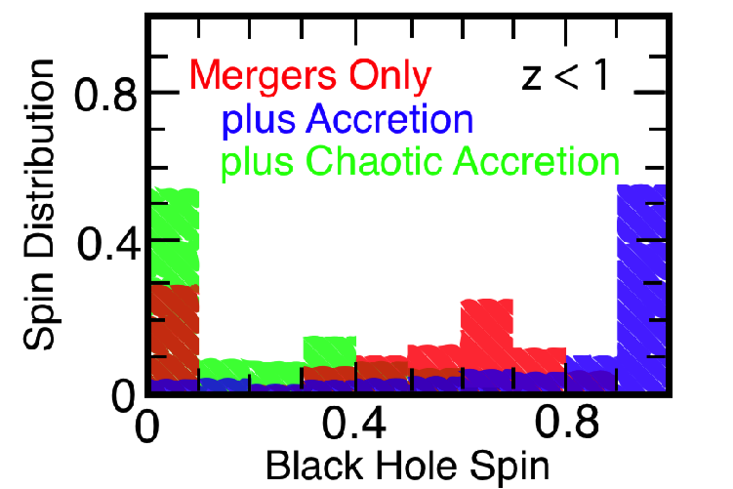
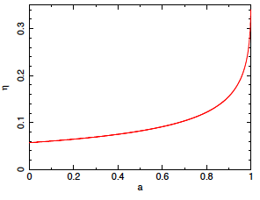
Black Hole Spin
Walton+13
Berti+08
Fits also typically imply that most black holes are rapidly rotating, consistent with (coherent) accretion-driven growth scenarios (see also review by Reynolds+19)
BUT…
High-spin biases are expected
(higher expected radiative efficiencies)
Reynolds+12

Slide 32
Relativistic Reflection in AGN
Risaliti+13, Walton+14
XMM
NuSTAR
NGC1365
(4 observations, separated in time)
Coordinated XMM+NuSTAR observations of NGC1365 all show clear evidence for relativistic disc reflection, with consistent physical parameters: a > 0.95
[Other prominent examples: MCG-6-30-15 (e.g. Marinucci+14a), Mrk335 (e.g. Parker+14),
IRAS 13224-3809 (e.g. Jiang+18), Swift J2127.4+5654 (e.g. Marinucci+14b), NGC4151 (e.g. Beuchert+17), NGC3783 (e.g. Brenneman+11), 1H0707-495 (e.g. Fabian+09), etc. etc.]

Slide 33
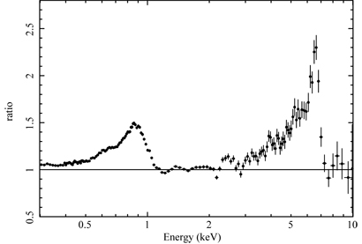
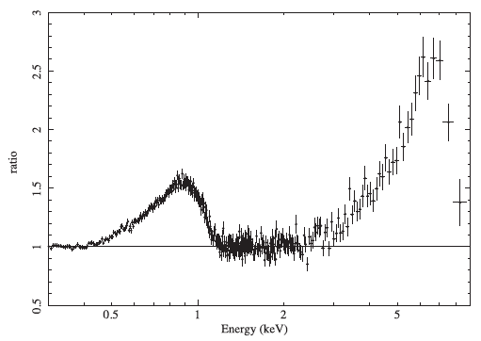
Iron L-shell Emission
1H0707-495
(Fabian+09)
IRAS 13224-3809
(Fabian+13)
In some rare cases, strong and relativistically broadened iron L-shell emission (~1 keV) can be seen in addition to and with a similar line profile as the relativistically broadened iron K-shell emission (~6.4 keV)
(This is likely related to high iron abundances)

Slide 34
Relativistic Disc Reflection
Broad Fe K emission
High-energy continuum
Soft excess?
Δt
Relativistic disc reflection carries information regarding both the spin of the black hole and the geometry of the ‘corona’

Slide 35
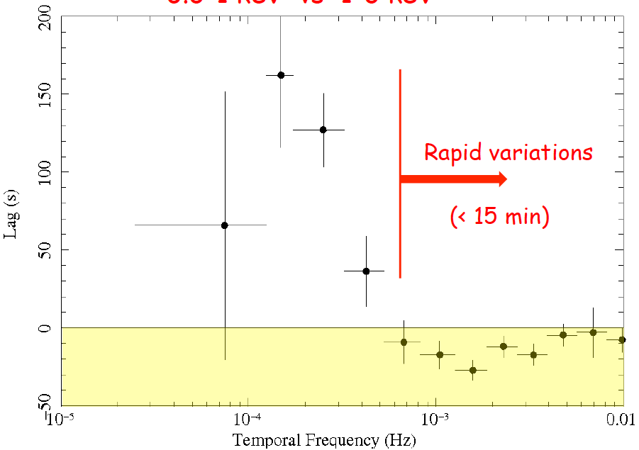
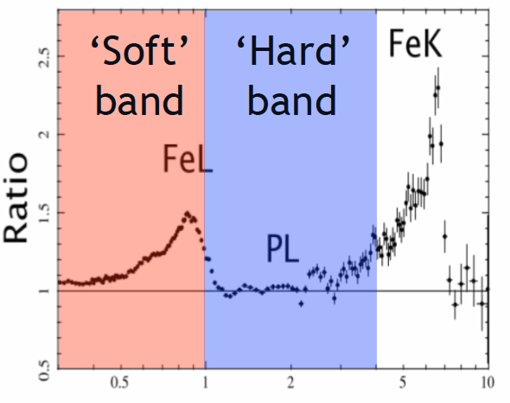
Soft X-ray Reverberation
Intrinsic continuum lags (propagation delays?)
Reverberation
+ve: soft leads hard
−ve: hard leads soft
Soft X-ray reverberation seen for the first time in 1H0707-495 (Fabian+09)!

Slide 36
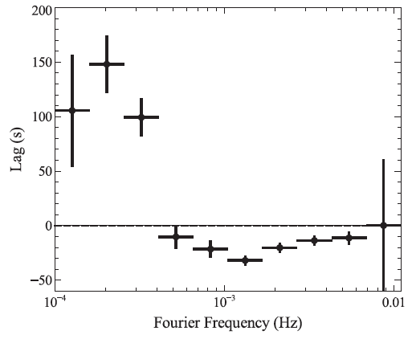
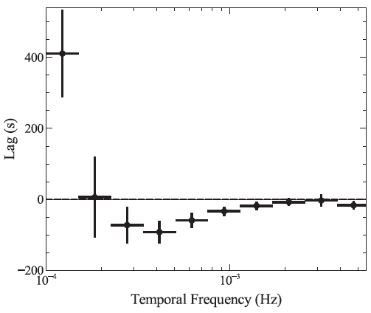
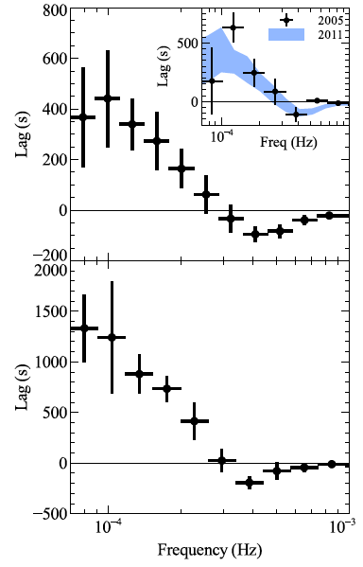
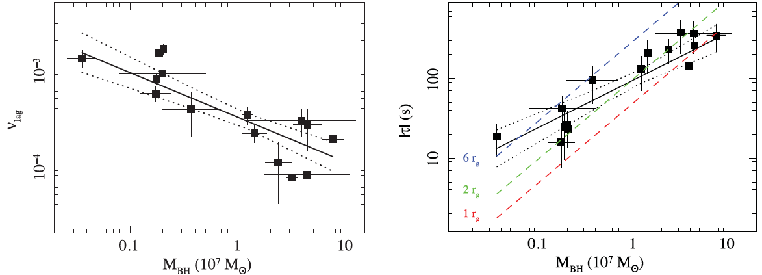
Soft X-ray Reverberation
1H0707-495
(Kara+13a)
IRAS 13224-3809
(Fabian+13)
Ark 564
(Kara+13b)
High-frequency soft lags are quite common (although there are unusual exceptions), and behave broadly as expected for different BH masses!
De Marco+13

Slide 37
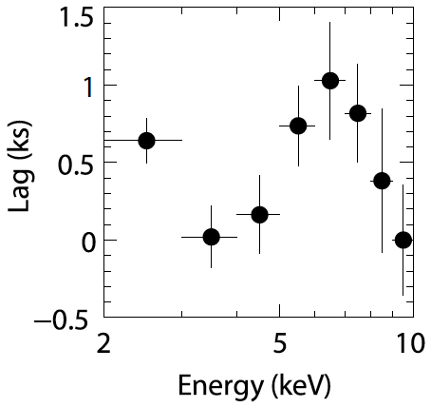
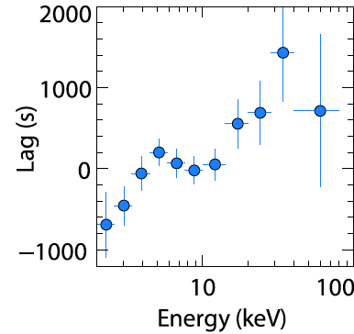
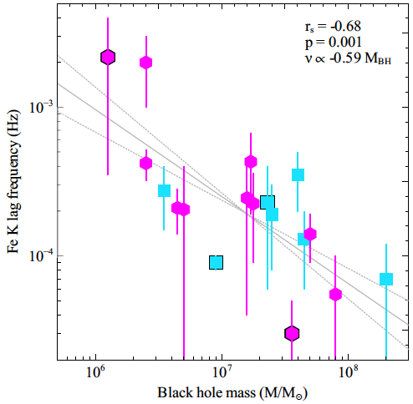
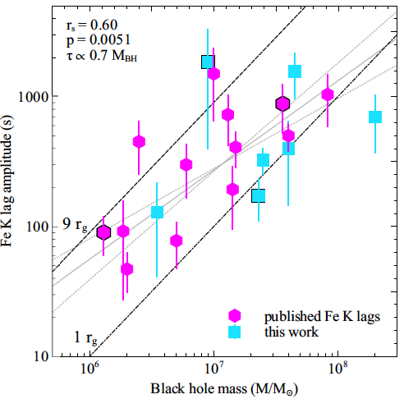
Fe K Reverberation
MCG-5-23-16
XMM
MCG-5-23-16
NuSTAR
Fe K reverberation lags have now been seen in a number of cases (also behave as expected), as well as some evidence for reverberation of the Compton hump in a few
Zoghbi+13,14
Fe K reverberation lags shows similar amplitudes to soft X-ray reverberation lags
Reprocessing occurs in broadly the same region
Kara+18

Slide 38
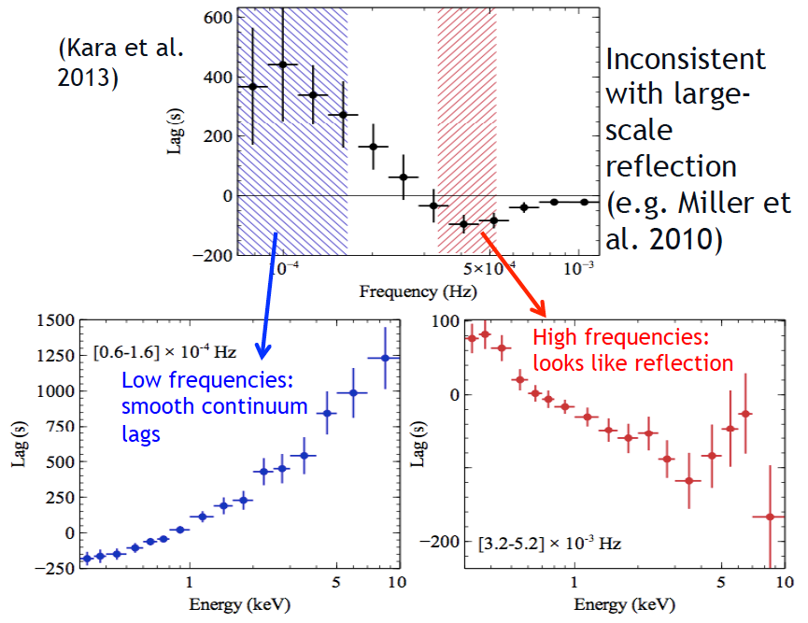
Low vs High Frequencies
Ark 564
(Kara+16)

Slide 39
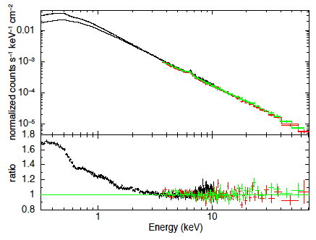
Hard X-rays and the Soft Excess
Fit: 3-79 keV
Fit: 0.3-79 keV
Ark 120
XMM+NuSTAR
Porquet+18
Taking a simultaneous broadband view, combining XMM+NuSTAR, simple relativistic reflection models appear to struggle to reproduce both the soft excess and the high-energy emission in some cases (Ark 120; see also Matt+14)

Slide 40
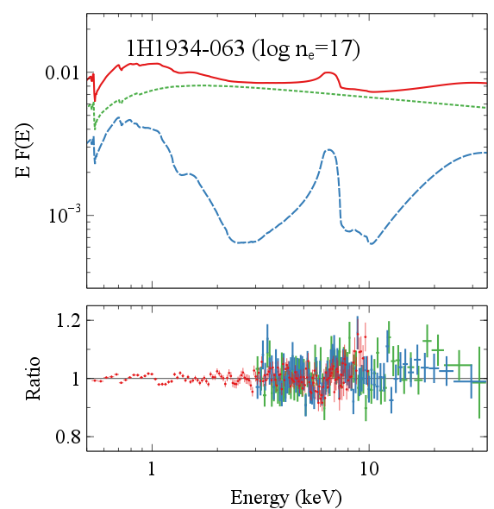
Hard X-rays and the Soft Excess
Mrk509: Garcia+16a
1H 1934-063
Jiang+19a
In other cases with simultaneous observations, the reflection model can reproduce the available soft and hard X-ray data

Slide 41
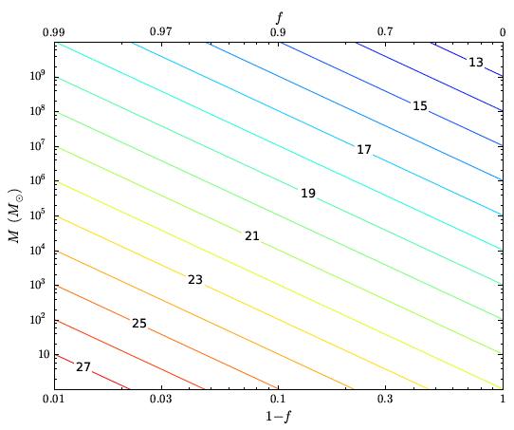
Accretion Disc Density
“Classic”
REFLIONX/
XILLVER
f – fraction of accretion power dissipated in the corona
SS73
Garcia+16b, based on disc-corona solutions from Svensson+94

Slide 42
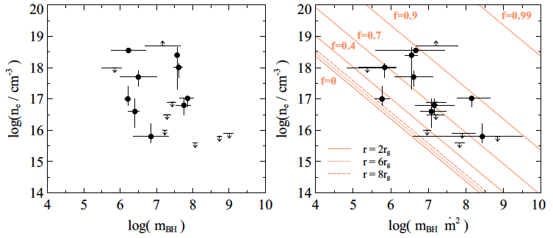
Variable Density Models – Results
Jiang+19a
Variable density models fit to a selection of AGN, combining sources with X-ray data from the reverberation-mapped sample and sources with high Fe abundances
Some evidence for anti-correlations seen for n_{e} vs M and MṀ ²
Notes:
Took 4 coordinated observations of SMBH in NGC1365 with XMM and NuSTAR
All show the broad iron emission and characteristic high-energy continuum, and independently find the BH in NGC1365 is rapidly rotating

Slide 43
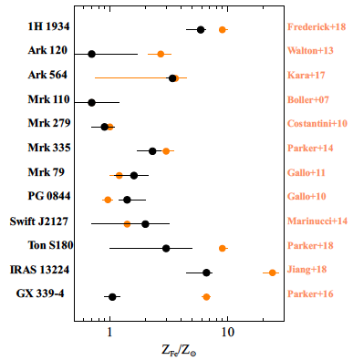
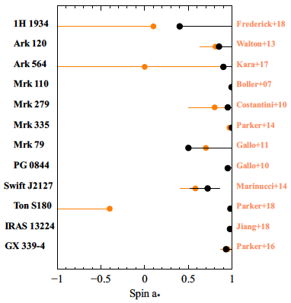
Variable Density Models – Results
Jiang+19a
High-density models help bring Fe abundances down in the most extreme cases
Spin estimates generally consistent with those obtained previously (assuming the soft excess is reflection), still typically imply rapidly rotating BHs
Notes:
Took 4 coordinated observations of SMBH in NGC1365 with XMM and NuSTAR
All show the broad iron emission and characteristic high-energy continuum, and independently find the BH in NGC1365 is rapidly rotating

Slide 44
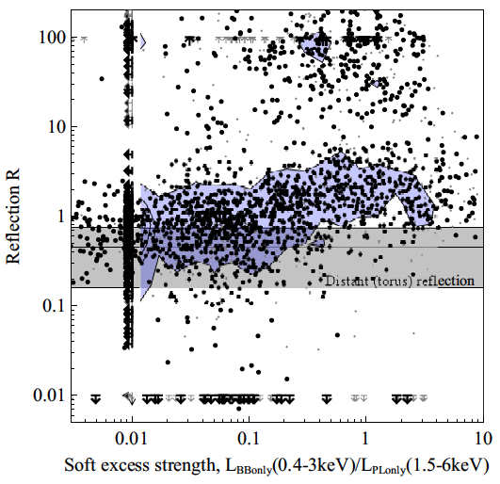
Hard X-rays and the Soft Excess
Simulations suggest we should expect a statistical correlation between soft excess strength and reflection fraction (Vasudevan+14)
Notes:
Took 4 coordinated observations of SMBH in NGC1365 with XMM and NuSTAR
All show the broad iron emission and characteristic high-energy continuum, and independently find the BH in NGC1365 is rapidly rotating

Slide 45
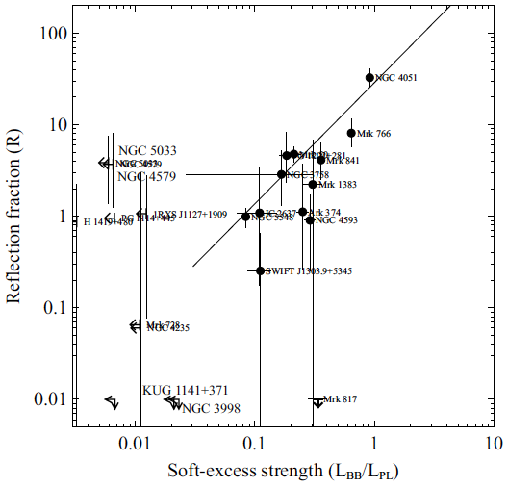
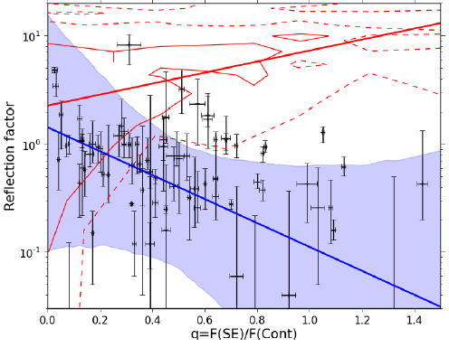
Hard X-rays and the Soft Excess
Vasudevan+14
Boissay+16
Combining XMM and Swift-BAT, Vasudevan+14 find weak evidence for a positive correlation, but Boissay+16 find evidence for an anti-correlation (!)
Something of an open issue…
Notes:
Took 4 coordinated observations of SMBH in NGC1365 with XMM and NuSTAR
All show the broad iron emission and characteristic high-energy continuum, and independently find the BH in NGC1365 is rapidly rotating

Slide 46
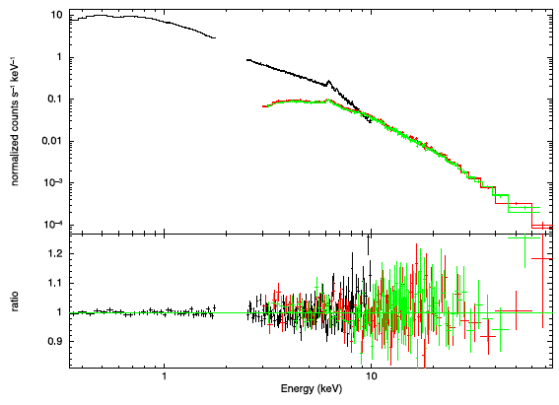

Hard X-rays and the Soft Excess
Ark 120
XMM+NuSTAR
Matt+14
Taking a simultaneous broadband view, combining XMM+NuSTAR, simple relativistic reflection models appear to struggle to reproduce both the soft excess and the high-energy emission in some cases (Ark 120; see also Porquet+18)
Notes:
Took 4 coordinated observations of SMBH in NGC1365 with XMM and NuSTAR
All show the broad iron emission and characteristic high-energy continuum, and independently find the BH in NGC1365 is rapidly rotating

