Slide 1
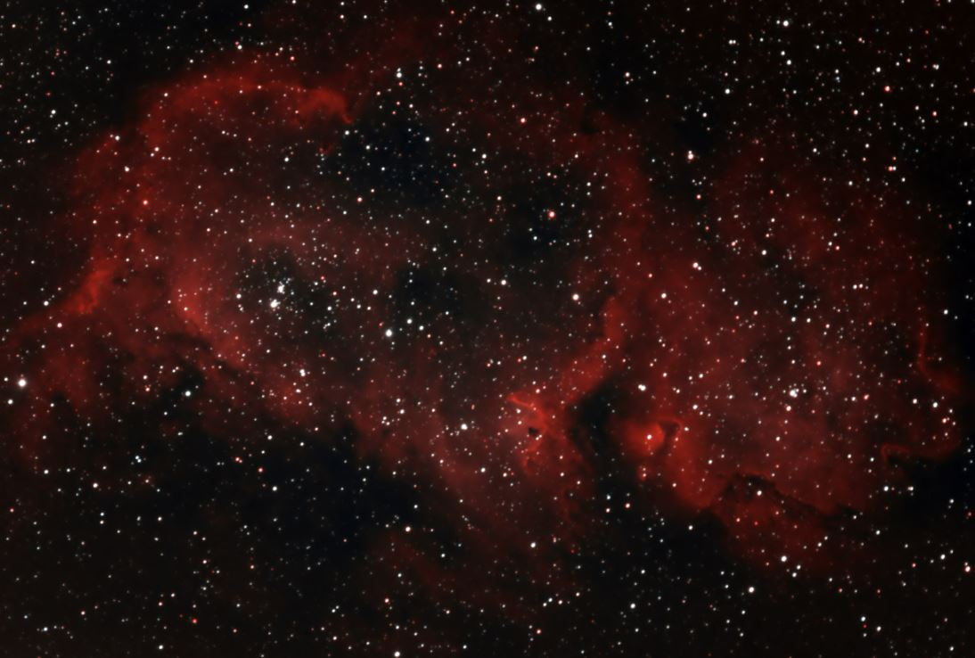



AGN Feedback and Dynamical Properties of the earliest Relic Galaxy: Vigorous stellar rotation, low Dark Matter content and moderate neutral gas outflows
(arXiv 2505.06349)
Robert Pascalau, Francesco D’Eugenio,
Sandro Tacchella, Roberto Maiolino, Michele Cappellari et al.
(NAM 2025, July 8th - Parallel session #78)
rgp34@cam.ac.uk

Slide 2
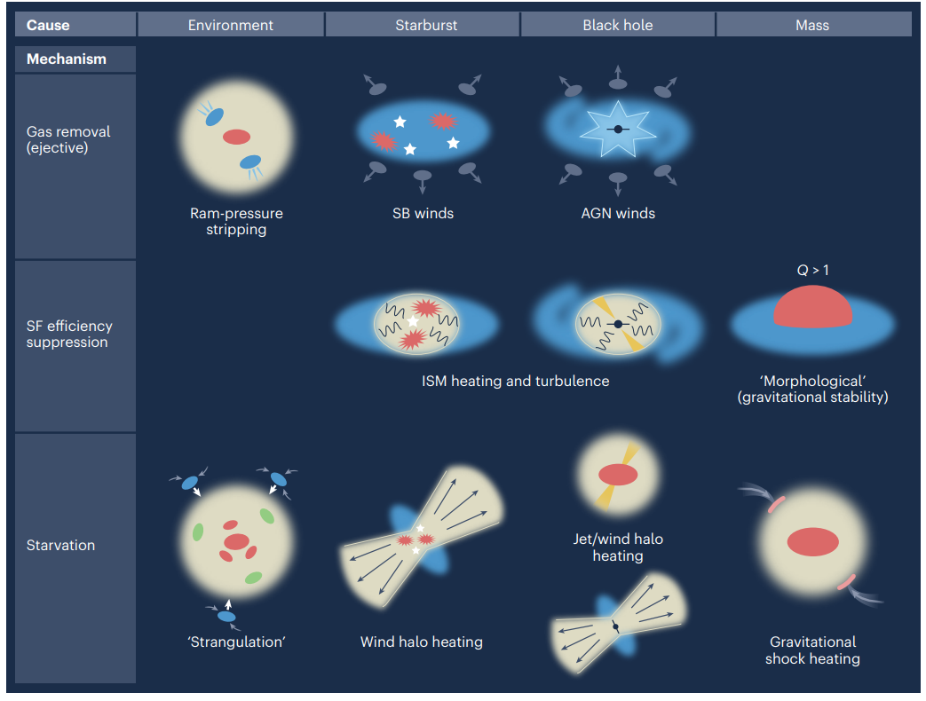
Quenching in action. AGN Feedback
2 Types: Ejective & Preventative:
Ejective: Expels away cold molecular gas → reduces SF
Preventative: Heating of the gas in the ISM/halo → prevents new gas accretion
rgp34@cam.ac.uk
Credits: Curtis-Lake+23, R. Maiolino

Slide 3
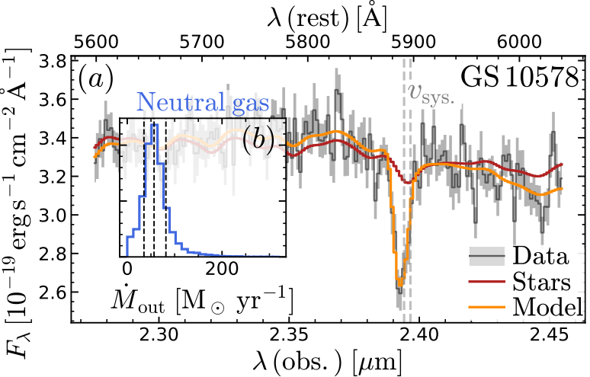
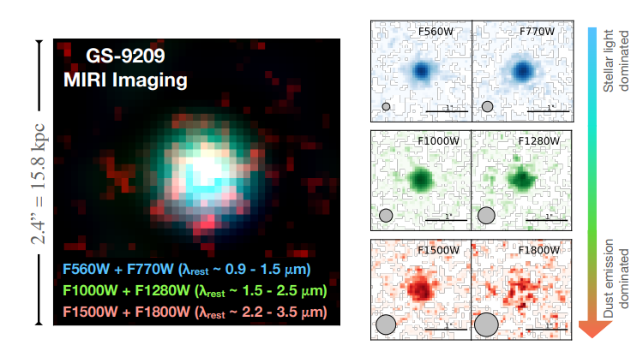
High z Massive Quenched Galaxies (MQGs) → Triple Trouble
Overabundance of z > 3 MQGs in JWST observations compared to numerical simulations (e.g. Baker+24, Carnall+24, de Graaff+24, Nanayakkara+24)
They grew their M* very quickly (e.g. de Graaff+24a, Glazebrook+24, Weibel+24) → formation redshifts z_{form} > 8
Extremely fast quenching timescale (GS-9209 quenches in < 60 Myr): 9/14 galaxies in Blue Jay and 12/18 in Baker+24 sample have quenching timescale < 500 Myr
Solution: Ejective AGN feedback → strong AGN driven neutral outflows (D’Eugenio+24)
But preventative AGN Feedback needed to keep a galaxy quiescent (e.g. hot dust ring around GS-9209 → Ji+24)
Notes:
Possible explanations for 2: i) overmassive halos at high z? ii) Very effective baryon accretion and conversion into stars f* ~ 0.5? iii) Top-heavy IMFs?
Also need to take into account that various SFH priors product different estimates of formation redshifts (e.g. Turner+24)
→ 30%- 50% of z >2 MQGs have AGN activity

Slide 4
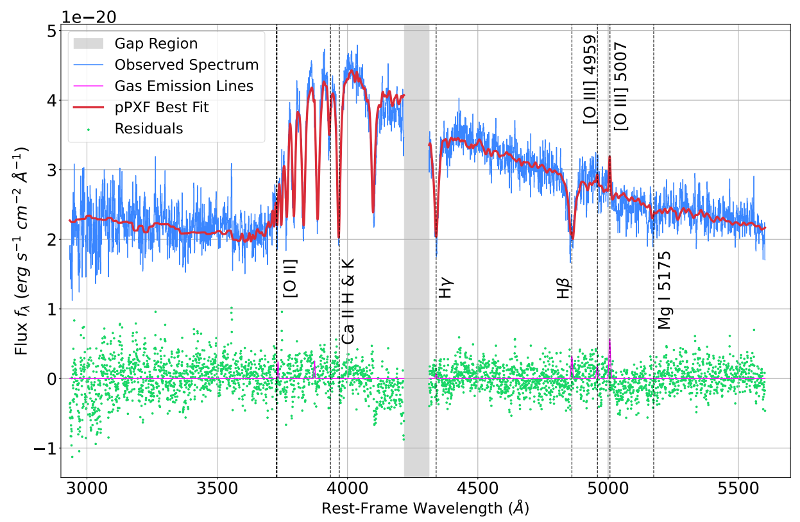

GS-9209: a massive quenched galaxy at z = 4.66
-Balmer break ~ 2-2.25 → old stellar populations
High resolution G235H / F170 LP integrated-aperture spectrum of GS-9209 (Pascalau+25)
rgp34@cam.ac.uk
Notes:
Aperture is covers about up to 5 effective radii (the maximum extent to which we have resolved kinematics data at all)

Slide 5
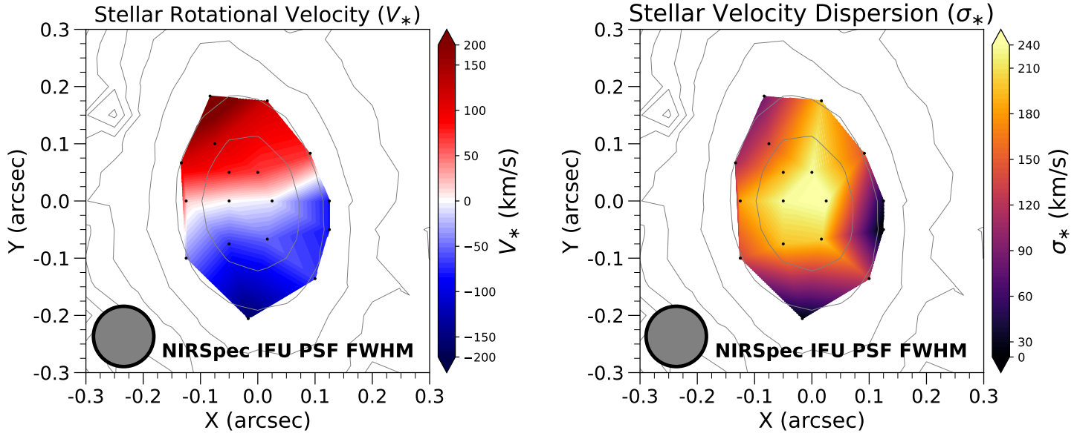
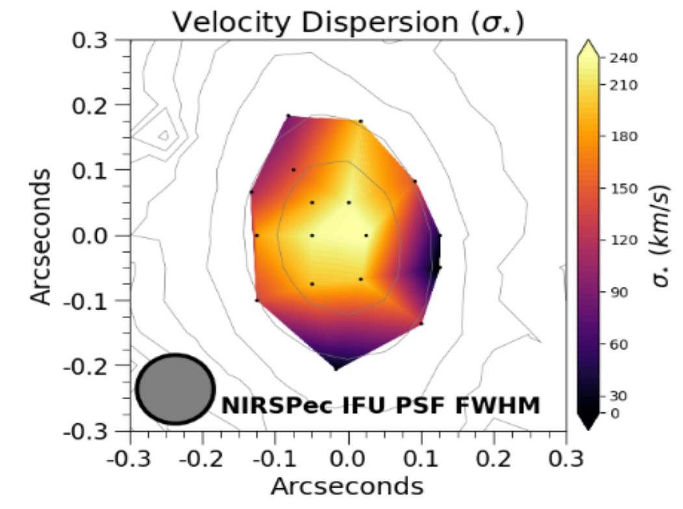
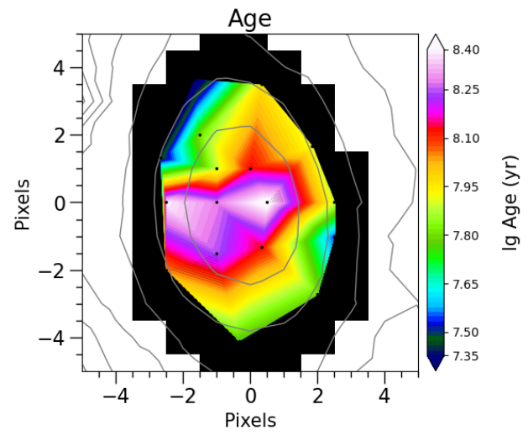
Spatially resolved stellar kinematics maps
Highest redshift spatially resolved stellar kinematics (Pascalau+25)
From spectroscopy: the older stellar core is real (not just beam smearing)
rgp34@cam.ac.uk
Notes:
Voronoi bins containing individual spaxels have better S/N than if we would have done the resolved kinematic analysis spaxel-by-spaxel;
We voronoi bin on the medial signal map for lambda_rest < 3500 AA in order to catch the flattest region of the spectrum (and with no emission lines)
PSF FWHM size is about 0.1 arcsec

Slide 6
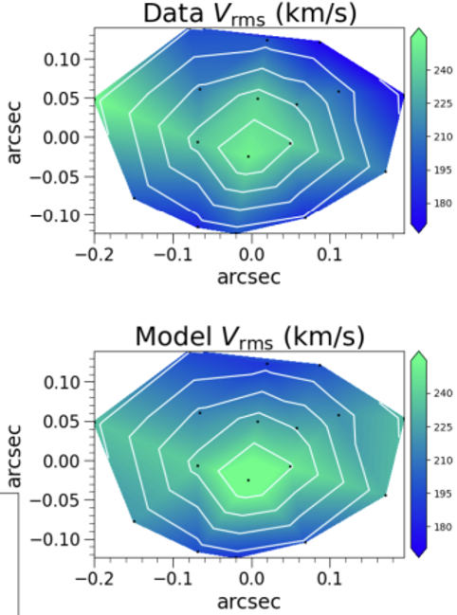

Insights from JAM Dynamical Modelling
GS-9209 has a MW-like IMF (Kroupa or Chabrier)
→ GS-9209 is ultra-compact (Reff ~ 200 pc)
→ DM fraction 6.3 % within 1 Reff
→ Stellar Kinematics Maps show it is a fast rotator (also spin parametre λ_{Reff} = 0.65 ± 0.14)
rgp34@cam.ac.uk
Notes:
Qintr = 0.62 pm 0.10; sigma_z/sigma_R= 0.85 pm 0.08
DM fraction (within 1 Re) = 6.3 + 2.8 -1.7 % (well constrained)
-we put a Gaussian prior on BH mass based on scaling relations using broad Halpha (Carnall+23). BH + MFL dynamical model cannot resolve the BH sphere of influence

Slide 7
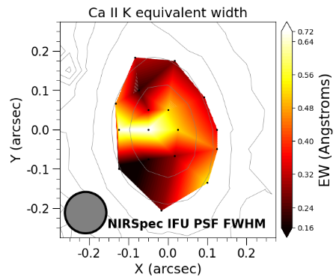
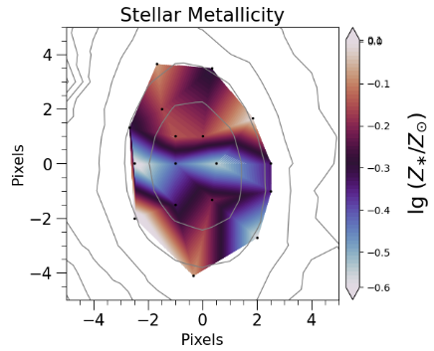
Possible Metal-rich outflows in GS-9209?
→ high EW regions trace the off-centre outflow
→ possible speculative correlation with metal poor regions along the kinematic minor axis
rgp34@cam.ac.uk

Slide 8
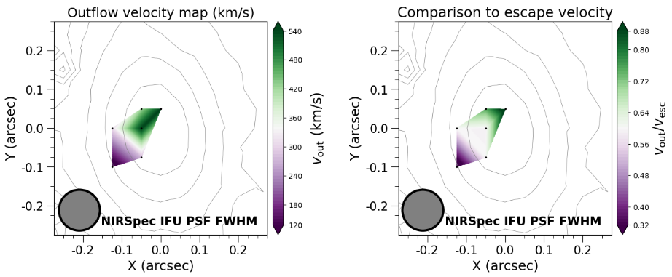
Possible Metal-rich outflows in GS-9209?
→ geometry: likely the lateral side of the bi-conical outflow
→ dMout / dt = 0.67 - 13.5 Msun / yr
→ Fiducial estimate: 2.3-3.0 Msun/yr → mass loading factor η~1
→ outflowing gas is unable to escape from galaxy’s gravity
rgp34@cam.ac.uk

Slide 9
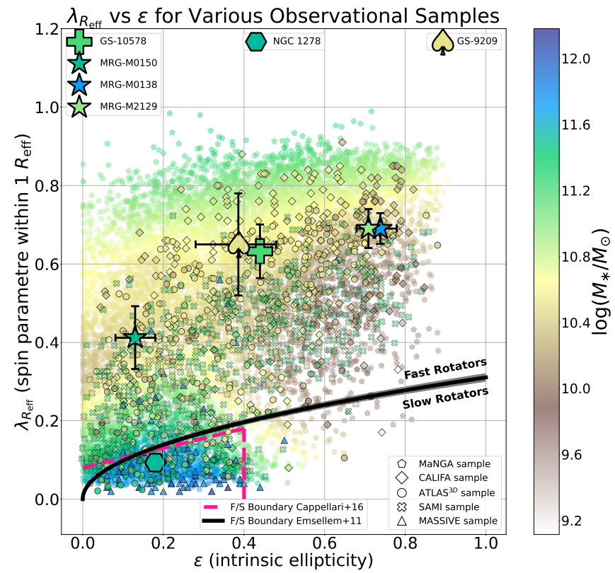
Why the discrepancy?
→ GS-10578 (D’Eugenio+24) has very similar kinematics, but is 5 times more extended and 5 times more massive.
→ But neutral gas mass outflow rates ~ 100 Msun/yr.
1) Different moments of PSB galaxy evolution are captured
2) Different formation / mass assembly scenarios (see e.g. Dekel+23, Kimmig+25, McClymont+25)
Stellar kinematics measurements (Pascalau+25)

Slide 10
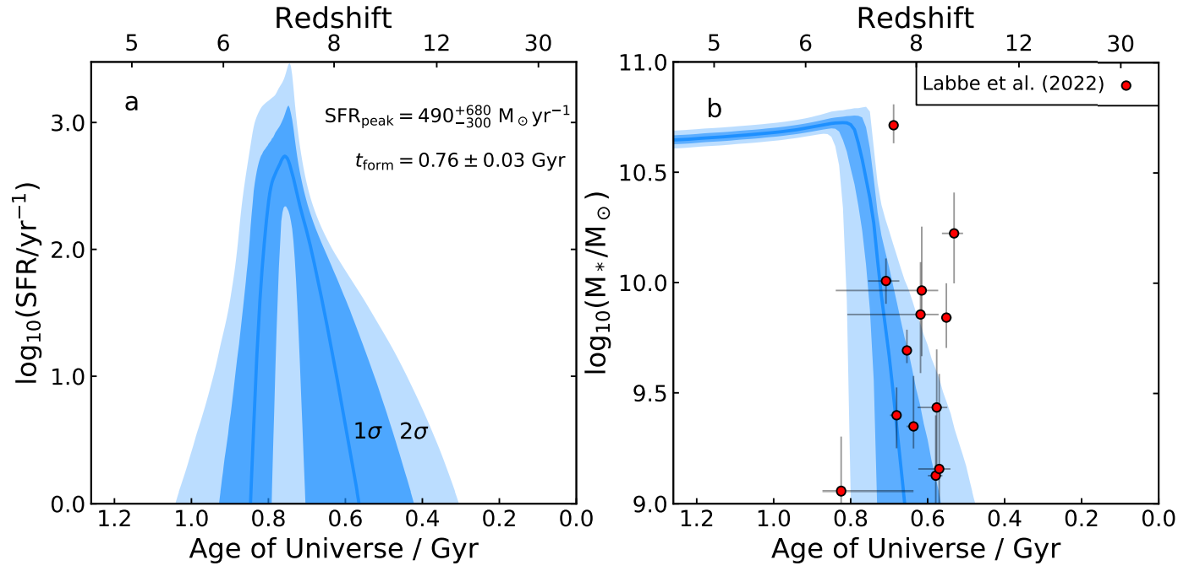
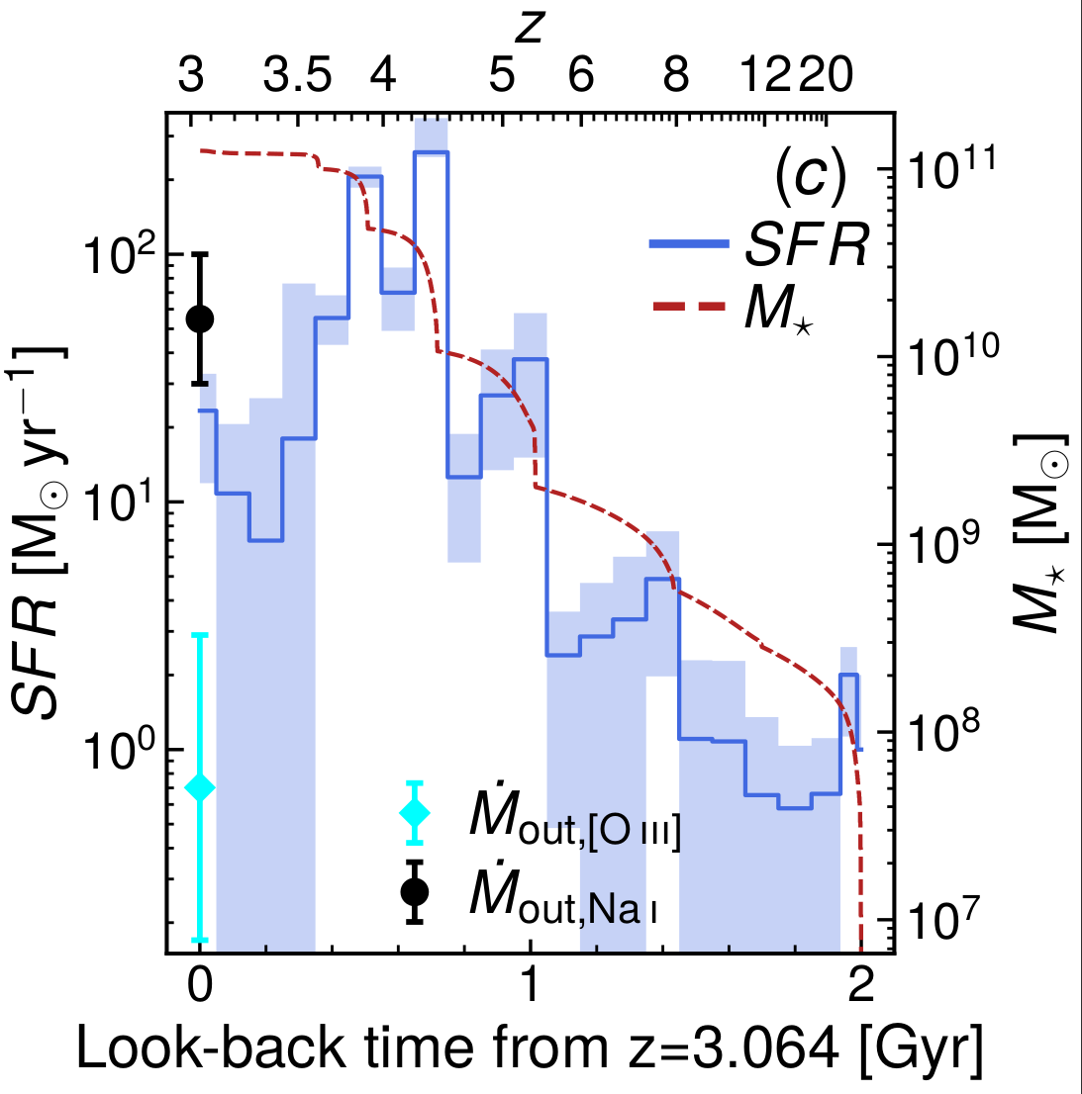
Why the discrepancy? Scenario 1) Different evolutionary stages
SFH of GS-10578 (Left, D’Eugenio+23) and GS-9209 (Right, Carnall+23)
rgp34@cam.ac.uk

Slide 11
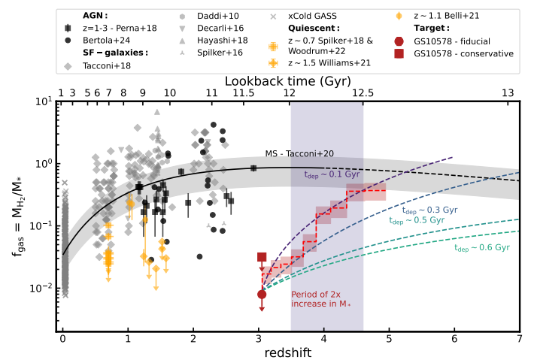
Why the discrepancy? Scenario 1) Different evolutionary stages
→ Scholtz+24: gas fraction in GS-10578 is < 3%
→ GS-10578 likely observed in a short, intense epoch when ejective AGN feedback drives huge outflows.
Scholtz+24 (also Pascalau+ in prep.) studied Gas Consumption Histories (GCHs with ALMA) → cold gas depletion time-scale in GS-10578 ~ 0.1 - 0.2 Gyr
rgp34@cam.ac.uk

Slide 12
Thank you!
If interested, please check out my recent paper (Pascalau+25)
rgp34@cam.ac.uk

