Slide 1

SMART-1 end of life: lessons learnt from a lunar impact ending
Mark J. Burchell, Penelope J. Wozniakiewicz
Centre for Astrophysics and Planetary Science,
School of Engineering, Mathematics and Physics,
Univ. of Kent.
m.j.burchell@kent.ac.uk; p.j.wozniakiewicz@kent.ac.uk
NAM July 2025

Slide 2
Lunar space is increasingly populated.
This involves orbiters, future space-stations, transfer stages, ascent/descent modules…..more objects will arrive and populate orbits not currently used.
There are/will increasingly be multiple actors – different states, private players……….
The problems of congestion in LEO are a foretaste of what is to come in cis-lunar space as a whole.
Do we repeat the past or learn from it?

Slide 3
Why is End of Life (EOL) important in LEO?
Old satellites are junk, out of control and hazardous. As more new satellites go up, the need for collisional avoidance manoeuvres increases, risk goes up…….
So, in Earth orbit, to reduce the number of individual hazards, and the risk of sources of large populations of small debris in the event of a break-up, you have an EOL strategy - 25 years was previously the time NASA allowed to enact this for a satellite (max. 30 years after launch).
Traditionally in low altitude LEO, below say 450 km, atmospheric drag will slowly deorbit. If at higher altitude you can move to one side, or put into a deliberate decaying orbit, hoping drag accelerates this at some stage.
Recent models, show this is in-sufficient. In the US, the rule is now 5 years, ESA agrees. But the models also show there are so many old satellites up there already, plus some new ones will fail, so we need to have active de-orbiting missions, with at least 1 large old satellite removed per year.
Key to all of this in LEO is aerodrag, atmospheric re-entry and burn-up in the atmosphere………
………………………………………………………………………..the Moon has no appreciable such atmosphere

Slide 4
What does EOL mean at the Moon?
There are 4 main options according to ESA (“ESA Space Debris Mitigation Requirements,” Tech. rep., ESA Space Debris Mitigation Working Group, 2023) – listed in order of preference:
Insert into heliocentric orbit
Lunar Impact (“The suitability of possible impact area locations on the Moon surface are analysed with respect to points of interest such as space heritage artifacts, or operational assets on the lunar surface.”)
Earth re-entry
Lunar graveyard orbit
Naively, one may expect cost and convenience to dictate choices

Slide 5
Lunar Impact
According to Wyseck, “Cislunar Missions End-of-Life Disposal Strategies”, Advanced Maui Optical and Space Surveillance Technologies Conference (AMOS), 2024:
“Designing a maneuver strategy to crash into the Moon is straightforward when using a single maneuver and not considering the impact location.”
“When a specific area on the surface must be targeted, cislunar orbits may require a set of maneuvers to setup a low altitude circular staging orbit, from which the final descent can be achieved. A target location that is in-line with the orbital plane would require minimal additional fuel to achieve. Whereas, a plane change could be required for other target areas. The staging orbit provides access to more of the surface for impact locations”.
These are strategies not consequences!
Naively, one may expect cost and convenience to dictate choices

Slide 6
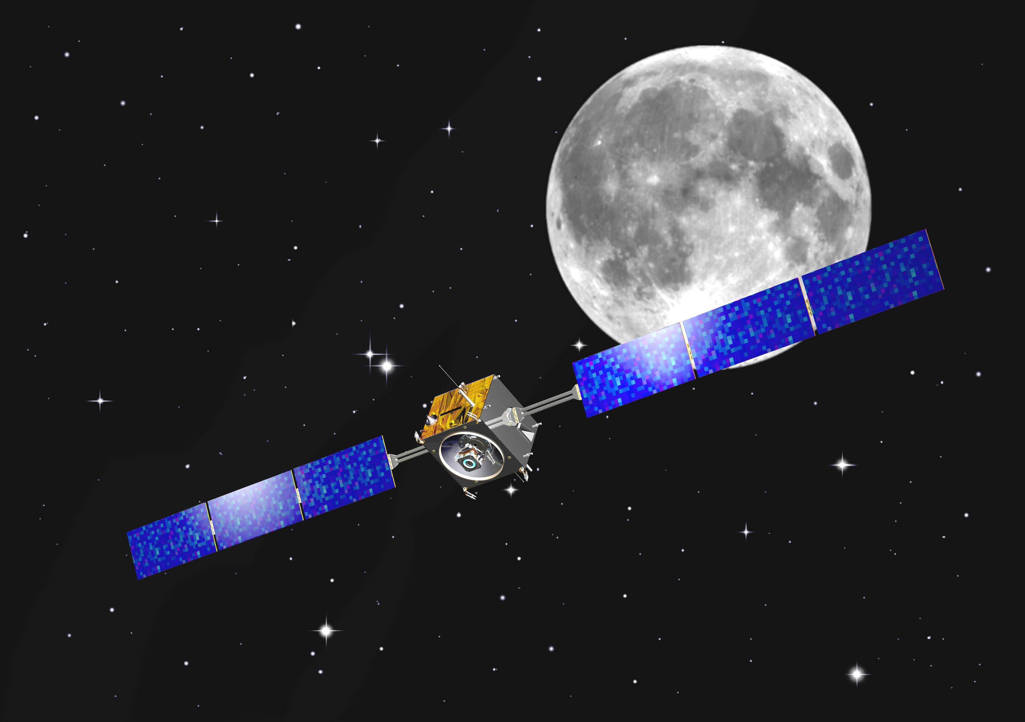
This has all been done before……..
Consider Smart-1
Smart 1 was an ESA spacecraft, testing electric propulsion and which orbited the moon.
Launched Sept. 2003, entered lunar orbit Nov. 2004, EOL via lunar impact Sept 2006.

Slide 7
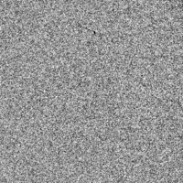
The EOL strategy was to go to a low altitude near circular orbit and then descend on a very shallow orbit until impacting the lunar surface.
The plan was a very shallow angle
(2°) impact at 2 km s⁻¹.
The impact was witnessed from Earth
Source: Canada-France-Hawaii telescope.

Slide 8
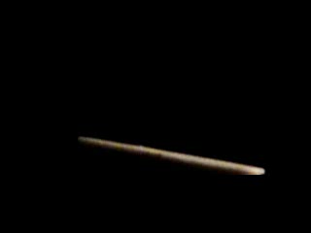
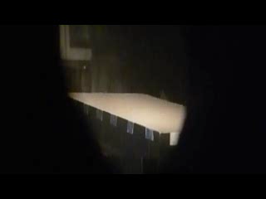
What does such an impact look like?
See: Burchell et al., Icarus 207, 28-38, 2010 and MAPS 50, 1436 – 1448, 2015.

Slide 9
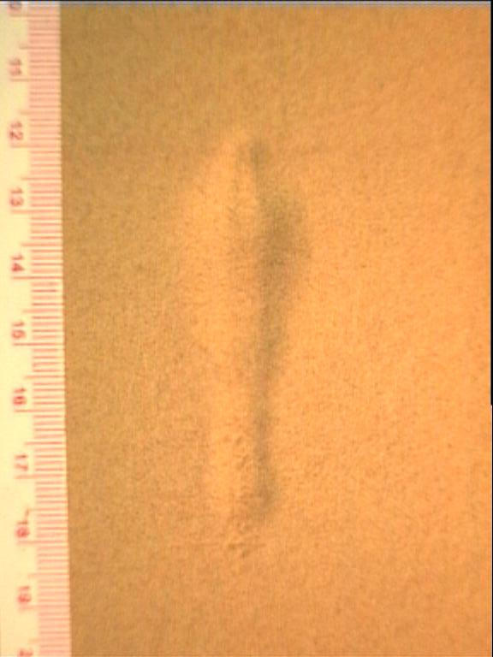
Finally in 2017, someone found it!
Stooke, Icarus 321, 112 – 115, 2019.
Burchell et al., Icarus 207, 28-38, 2010

Slide 10
Size: 4 m wide, 30 km long (Stooke, 2019). Predicted by Burchell et al., Icarus 207, 28 – 38, 2010, as 2 – 9 m wide and 5 – 26 m long
Volume: Burchell et al. (2010) predicted 0.71 – 6.9 m³
Ejecta: Yes. Burchell et al. (2010) predicted 2,200 – 21,800 kg of material on a ballistic trajectory. (Smart 1 dry mass was 287 kg.)
Ricochet? Our lab experiments said yes
Was it where it was supposed to be? Stooke (2019) says about 4 km from pre-impact prediction. (One issue was a lack of high-res, pre-impact imagery of the area.)

Slide 11
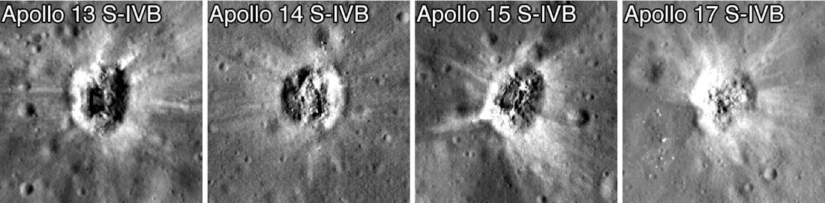
Don’t forget rocket stage impact sites
These are 35 – 45 m diameter
Source: LRO NASA/Goddard/Arizona State University

Slide 12
Consequences:
Need defined graveyards on lunar surface.
They need to be over 100 km across and should be visible from high-res. lunar orbiting cameras which visit the sites at short intervals (before and after impact) and can resolve sub-m features. A range of illumination angles is needed to show surface ejecta rays.
Ejecta will be produced (including some impactor material), some ballistic and some higher speed. Some ejecta will fall back a large distance away. Some will reach lunar orbit altitudes
Worse still: ricochet of the impactor can be expected for very shallow angle impacts.
As more and more sites are used, or deemed of interest, the presence of the “graveyards” will be a constraint or will need to be moved.
The ejecta can be detected by impact sensors mounted at dedicated surface stations, which can also monitor seismic activity, and will be a background to science instruments doing lunar impact flux, internal structure studies etc.

Slide 13
Some ejecta may reach lunar orbiting satellites and beyond…..
As an interesting aside, it has recently been suggested that the possible lunar impact of asteroid 2024 YR4 may produce ejecta which can threaten Earth orbiting satellites. See Weigert et al., The Potential Danger to Satellites due to Ejecta from a 2032 Lunar Impact by Asteroid 2024 YR4, https://doi.org/10.48550/arXiv.2506.11217 which they suggest will increase the dust flux of mm scale impactors in LEO by about 1000.
Of course this is for a 60m wide asteroid, not a small satellite. Looking further ahead, the proposed lunar Gateway will have a final mass of 63,000 kg (vs. 220 million kg for 2024 YR4), about 3000 times lower mass.
As an interesting exercise you might want to see how much the flux in LEO rises for a future Gateway lunar impact disposal, you would want to know what it would do to the flux on the lunar surface away from the impact site……….and in lunar orbit!

Slide 14
Conclusion:
There is no easy lunar EOL for satellites
Lunar impact is not a well constrained, zero
risk option. It is not a precise science, and produces ejecta and even ricochet events.
For small satellites it is ok-ish, but larger ones?
m.j.burchell@kent.ac.uk;p.j.wozniakiewicz@kent.ac.uk

