Slide 1
From Glass to Galaxies: Entangled Visions - How Art Shapes our Understanding of the Universe
Alison Stott MA Glass - University of Arts Plymouth

Slide 2
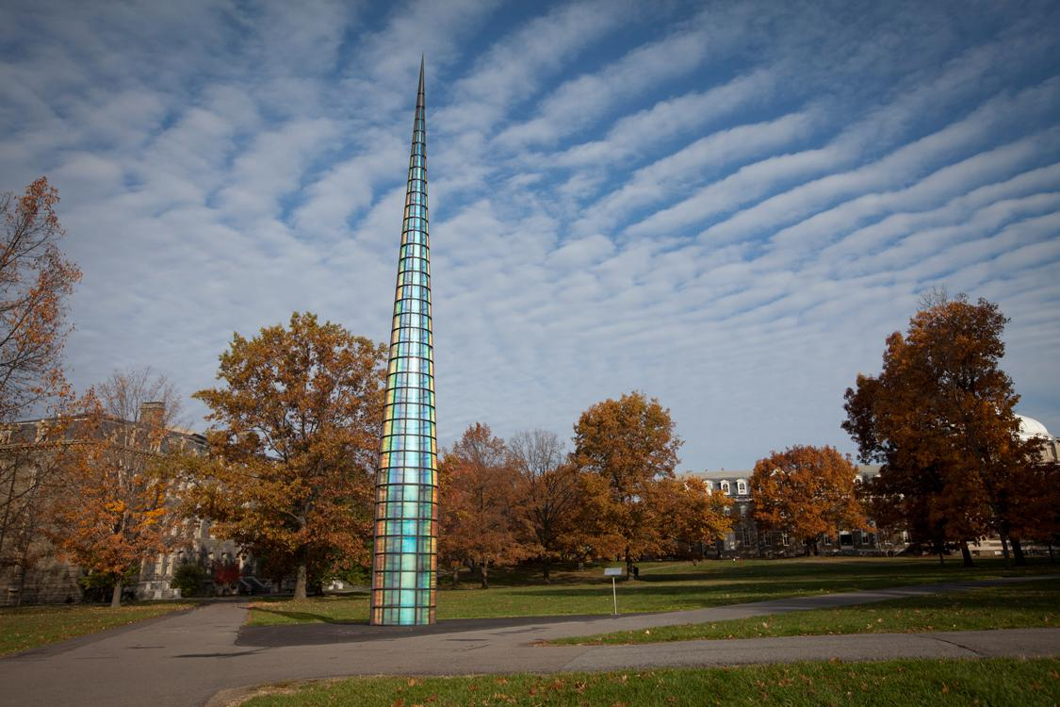
Kimsooja
A Needle Woman: Galaxy was a memory, Earth is a Souvenir. 2014
Commissioned by Cornell Council for the Arts, NY.
A collaboration with Stephanie Owens, Ulrich Wiesner, Ferdinand Kohle and Jaeho Chong.
Kimsooja unfolds the notion of a needle as an intersection between distance and memory threading across a cosmic scale.

Slide 3
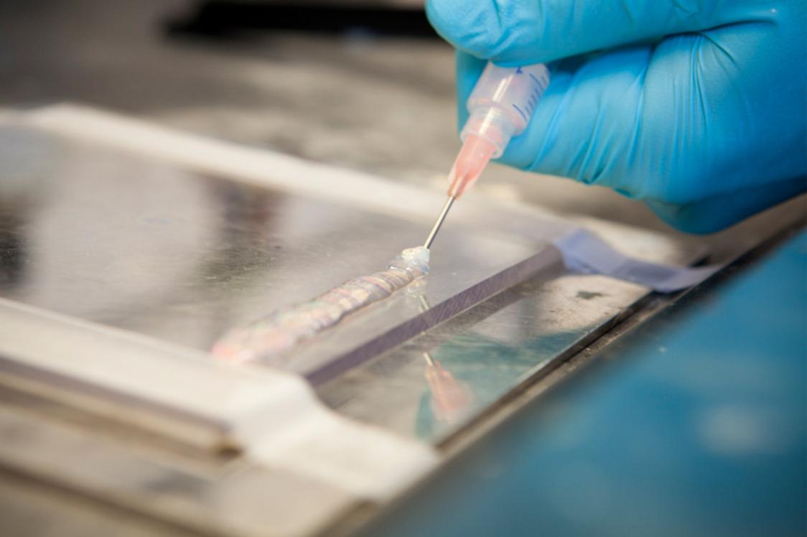
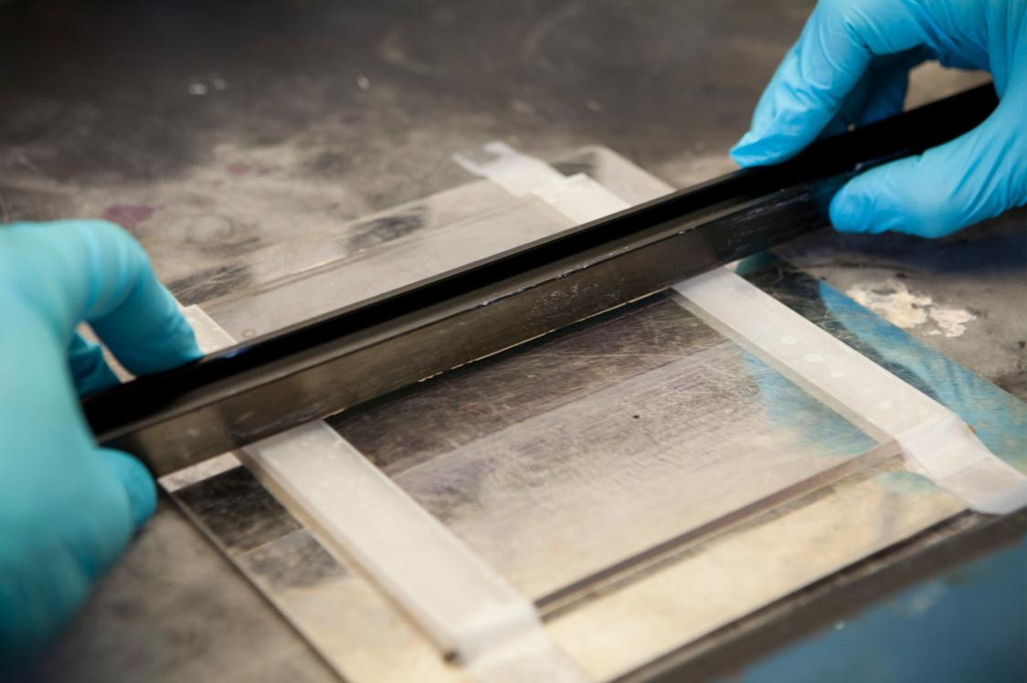
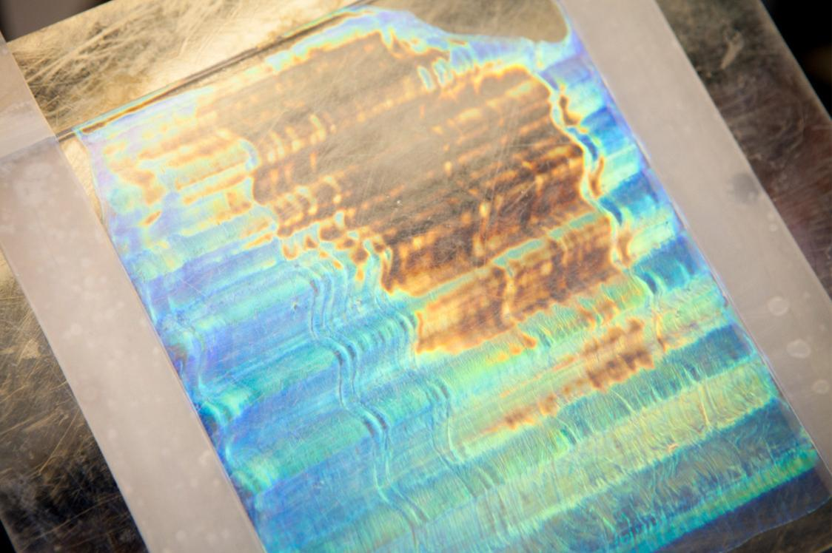
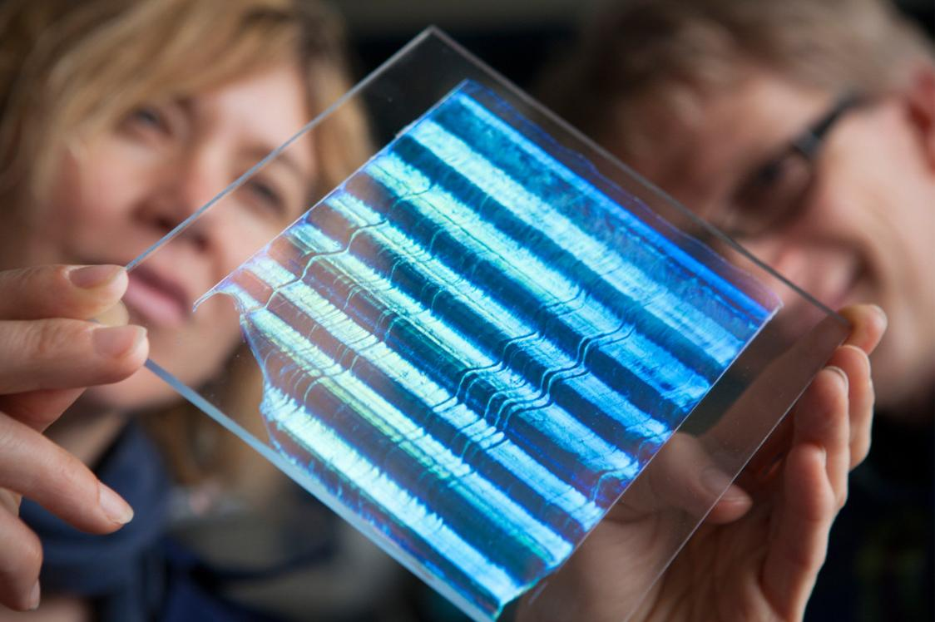

Slide 4
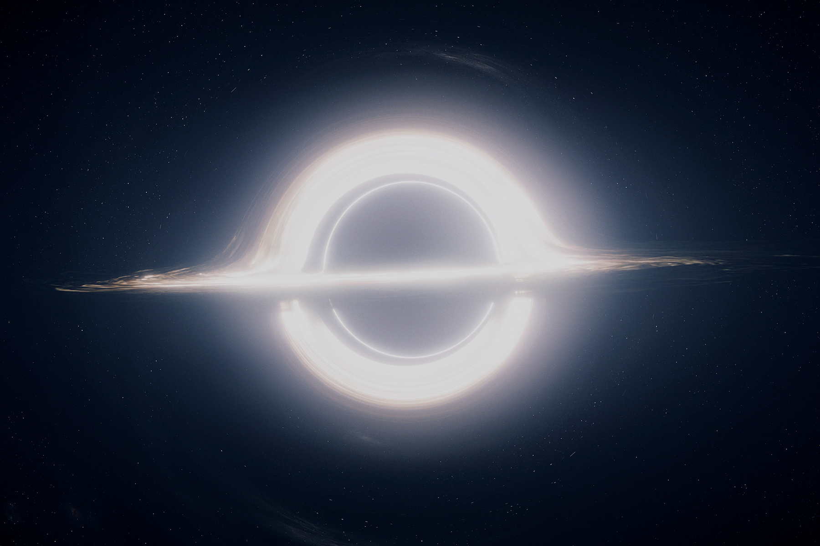
‘Gargantua’
Interstellar - Directed by Christopher Nolan, Executive Producer Kip Thorne
DNeg/Warner Bros Entertainment Inc
Paul Franklin - Creative Director for DNeg
Eugenie Von Tunzelman - VFX Supervisor for DNeg

Slide 5
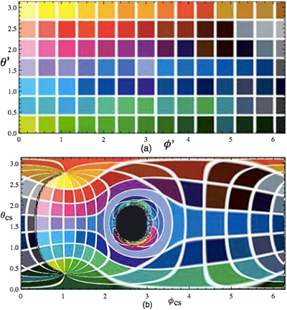
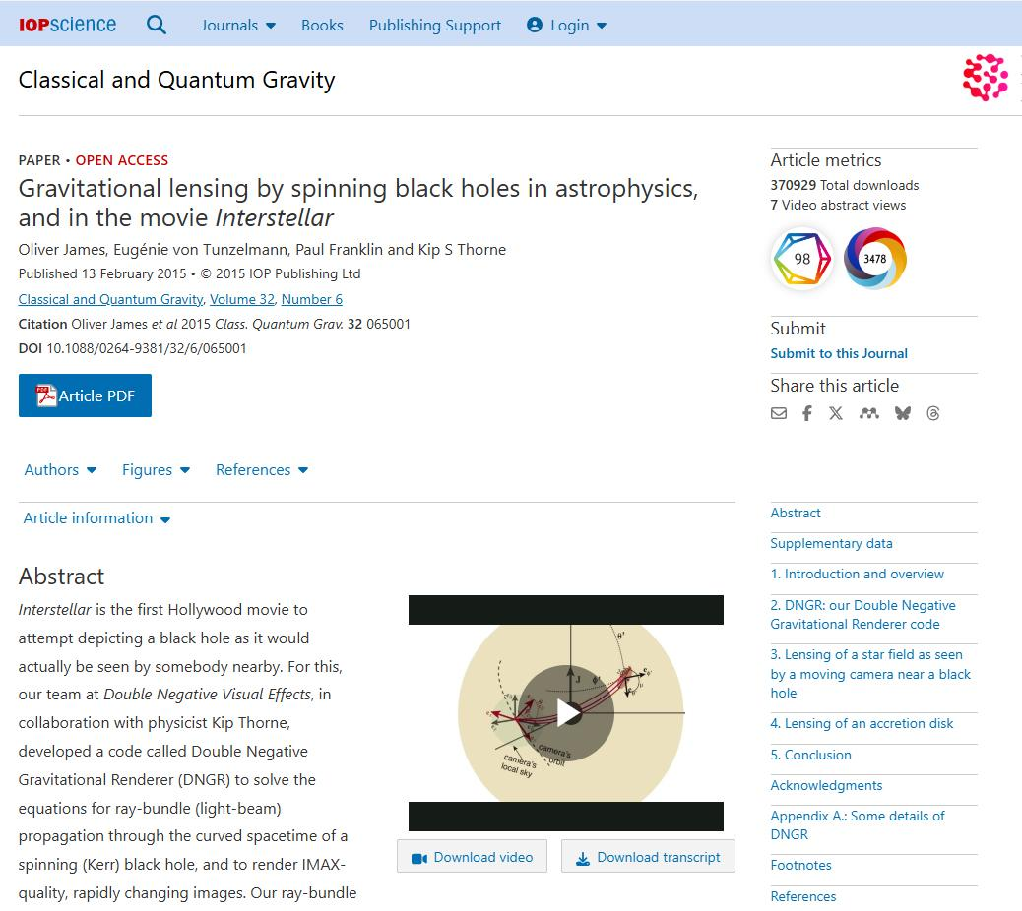
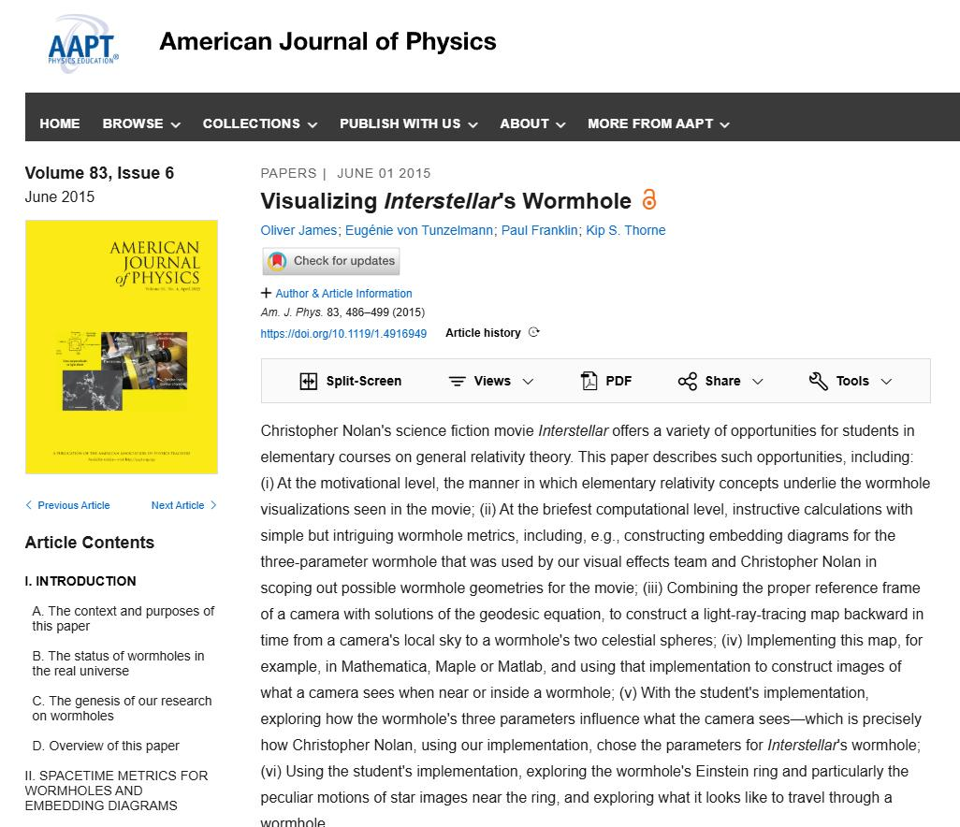
Thorne’s diagram of how a black hole distorts light

Slide 6
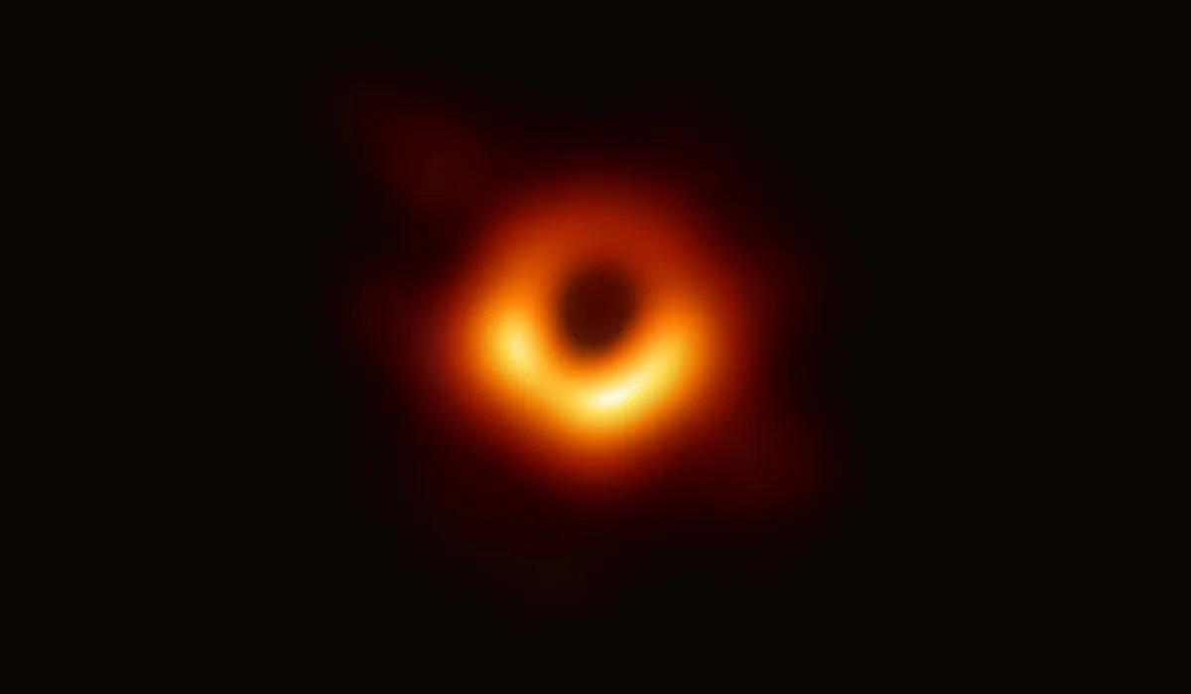
Supermassive Black Hole in Galaxy M87
Credit: EHT Collaboration

Slide 7
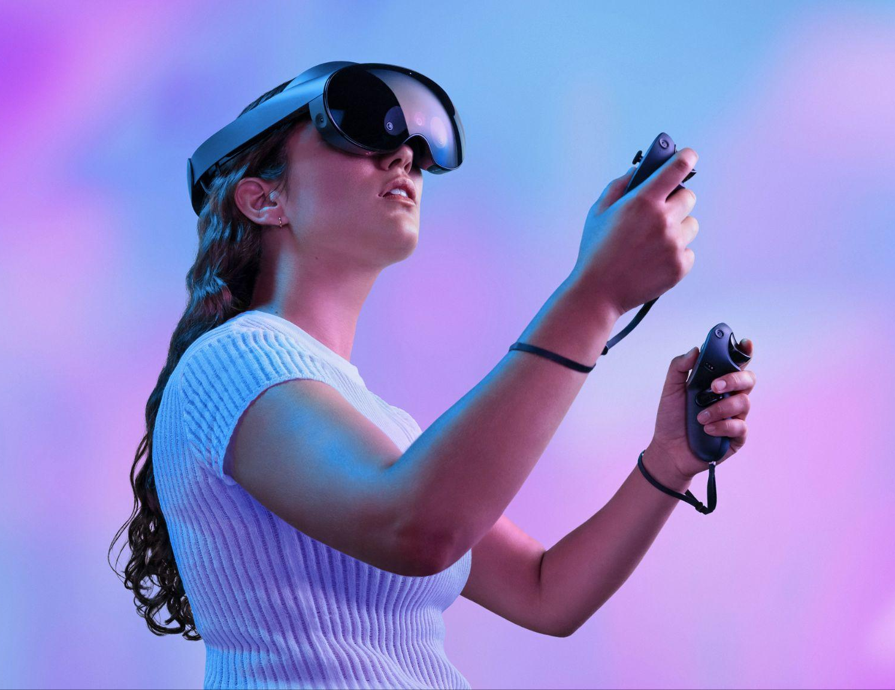
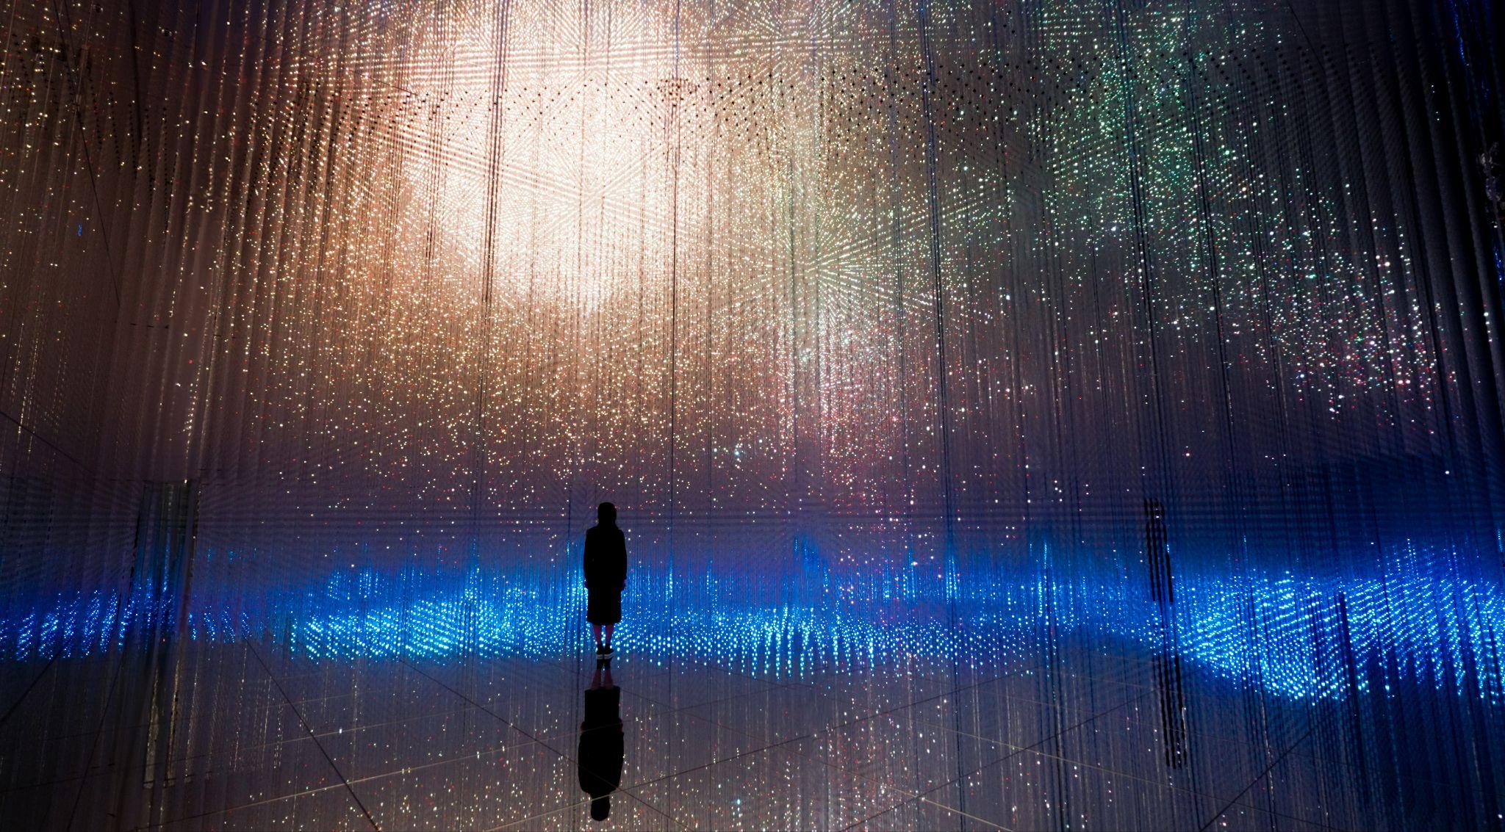
Meta VR Headset
‘Infinite Crystal World’ by Team Lab, Tokyo Digital Art Museum

Slide 8
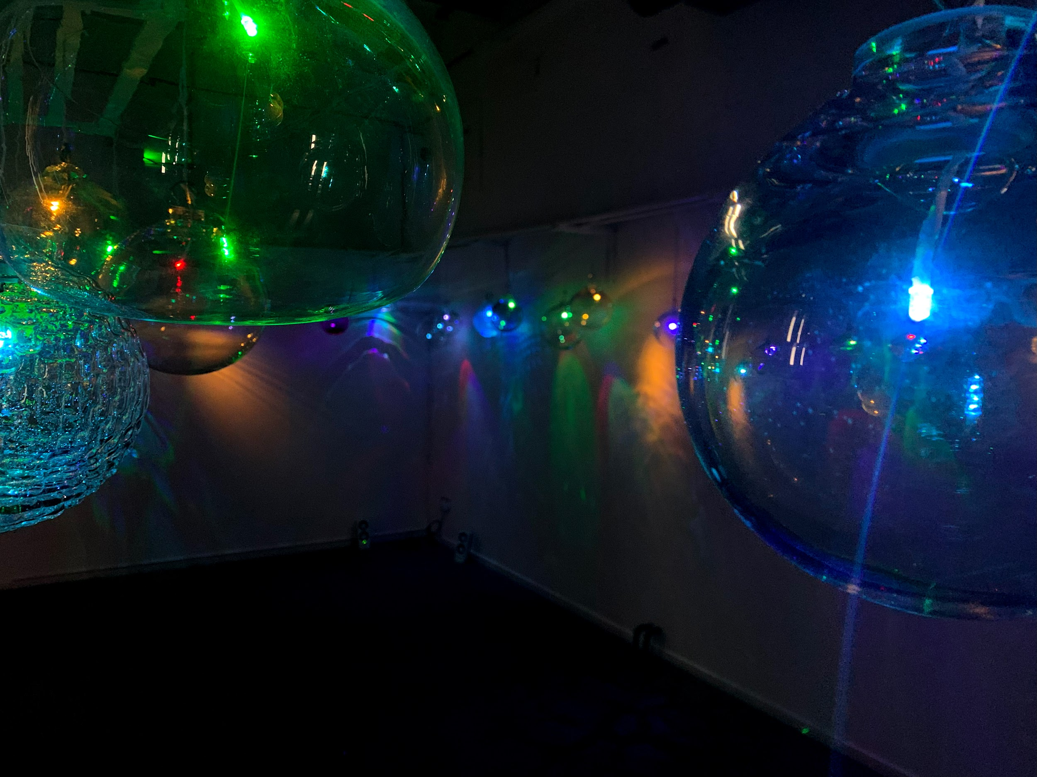
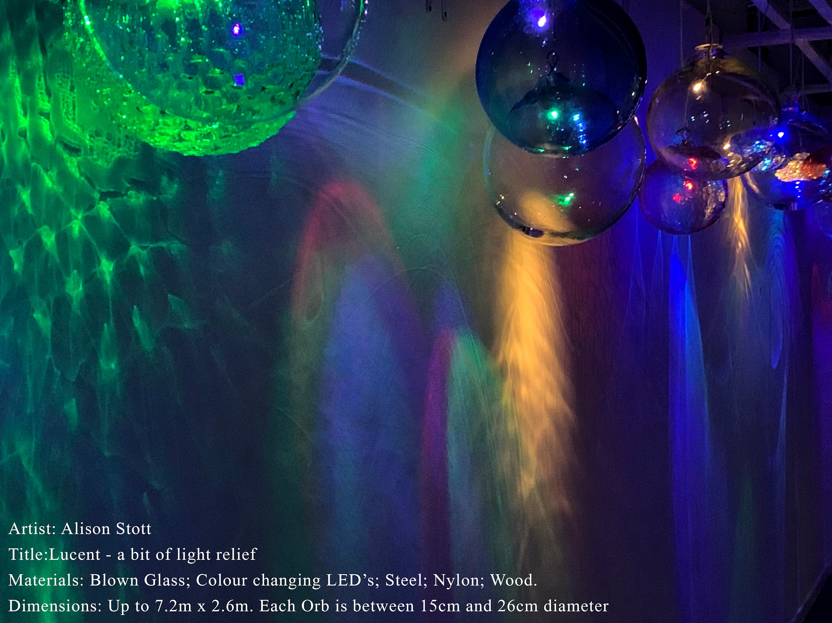
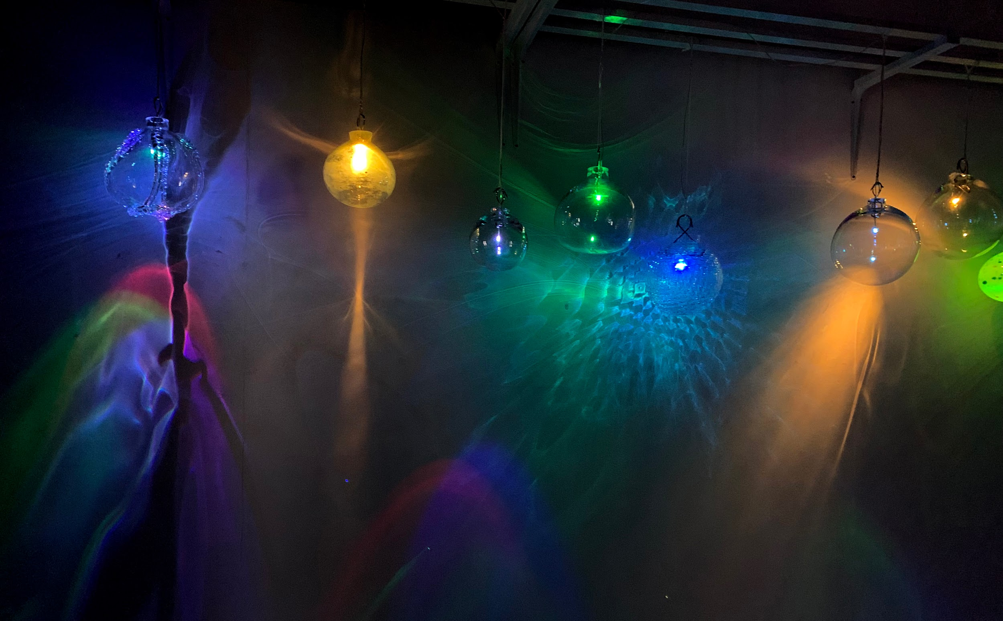
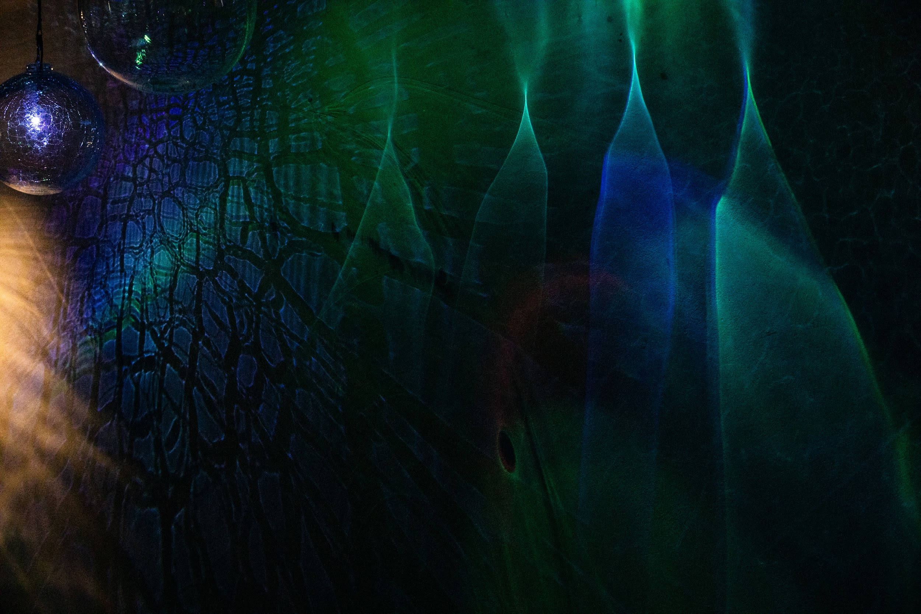
Lucent: A Bit of Light Relief
Alison Stott

Slide 9
Installation at 'Artober', Royal William Yard, Plymouth
Alison Stott

Slide 10
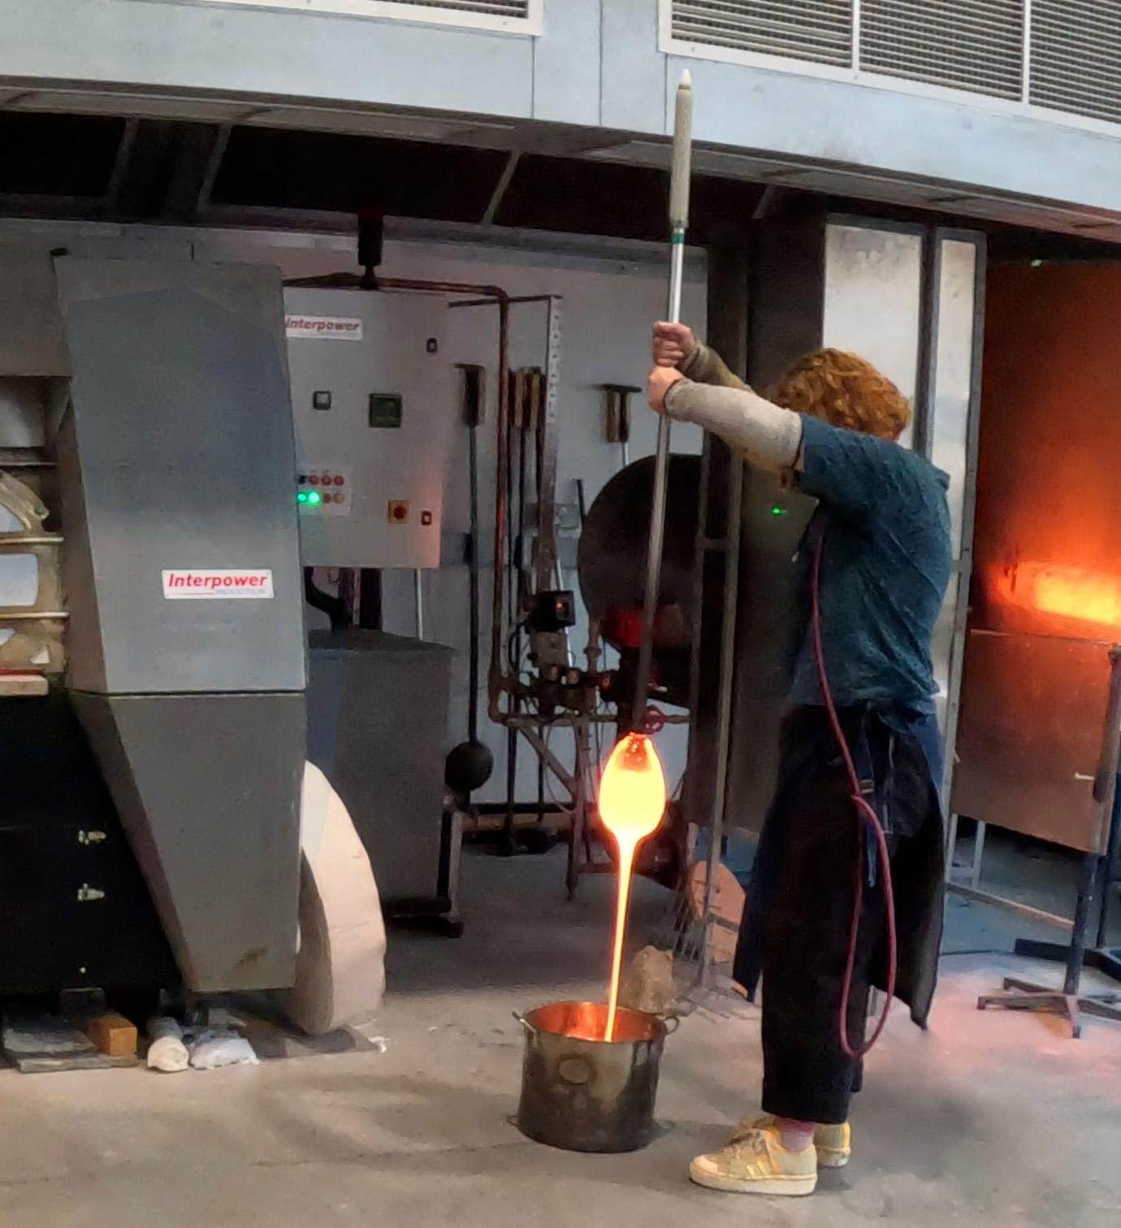
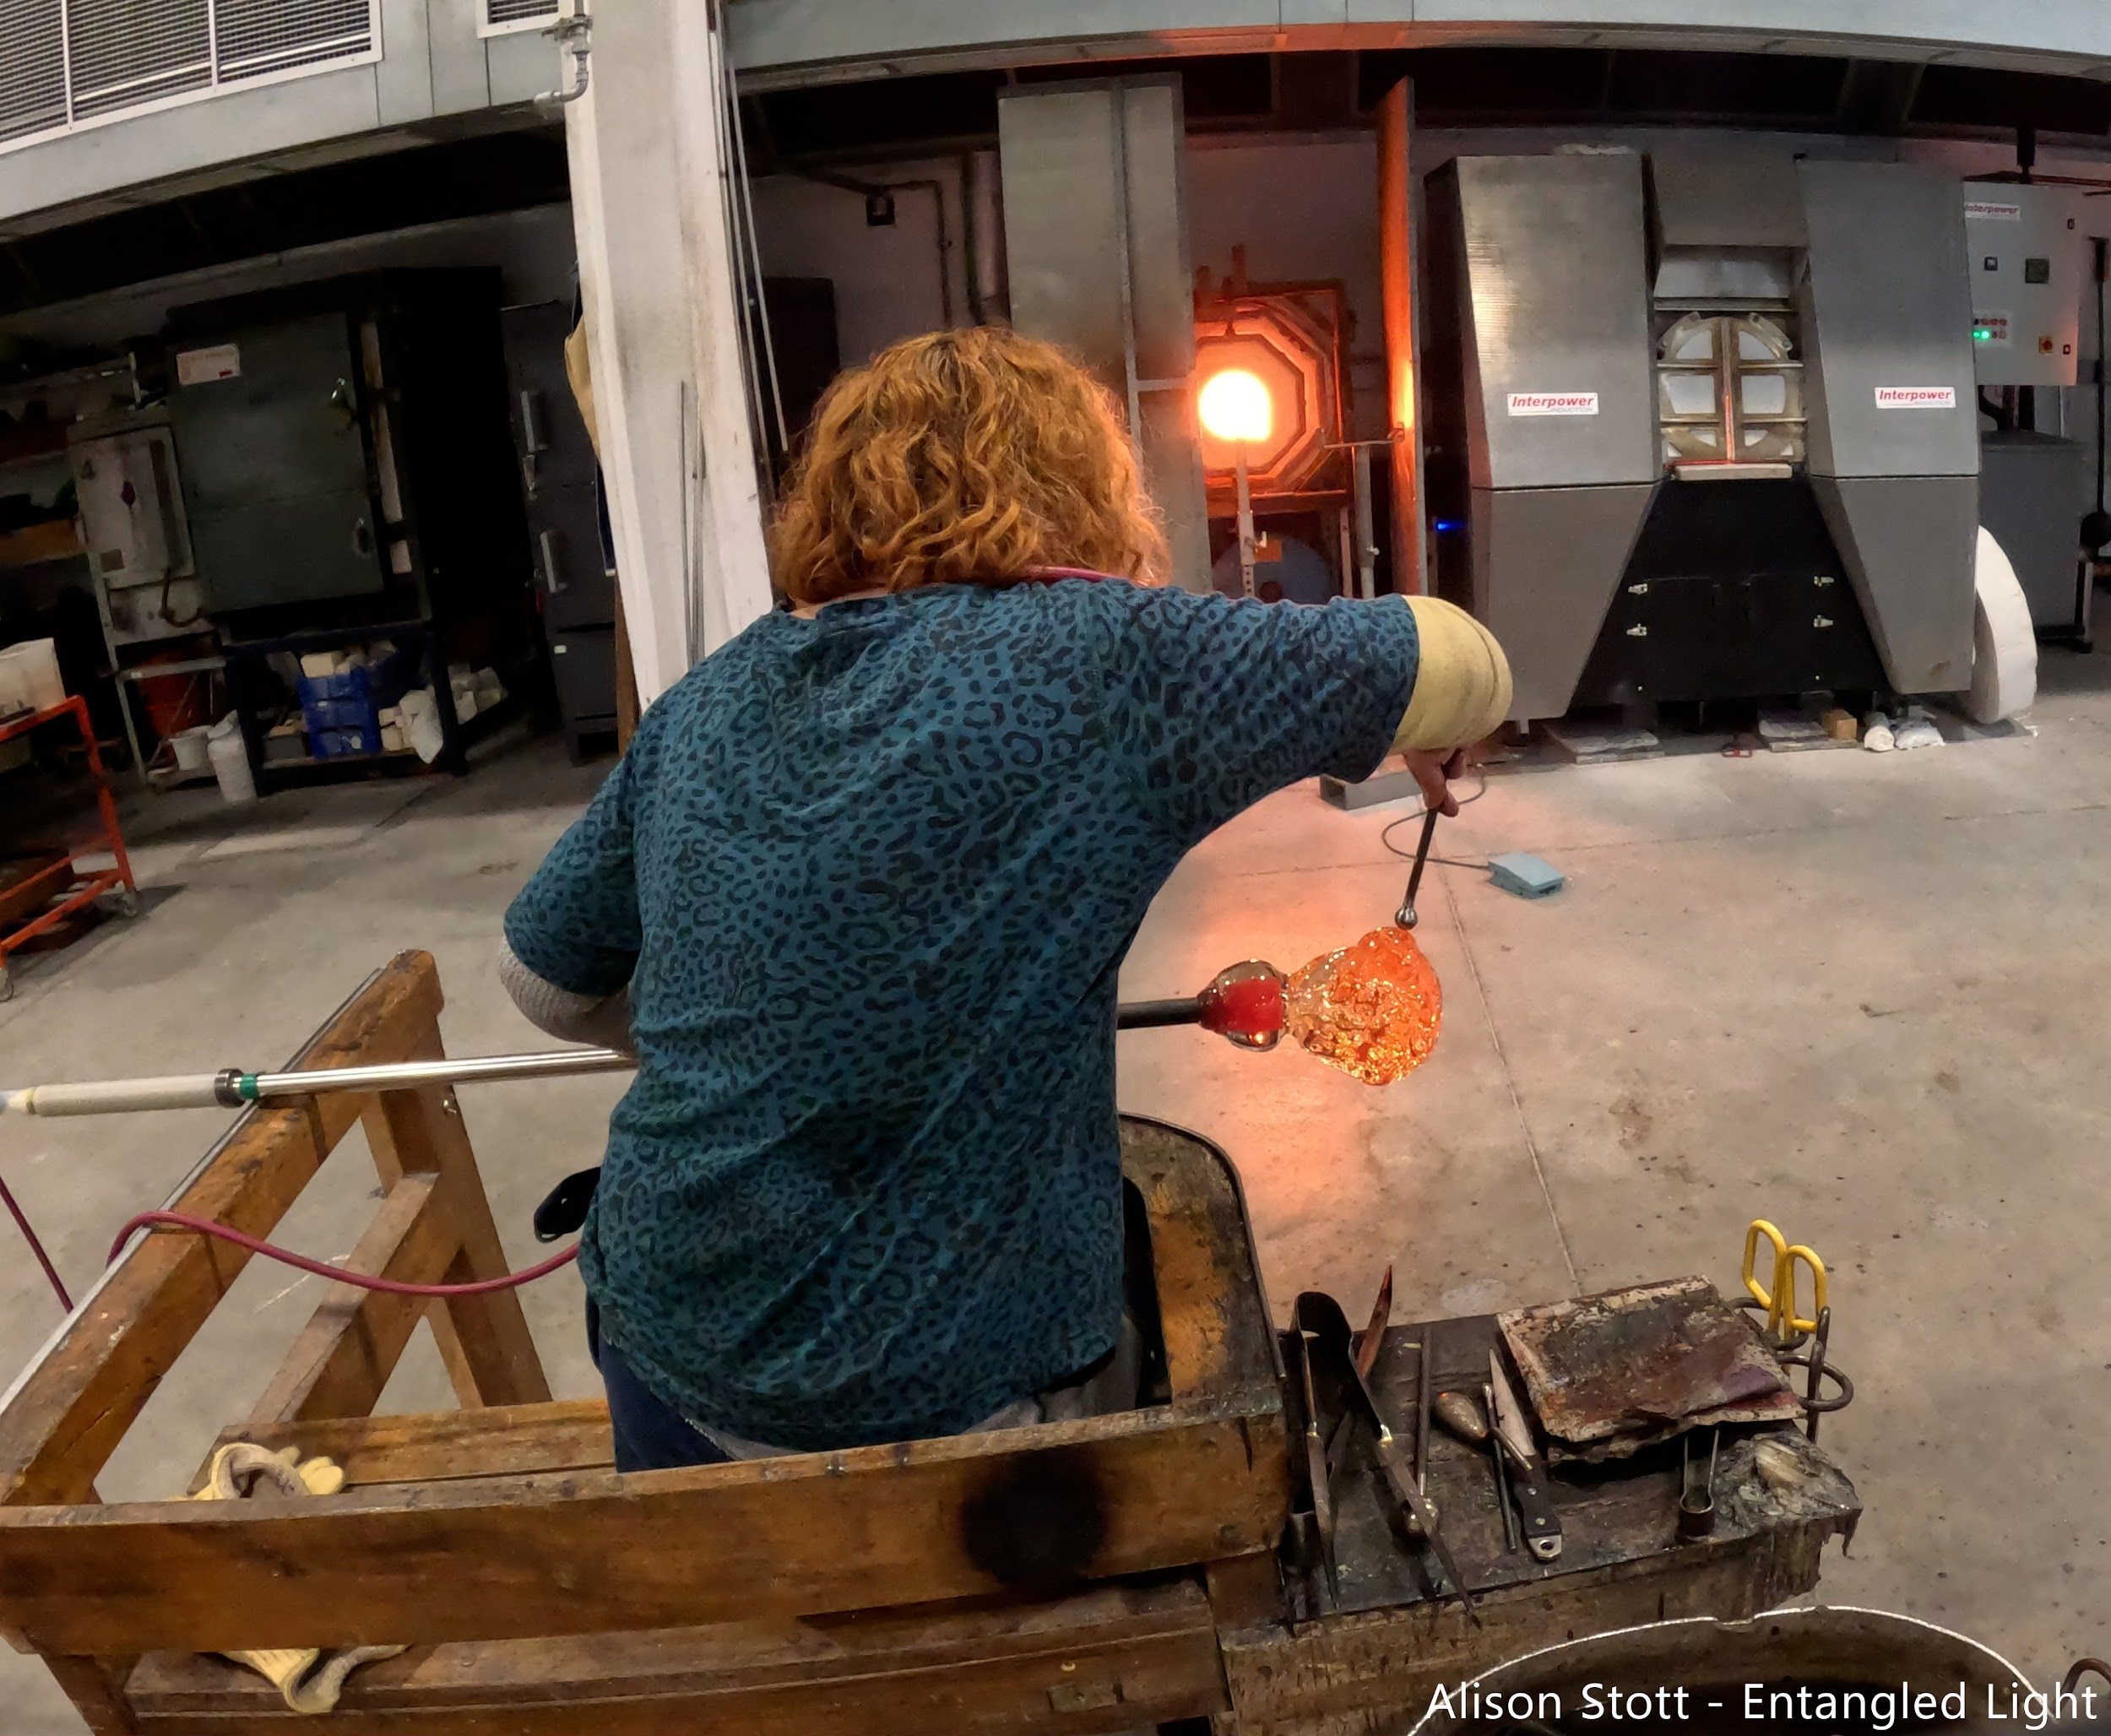

Slide 11
Installation at Royal William Yard, Plymouth as part of 'Artober'
Alison Stott

Slide 12
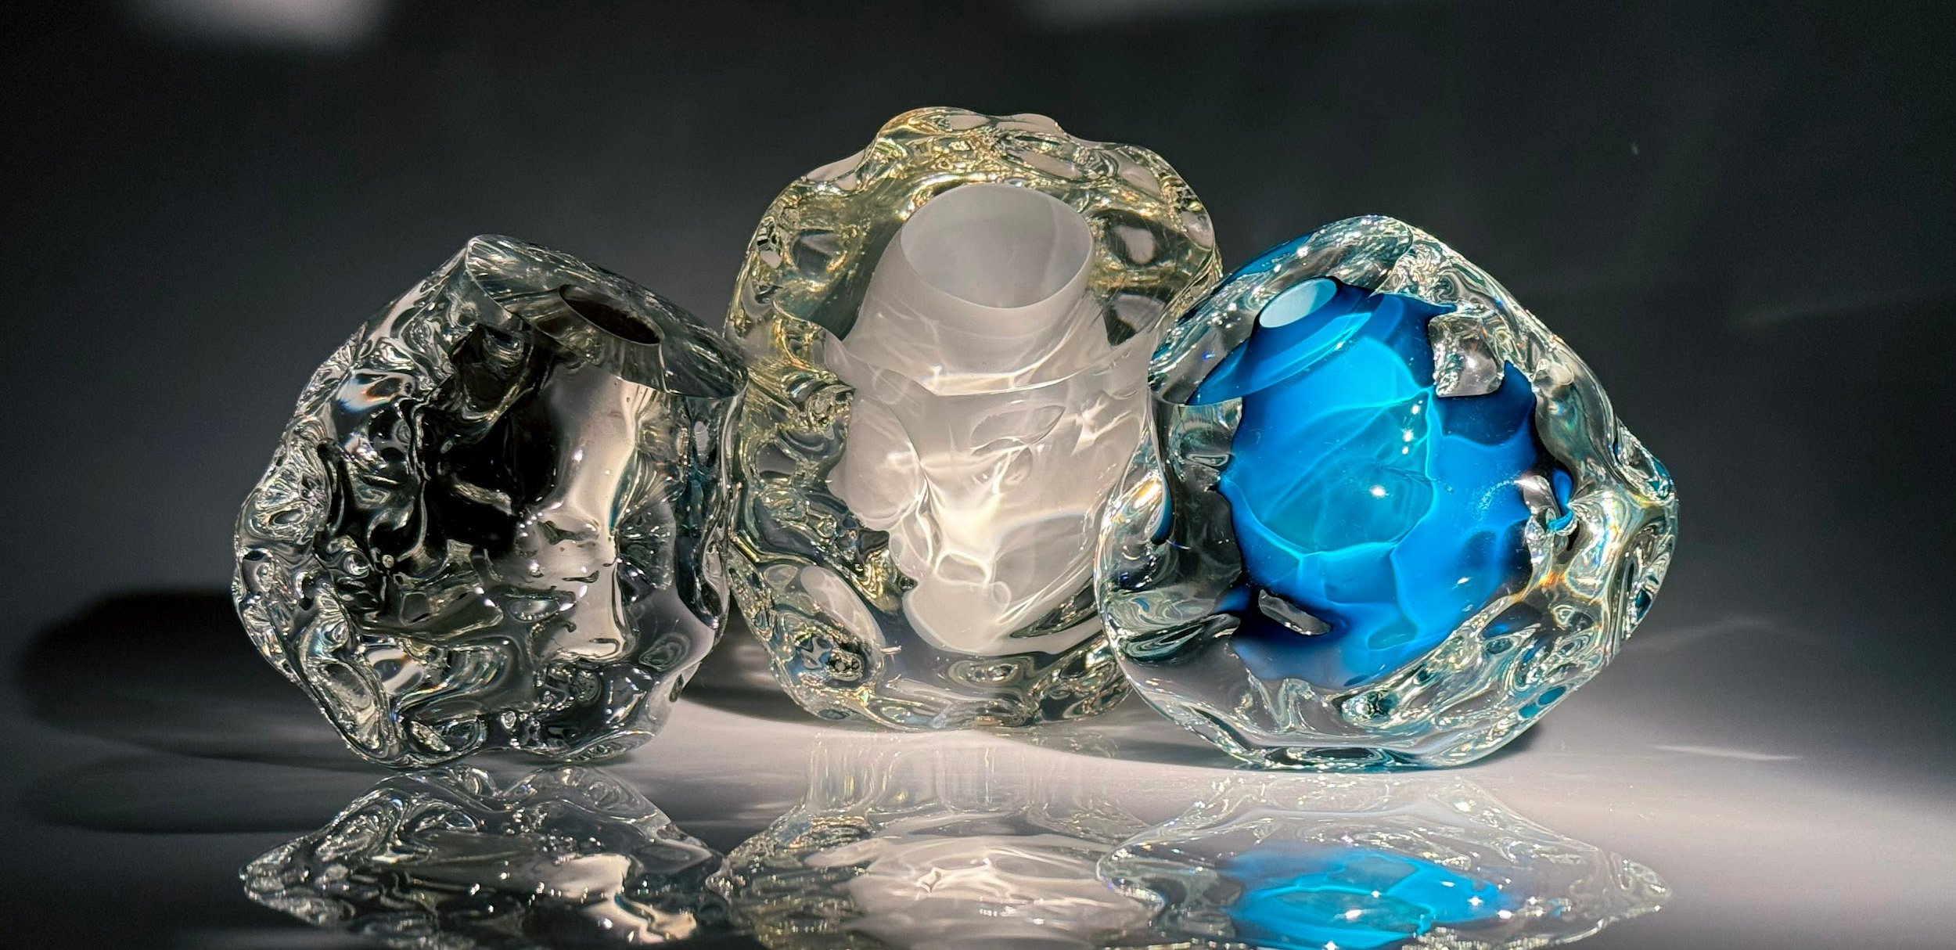
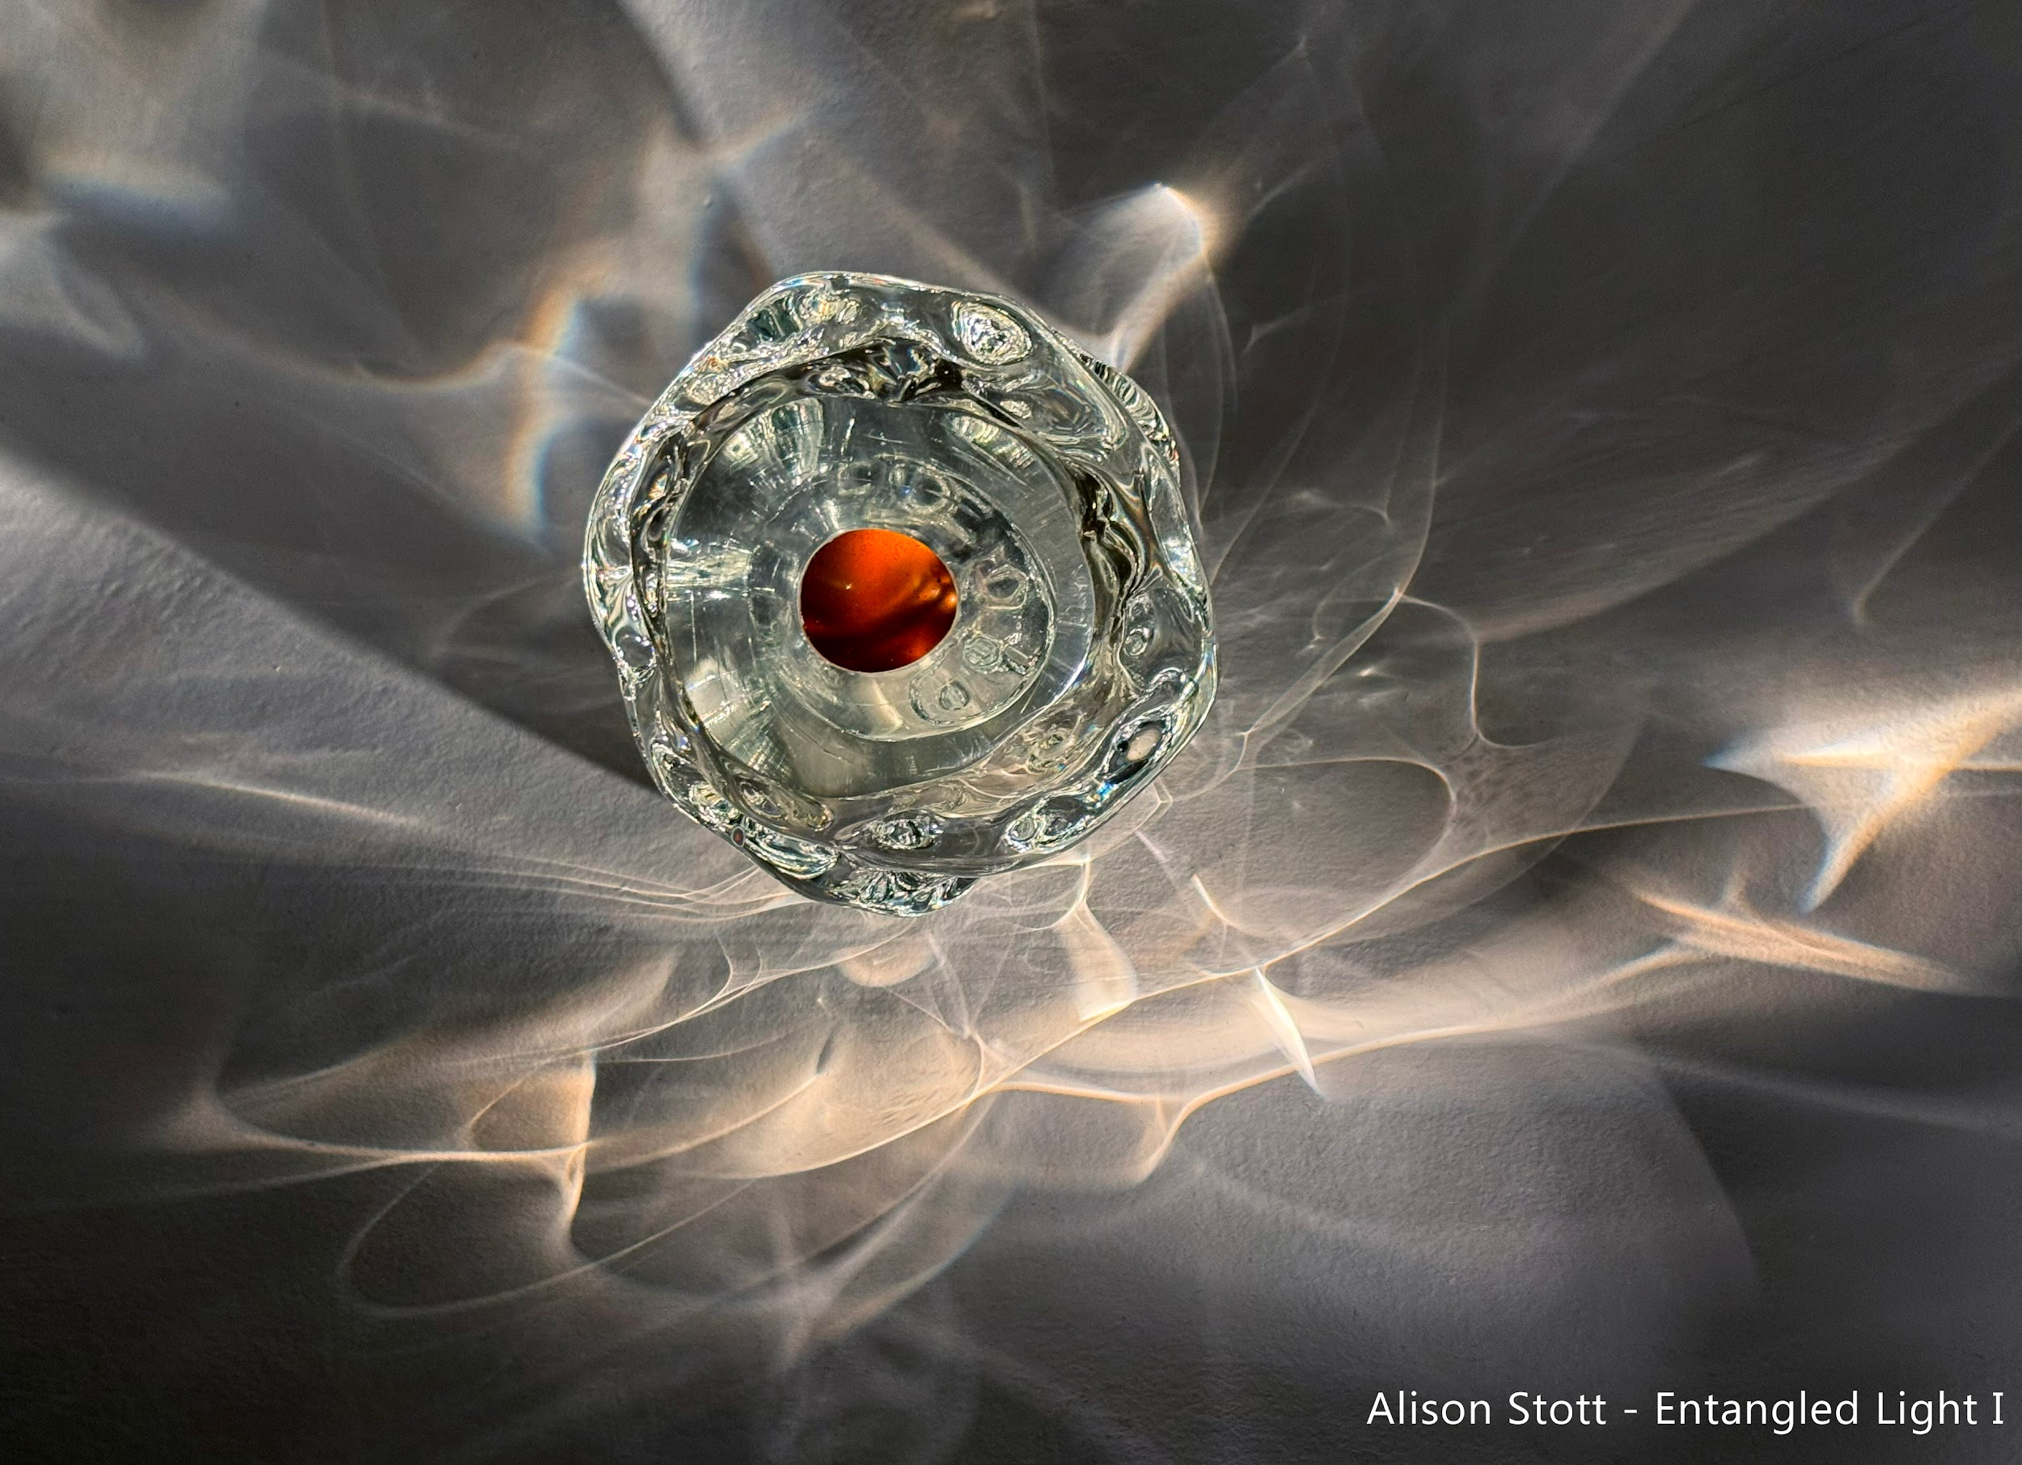
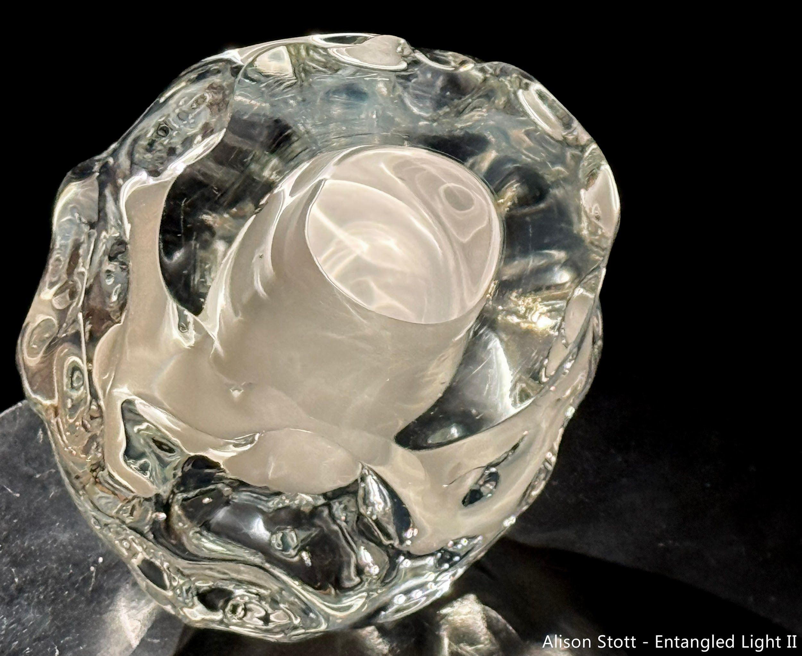
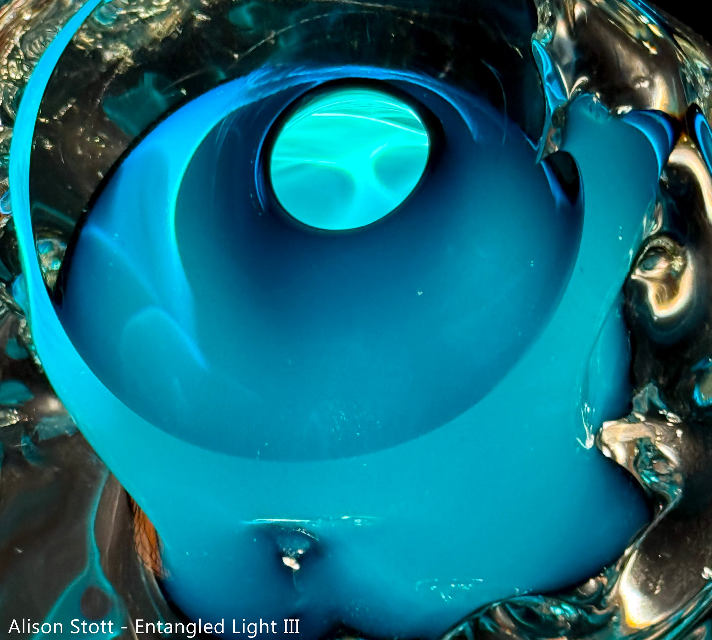

Slide 13
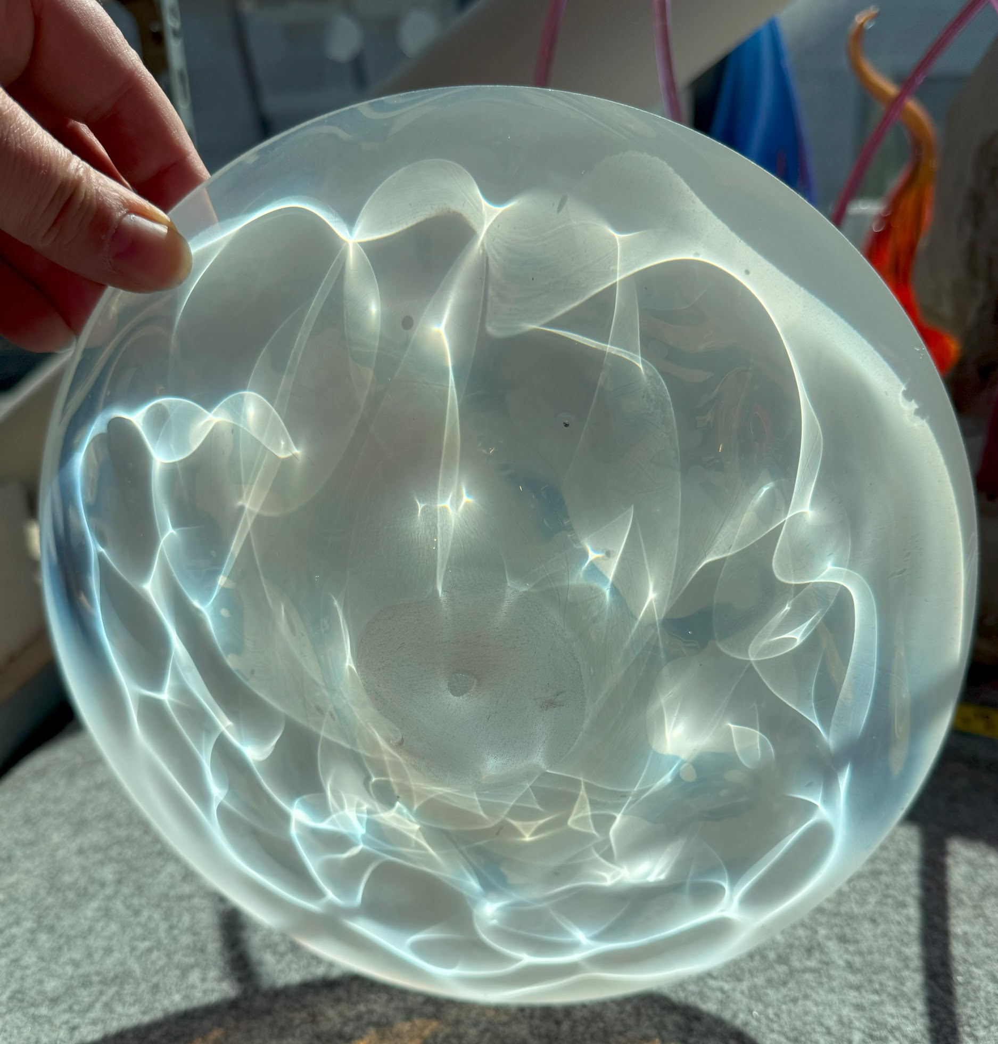
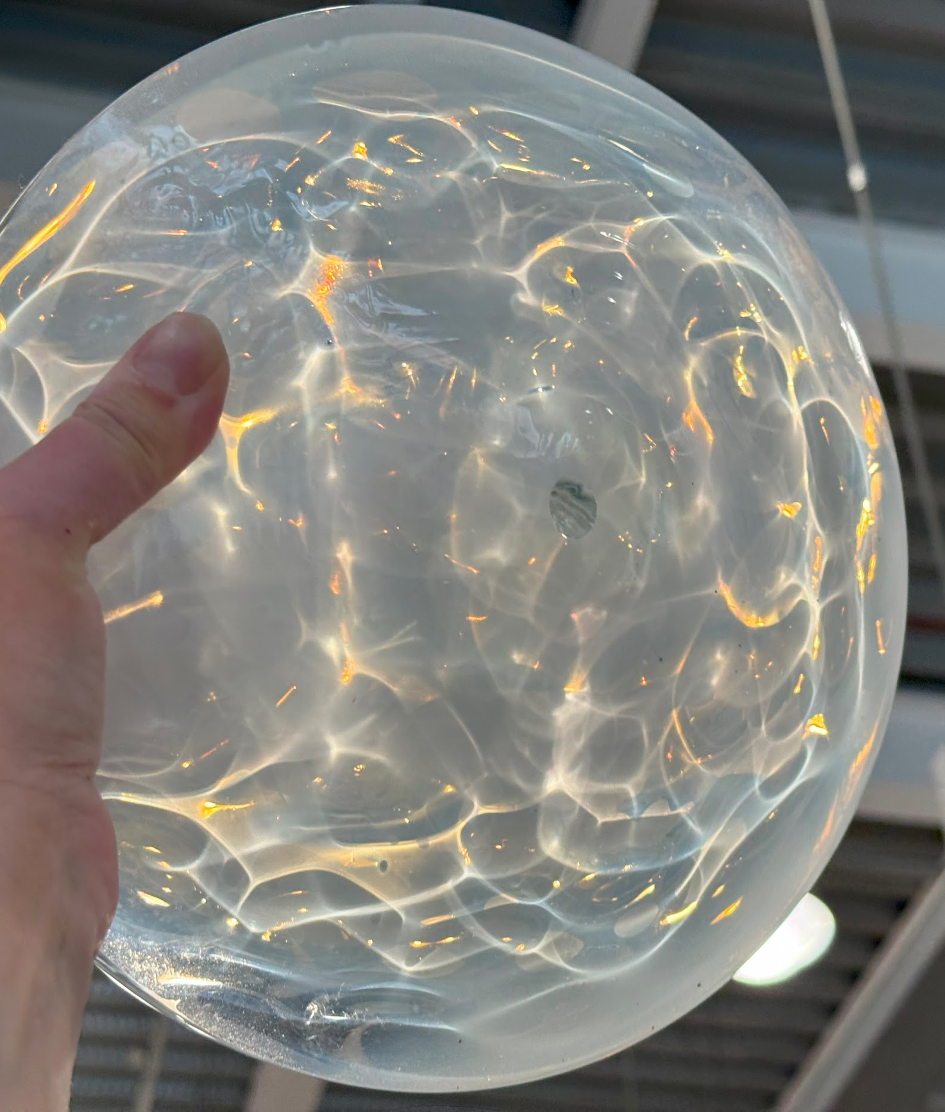
Development of 'Natural Focussers' for Bristol University Physics dept
Alison Stott

Slide 14
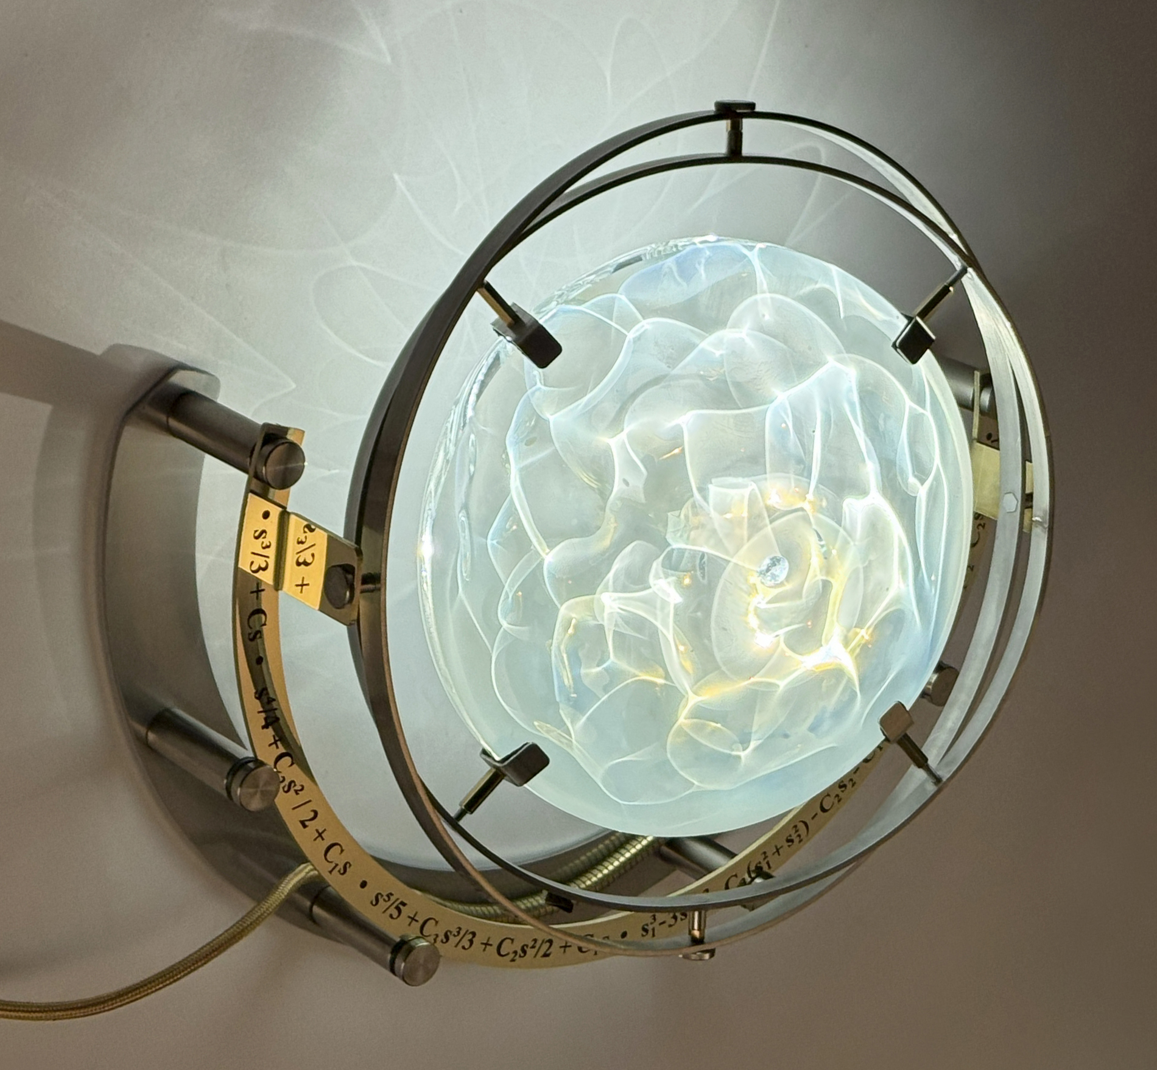
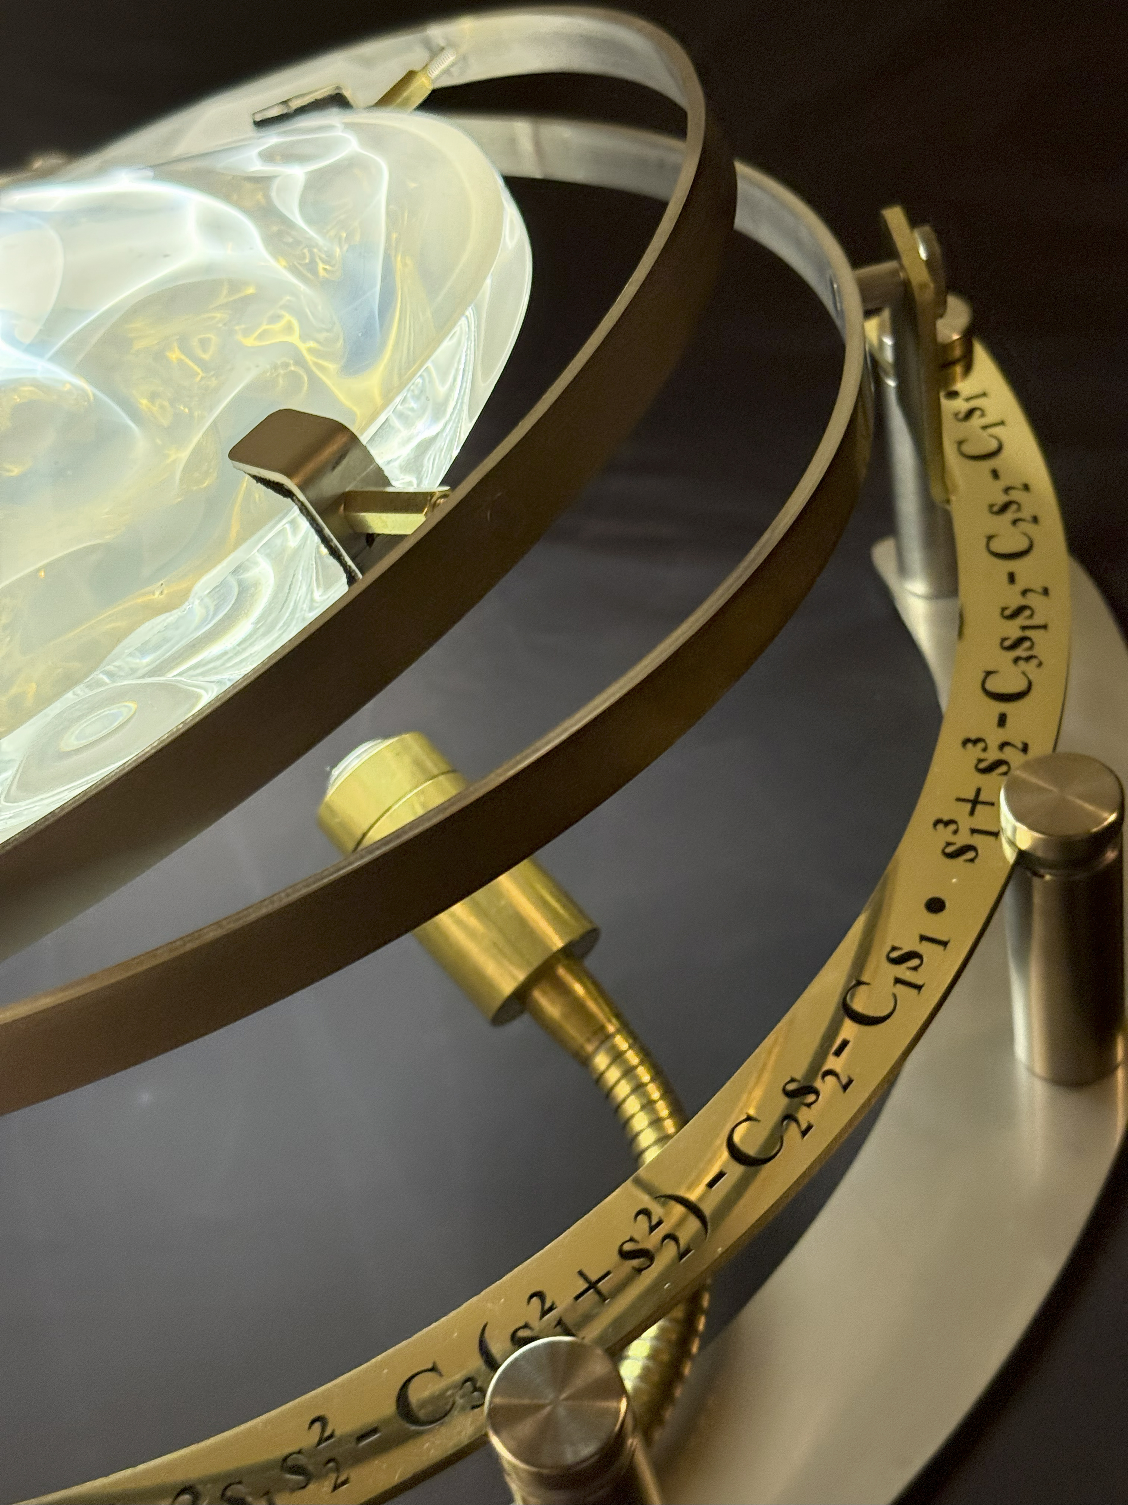
'Natural Focusser' for Bristol University Physics dept
Alison Stott

Slide 15
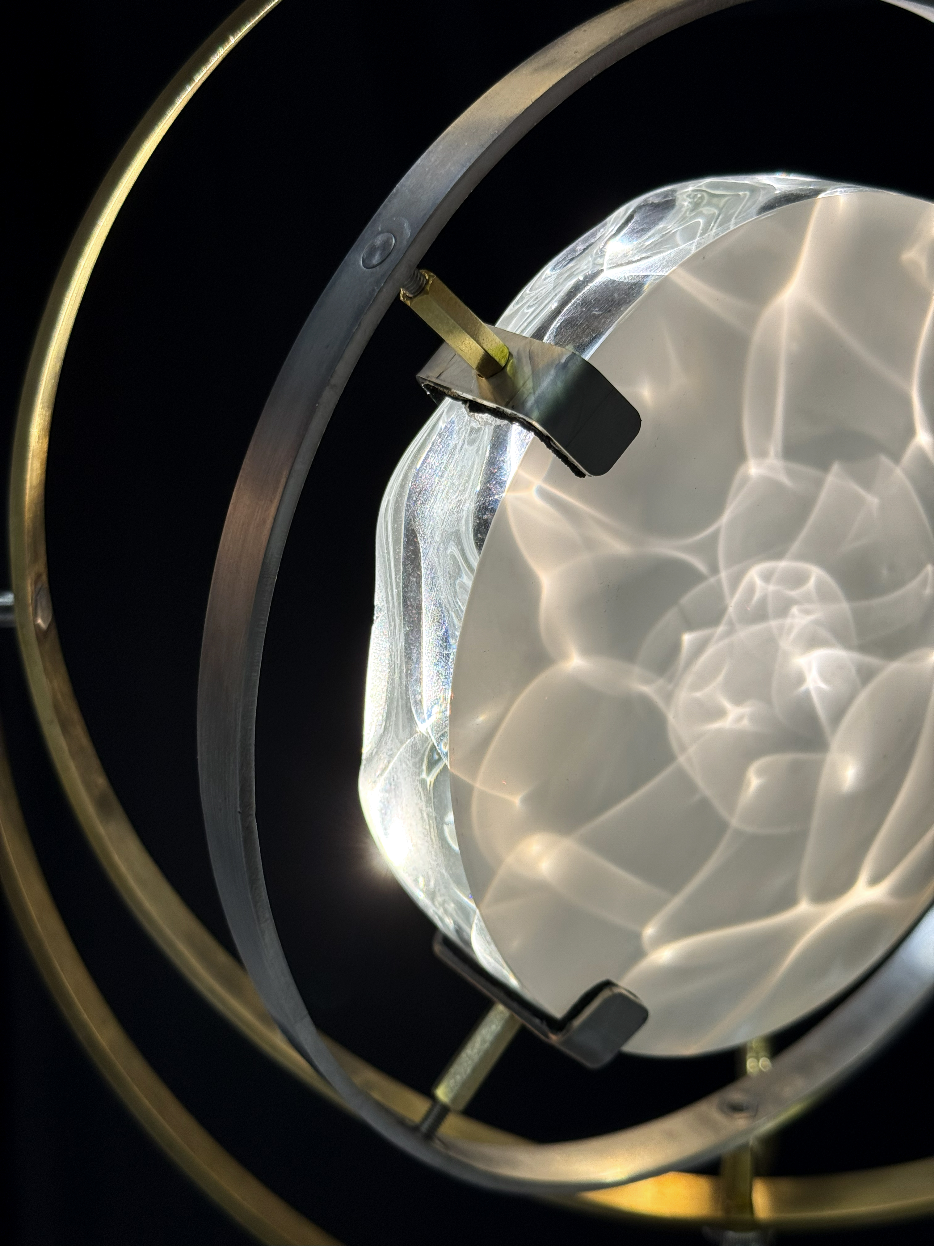
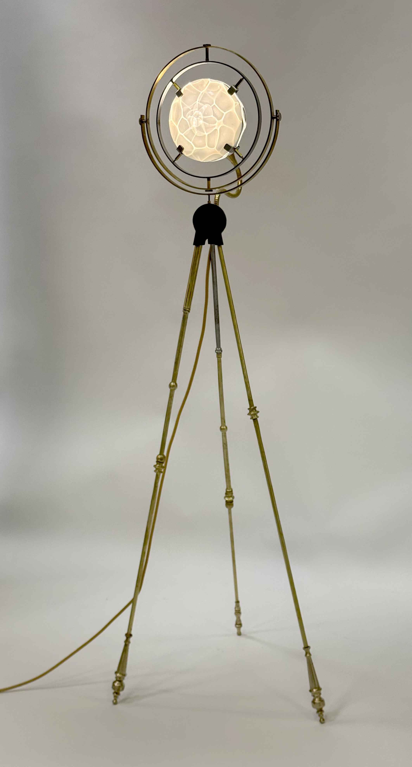

Slide 16
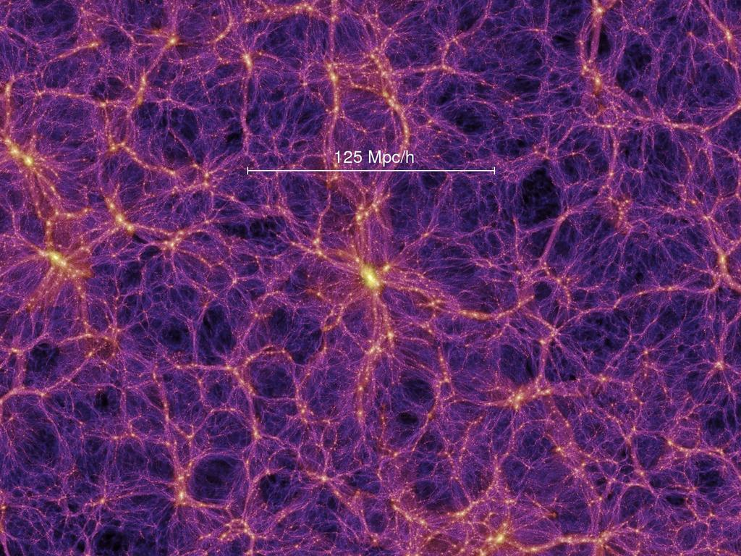
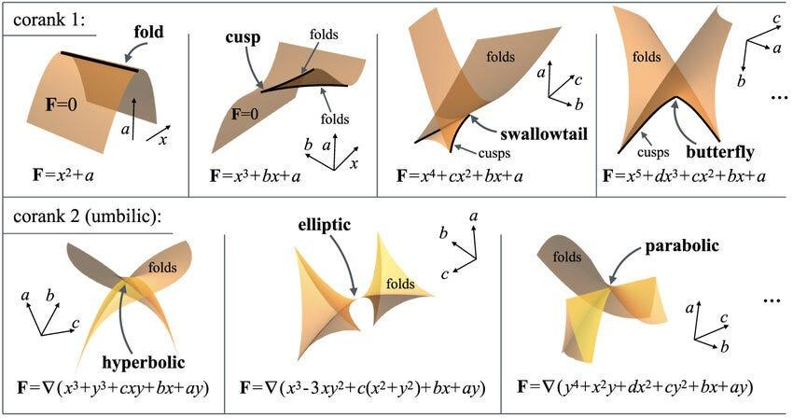
Caustic Skeleton of the Cosmic Web (Arnol’d, 1982; Hidding et al., 2014; Feldbrugge et al., 2018)
Image Credit: Research Gate
Image taken from
‘Catastrophe Optics: Morphologies of Caustics and Their Diffraction Patterns by M.V.Berry & C.Upstill
Image Credit: Volker Springel, Virgo Consortium

Slide 17
Thank You for Your Time!
Alison Stott
alison@alisonstott-art.com

