Slide 1
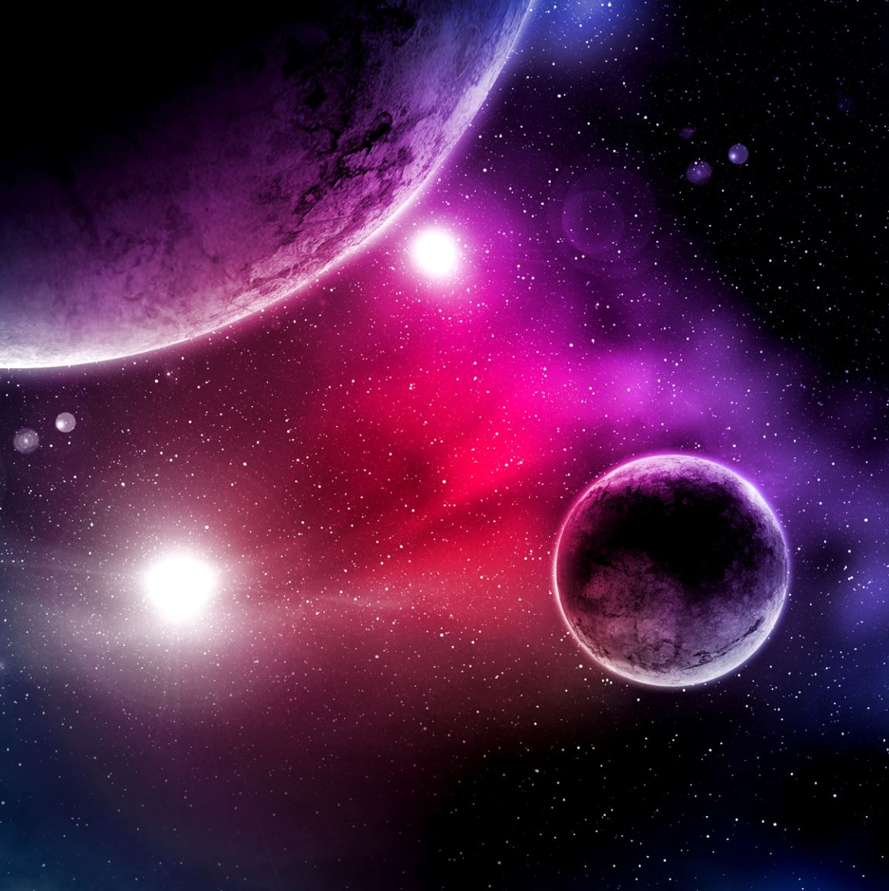
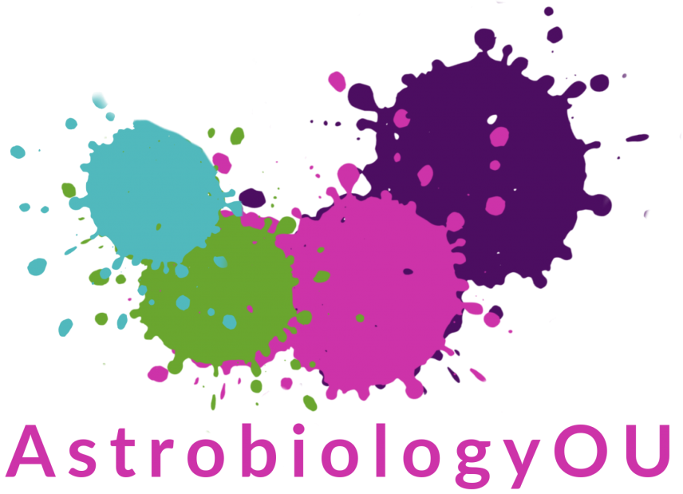
Exoplanets in Science Fiction
Dr Emma Johanna Puranen
AstrobiologyOU
NAM 2025
Notes:
Hi, I’m currently a postdoc at AstrobioOU at the Open University, but I’m here discussing projects from my recently finished PhD, one on creating a Bayesian network of fictional exoplanets, one on creating an anthology of science fiction exoplanets. Qualitative and quantitative.

Slide 2
Research question: how does science fiction portray science?
Science fiction has potential for science communication and science literacy
What discussions are scientists and SF creators having?
Investigate with exoplanet science as it has undergone a big change
Focused question: to what extent are scientific concepts about exoplanets diffused through science fiction?
Solution: Big data, digital humanities approach
Scientists
Science fiction creators
General public
Notes:
Begin with premise that SF has potential for science communication—big readership, 10-20% of box office, millions of copies sold of books like The Martian and The Three-Body Problem—shared lexicon, introduces concepts from science to people?—studies have investigated audience reactions to SF, but not looked at the science content of SF itself
Science fiction: cognitive estrangement, future-oriented, technological, explore “what-ifs” of science—soft or hard, but always based on an idea from science—features an imaginative framework alternative to the author’s empirical environment

Slide 3
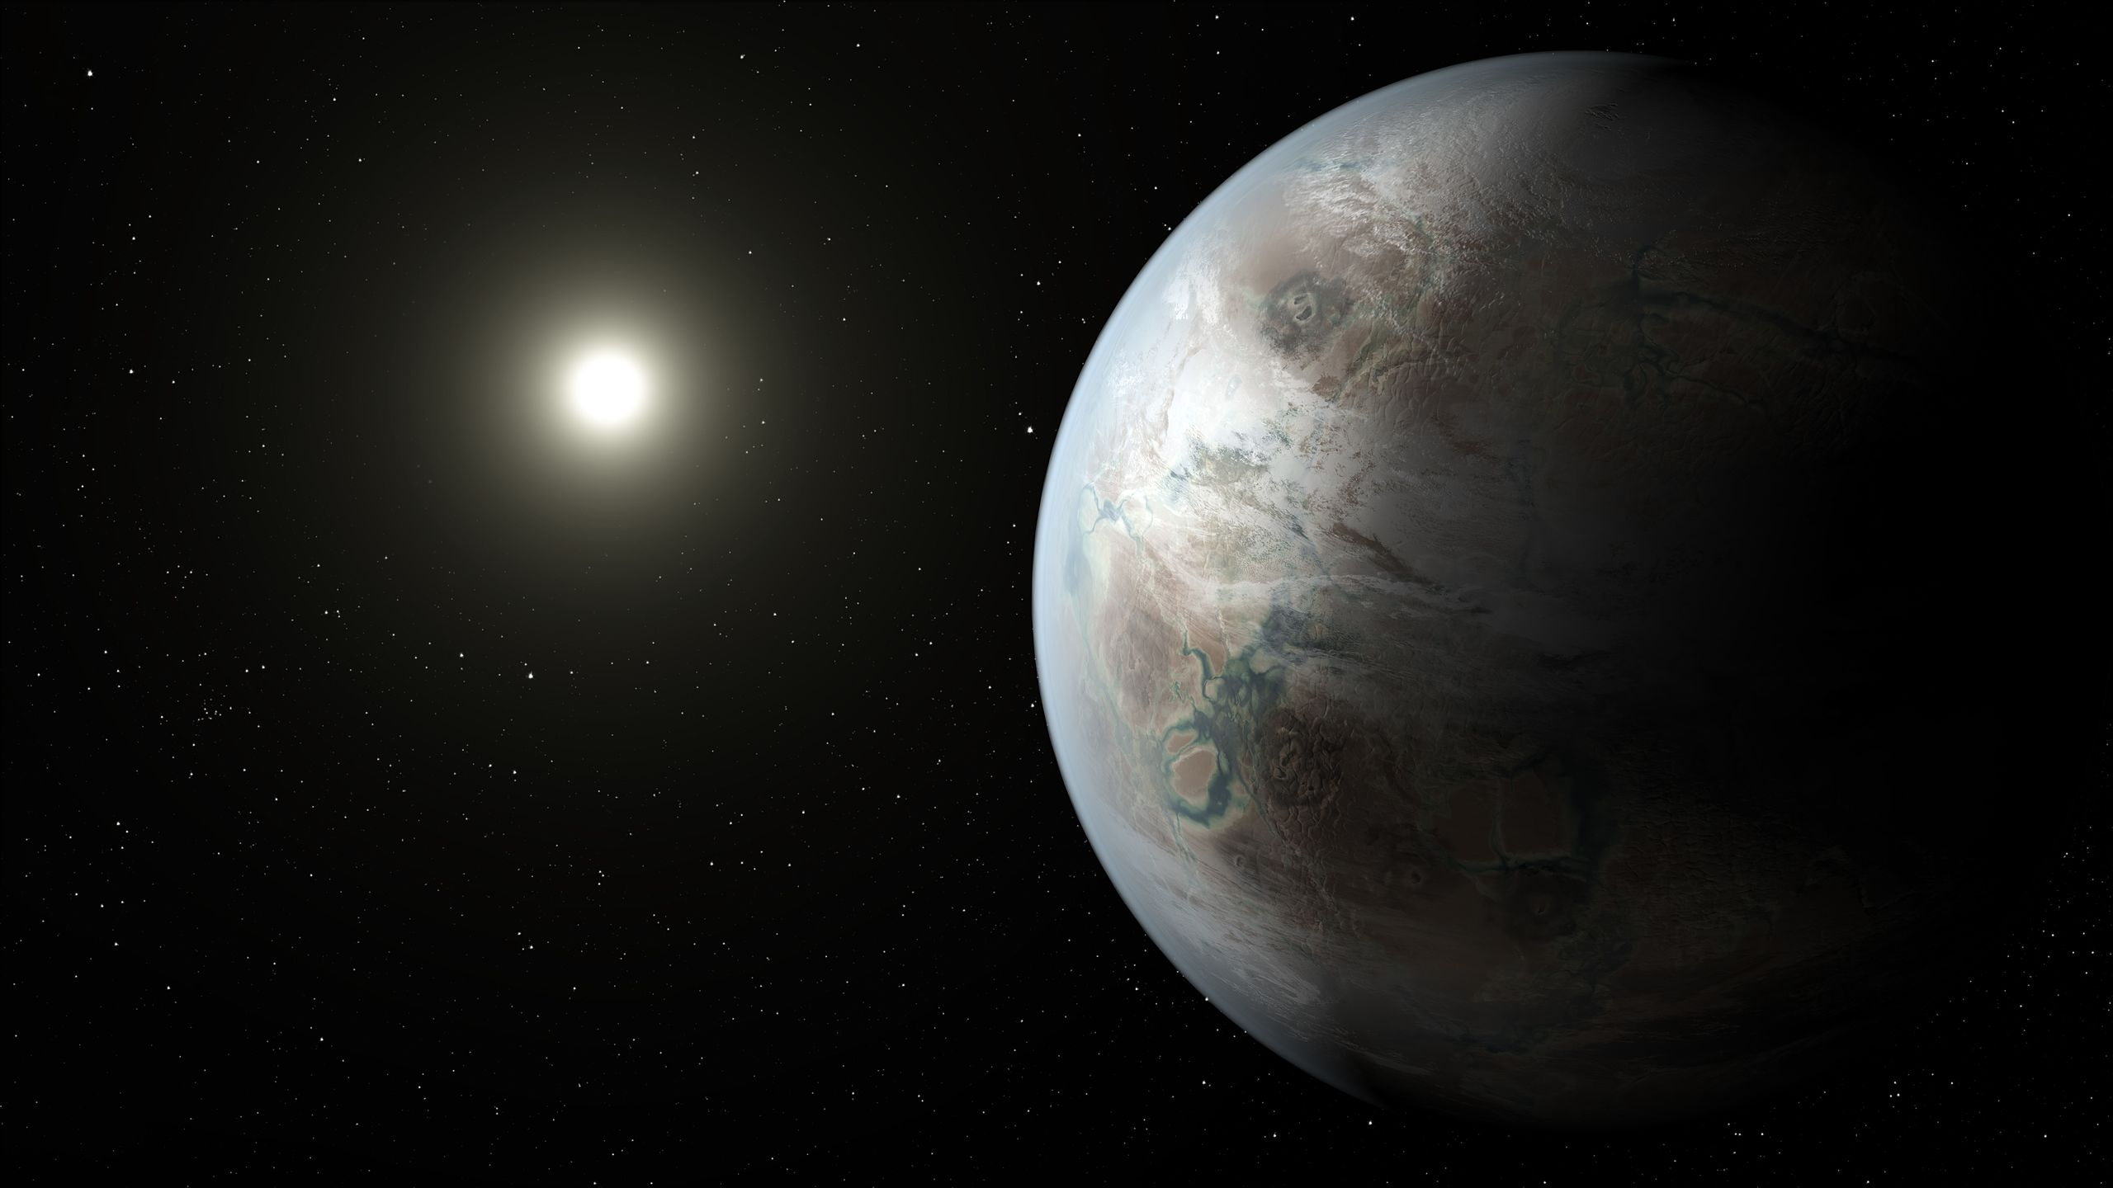
Why exoplanets?
Why exoplanets?
Exoplanet: planet outside our solar system
Common setting in SF stories before and after discovery of real exoplanets
Mostly not taught in school; people are familiar through science fiction
Artist’s concept of Kepler-452b
NASA Ames/JPL-Caltech/T. Pyle
Artist’s concept of Kepler-452b
NASA Ames/JPL-Caltech/T. Pyle
Notes:
Investigate with exoplanets as they’ve undergone a big change in scientific understanding, 6000 since the 90s, very different than what we expected from our own solar system, new types of planets

Slide 4
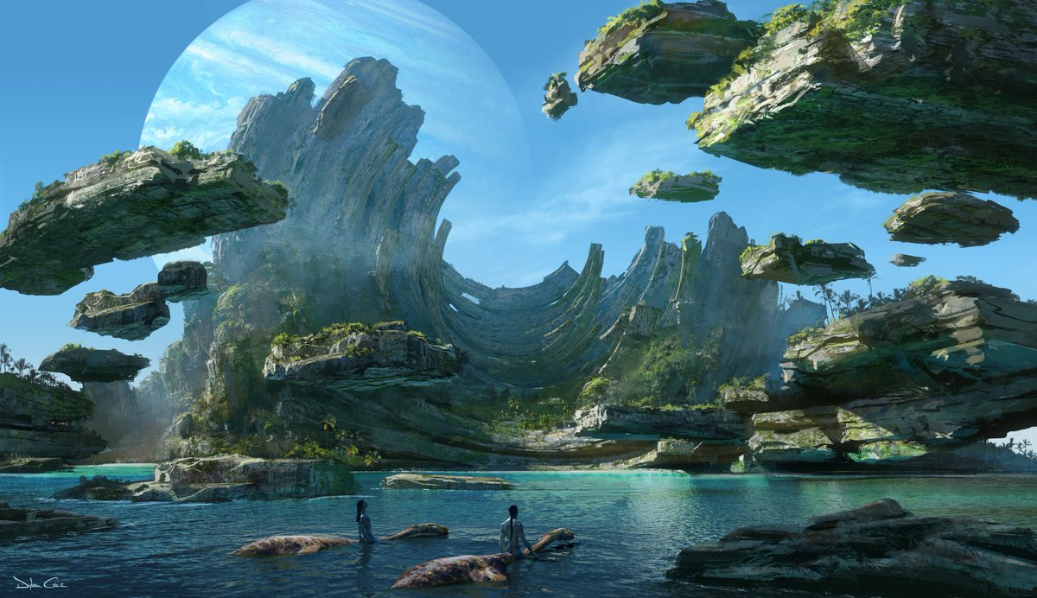
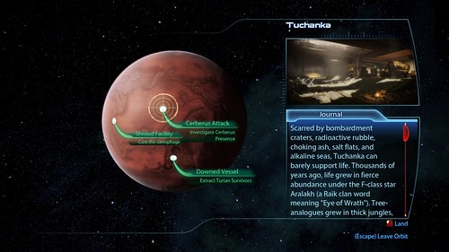
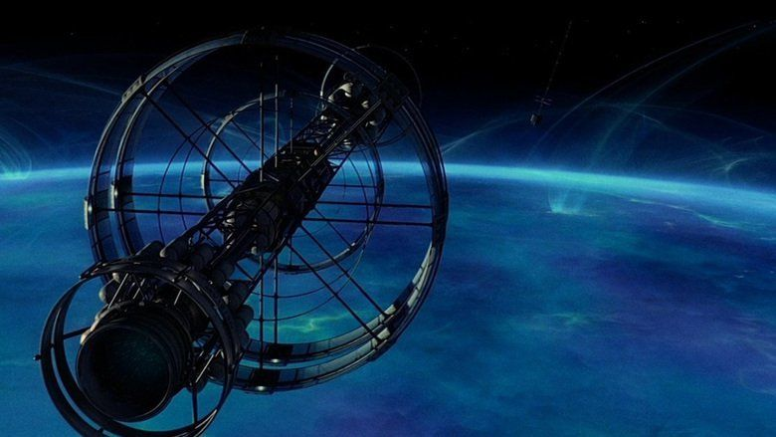
Science Fiction Exoplanets
The New York Times
Avatar 2 Concept Art
Solaris (2002)
Mass Effect 3
Notes:
Featured in SF before and after discovery, science communication potential because not taught in schools

Slide 5
Methodology
Collect data on fictional exoplanets in science fiction
Create Bayesian network
Structure learning (using machine learning to find network from data)
Banjo (Hartemink, Duke University) for structure learning
BayesPiles for data analysis and GraphViz for visualisation
Notes:
Machine learning: algorithms that can learn from data
Bayesian network: network that tells you how characteristics influence each other

Slide 6
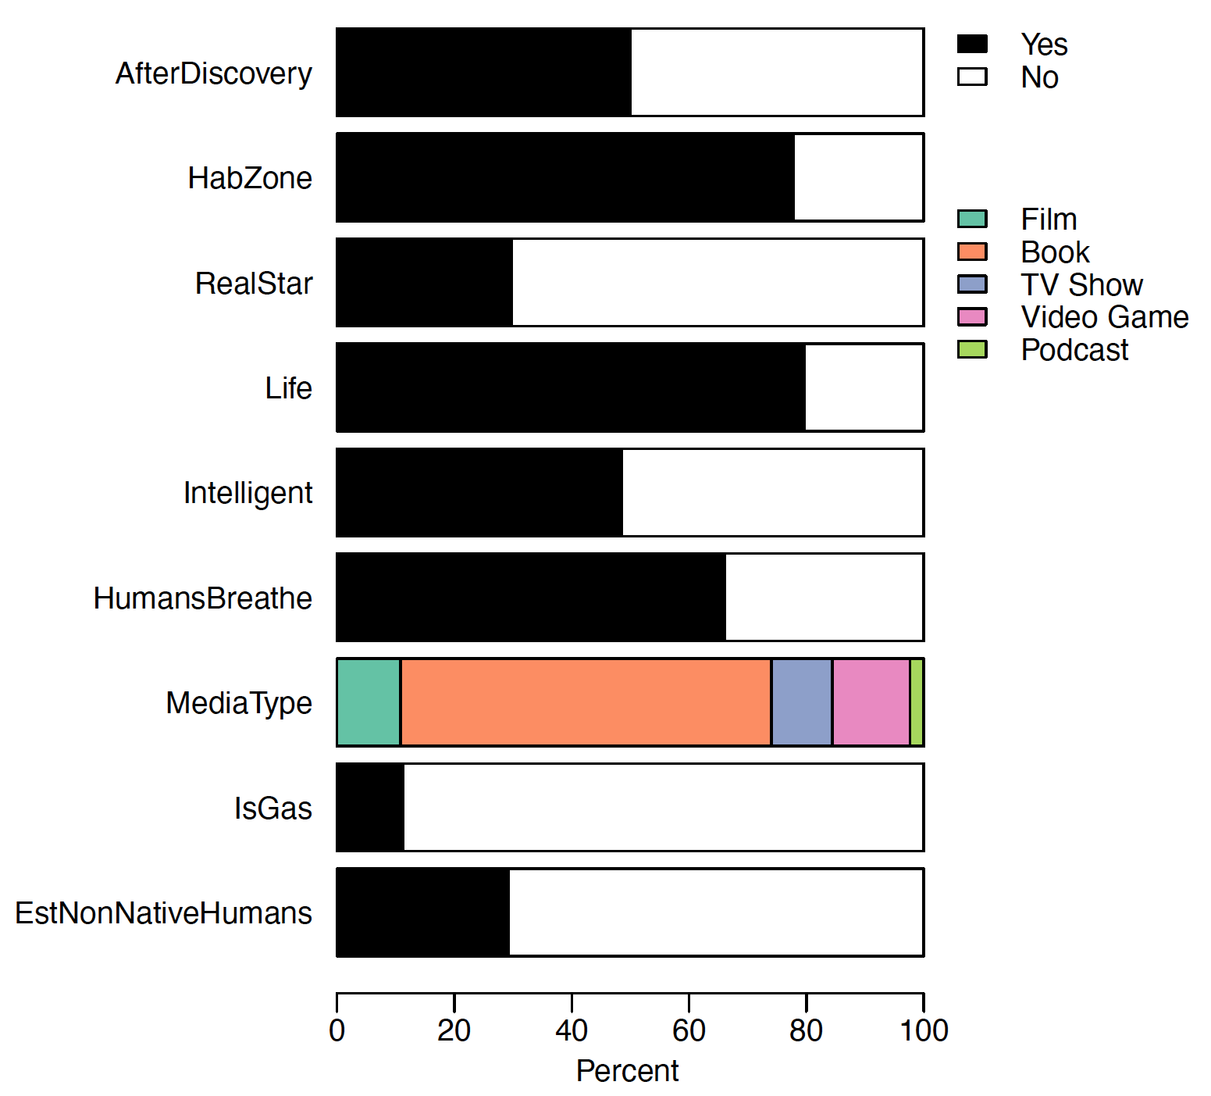
Notes:
Database is a result in itself, represents a repository of human imaginings of exoplanets
212 exoplanets in database

Slide 7
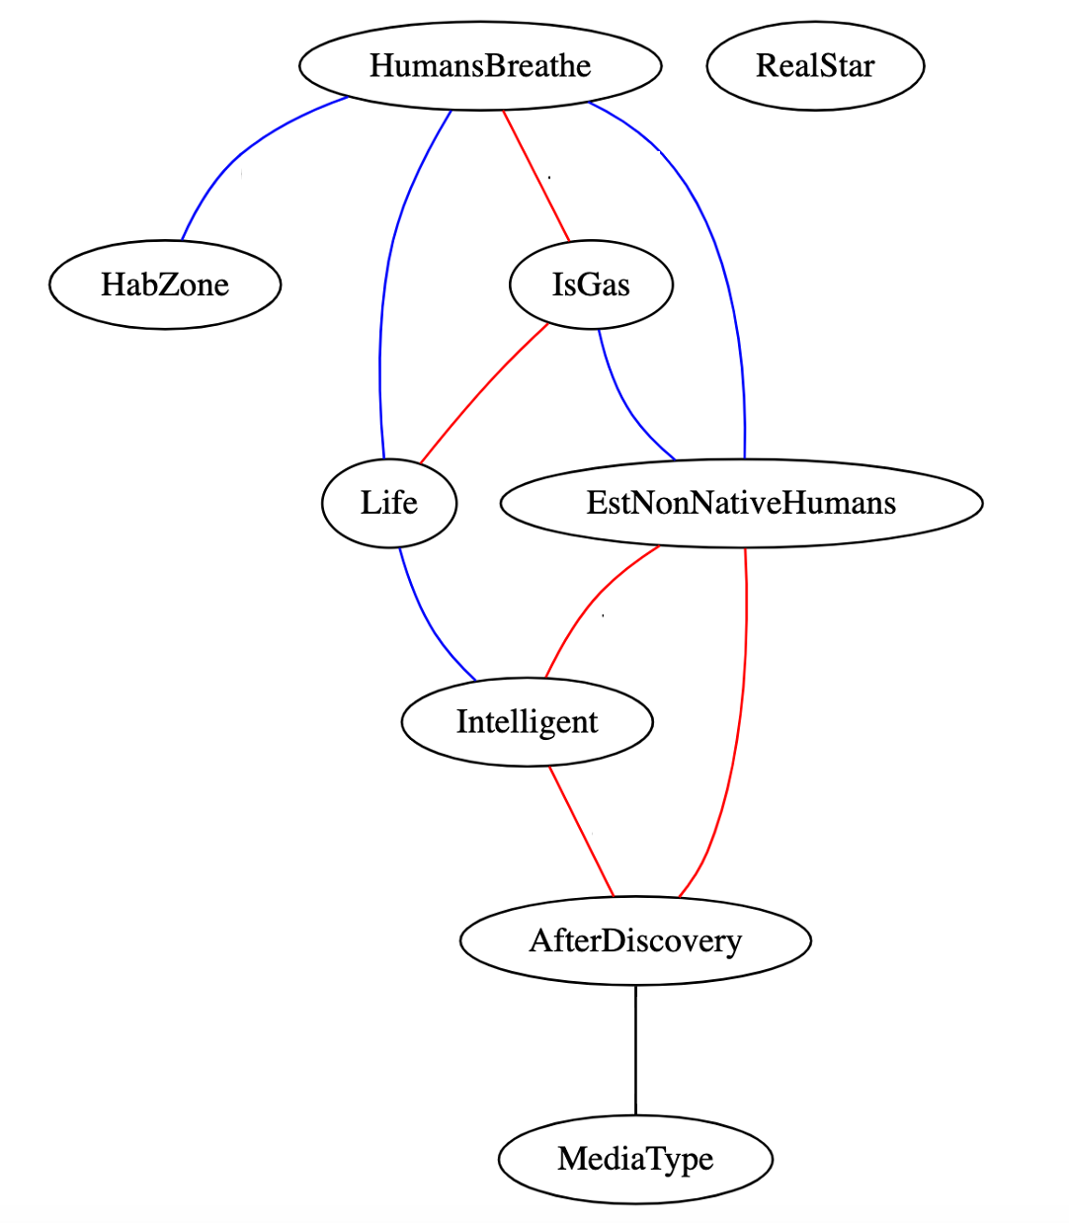
Findings
Results show fictional exoplanets have become less human-hospitable and less Earth-like since 1995 discovery of real exoplanets
Database still dominated by Earth-like worlds
Mirrors real-life discoveries, which have received media coverage
Finding: SF incorporates new exoplanet science discoveries into its storytelling
Output: Puranen, EJ, Finer, E, Helling, C, and Smith, VA ‘Science fiction media representations of exoplanets: portrayals of changing astronomical discoveries’ in JCOM Journal of Science Communication (2024), reviewed in science journalism outlets space.com, Universe Today, Eos, and more.
Notes:
Blue links are positive, red are negative, black are non-monotonic
Positive influences between Life, HumansBreathe, HabZone, EstNonNativeHumans and Intelligent expected
RealStar isolated
Found AfterDiscovery most interesting
Life, Intelligent, HabZone, EstNonNativeHumans, and HumansBreathe form a cluster of earth-like characteristics, showing the positive interconnectedness of these variables in science fiction worldbuilding considerations
Intelligent and EstNonNativeHumans mediate AfterDiscovery’s connections with the earth-like cluster, showing these are the likeliest to be absent in a post-discovery fictional exoplanet
IsGas-EstNonNativeHumans—counterintuitive, due to small sample size, only 2 gas giants in dataset with estnonativehumans, bespin from star wars and goldblatt’s world from Larry Niven’s Integral Trees. For both of these, HumansBreathe is also true—the link between IsGas and EstNonNativeHumans is found in the context of IsGas’s parent variable HumansBreathe, making this a case where directionality DOES matter in order to understand what is happening. This provides a useful example of how networks are constructed, though its clear from considering larger context that gas giant planets are not more likely to host established non-native human populations in science fiction.
I discovered that SF incorporates new exoplanet science discoveries into its storytelling, with fictional exoplanets becoming less-Earth-like following real-life discoveries of very uninhabitable planets. This result is of interest to science communicators concerned that SF might spread misconceptions, and to scientists for highlighting a potential impact avenue of their research as well as an avenue of exploration for public understanding of science. This research was published in JCOM Journal of Science Communication and reviewed in multiple science journalism outlets like space dot com, Universe today, Eos, and more, demonstrating the strong public engagement potential of my research.
Undirected links: I am not claiming causality but instead informativeness, an undirected interaction better reflects this property, also to do with equivalence class (all Bayesian networks can be written as an equation of the joint probability distribution, by algebraic manipulation substituting any term with its representation from Bayes Rule, one can transform any member of an equivalence class into another member of the same equivalence class

Slide 8
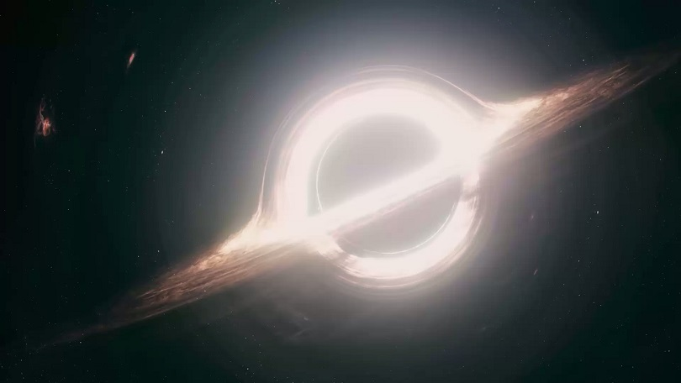
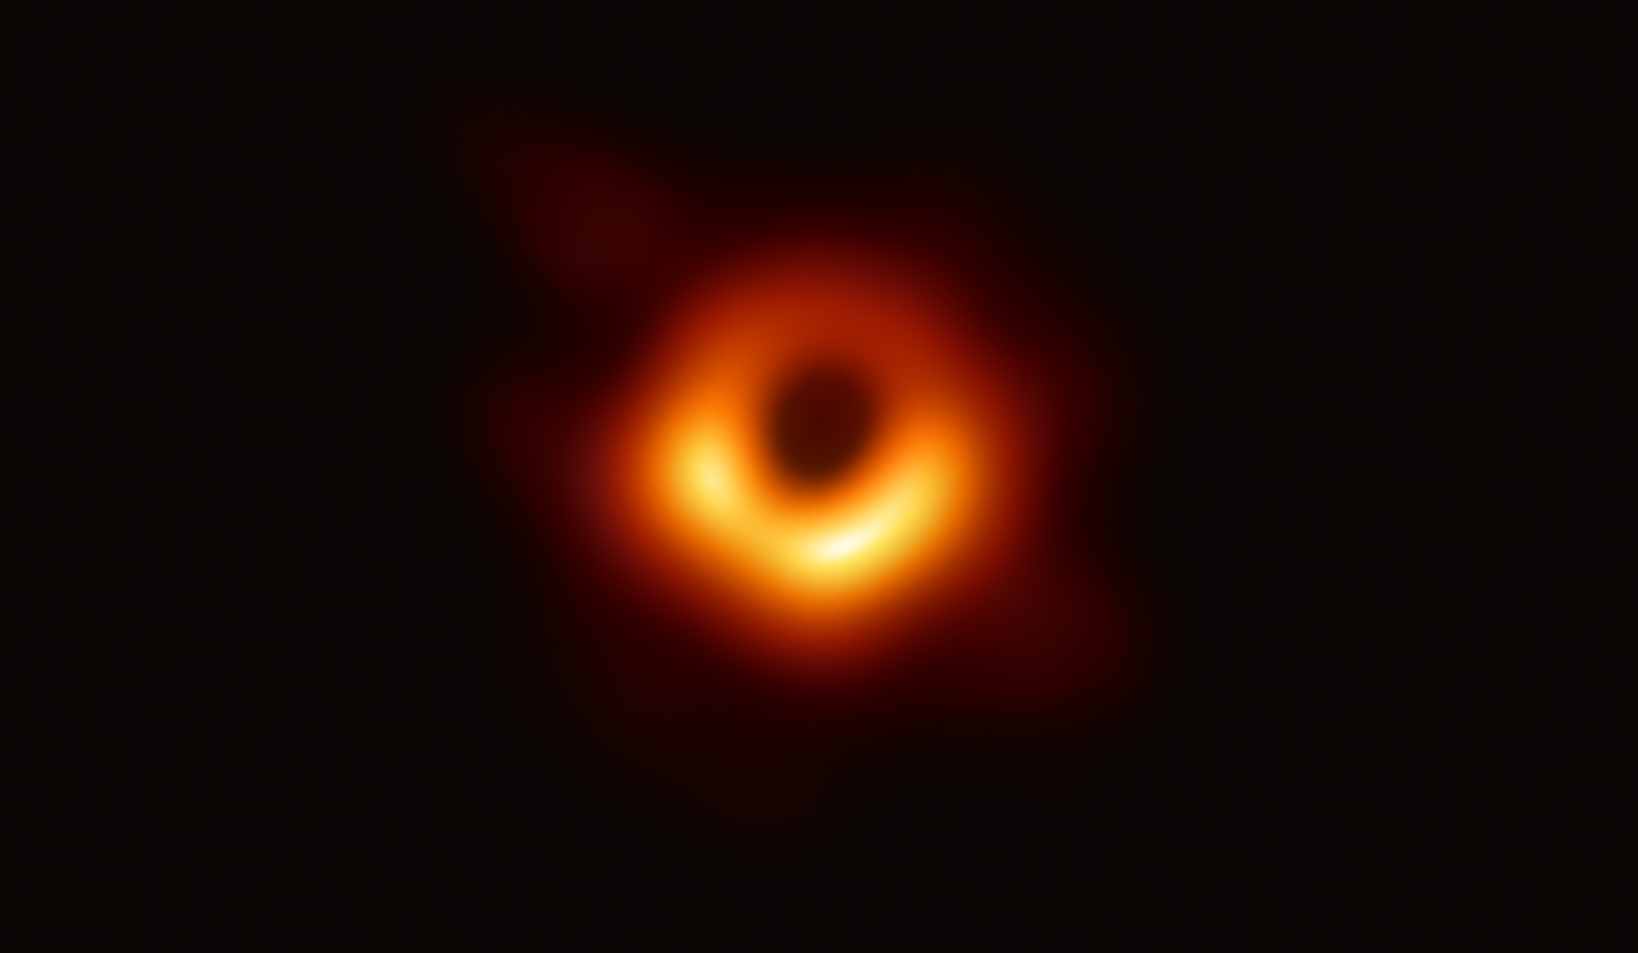
Anthology project
What is the role of a science consultant for an SF story? How are decisions made regarding the portrayal of science in SF? What is the role of SF in science communication?
The Questionnaire asked:
What was discussed at this meeting?
What story ideas were generated?
What story decisions were made?
Describe any communication difficulties.
Describe any communication successes.
Describe the current status/progress of the story.
Interstellar
Event Horizon Collaboration
Notes:
In writing SF, authors often undertake some scientific research, and might reach out to a science consultant. Thinking about the role of a science consultant—I read an interview with a science consultant who said it basically was a quick chat with a director and then you never hear anything again until you’re in theatres watching the film. On the other hand you have science consultants like Kip Thorne with Interstellar, who modelled the visual wavelength appearance of a black hole for the movie and published real papers about it—and then when we got an image of the real thing his model was proven accurate.
So I wanted to create an anthology, and also have a research component to the project
Creative writers and StACES scientists, 5 of 9 groups participated in research component, at least 3 meetings, questionnaire asked these questions.
Focus on the processes of deciding when to stay realistic, when to be plausible, and when to make things up—how science fiction worlds are built.

Slide 9
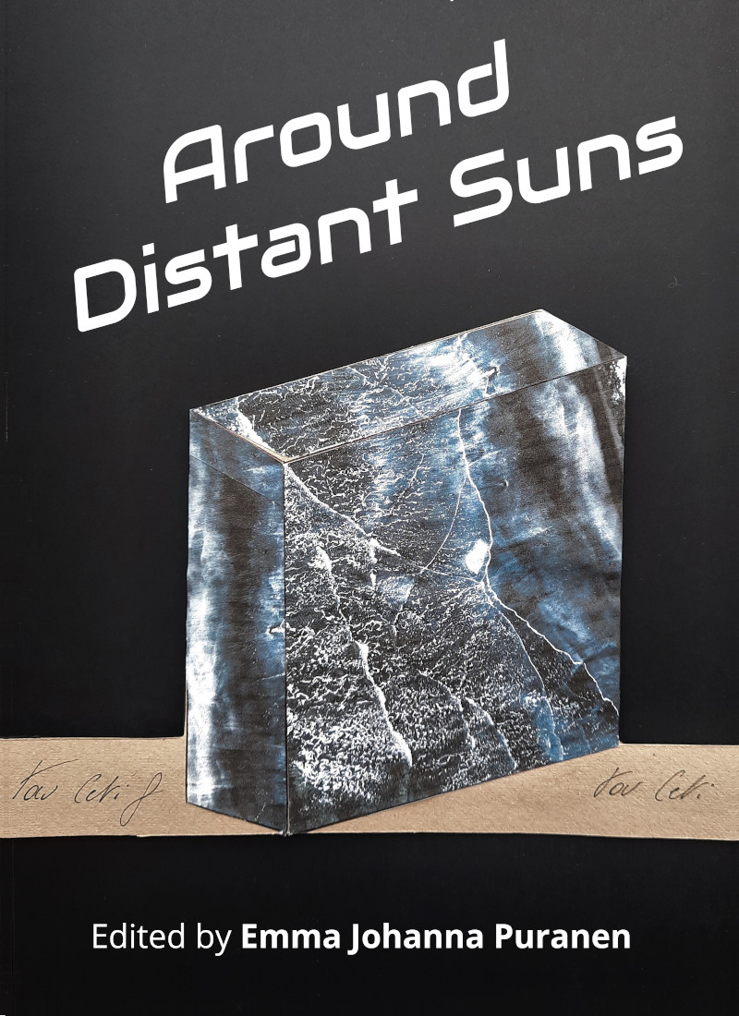
Findings
Hesitance of the scientist
Scientist provides justifications
Scientist provides technical terminology
Research work undertaken during writing process
Focus on fieldwork
Discussion of shared interest in SF
Scientist-focused Q&A at first meeting
Balanced Q&A at first meeting
Focus on sense of ambiguity/mystery
Output: Puranen, EJ et al ‘Around Distant Suns: Nine Stories Inspired by Research from the St Andrews Centre for Exoplanet Science’ (2021), reviewed in Nature Astronomy; Puranen, EJ ‘Dialogues between Science and Fiction in the Creation of an Anthology’ in BSFA Vector (2023)
Notes:
Around Distant Suns—5 short stories, 2 poems, 2 radio plays. Stories feature the stripped core of a hot Jupiter, graphite rain, sentient mist, and talking clouds.
Go over findings

Slide 10
Quotes from participants
“It helped build the emotional truth of field research for me, which is really what stories are trying to capture and convey while technical details are just the icing on the cake.”
“We both are comfortable to reach into the others field of expertise with the expectation to be corrected and learn from it.”
“We also discussed the roles of scientists in society, and how difficult it can sometimes be for non-scientists to understand the scientific results.”
“…try and inspire an interest in non-science based readers and rather not get bogged in the details of the science.”
“I think a great story is all about a question, but it’s not up to the writer to answer it, it’s for them to explore.”
“…education not being about telling things, but enabling to explore and arrive at conclusions.”

Slide 11
Conclusions
“Science fiction is not predictive; it is descriptive” – Le Guin
Science fiction changes with new scientific discoveries
Participants in the anthology project found an inspirational, exploratory role for SF in science communication efforts
Notes:
A recurring theme throughout my thesis was that the more unknowns there are in a field of science, the more likely researchers are to look to interdisciplinary collaboration to combine expertise to address the problem, and the more likely they are to reference the sort of applied speculation so common in SF. Exoplanet science is a field at the cutting-edge of our understanding of the universe, filled with unknowns, and does indeed frequently collaborate with fields like geology, planetary science, atmospheric science, astrobiology, and more. Science fiction, as well, deals in the unknown. Novels purposely leave questions unanswered to create a narrative tension—this negative space fires the reader’s mind to fill it with possibilities. I argue that this element is a part of why science fiction is documented to inspire so many scientists into their fields to try and answer these unknowns. Science, of course, unlike fiction, aims to find answers by collecting evidence. More exploration of the effects of the unknown on both science and SF could be another fruitful avenue for future research. Science fiction is valuable not only as art, but also for science. It provides a human perspective on scientific advances, and sometimes an ethical check, as well as sometimes acting as the public’s window into scientific progress and possibilities, and its something scientists ought to pay attention to.

Slide 12
THANK YOU!
Around Distant Suns → http://www.guardbridgebooks.co.uk/books/AroundDistantSuns.html
Anthology paper → https://vector-bsfa.com/2022/10/05/dialogues-between-science-and-fiction-in-the-creation-of-an-anthology/
Bayesian exoplanets paper → https://jcom.sissa.it/article/pubid/JCOM_2301_2024_A04/
Follow me on Bluesky @spacesword.bsky.social

