Slide 1
Cataclysmic variables that splutter
Keith Inight
Warwick University

Slide 2
18th January 2024
Notes:
My age is misleading – I took up astronomy when I retired and got my PhD 2 years ago

Slide 3
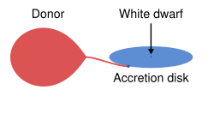
Cataclysmic Variables (CVs)
Close binary systems where a white dwarf is accreting from a companion star that is filling its Roche lobe.
Non-magnetic
Magnetic
Source: Wikipaedia
Notes:
There are also Intermediate polars where the magnetic field is not strong enough to completely suppress the disk. In Ips accreted material initially joins a truncated disk and then subsequently follows field lines.

Slide 4
Dwarf Nova
Regular outbursts
Notes:
Outbursts are caused by instability in the disk – no change in the accretion rate from the donor

Slide 5
Novalike
State change
Notes:
This is a VY Scl subtype. In the high state material flows continuously through a completekly ionised disk, At some point the accretion rate from the donor drops off.

Slide 6
Magnetic (polar)
State change
Notes:
Again the accretion rate from the donor changes

Slide 7
SU UMa
Superoutbursts

Slide 8
Non-orbital photometric variations
 |  |  | Amplitude (Δm) | Duration | Recurrence | References
Non-Magnetic | Dwarf Novae | Outbursts | 3-5 | A few days | Days to decades | Osaki, Y (1974)
 |  | Superoutbursts | 3-9 | A few weeks | Months to decades | Buat-Ménard, V et al (2002)
 | Novalikes | State changes | Several | Months to Years | Years | Dhillon, V.S. (1996)
 |  | Stunted outbursts | 0.14-1.35 | 5-50 days | Months | Honeycutt, R. K. et al (2025)
 | Z Cam | Standstills | 0.5-4 | Tens of days to years | Years | Simonsen, M. et al (2014)
Magnetic | Polars | State changes | 1-5 | Months | Years | Kafka,S & Honeycutt,R.K. (2005)
All |  | Flickering | <0.25 | Minutes | Minutes | Bruch, A (2021)
Notes:
Key point is that we see various forms of outbursts and state changes. We also see flickering – stochastic small changes in luminosity.

Slide 9
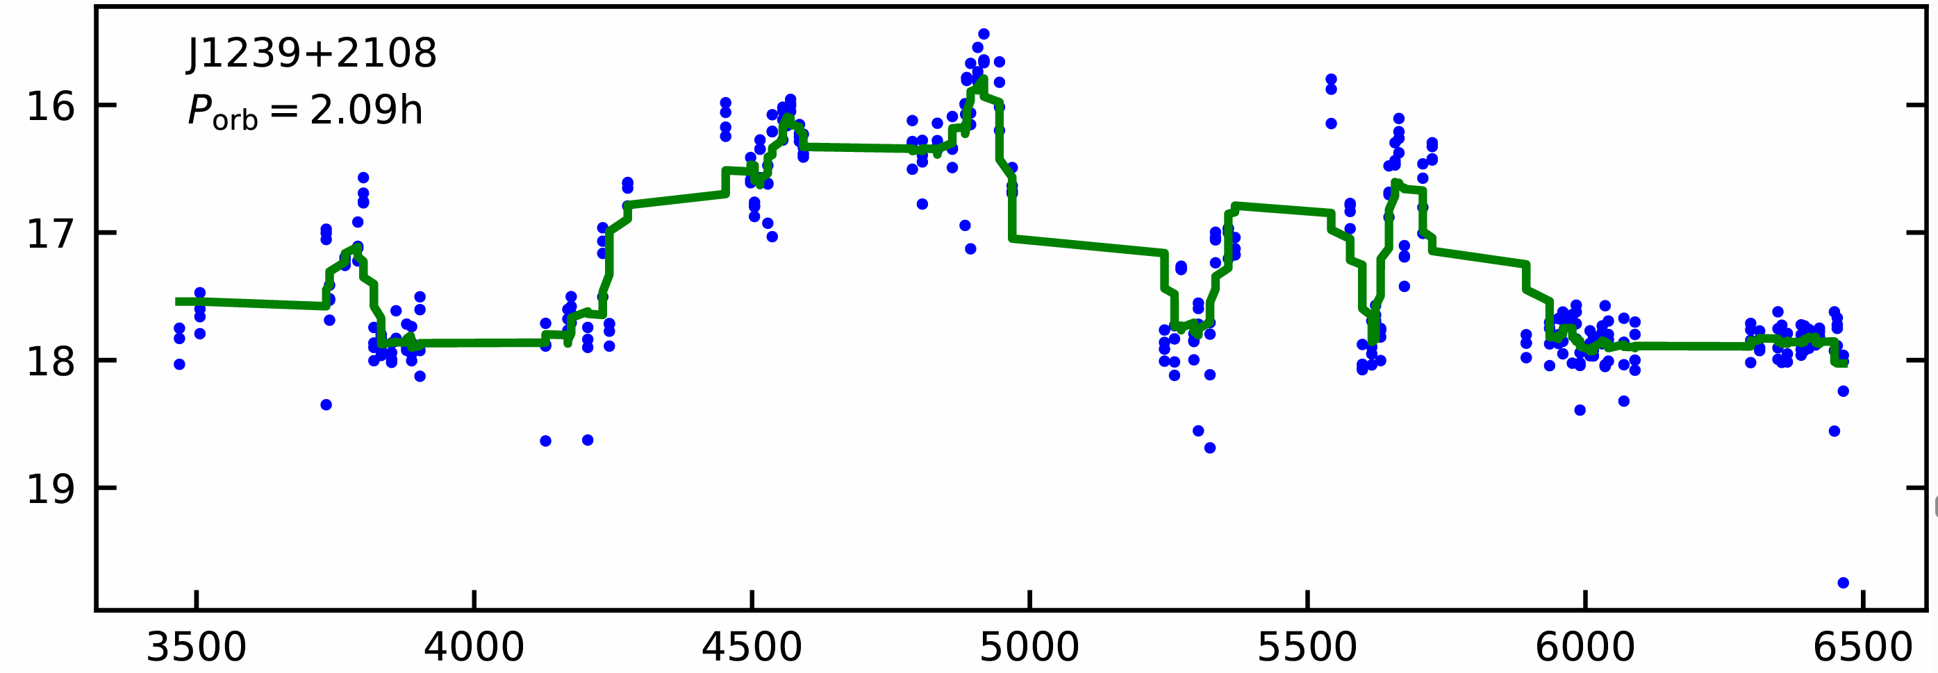
IR Com – light curve from ZTF
Magnitude
MJD-50000
Manser, C. J. and Gansicke, B. T. (2014)
Notes:
Observations 54481 and 56090
Green is boxcar smoothing. The paper showed from spectroscopy at high and low states that the drop in luminosity was related to the disk and epitomised by the disappearance of emission lines. The contribution of the WD and donor were unchanged. A key point is that none of the changes are “outbursts”.

Slide 10
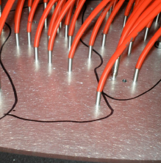
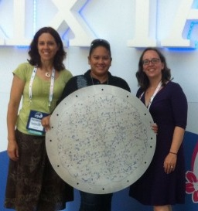
Sloan Digital Sky Survey
IR Com is not alone
Notes:
BOSS – 1000 fibers

Slide 11
IR Com is not alone
A catalogue of cataclysmic variables from 20 years of the Sloan Digital Sky Survey with new classifications, periods, trends and oddities.
Inight et al (2023)
Magnitude
Discovered from spectroscopy not transients
8 out of 507 implies ~1.6%
Notes:
Eight out of 507

Slide 12
DESI
Magnitude
Inight et al in prep
7 out of 750 implies ~1%
MJD-50000
Notes:
Searching 98 million spectra. Work in progress.

Slide 13
What is going on?
Spectroscopy confirms that these CVs have disks; the absence of outbursts indicates a low $\dot{M}$
No evidence of magnetism in the WD (such as He II emission, x-ray bright.., WD spin detected)
Periods vary from 1.7-6h indicating widely varying evolutionary stages
So the assumption is that the cause is changes in the mass loss rate from the donor
Speculation
Some sort of changes in the magnetic field of the donor possibly resulting in starspots (cf Kafka,S & Honeycutt,R.K. (2005))?
Notes:
We note that the periods of these systems cluster both near the lower edge of the period gap, and in the ≃4−6h range, indicating widely varying evolutionary stages. The lack of outbursts is indicative of a low 𝑀. A low 𝑀 is corroborated by the detection of the donorstarsintheshort-periodsystems,asnon-magneticCVswithin this period range are typically SUUMa systems with accretion disc dominated spectra. The long-period systems coincide with the pe riod range where dwarf novae are usually found (we encourage the reader to inspect section 7.2 of Knigge et al. 2011 for a discussion of the inconsistency between the CV sub-type distribution in the 3 −6h period range and the theoretical predictions of 𝑀 and the critical accretion rate for disc instabilities to (not) occur). We spec ulate that these eight systems may either contain weakly magnetic white dwarfs, with fields that are sufficiently low so that they do not develop the hallmarks of polars or intermediate polars, but strong enough to affect the structure of the disc. However, we also note that a number of intermediate polars exhibit dwarf nova outbursts– so the tentative suggestion of weak fields does not explain the absence of outbursts. An alternative idea is that these systems are under going some type of state change in their donor stars, as possibly suggested by their location near the lower edge of the period gap, and in the range where dwarf novae and novalike overlap above the period gap.
Kafka,S & Honeycutt,R.K. (2005) suggest that state changes are due to starspots (ie magnetic) on the donor

Slide 14
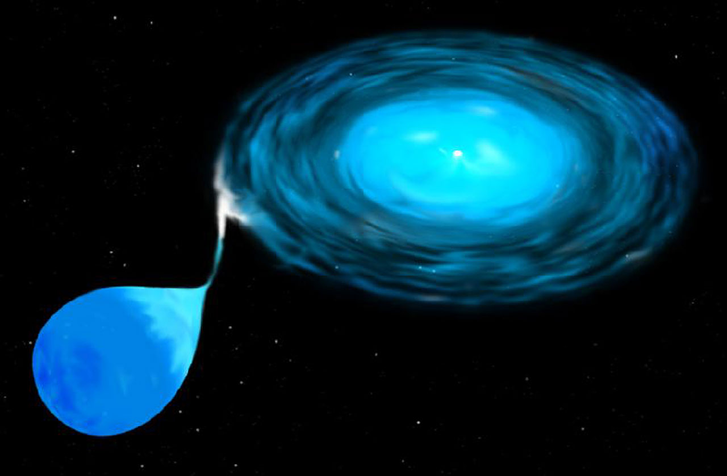
Questions?

