Slide 1
Odisseo: Optimized Differentiable Integrator for Stellar Systems Evolution of Orbit
Giuseppe Viterbo, Astro-Ai lab
Heidelberg University

Slide 2
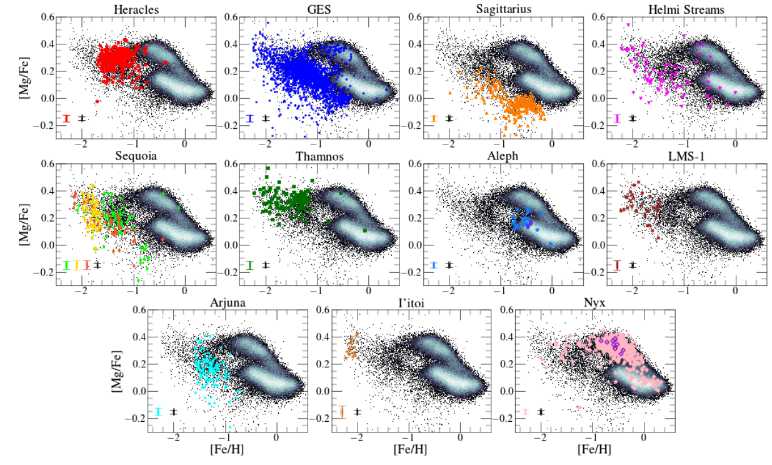
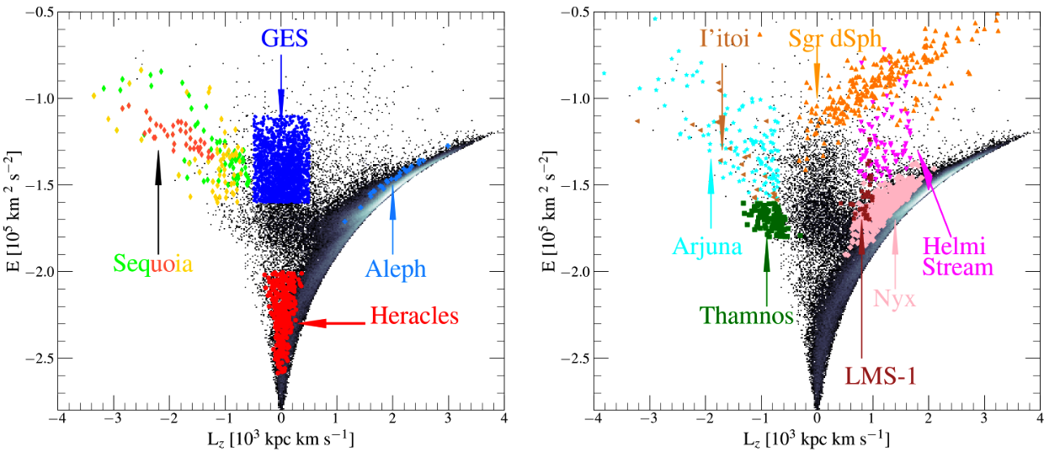
Galactic Archaeology Inverse modelling
Dynamics
Chemistry

Slide 3
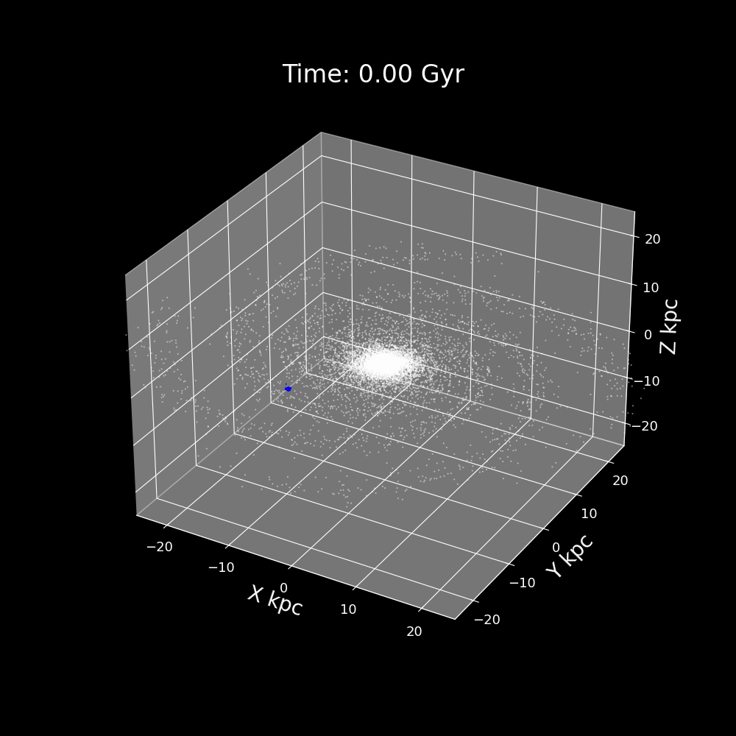
Odisseo
Differentiable direct N-body simulator

Slide 4
Odisseo
Differentiable direct N-body simulator

Slide 5
Galactic Archaeology Inverse modelling
Force calculation is exact
Differentiable simulations S in jax: informative for inverse modeling !

Slide 6
Galactic Archaeology Inverse modelling
Force calculation is exact
Differentiable simulations S in jax: informative for inverse modeling !
$$\begin{matrix}Loss & =-logP(x|theta) \\ & =-logP(S(θ)|θ)\end{matrix}$$

Slide 7
Galactic Archaeology Inverse modelling
Force calculation is exact
Differentiable simulations S in jax: informative for inverse modeling !
$$\begin{matrix}Loss & =-logP(x|theta) \\ & =-logP(S(θ)|θ)\end{matrix}$$
Automatic-differentiation
$$∇_{θ}logP(x|θ)$$

Slide 8
Galactic Archaeology Inverse modelling
Force calculation is exact
Differentiable simulations S in jax: informative for inverse modeling !
$$\text{Chain Rule}!$$
$$\begin{matrix}Loss & =-logP(x|theta) \\ & =-logP(S(θ)|θ)\end{matrix}$$
Automatic-differentiation
$$∇_{θ}logP(x|θ)$$

Slide 9
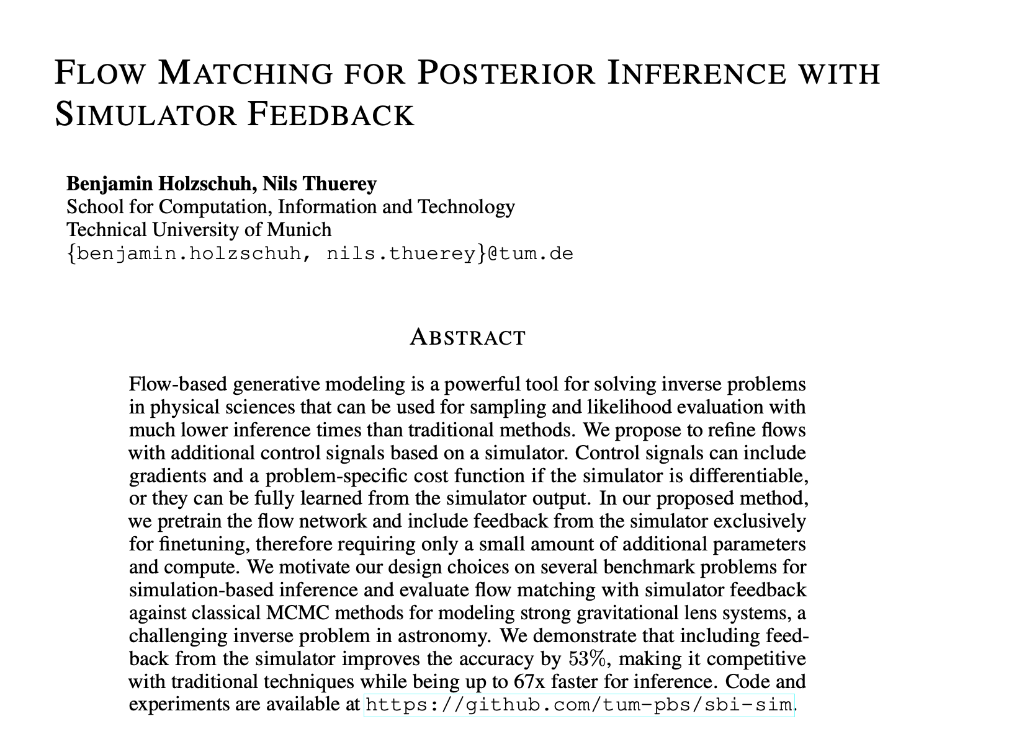
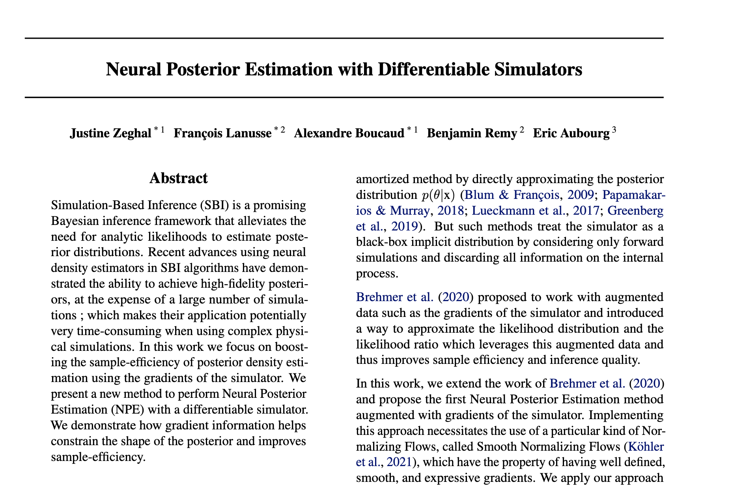
Galactic Archaeology Inverse modelling
Force calculation is exact
Differentiable simulations S in jax: informative for inverse modeling !
The gradient can be used in many ways:
Direct gradient descend
SBI with feedback from the simulation
https://arxiv.org/pdf/2410.22573
https://arxiv.org/abs/2207.05636

Slide 10
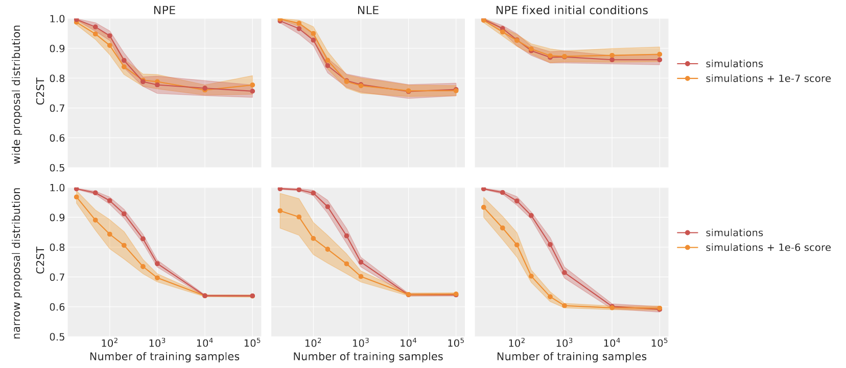
Galactic Archaeology Inverse modelling
Force calculation is exact
Differentiable simulations S in jax: informative for inverse modeling !
The gradient can be used in many ways:
Direct gradient descend
SBI with feedback from the simulation
“Neural Posterior estimation with differentiable simulator”, Zeghal et al. 2022

Slide 11
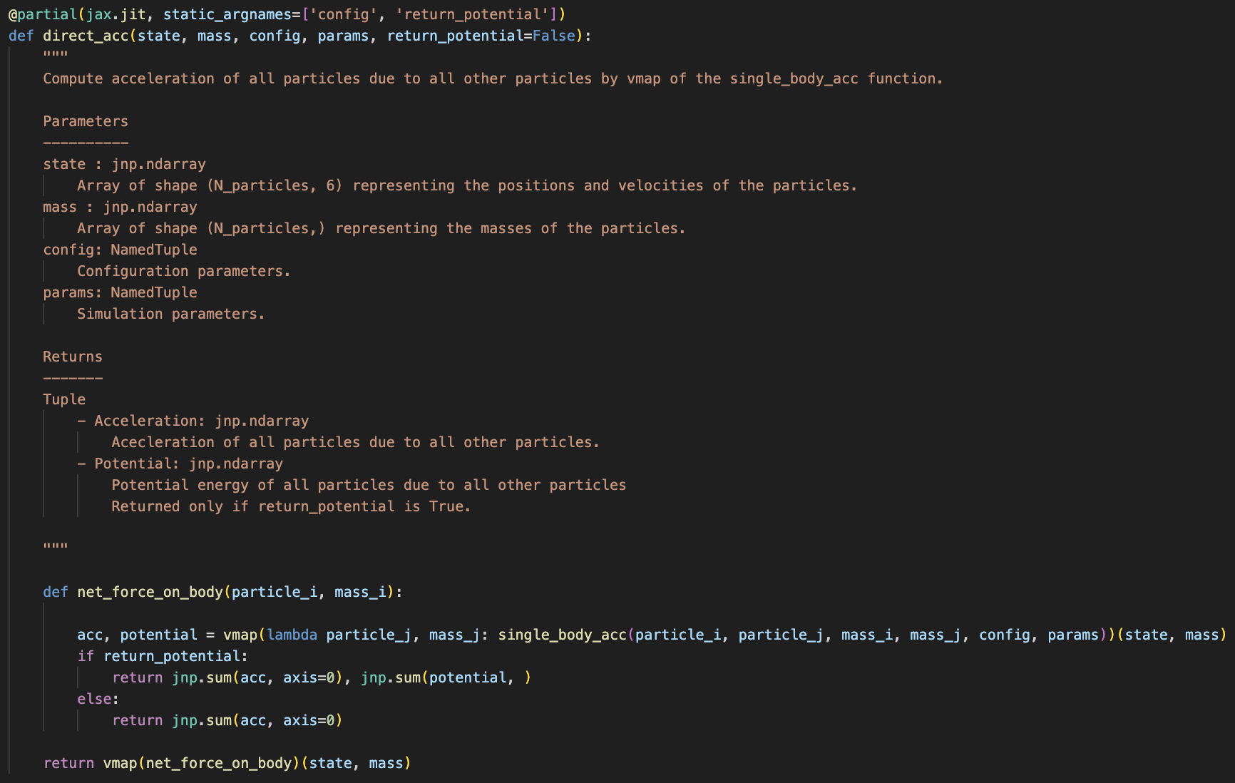
Main features:
Pure Python function: no side effects, deterministic, only jax compatible operations
SPEED

Slide 12
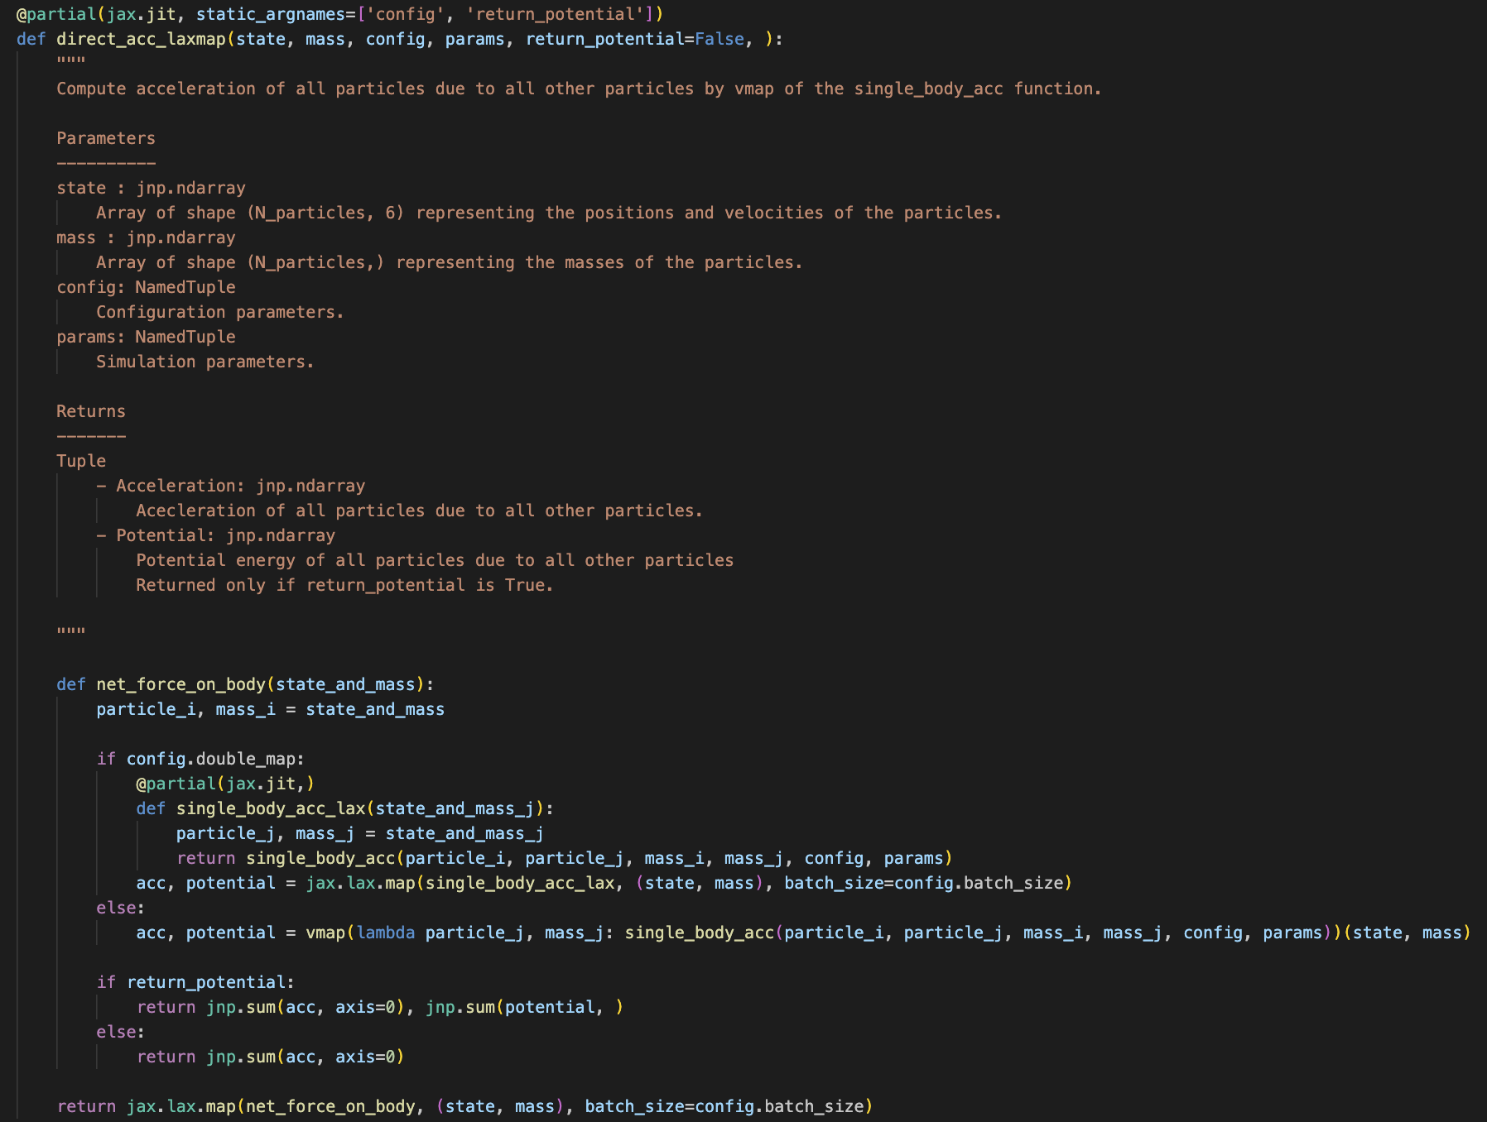
Main features:
Pure Python function: no side effects, deterministic, only jax compatible operations
Memory efficient

Slide 13
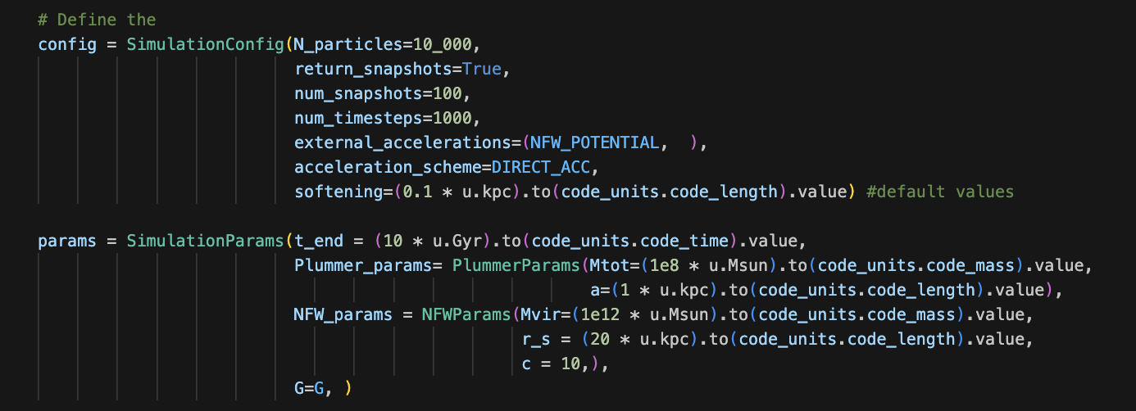
Main features:
Pure Python function: no side effects, deterministic, only jax compatible operations
Easy to set config and params
Modular

Slide 14
Main features:
Pure Python function: no side effects, deterministic, only jax compatible operations
Easy to set config and params
Astropy units

Slide 15
Main features:
Pure Python function: no side effects, deterministic, only jax compatible operations
Easy to set config and params
Astropy units
Multiple external potentials

Slide 16
NFW
Visualization
Power Spherical
Potential Cutoff
Miyamoto Nagai
$$ρ(R)=-{\left(\frac{r_{s}}{R}\right)}^{α}exp\left(-{\left(\frac{R}{r_{c}}\right)}^{2}\right)$$
$$Φ(r)=-\frac{4πGρ_{0}R_{s}^{3}}{r}ln\left(1+\frac{r}{R_{s}}\right)$$
$$Φ(R,z)=-\frac{GM}{\sqrt{R^{2}+(\sqrt{z^{2}+b^{2}}+a)^{2}}}$$

Slide 17
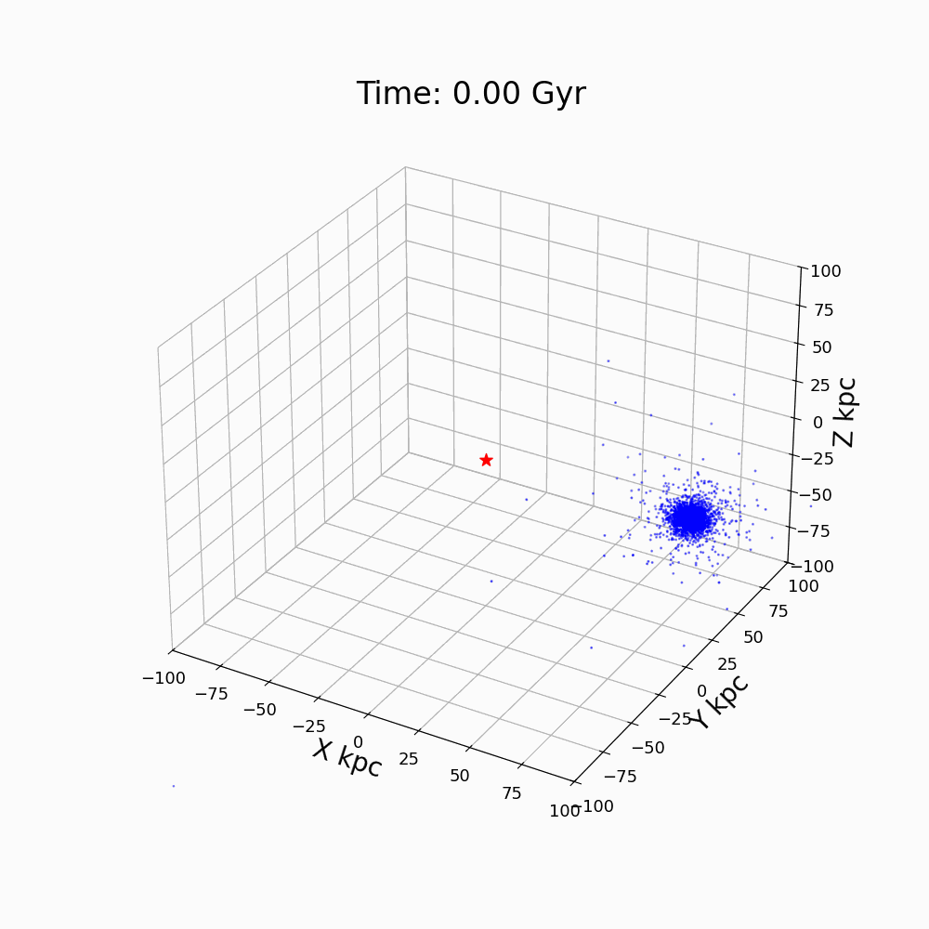
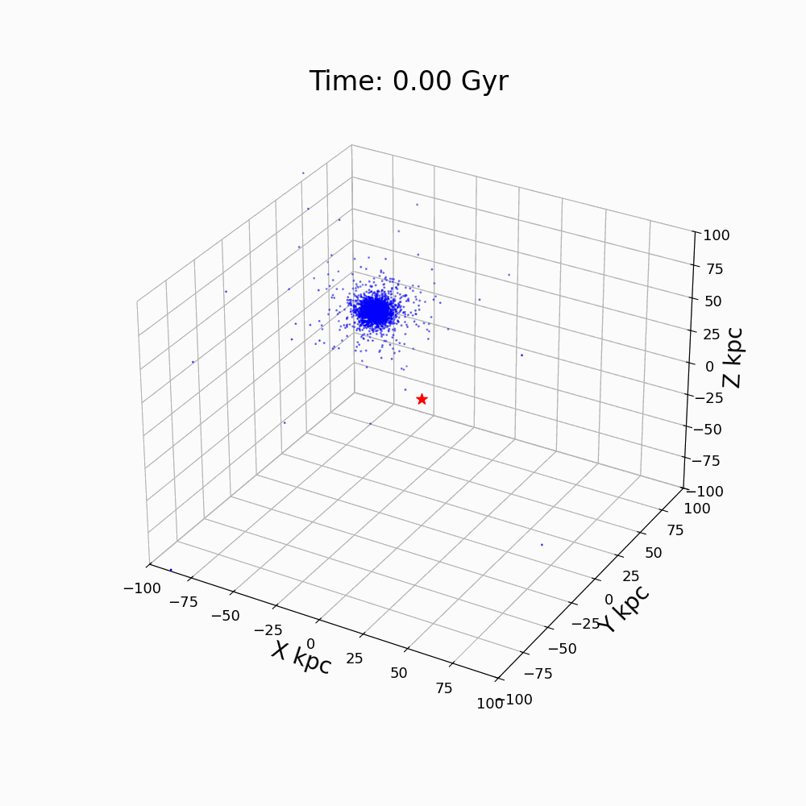
Visualization
Power Spherical
Potential Cutoff
NFW
Miyamoto Nagai

Slide 18
NFW
Conserved property
PointMass
Miyamoto Nagai

Slide 19
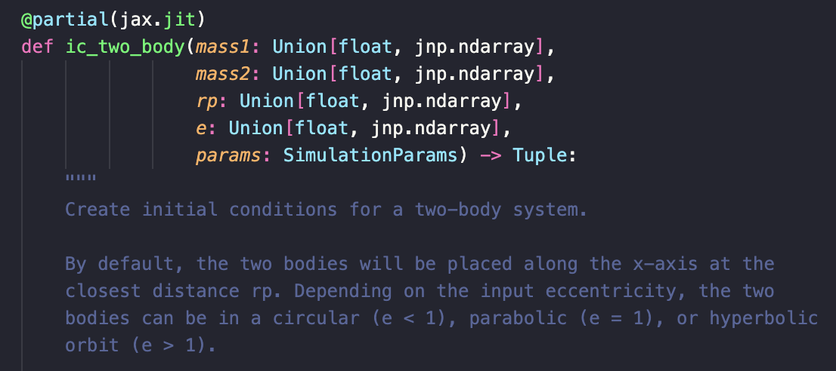
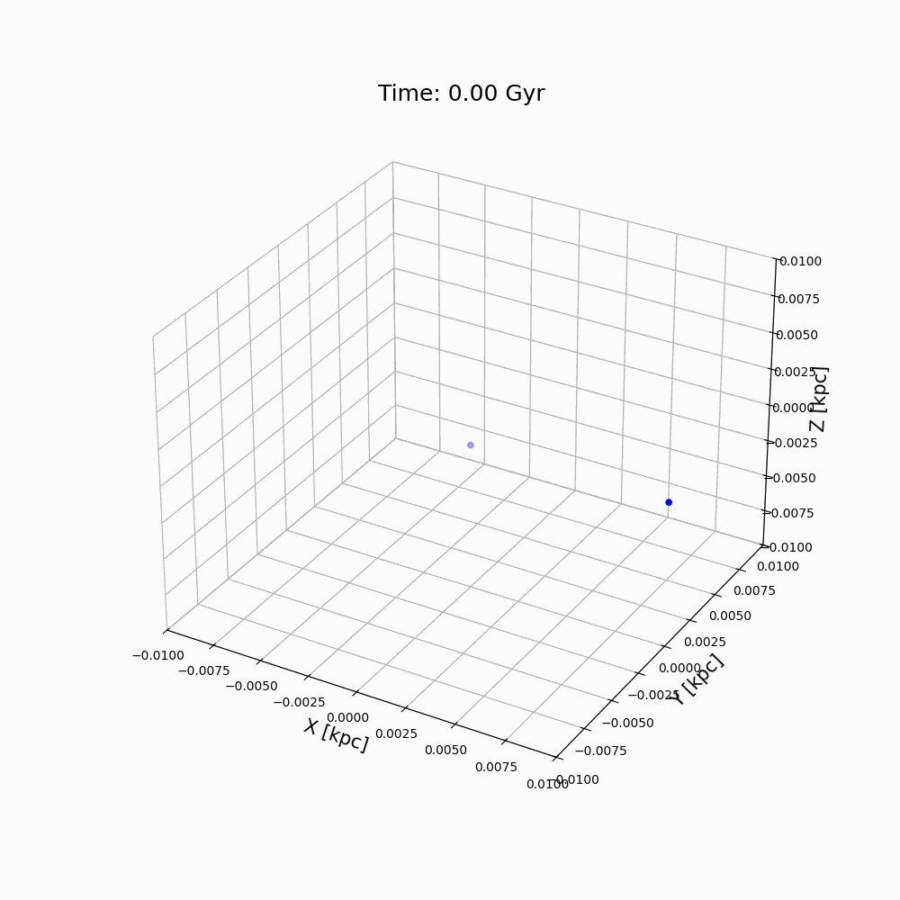
Main features:
Initial conditions

Slide 20
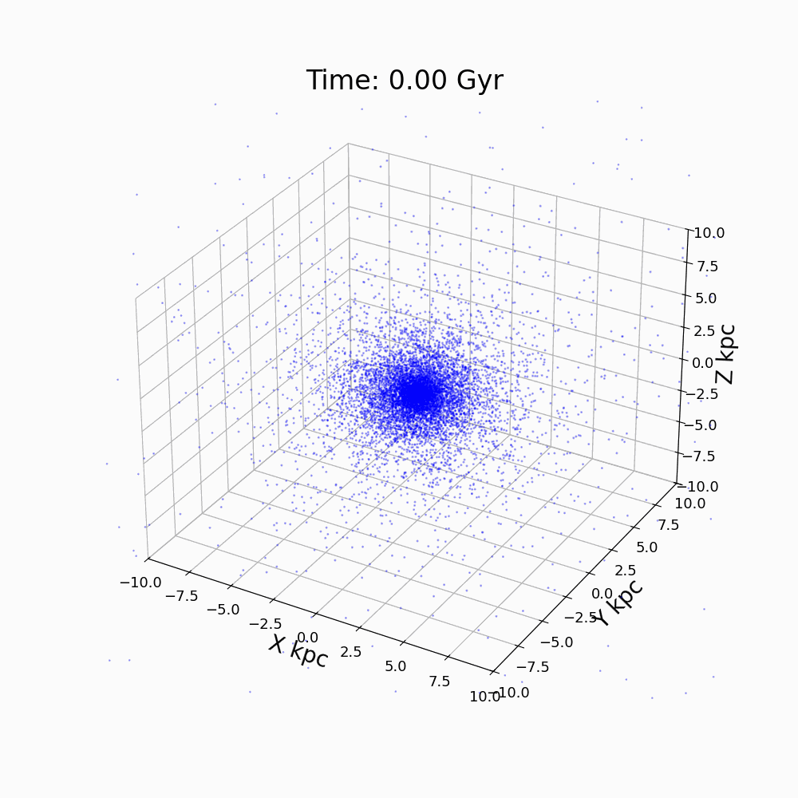
Main features:
Initial conditions

Slide 21
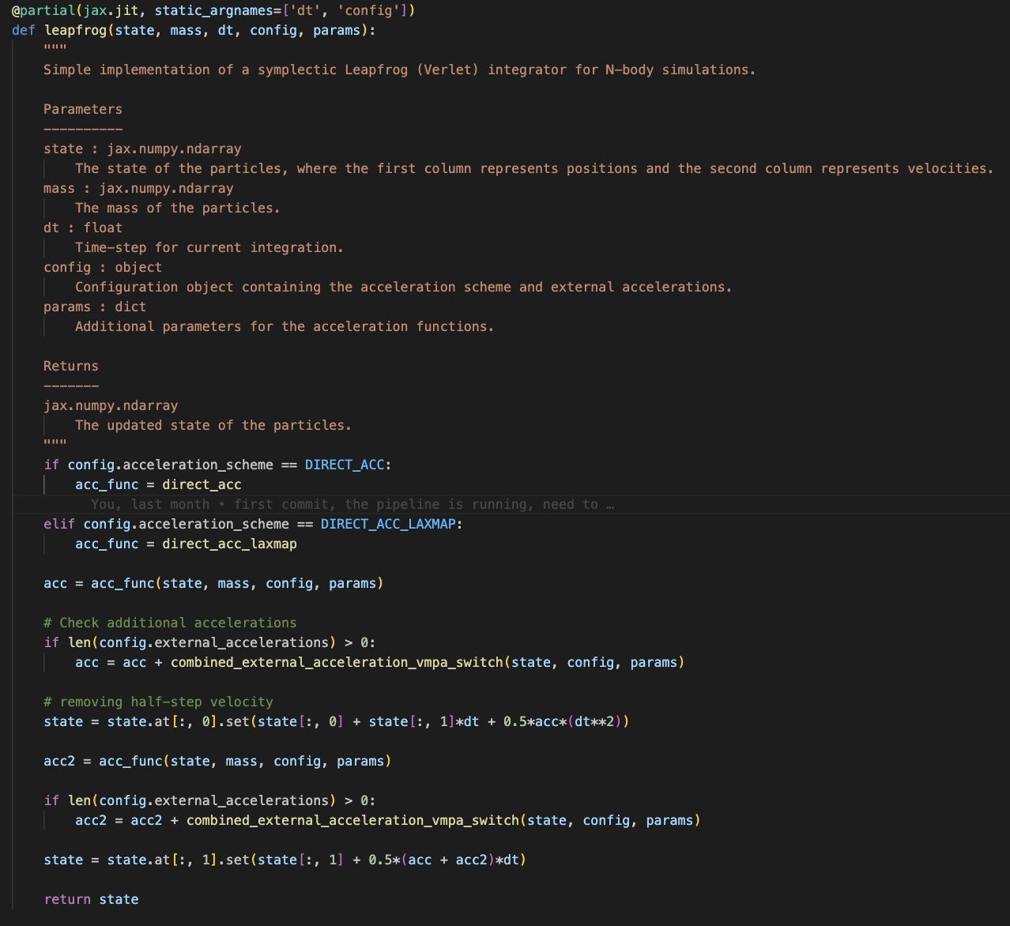
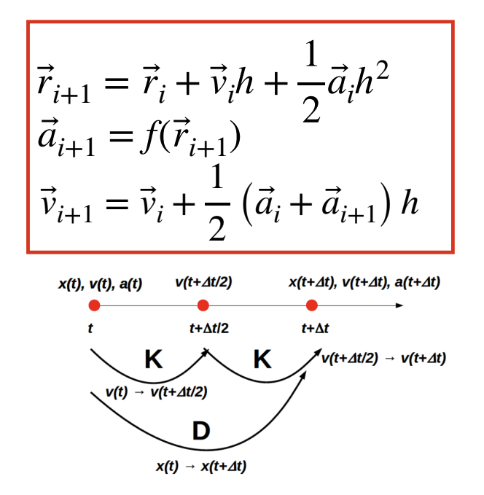
Main features:
Initial conditions
Integrator(s):
Leap-frog
RK4

Slide 22
Main features:
Initial conditions
Integrator(s):
Leap-frog
RK4
Diffrax backend

Slide 23
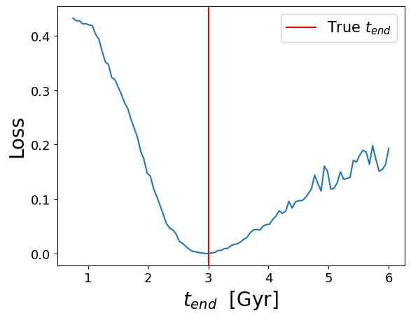
Main features:
Initial conditions
Integrator(s)
Gradient! (WIP)
1 parameter

Slide 24
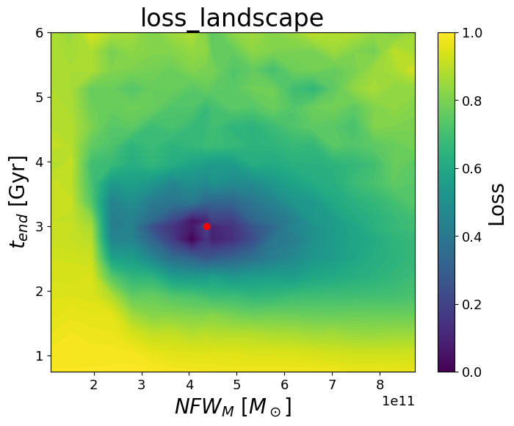
Main features:
Initial conditions
Integrator(s)
Gradient! (WIP)
1 parameter
2 parameters
Full inference and SBI integration !

Slide 25
Thank you for your attention
Summary:
Differentiable N-body code
Jax friendly
GitHub repo: https://github.com/vepe99/Odisseo
Qr code:

Slide 26
ROAD MAP:
REBOUND
More integrators !
IAS15
WHFast512

Slide 27
ROAD MAP:
REBOUND
More integrators !
IAS15
WHFast512

Slide 28
ROAD MAP:
REBOUND
More integrators !
IAS15
WHFast512

Slide 29
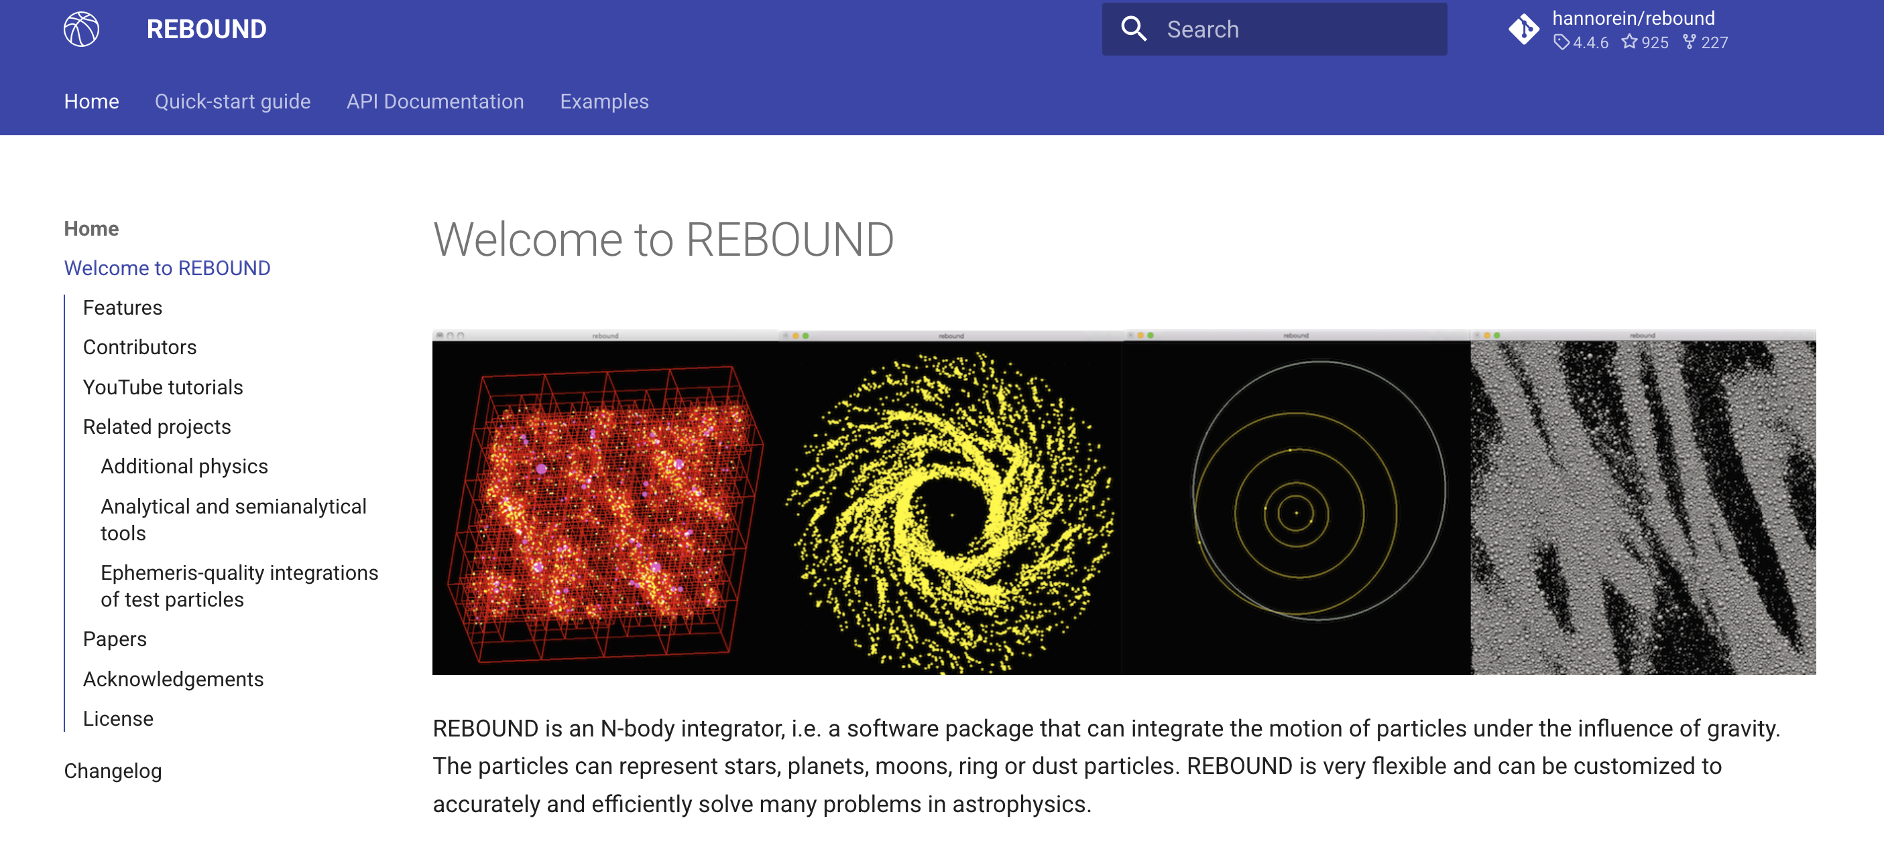
ROAD MAP:
REBOUND
More integrators
Evaluate the accuracy with other Nbody code

Slide 30
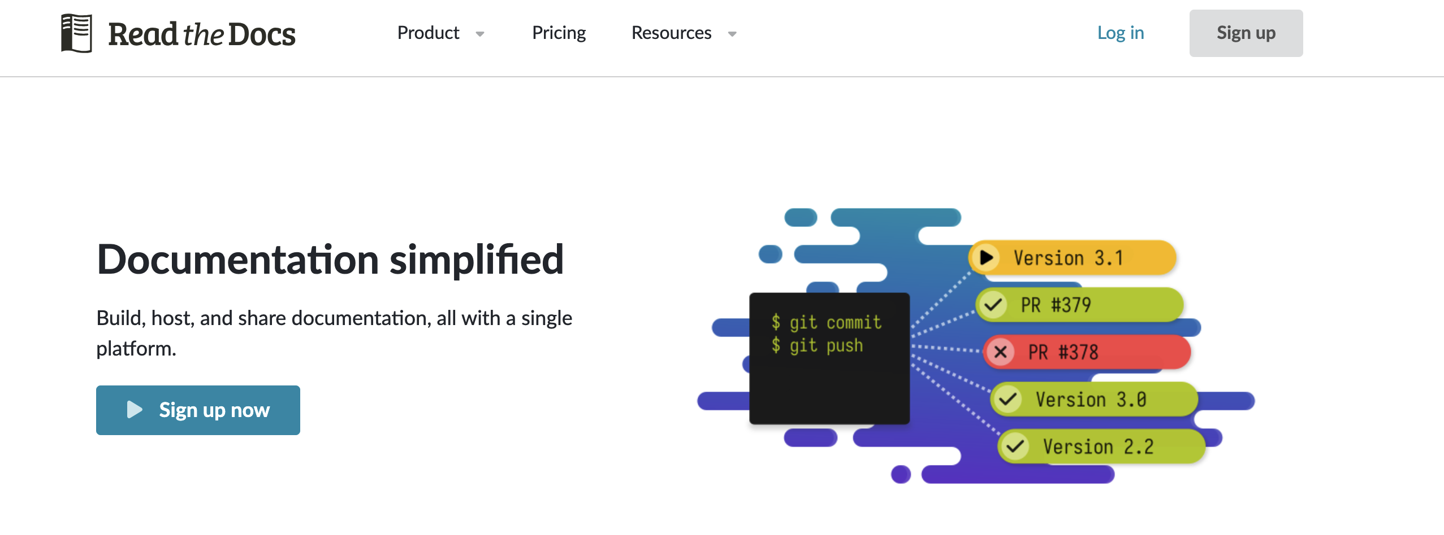
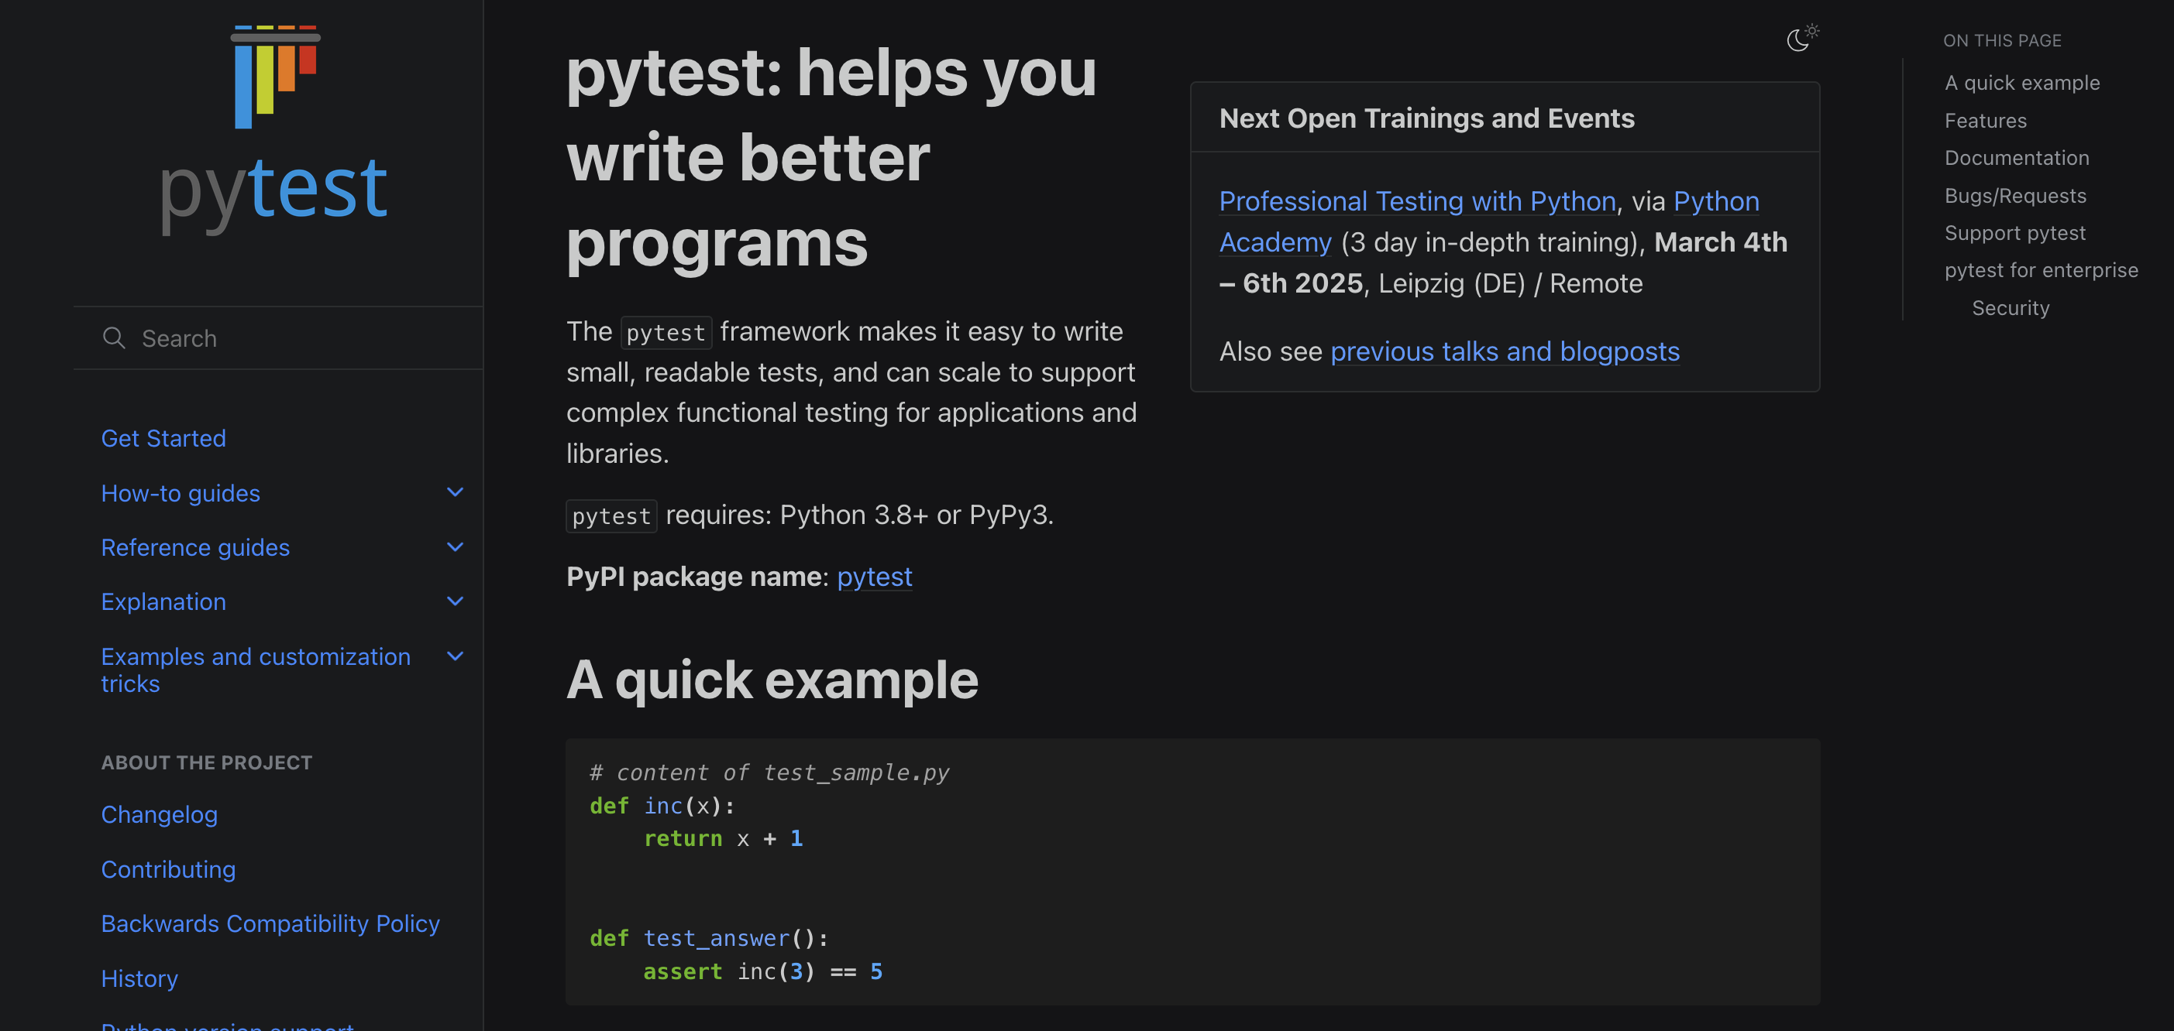
ROAD MAP:
More integrators
Evaluate the accuracy with other Nbody code
Testing, documentation, …

Slide 31
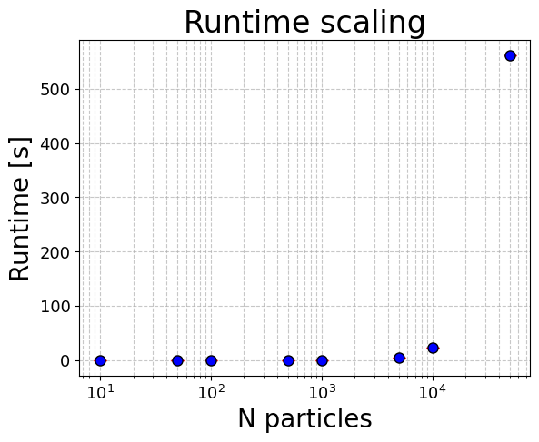
ROAD MAP:
More integrators
Evaluate the accuracy with other Nbody code
Testing, documentation, …
Scalability (speed and memory)

Slide 32
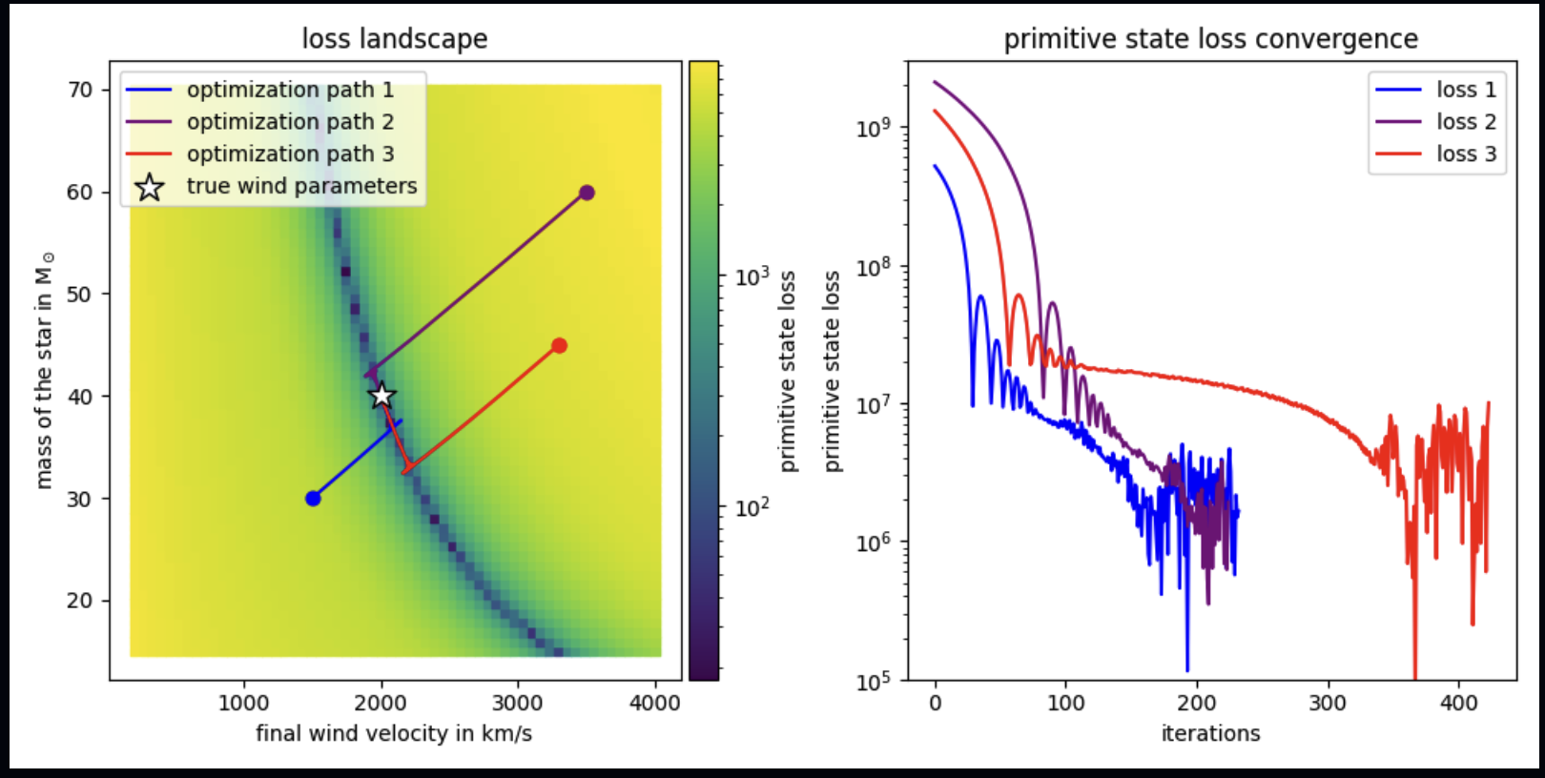
ROAD MAP:
More integrators
Evaluate the accuracy with other Nbody code
Testing, documentation, …
Scalability (speed and memory)
Loss function/Gradient Optimization
“Differentiable Conservative Radially Symmetric Fluid Simulations and Stellar Winds ◦ jf1uids”, Storcks L. And Buck T. 2024

Slide 33
ROAD MAP:
More integrators
Evaluate the accuracy with other Nbody code
Testing, documentation, …
Scalability (speed and memory)
Loss function/Gradient Optimization
SBI (finally!)

Slide 34
Additional slides

Slide 35
Sampling of the Plummer potential
Initial conditions
“Computational Astrophysics lecture slide”, Giuliano Iorio

Slide 36
Sampling of the Plummer potential
For a stationary, spherical, isotropic system the df depend only on the specific energy of the particle
Initial conditions
$$f({\overset{˜}{E}}_{tot})$$
“Computational Astrophysics lecture slide”, Giuliano Iorio

Slide 37
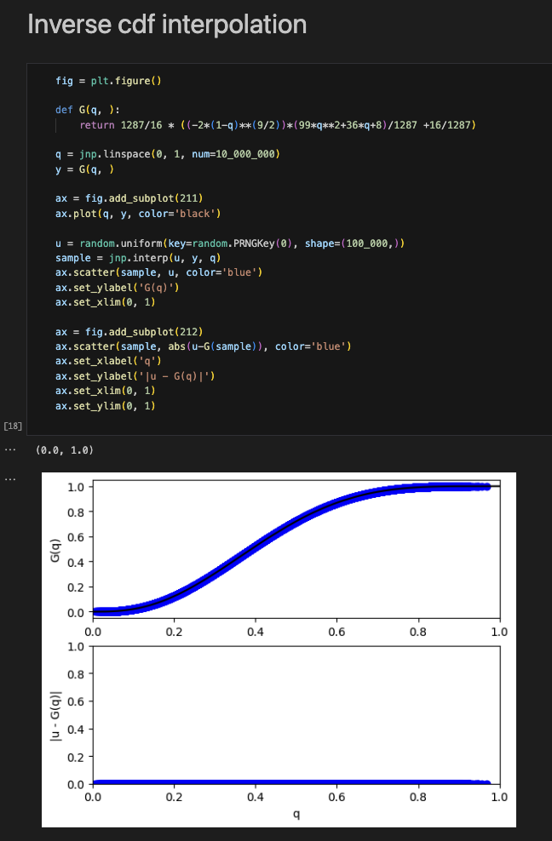
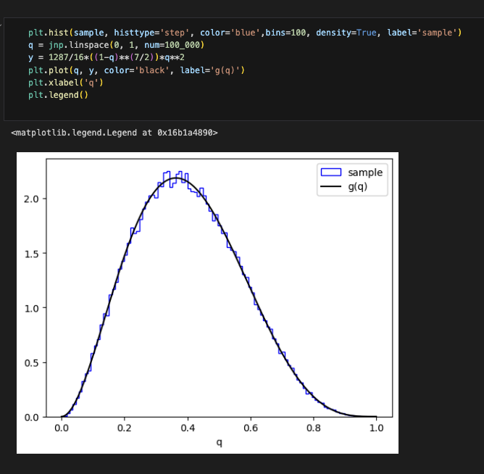
Sampling of the Plummer potential
Initial conditions

Slide 38
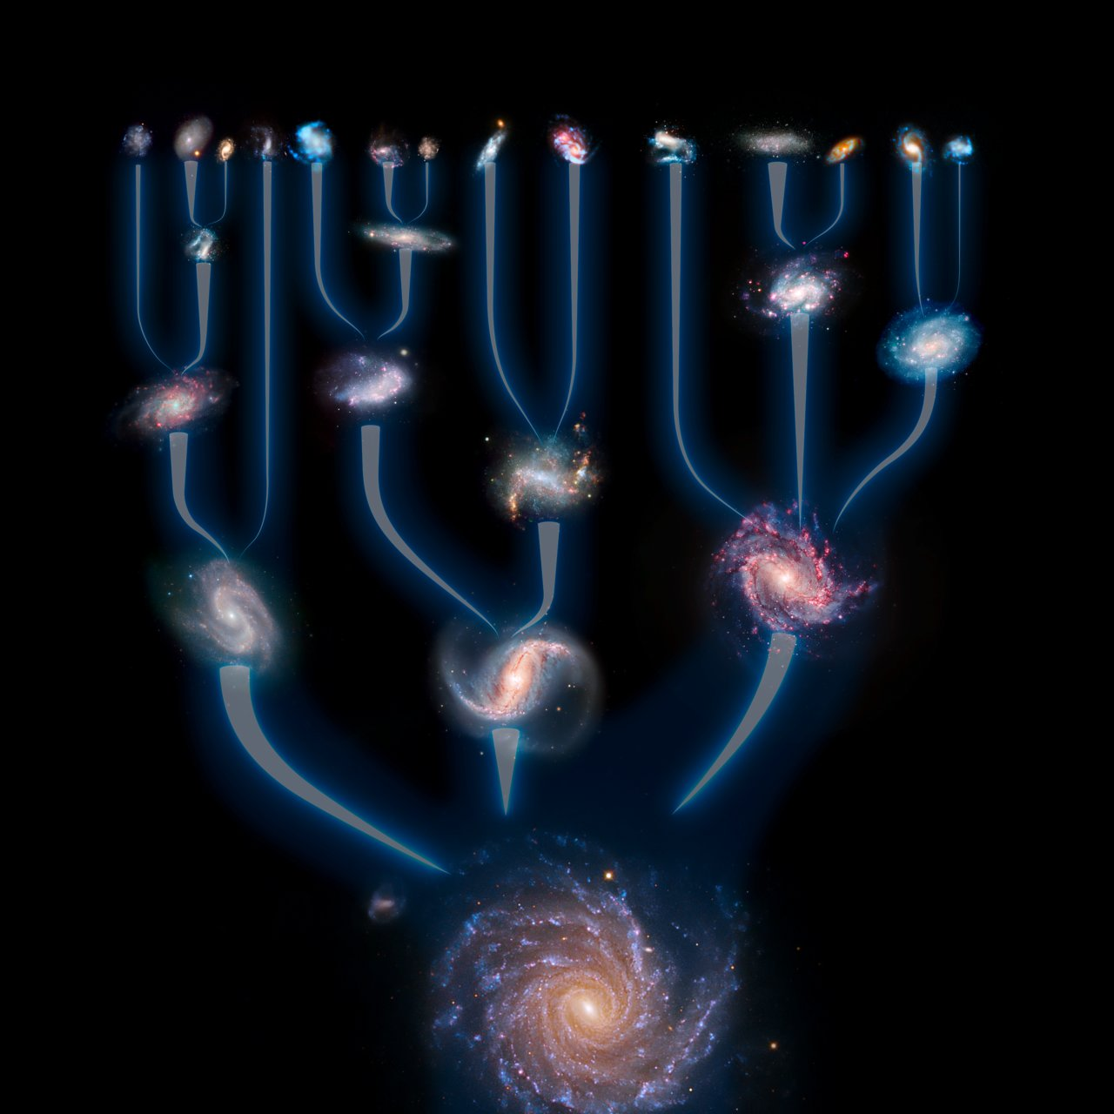
Hierarchical growth
ESO/L. Calçada

Slide 39
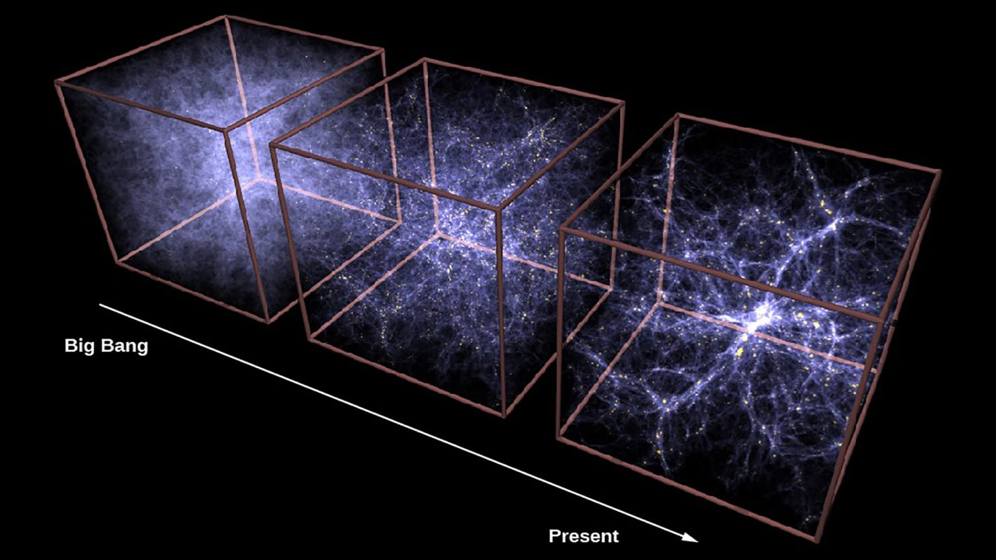
Hierarchical growth
$$ΛCDM:\frac{dn}{dM}∝M^{-1.9}$$
Springel
‘Exploring the Geometry, Topology and Morphology of Large Scale Structur using Minkowski Functionals’, Sheth et al. 2005.

Slide 40
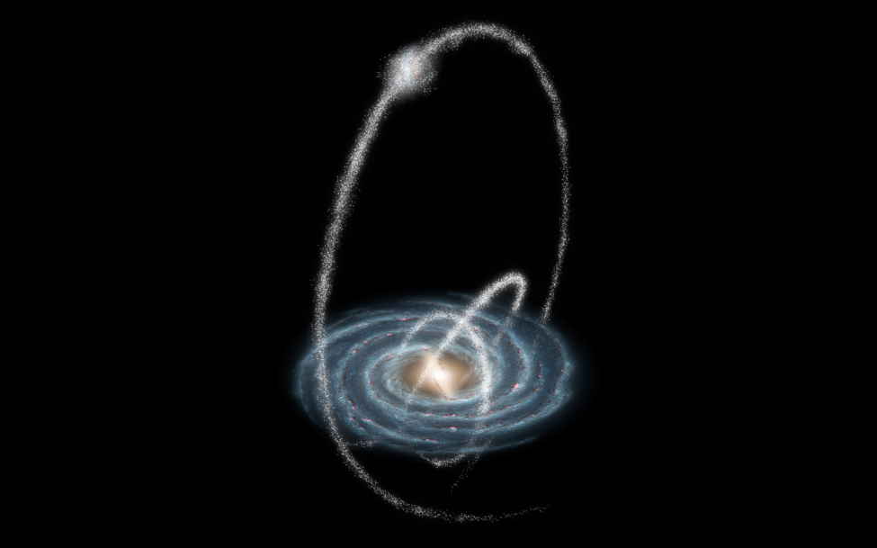
Hierarchical growth
$$ΛCDM:\frac{dn}{dM}∝M^{-1.9}$$
Springel
‘Exploring the Geometry, Topology and Morphology of Large Scale Structur using Minkowski Functionals’, Sheth et al. 2005.
Stellar Halo

Slide 41
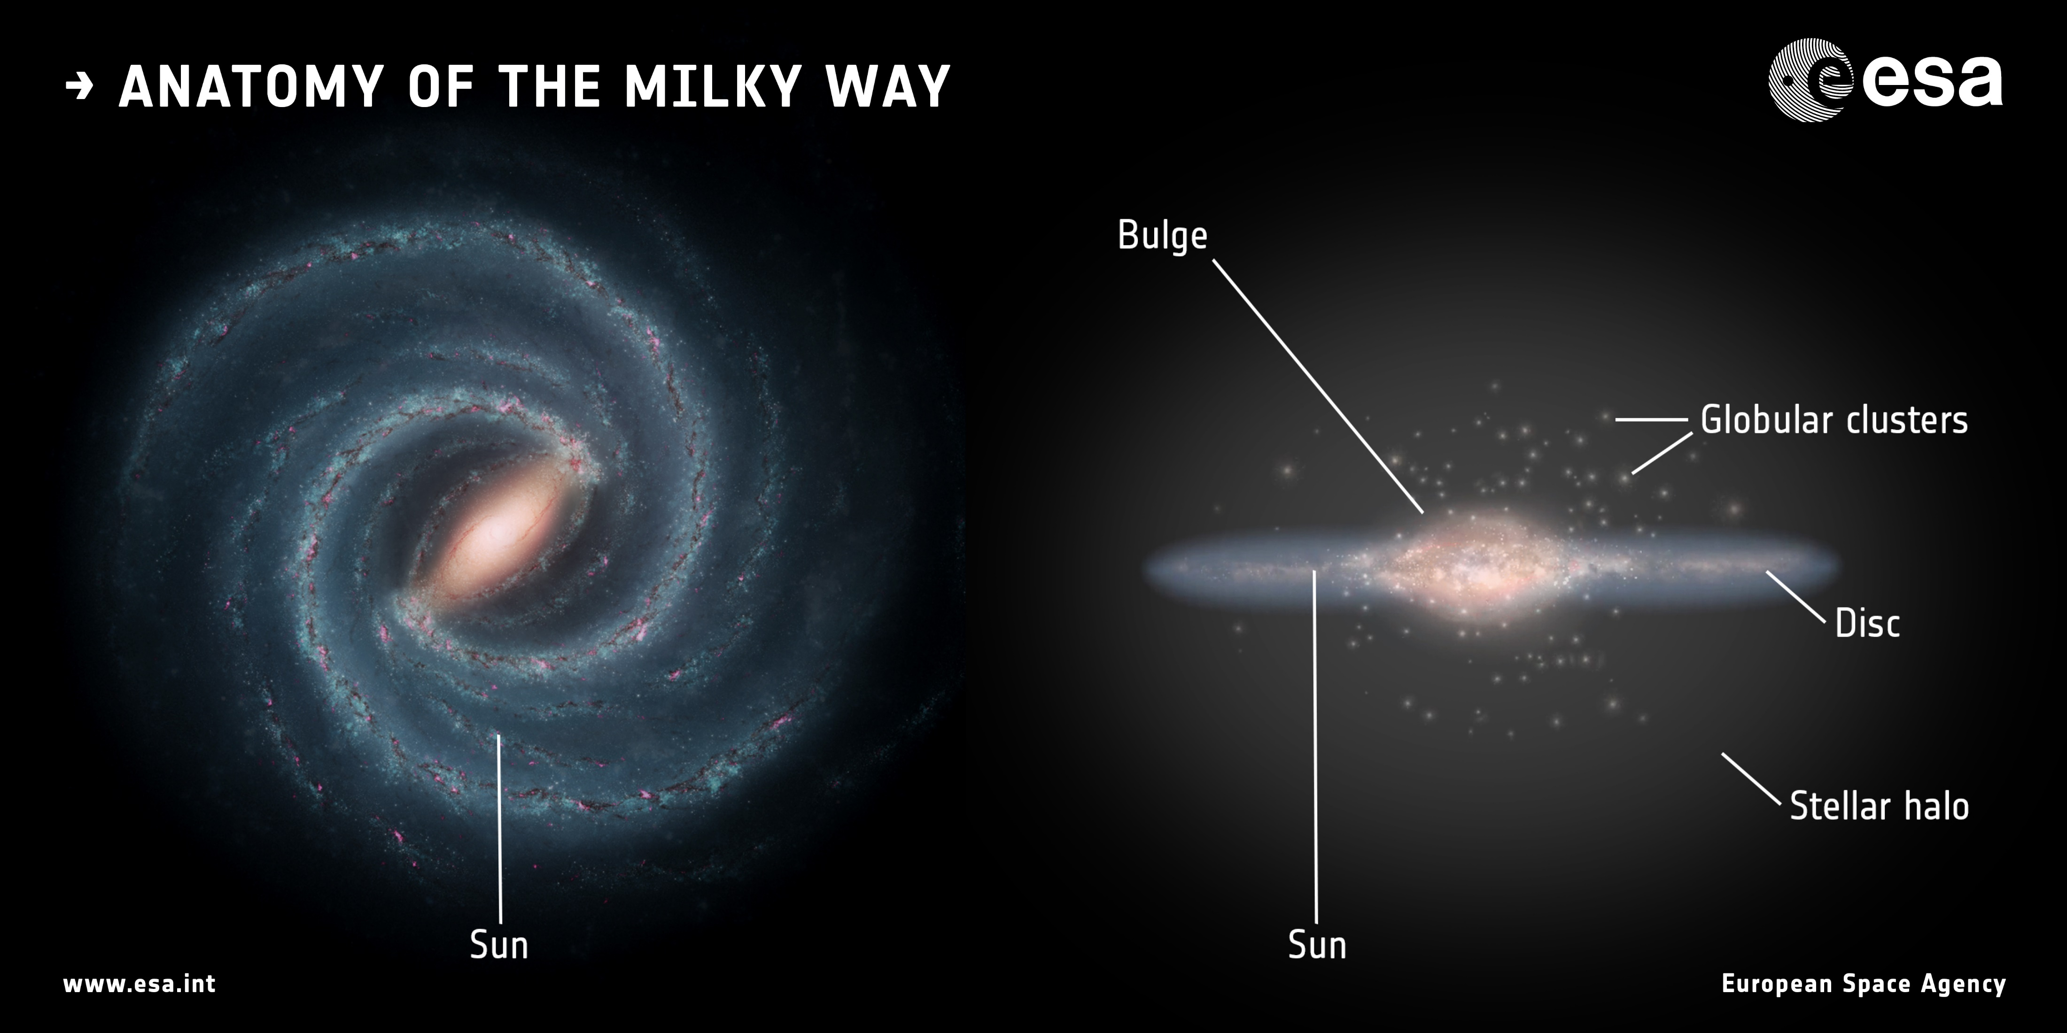
Anatomy of the Milky Way

Slide 42
Milky Way satellite map
‘Small-Scale Challenges to the ΛCDM Paradigm’, Bulloc et al. 2017

Slide 43
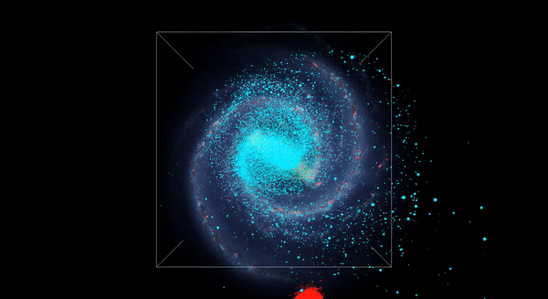
Merger simulation
‘The merger that led to the formation of the Milky Way’s inner stellar halo and thick disk’, Helmi et al. 2018

Slide 44
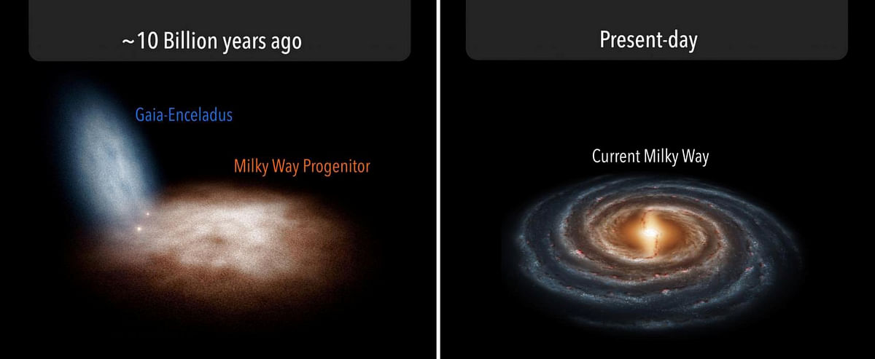
Galactic Archaeology

Slide 45
Dynamics: $(\overset{⃗}{x},\overset{⃗}{v})$
‘The merger that led to the formation of the Milky Way’s inner stellar halo and thick disk’, Helmi et al. 2018

Slide 46
Dynamics: $(\overset{⃗}{x},\overset{⃗}{v})$
Chemistry: $(Z,α)$
‘The merger that led to the formation of the Milky Way’s inner stellar halo and thick disk’, Helmi et al. 2018

Slide 47
Dynamics: $(\overset{⃗}{x},\overset{⃗}{v})$
Gaia Sausage-Enceladus (GS/E)
Chemistry: $(Z,α)$
‘The merger that led to the formation of the Milky Way’s inner stellar halo and thick disk’, Helmi et al. 2018

Slide 48
Dynamics
The modern picture
Chemistry
‘On the mass assembly history of the Milky Way:
clues from its stellar halo’, Horta et al. 2024

Slide 49
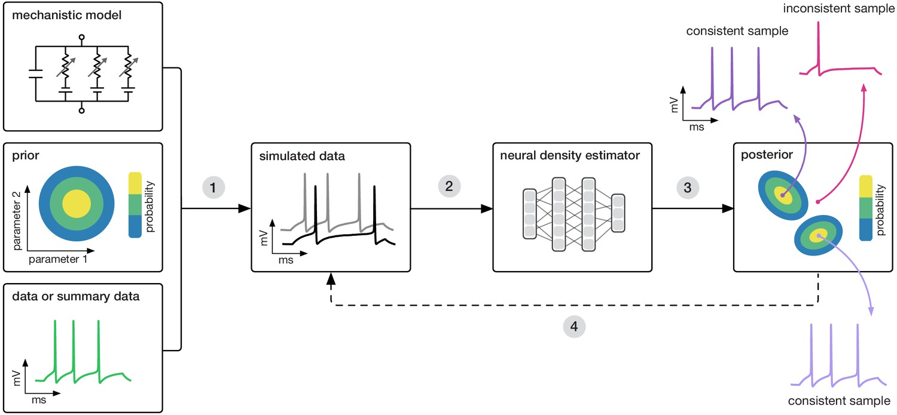
Simulation Based Inference (SBI)
Train a Neural Density Estimate (NDE) of the Posterior $p(θ|x)$ on $(θ,x)$ pairs
"Training deep neural density estimators to identify mechanistic models of neural dynamics“, Gonçalves, et al. 2024

Slide 50
Simulation Based Inference (SBI)
Train a Neural Density Estimate (NDE) of the Posterior $p(θ|x)$ on $(θ,x)$ pairs
Ingredients:
Prior $p(θ)$
"Training deep neural density estimators to identify mechanistic models of neural dynamics“, Gonçalves, et al. 2024

Slide 51
Simulation Based Inference (SBI)
Train a Neural Density Estimate (NDE) of the Posterior $p(θ|x)$ on $(θ,x)$ pairs
Ingredients:
Prior $p(θ)$
Simulator $S$
"Training deep neural density estimators to identify mechanistic models of neural dynamics“, Gonçalves, et al. 2024

Slide 52
Simulation Based Inference (SBI)
Train a Neural Density Estimate (NDE) of the Posterior $p(θ|x)$ on $(θ,x)$ pairs
Ingredients:
Prior $p(θ)$
Simulator $S$
Observations $x=S(θ)$
"Training deep neural density estimators to identify mechanistic models of neural dynamics“, Gonçalves, et al. 2024

Slide 53
Simulation Based Inference (SBI)
Train a Neural Density Estimate (NDE) of the Posterior $p(θ|x)$ on $(θ,x)$ pairs
Ingredients:
Prior $p(θ)$
Simulator $S$
Observations $x=S(θ)$
NDE $q_{φ}\left(θ | x\right)\sim p(θ|x)$
"Training deep neural density estimators to identify mechanistic models of neural dynamics“, Gonçalves, et al. 2024

Slide 54
Neural Density Estimation (NDE)
Normalizing Flow (NF):
$q_{ϕ}(θ|x)∼p(θ|x)$ -> conditional probability !
Trained on target distribution samples
$$θ$$

Slide 55
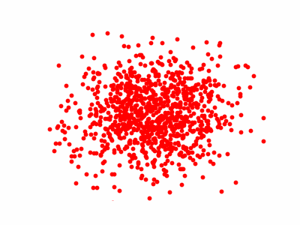
Neural Density Estimation (NDE)
Normalizing Flow (NF):
$q_{ϕ}(θ|x)∼p(θ|x)$ -> conditional probability !
Trained on target distribution samples
$$θ$$

Slide 56
Galactic Archaeology SBI
With chemistry we constrained the stellar mass
CASBI: chemical abundance simulation based inference
https://arxiv.org/abs/2411.17269

Slide 57
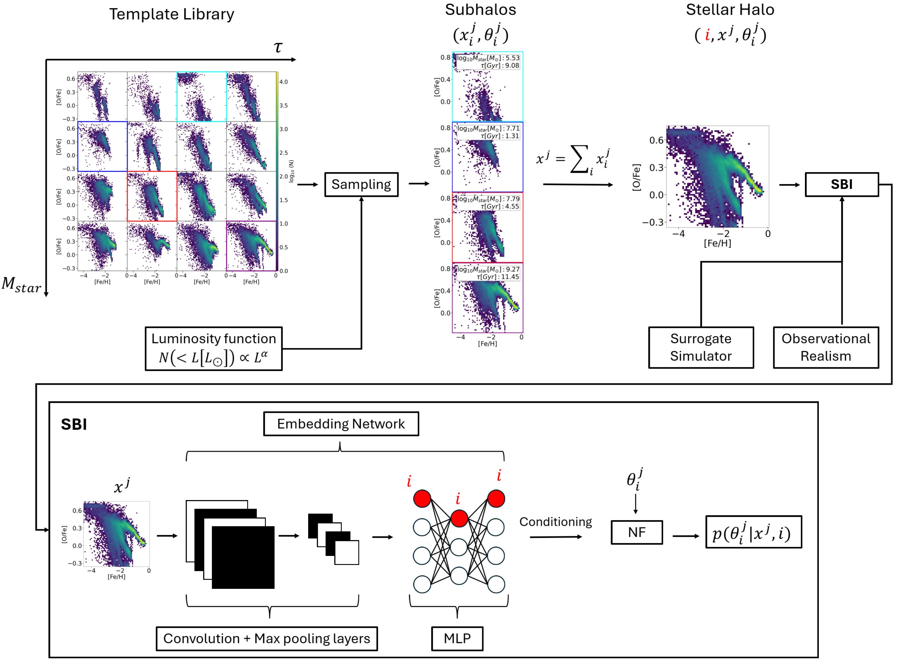
Galactic Archaeology SBI
With chemistry we constrained the stellar mass
CASBI: chemical abundance simulation based inference
https://arxiv.org/abs/2411.17269

Slide 58
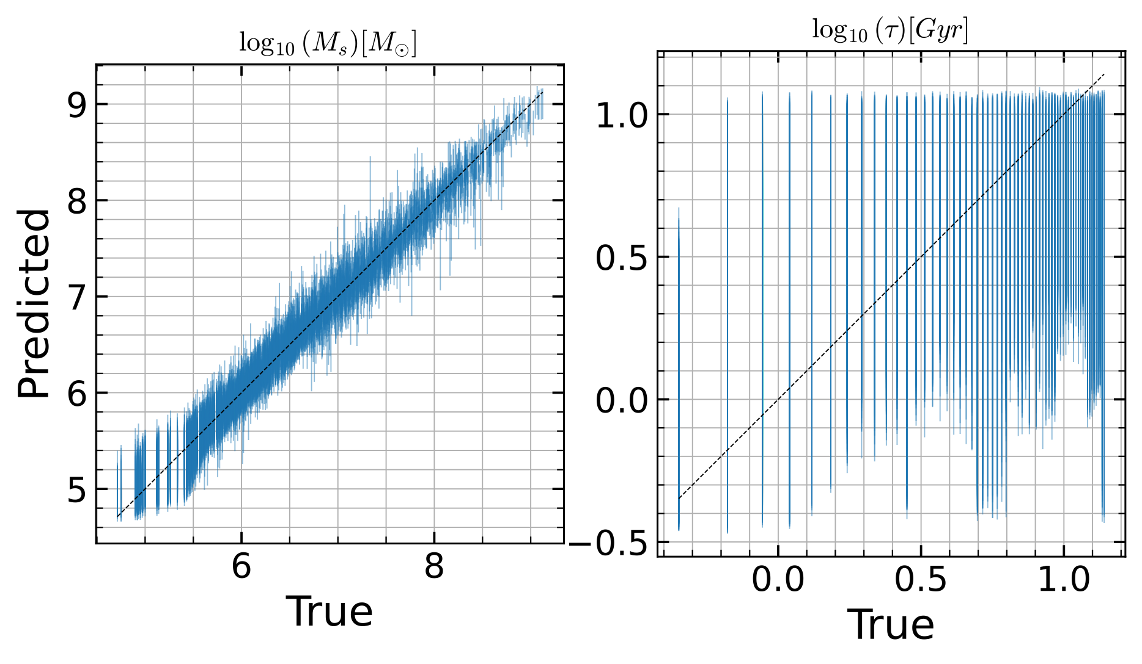
Galactic Archaeology SBI
With chemistry we constrained the stellar mass
Bad results on the infall time
CASBI: chemical abundance simulation based inference
https://arxiv.org/abs/2411.17269

Slide 59
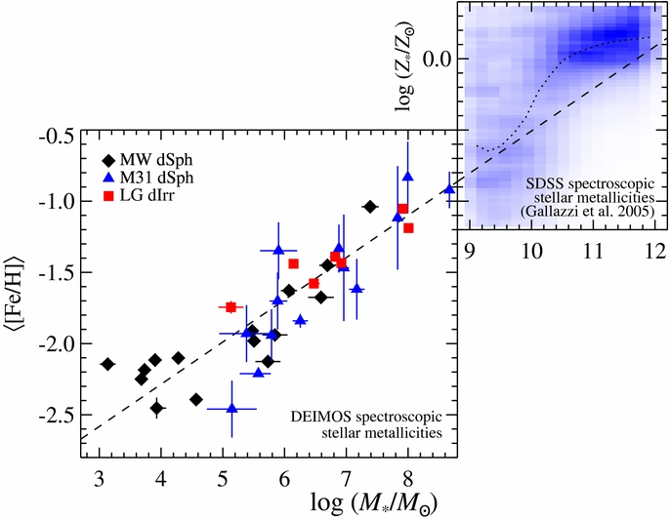
Galactic Archaeology SBI
With chemistry we constrained the stellar mass
Bad results on the infall time
‘The universal stellar mass-stellar metallicity relation for dwarf galaxies’, Kirby et al. 2013

Slide 60
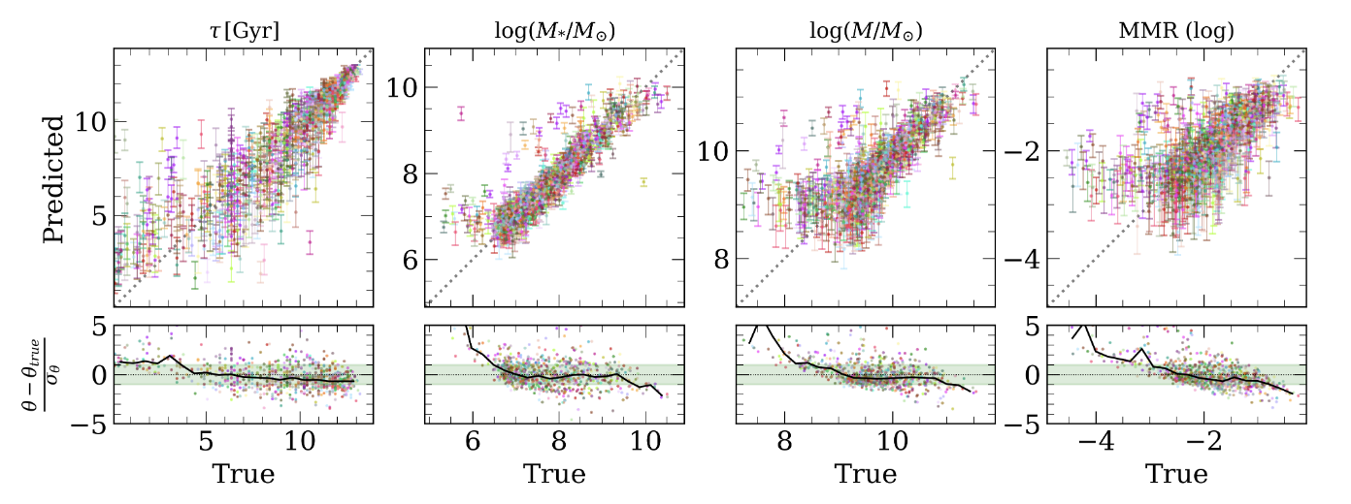
Galactic Archaeology SBI
With chemistry we constrained the stellar mass
Bad results on the infall time
Chemistry + Dynamics have (recently) proven to be good observables for GA-SBI
“GalactiKit: reconstructing mergers from 𝑧 = 0 debris using simulation-based inference in Auriga", Sante et al. 2025

