Slide 1
The discovery of new eclipsing white dwarf binary systems from NGTS
Taf Zivave
1st Year PhD Student
Supervisors: Dr Ingrid Pelisoli & Dr James McCormac
Notes:
Good afternoon, and welcome to my talk today. My name is Taf Zivave and I will be presenting my work on the discovery of new eclipsing white dwarf binary systems from NGTS.

Slide 2
Next-Generation Transit Survey
Consists of 12, 20cm telescopes
12 second cadence
Operates within a band pass range of 520 – 890nm
Instantaneous field of view of 96 deg²
Notes:
The Next Generation Transit Survey is a ground-based transiting exoplanet survey located at the Paranal Observatory in Chile. NGTS consists of twelve identical, 20cm f/2.8 telescopes which have 12s cadence, operates within a band-pass range of 520-890nm and has a field of view of 8 deg$^2$, resulting in a combined instantaneous field of view of 96 deg$^2$. The main goals of this survey was previously to look for Neptune-sized exoplanets however their focus has shifted to focus on long-period transiting planets, confirming transit planet candidates detected by the Transiting Exoplanet Survey Satellite. However, the reason for us choosing NGTS is because of their high cadence and the fact that they spend multiple hours a night on each field meaning we are able to look at both short and long period targets as well as the lack of WD surveys focused on the southern hermisphere.

Slide 3
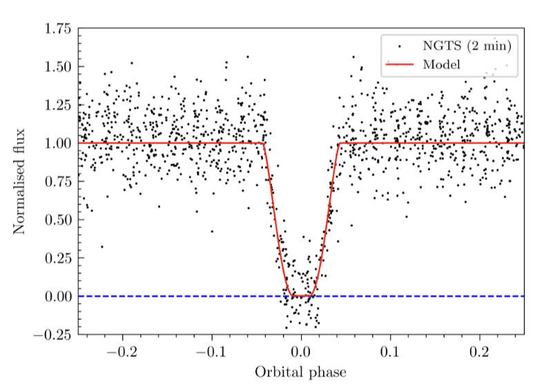
Motivation
Discovery of NG01: WD+BD system with an orbital period of 0.0592 days (1.42 hours)
WD: 8400±400 K & 0.017±0.002 solar radius
BD: 2250±200 K & 0.13±0.02 solar radius
Only a handful of close WD+BD binaries known, with around 0.1-0.5% of WDs thought to have a BD companion
Goal to extend the search for white dwarfs in EBs to the entire NGTS data archive
Notes:
The motivation for the search stems from a similar project I did during my Bachelors in which I searched through a small data sample and discovered NG01, which is a white dwarf—brown dwarf binary system with a very short orbital period of around 1.42 hours. We applied for further observations with XSHOOTER and ULTRACAM which was accepted in 2023 and the final stages of the analysis for this target is still ongoing and the paper is currently in prep too. The significance of this result is based on how rare this finding is, with only a handful of these systems actually being confirmed. And therefore the goal of this project is to extend this search across the entire NGTS private data archive to discovered systems similar to this, as well as any other interesting and rare EBs

Slide 4
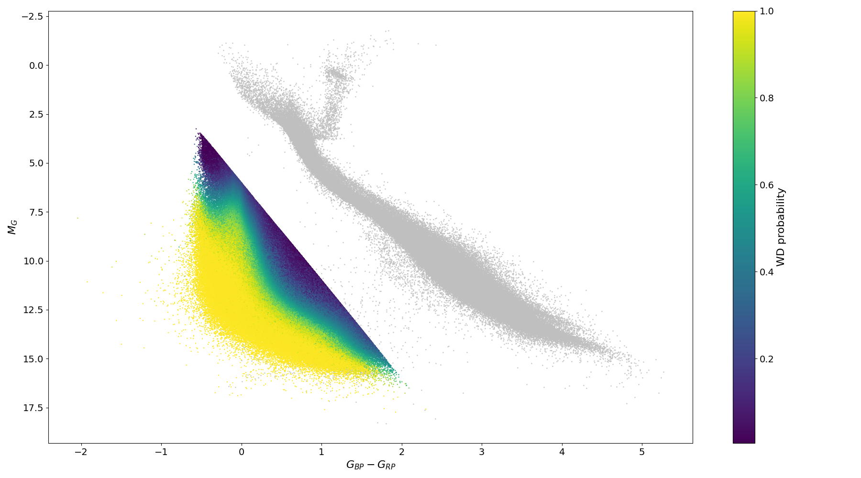
WD Pipeline
Crossmatch
Process
Combine
Analyse
Notes:
We built a WD pipeline, which comprises of 4 stages that i will go through now. The first stage is the crossmatching process, where we start off with the gaia table contents from gentile fusillos 2021 catalogue. We apply a selection criteria based on their gaia magnitudes and then select 100 comparison stars. The overall product for this is a new catalogue for each NGTS field in the database with both WDs and comparison stars that lie within the field.

Slide 5
WD Pipeline
Crossmatch
Process
Combine
Analyse
Notes:
For process, we conduct forced photometry by placing apertures on the locations of the known WDs and comparison stars across a field using old and new data that is available. We adjust the reference image through background correction, removal of the 20 pixel overscan and monitoring the defocus level. Then we perform the source extraction for the objects in the field and crossmatch them with the catalogue created in step one.

Slide 6
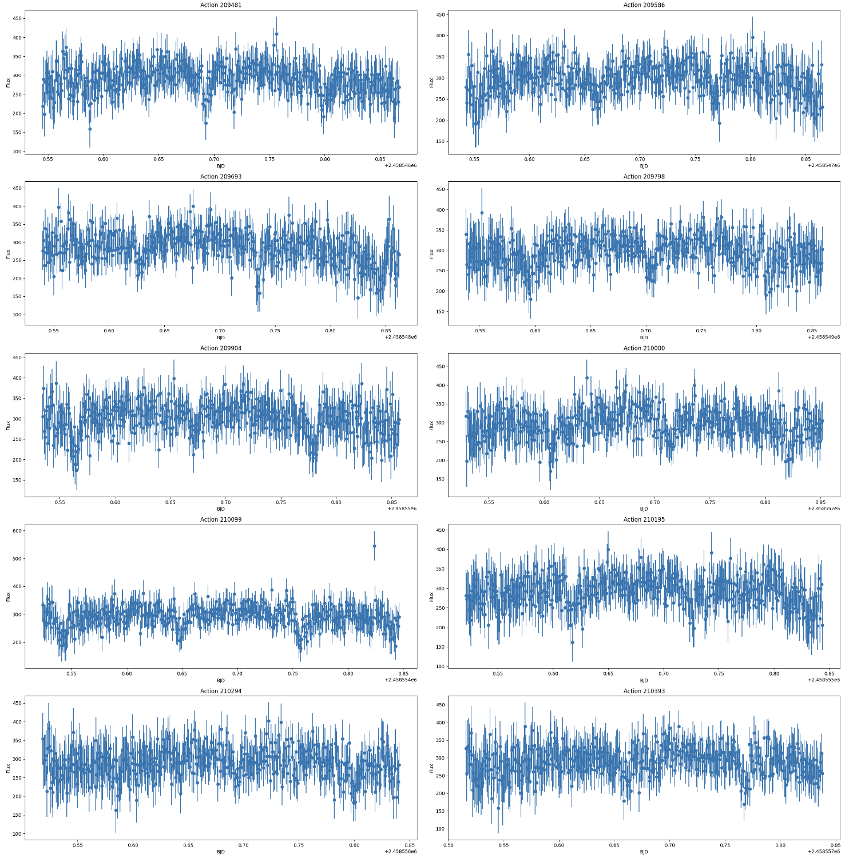
WD Pipeline
Crossmatch
Process
Combine
Analyse
Notes:
Combine then takes the outputs from process and builds a file containing the light curve for each WD. This is done by first removing the bad comparison stars and then stacking each nightly observation from the outputs of process into a combined multi-night light curve.

Slide 7
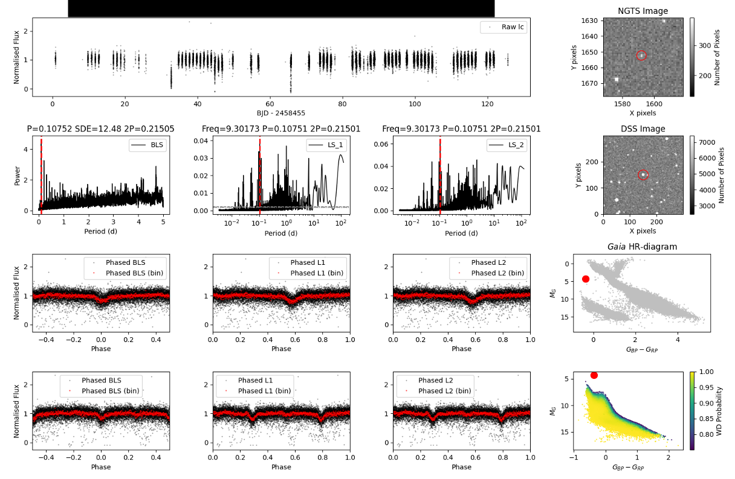
WD Pipeline
Crossmatch
Process
Combine
Analyse
Notes:
We extract the outputs of the combine script and conduct analysis to look for transit-like features in the lightcurves using the Box Least Squares algorithm and for oscillatory behaviour using the Lomb-Scargle algorithm. The resulting output for analyse stage is a diagnostic plot, collating of key plots and information surrrounding the target. And I am just going to briefly breakdown each of these plots.

Slide 8
WD Pipeline
Crossmatch
Process
Combine
Analyse
Notes:
here we have the stacked, multi-night lightcurve output from combine

Slide 9
WD Pipeline
Crossmatch
Process
Combine
Analyse
Notes:
we have the periodograms created from BLS, as well as lomb scargle 1 and 2, where LS 1 is equivalent to a single-term sinusoidal fit to the data at each frequency while the LS 2 expands this to a truncated Fourier series with multiple frequencies.

Slide 10
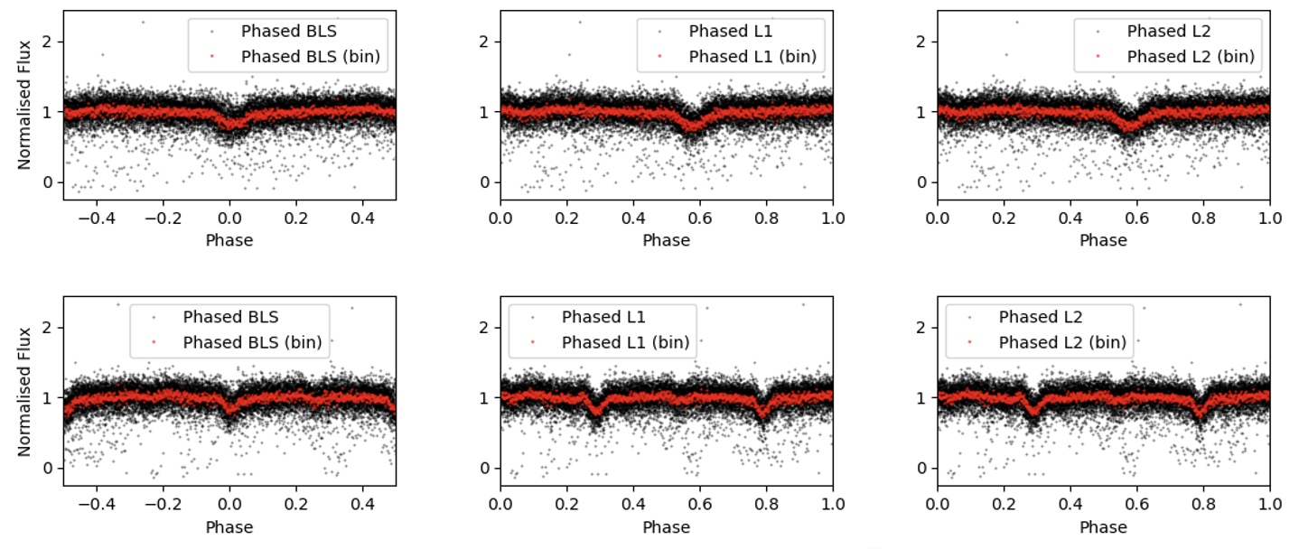
WD Pipeline
Crossmatch
Process
Combine
Analyse
Notes:
We have the phased light curves, folded on the period as well as twice the period, to help identify any secondary eclipses in the lightcurves.

Slide 11
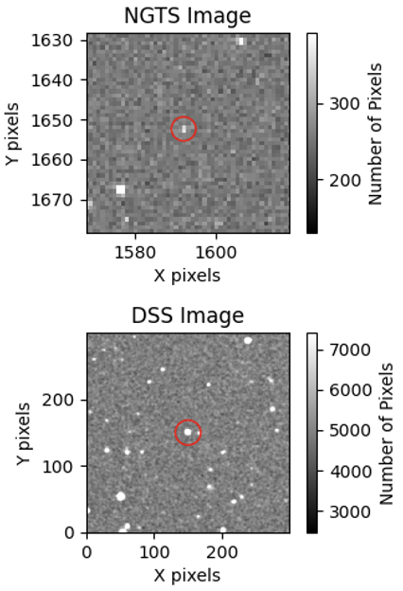
WD Pipeline
Crossmatch
Process
Combine
Analyse
Notes:
We have snapshot plots from NGTS and DSS to monitor the aperture, making sure that nothing else is contributing the signal we observe

Slide 12
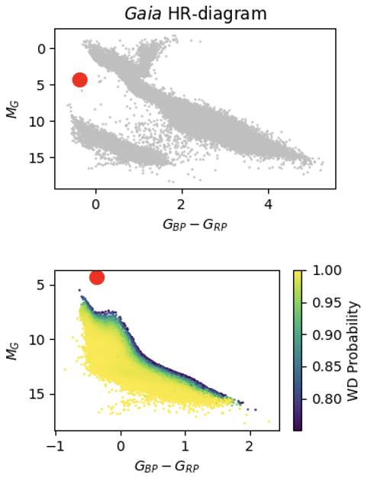
WD Pipeline
Crossmatch
Process
Combine
Analyse
Notes:
and lastly, we have the HR diagram, which allows us to place assumptions on the type of system that we could possibly be seeing based on their location on the hr diagram.

Slide 13
Current Pipeline Outputs
Currently looked at ~2500/4859 fields available in the NGTS private data archive
Discovered 10 new EBs so far, along with 6 new variable candidates
2 candidates were submitted in an ESO proposal in March (Accepted: Ultracam time of 14hrs in total)
hot subdwarf + hot subdwarf/WD
cataclysmic variable: WD+MS

Slide 14
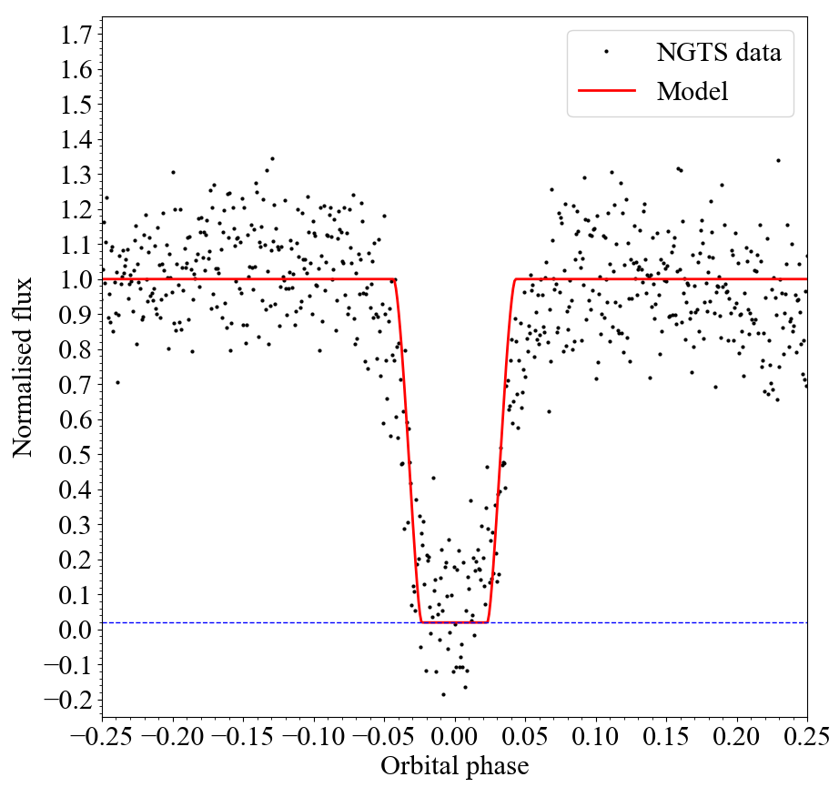
ESO Proposal: HS+HS/WD candidate
Notes:
Here we have the first target. A HS+HS or WD, however we believe that this target is leaning towards being a HS+WD since we were able to observe a secondary eclipse in the lightcurve in the diagnostic plot. The targets both have similar temperatures which was an assumption based on the SED plot.
This target has a very short period of 2.4 hrs. Currently, only 6 hot subdwarfs are known in compact binary systems with a WD, with a orbital period shorter than 2.5hrs, and therefore this is an extremely rare and exciting find for us.

Slide 15
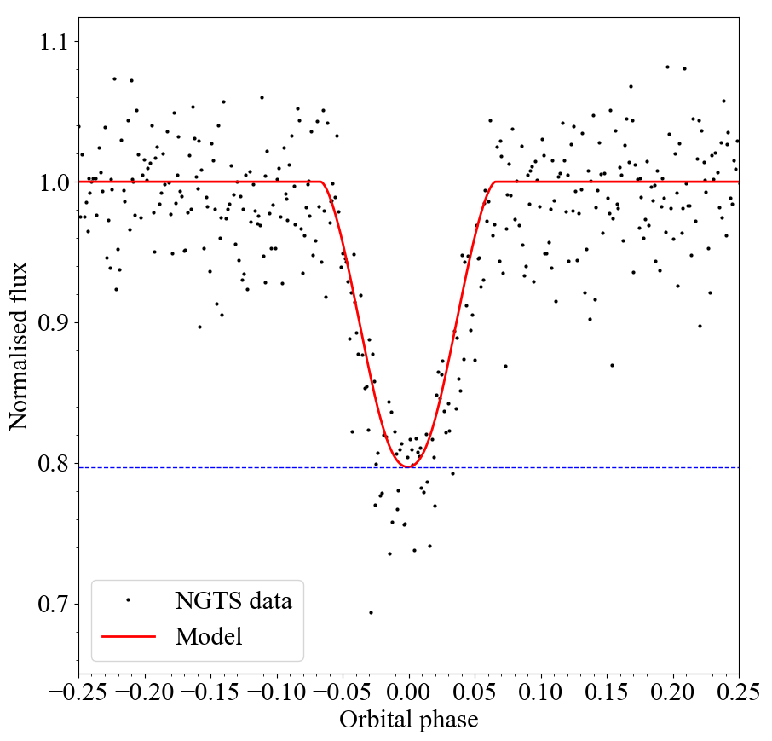
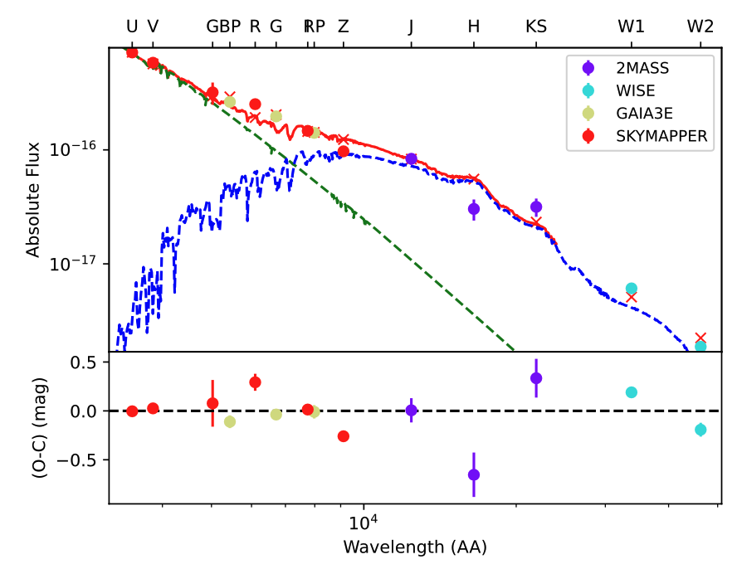
ESO Proposal: CV candidate
Notes:
The next target is labelled as a cataclysmic variable candidate, in which we assume consists of a white dwarf with a low mass main sequence star. We unfortunately do not observe any outbursts in the data we have so we cannot confirm or deny whether it is a CV or not. Again, it is another very short period binary, with a period of 1.88 hrs.

Slide 16
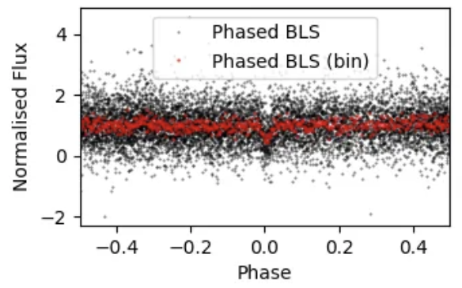
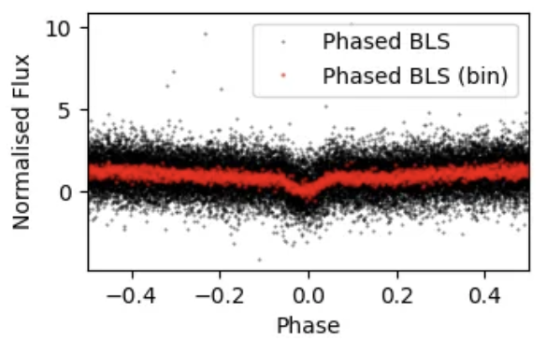
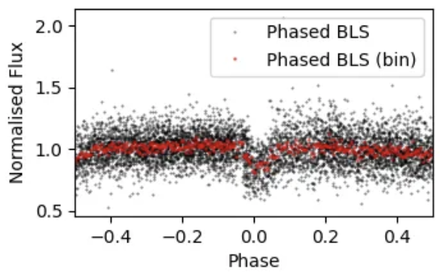
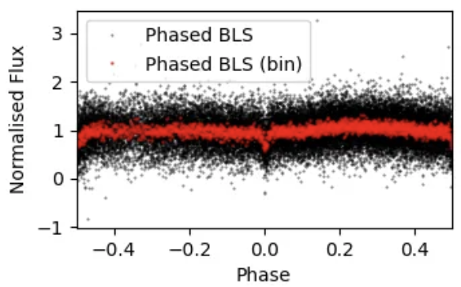
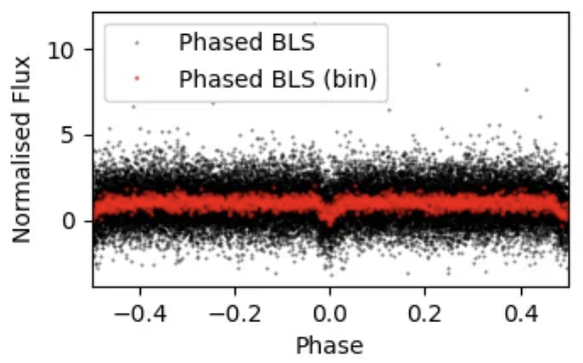
WD + MS

Slide 17
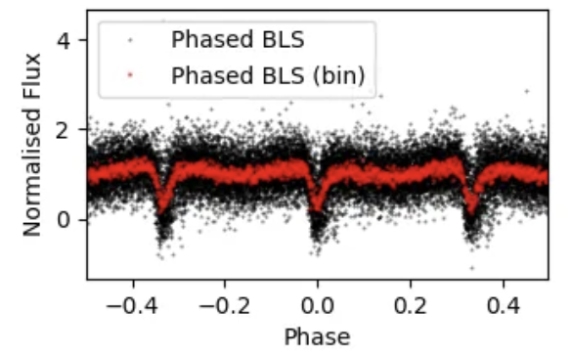
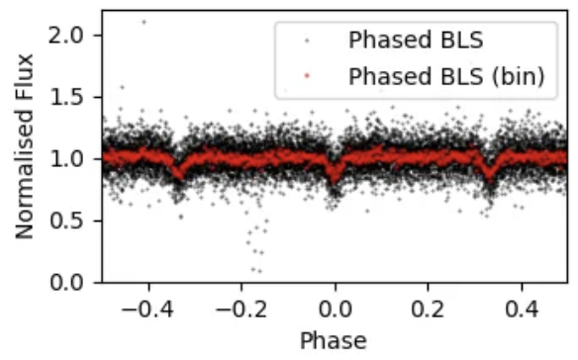
CV

Slide 18
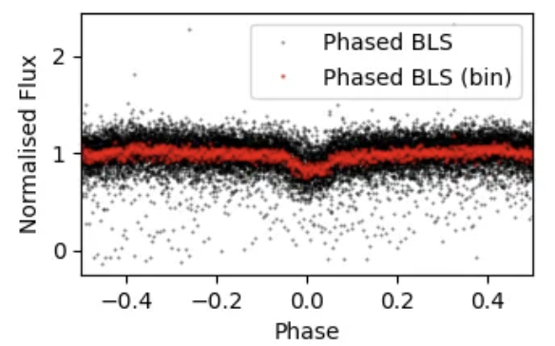
HS + WD

Slide 19
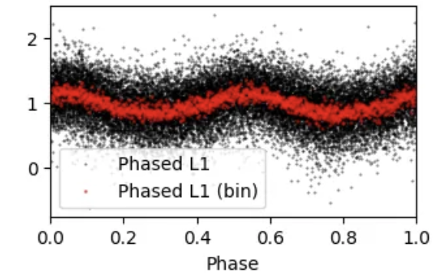
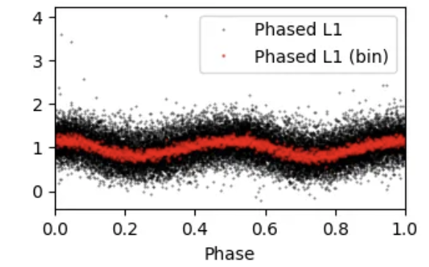
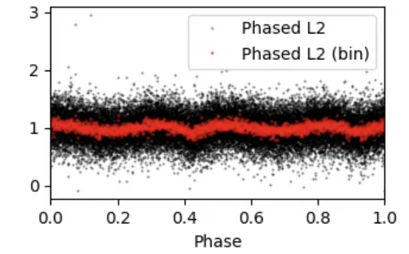
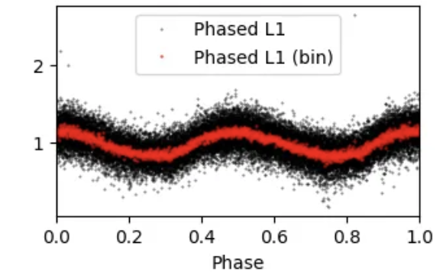
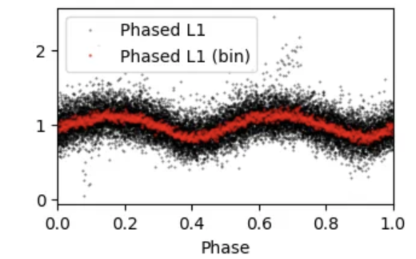
Non-EBs

Slide 20
Summary
Applied a pipeline across the available NGTS fields in the private data archive
So far, discovered new 10 EBs, along with 6 new non-EB systems
2 were submitted for an ESO proposal
Currently reviewing the remaining ~2300 number of NGTS fields
In the process of conducting nightly observations of WD fields
Notes:
I shall leave the summary up, and if you have any questions feel free to ask. Thank you for listening.

Slide 21
WD Nightly Observations

