Slide 1



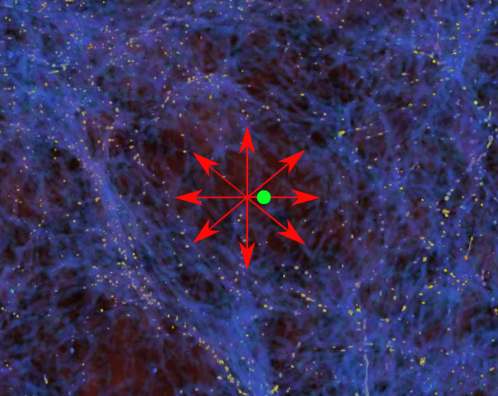
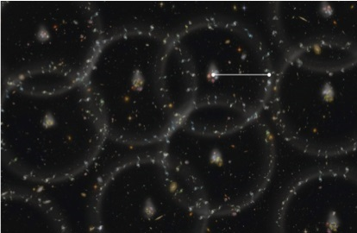

MNRAS, 499, 2845 – 2883 (December 2020)
MNRAS, 527, 4388 – 4396 (January 2024)
MNRAS, 536, 3232 – 3241 (January 2025)
YouTube channel: indranilbanik3424
The observed local supervoid could solve the Hubble and BAO tensions with ΛCDM

Slide 2




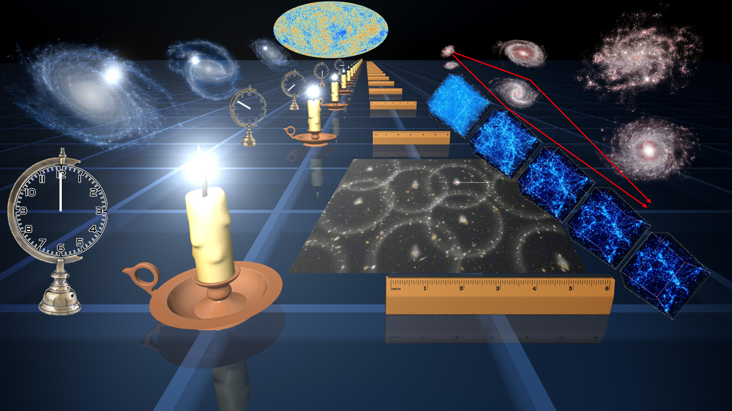

Special Issue: "Theoretical and Observational Approaches to the Hubble Tension in Cosmology"
Closing date will be near end of 2025 to allow time to include results presented here.
Guest Editor
An important aim of this Special Issue is to exploit the increasing sensitivity of various techniques to give readers an idea of which ones actually show a tension with ΛCDM. This will give a deeper insight into the origin of the Hubble tension.
Dr. Indranil Banik
Institute of Cosmology and Gravitation, University of Portsmouth, Dennis Sciama Building, Burnaby Road, Portsmouth PO1 3FX, UK
Dr. Harry Desmond
Institute of Cosmology and Gravitation, University of Portsmouth, Dennis Sciama Building, Burnaby Road, Portsmouth PO1 3FX, UK
Special Issue website:
https://www.mdpi.com/journal/galaxies/special_issues/BS2131Z18Q

Slide 3
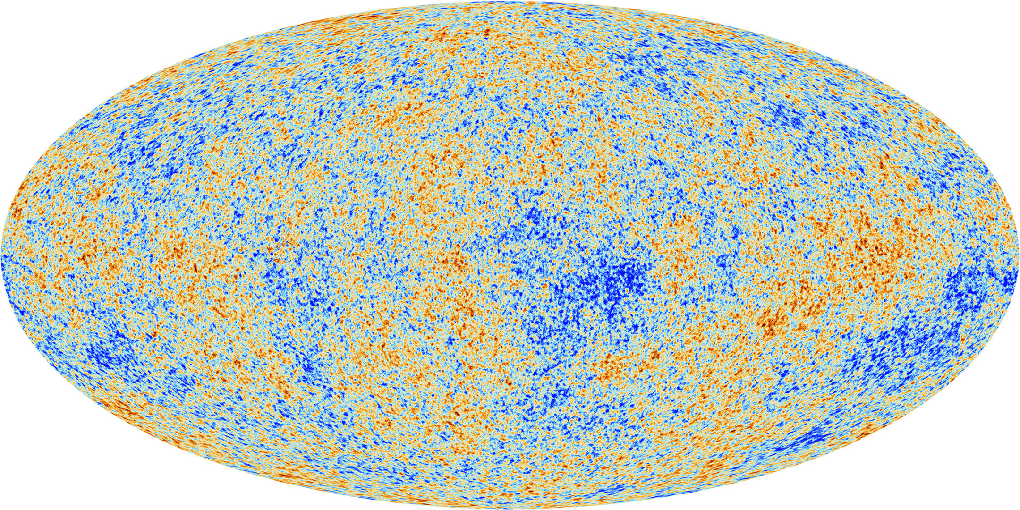
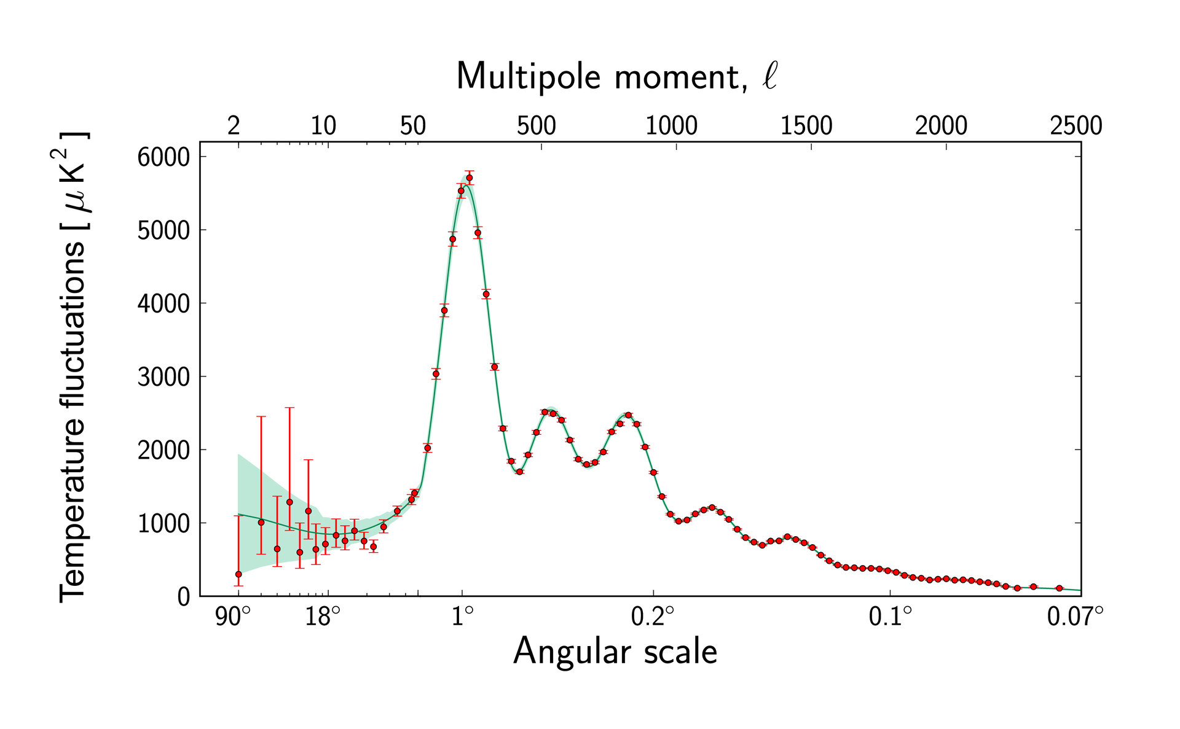
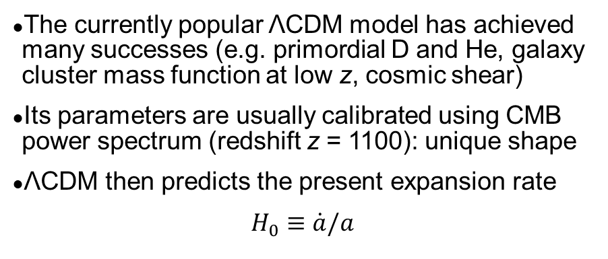
Two routes to the present expansion rate
The currently popular ΛCDM model has achieved many successes (e.g. primordial D and He, galaxy cluster mass function at low z, cosmic shear)
Its parameters are usually calibrated using CMB power spectrum (redshift z = 1100): unique shape
ΛCDM then predicts the present expansion rate
$$H_{0}≡\dot{a}/a$$
Credit: ESA (Planck)

Slide 4
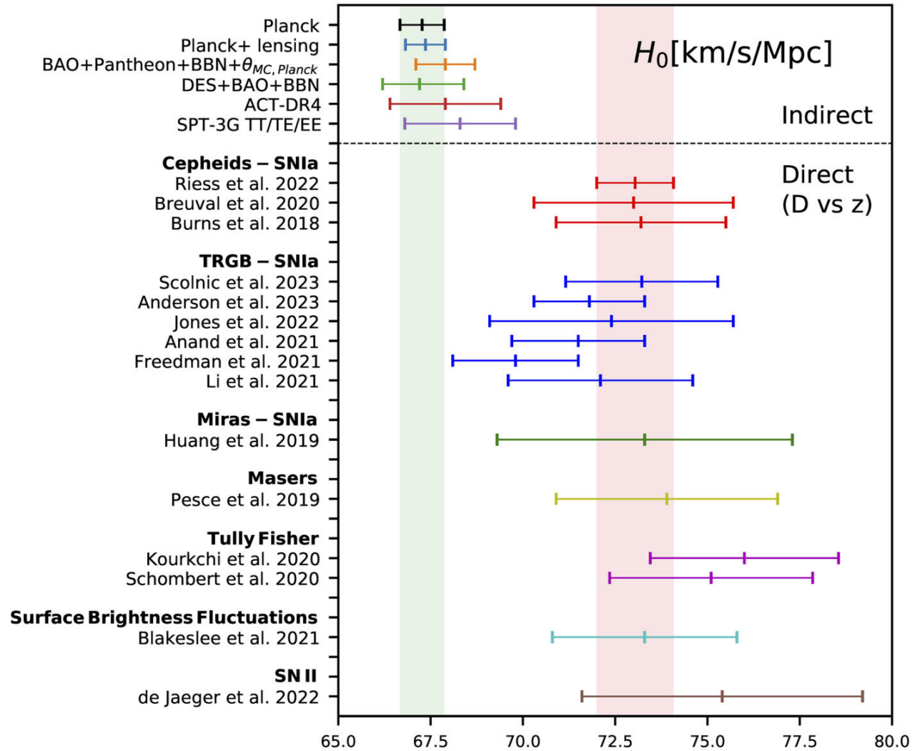

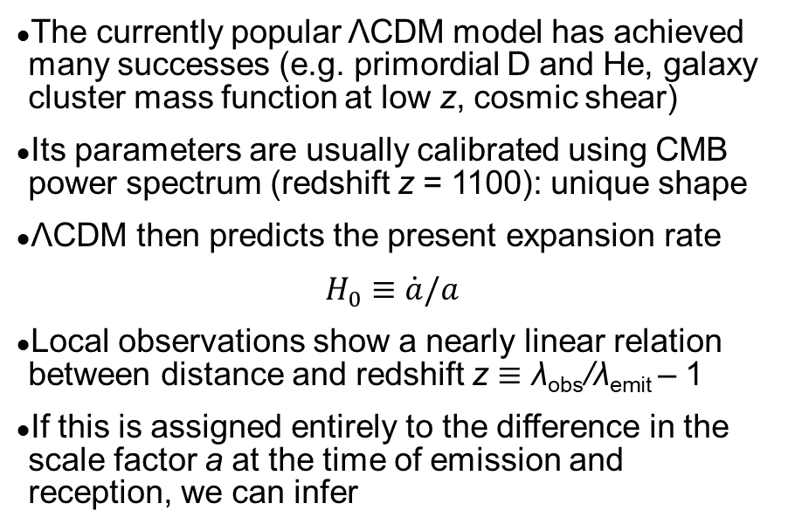
Two routes to the present expansion rate
The currently popular ΛCDM model has achieved many successes (e.g. primordial D and He, galaxy cluster mass function at low z, cosmic shear)
Its parameters are usually calibrated using CMB power spectrum (redshift z = 1100): unique shape
ΛCDM then predicts the present expansion rate
$$H_{0}≡\dot{a}/a$$
Local observations show a nearly linear relation between distance and redshift z ≡ λ_{obs}/λ_{emit} – 1
If this is assigned entirely to the difference in the scale factor a at the time of emission and reception, we can infer
Credit: Eleonora di Valentino
(Arxiv: 2308.10954)
$$H_{0}=\lim_{z→0}{c\frac{dz}{dr}}$$

Slide 5
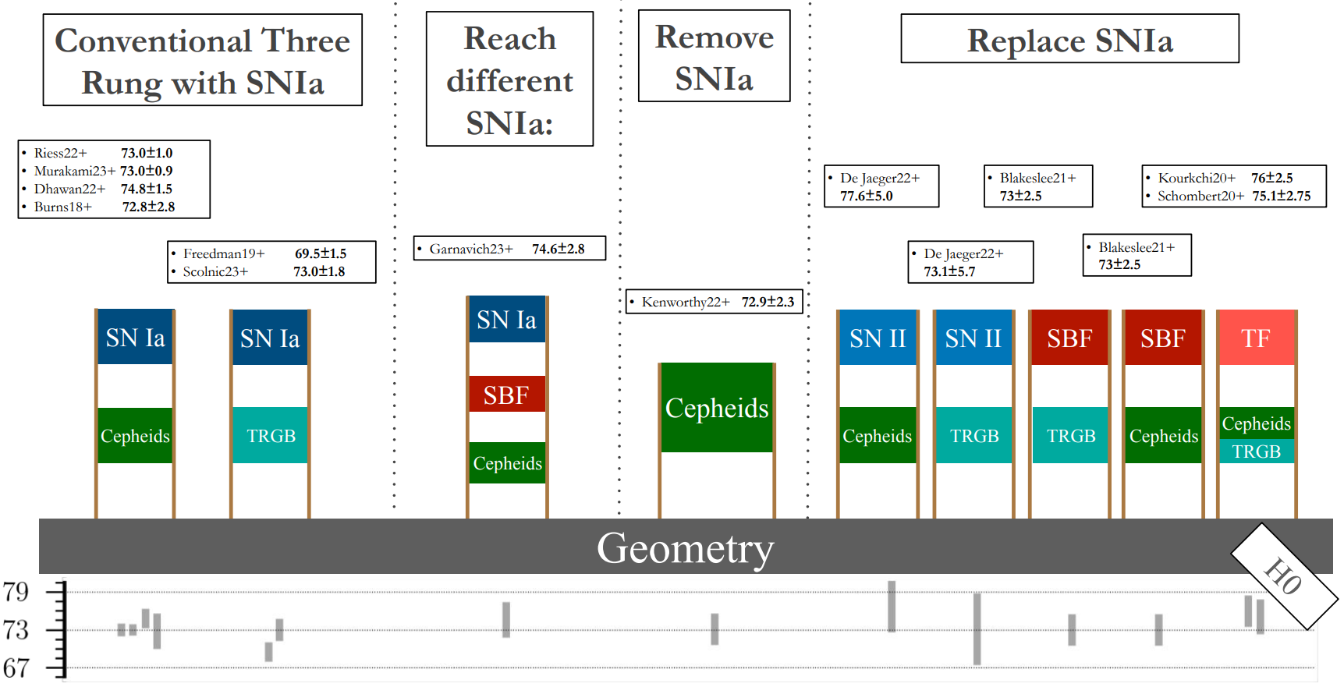
The local redshift gradient without SNe
Can estimate without Cepheids in 1st rung and/or without Type Ia SNe in 2nd rung
Megamasers give 73.9±3.0 km/s/Mpc using only geometric distances out to 132 Mpc (Pesce+ 2020)
HST Cepheids by Riess and JWST TRGB with Freedman give similar distances (Riess+ 2024).
Scolnic & Vincenzi (2023)

Slide 6
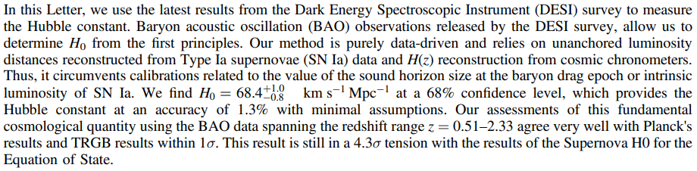
Cosmic chronometers prefer Planck H₀
Guo+ 2025 (ApJL, 978, L33)
Use uncalibrated SNe and BAOs only to constrain a(t/t_{U}), which does not directly constrain H₀
Use cosmic chronometers to constrain absolute timescale via dz/dt and thereby get H₀
Data almost entirely at z > 0.2 as long timespans needed to get slope of time-redshift relation.

Slide 7
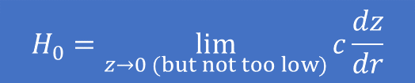
The impact of local structure
The local measurement of H₀ is affected by peculiar velocities, which are velocities in the CMB rest frame (e.g., M31 is approaching us)
Impact of peculiar velocities should decrease as we consider more distant galaxies, which have more redshift from cosmic expansion
But if we are near the centre of a large void, outward peculiar velocity could rise at first and only start decreasing quite far out
Peculiar velocities might skew the local H₀.
$$H_{0}=\lim_{z→0 (but not too low)}{c\frac{dz}{dr}}$$
Credit: Zarija Lukic, annotations: Moritz Haslbauer

Slide 8
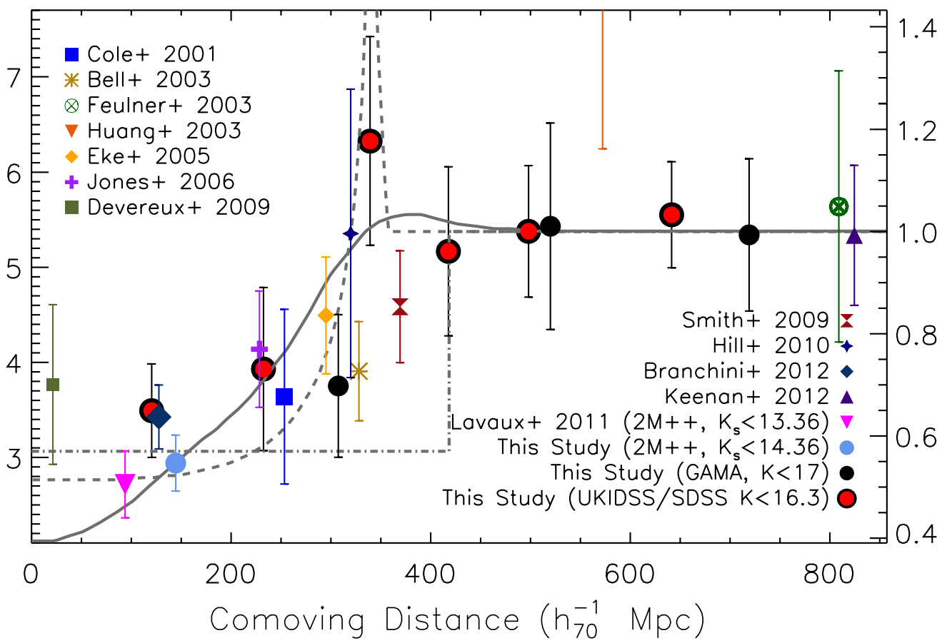
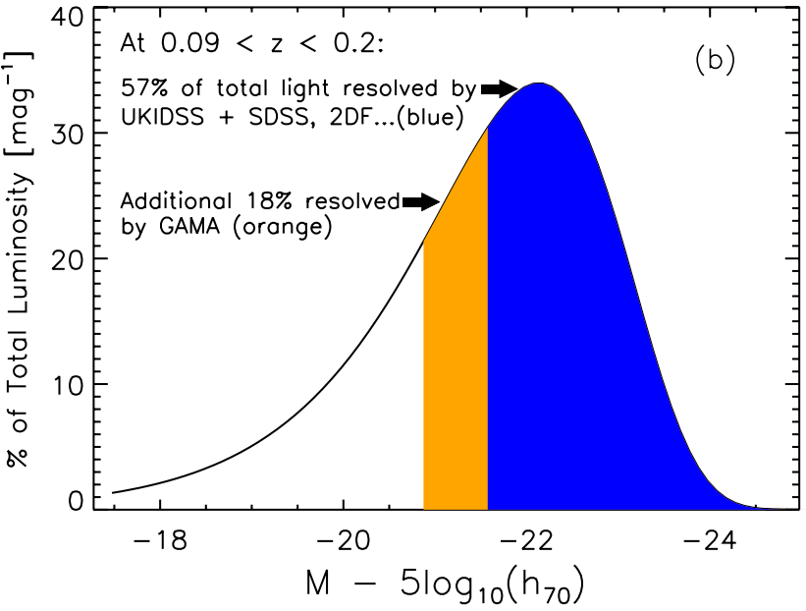
The KBC void (Keenan+ 2013)
Galaxy number counts over 90% of sky and most of the luminosity function show an underdensity at 40 – 300 Mpc.
Comoving luminosity density (arbitrary units)

Slide 9
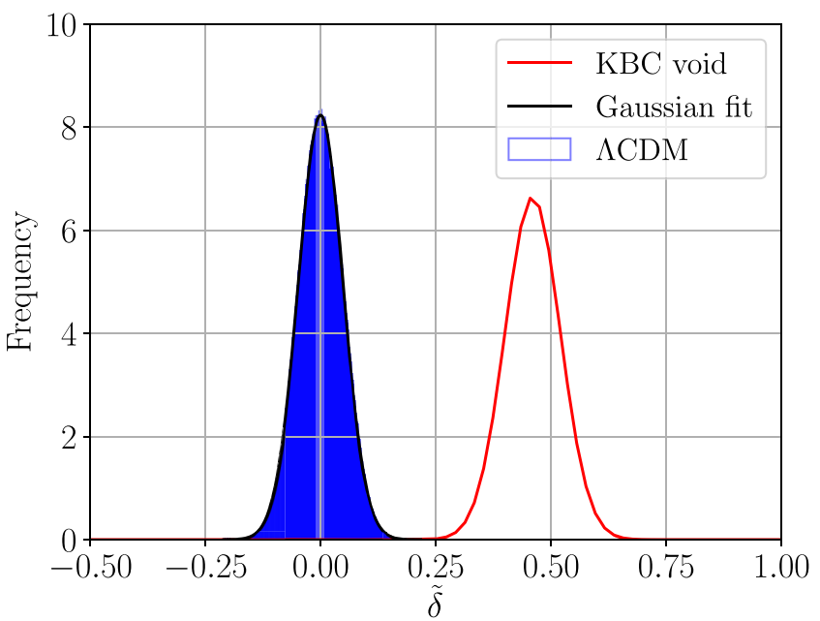
Analogues in ΛCDM
Uniform grid of 10⁶ vantage points in Millennium XXL (Angulo+ 2012), a ΛCDM N-body simulation with 4.1 cGpc box size.
Get total mass in halos with semi-analytic M* > 10¹⁰ M/h within 40 – 300 Mpc of each vantage point
Compare density to cosmic mean value
Enhance the density contrast 1.5x to allow for redshift space distortions: observers think they are seeing out to some distance d based on the redshift z, but outflows from local void mean the actual distance <d, reducing the galaxy number count
Tension with ΛCDM is 6.04σ.
Frequency distribution
Haslbauer, Banik & Kroupa (2020)

Slide 10
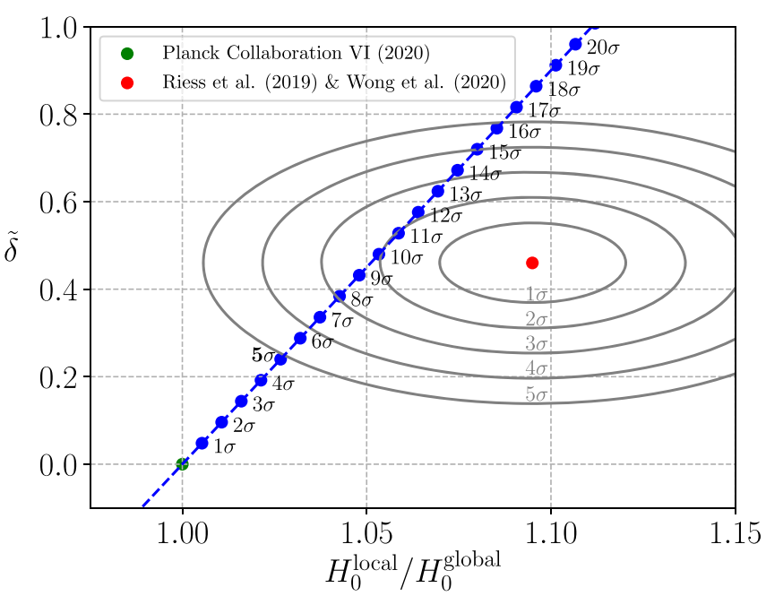
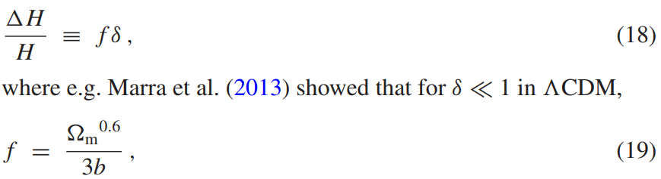
Increasing the cosmic variance
Cosmic variance in local measurements of H₀ should be quite small in ΛCDM
Cannot solve the Hubble tension
But structure formation must be enhanced to explain the KBC void (local void also found by Wong+ 2022)
Can we relate the observed local void to the Hubble tension?
Haslbauer, Banik & Kroupa (2020)

Slide 11
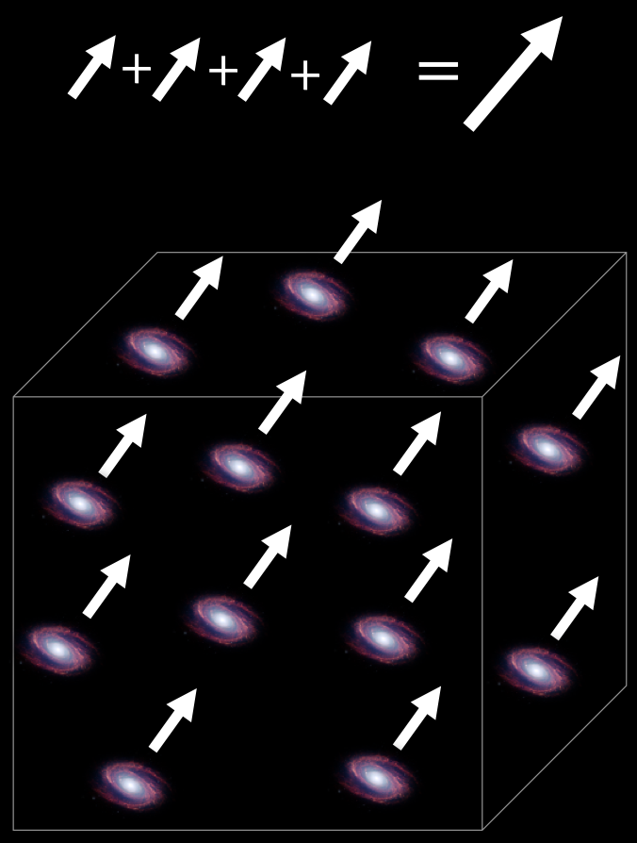

Bulk flow definition
Ideally, we want average of 3D peculiar velocity vectors within spherical region
Need to make do with line of sight (LOS) peculiar velocity of each galaxy
Consider this as a vector pointing along the LOS
Take average of these LOS peculiar velocity vectors, give higher weights to galaxies in more sparsely sampled regions (want to sample the velocity field)
Galaxies weighted by 1/r² (Peery+ 2018) & weighted mean found
Final result tripled (Nusser 2016).
Credit: Abbe Whitford (from AstroBites)
Consequences:
If all galaxies have the same peculiar velocity v, then v_{bulk} = v despite projection effects
Assumed H₀ has no effect on v_{bulk} as it affects peculiar velocities in spherically symmetric manner, which does not affect the vector average.
AstroBite explaining this (search for: Astrobites bulk flow)

Slide 12
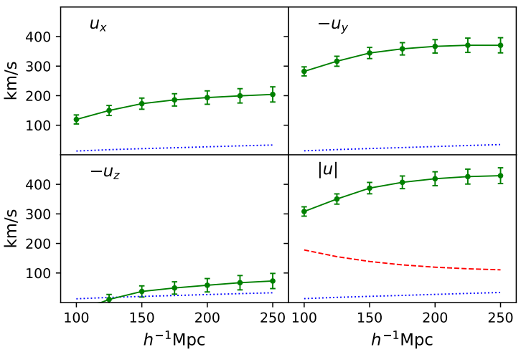
Bulk flow observations
Need galaxy survey with redshift-independent distances
Use CosmicFlows-4 (Tully+ 2023)
Bulk flow analysis by Watkins+ (2023)
Subsequent study by independent team (Whitford+ 2023) reports “excellent agreement” out to 173/h Mpc, but their method did not extend further out
Changing H₀ affects peculiar velocities in a spherically symmetric manner, not affecting vector average ≡ bulk flow
Bulk flow tension ≠ Hubble tension.
ΛCDM
Watkins+ (2023)

Slide 13
Best-fit results with each profile
Overall tension as equivalent no. of standard deviations for a single Gaussian
 | Offset (Mpc) | Tension (σ)
Exponential | 40 | 0.285
 | 55 | 1.089
Gaussian | 40 | 0.132
 | 500 | 1.520
Maxwell-Boltzmann | 210 | 0.116
 | 300 | 0.642
Inner: solid
Outer: dashed
Credit: Sergij Mazurenko

Slide 14
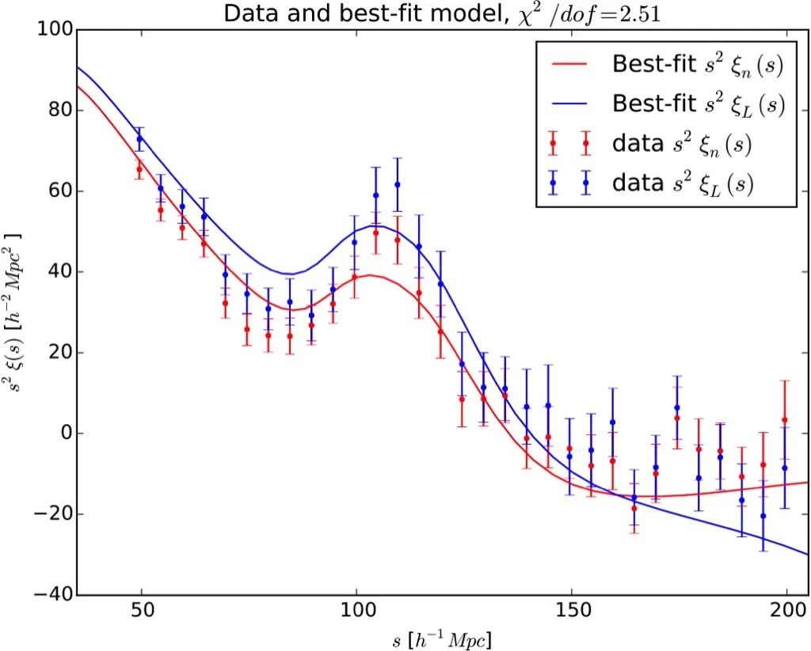
Baryon acoustic oscillation (BAO) basics
Sound horizon at recombination frozen in place and imprinted on large-scale galaxy distribution
Comoving length scale of first acoustic peak at the time of recombination is visible at late times!
Galaxy correlation function

Slide 15
BAO results: angular scale
r_{d}
D_{c}
BAO angular scale is ratio of comoving distance D_{c} to comoving length r_{d} of BAO ruler
Take r_{d} from Planck Collaboration 2020
Divide angles by expected value assuming Planck cosmology with no local void.
Banik & Kalaitzidis 2025 (MNRAS, 540, 545)

Slide 16
BAO results: isotropic average
BAO is a 3D feature, so can combine angular scale with redshift depth to get the isotropic average: D_{V}³ ≡ zD_{c}²D_{H}
Averaging independent measurements (from orthogonal directions) reduces the uncertainty
Many papers only report D_{V} as it is easier to obtain, esp. at low z.
Banik & Kalaitzidis 2025

Slide 17
Overall goodness of fit
BAO data not used to constrain model parameters in all cases.
Most discriminative test was expected to be D_{V} due to availability of more points at low z and higher accuracy by averaging angular scale with redshift depth
Clear preference for void models, which reduce χ² by about 24–28 (36–38 including D_{c} only points)
Void models with 2020 parameters are vastly more likely than the homogeneous Planck cosmology.
Note: 7 studies only report D_{c} and thus do not constrain D_{V}. These are included in final column.
Banik & Kalaitzidis 2025

Slide 18
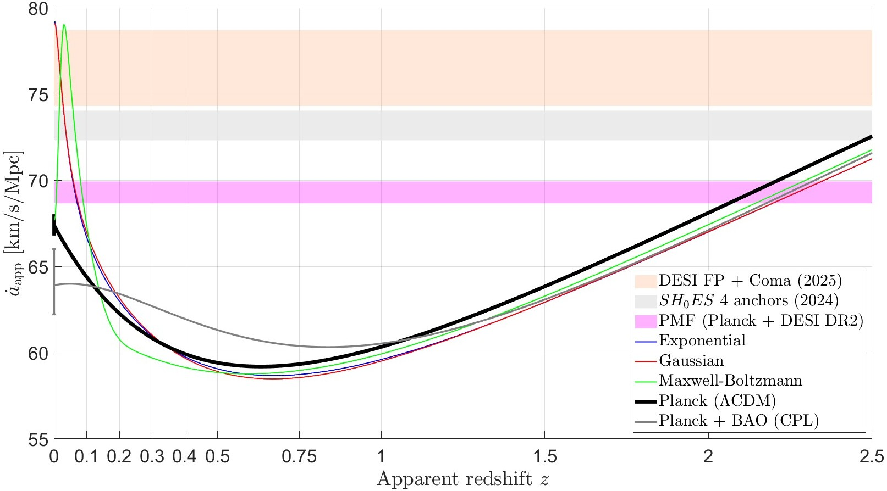
Predictions for cosmic chronometers
Assuming redshift is purely cosmological, get a_{app} ≡ (1 + z)^{–1}
Can get dz/dt using cosmic chronometers, which are passively evolving galaxies
Upper limit to stellar mass drops with time as more massive stars use up fuel faster
No cosmological assumptions.
Credit: Vasileios Kalaitzidis

Slide 19
Conclusions
Galaxy number counts show that we are in a significant underdensity out to ≈300 Mpc (Keenan+ 2013, Wong+ 2022) – good evidence across the whole electromagnetic spectrum (see introduction to Haslbauer+ 2020); significant tension with ΛCDM
Given the nearly uniform initial conditions in the CMB, this requires significant local outflow
Locally measured H₀ is indeed larger than predicted in ΛCDM by ≈10% (di Valentino+ 2025)
Hubble & void tensions were linked in semi-analytic void model of Haslbauer+ 2020
BAO observables deviate from Planck ΛCDM as expected in void model, which reduces χ² by 36–38 and thus tension (49 data points) from 3.8σ to 1.1–1.3σ (Banik & Kalaitzidis 2025)
Inferred H₀(z) curve agrees well with local void model (Mazurenko+ 2025; Jia+ 2023, 2025)
Early time solutions to the Hubble tension face at least seven difficulties (Vagnozzi+ 2023)
Ages of old Galactic stars and cosmic chronometers give Planck H₀ (Valcin+ 2025; Guo+ 2025)
Very few proposed solutions to the Hubble tension had a different motivation and made a successful a priori prediction of a different phenomenon that is unlikely in ΛCDM.
YouTube lecture: search for Indranil Banik

Slide 20
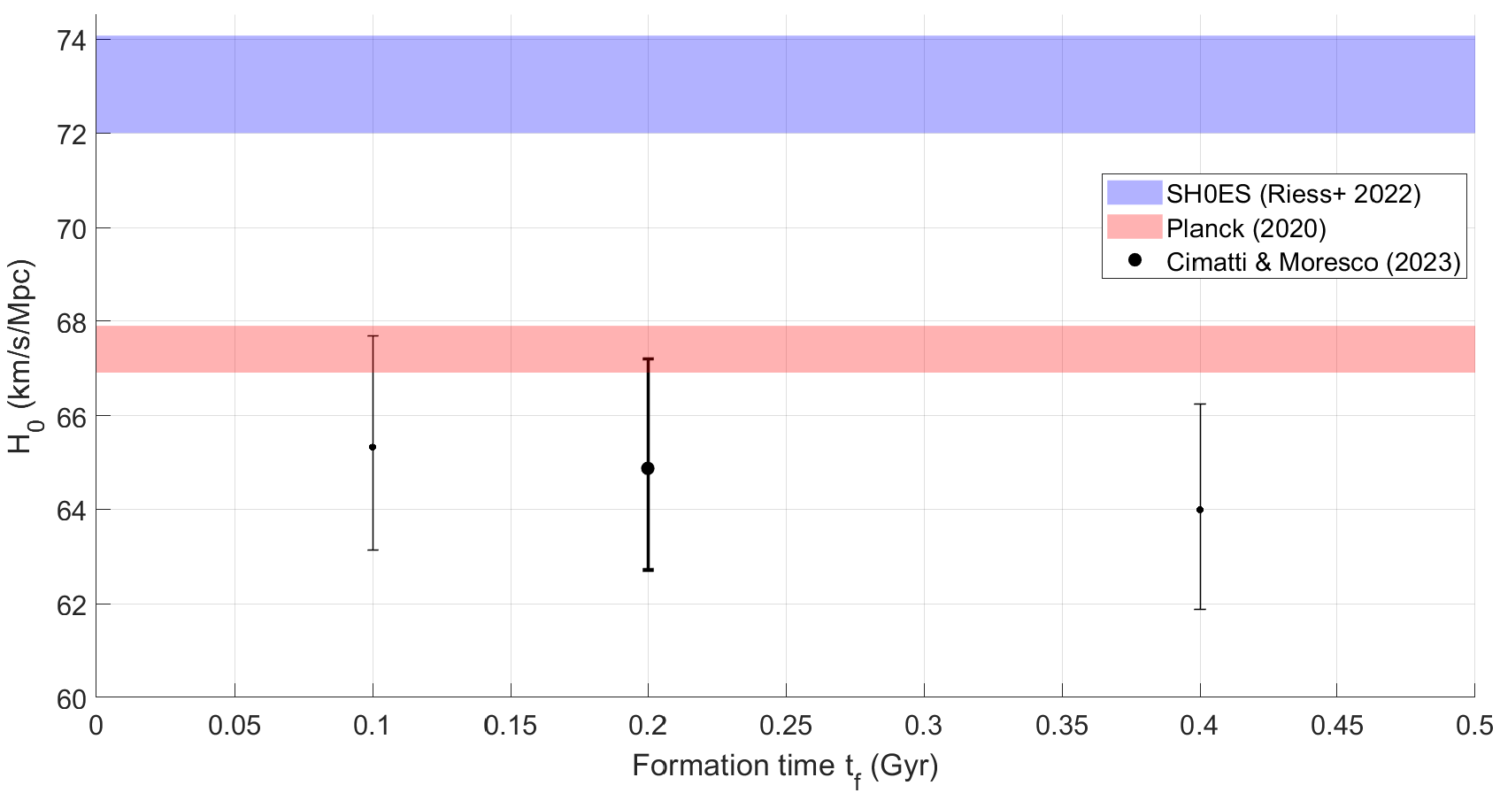
Dating the Universe
The age of the Universe is inversely proportional to its expansion rate H₀
The ages of 11 carefully chosen old objects (stars and globular clusters) give us H₀ independently of cosmological datasets
Ω_{m} = 0.302 ± 0.008 is independent of CMB and contributes negligible uncertainty of 0.5 km/s/Mpc (Lin+ 2021)
Planck H₀ correct, so local dz/dr is inflated.
t_{U} = 14.05 ± 0.25 Gyr
+ 0.2 Gyr (x2 or ÷2) formation time
Credit: Vasileios Kalaitzidis (RAS summer student)

Slide 21
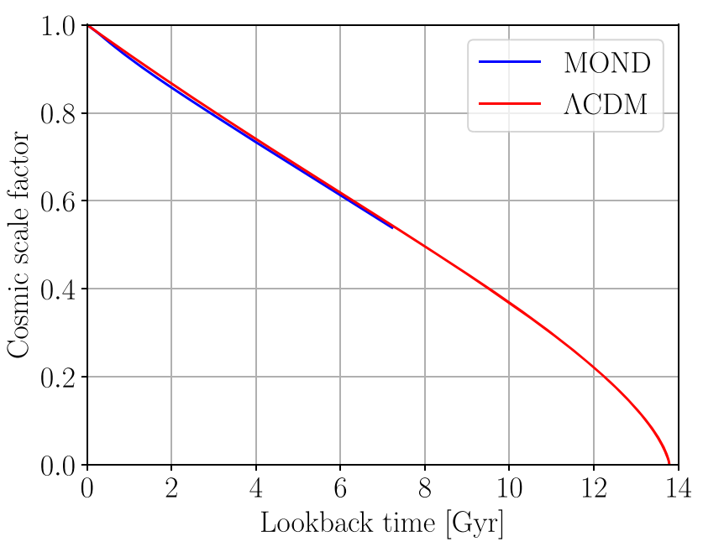
A subtle change can solve the H₀ tension
A subtle difference between the actual and apparent expansion histories can solve the Hubble tension.
Local void solutions create peculiar velocities out to quite high redshift in MOND due to slower decay of the gravity law
This means the return to a Planck cosmology could be fairly slow, contradicting the assumptions in the famous Kenworthy+ 2019 paper which argued against the directly observed local void (Planck cosmology assumed to be fully recovered when z > 0.1).
Haslbauer+ 2020

Slide 22
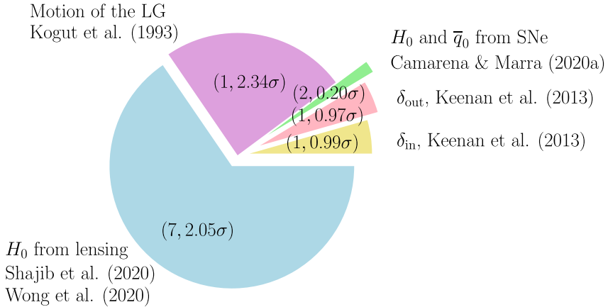
Overall goodness of fit of local void model
Overall tension is 2.53σ
Pie chart: summary of individual contributions
v_{LG} tension is based on fraction of void volume with a slower velocity in CMB frame
Bulk flows not considered
No substantial tensions.
(Degrees of freedom, equivalent tension for 1D Gaussian)
Haslbauer+ 2020

Slide 23
Dipole in supernova H₀
Galaxy bulk flow reported by Watkins+ 2023 towards Galactic coordinates (300°, 0°)
Supernovae over z_{CMB} = 0.02 – 0.2 analysed allowing for dipole in z and q₀ (common direction) such that:
(1 + z) = (1 + z_{c})(1 + z_{d}.n)
Results from Pantheon+ SNe catalogue reveal a clear dipole in the Watkins+ 2023 direction
Magnitude similar to their inferred bulk flow
Plan is to compare SN peculiar velocity field (assuming Planck cosmology) with that predicted by the local void model (Mazurenko+, in prep).

Slide 24
Varying the initial direction for the MCMC
Gradient descent used to minimise χ² starting from grid of initial directions
Best outcome used for the nominal MCMC
Two directions orthogonal to it & to each other also used as starting point for MCMC chain
Results almost identical, so the MCMC result is barely sensitive to the initial direction used for the chain.
A clear dipole signature is identified in a very well-defined direction, which is consistent with the independent determination using galaxies.

Slide 25
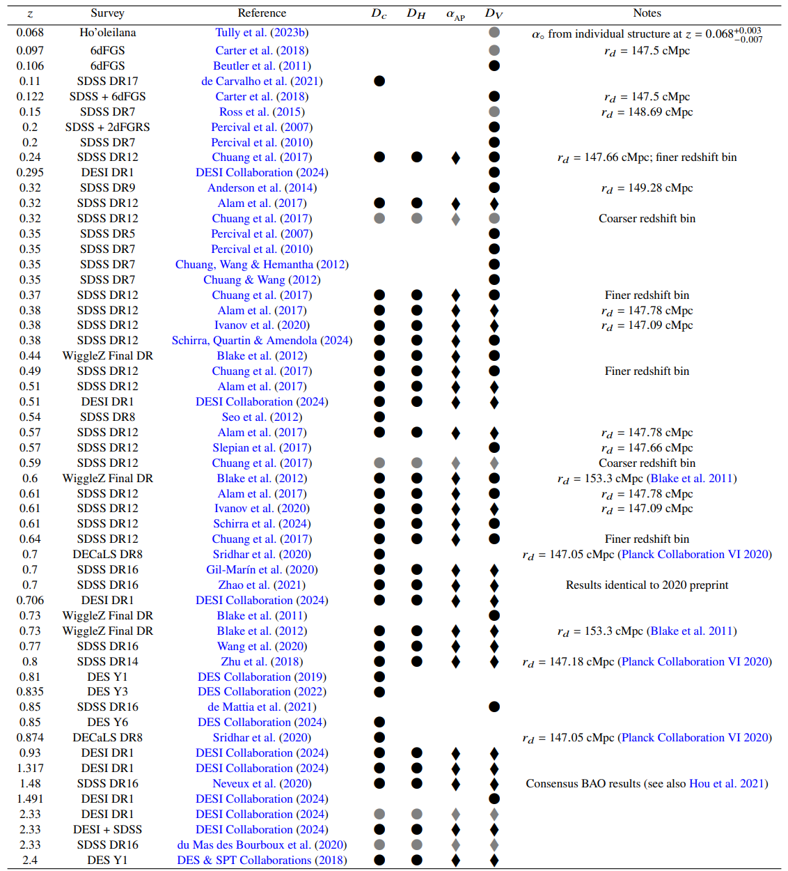
BAO observations over the last 20 years
Grey points not used for χ²
At low redshift, often only D_{V} is available
Some studies write an actual distance in Mpc rather than its dimensionless ratio with r_{d}. We looked up the assumed r_{d}.
D_{V} often not given, even though D_{c} and D_{H} are available. We worked out D_{V} in these cases, combining fractional uncertainties in quadrature as D_{V} is essentially the geometric mean of D_{c} and D_{H}.
Banik & Kalaitzidis 2025

Slide 26
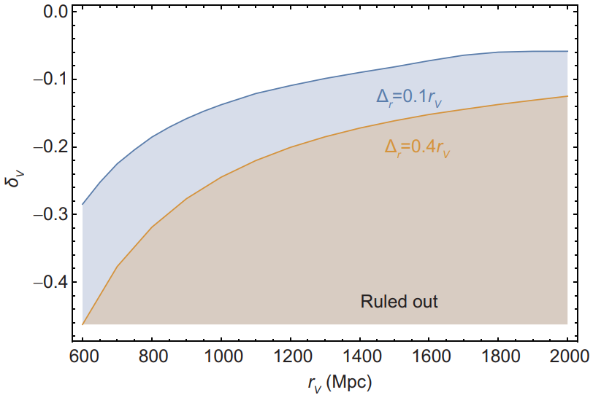
Kinematic Sunyaev-Zel’dovich constraints
Significant peculiar velocities implied by local void model would cause gas in galaxy clusters to boost CMB photons via kSZ effect
KBC void implies about 20% underdensity out to 300 Mpc (deeper in redshift space)
This is consistent with Planck
Various common objections to local void model discussed in section 5.3 of Haslbauer+ 2020 (MNRAS, 499, 2845).
Arxiv:1912.12600
Ding+ 2020
See also Cai, Ding & Wang (2025)

