Slide 1

Identification of nonlinear damping of transverse loop oscillations by KHI-induced turbulence
Sihui Zhong, University of Exeter, UK
Collaborators: Andrew Hillier, University of Exeter, UK
Inigo Arregui, IAC, Spain

Slide 2
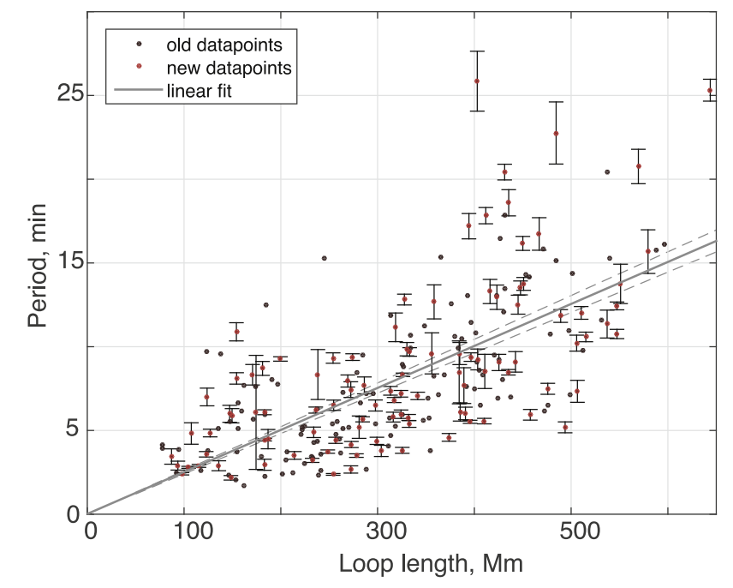
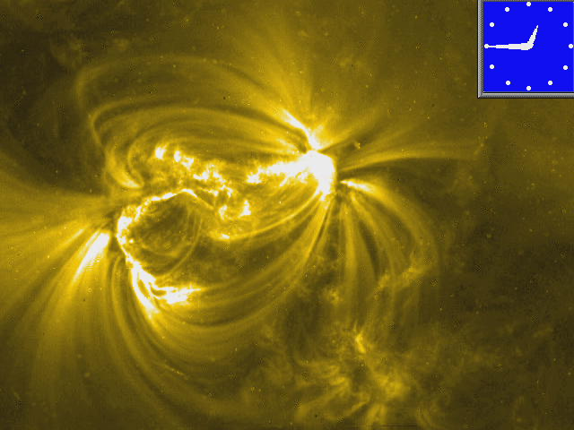
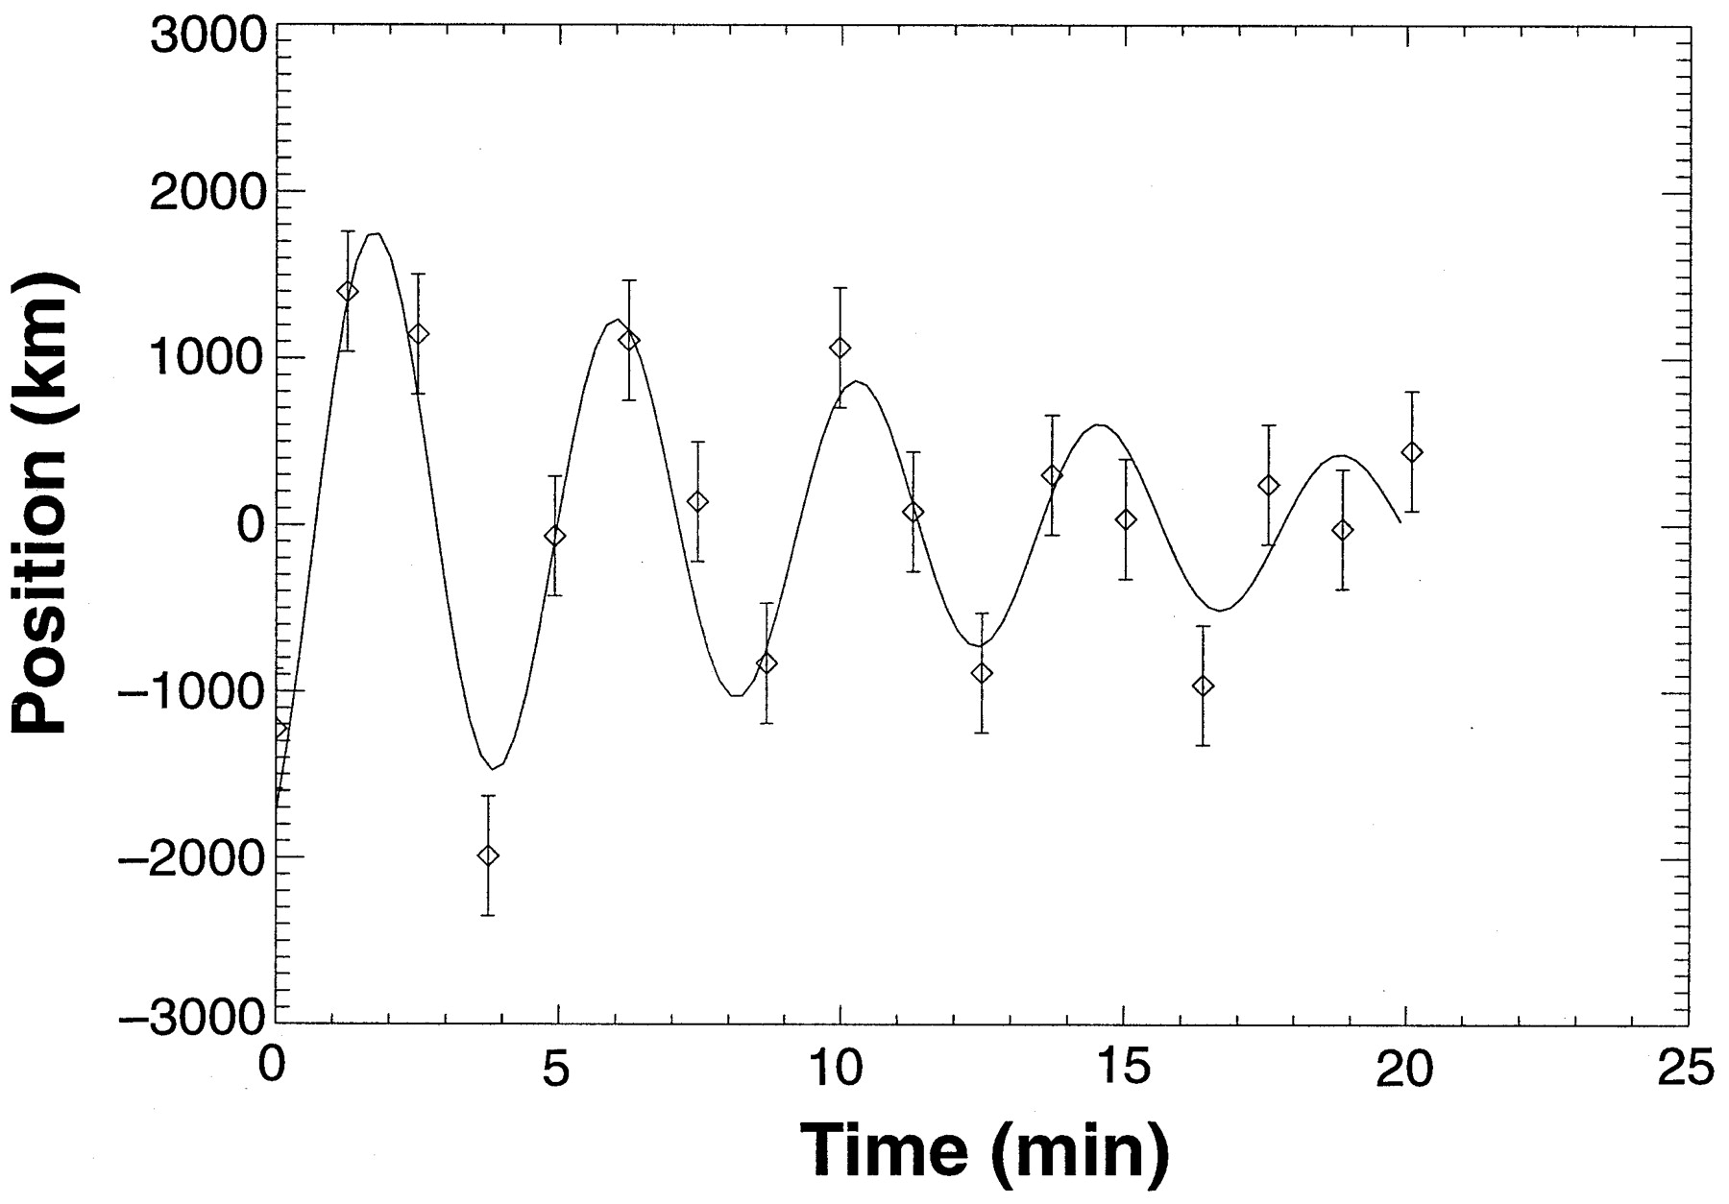
Decaying kink oscillations
First detection:
  1998 July by TRACE
Characteristics:
  Associated with impulsive energy releases
  Large amplitude —1-25 Mm
  Strong decay
  Oscillation period ∝ loop length
Significance:
  Heating (van Doorsselaere et al. 2020, SSRv)
  Plasma diagnostics via MHD seismology (Nakariakov et al. 2021, SSRv)
Nakariakov et al. 1999, Science, 285, 5429
Nechaeva et al. 2019, ApJS, 241, 31
Notes:
First detection, characteristics, significance (heating + plasma diagnostics)

Slide 3
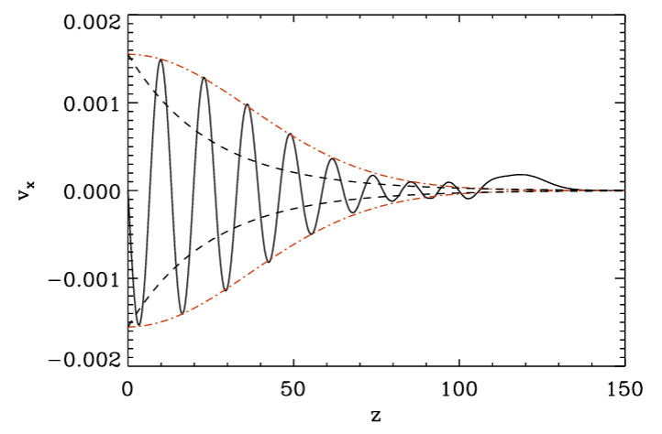
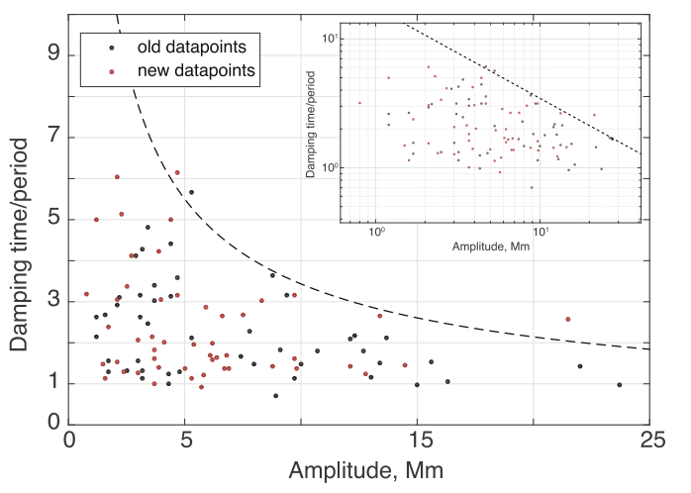
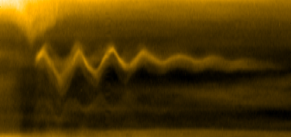
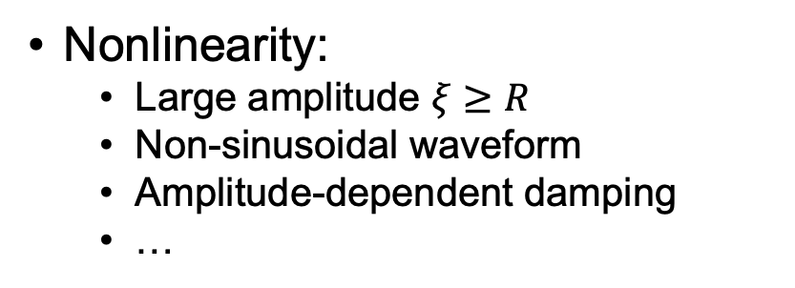
Strong damping of kink oscillations
Damping mechanisms:
  Resonant absorption, phase mixing, mode coupling, etc
Damping profiles:
Nonlinearity:
  Large amplitude $ξ≥R$
  Non-sinusoidal waveform
  Amplitude-dependent damping
  …
Exponential
Gaussian-exponential
Pascoe et al. 2016, 585, L6
Pascoe et al. 2012, A&A, 539, A37
Nechaeva et al. 2019, ApJS, 241, 31
Notes:
Exponential and Gaussian-exponential profile.

Slide 4
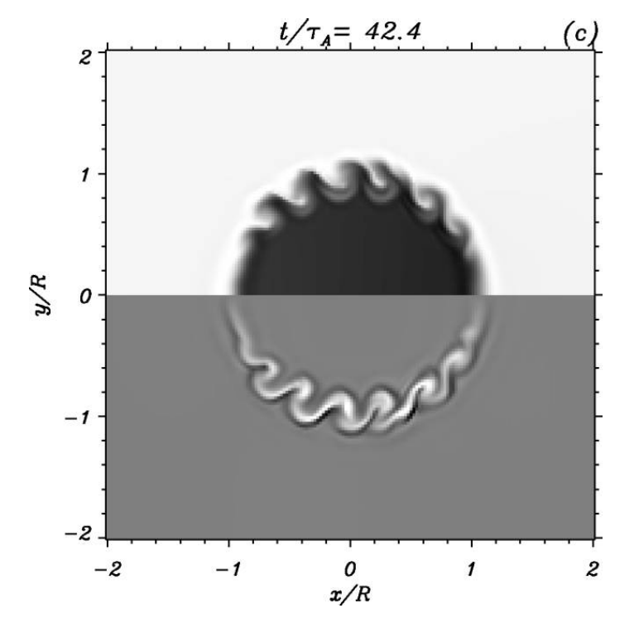
Nonlinear kink waves
Theoretical predictions:
Frequency drift (Ruderman & Goossens, 2014)
Ponderomotive force (Terradas & Ofman, 2004)
Higher-order modes m≥2 (e.g., Ruderman 2017)
  Nonlinear cascade to higher-order modes (van Doorsselaere et al. 2021)
Kelvin-Helmholtz Instability (KHI) & turbulence (e.g., Terradas et al. 2008)
  The greater the velocity, the faster the damping (Magyar & Nakariakov, 2016)
However, no direct observational evidence
Terradas et al. 2008, ApJL, 687, L115
Aim: to identify detectable features of nonlinear oscillations damped by KHI-induced turbulence

Slide 5
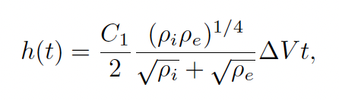
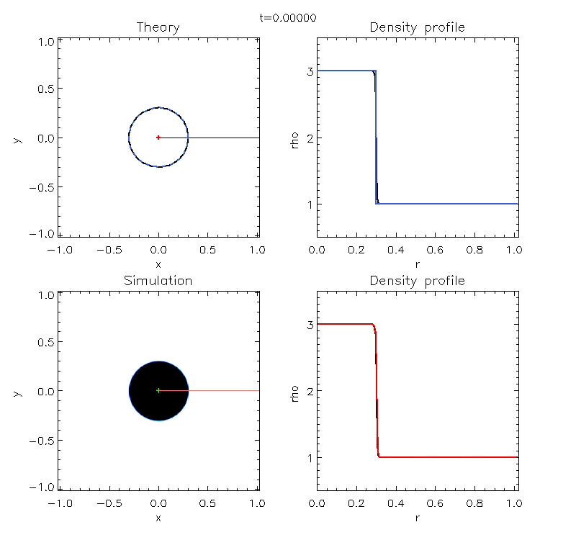

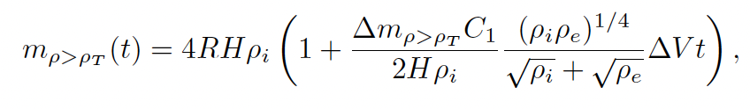
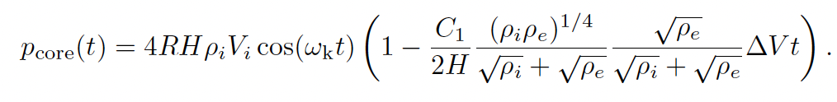
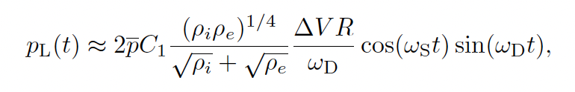
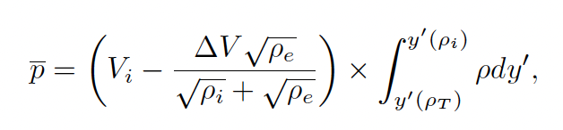
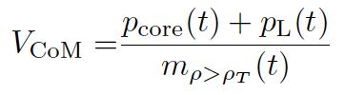
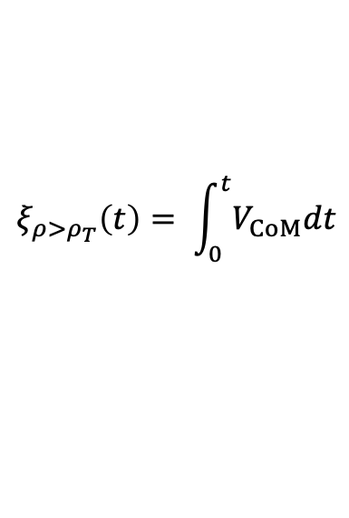
Mixing process
Key: the mixing layer grows ∝ t
$$ξ_{ρ>ρ_{T}}\left(t\right)= \int_{0}^{t}{V_{CoM}dt}$$
Data taken from Hillier et al. 2024, ApJ

Slide 6
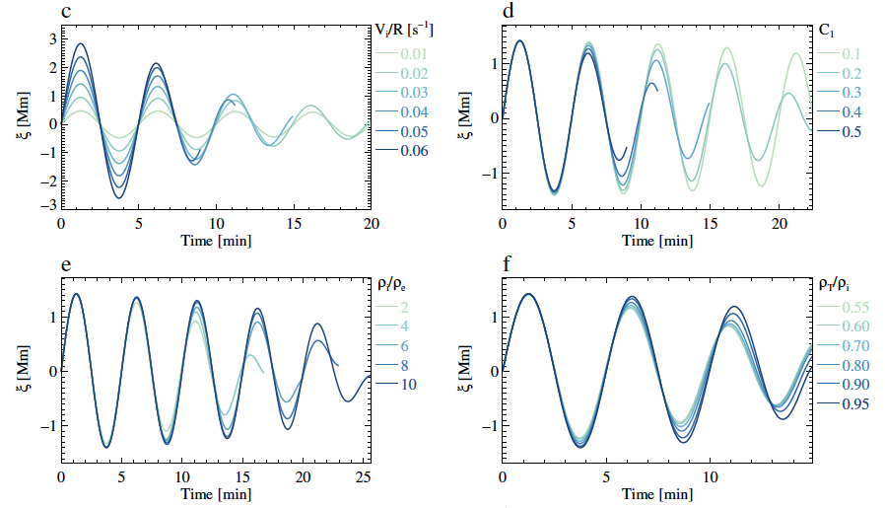
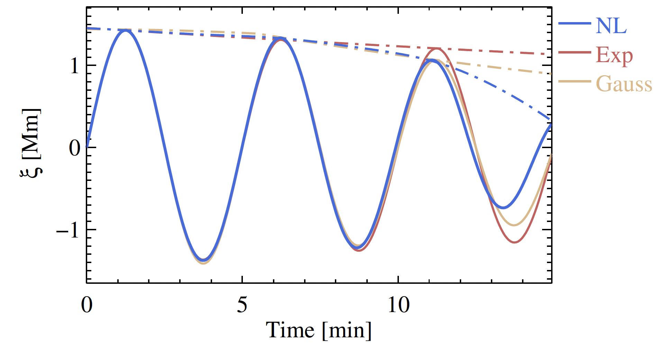
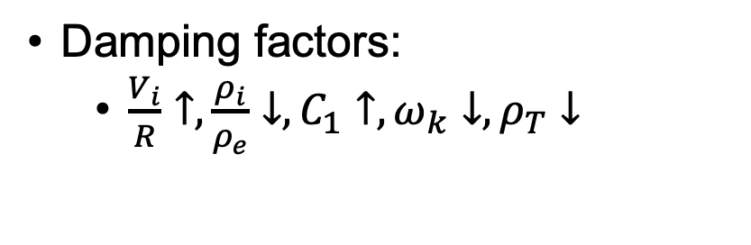

Oscillation damped by KHI-induced turbulence
Characteristics:
  Period drift
  Time-evolving damping rate
Damping factors:
  $\frac{V_{i}}{R}↑,\frac{ρ_{i}}{ρ_{e}}↓,C_{1}↑,ω_{k}↓, ρ_{T}↓$
$$ω_{k}−→ω_{A}$$
Damping effect of each parameter

Slide 7
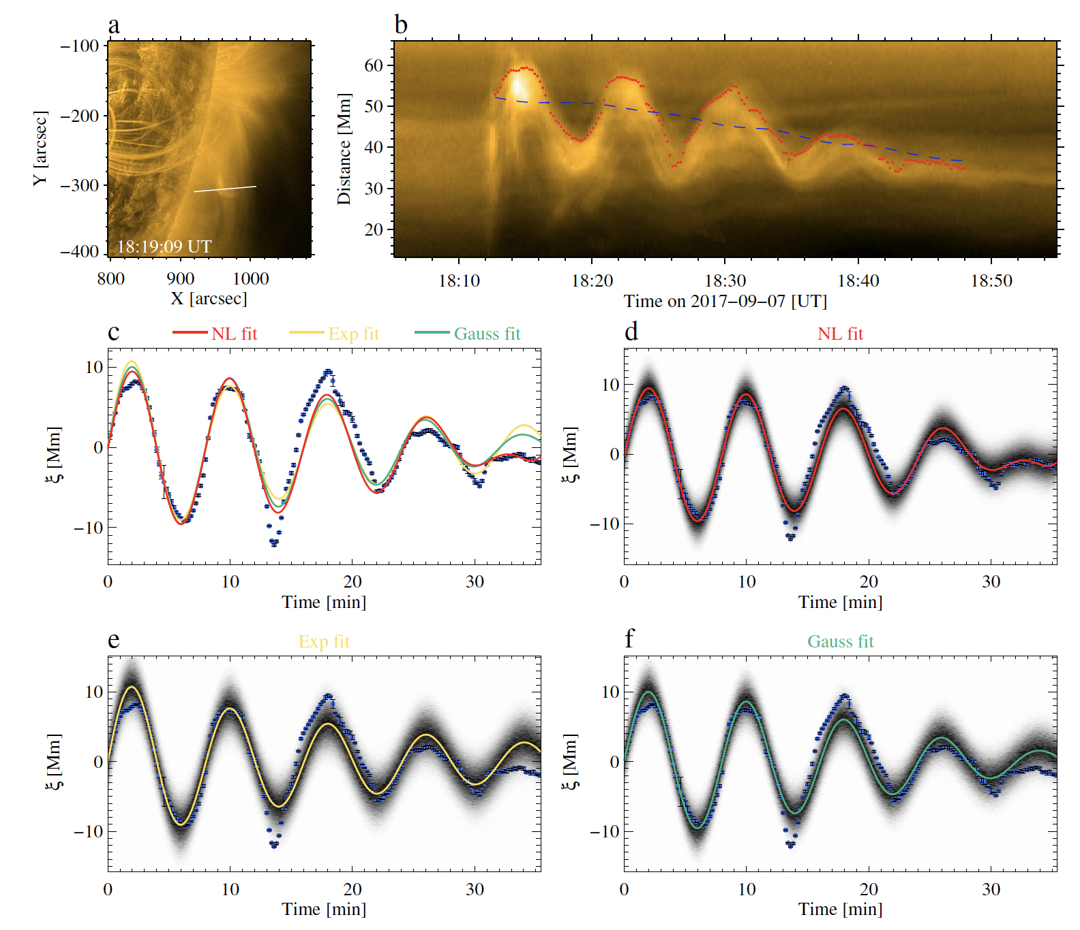
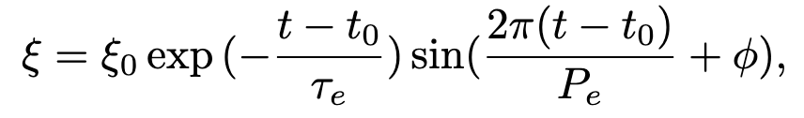
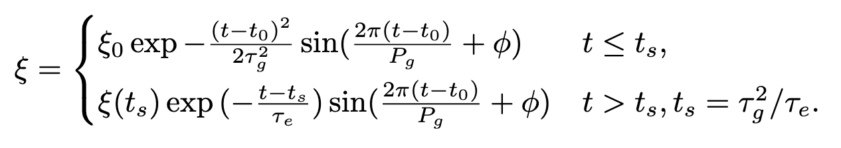
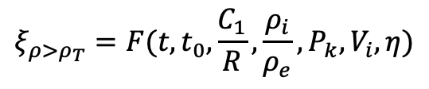
Curve fitting and Bayesian model comparison
Fit the observed oscillations with:
$$ξ_{ρ>ρ_{T}}=F(t, t_{0},\frac{C_{1}}{R},\frac{ρ_{i}}{ρ_{e}},P_{k},V_{i},η)$$
SoBAT Toolkit: Anfinogentov et al. 2021, ApJS, 252, 11
Notes:
Inference, best-fit represents the maximum posterior with maximum marginal likelihood, then comparison

Slide 8
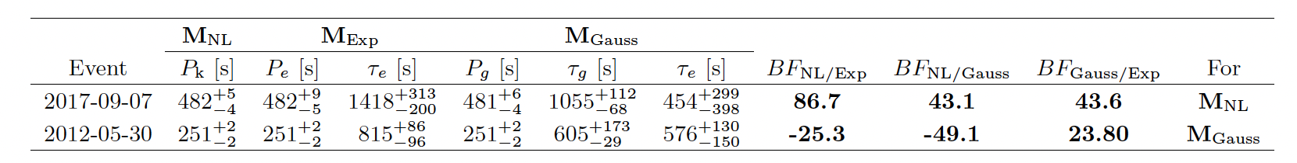
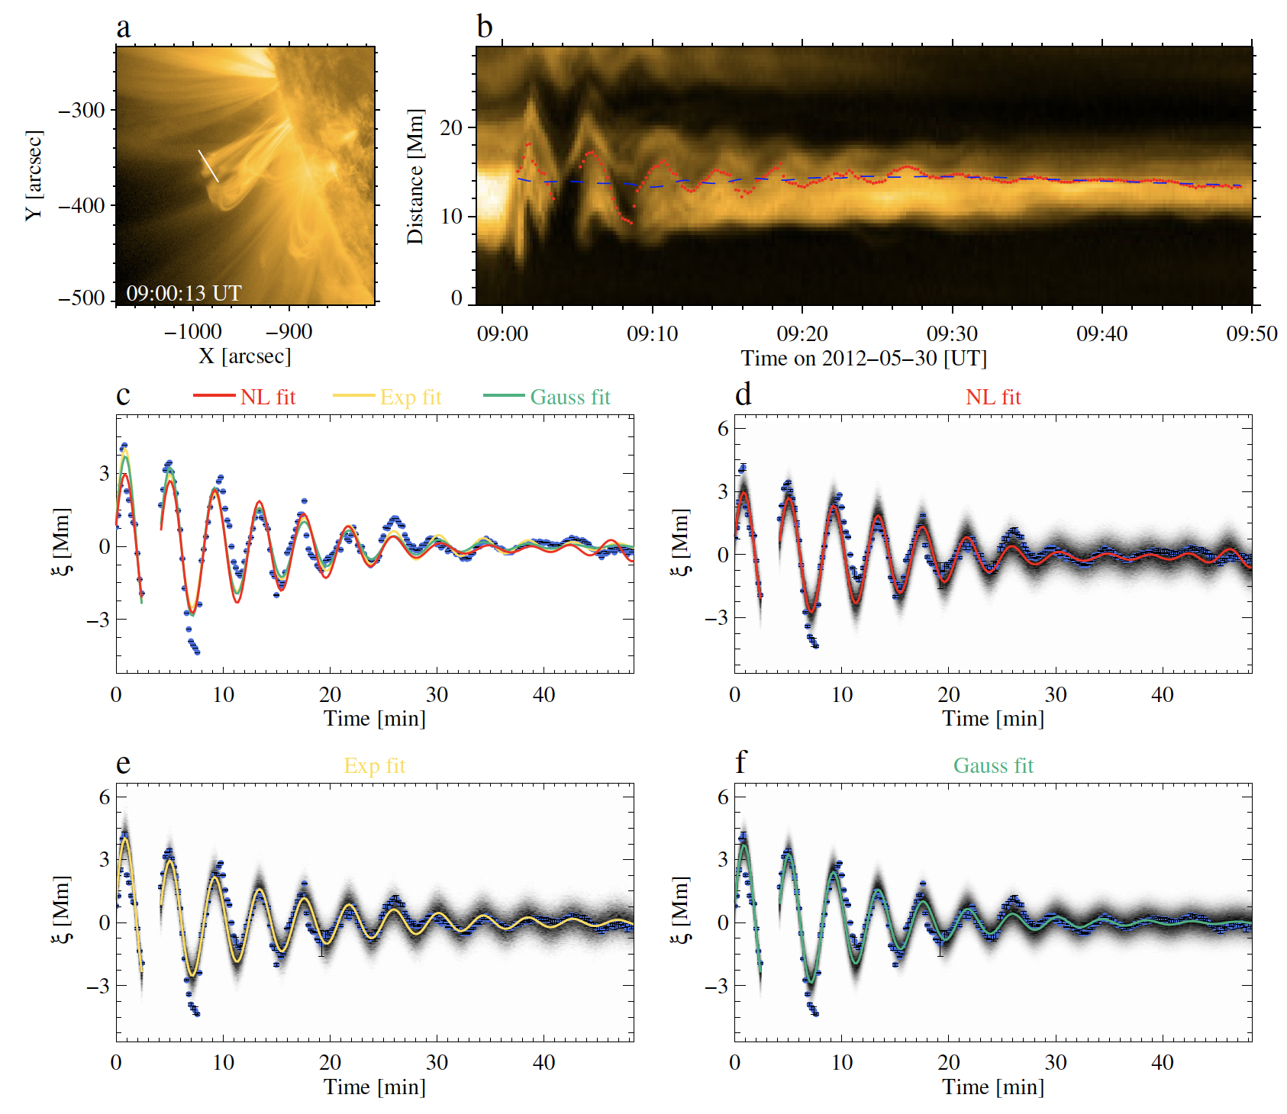

Curve fitting

Slide 9
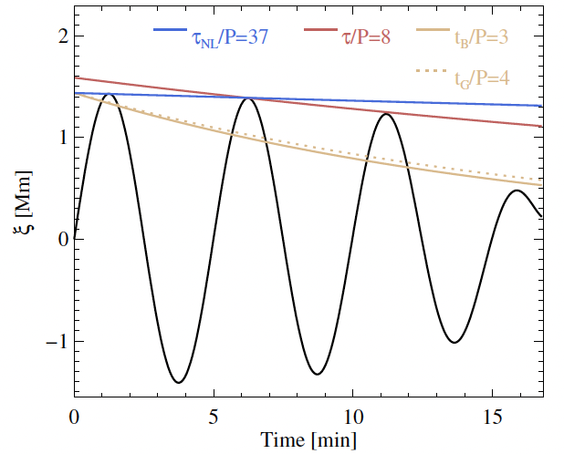
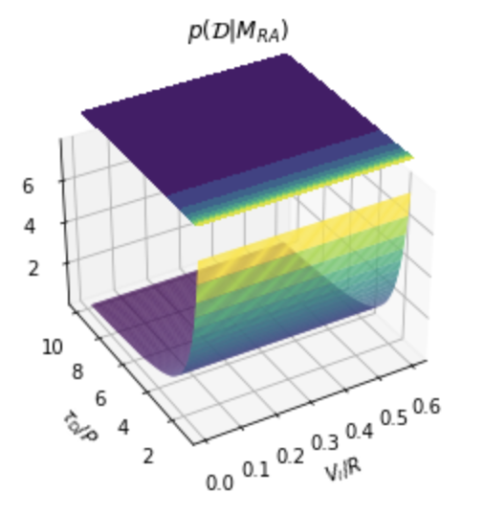
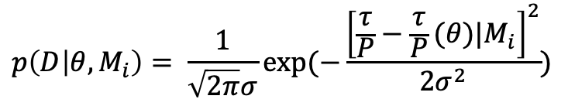
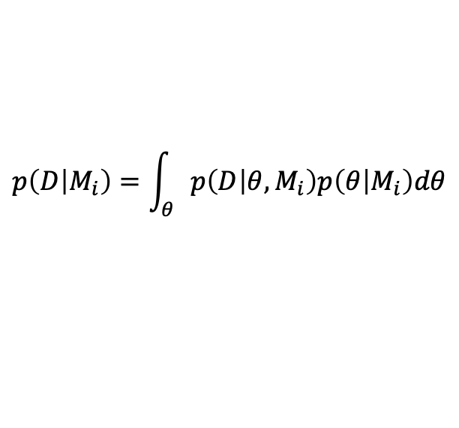
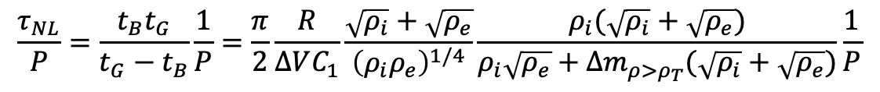
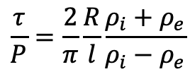
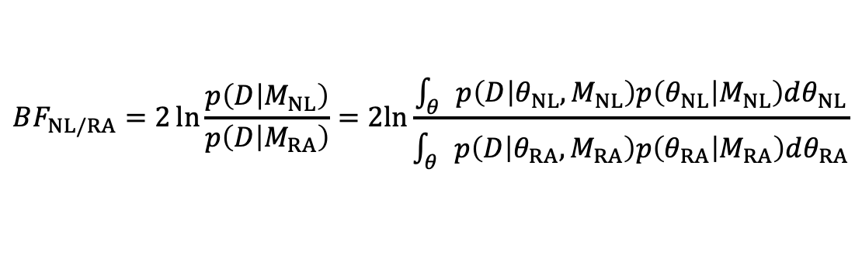
Bayesian model comparison with damping rate
Turbulence damping time in the first cycle:
Damping time predicted by resonant absorption:
Bayesian marginal likelihood:
$$\frac{τ_{NL}}{P}=\frac{t_{B}t_{G}}{t_{G}−t_{B}}\frac{1}{P}=\frac{π}{2}\frac{R}{∆VC_{1}}\frac{\sqrt{ρ_{i}}+\sqrt{ρ_{e}}}{{\left(ρ_{i}ρ_{e}\right)}^{1/4}}\frac{ρ_{i}(\sqrt{ρ_{i}}+\sqrt{ρ_{e}})}{ρ_{i}\sqrt{ρ_{e}}+∆m_{ρ>ρ_{T}}(\sqrt{ρ_{i}}+\sqrt{ρ_{e}})}\frac{1}{P}$$
$$\frac{τ}{P}=\frac{2}{π}\frac{R}{l}\frac{ρ_{i}+ρ_{e}}{ρ_{i}−ρ_{e}}$$
(Gossens et al. 2002, A&A)
$$p\left(D | M_{i}\right)=\int_{θ}{p\left(D | θ,M_{i}\right)p\left(θ | M_{i}\right)dθ}$$
$$p\left(D | θ,M_{i}\right)= \frac{1}{\sqrt{2π}σ}exp⁡(−\frac{{\left[\frac{τ}{P}−\frac{τ}{P}(θ)|M_{i}\right]}^{2}}{2σ^{2}})$$
Bayes factor:
$$BF_{NL/RA}=2\ln{\frac{p\left(D | M_{NL}\right)}{p\left(D | M_{RA}\right)}}=2ln⁡\frac{\int_{θ}{p\left(D | θ_{NL},M_{NL}\right)p\left(θ_{NL} | M_{NL}\right)dθ_{NL}}}{\int_{θ}{p\left(D | θ_{RA},M_{RA}\right)p\left(θ_{RA} | M_{RA}\right)dθ_{RA}}}$$
Notes:
Make it more readable

Slide 10
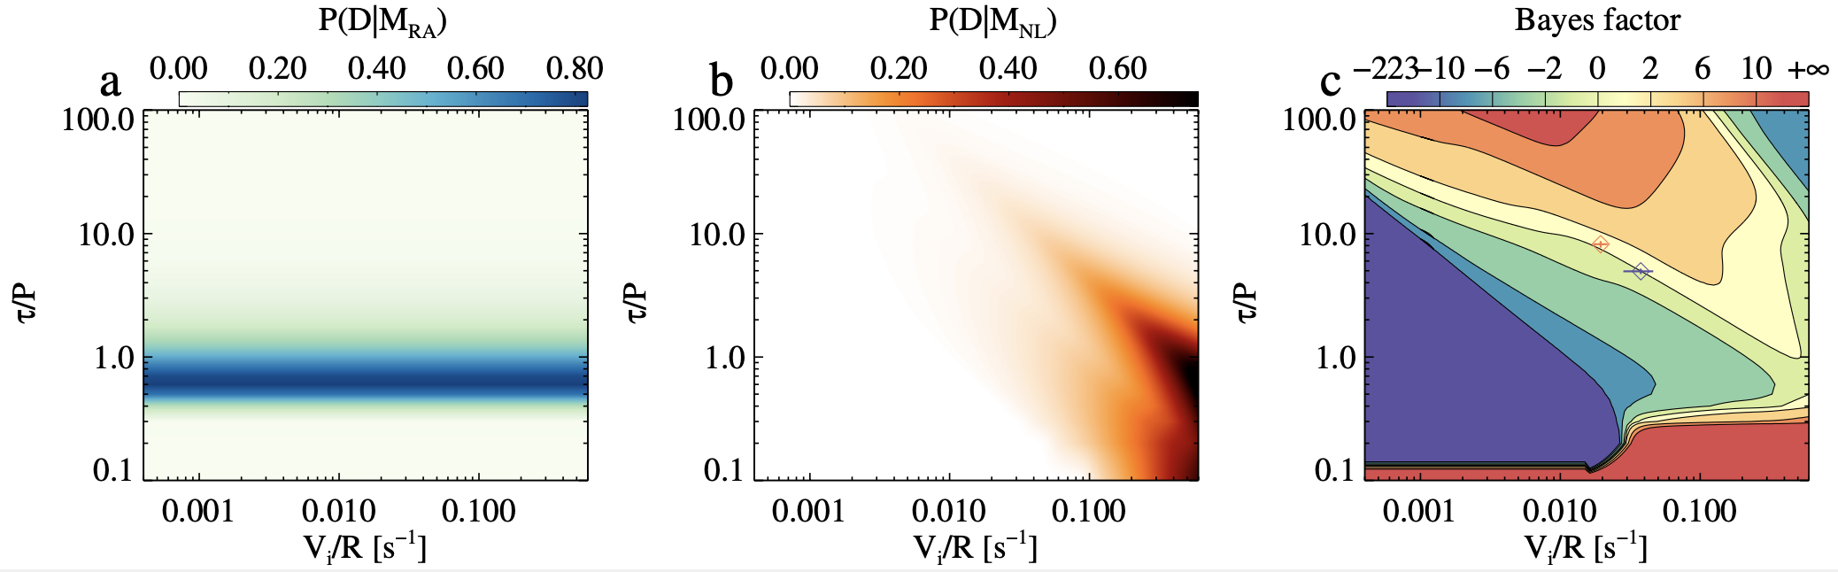
Bayesian model comparison with damping rate
Marginal likelihood of 𝜏/P vs. V_{i}/R of the turbulence-induced damping model (a) and resonant absorption model (b), and their ratio (c).

Slide 11
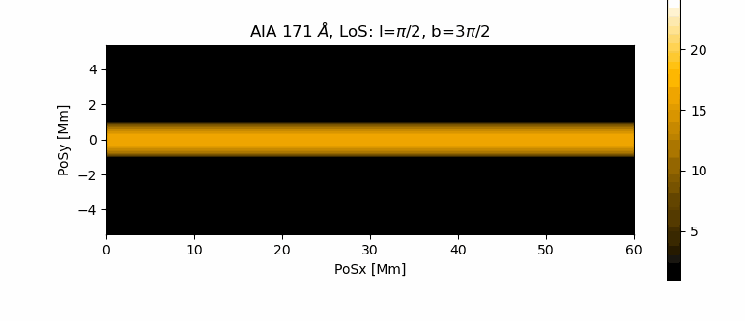
Summary
(Zhong et al. ApJ, in revision)
An analytic formula for the transverse loop oscillation damped by KHI-induced turbulence
  Period drift and time-evolving damping rate
The model is applied to identify linear/nonlinear regime by
  Fitting the time series of observational events
  Explaining the damping ratio vs. amplitude
Follow-up study (in prep.):
  Imaging signatures via Forward Modelling

Slide 12
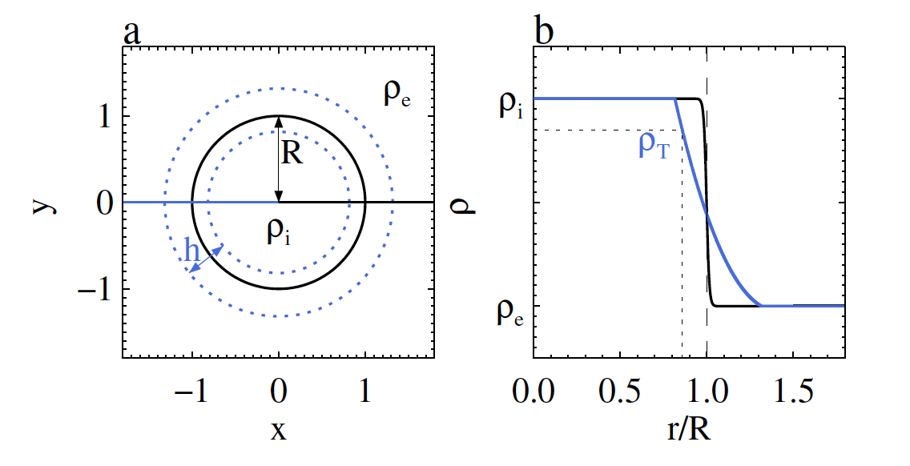
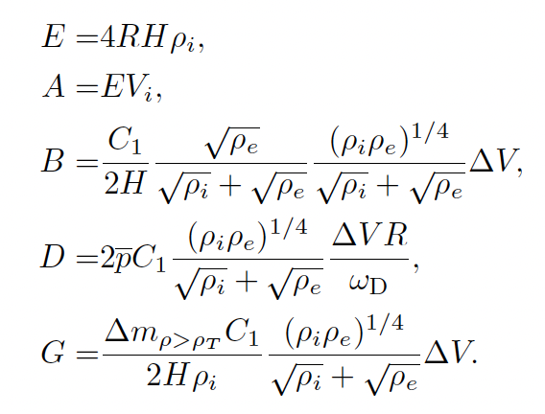
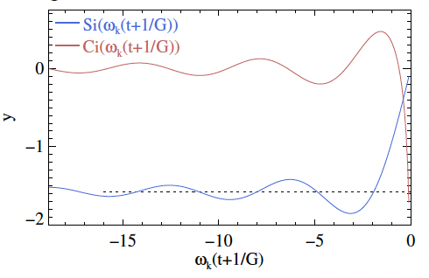
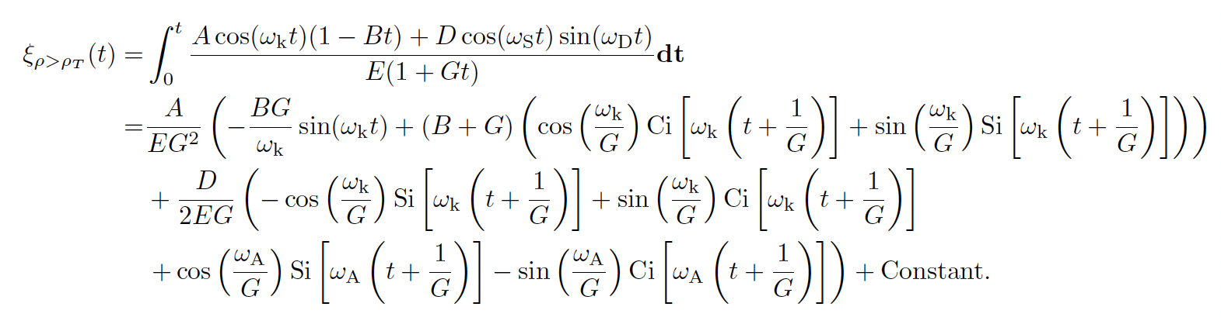
Derivation

Slide 13
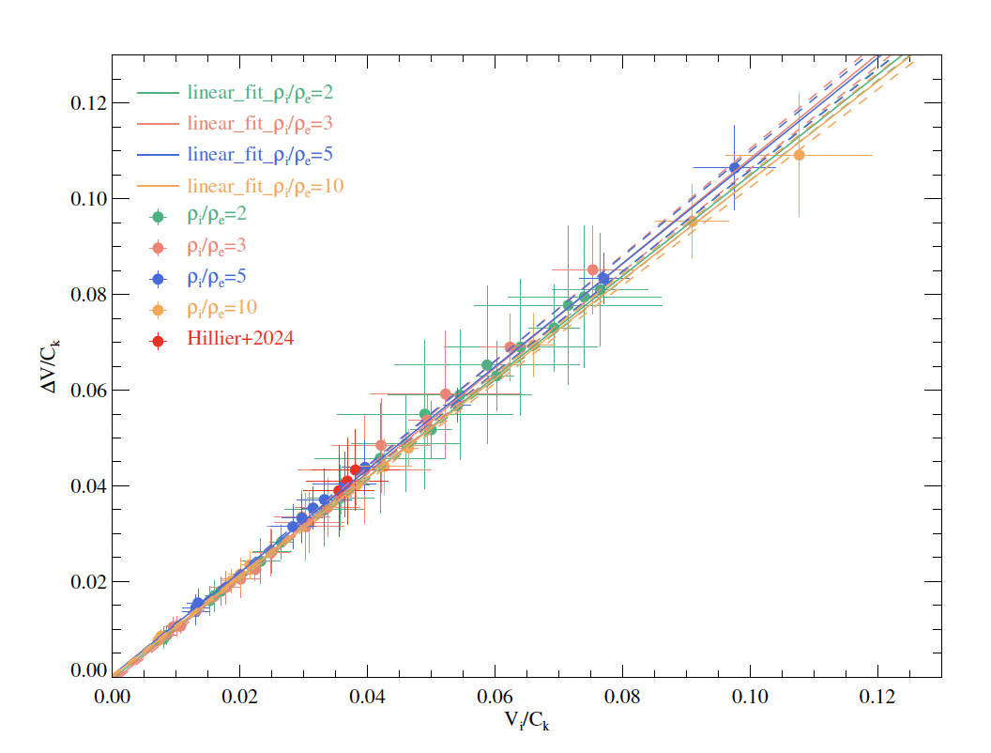
Vi--\Delta_V scaling obtained from a set of MHD simulations

Slide 14
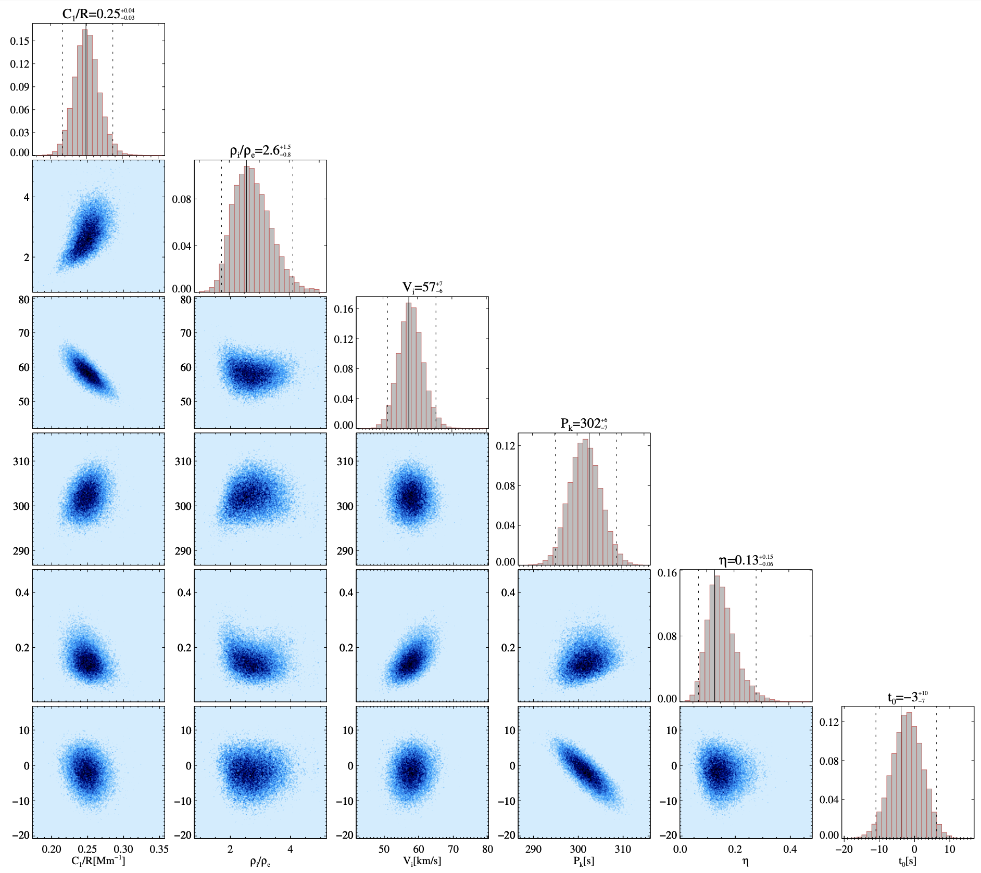
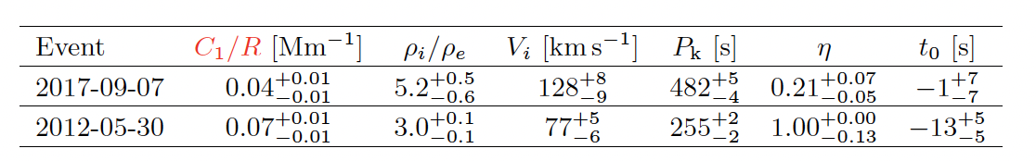
Corner plot showing the relationship between parameters

Slide 15
Bayesian model comparison with damping rate
Marginal likelihood of 𝜏/P vs. V_{i}/R of the turbulence-induced damping model (a) and resonant absorption model (b), and their ratio

