Slide 1
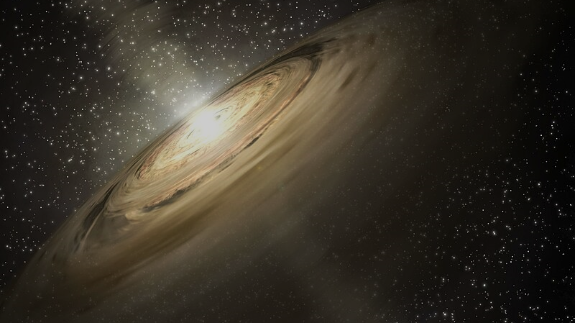
PEBBLeS in Protoplanetary Discs
NASA/JPL-Caltech
Jane Greaves (Cardiff University)
for the PEBBLeS team, key personnel:
Katie Hesterly (Cardiff), Emmanuel Bempong-Manful (JBCA Manchester), Anita Richards (JBCA)

Slide 2
Planet-Earth Building-Blocks Legacy e-MERLIN Survey
looking for emission from SERIOUSLY LARGE dust grains – centimetre sizes – as a key step to sticking solids together to make planets
theory says collisions + inwards drift could lose pebbles before larger rocks can form!
e-MERLIN is unique because
need to observe at < ~10 GHz to see down to inner disc midplane
need 100’s km baselines to resolve dust on orbits of rocky planets

Slide 3
…this is really hard at 6.8 GHz, because total dust fluxes are a few 10’s μJy!
https://www.e-merlin.ac.uk/

Slide 4
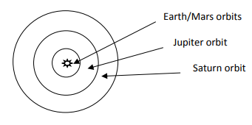
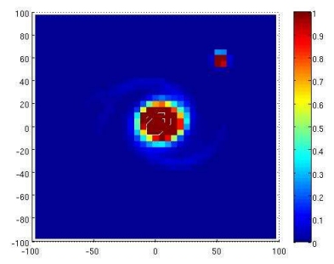
max. resolution at ~6.8 GHz:
simulation: HL Tau (Ken Rice)

Slide 5
data
team
DUST

Slide 6
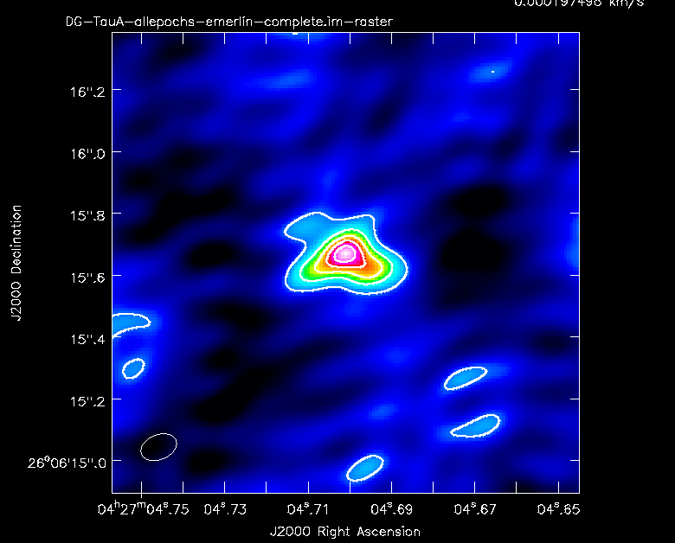
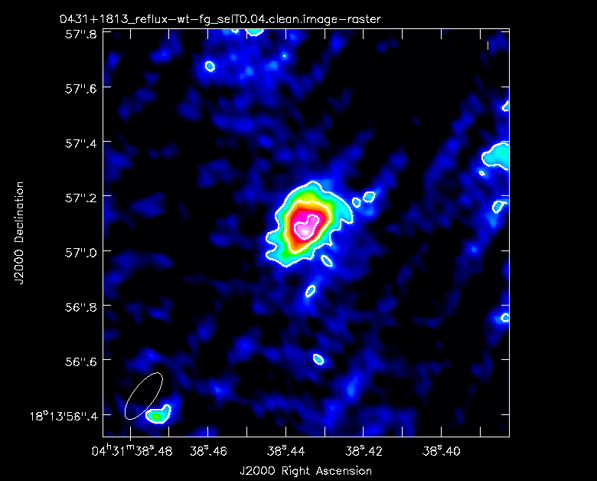
key results
from unbiased flux-ordered survey of 10 fields,
2 dust discs extending to tens of AU, 2 candidate compact dust discs
disc candidates around extra targets (mm-faint)
< HL Tau b?

Slide 7
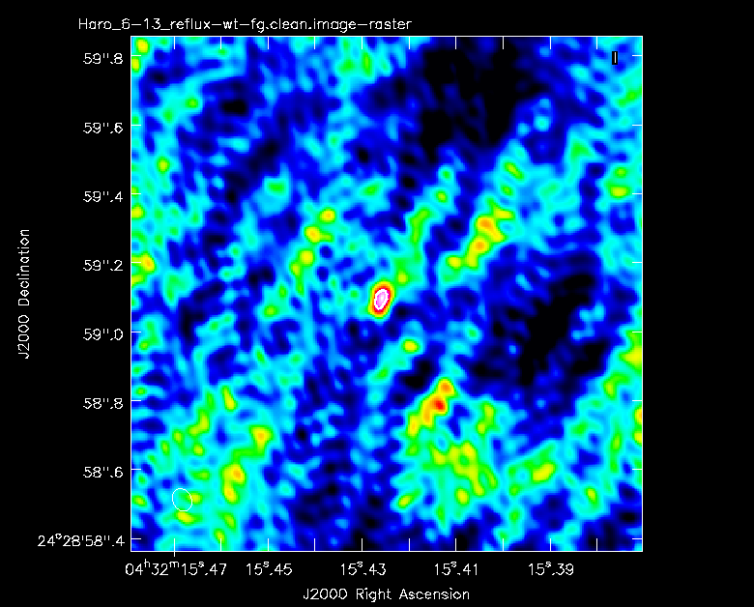
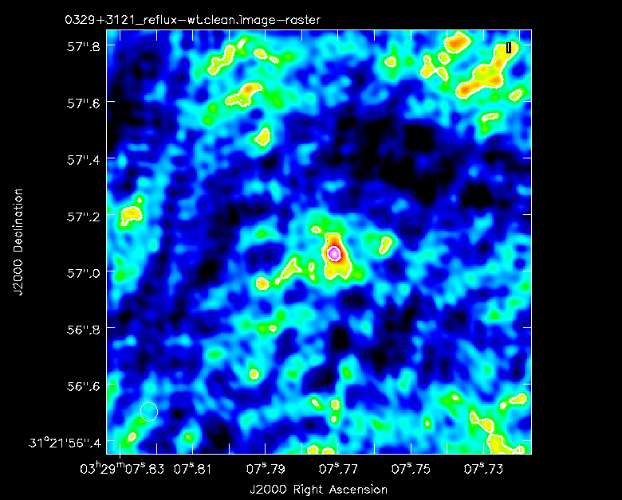
key results
from unbiased flux-ordered survey of 10 fields,
2 dust discs extending to tens of AU, 2 candidate compact dust discs
and disc candidates around extra disc-hosts (mm-faint)

Slide 8
outcomes
selection from <1cm dust fluxes: no relation to 4.5cm dust flux
the two large discs are 5th and 10th in mm-flux-order
their host stars have little in common (except wide companions?)
few pebble-discs around youngest stars? – contrary to theory
so pebbles…
exist for only a short time?
form only in the inner disc? (Jupiter-orbit-sized discs smallest resolved)
aren’t needed for planets to form?

Slide 9
to progress: Square Kilometre Array!
Cradle of Life team (M. Hoare et al.):
noise <0.1 μJy/beam (~50 mas beam at 7.4 GHz, 150 km baselines)
similar time-commitment to PEBBLeS, but detecting further-out dust
given PEBBLeS outcomes: will need more targets?
d35-SKA-TEL-SKO-0000015-04_Science_UseCases (2.34)

