Slide 1
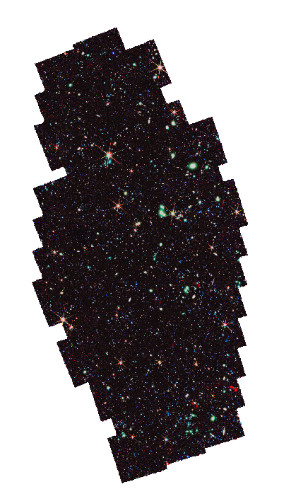

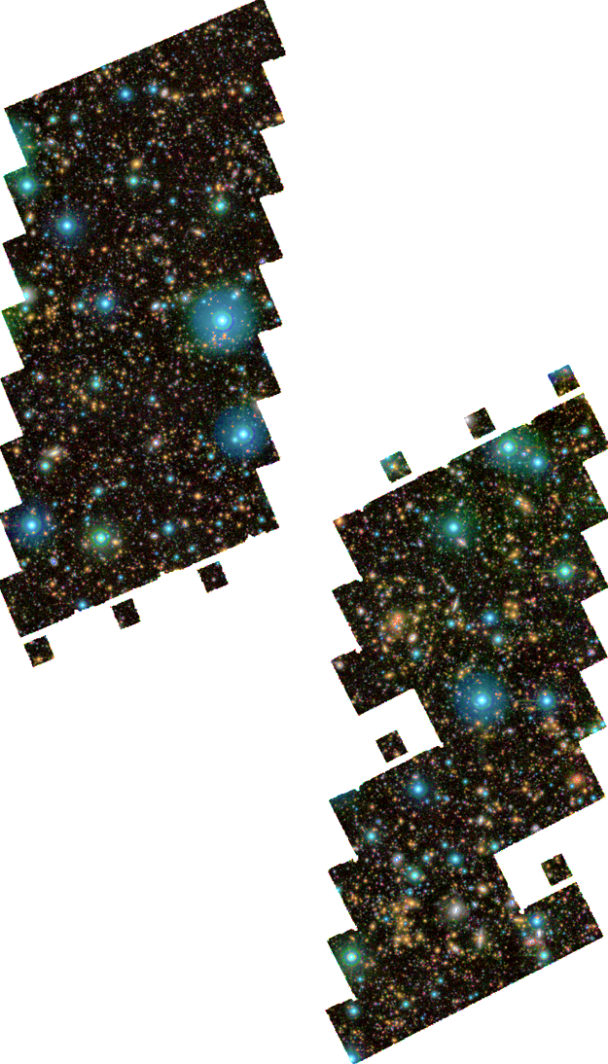
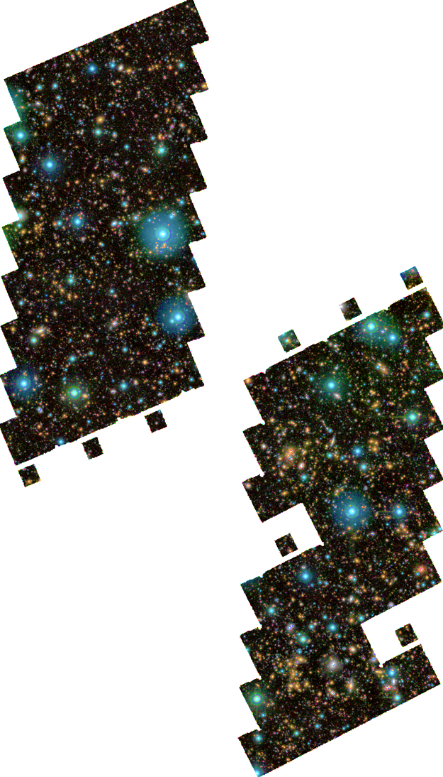



Dust-obscured Cosmic Star-Formation History Back to z ≃ 7 Revealed by ALMA and JWST PRIMER
Speaker: Feng-Yuan Liu (Frey)
University of Edinburgh, 2nd -year PhD student
Collaborators: James Dunlop, Ross McLure, Derek McLeod, Laia Barrufet, Adam Carnall, Fergus Cullen, and PRIMER team
National Astronomy Meeting 2025, Durham, UK

Slide 2

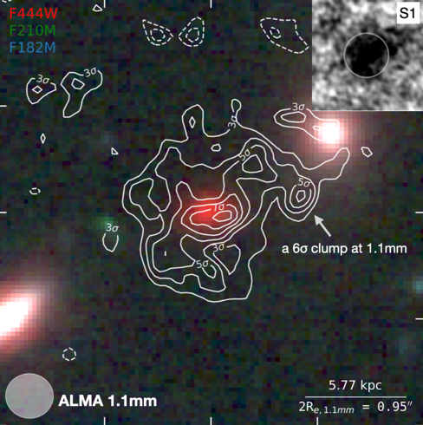


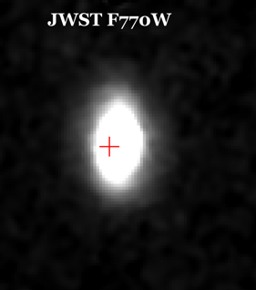
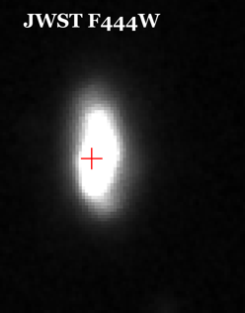
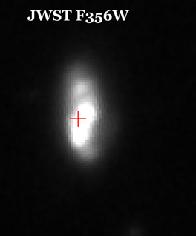
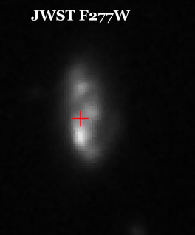
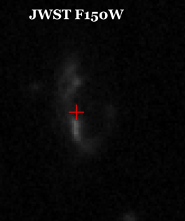
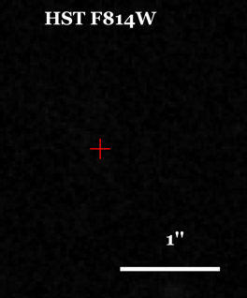
mm dust emission could be different from optical/NIR estimate: A Gastly might be a Haunter, or even Gengar!
(Xiao et al. 2024)
Optical-faint/HST-dark galaxies
(Liu et al. 2025)
Notes:
Why do we want to find the ALMA counterparts? The most obscured galaxies at high redshift are either invisible in optical, or need attenuation correction from near-infrared imaging. We you see through millimeter directly at the dusty star formation, the physical properties and morphology might be different from what you’d expect.

Slide 3

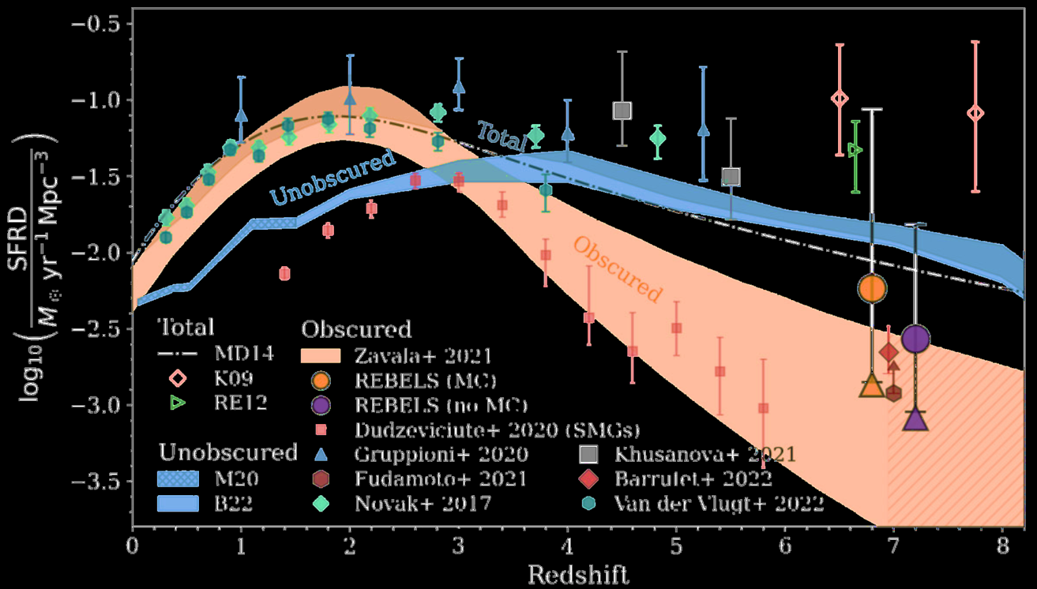
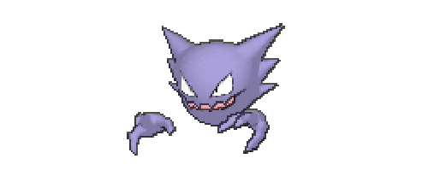

The dark side of the cosmic star formation history
(Algera et al. 2023)
Notes:
This population of dusty star-forming galaxies is not only interesting but also critical. They are dominant at intermediate redshift, and at higher redshifts, we see a large uncertainty because there’s little data to constrain them. The intuitive solution is of course to survey a large field, but mm instrument features make it very difficult. So at the mean time of proposing large ALMA surveys, we can also collect all public data in a field as a ‘semi-survey’.

Slide 4

A JWST PRIMER COSMOS sample
with A3COSMOS
and UltraVISTA
128 ALMA sources within JWST PRIMER footprints
Not complete but very deep, ~10 times larger than blind surveys
100% detected by JWST PRIMER by NIRCam and /or MIRI
(Liu et al. 2025)
Notes:
The starting point of this work is A3COSMOS, a collection of all public ALMA data in COSMOS. Blind surveys have covered the field, but because they are shallow, only the brightest mm sources can be detected. By collecting all different ALMA programs in the field, we have a sample 10 times larger and spanning two orders of magnitude in flux. It is a sample of 128 ALMA sources in the PRIMER COSMOS footprint.

Slide 5
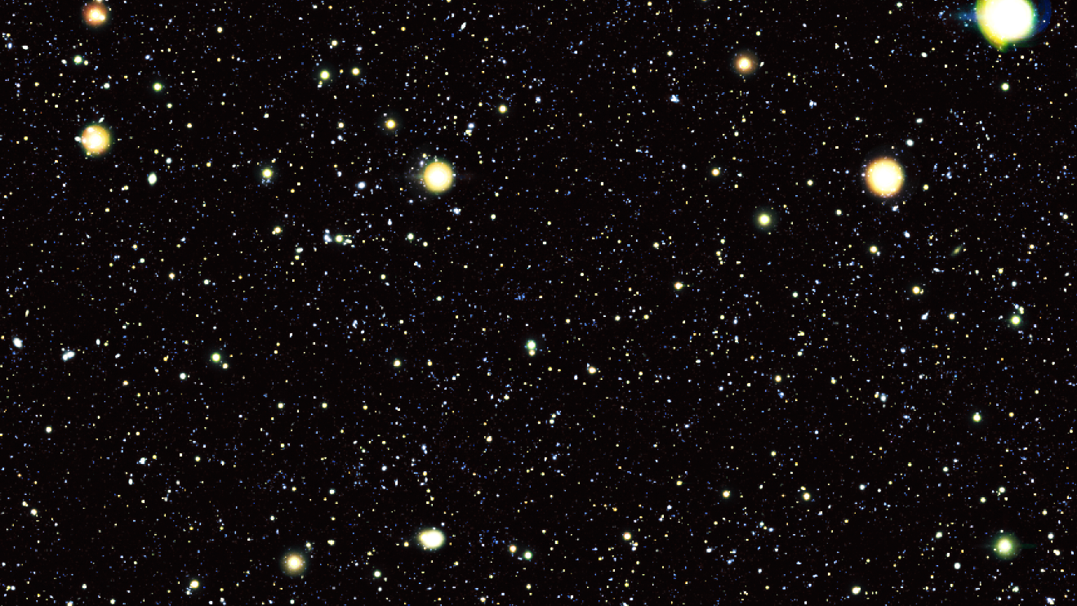

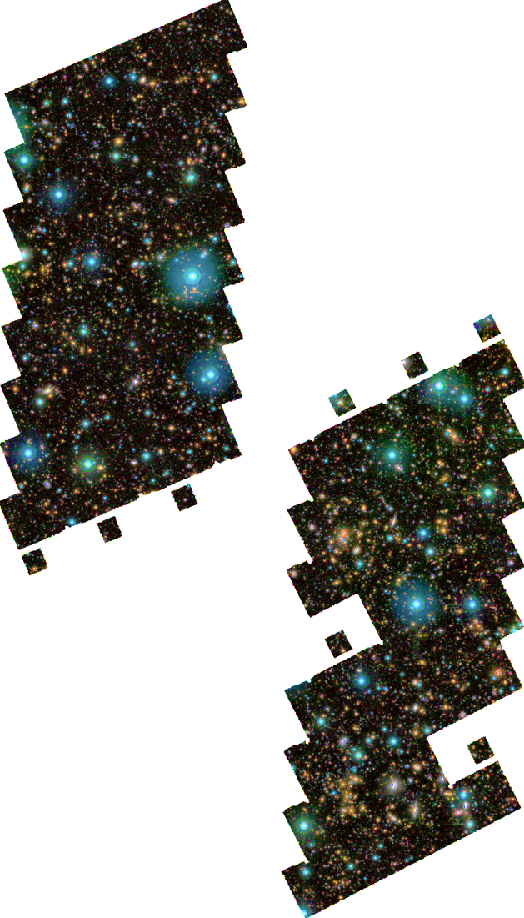
JWST NIRCam
F444W
F277W
F115W
UltraVISTA
Ks H J
JWST MIRI
F770W F1080W
Notes:
Of course, you can only infer dust and star-forming properties from dust, so for other properties we need the strong support from JWST PRIMER, NIRCam and MIRI, and UltraVISTA.

Slide 6
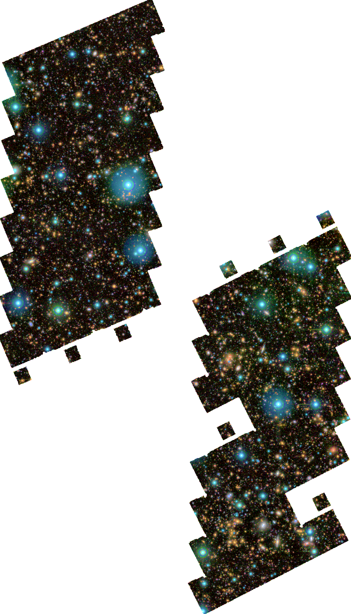
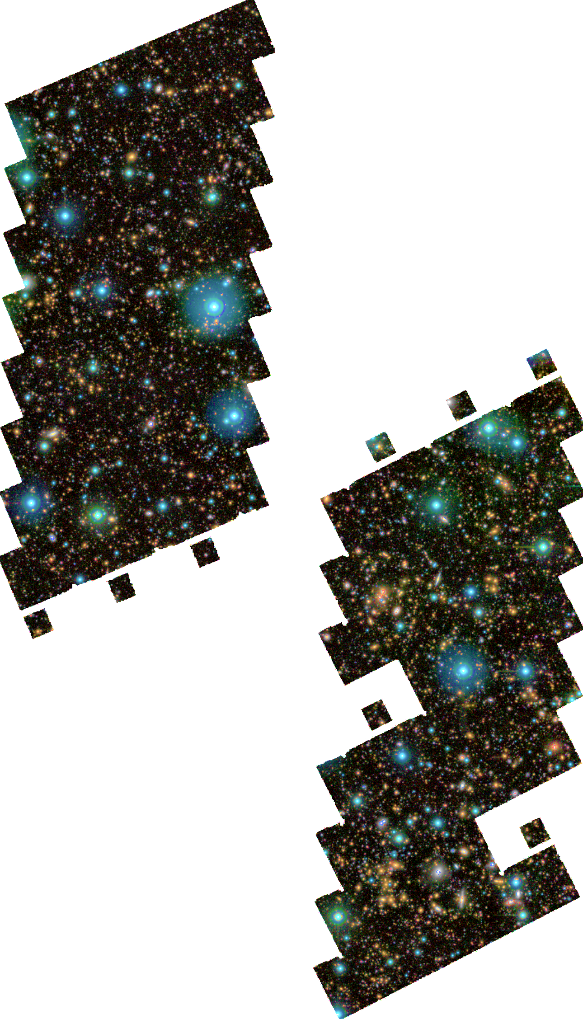
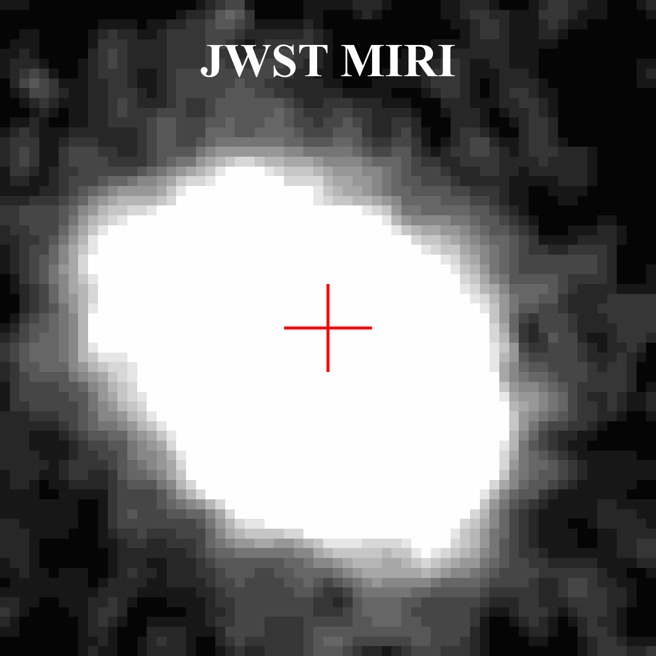
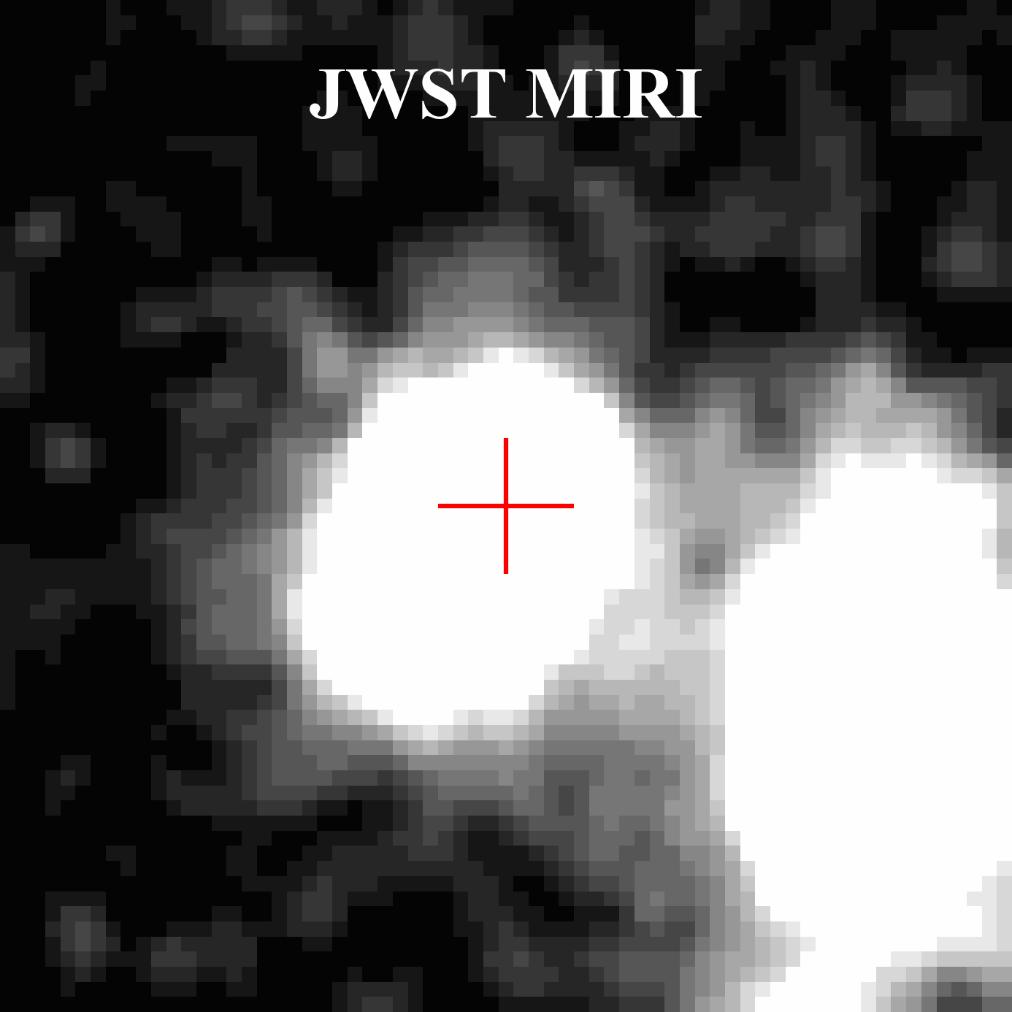
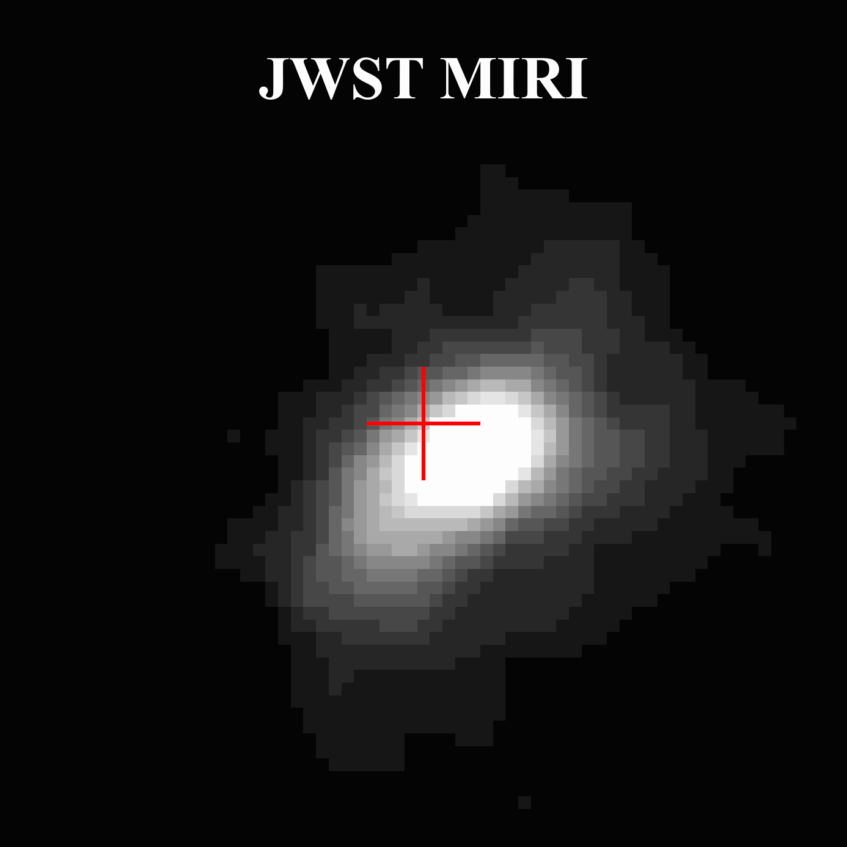
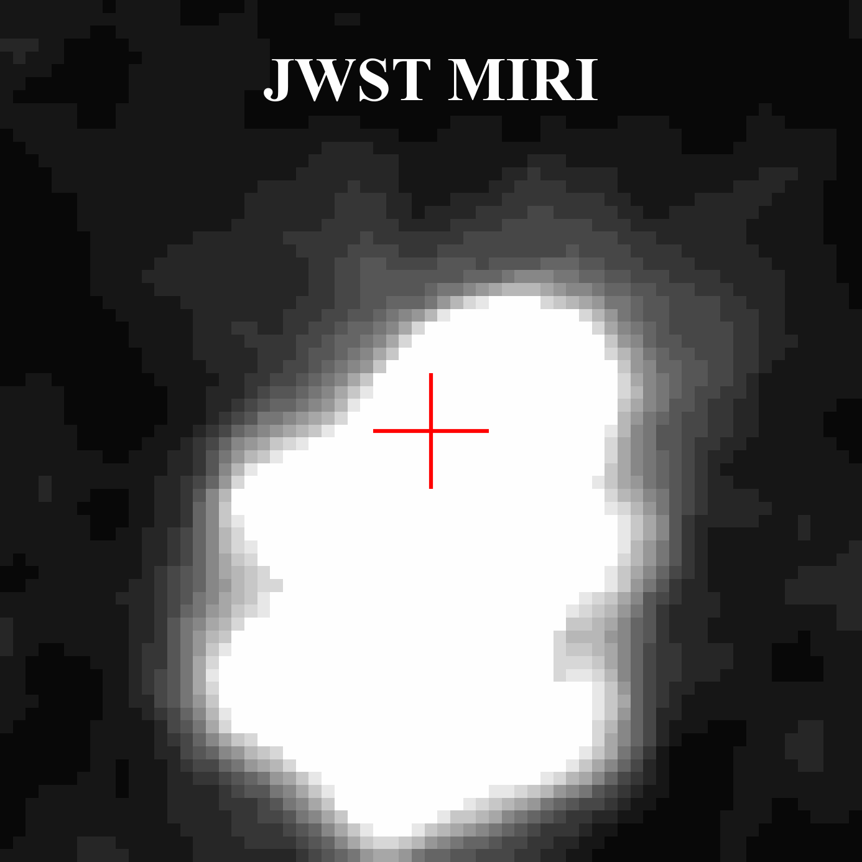
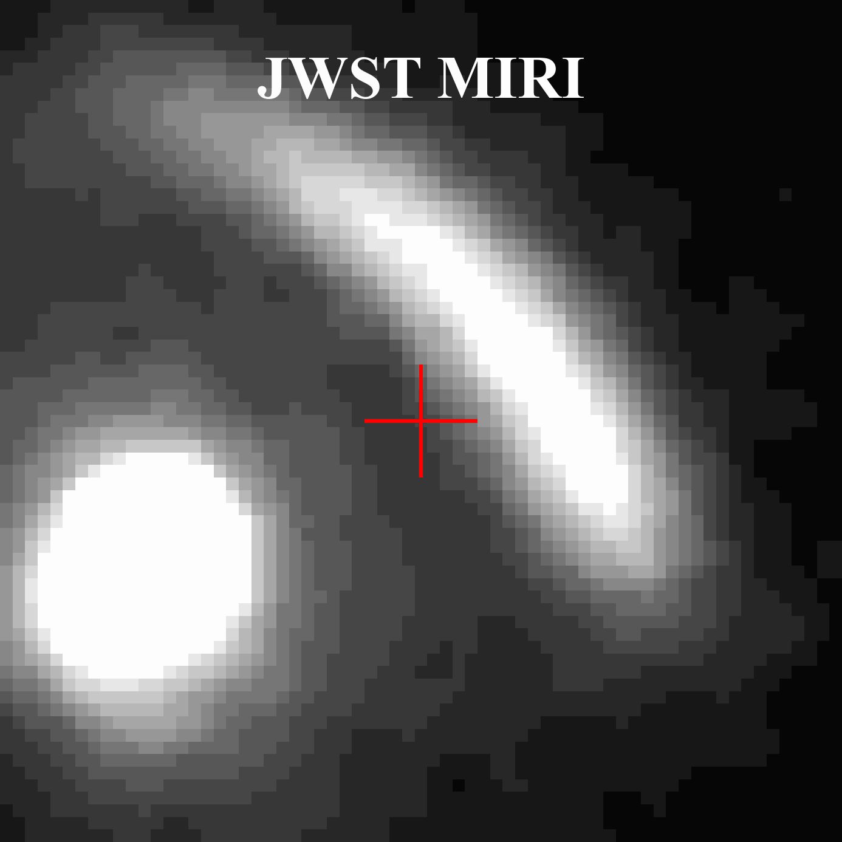
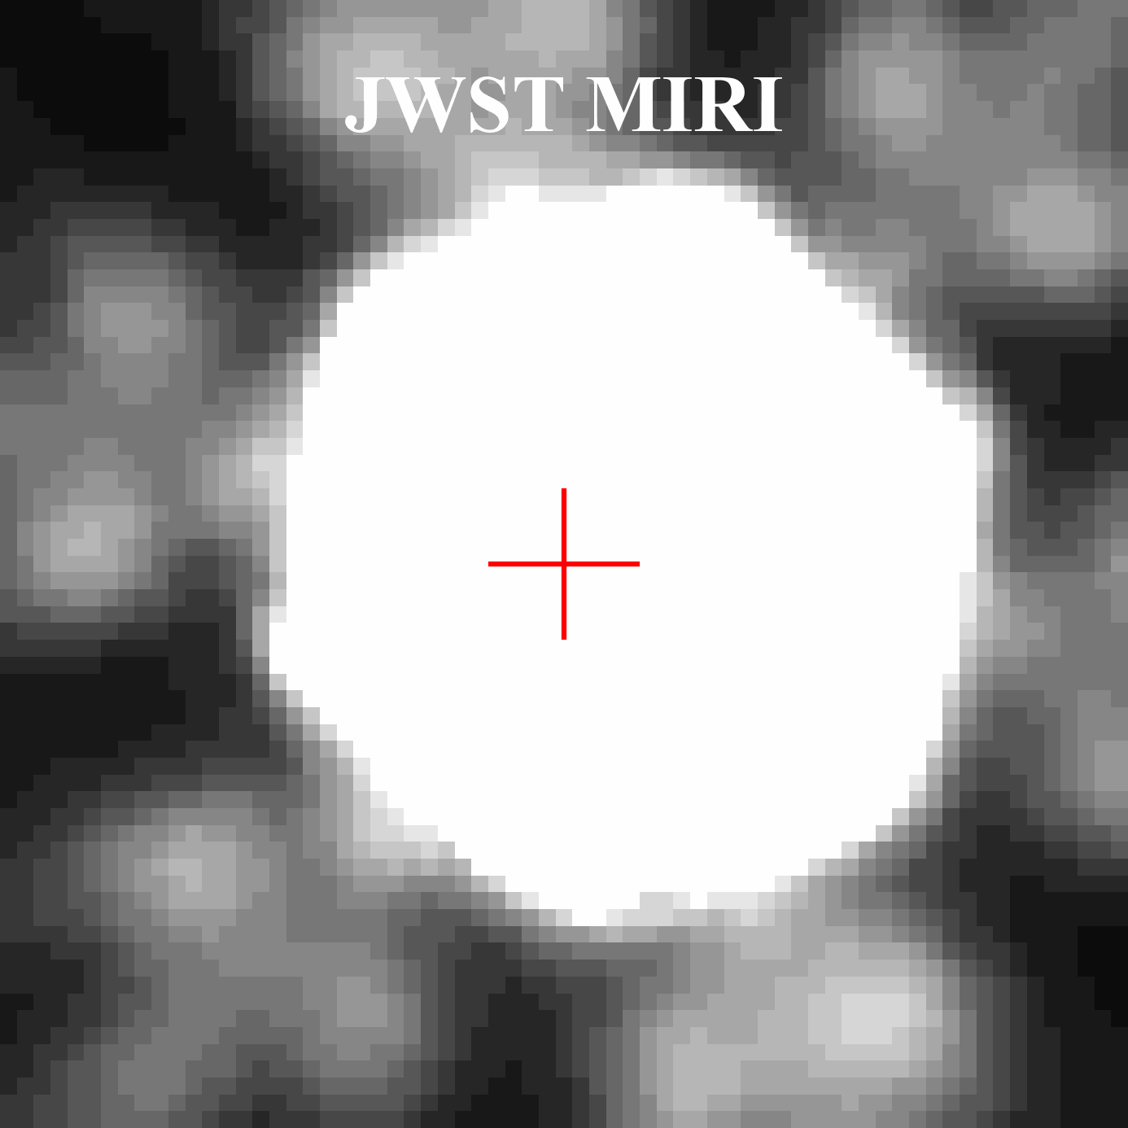
(Optical-dark galaxies invisible to Hubble)
Companions, lensed galaxies, AGN…
A treasure hidden at shorter wavelengths
Notes:
JWST PRIMER has 100% detect all ALMA sources, no matter how bright or faint they are in mm. These gifs show their morphology in different JWST and HST filters. Many of them are invisible to hubble. And this sample is a zoo of different galaxies.

Slide 7
With great resolution, comes great photo-z
(Liu et al. 2025)
Notes:
The JWST data gave us excellent photo-z. For half of the sample, we have spec-z from the literature, they’re highly consistent apart from several outliers. So we have a good sense of where they are in the cosmic history, and stellar mass estimate. Our sample connects the UV-bright galaxies selected from optical and near-infrared, and the normal SMG at intermediate redshifts. Our sample goes all the way up to redshift 7.

Slide 8


A highly obscured population: necessity of FIR observation
(Liu et al. 2025)
Notes:
Unsurprisingly, the vast majority of the targets are very dusty. Over 80% star formation is obscured. And when the source becomes very dusty, the accuracy of attenuation from NIR SED fitting becomes worse.

Slide 9

Obscured star formation and main sequence
(Liu et al. 2025)
Notes:
So the majority of SFR comes from FIR. And we see a main-sequence correlation between the total SFR and stellar mass – be aware that they are derived from independent methods, no dependency of SED fitting degeneracy. The ALMA sources are all very massive, over 10 to the 10 solar mass. We can even see a rise in star formation efficiency at higher redshift.

Slide 10
Constraining the obscured CSFH: a slow early increase
(Liu et al. 2025)
Notes:
Using this sample, we can constrain the dusty star forming history of the universe. Because the ALMA detections come from pointed observations, they only set a lower limit, as the patched region here. However, because we know ALMA sources are all JWST PRIMER has detect 100% ALMA sources, we can extrapolate the ALMA properties to the whole massive PRIMER sample and get a complete cosmic star formation history. It is very consistent with a slow increase from high redshift, as derived from ALMA HUDF.

Slide 11
Constraining the obscured CSFH: a comparison to literature
(Liu et al. 2025)
Notes:
This is a comparison to previous studies. This is the tightest constraint so far into the epoch of reionization out to redshift around 7.

Slide 12
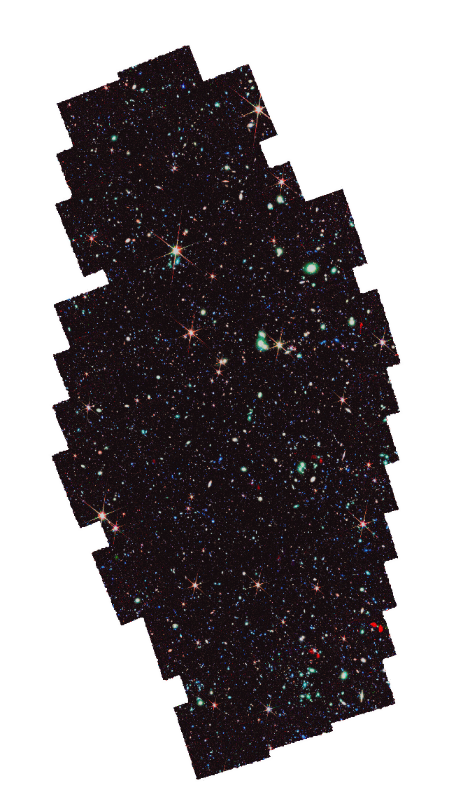

Take-home messages:
(Liu et al. 2025, arXiv:2503.07774)
We used JWST to 100% detect 128 ALMA archival galaxies in the PRIMER COSMOS field;
These galaxies are massive, main-sequence star-forming, and highly dust-obscured;
Our work agrees with an early slow increase in the obscured cosmic star formation history.

