Slide 1
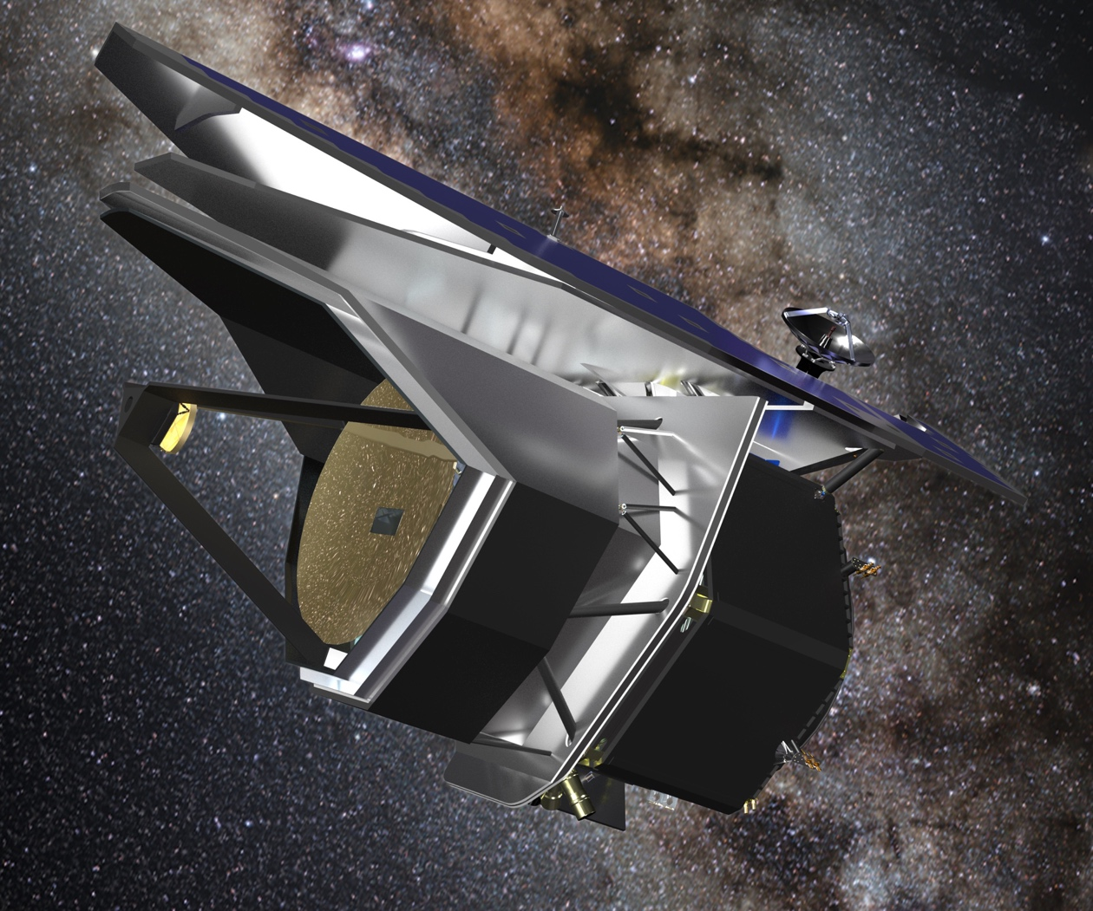


Seb Oliver
PRIMA Science Affiliate
PI of UKSA funded PRIMA-UK project
University of Sussex
7th July 2025
Notes:
Introduce PRIMA, tell people to check out the website for everything shared in this talk and much much more!

Slide 2
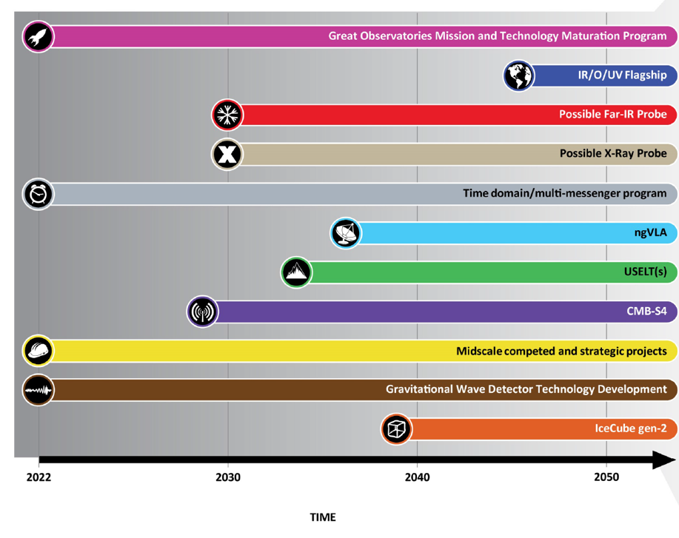
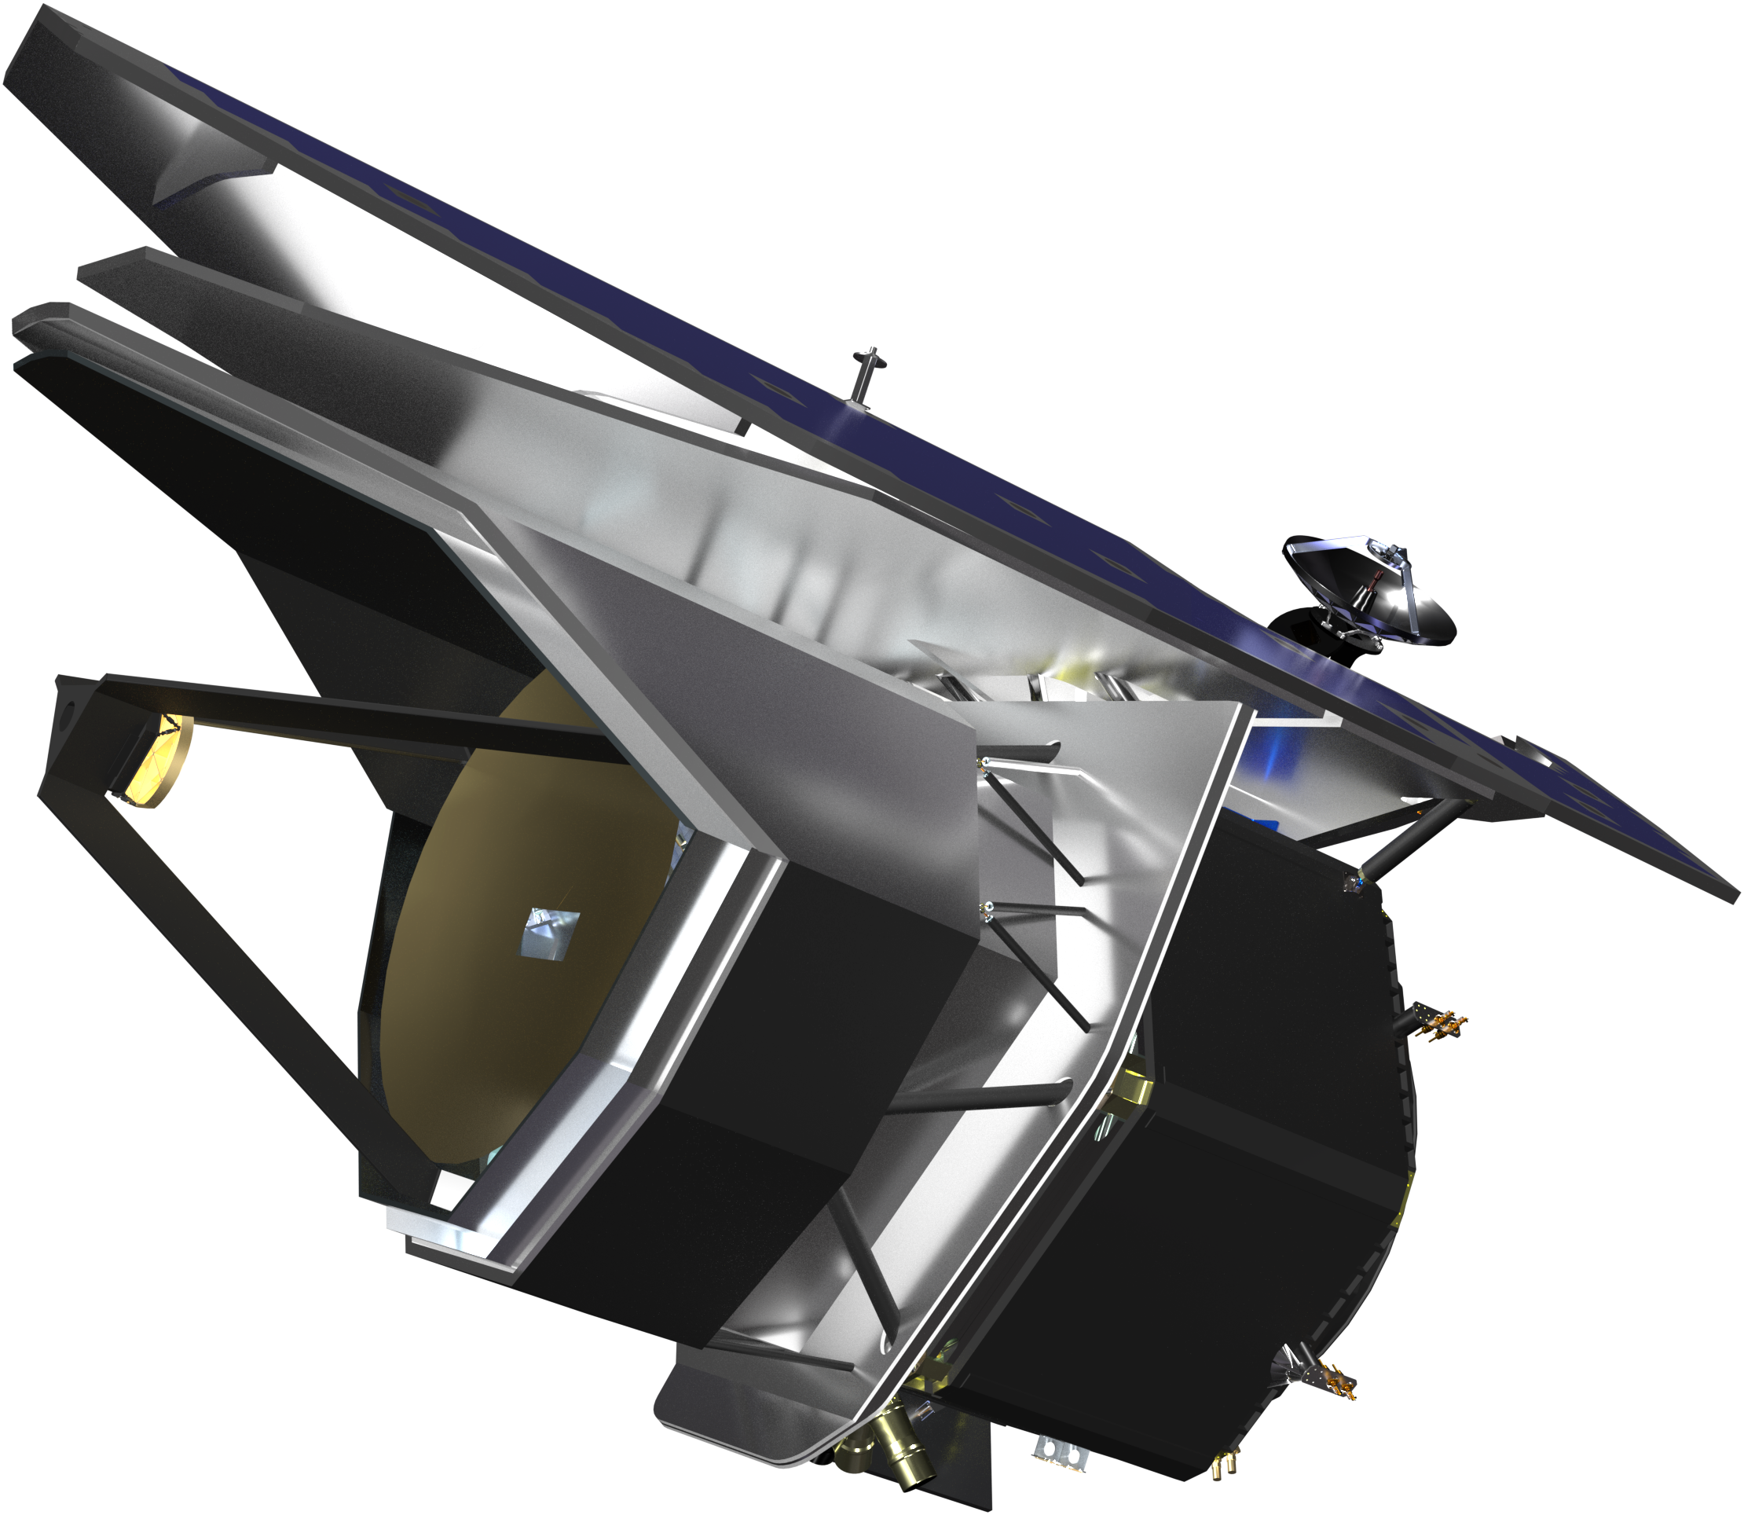
PRIMA is a Far-IR probe mission concept currently in Phase A study
Maybe PRIMA?
Astro2020 Decadal Report Timeline
Notes:
Placing PRIMA in context for astrophysics. The current proposal call for (APEX: Astrophysics Probe EXplorer) is a new class of missions, smaller than flagships and bigger than a small mission. Built both for PI science AND for the community.

Slide 3
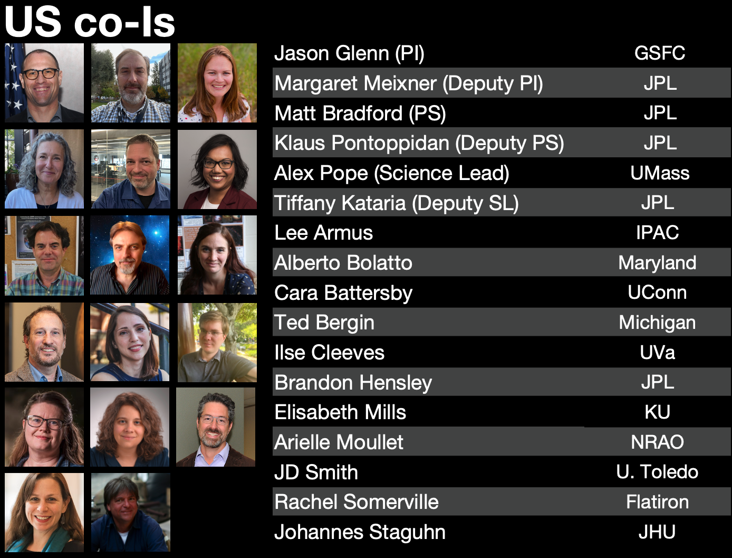
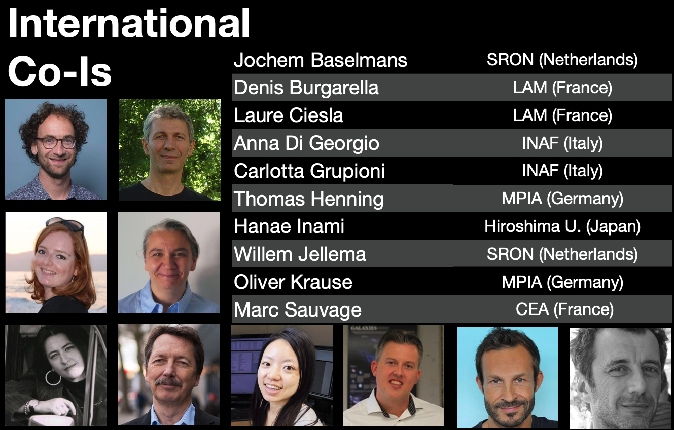
PRIMA is being developed by an international team of astrophysics and technology experts
Co-Is shown, plus a strong corps of engineers and scientists at JPL, GSFC, & BAE Systems
Partner Institutions: JPL, GSFC, BAE Systems, ASI / INAF, Cardiff, IPAC, LAM, MPIA, SRON
We also have amazing science affiliates leading key projects and working groups - see our website for names!
Notes:
PRIMA is made possible by a huge group of people, only some of whom who are shown here!

Slide 4

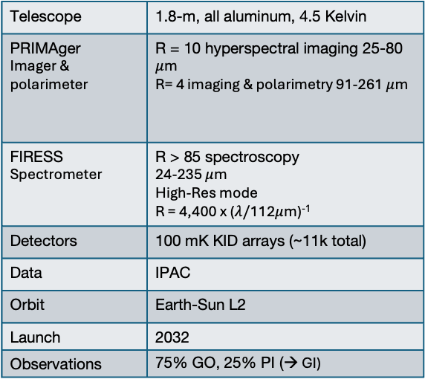
PRIMA Overview
25% of observing time for Principal Investigator science,
75% of observing time for Guest Observers
PI data will be available quickly for Guest Investigator science
Telescope | 1.8-m, all aluminum, 4.5 Kelvin
PRIMAger Imager & polarimeter | R = 10 hyperspectral imaging 25-80 $μ$m R= 4 imaging & polarimetry 91-261 $μ$m
FIRESS Spectrometer | R > 85 spectroscopy 24-235 $μ$m High-Res mode R = 4,400 x ($λ/$112$μ$m)⁻¹
Detectors | 100 mK KID arrays (~11k total)
Data | IPAC
Orbit | Earth-Sun L2
Launch | 2032
Observations | 75% GO, 25% PI (→ GI)
Notes:
Highlight that PRIMA has 75% of observing time for Guest Observers and we will release PI data for guest investigator science. General telescope architecture and design graphic.

Slide 5
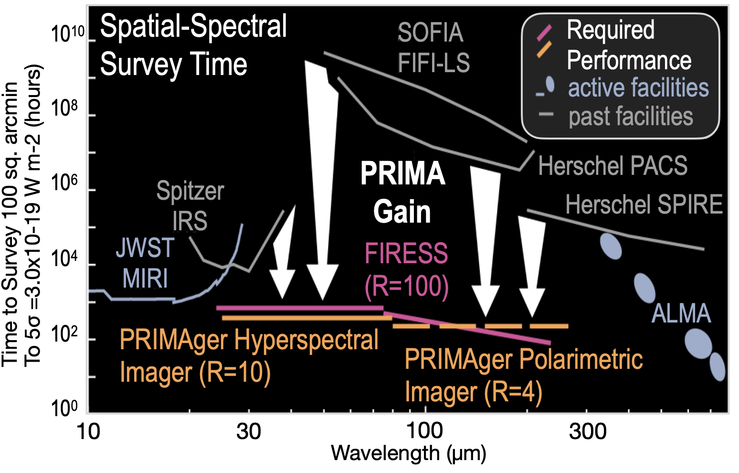
PRIMA takes advantage of incredibly large gains and new capabilities from sensitive KID arrays
KIDs have now reached sensitivities such that, coupled with actively cooled mirrors, observations are only limited by astrophysical backgrounds (e.g., the Zodaical light)
Notes:
The crazy sensitivity and fast mapping speed of PRIMA is only possible due to decades of technological investment and advances in Far-IR detector technology.

Slide 6
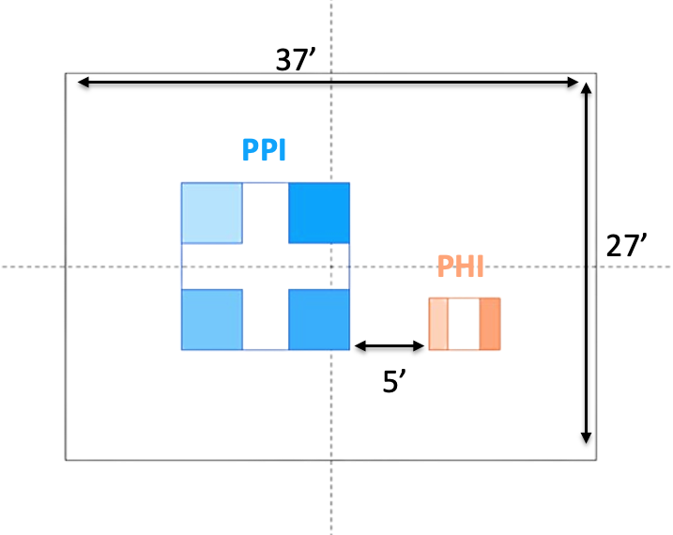
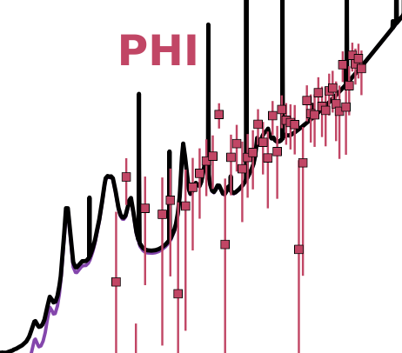
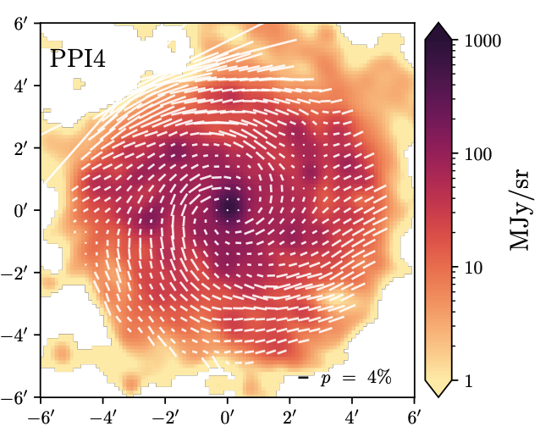
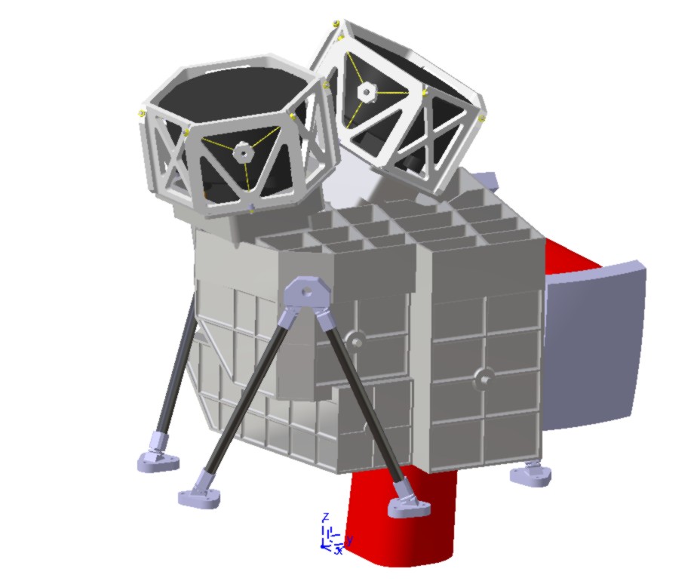
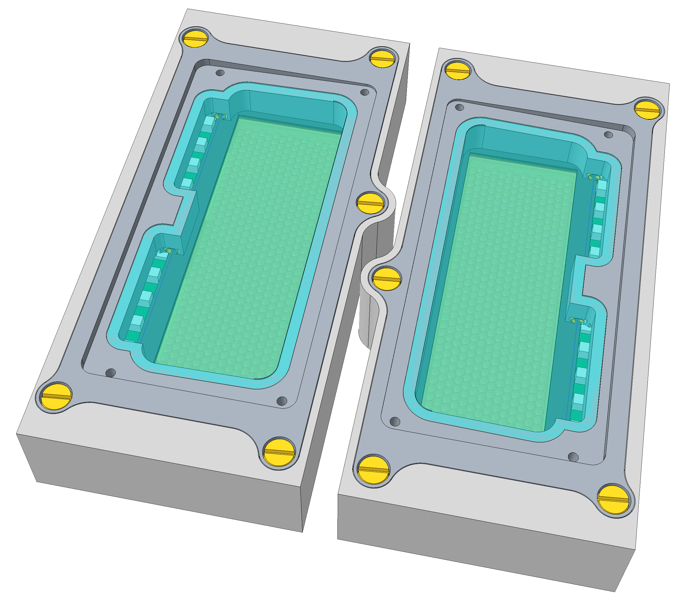
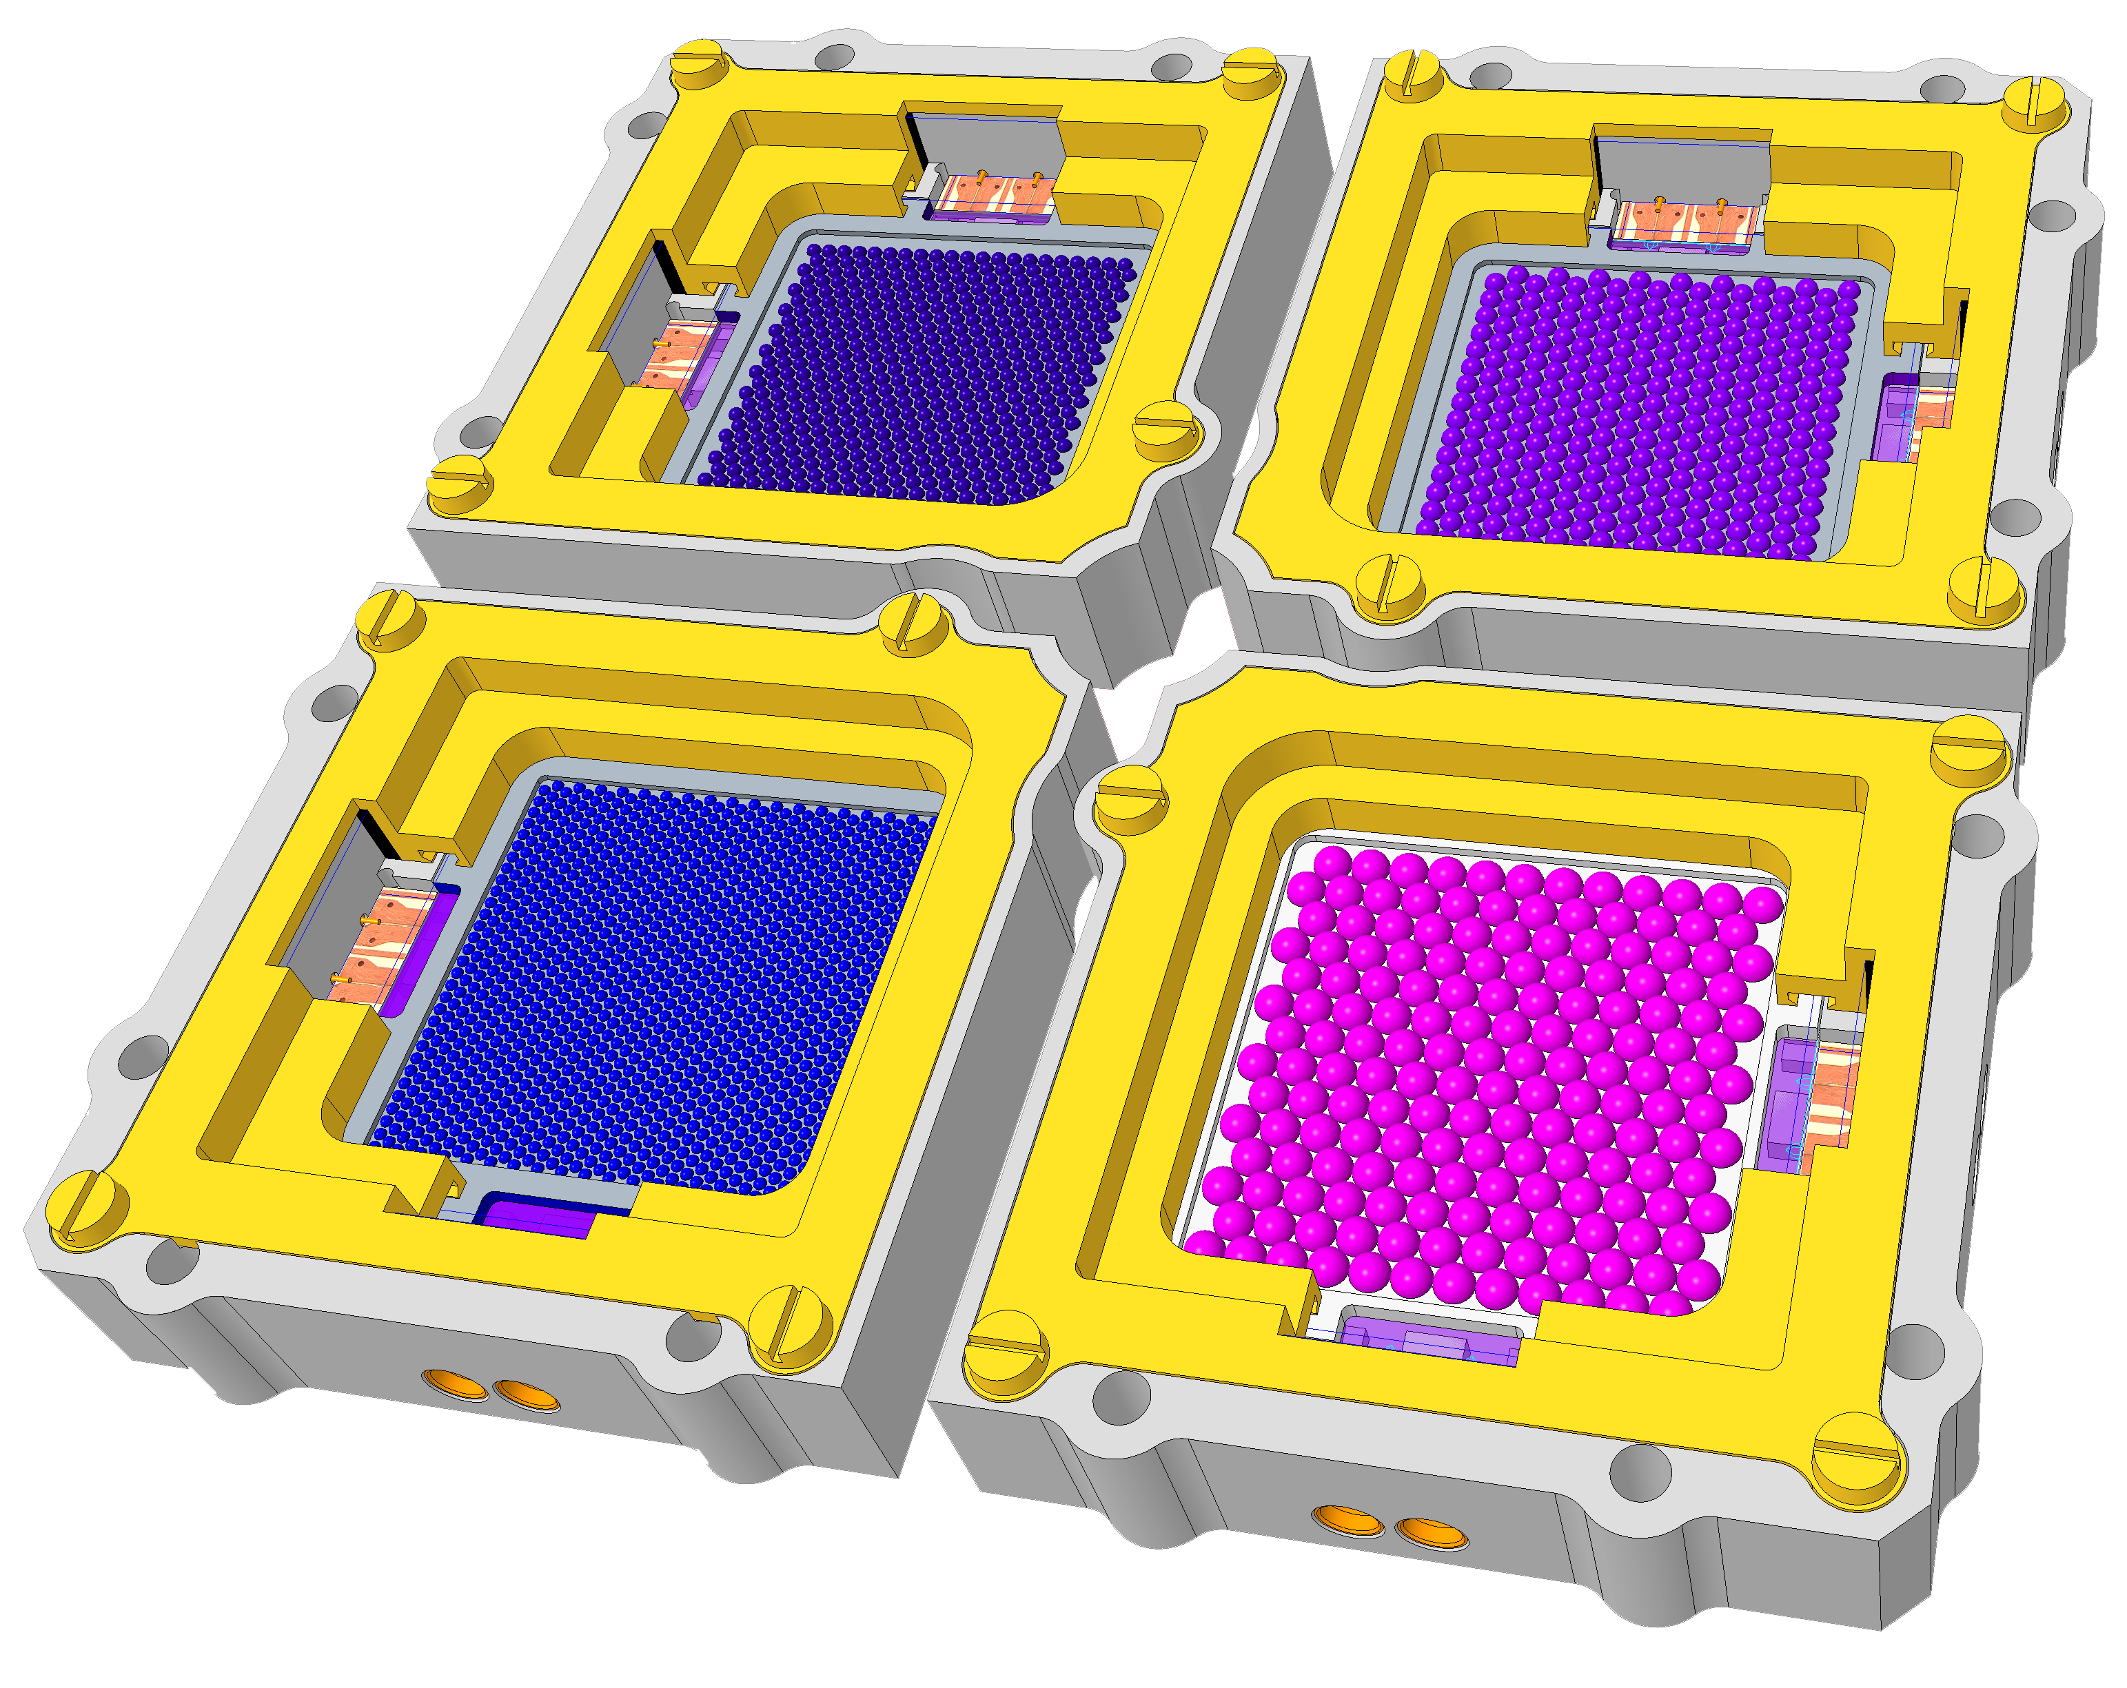
PRIMA has two main instruments: PRIMAger and FIRESS
PRIMAger is a mapping instrument.
Each pixel of the two focal planes (PHI and PPI) must see the object of interest.
Large map mode:
> 15’ x 15’ - combination of telescope scan and BSM
Small map mode:
~10’x10’ < area < 15’x15’ – BSM only
Hyperspectral Imaging (PHI)
Polarimetry Imaging (PPI)
24—84 microns
R= 8
Linear Variable Filter
Total Intensity
FWHM: 4.7” – 8.7”
92, 126, 183, 235 microns
R= 4
Total intensity, polarization
FWHM: 11” – 28”
Notes:
PRIMAger set up on the sky plus cartoon of detectors and synthetic observations – more details on the “instruments” page of the website!

Slide 7
PRIMA has two main instruments: PRIMAger and FIRESS
FIRESS
Bands 1 + 3 overlap, Bands 2 + 4 overlap
2 pointings for full spectrum of a source, though all 4 bands read out.
High-res mode couples all bands when engaged
4 slit-fed grating modules spaced logarithmically with some wavelength overlap.
All detectors in all bands read out simultaneously.
Band 1 and 2 common design and plate scale.
All aluminum, no moving parts.
Parameter | Band 1 | Band 2 | Band 3 | Band 4
Spectral range (µm) | 24–43 | 42–76 | 74–134 | 130–235
Spectral sampling (µm) | 0.23 | 0.41 | 0.73 | 1.29
Resolving power | 95-150 | 85-120 | 90-125 | 95-130
Array format per band | 24 spatial ×84 spectral pix, 900-µm pitch
Pix size on sky (arcsec) | 7.6 |  | 12.7 | 22.9
Pix pitch ratio to B1,2 | - |  | 5:3 | 3:1
Notes:
Here is the FIRESS 5-sigma 1 hour line sensitivity showing the ~2 orders of magnitude improvement over facilities at this wavelength (improvement is even better if you consider mapping)

Slide 8

PRIMA provides an enormous leap in sensitivity, enabled by decades of NASA technology investment
PRIMA’s 1.8m aperture will be cryogenically cooled to 4.5 K. PRIMA maximizes the science return from a cooled aperture by using microwave kinetic inductance detectors (MKIDs) to reach background-limited sensitivities
10X
30X
100,000X
Higher spectral resolution than JWST in the mid-IR
More sensitive than Herschel for point sources
Faster mapping speed for imaging and wideband spectroscopy vs. previous far-IR missions
Notes:
PRIMA opens up incredible discovery space, particularly in gathering large sample sizes and statistics enabled by its high mapping speed. Every time we have opened up new technology in a window of the electromagnetic spectrum, we have opened the window to incredible discovery space.

Slide 9
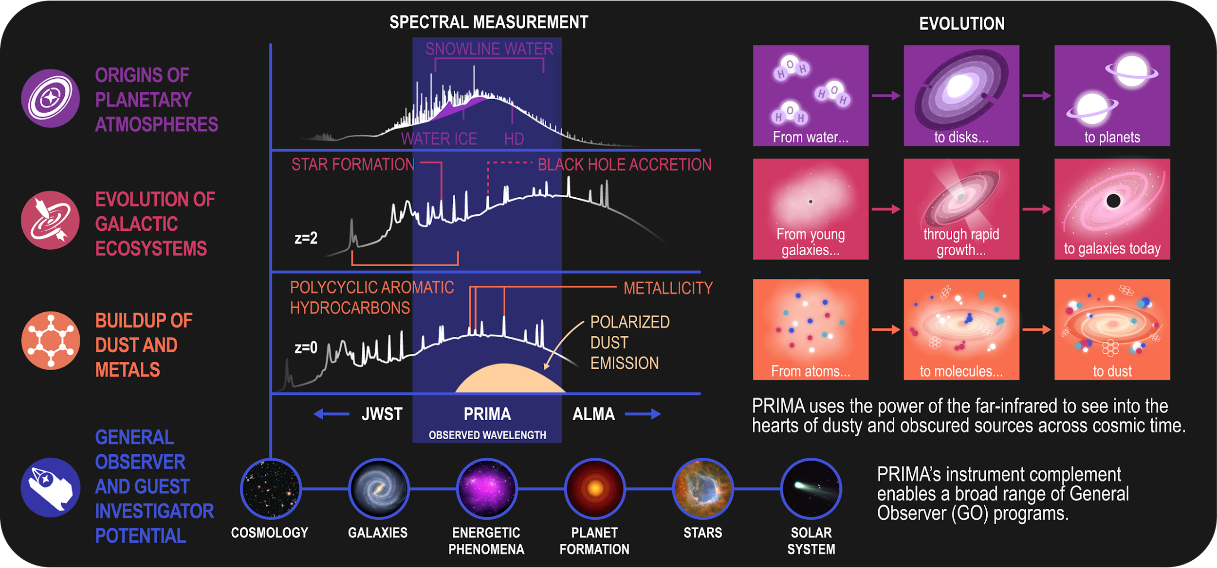
PRIMA PI science
Notes:
PRIMA’s PI science is focused on three major areas: origins of planetary atmospheres, evolution of galactic ecosystems, and the buildup of dust and metals. However, we have done our best to ensure that the mission is well-designed to accommodate community science interests and seek your help in submitting cases!

Slide 10
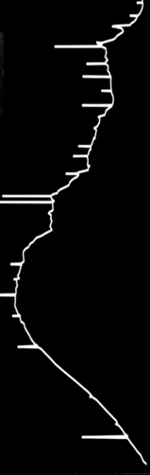
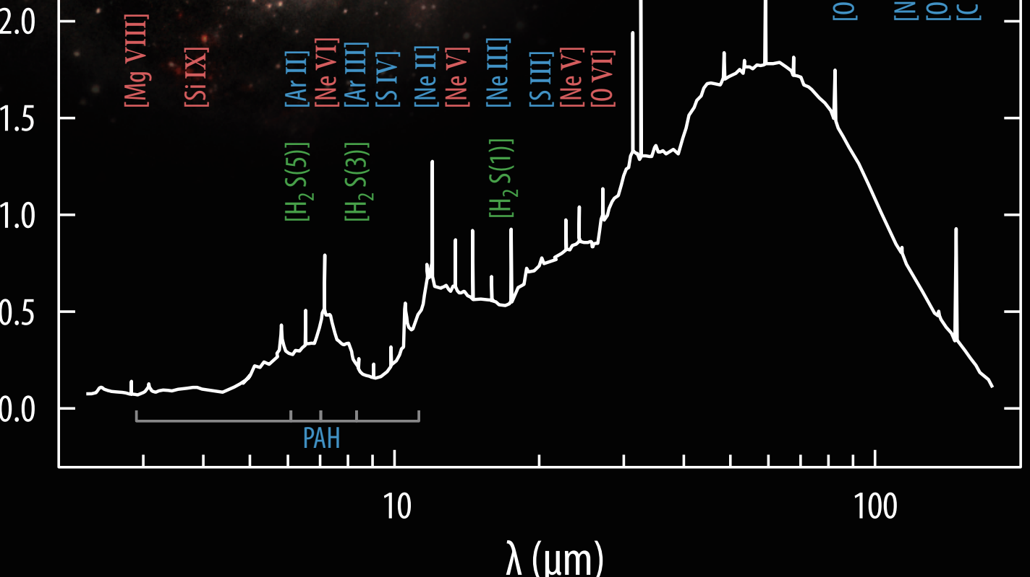
10 μm
20 μm
The
majority
of light from dusty objects is emitted at far-infrared wavelengths
and can only be observed from space
30 μm
40 μm
50 μm
50% of light ever emitted by stars is re-processed by dust!
100 μm
Notes:
50% of light ever emitted by stars is re-processed by dust. So if you care about stars (or galaxies or AGN or star formation or planetary disks, or or or)… you probably care about dust!
PS. Real icebergs don’t look like this (not stable!) but it’s a fun graphic, right?

Slide 11

GO Science
The
majority
of light from dusty objects is emitted at far-infrared wavelengths
and can only be observed from space
75% of PRIMA observing time is dedicated to GO science
There are currently no operating or planned far-infrared missions
Notes:
MOST of PRIMA’s observing time is for GO science! Far-IR can only be done from space! And there are no operating or planned far-IR missions!

Slide 12
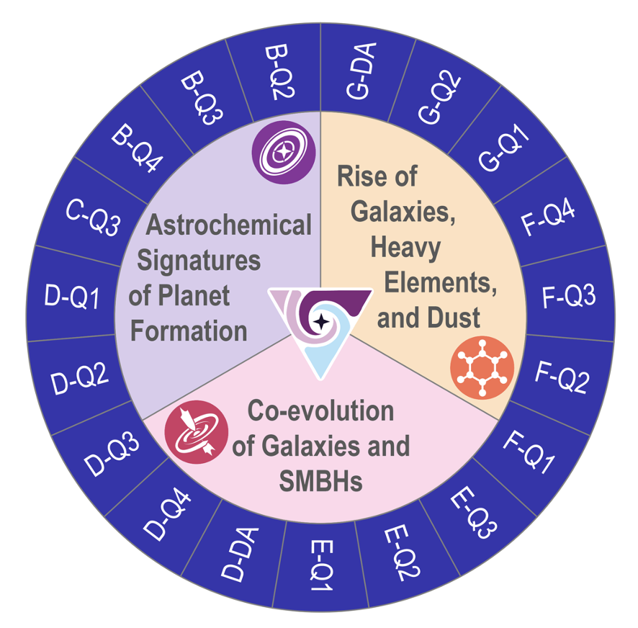
GO Science
Planet Formation
The
majority
of light from dusty objects is emitted at far-infrared wavelengths
and can only be observed from space
75% of PRIMA observing time is dedicated to GO science
PRIMA measures cool water (T < 150 K) only seen in the far infrared
There are currently no operating or planned far-infrared missions
Far-infrared tracers of the complete water reservoir in disks are the missing key to understand the origins of planets
Notes:
We can use far-ir to trace the full water reservoir in planet-forming disks to understand the origin of planets.

Slide 13
GO Science
Planet Formation
Co-evolution of black holes and star formation
The
majority
of light from dusty objects is emitted at far-infrared wavelengths
and can only be observed from space
75% of PRIMA observing time is dedicated to GO science
PRIMA measures cool water (T < 150 K) only seen in the far infrared
PRIMA uniquely provides a simultaneous measure of how black holes and galaxies grow
There are currently no operating or planned far-infrared missions
Far-infrared tracers of the complete water reservoir in disks are the missing key to understand the origins of planets
More than half of star formation and black hole growth in the early universe is obscured by dust and only visible in the far-infrared
Notes:
We can measure black hole accretion rate and star formation rate simultaneously over huge numbers of galaxies over cosmic time to understand how galaxies evolve.

Slide 14
GO Science
Planet Formation
Co-evolution of black holes and star formation
Rise of dust and metals
The
majority
of light from dusty objects is emitted at far-infrared wavelengths
and can only be observed from space
70% of PRIMA observing time is dedicated to GO science
PRIMA measures cool water (T < 150 K) only seen in the far infrared
PRIMA uniquely provides a simultaneous measure of how black holes and galaxies grow
PRIMA determines if dust formation and metal abundance peak at cosmic noon
PRIMA: See what we have been missing
There are currently no operating or planned far-infrared missions
Far-infrared tracers of the complete water reservoir in disks are the missing key to understand the origins of planets
More than half of star formation and black hole growth in the early universe is obscured by dust and only visible in the far-infrared
Far-infrared observations fill a critical gap between JWST and ALMA for understanding the evolution of dust and metal abundances
Notes:
PRIMA can track the rise and evolution of dust and metals across cosmic history and into the present day.

Slide 15
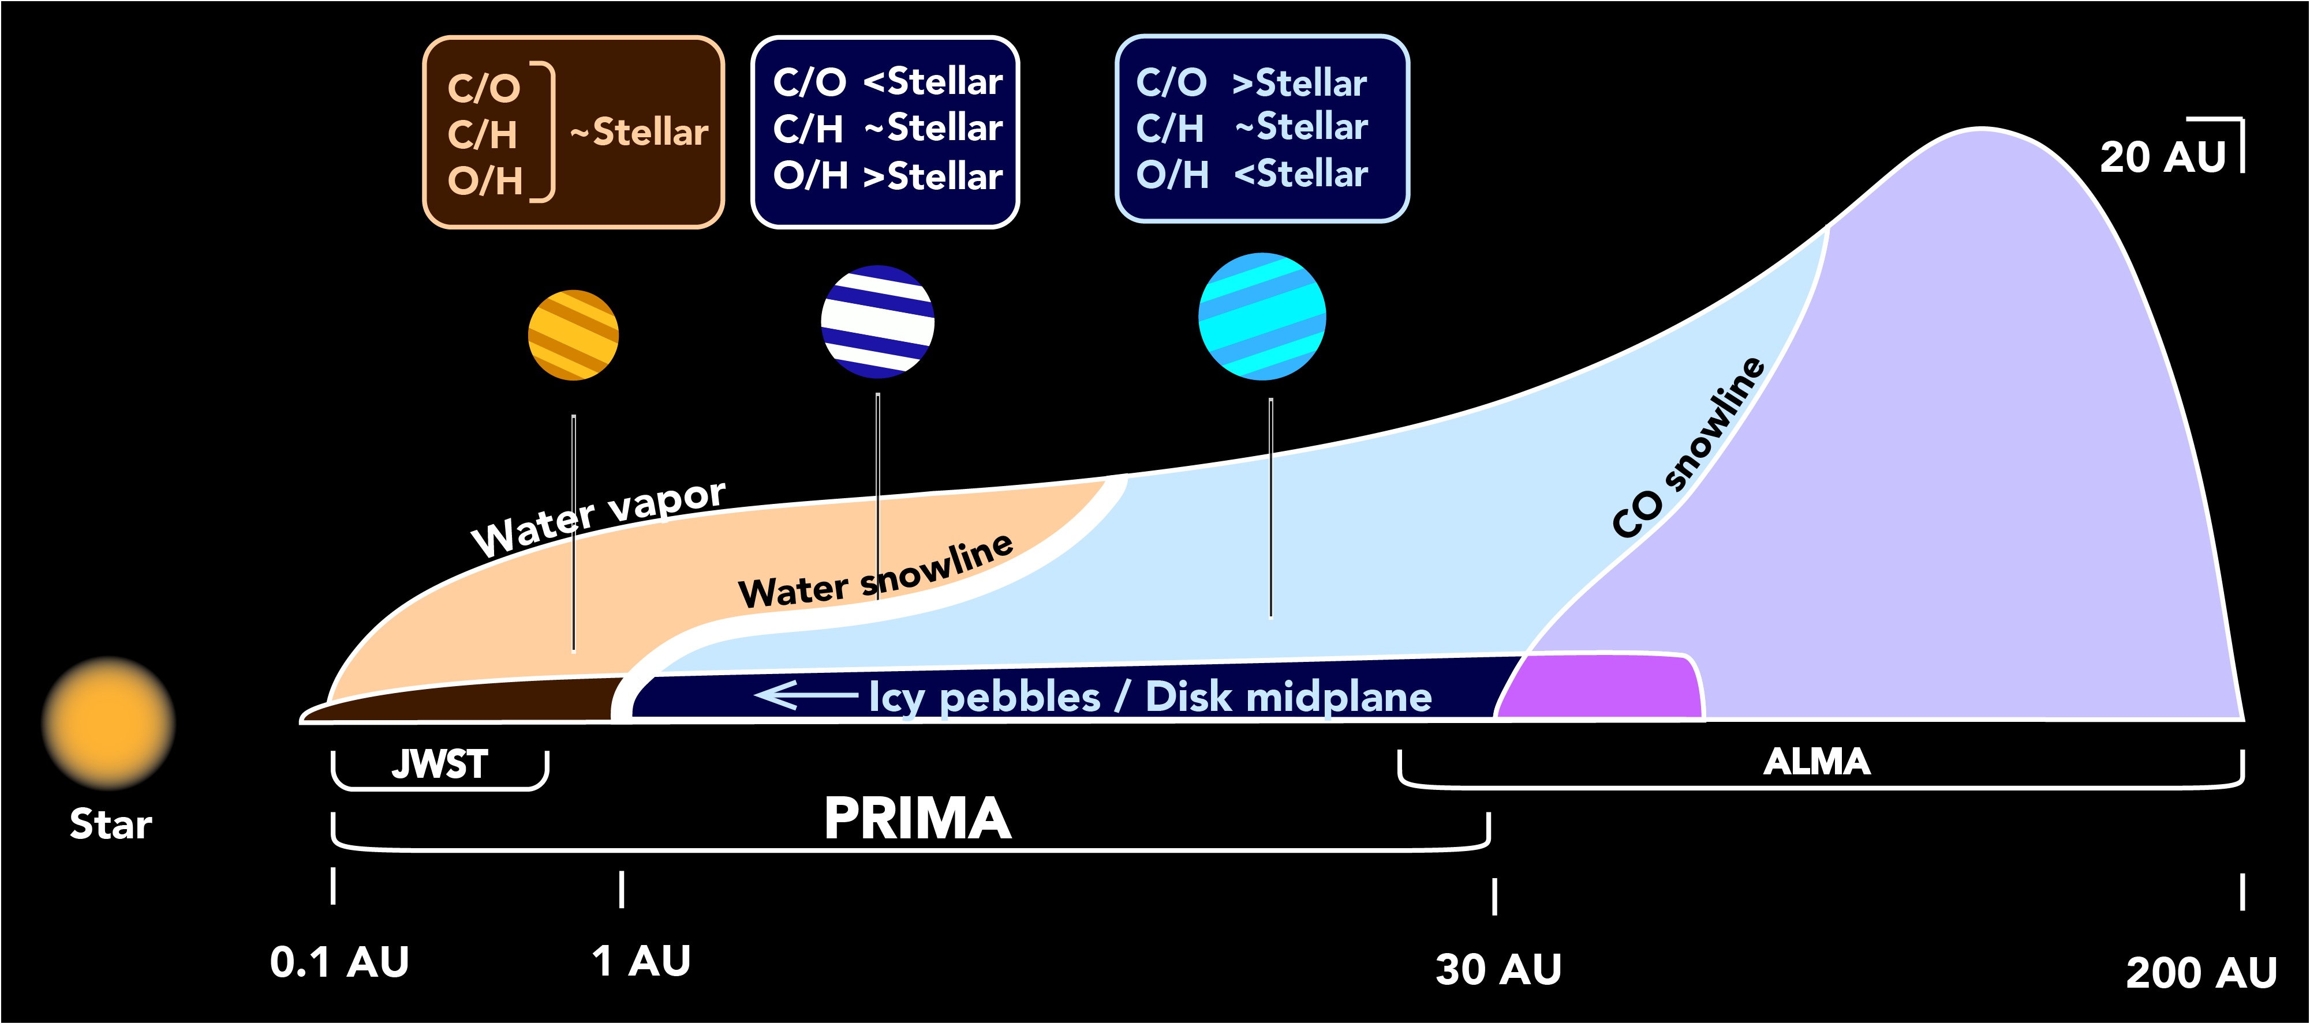
Gas phase water
Gas phase CO
Water ice
CO
ice
Formation of Planets
PRIMA reveals origins of exoplanet atmospheres in protoplanetary disks by producing surveys of disk properties that will have a transformative effect on the field of exoplanet science
Notes:
PRIMA is sensitive to a critical part of protoplanetary disks that are inaccessible with ALMA and JWST. Allows us to study the water reservoir. We can compare abundances of exoplanet atmospheres with protoplanetary disks to understand the origin of planetary atmospheres.
This is done with spectral lines, we don’t spatially resolve the disks.

Slide 16
The atmospheres of giant exoplanets reflect the conditions at the locations in the disk where they formed
Formation of Planets
PRIMA reveals origins of exoplanet atmospheres in protoplanetary disks by producing surveys of disk properties that will have a transformative effect on the field of exoplanet science
Notes:
PRIMA is sensitive to a critical part of protoplanetary disks that are inaccessible with ALMA and JWST. Allows us to study the water reservoir. We can compare abundances of exoplanet atmospheres with protoplanetary disks to understand the origin of planetary atmospheres.
This is done with spectral lines, we don’t spatially resolve the disks.

Slide 17
PRIMA constrains the initial abundances in protoplanetary disks that are preserved in exoplanet atmospheres
Formation of Planets
PRIMA reveals origins of exoplanet atmospheres in protoplanetary disks by producing surveys of disk properties that will have a transformative effect on the field of exoplanet science
Notes:
PRIMA is sensitive to a critical part of protoplanetary disks that are inaccessible with ALMA and JWST. Allows us to study the water reservoir. We can compare abundances of exoplanet atmospheres with protoplanetary disks to understand the origin of planetary atmospheres.
This is done with spectral lines, we don’t spatially resolve the disks.

Slide 18
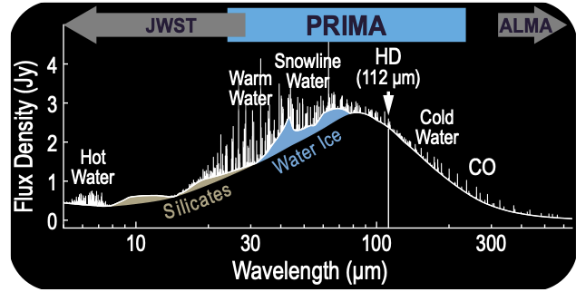
Formation of Planets
PRIMA reveals origins of exoplanet atmospheres in protoplanetary disks by producing surveys of disk properties that will have a transformative effect on the field of exoplanet science
PRIMA provides unique access to these spectral lines.
Notes:
PRIMA fills in a critical wavelength gap between JWST and ALMA

Slide 19
Broadly, star formation activity in the universe peaks around z = 2 (cosmic noon)
Evolution of Galactic Ecosystems
PRIMA links the growth of galaxies and black holes over cosmic time by simultaneously measuring rates of black hole accretion and star formation in dust-obscured galaxies to answer major questions about black hole growth and feedback
Star formation rate
Rate Density
0 1 2 3 4
Redshift
Notes:
PRIMA allows us to test theories of how galaxies and black holes co-evolve. PRIMA does this by simultaneously measuring the black hole accretion and star formation rates of galaxies across cosmic time.

Slide 20
Black hole growth likely peaks at a similar time, however it is difficult to get a complete census as growth often occurs in highly obscured central regions of galaxies
Evolution of Galactic Ecosystems
Black Hole accretion rate
IR
PRIMA links the growth of galaxies and black holes over cosmic time by simultaneously measuring rates of black hole accretion and star formation in dust-obscured galaxies to answer major questions about black hole growth and feedback
Star formation rate
X-Ray
Rate Density
0 1 2 3 4
Redshift
Notes:
PRIMA allows us to test theories of how galaxies and black holes co-evolve. PRIMA does this by simultaneously measuring the black hole accretion and star formation rates of galaxies across cosmic time.

Slide 21
PRIMA simultaneously measures star formation and black hole accretion rates, independent of any dust and gas obscuration, out to cosmic noon
Evolution of Galactic Ecosystems
Black Hole accretion rate
IR
PRIMA links the growth of galaxies and black holes over cosmic time by simultaneously measuring rates of black hole accretion and star formation in dust-obscured galaxies to answer major questions about black hole growth and feedback
Star formation rate
X-Ray
Rate Density
0 1 2 3 4
Redshift
Notes:
PRIMA allows us to test theories of how galaxies and black holes co-evolve. PRIMA does this by simultaneously measuring the black hole accretion and star formation rates of galaxies across cosmic time.

Slide 22
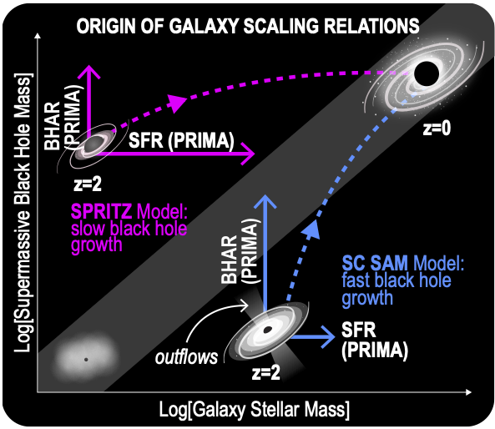
With measures of black hole accretion rate and star formation rates, we can test models of galaxy evolution
Evolution of Galactic Ecosystems
PRIMA links the growth of galaxies and black holes over cosmic time by simultaneously measuring rates of black hole accretion and star formation in dust-obscured galaxies to answer major questions about black hole growth and feedback
Notes:
PRIMA allows us to test theories of how galaxies and black holes co-evolve. PRIMA does this by simultaneously measuring the black hole accretion and star formation rates of galaxies across cosmic time.

Slide 23
Notes:
PRIMA will trace the rise of dust and metals over cosmic time, yielding samples 100x larger than Herschel. It does this by filling a critical wavelength gap between JWST and ALMA with key tracers of dust and metallicity.

Slide 24
Notes:
PRIMA will trace the rise of dust and metals over cosmic time, yielding samples 100x larger than Herschel. It does this by filling a critical wavelength gap between JWST and ALMA with key tracers of dust and metallicity.

Slide 25
Notes:
PRIMA will trace the rise of dust and metals over cosmic time, yielding samples 100x larger than Herschel. It does this by filling a critical wavelength gap between JWST and ALMA with key tracers of dust and metallicity.

Slide 26
Notes:
PRIMA will trace the rise of dust and metals over cosmic time, yielding samples 100x larger than Herschel. It does this by filling a critical wavelength gap between JWST and ALMA with key tracers of dust and metallicity.

Slide 27
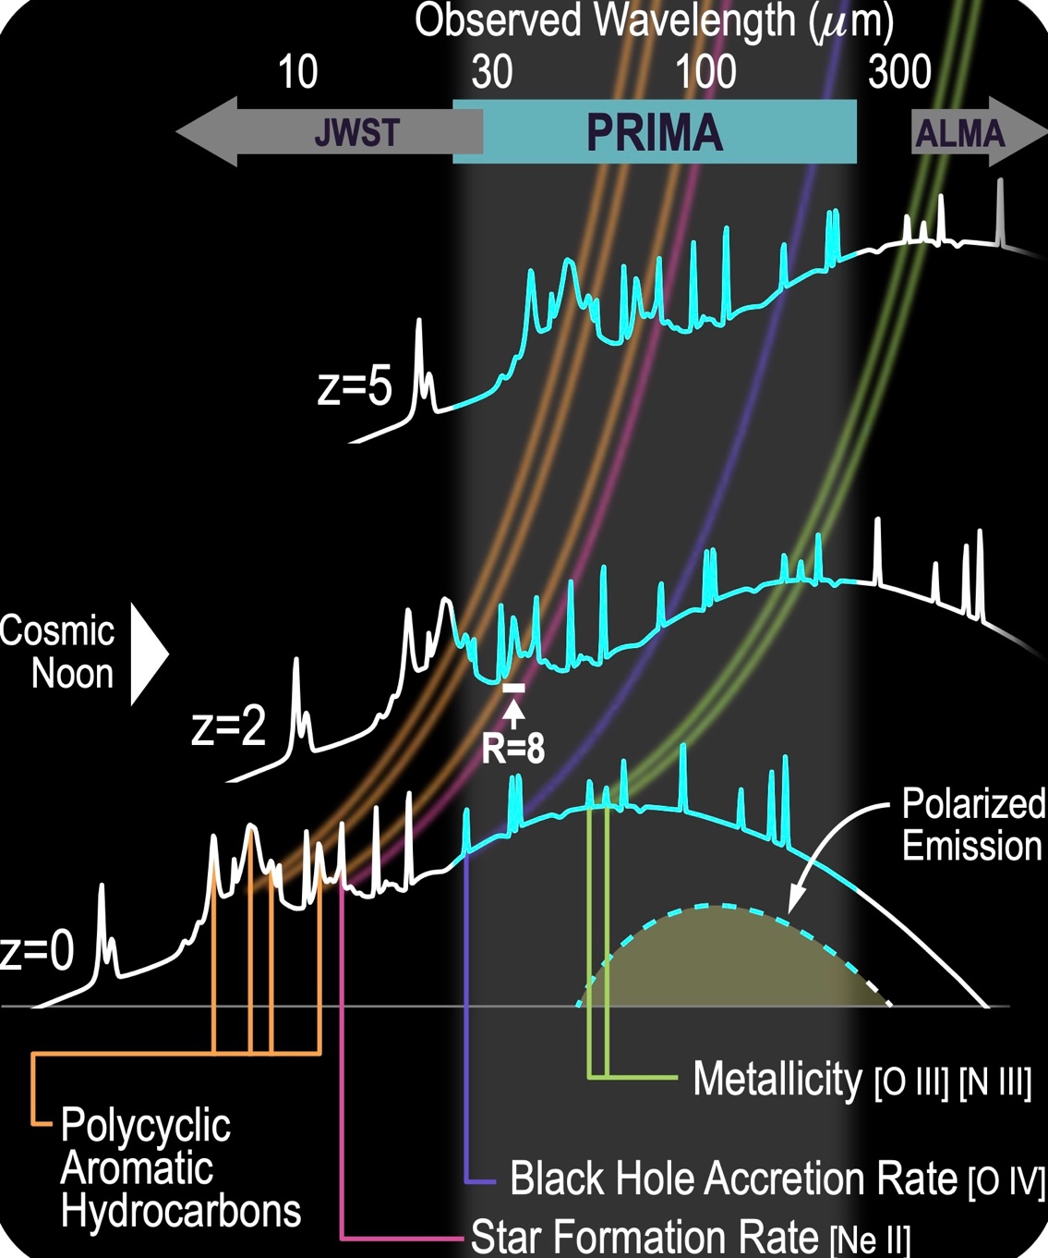
PRIMA will trace the rise of dust and metals over cosmic time
Notes:
PRIMA will trace the rise of dust and metals over cosmic time, yielding samples 100x larger than Herschel. It does this by filling a critical wavelength gap between JWST and ALMA with key tracers of dust and metallicity.

Slide 28
75% of PRIMA’s time is dedicated to General Observer Science
PI surveys define mission requirements- the goal is to create a powerful and flexible set of observatory capabilities that enables a rich program of community science.
The PRIMA team wants this to be YOUR observatory. You can help the PRIMA team by starting early to define the science you would perform with PRIMA. This helps ensure that your scientific needs can be met with this observatory and demonstrates the community’s need for this facility!
All PI data will be public after initial validation- In addition to GO cases, we welcome examples of GI use cases that demonstrate the rich potential of the PI surveys.
Notes:
PRIMA is for YOU! Help us to make sure the telescope is designed to work for YOU by sharing your science use cases and ideas.

Slide 29
Working Groups
Launched March 2025. Contact leads to join
Galaxy evolution from cosmic dawn to cosmic noon #galaxy-evolution
Co-I contacts: @JD Smith @Alexandra Pope
WG leads: @Irene Shivaei @Jed McKinney
AGN across cosmic time #agn-across-cosmic-time
Co-I contact: @Carlotta Gruppioni
WG leads: @Sylvain Veilleux
Cosmic ecosystems #cosmic-ecosystems
Co-I contact: @Alberto Bolatto
WG leads: @Becca Levy
Milky Way Interstellar Medium and Star Formation #ism-star-formation
Co-I contact: @Cara Battersby
WG leads: @Yao-Lun Yang @Dylan Pare @Frédérique MOTTE
Mapping Magnetic Fields in the Local Universe #magnetic-fields
Co-I contact: @Brandon Hensley
WG leads: @Kate Pattle, @Enrique Lopez-Rodriguez
Stars and Stellar Evolution #stars-stellar-evolution
Co-I contact: @Margaret Meixner
WG leads: @Sundar Srinivasan, @Olivia Jones
Solar System/Planetary Science #solar-system
Co-I contact: @Arielle Moullet
WG leads: @Dariusz Lis
Planet Formation and Exoplanets #planet-formation-exoplanets
Co-I contact: @Edwin Bergin
WG leads: @Andrea Banzatti, @Coco Zhang
Time Domain/Transients #time-domain
co-I contact: @Elisabeth Mills
WG leads: Mansi Kasliwal, Dan Stearn
PRIMA GO science Book Volume 1: Volume1 published on ArXiv in November 2023 (arXiv:2310.20572
PRIMA GO science book Volume 2: now in preparation
Notes:
You can contact leads to join or find information on our website about how to sign up!

Slide 30
Requirements for UK contribution
FIR Filters
Ground Segment
Optical Characterisation and Testing
Assembly, Integration and Testing of PRIMAger
Contribution of internal calibration sources for FIRESS & PRIMAger
Straylight analysis for PRIMA and PRIMAger
Explicitly sought by US collaborators because of …
Unique UK capabilities
UK heritage & track record
Previous collaboration esp. on Herschel (e.g. PRIMA PI a Herschel-SPIRE Co-I)

Slide 31
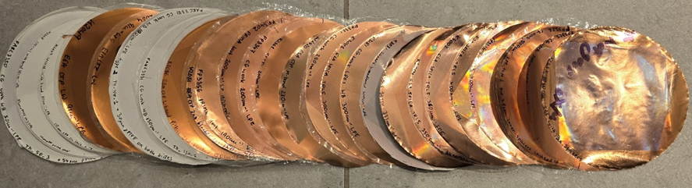
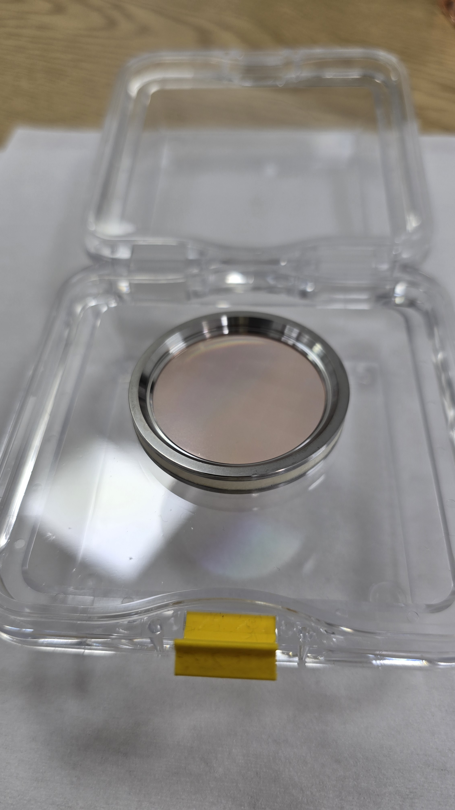

Provided filters for the KID detector array test-beds
Carole Tucker (Celtic Terahertz Technology Ltd and Cardiff University
  Filters provided to the detector test-beds at SRON, JPL and NASA-Goddard ✓
  32 devices delivered under UKSA_ST/Y000250/1 ✓
  A further 16 delivered under UKSA_ ST/Y005465/1 ✓
  Devices developed and delivered for three SRON testbeds. Part commercial contracts through CTT. ✓
Some of the filter prototypes manufactured.
Mounted up versions provided to detector teams

Slide 32
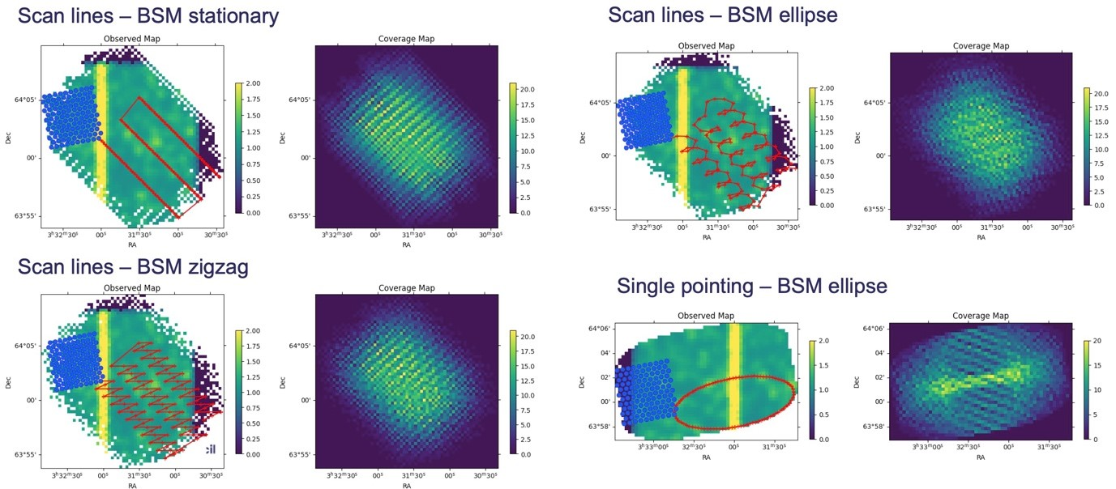
Development of a PRIMAger Observation Simulator
Ed Polehampton, Chris Pearson (RAL Space)
  Production of initial PRIMA observation simulator.
  Incorporate current instrument design to develop and test observing mode strategies and to produce timelines of simulated data.
  Simulator takes into account telescope, instrument parameters and observing modes.

Slide 33
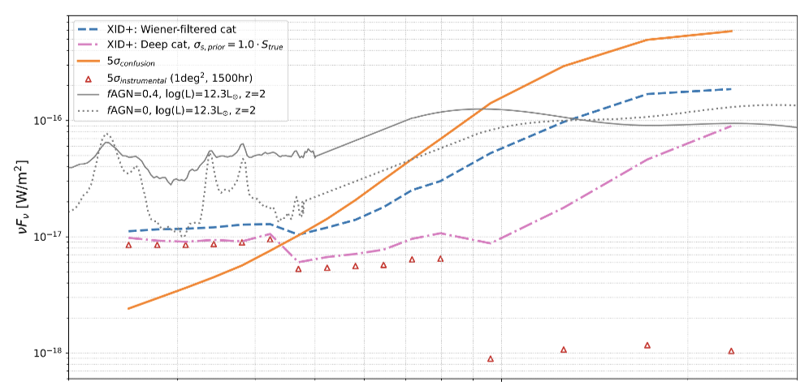
Confusion Mitigation studies
James Donnellan, Longji Bing, Borja Pautasso, Seb Olive (University of Sussex)
Objective (vi) Establish a significant role for the UK in the Ground Segment activities
  High sensitivity of PRIMA creates problems with confusion
  essential to mitigate the confusion noise to be able to reach substantially below the classical confusion limit
  UK-led confusion working group producing simulations and confusion mitigation studies using in-house source detection techniques
Donnellan et al. 2024MNRAS.532.1966
30um
100um
200um

Slide 34
Get involved and help to make PRIMA YOUR telescope!
Please see the PRIMA website
for all this information and
much much more!
https://prima.ipac.caltech.edu/
Join UK mailing list
PRIMA-NEWS-UK@JISCMAIL.AC.UK
Notes:
Please join us to make PRIMA YOUR telescope!

Slide 35
PRIMA has two main instruments: PRIMAger and FIRESS
FIRESS
Bands 1 + 3 overlap, Bands 2 + 4 overlap
2 pointings for full spectrum of a source, though all 4 bands read out.
High-res mode couples all bands when engaged
4 slit-fed grating modules spaced logarithmically with some wavelength overlap.
All detectors in all bands read out simultaneously.
Band 1 and 2 common design and plate scale.
All aluminum, no moving parts.
Parameter | Band 1 | Band 2 | Band 3 | Band 4
Spectral range (µm) | 24–43 | 42–76 | 74–134 | 130–235
Spectral sampling (µm) | 0.23 | 0.41 | 0.73 | 1.29
Resolving power | 95-150 | 85-120 | 90-125 | 95-130
Array format per band | 24 spatial ×84 spectral pix, 900-µm pitch
Pix size on sky (arcsec) | 7.6 |  | 12.7 | 22.9
Pix pitch ratio to B1,2 | - |  | 5:3 | 3:1
Notes:
FIRESS is the spectral powerhouse of PRIMA. There are four bands from 24-235 microns with specs listed below. The figure on the right shows the size and position of the slits relative to the field of view. Bands 1 and 3 and bands 2 and 4 overlap. FIRESS requires 2 pointings for a full spectrum of a source. More information on the “instruments” page of our website.

Slide 36
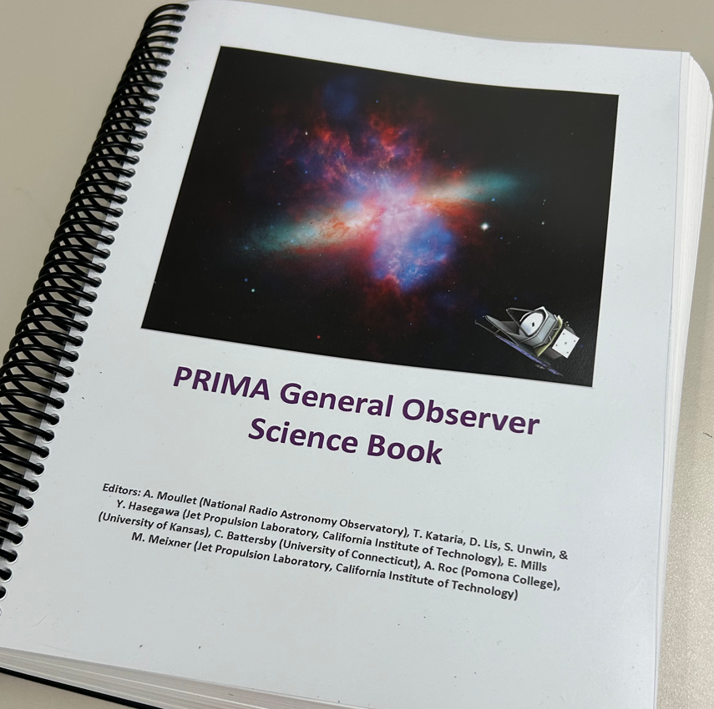
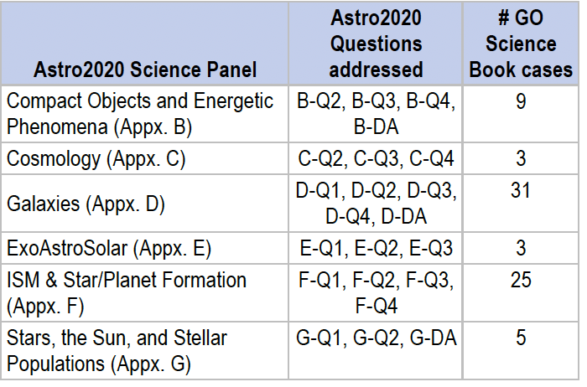
PRIMA GO science Book Volume 1
Volume1 published on ArXiv in November 2023 (arXiv:2310.20572)
Collection of 76 community-contributed cases, spanning scientific areas from comets to high-z polarimetry
Volume 1 totals about ~21,000 h of observations, or about 65% of the expected time available for GO observations.
Approximately use requests for PRIMAger (35% of cases), FIRESS (32%) or both instruments (32%).
Thank you to all case writers!
Notes:
It is SO important for the community to stand up and show how interested and eager they are for PRIMA!

Slide 37
GO science book Volume 2 now in preparation
The PRIMA team asked any member of the international astronomy community to develop and submit case for Volume 2 for May 31, 2025. More than 100 community PRIMA GO cases were received and are currently being edited and compiled into GO science book Volume 2.
We are here to support contributors
Main contacts:
Arielle Moullet (amoullet@nrao.edu),
Denis Burgarella (denis.burgarella@lam.fr)
Moreover, a team of editors + PRIMA team is available for general support
Notes:
Remember, NASA will control the GO program.
Reach out with questions.

Slide 38
Jason Glenn, Principal Investigator, GSFC
Margaret Meixner, Deputy PI, JPL
Matt Bradford, Project Scientist, JPL
Klaus Pontoppidan, Deputy PI, JPL
Alexandra Pope, Science Lead, UMass
Tiffany Kataria, Deputy SL, JPL
Jenn Rocca, Proposal Capture Lead, JPL
Please see the PRIMA website
for a full list of Co-Is
and science affiliates,
all this information and so
much more!
https://prima.ipac.caltech.edu/
Notes:
Introduce PRIMA, tell people to check out the website for everything shared in this talk and much much more!

