Slide 1



Mapping Faraday Rotation in Large Radio Galaxies from POSSUM
S. Venables¹, J.P Leahy¹, C. Anderson², L. Baidoo³
1) Jodrell Bank Centre for Astrophysics, University of Manchester
2) Australian National University
3) Dunlap Institute, University of Toronto

Slide 2
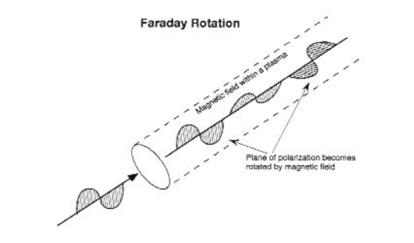
Polarisation of Double Radio Sources
Polarised synchrotron emission of jets
Measure Faraday rotation & depolarisation
Probe IGM and IGrM magnetic fields.
AGN contributions to these.
Study existing patterns:
  Laing-Garrington effect
  RM ‘stripes’
https://www.gb.nrao.edu/GBTopsdocs/primer/faraday_rotation.htm

Slide 3
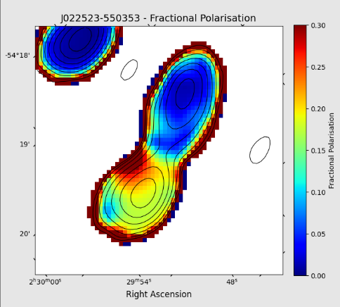
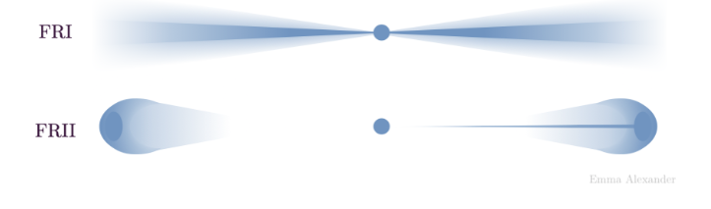

The Laing-Garrington effect
“One-sided” observed jet $→$ relativistic beaming
More polarisation on jet side
E. Alexander, Github: https://emmaalexander.github.io/resources.html

Slide 4
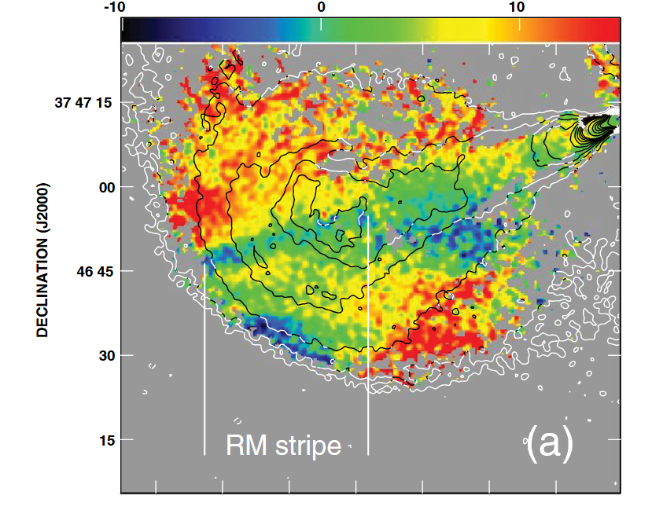
RM stripes
Surface effect of ICM effect?
D. Guidetti et al. (2012)

Slide 5
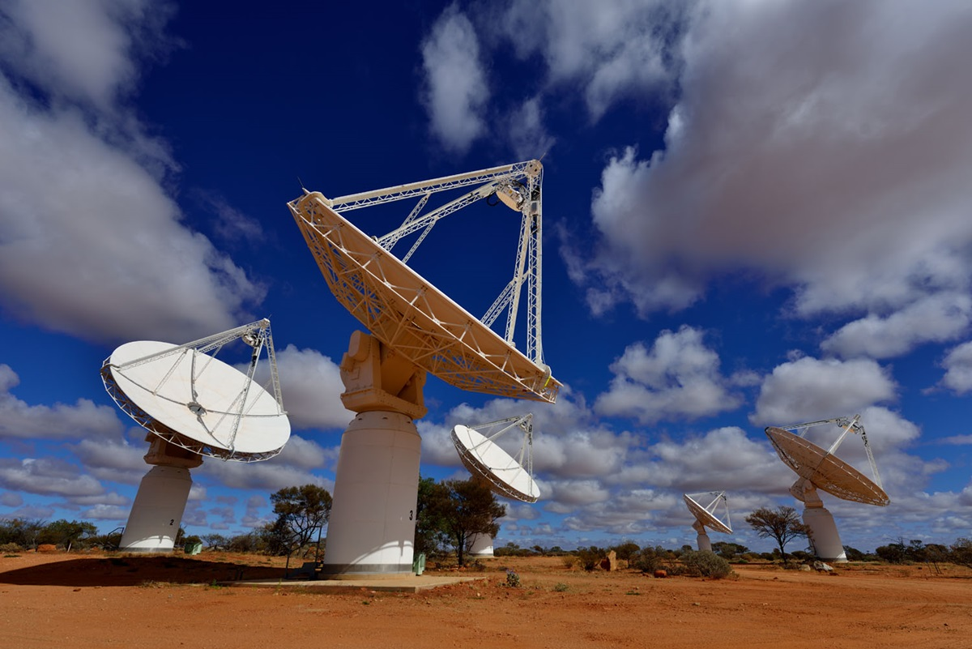
POSSUM
Australian SKA Pathfinder project
50% of sky (southern hemisphere)
30-50 RMs per sq deg
Band 1: 800-1088 MHz
1.5 x 1.5 sq deg single HPX tiles
Resolved sources: 1500 pixels, 1.5’.
Credit: CSIRO
Gaensler et al. (2025)

Slide 6
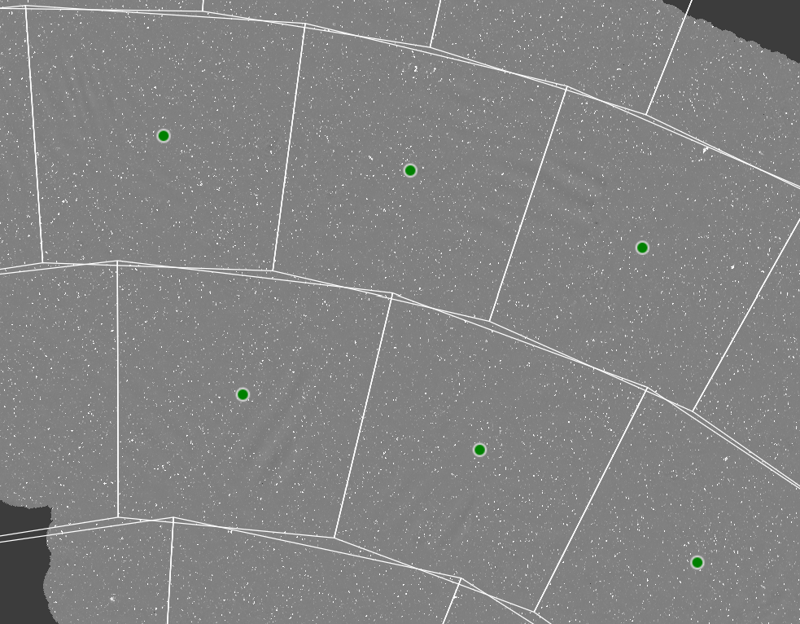
EMUCAT
Evolutionary Map of the Universe – 15” resolution
Value Added Catalogue of EMU sources
EMU field (36 sq deg)
EMUCAT region (70 sq deg)
  Mosaic of overlapping fields
Total POSSUM/EMU area 20,630 sq deg
0307-51
0213-51
0210-51
0244-60
0138-60
Norris et al. (2011, 2021)
Hopkins et al. (2025)

Slide 7
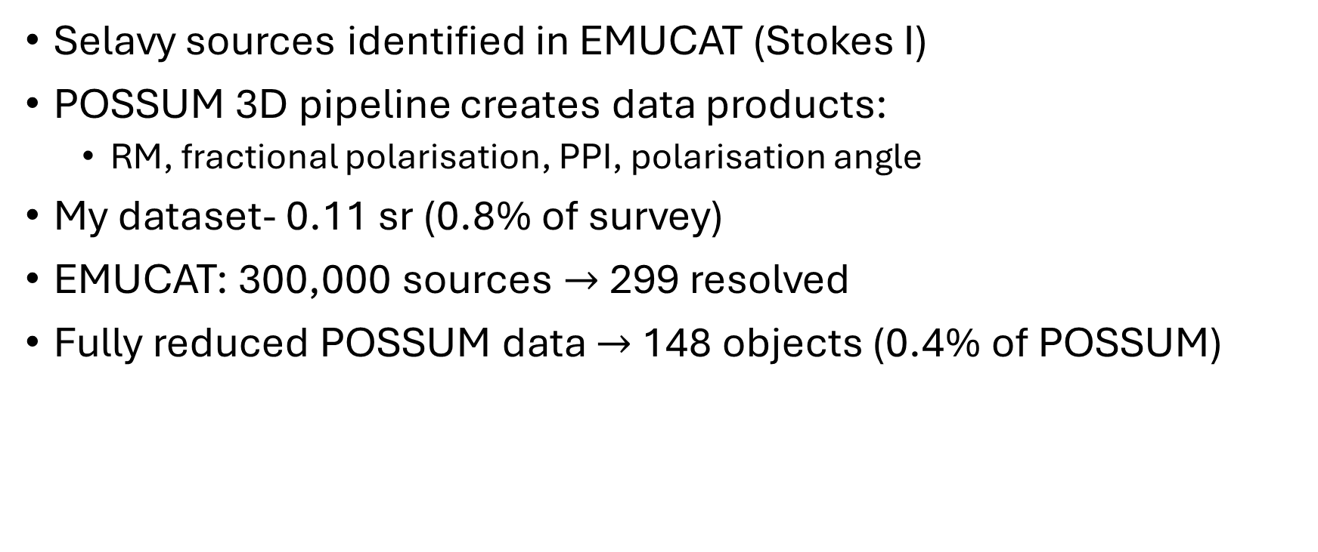
Data
Selavy sources identified in EMUCAT (Stokes I)
POSSUM 3D pipeline creates data products:
  RM, fractional polarisation, PPI, polarisation angle
My dataset- 0.11 sr (0.8% of survey)
EMUCAT: 300,000 sources $→$ 299 resolved
Fully reduced POSSUM data $→$ 148 objects (0.4% of POSSUM)
Selavy – Whiting & Humphreys (2012)

Slide 8
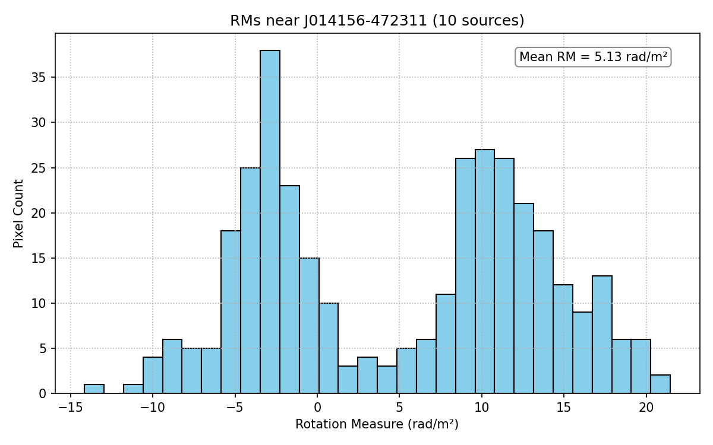
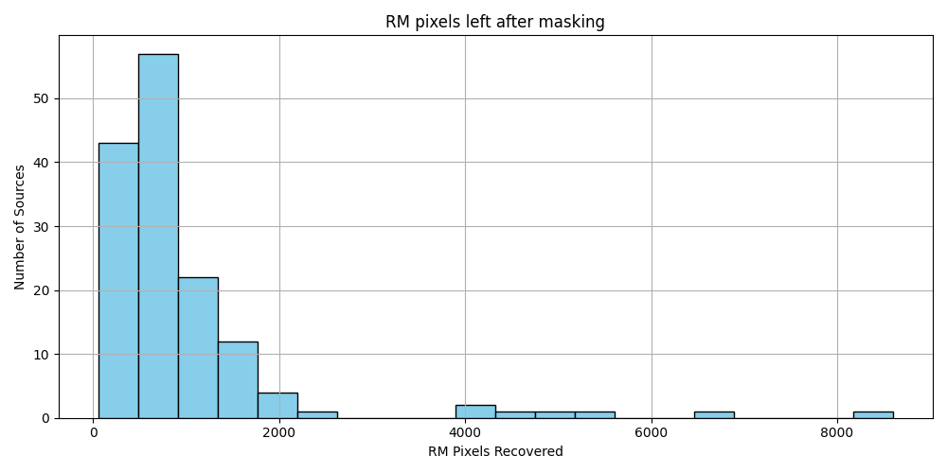
Creating cutouts
Type 1 POSSUM tiles used
Threshold on RM: 5σ above mean total I, PPI SNR > 8 (Vanderwoude et al. 2024)
Foreground subtraction:
  Take average RM of any unresolved source within 0.5 deg
  RMs must have > 3% polarisation and > 5σ above mean total I

Slide 9
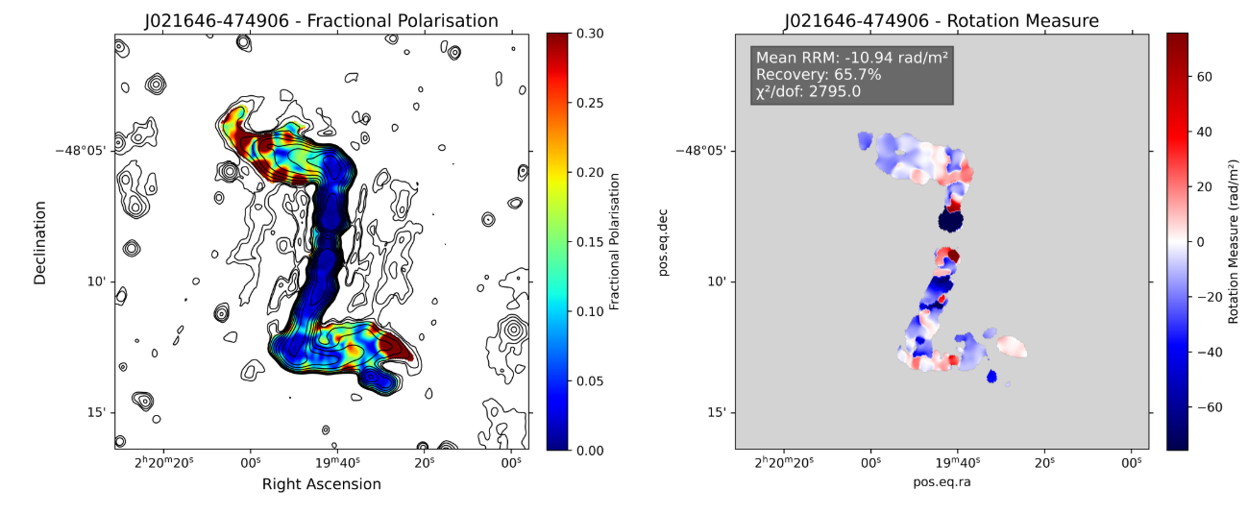
J021646-474906
Weighted mean RM = 2.0 rad/m²,
Background = -10.5 rad/m²
Std dev = 32 rad/m²
IQR = 18 rad/m²
Notes:
Gaussian IQR = 1.3 sig

Slide 10
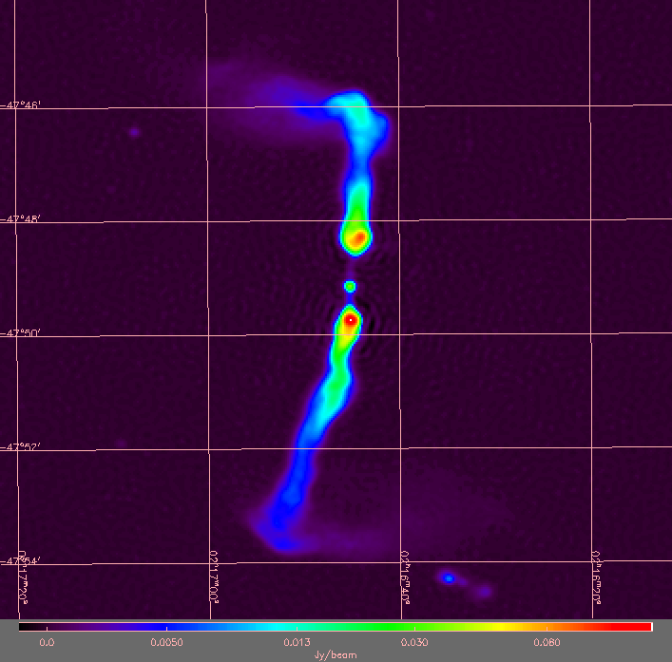
ESO 198-1
z = 0.064271 +/-0.00015

Slide 11
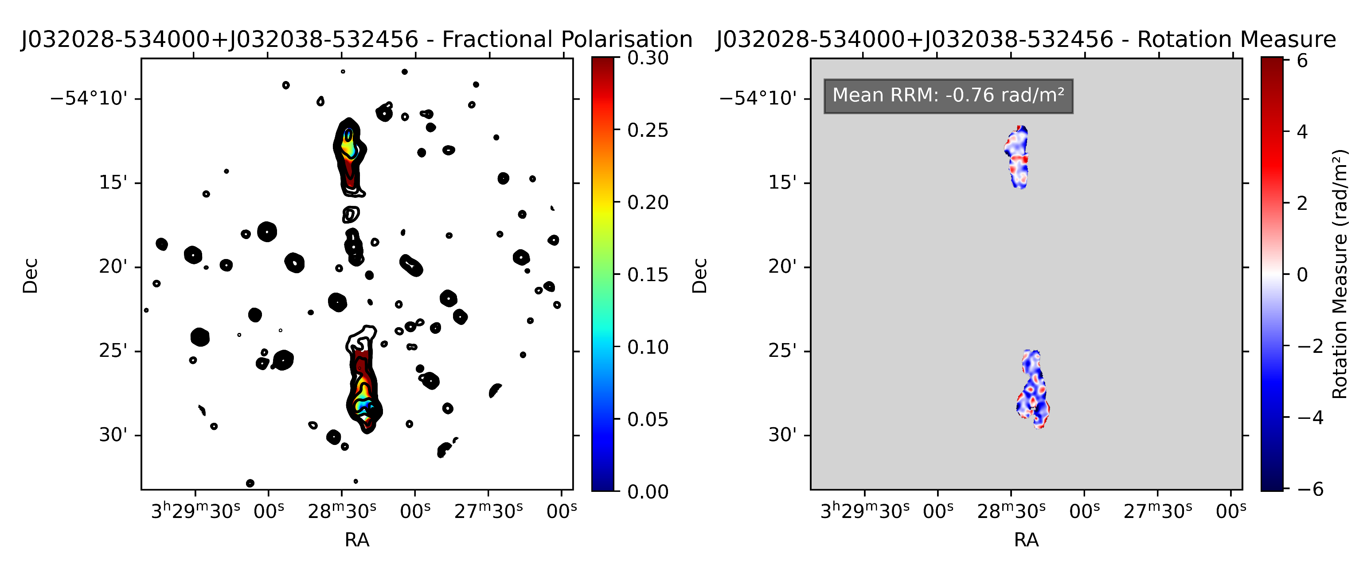
J032028-534000 & J032038-532456

Slide 12
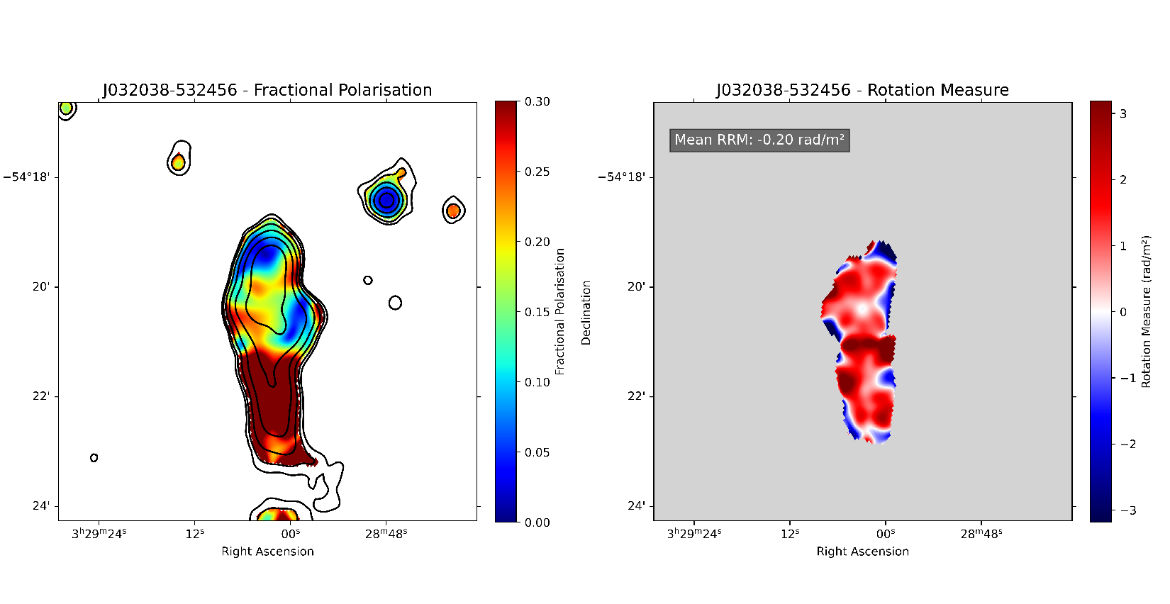
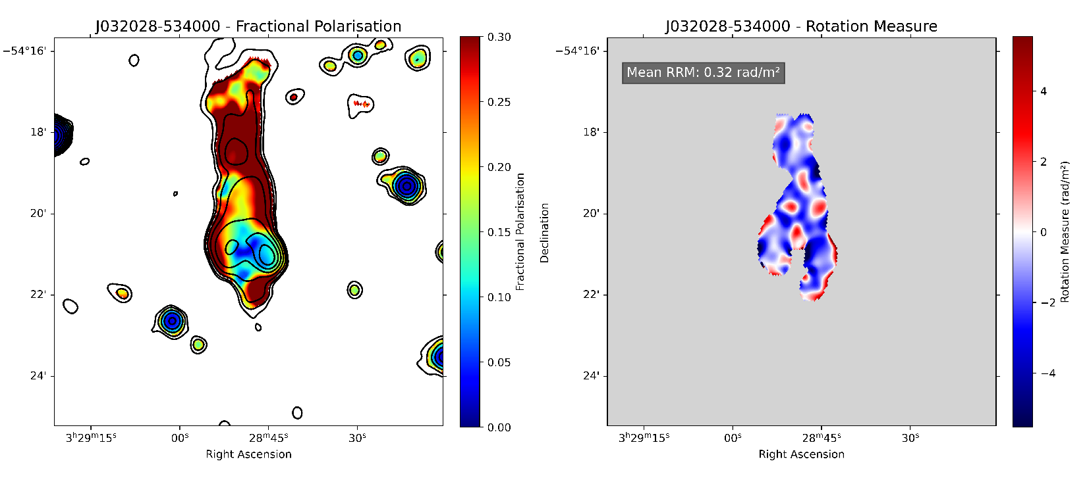
Weighted mean RM = 38.9 rad/m²
Foreground RM = 37.7 rad/m²
Std dev = 6.2 rad/m²
IQR = 1.4 rad/m²
Weighted mean RM = 38.9 rad/m²
Foreground RM = 39.2 rad/m²
Std dev = 2.2 rad/m²
IQR = 1.9 rad/m²

Slide 13
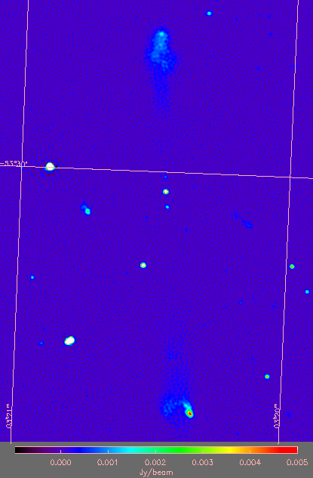
03 20 35.48, -53 30 52
No spec z
Detected in J, K 2MASS, WISE, SUMSS
20 mag
DESI photo z = 2.5
Estimate around 4.7 Mpc

Slide 14
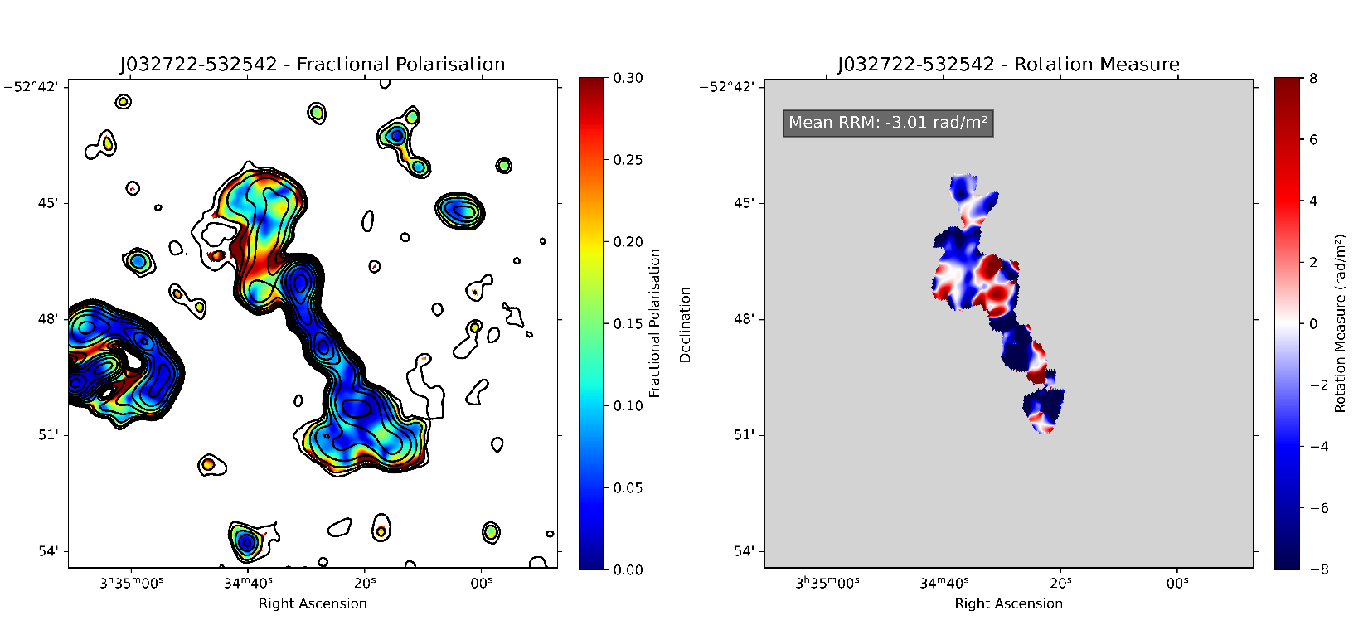
J032722-532542
Weighted mean RM = 26.0 rad/m²
Foreground RM = 26.1 rad/m²
Std dev = 8.4 rad/m²
IQR = 8.3 rad/m²

Slide 15
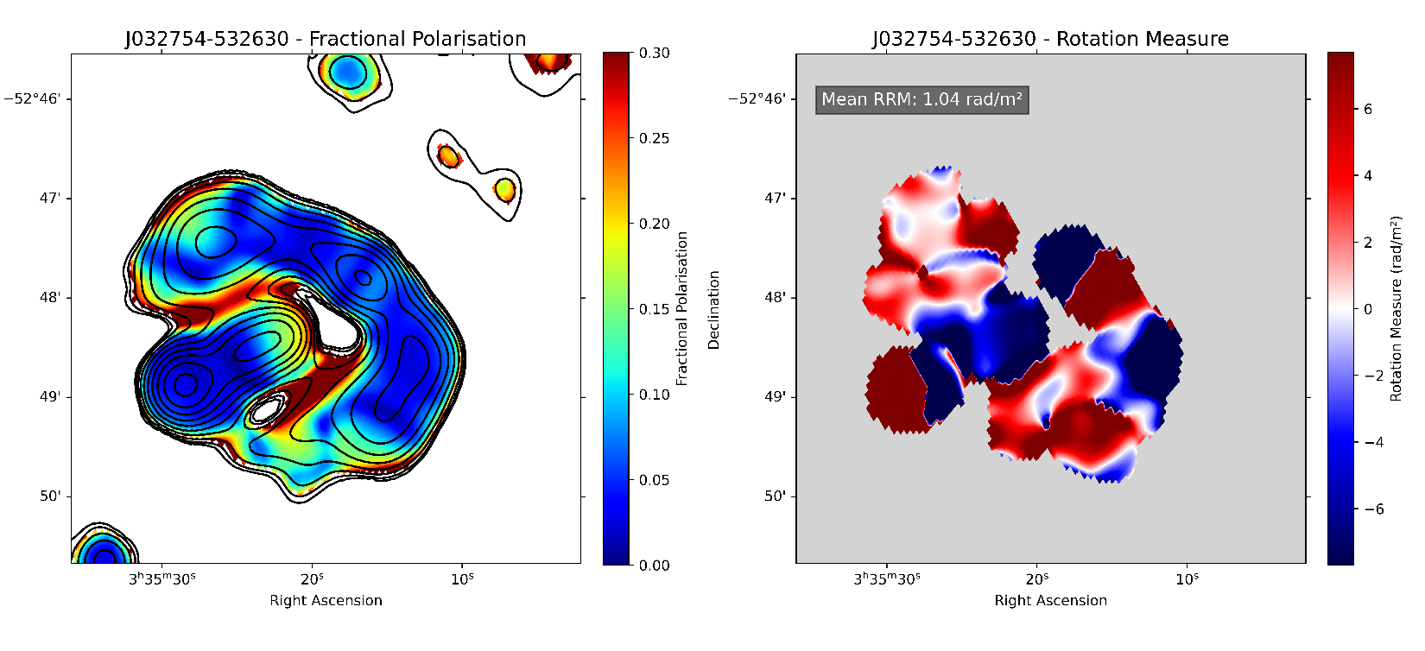
J032754-532630
Weighted mean RM = 26.1 rad/m²
Foreground RM = 25.7 rad/m²
Std dev = 9.0 rad/m²
IQR = 8.2 rad/m²

Slide 16
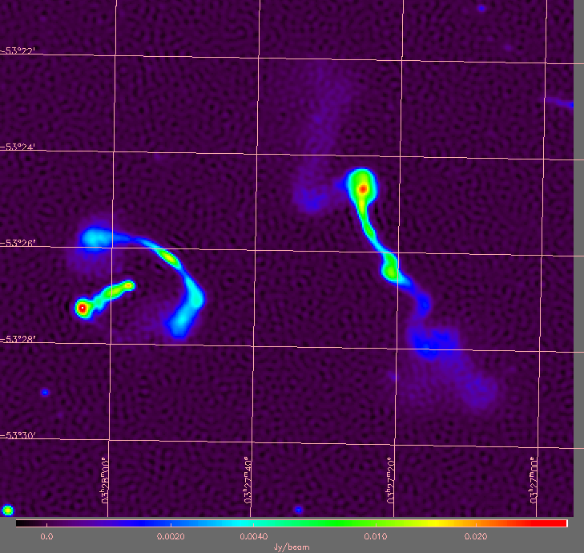

Slide 17
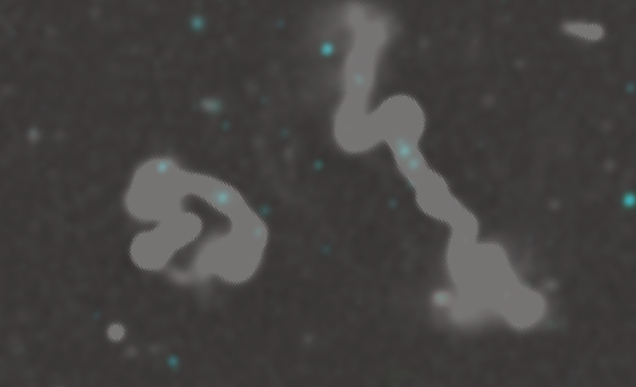
EMUCAT Aladdin with ALLWISE overlay
2MASX J03273115-5323399
0.064575 ± 3.34e-4
2MASS J03272477-5325176
z = 0.062281
2MASX J03272353-5325348
z = 0.064171 ± 1.87e-4
2MASX J03275206-5326099
z= 0.059191 ± 1.03e-4

Slide 18
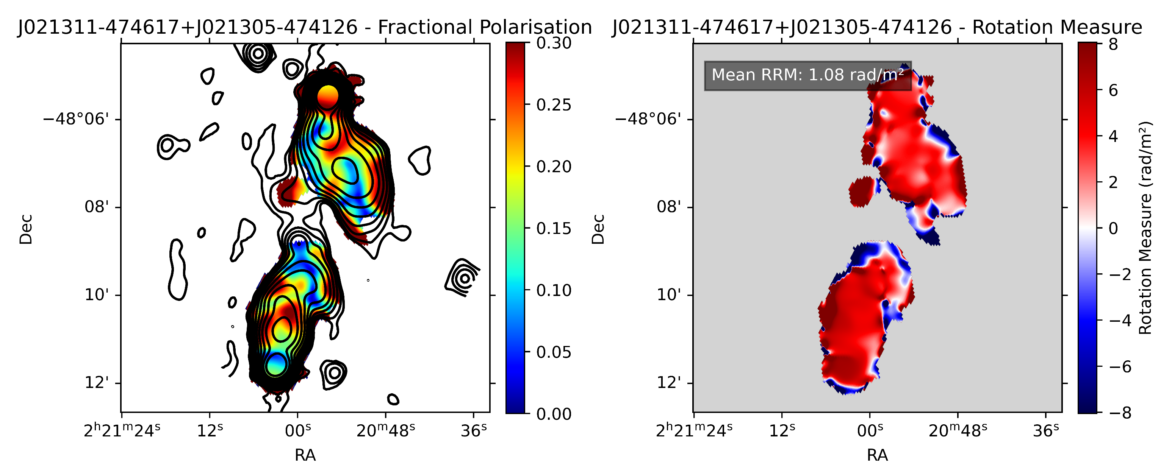
J021305-474126 & J021311-474617
Weighted mean RM = 7 rad/ m²
Std dev = 3.0 rad/ m²
IQR = 4 rad/ m²

Slide 19
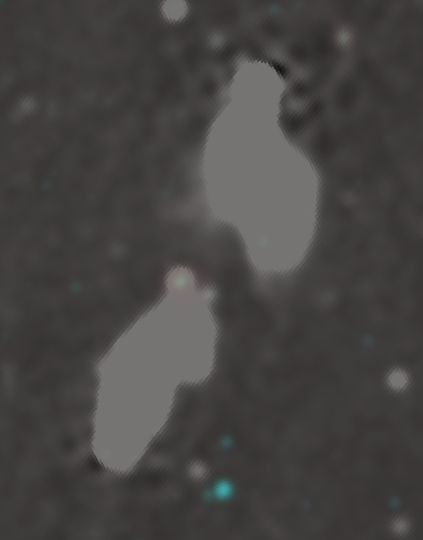
PKS 0211-479, z = 0.22
EMUCAT Aladdin with ALLWISE overlay

Slide 20
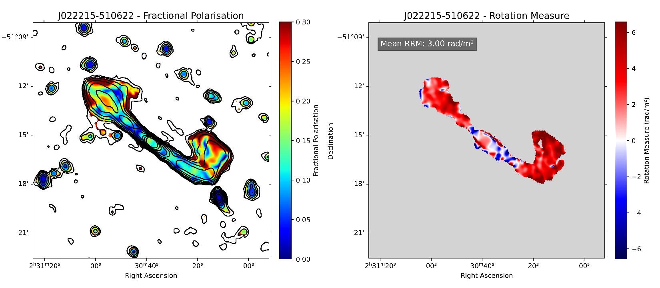
J022215-510622
Weighted RM mean = 21.1 rad/m²
Foreground RM = 19.8 rad/m²
Std dev = 2.5 rad/ m²
IQR = 2.8 rad/ m²

Slide 21
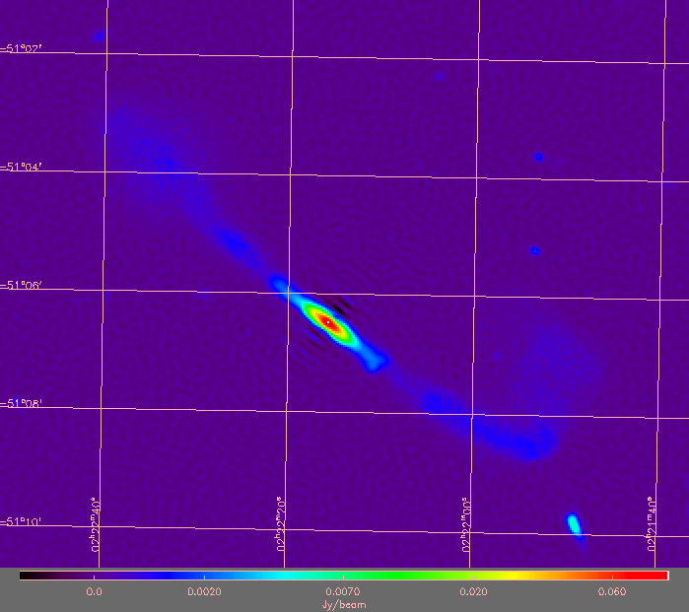
ESO 198-8,BClG
z= 0.048645 +/- 0.000037

Slide 22
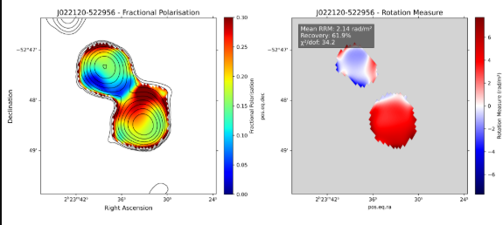
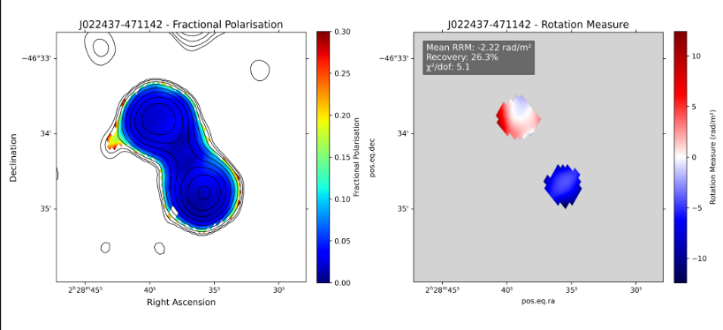
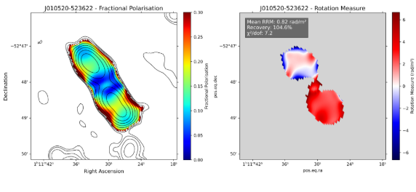
One Lobe variation

Slide 23
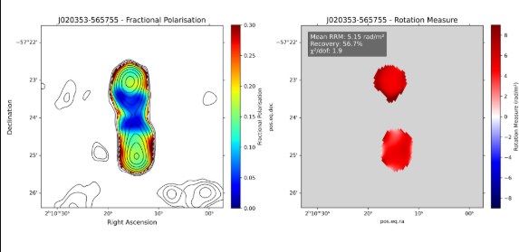
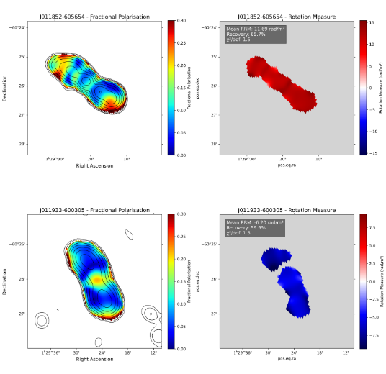
No significant variation

Slide 24
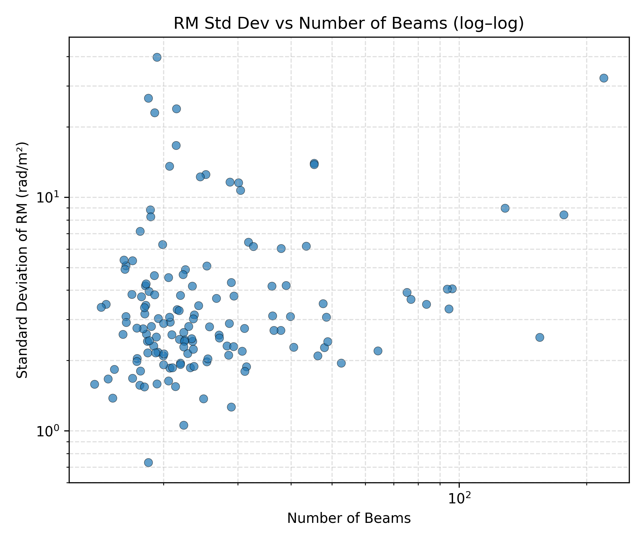
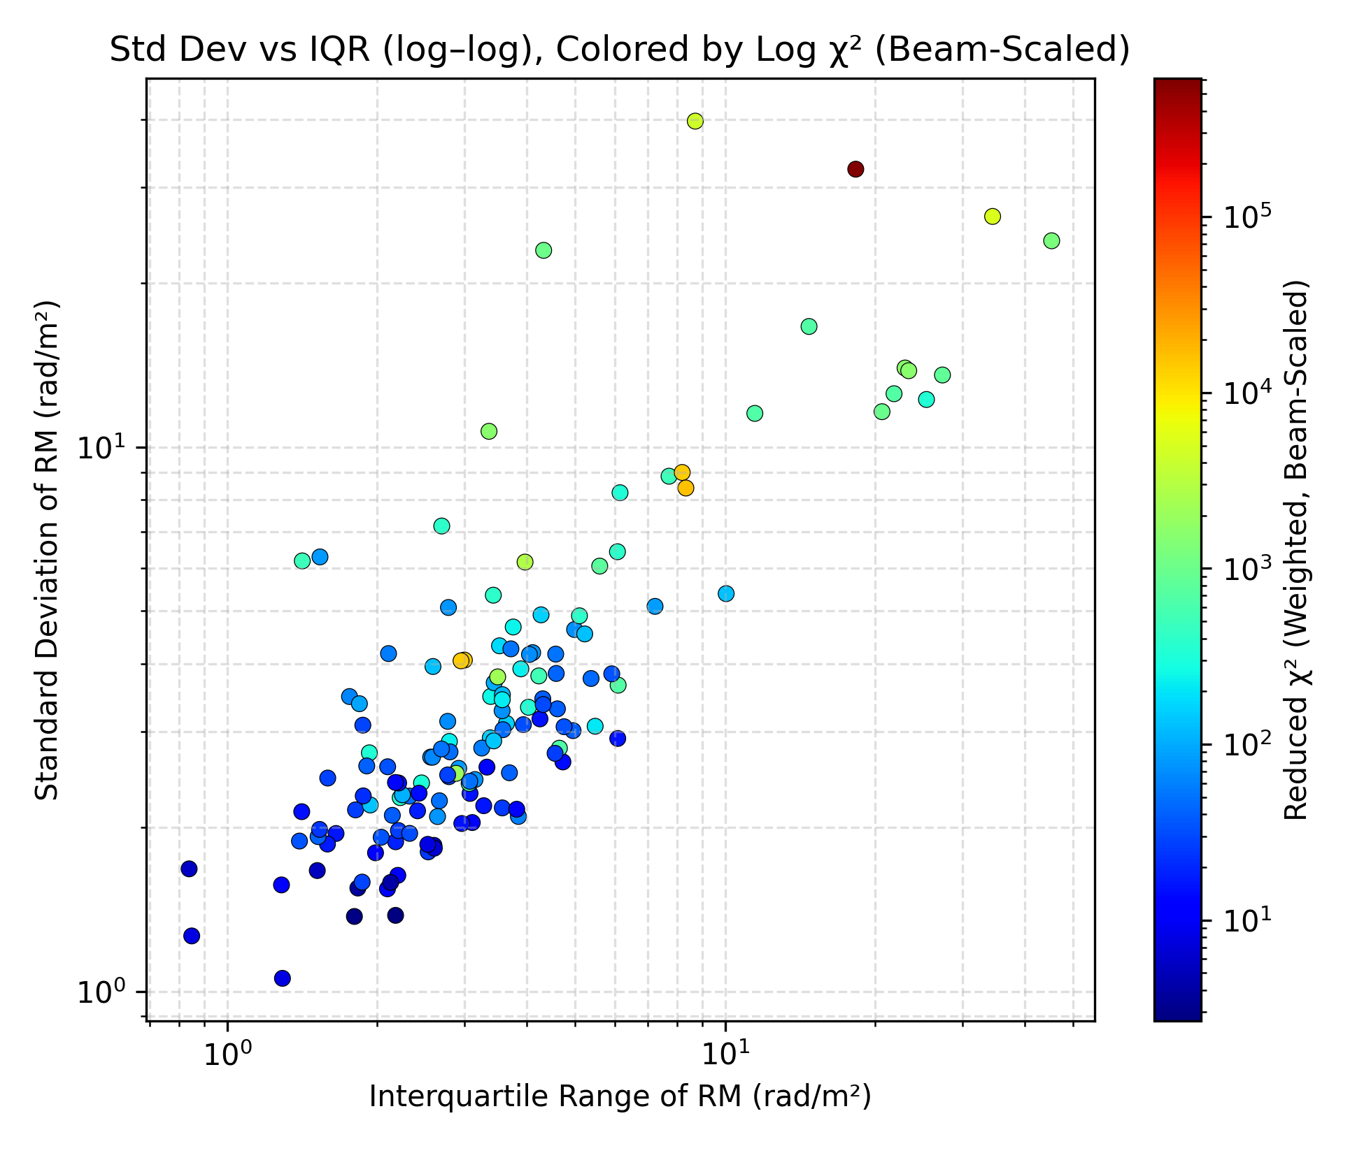
66 objects show significant RM variation at 3$σ$ threshold

Slide 25
What’s next for me?
Initial results: Large number of objects with statistically significant variation in RM.
How do RM fluctuations vary from lobe to lobe?
Depolarisation ratio estimates.
What’s next for POSSUM
Next generation of tiles
Band 2 – better depolarisation estimates
Rest of survey (99.6%)

Slide 26
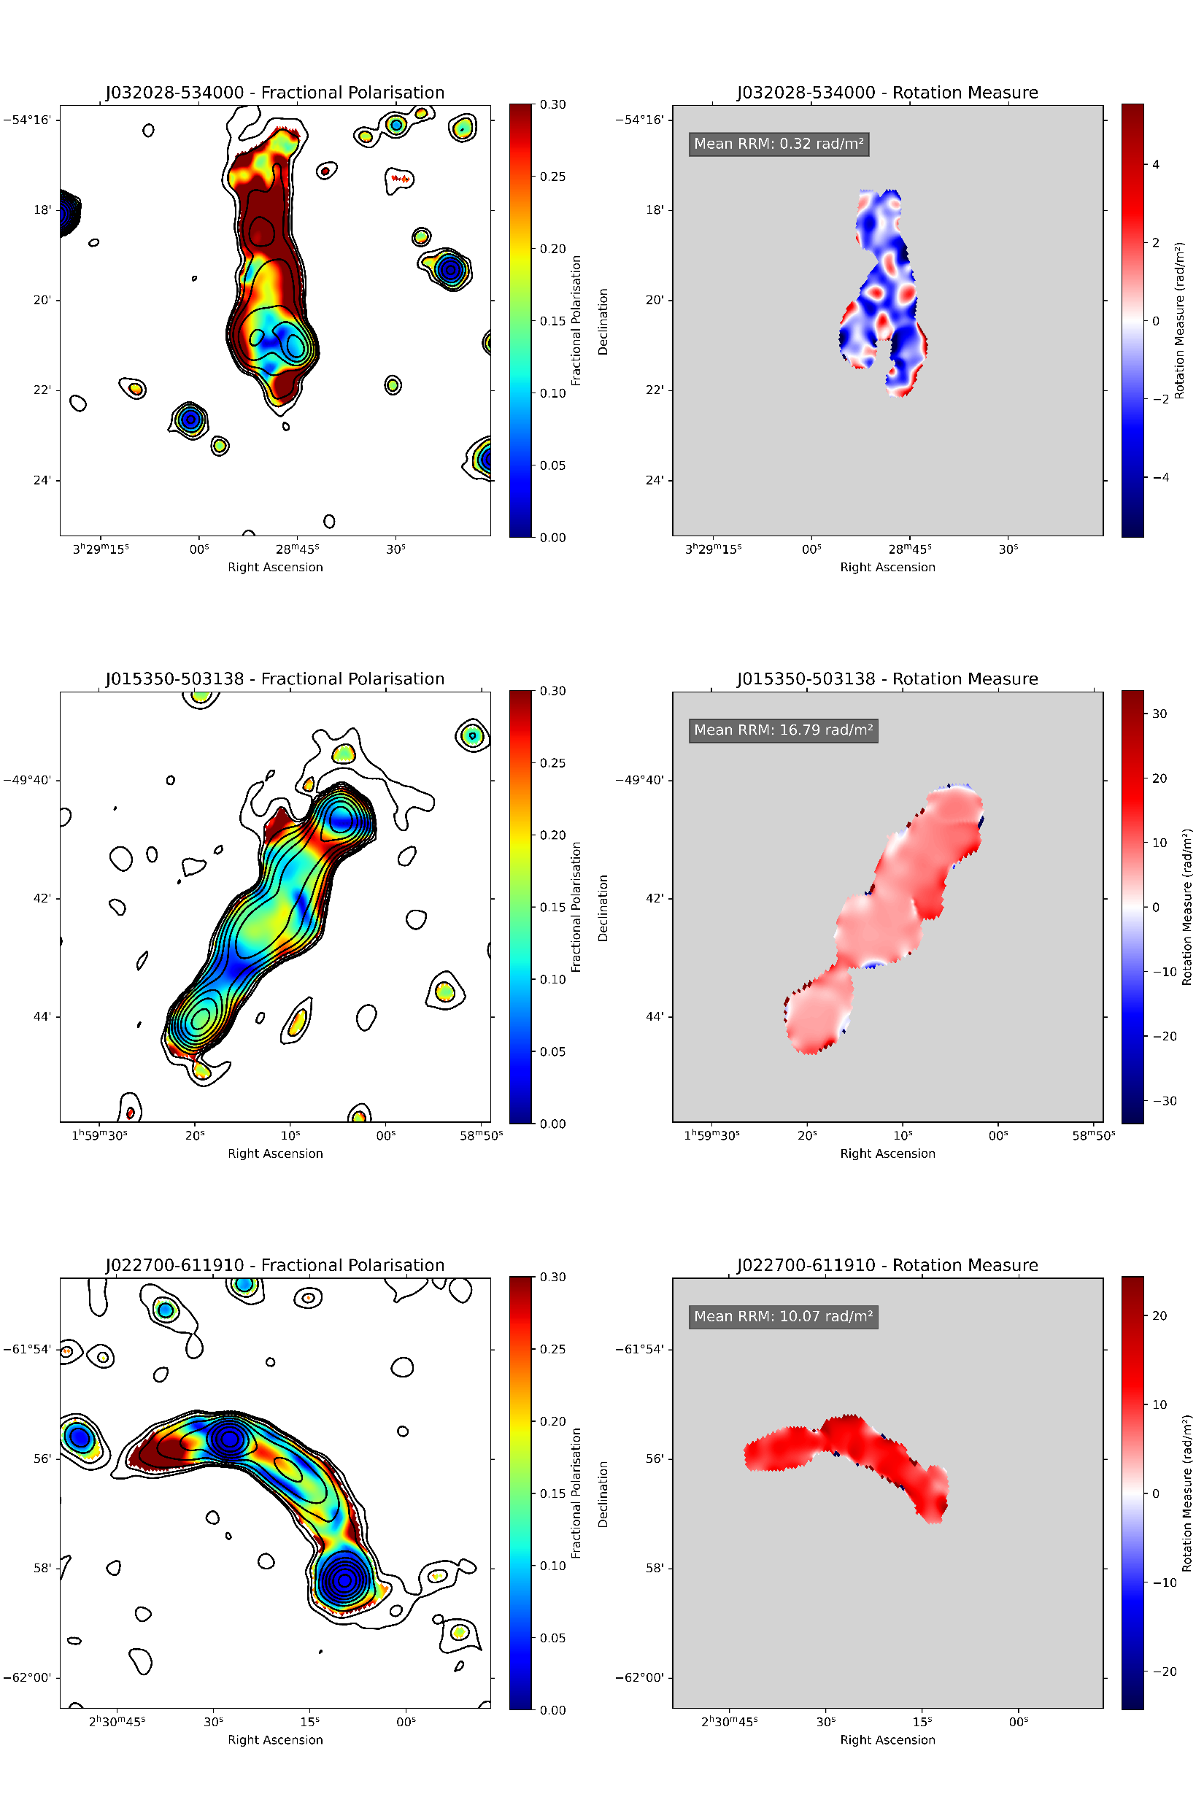
J022700-611910

Slide 27

LEDA 127941, z = 0.077724
LEDA 356222, z = 0.076416
SUMSS J022649-612044 (BL LAC)

Slide 28
J015350-503138

Slide 29
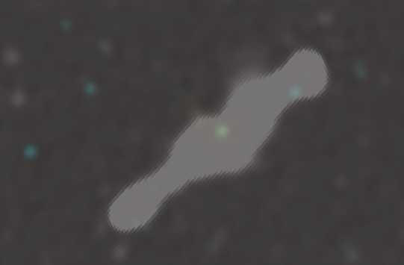
PKS 0151-507,
z = 0.105193 +/- 0.000030

Slide 30
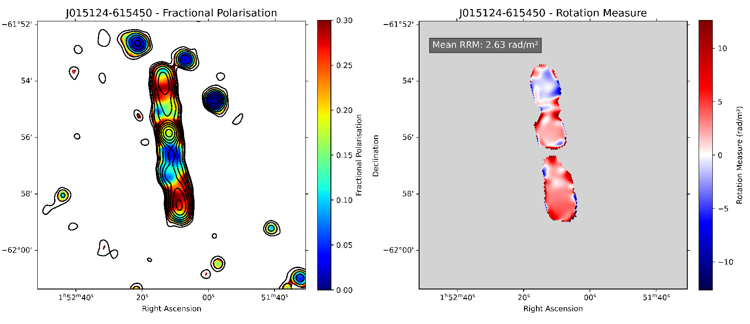
J015124-615450

Slide 31
