Slide 1



Black hole and galaxy co-evolution via merger-free processes
Bar-driven fuelling of AGN
Izzy Garland
@izgarland.bsky.social
garland@mail.muni.cz
(they/them)
9 July 2025
NAM-Durham

Slide 2
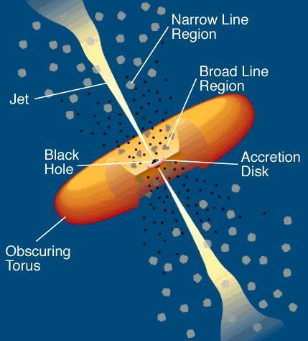
An active galactic nucleus is a rapidly growing supermassive black hole.
2
Urry & Padovani (1995)

Slide 3
M_{BH} correlates with bulge stellar mass which, in ellipticals, is equivalent to total stellar mass.
10¹⁰
10⁹
10⁸
M_{BH} [M⦿]
10⁷
10⁶
10⁵
10⁸
10⁹
10¹⁰
10¹¹
10¹²
10¹³
M_{bulge} [M⦿]
3
Häring & Rix (2004)

Slide 4
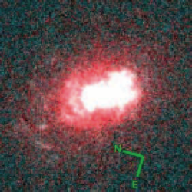
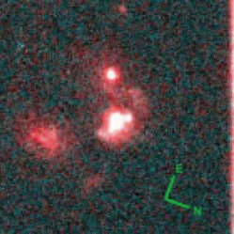
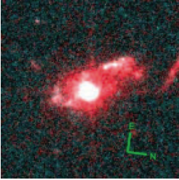
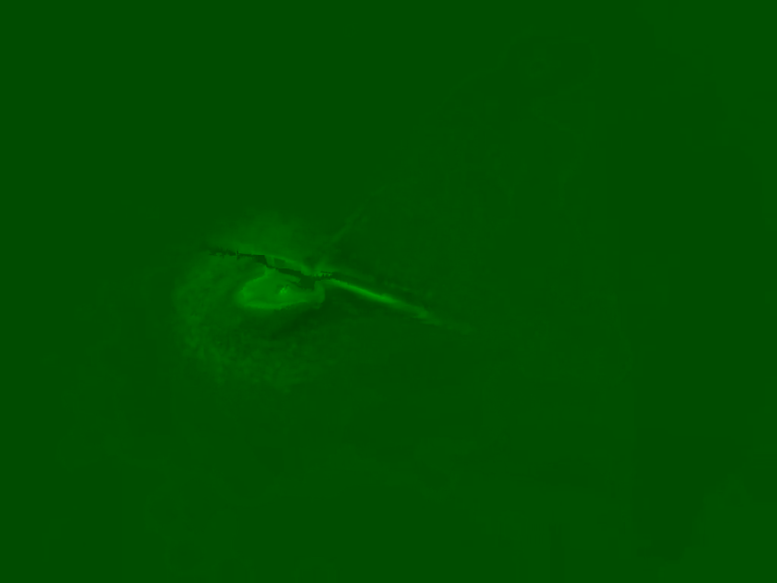
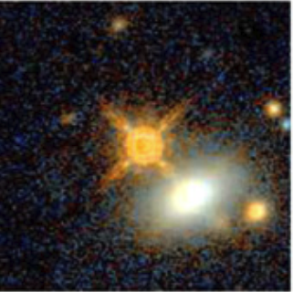
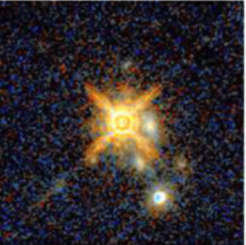
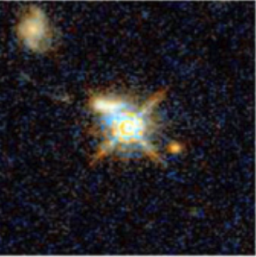
Mergers are one cause of co-evolution.
V. Springel / MPIA
Urrutia+08
Glikman+15
4

Slide 5
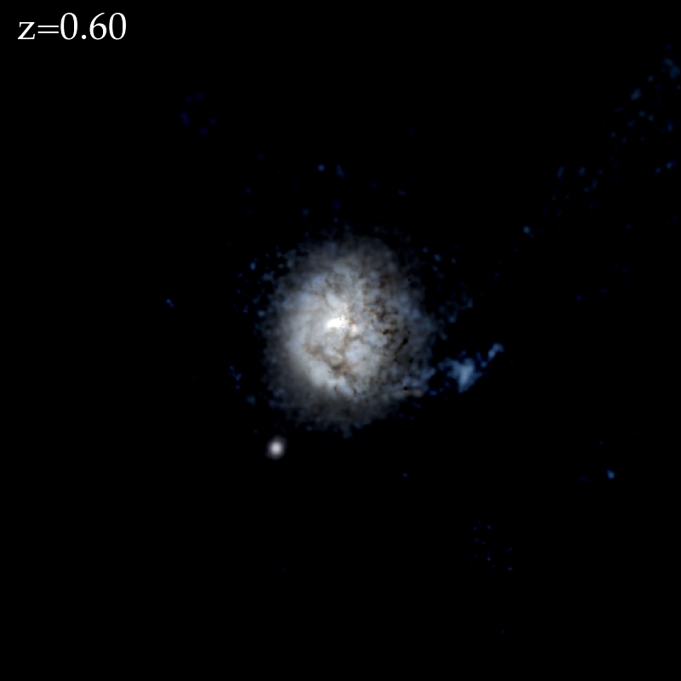
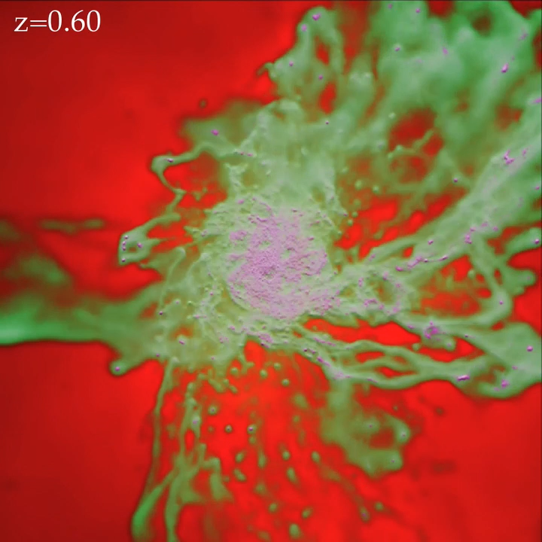
Disk-dominated galaxies have merger free histories.
5
FIRE Simulations

Slide 6
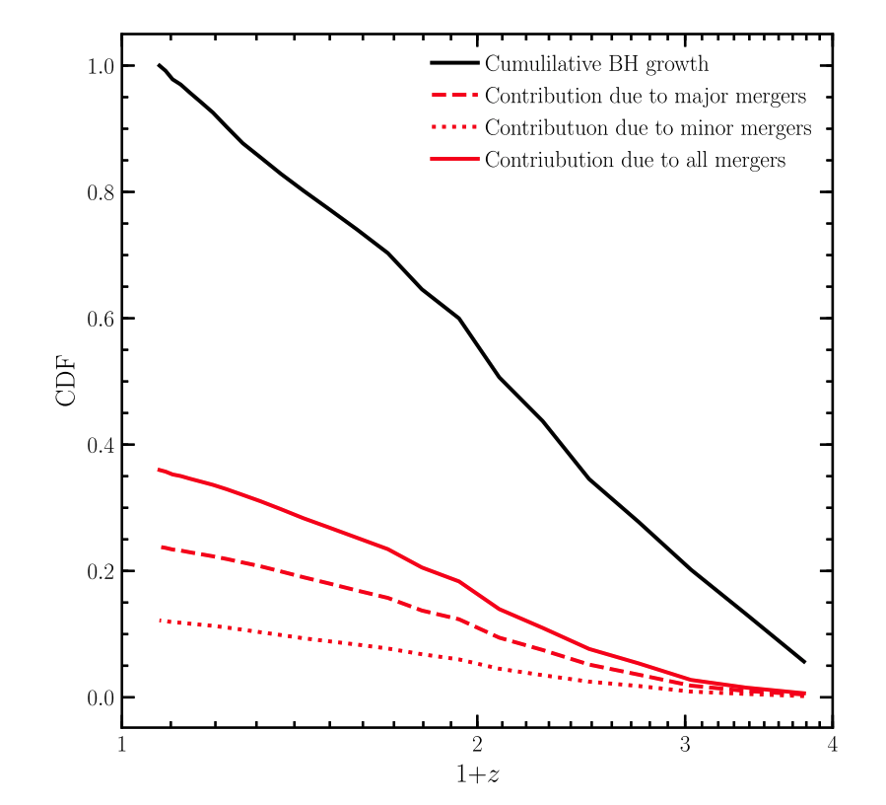
Most SMBH growth occurs via merger-free mechanisms.
1.0
0.8
All
0.6
Cumulative Black Hole Growth
Mergers only
0.4
0.2
0.0
1
2
3
4
1 + z
6
Martin+18

Slide 7
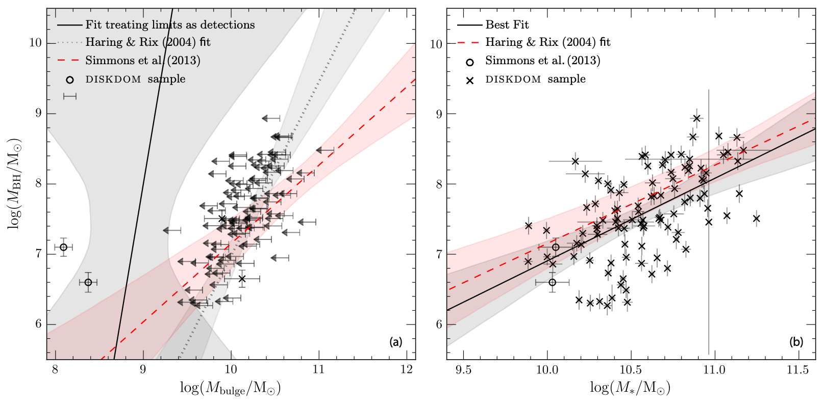
Merger-free growth is consistent with merger-driven growth.
7
Simmons, Smethurst & Lintott (2017)

Slide 8
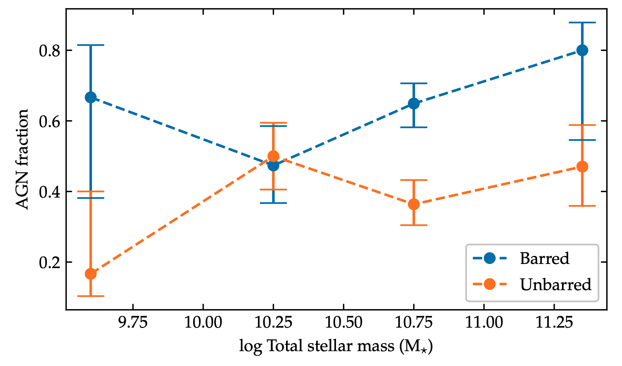
Contention in previous studies looking at AGN-bar link
8
Silva-Lima+22

Slide 9
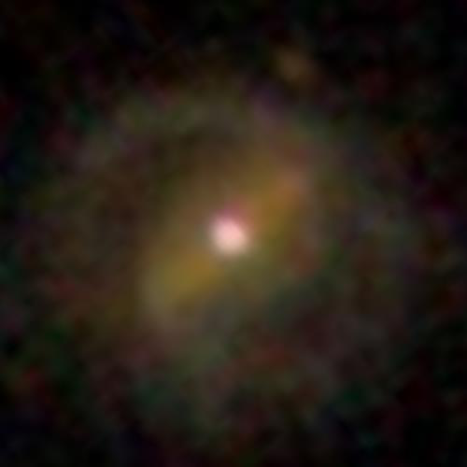
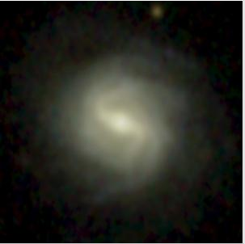
AGN host bar fraction: 59 ± 8 %
Inactive bar fraction: 44 ± 8 %
9
Garland+23

Slide 10
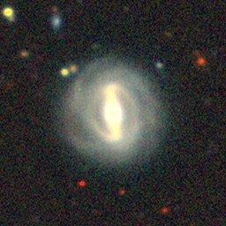
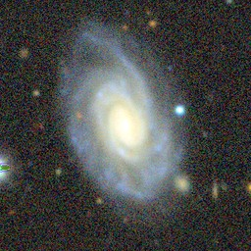
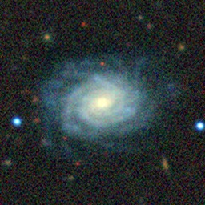
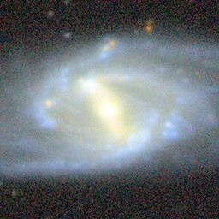
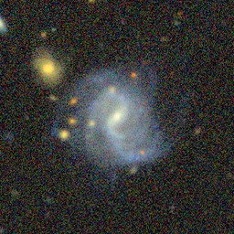
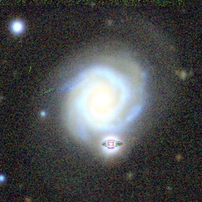
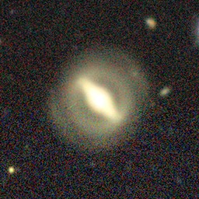
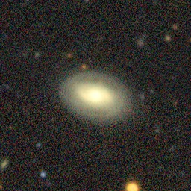
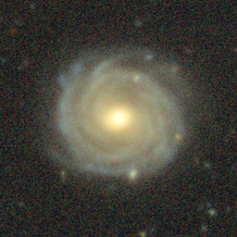
GZ DESI contains 3.8k AGN and 57.4k inactive galaxies in our volume limited sample.
Strong
Weak
None
AGN
Star-forming
Undetermined
Walmsley,…,Garland+23
Garland+24
10

Slide 11
Strongly barred galaxies most likely to host AGN
11
Garland+24

Slide 12

Strongly barred galaxies most likely to host AGN
11
Garland+24

Slide 13
We control for bulge prominence, and compare the AGN fractions to previous results
Stellar mass & colour controlled only
Stellar mass, colour & bulge controlled
12
Garland+ (in prep.)

Slide 14
The AGN fraction increases with both bulge prominence and bar strength
13
Garland+ (in prep.)

Slide 15
Take home points
Merger-free BH growth is poorly understood.
Strongly barred galaxies more likely to host an AGN than weakly barred, which are in turn more likely than unbarred
@izgarland.bsky.social
garland@mail.muni.cz
Izzy Garland

