Slide 1



Gaia’s view on the assembly of the Milky Way
Emma Dodd
Email: emma.l.dodd@durham.ac.uk
NAM Gaia NIR 10th July 2025

Slide 2
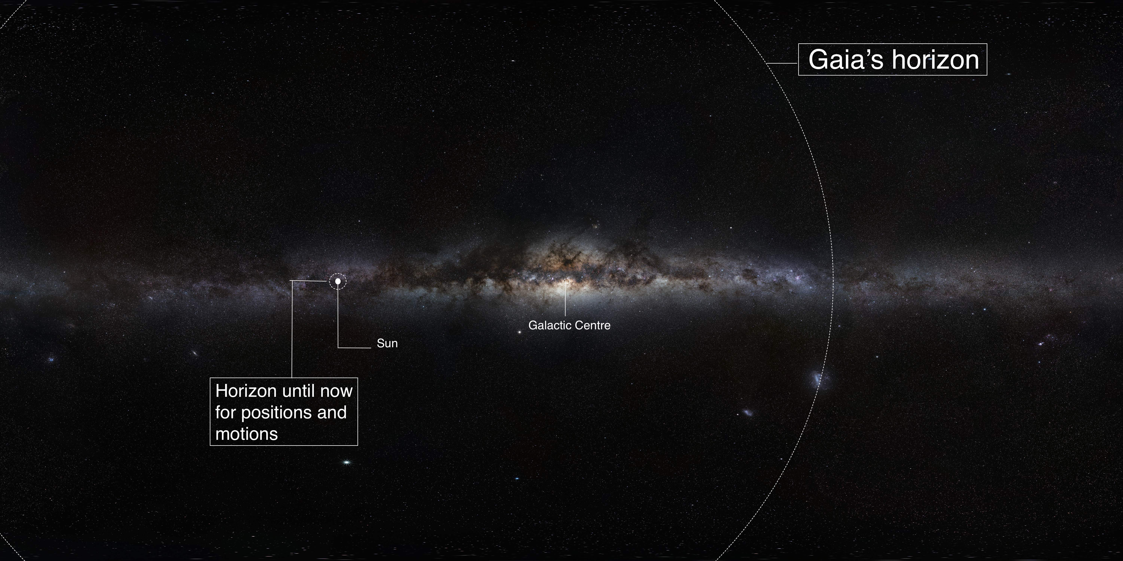
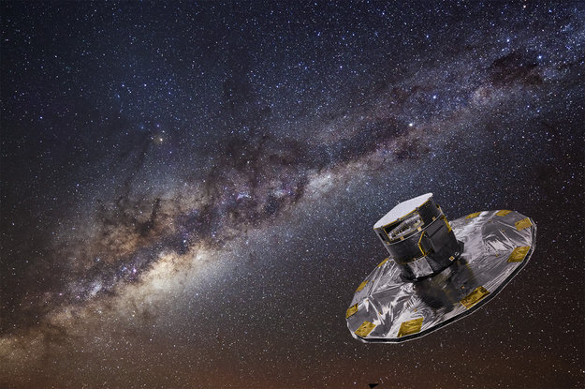
The Gaia revolution
(1 km/s proper motions)
(before 2013)
Gaia (10,000x more objects than predecessor); 100,000x bigger volume; 100x more precise
Gaia fully public data releases of nearly 2 billion stars – revolutionary!
Notes:
To give you a feeling of how a dramatic leap Gaia data provides, what we knew about the motions of stars in our Galaxy was until the launch of Gaia very much restricted to the small sphere. With Gaia we observed many more objects, through a representative volume of the MW, and 100x more precise. This is why Gaia is revolutionary and breaking walls and truly changing the field.

Slide 3
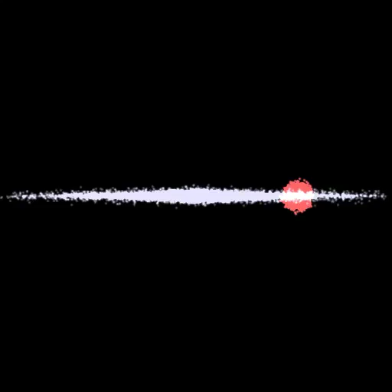
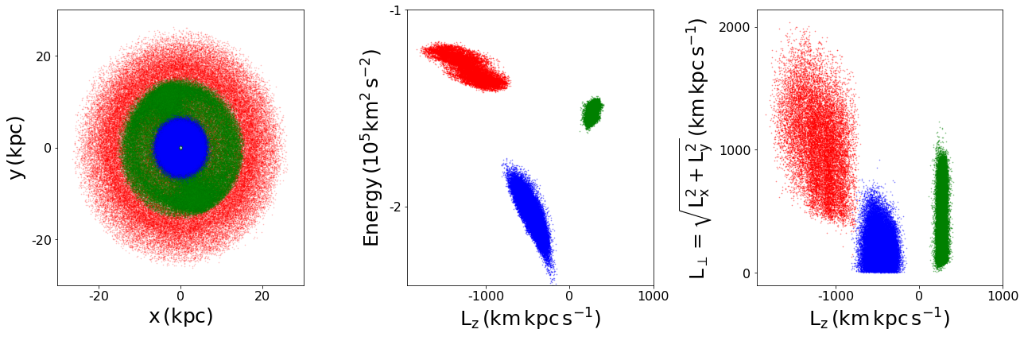
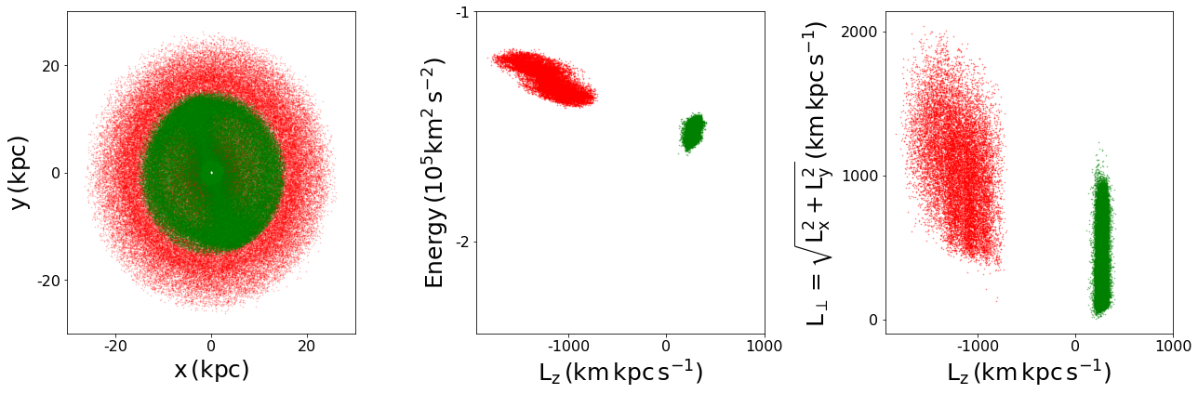
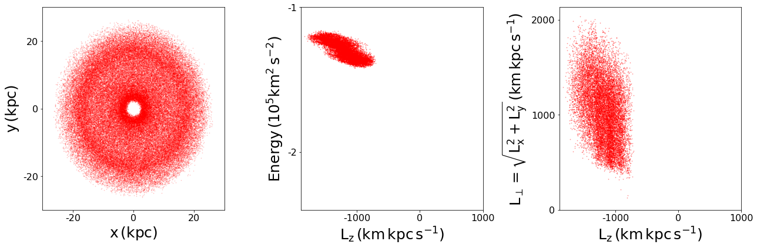
How do we find merger debris?
Sattellite galaxies debris after 10 Gyr disrupting in a static Milky Way like potential:
Integrals of Motion space:
Need 6D information – available for local samples with Gaia
Phase mixed merger debris. Credit: Maarten Breddels
& Amina Helmi, Kapteyn Astronomical Institute.
Adapted from Helmi et al. (2000)
Notes:
In reality more complex than this picture but to first order these cosnevrations hold

Slide 4
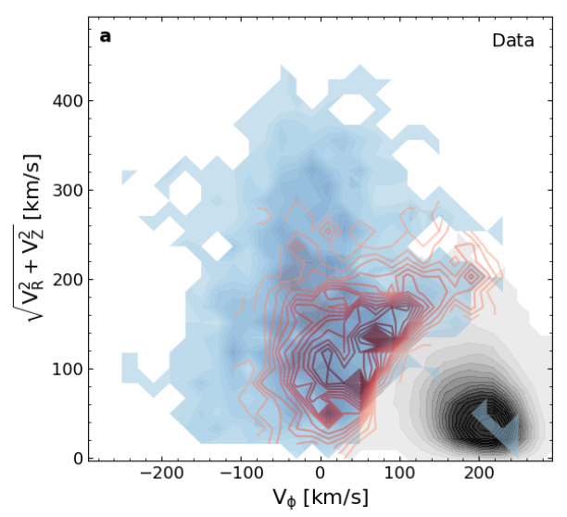
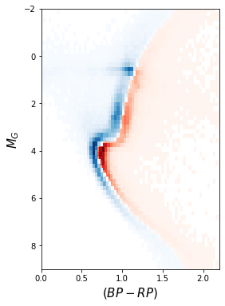
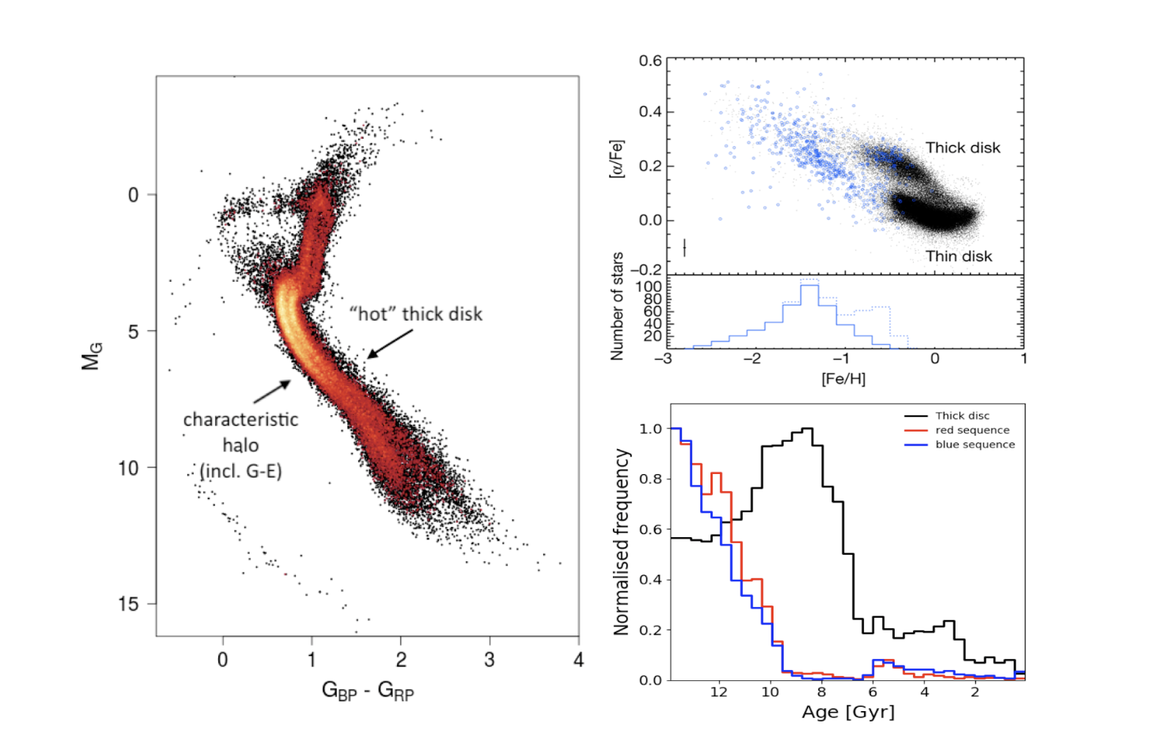
Gaia DR2: halo near the Sun
How do we characterise merger debris?
Tools of Galactic archaeology
motions → reveal site of origin
Dynamics
chemical composition → birth environment
ages → time of birth
Stellar populations
Ages
Chemistry
BS
BS
RS
thick disk
RS
Distinct chemical abundance track of blue sequence stars
Gallart et al. (2019)
Gallart et al. (2019)
Helmi et al. (2018)
Gaia Enceladus –
the last major merger
Belokurov et al. 2018,
Helmi et al. 2018
Colour-magnitude diagram of local halo stars (right), two sequences which also differ in their motions (left)
Notes:
Dynamics
Separate the halo, search for clumps/overdensities

Slide 5
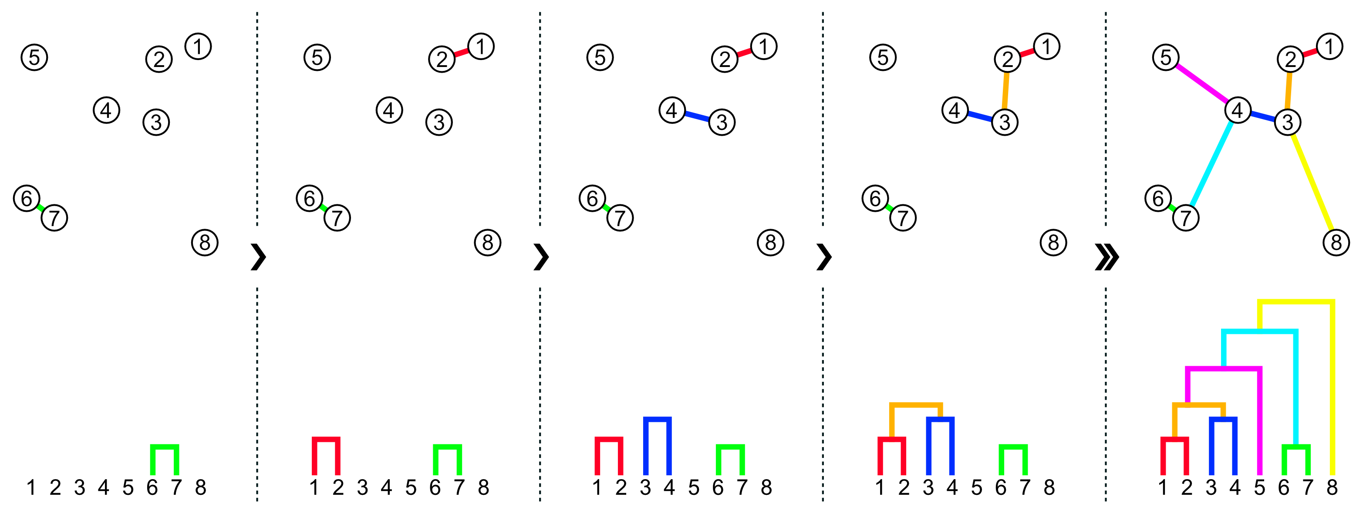
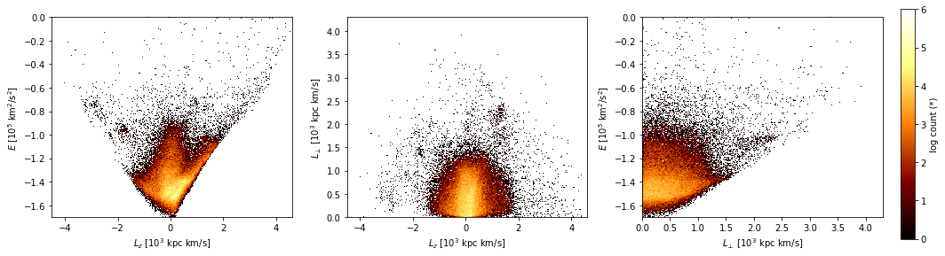
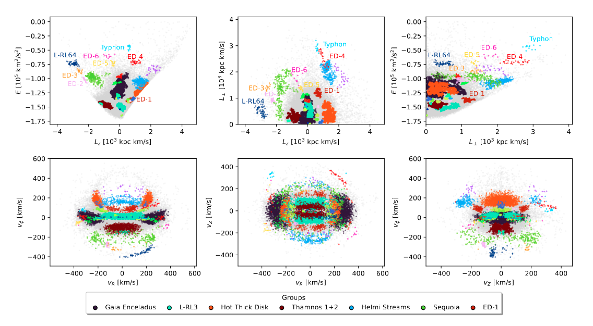
Local halo substructure with Gaia DR3
Clustering in IoM space (Lövdal et al. 2022, Ruiz-Lara et al. 2022, Dodd et al. 2023)
Dodd et al. 2023
Local halo where we have 6D information
Select halo stars kinematically
70,000 stars after quality cuts
Single-linkage algorithm, clusters are built hierarchically using distances between stars
every star is in a cluster
use significance to determine where to stop linkage
3D integrals of motion space of our halo sample
Typhon (Tenachi et al. 2022), L-RL64 (Lövdal et al. 2022, Ruiz-Lara et al. 2022)
Notes:
Our halo sample consists of a 2.5 kpc volume around the sun, a volume in which we can trust inverting the Gaia parallaxes to get the distances. This is shown by the dashed circles in the two plos here which are a birds eye and edge on view of our Milky Way.
We select the stars in Gaia EDR3 within this volume that have a error on the parallaz <= 20% (most are much less than 20% in this volume) . We select the stars that have 6D phase space – gaia radial velocity. And we extend the sample with ground bsed spectroscopic surveys to have more stars with 6D phase space.
We make some quality selctions vlos err < 20 km/s, ruwe<1.4,

Slide 6
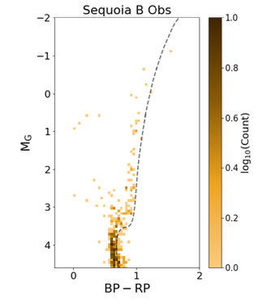
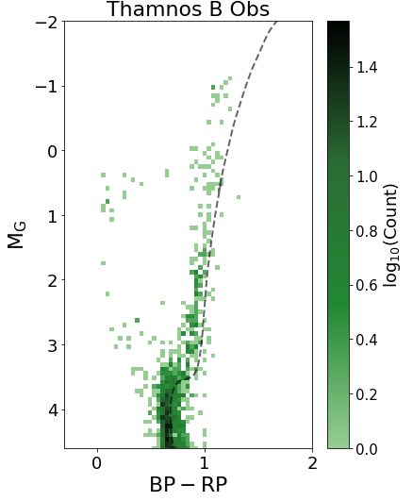
Characterising building blocks
Sequoia & Thamnos
Smaller objects (Sequoia), too few bright stars with 6D info → 5D dataset (no v_{los})
Select in pseudo-velocity space (assuming v_{los} = 0) and then clean samples
Increase in number of stars by > factor of 2
6D possible for larger objects (e.g. GE see Yllari et al. 2025) and will become possible for smaller ones with Gaia DR4
Dodd et al. (2025)
Notes:
Thamnos order of 1000 stars sequoia 406
Thanks to depth and precision of the Gaia photometry and accurate distances

Slide 7
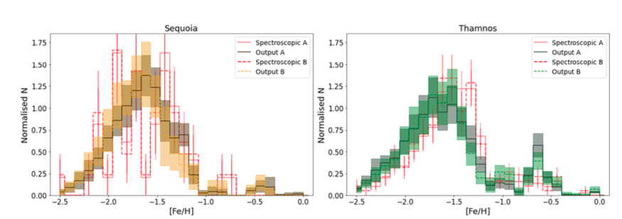
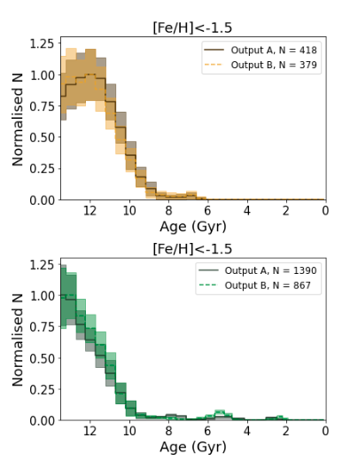
For Sequoia; an accreted galaxy + ~20% Gaia-Enceladus at [Fe/H] >-1.5 dex, Matsuno et al. (2022)
For Thamnos an excess of metal poor stars + dominanted by contamination from in-situ and Gaia-Enceladus
Age distributions
- Metallicity distributions consistent with spectroscopic (with small offset)
- Age distributions allow us to estimate infall times
Sequoia T₅₀∼ 12±0.3 Gyr z ∼ 4
Thamnos T₅₀ ∼ 12.3±0.3 Gyr z ∼ 5
Thamnos → Sequoia
GE T₅₀ ∼ 12.1±0.1 Gyr z ∼ 4.4
Helmi streams T₅₀∼ 10.5±0.2Gyr z ∼ 2.2 (Ruiz-Lara et al. 2022)
Dodd et al. (2025)

Slide 8
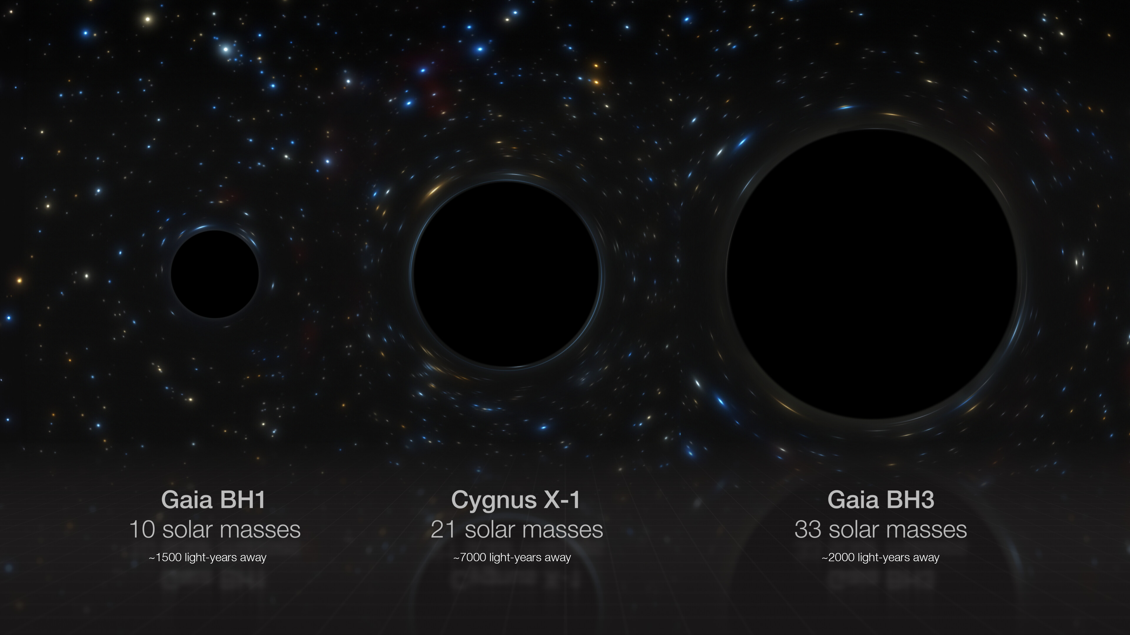
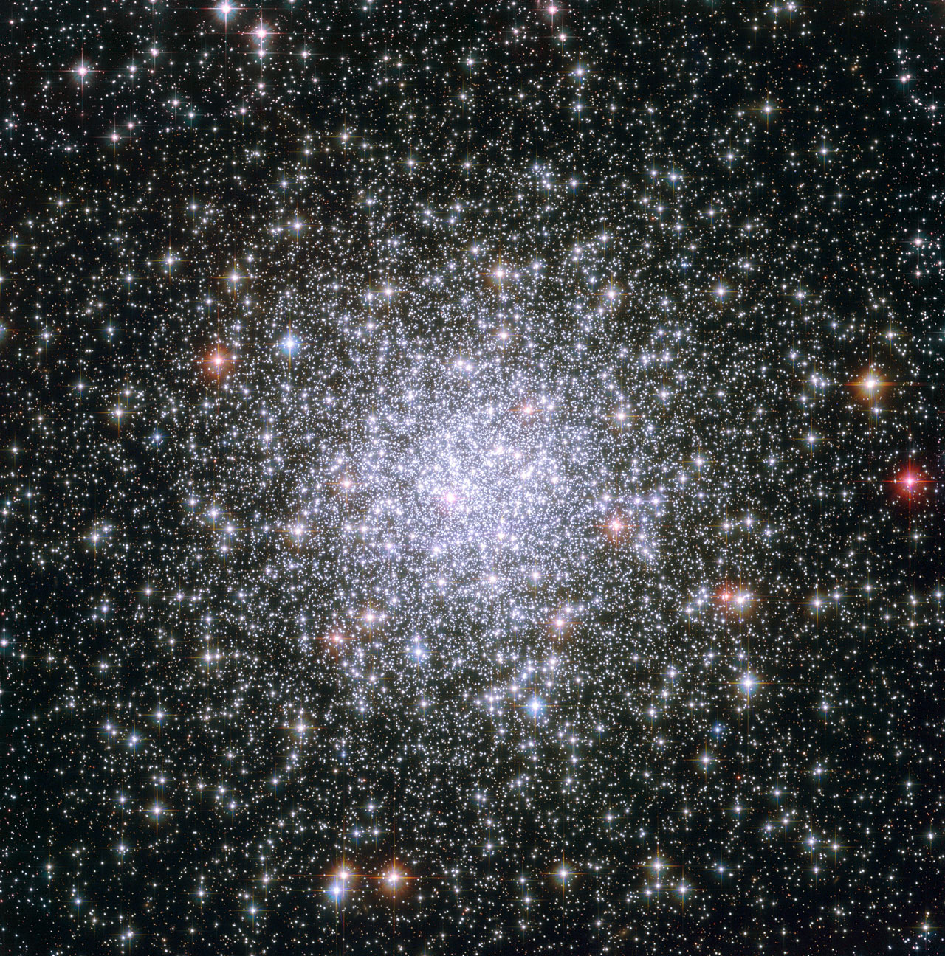
Characterising the small clumps
5 new and interesting small clusters ED-2 to -6 (Dodd et al. 2023)
High energy indicative of accreted origin
Very tight dynamically
HR follow-up (PI: Dodd, UVES)
BH3 is part of ED-2!
Hosts the 33 Msun Gaia BH3!
ED-2 stream: a disrupted ancient star cluster at low metallicity, [Fe/H] = -2.5 with negligble spread
Credit:ESO/M. Kornmesser
Compared to Fnx-1
(similar Fe/H, larger spread in other elements):
→ M_{ED-2} < (4.2 +- 0.1) x 10⁴ M_{sun}
Balbinot et al (inc Dodd, 2024): Dodd et al (2025)
ED2 and M92, 13.8 Gyr ([Fe/H] ~ -2.3)

Slide 9
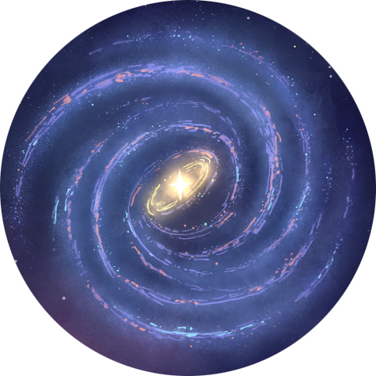
Timeline of the Milky Way
pre Gaia
Big Bang
disk formation
t= -13.8 Gyr
?
Ongoing mergers: Sagittarius (Ibata et al. 1994)
Helmi streams – merger debris in solar neighbourhood identified in Hipparcos data (Helmi et al. 1999)
LMC, SMC known satellittes but infall and orbital history unclear

Slide 10
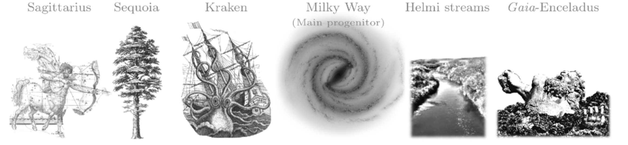
Timeline of the Milky Way
since Gaia
with Gaia Enceladus
Pre existing disk splashed onto halo like orbits by the merger
Starburst inducded formation of the present day thick disk
Big Bang
t= -13.8 Gyr
disk formation
thin disk formation
Gaia Enceladus: the last major merger
Belokurov et al. 2018,
Helmi et al. 2018
Ongoing mergers: Sagittarius

Slide 11
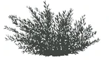
Timeline of the Milky Way
Non exhaustive!
since Gaia
In-situ proto Milky Way Belokurov & Kravstov (2022)
Pre existing disk splashed onto halo like orbits by the merger
Starburst inducded formation of the present day thick disk
Big Bang
t= -13.8 Gyr
t= -10 Gyr
disk formation
thin disk formation
ED-2
Helmi streams ~7-9 Gyr ago
Helmi et al. 1999, Koppelman et al. 2019, Ruiz-Lara
et al. 2022
Ongoing mergers: Sagittarius, LMC, SMC
Gaia Enceladus: the last major merger
Belokurov et al. 2018,
Helmi et al. 2018
Early major merger? Kraken/Heracules Kruissjen et al. 2020, Horta et al. 2021
And many more streams and substructures
Other mergers Sequoia, Thamnos
Myeong et al. 2019, Koppelman et al. 2019
Images adapted from Kruijssen et al. 2020

Slide 12
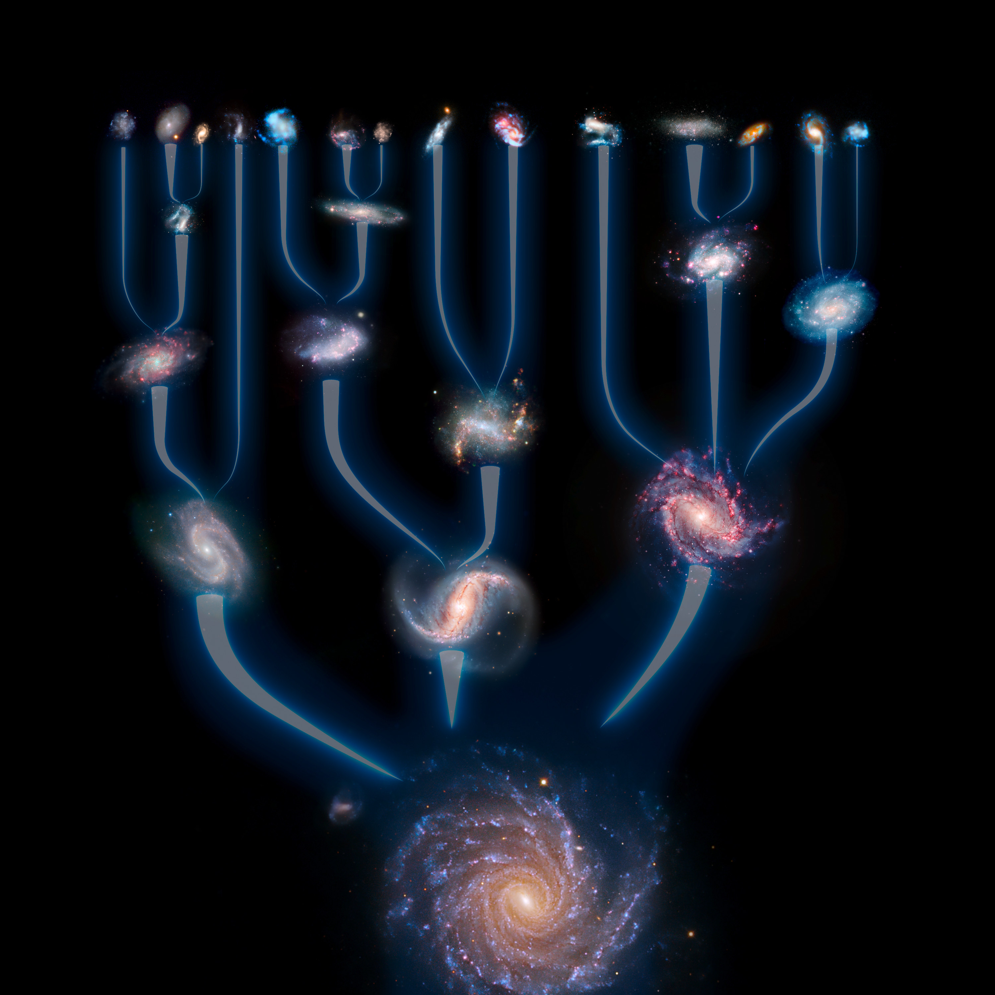

Summary
Gaia has revolutionised our understanding of the assembly of our galaxy
We know the main characters in the story but are unravelling also the smaller building blocks
Gaia NIR will allow us to push this type of work to larger volumes and to the inner galaxy → hosts the most ancient merger debris
Big thanks to all the hard work of the

