Slide 1
Preparing for HWO: perspectives from the exoplanet community
Faculty of Mathematical and Physical Sciences
Department of Space and Climate Physics, Mullard Space Science Laboratory (MSSL)
Vincent Van Eylen v.vaneylen@ucl.ac.uk
Annelies Mortier, Beth Biller, Hannah Wakeford, Jayne Birkby, Jo Barstow, Sasha Hinkley, Suzanne Aigrain

Slide 2
Who we are
We are a group of people interested in exoplanet science with HWO, aiming to ensure the UK Exoplanet Community is well-represented in ongoing discussions
We seek input from and engage with junior and senior exoplanet colleagues in the UK
We were endorsed at the latest strategy session at the UK Exoplanet Meeting (UKEXOM) to represent the UK exoplanet community

Slide 3
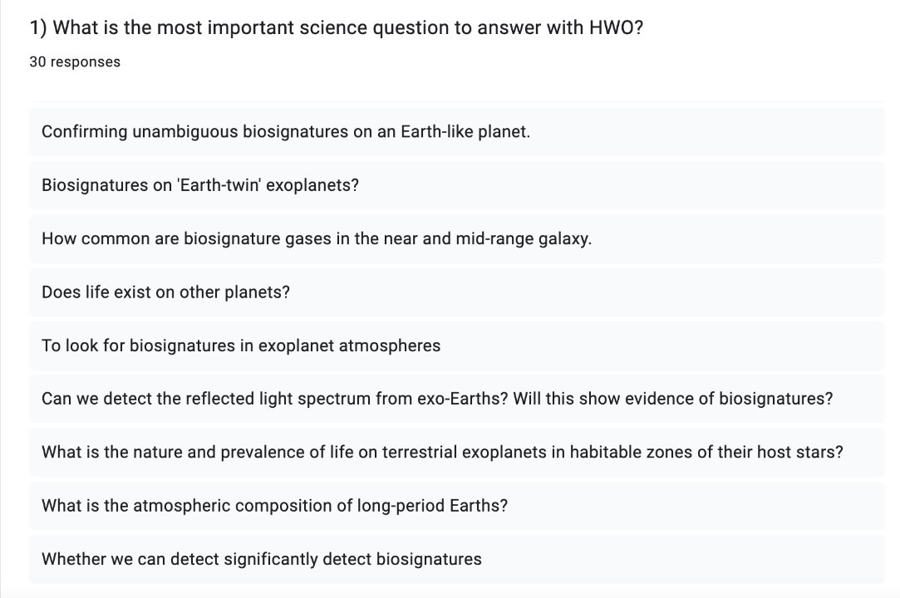
Community survey: HWO science

Slide 4
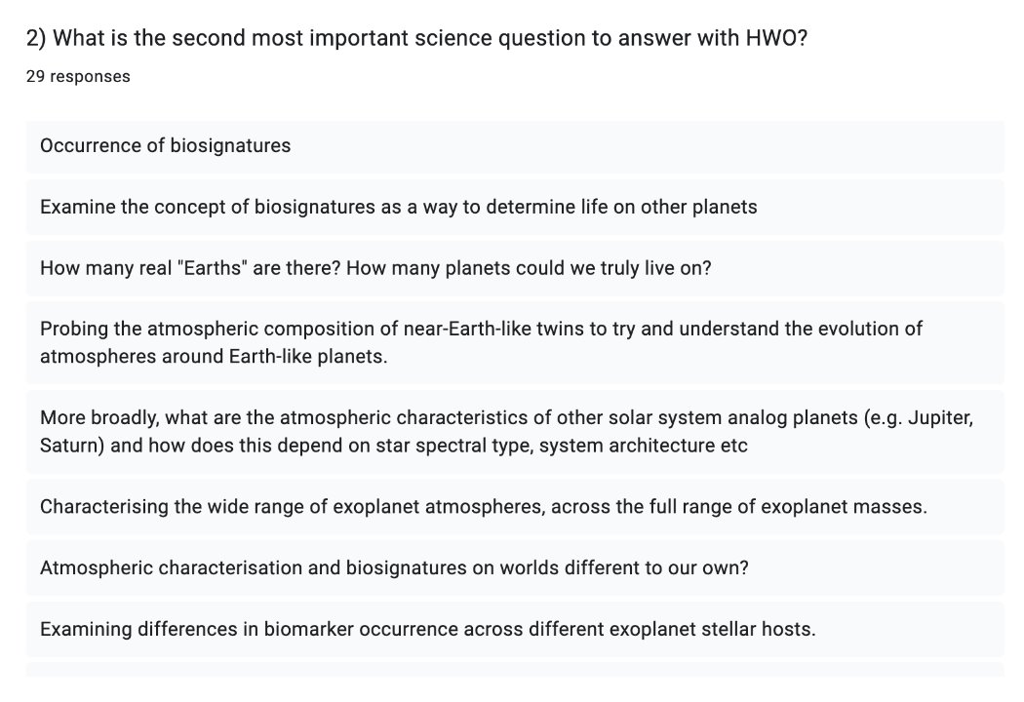
Community survey: HWO science (bis)

Slide 5
Community survey: HWO science (bis)

Slide 6
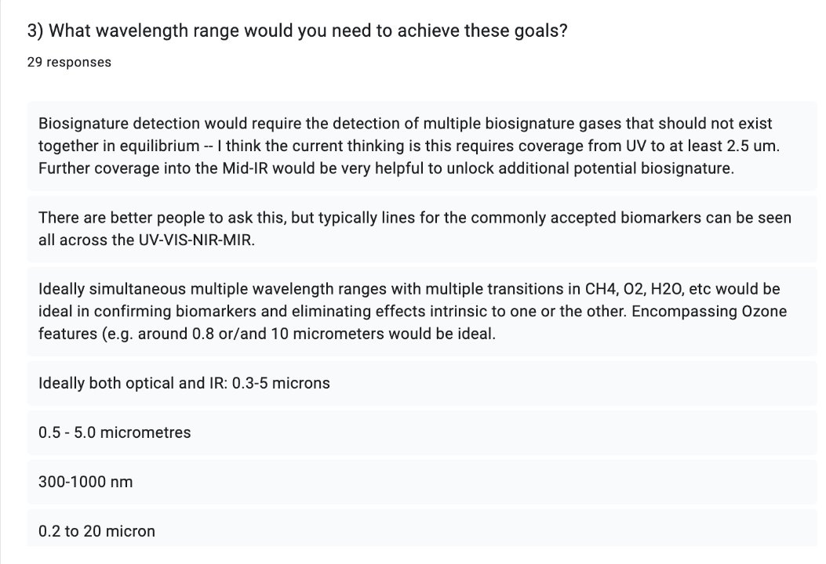
Community survey: wavelength range

Slide 7
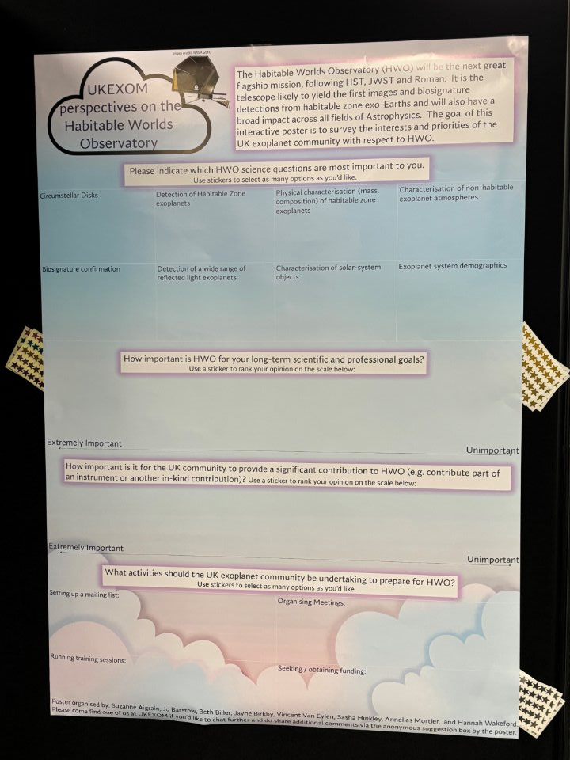
Community engagement at UKEXOM 2025
UKEXOM is the yearly UK exoplanet community meeting with ~200 participants, well-attended by both junior and senior exoplanet researchers
We hosted a brief HWO presentation to engage junior scientists
Strategy session with senior academics highlighted HWO as very exciting and a key priority
We sought community input through a HWO poster

Slide 8
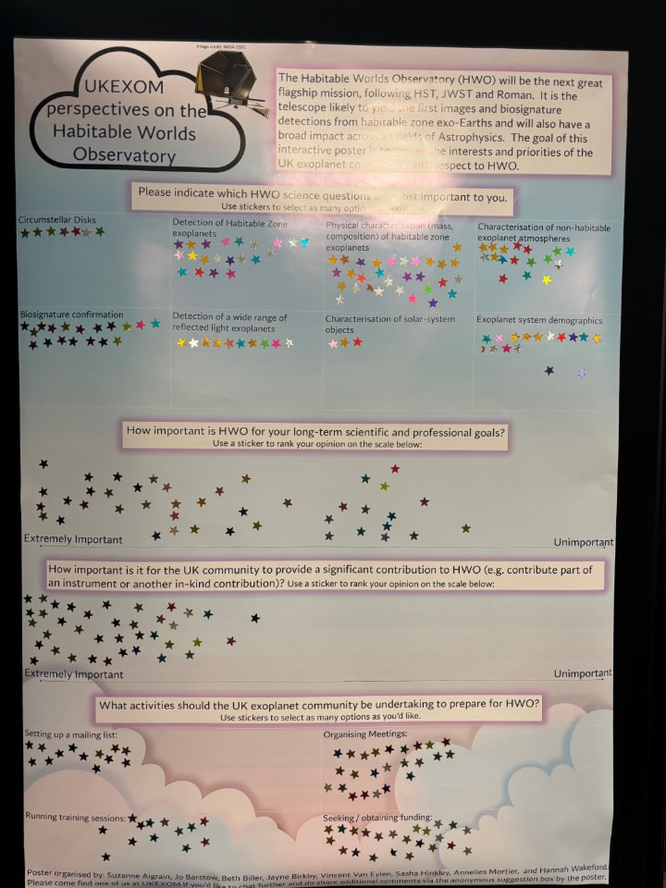
Community engagement at UKEXOM 2025
UKEXOM is the yearly UK exoplanet community meeting with ~200 participants, well-attended by both junior and senior exoplanet researchers
We hosted a brief HWO presentation to engage junior scientists
We sought community input through a HWO poster

Slide 9
HWO (exoplanet) science questions

Slide 10
Importance of HWO

Slide 11
Importance of a UK instrument on HWO
Vincent Van Eylen – v.vaneylen@ucl.ac.uk
Vincent Van Eylen – v.vaneylen@ucl.ac.uk

