Slide 1
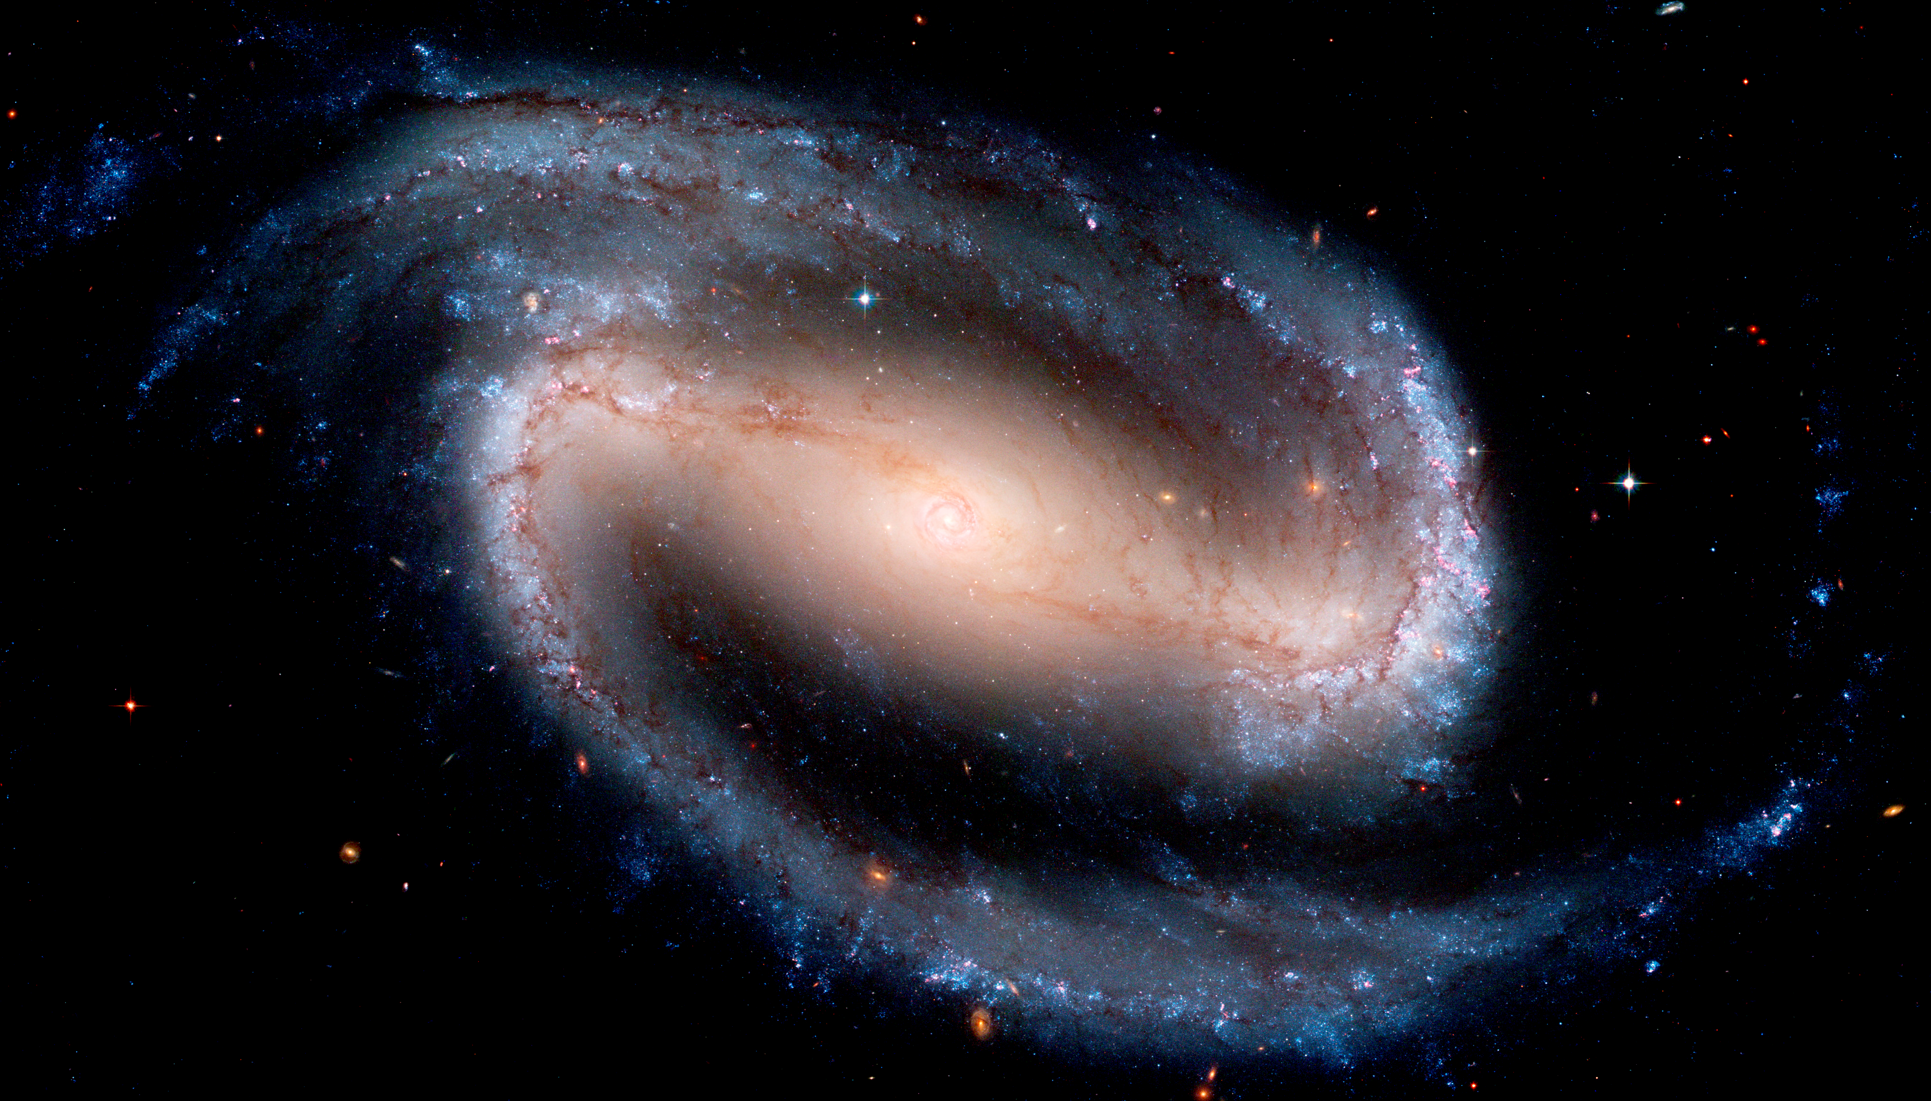
National Astronomy Meeting | 10.07.25
MUSE view of gas inflows in nearby galaxies: Connections to Nuclear Activity and Central Morphology
Dr Tutku Kolcu
Tutku.Kolcu@nottingham.ac.uk

Slide 2
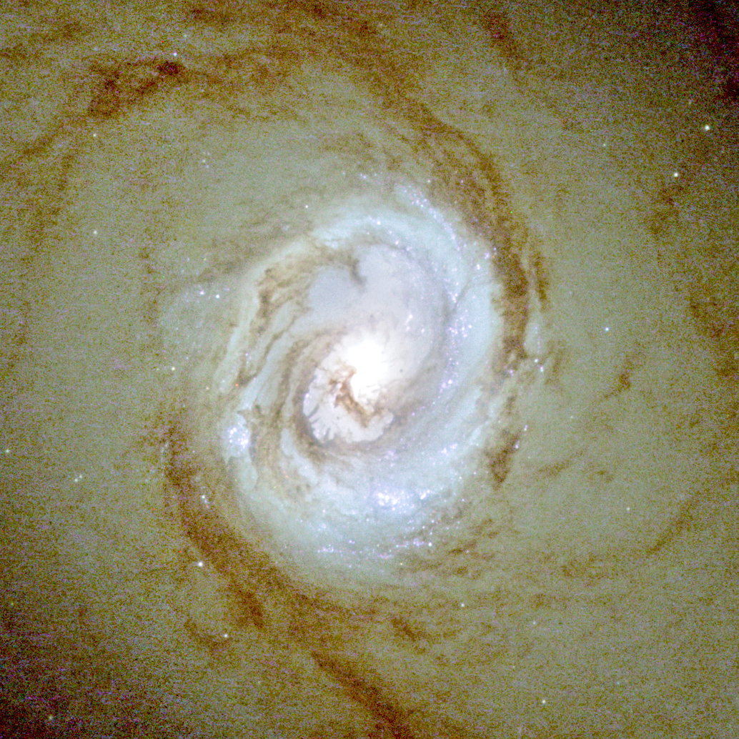
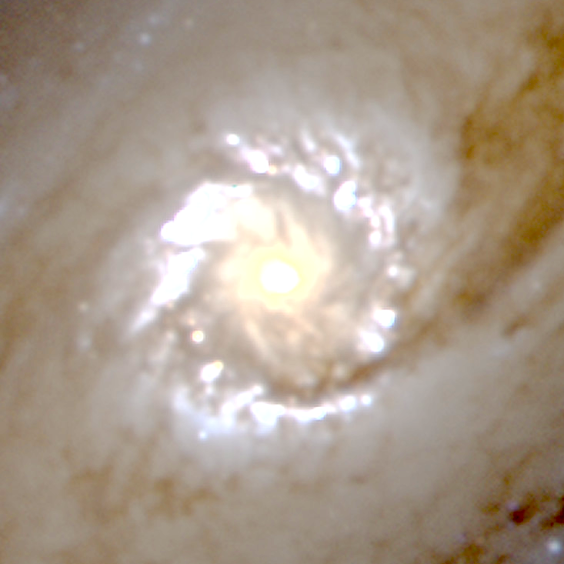
The role of bars in the context of gas inflows
The Bar induce torques which cause gas to and to fall in central regions, so-called
shock
Formation of nuclear rings & discs
gas inflow
AGN outflows
Gas inflows contribute to the galaxy evolution significantly:
<10pc
~0.1-1kpc
enhancing star formation
forming central stellar substructures
nuclear feeding and AGN feedback
~1-10kpc
Tutku Kolcu/
Tutku.Kolcu@nottingham.ac.uk
Notes:
Shear stength prevents SF.
Mass fraction in ionised gas is small, molecular is better

Slide 3
Open questions:
What is the dominant mechanism of gas inflows
to the nucleus?
How can we identify and trace the
extended shocks?
Gravitationally driven gas inflows occurs as (e.g., kinematic spirals)
Formation of nuclear rings & discs
coherent kinematic structures
AGN outflows
$$Σ_{gas}$$
$$V_{residual}$$
<10pc
~0.1-1kpc
Davies+09
~1-10kpc
Tutku Kolcu/
Tutku.Kolcu@nottingham.ac.uk
3
Notes:
Gas surface density in barred spiral galaxy on the left, and zoomed-in on the central region on the right.
Middle panel: line of sight velocity
Bottom panel: residual velocity compared to circular velocity
The movie plays through different position angles for the bar
Is Bar’s pull effective in the centre

Slide 4
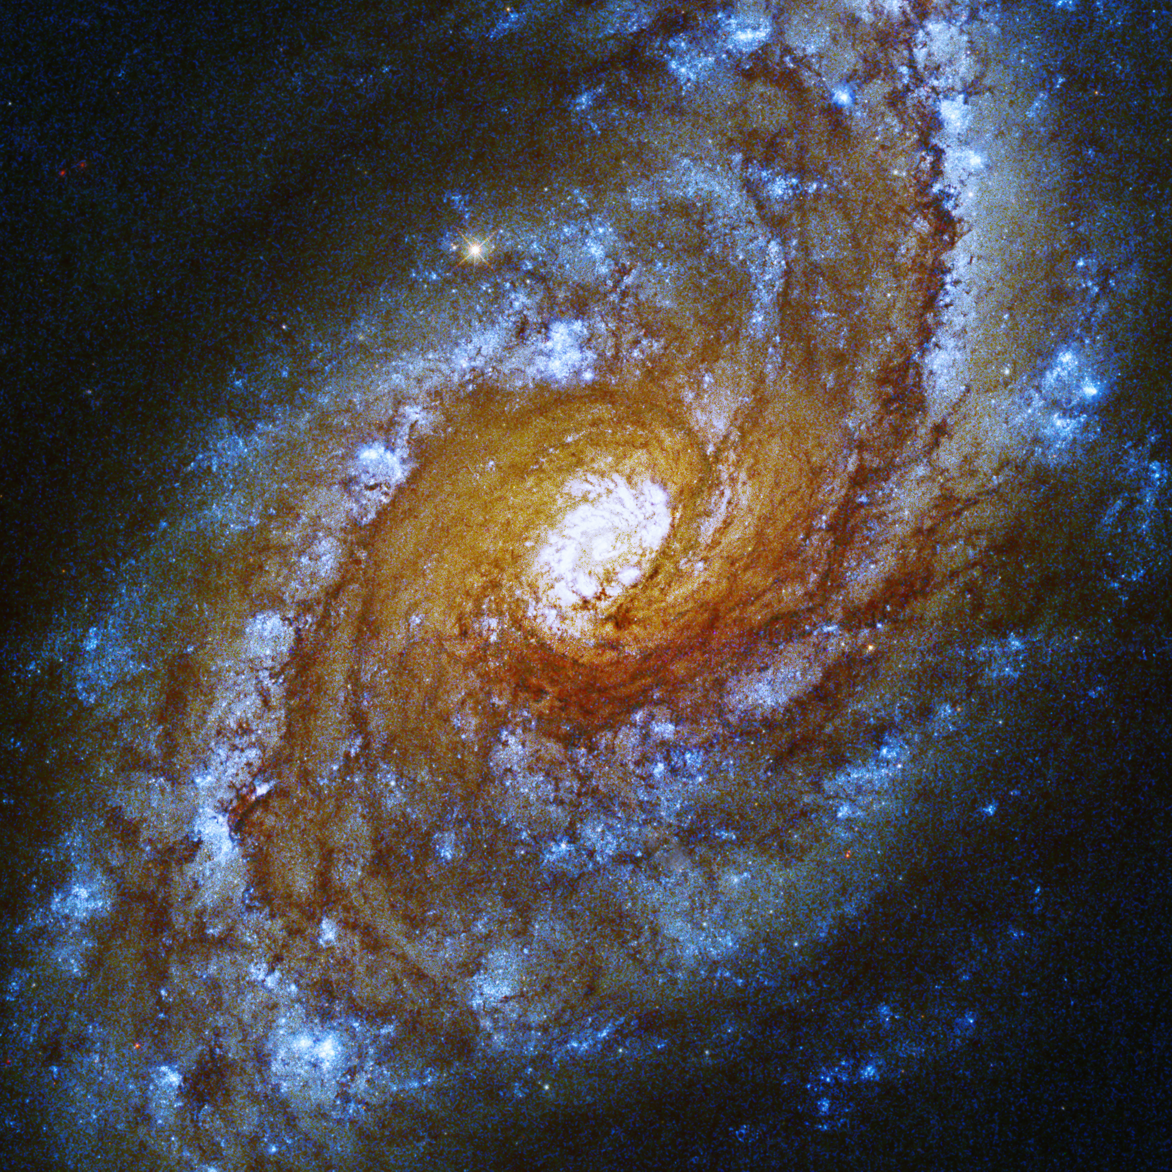
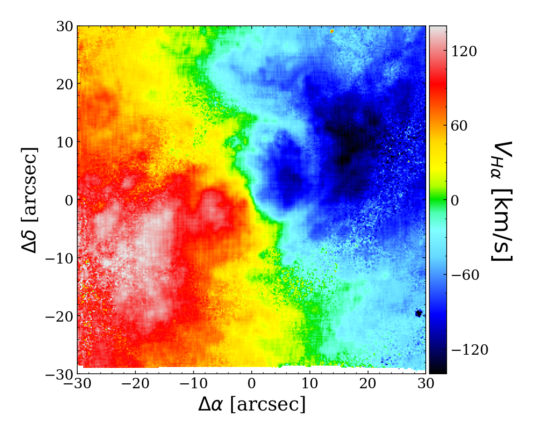
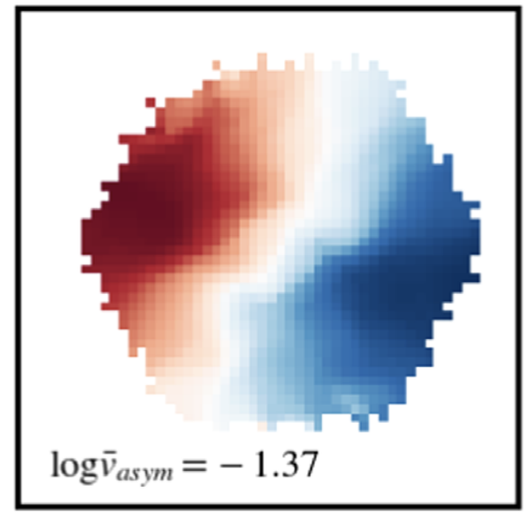
Instrumental limitations of former generation IFUs prevented resolving coherent kinematic structures
NGC 5248
SAURON
spatial sampling: ~0.8″/px
FoV: 33″x41″
$$V_{Hβ}−140/140$$
CALIFA
MUSE
MaNGA
Dumas+07
GMOS
NGC 5248
spatial sampling: ~0.2″/px, FoV: 7″x5″
CALIFA
MaNGA
GMOS
spatial sampling: ~1″/px
FoV: 74″x62″
spatial sampling: ~1-2″/px
SAURON
DFOV: 12″— 32″
NGC 1097
NGC 2916
10839–9101
MUSE
spatial sampling: 0.2″/px
FoV: 60″x60″
20
0
-20
-40
arcsec
Feng+22
Sánchez+15
NGC 5248
$$z=0.003$$
Fathi+06
Tutku Kolcu/
Tutku.Kolcu@nottingham.ac.uk
4

Slide 5
Extraction of the kinematic data
Implementation of GIST pipeline (Bittner et al. 2019)
Extracting flux and LOSVD moment maps from the data analysis pipeline (DAP)
We used multi-Gaussian approach to improve the quality of derived kinematics and fluxes.
$$Hα [NII]$$
$$[SII]$$
$$Hβ$$
$$[OIII]$$
Tutku Kolcu/
Tutku.Kolcu@nottingham.ac.uk
5

Slide 6
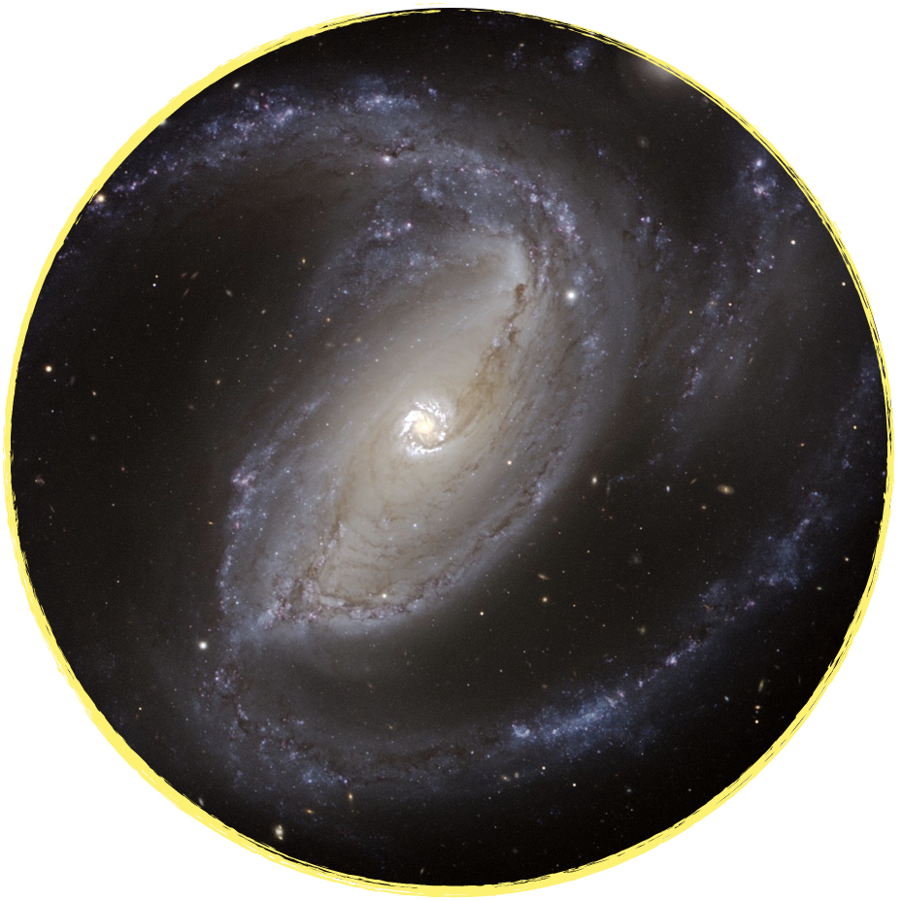
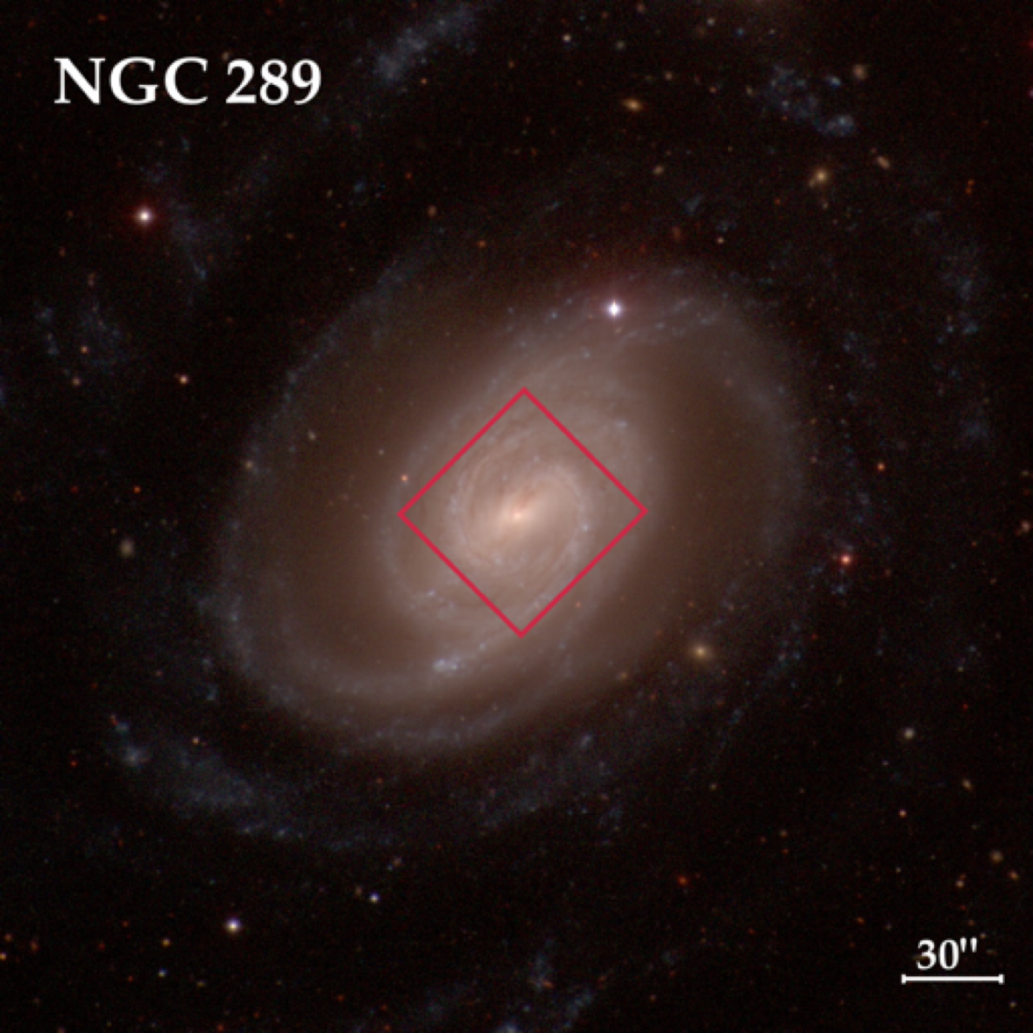
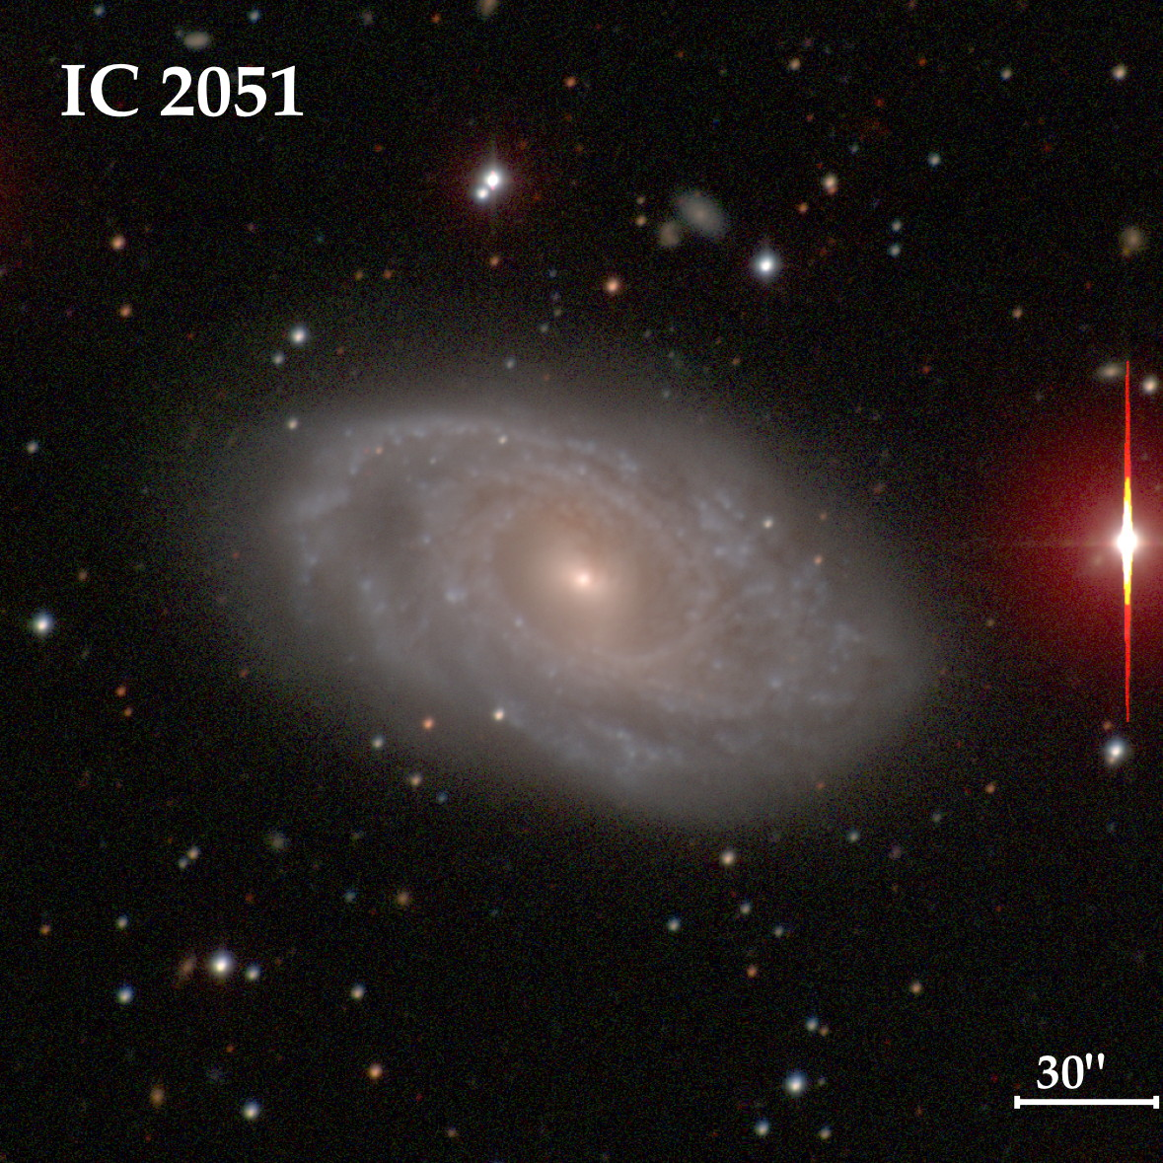
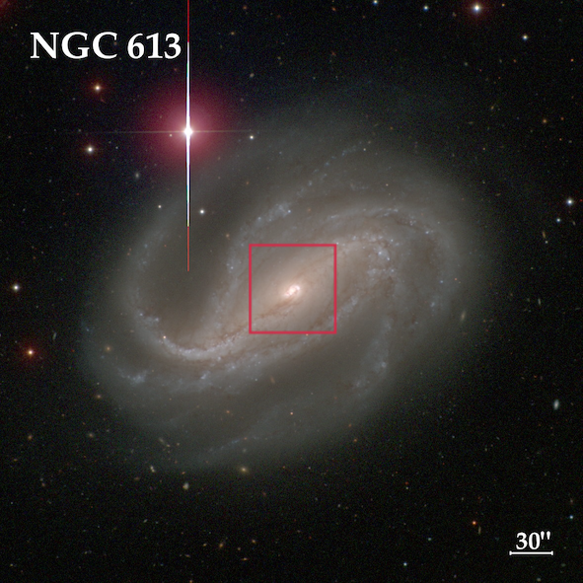
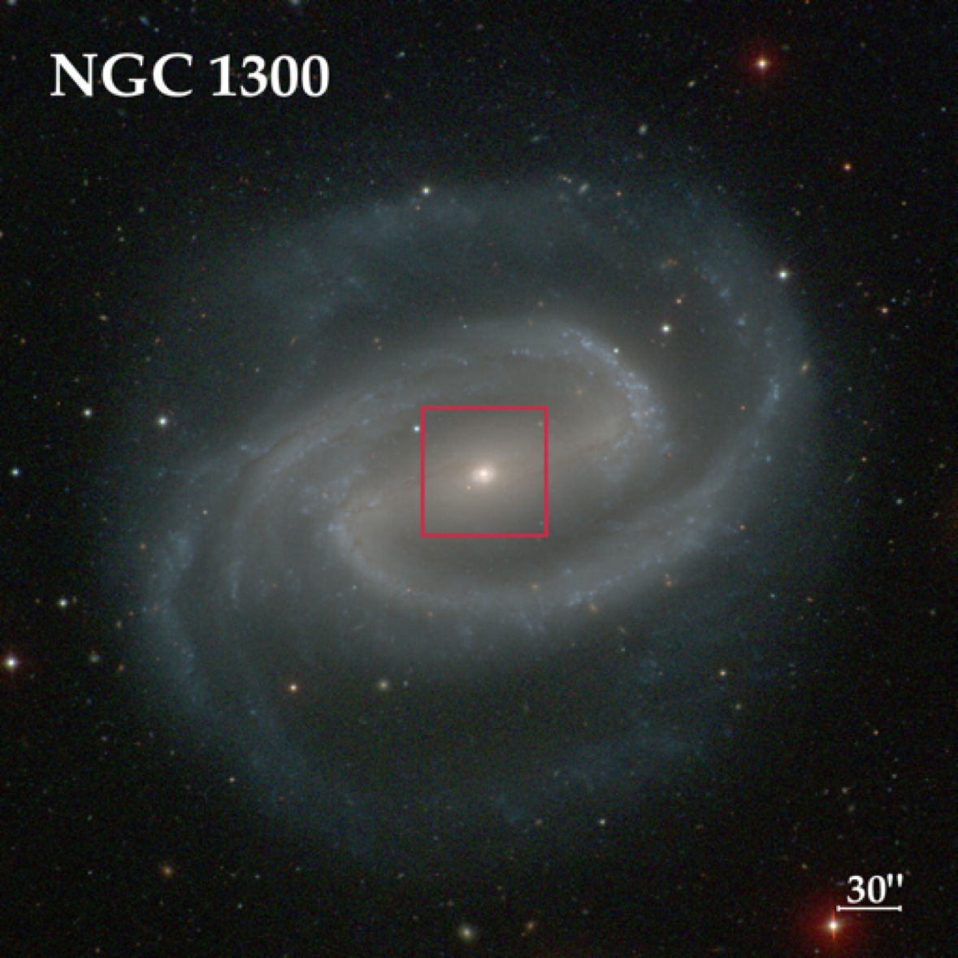
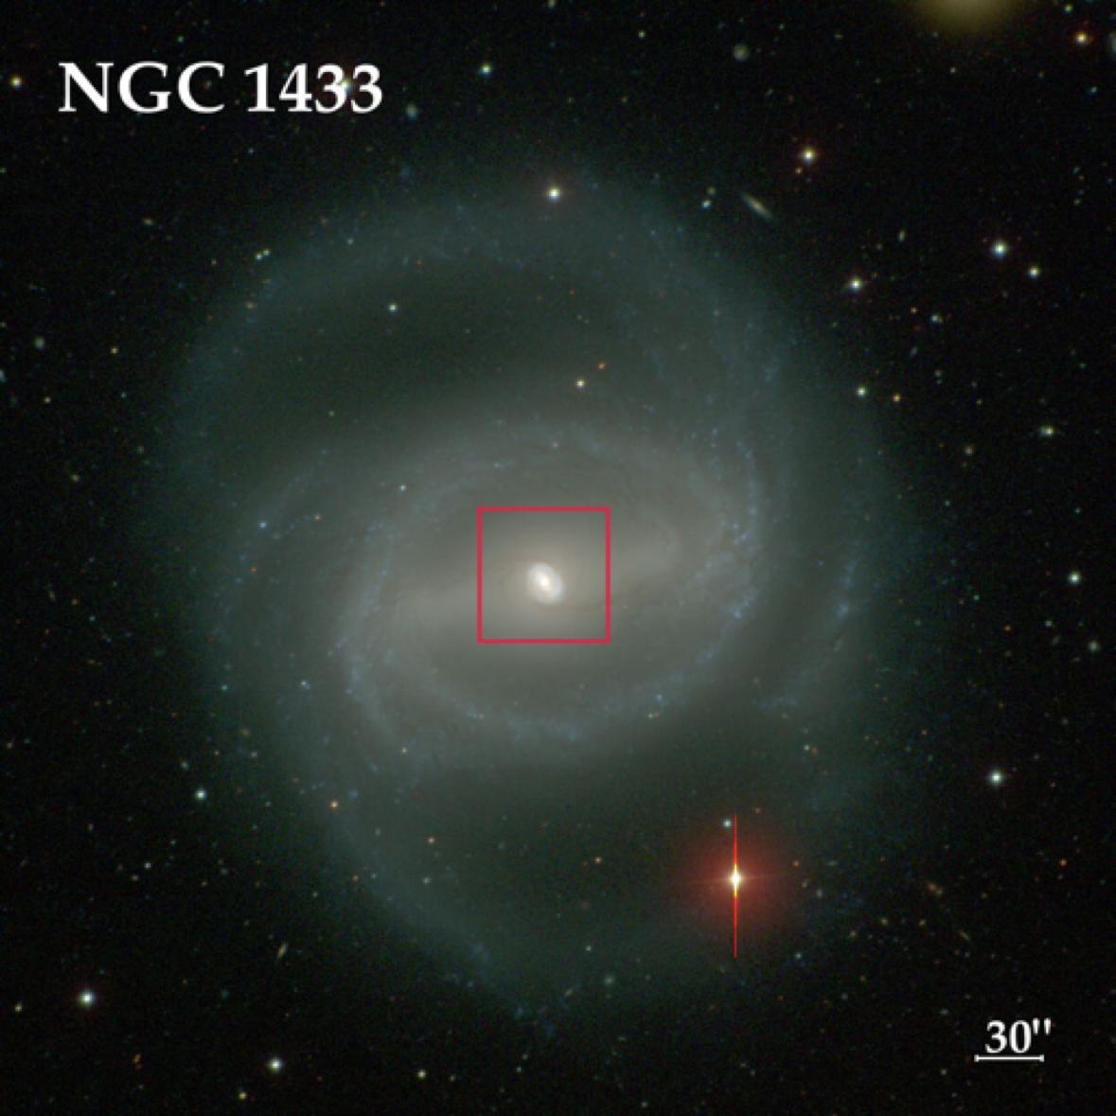
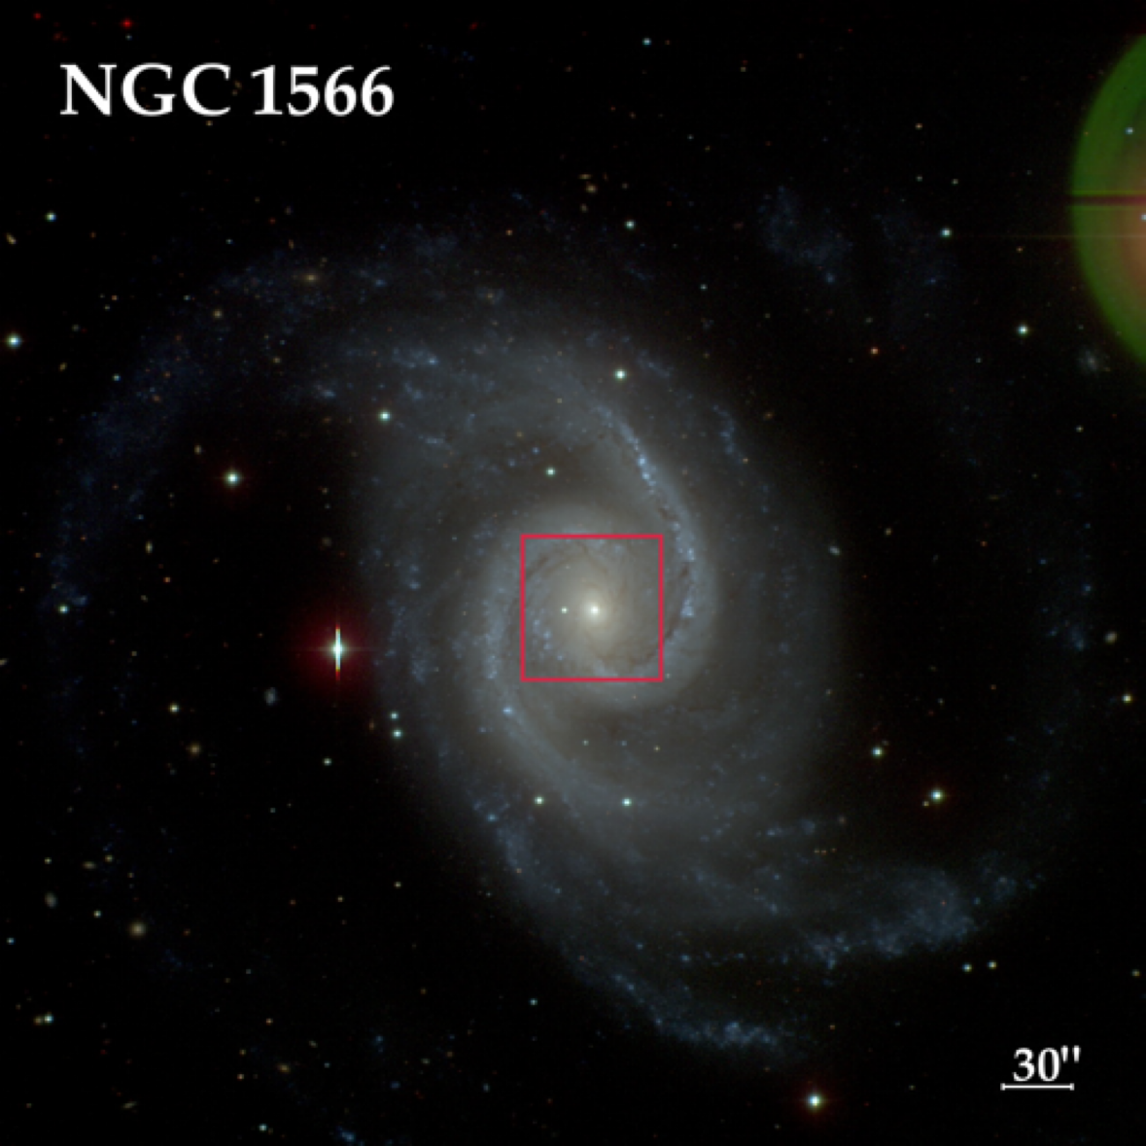
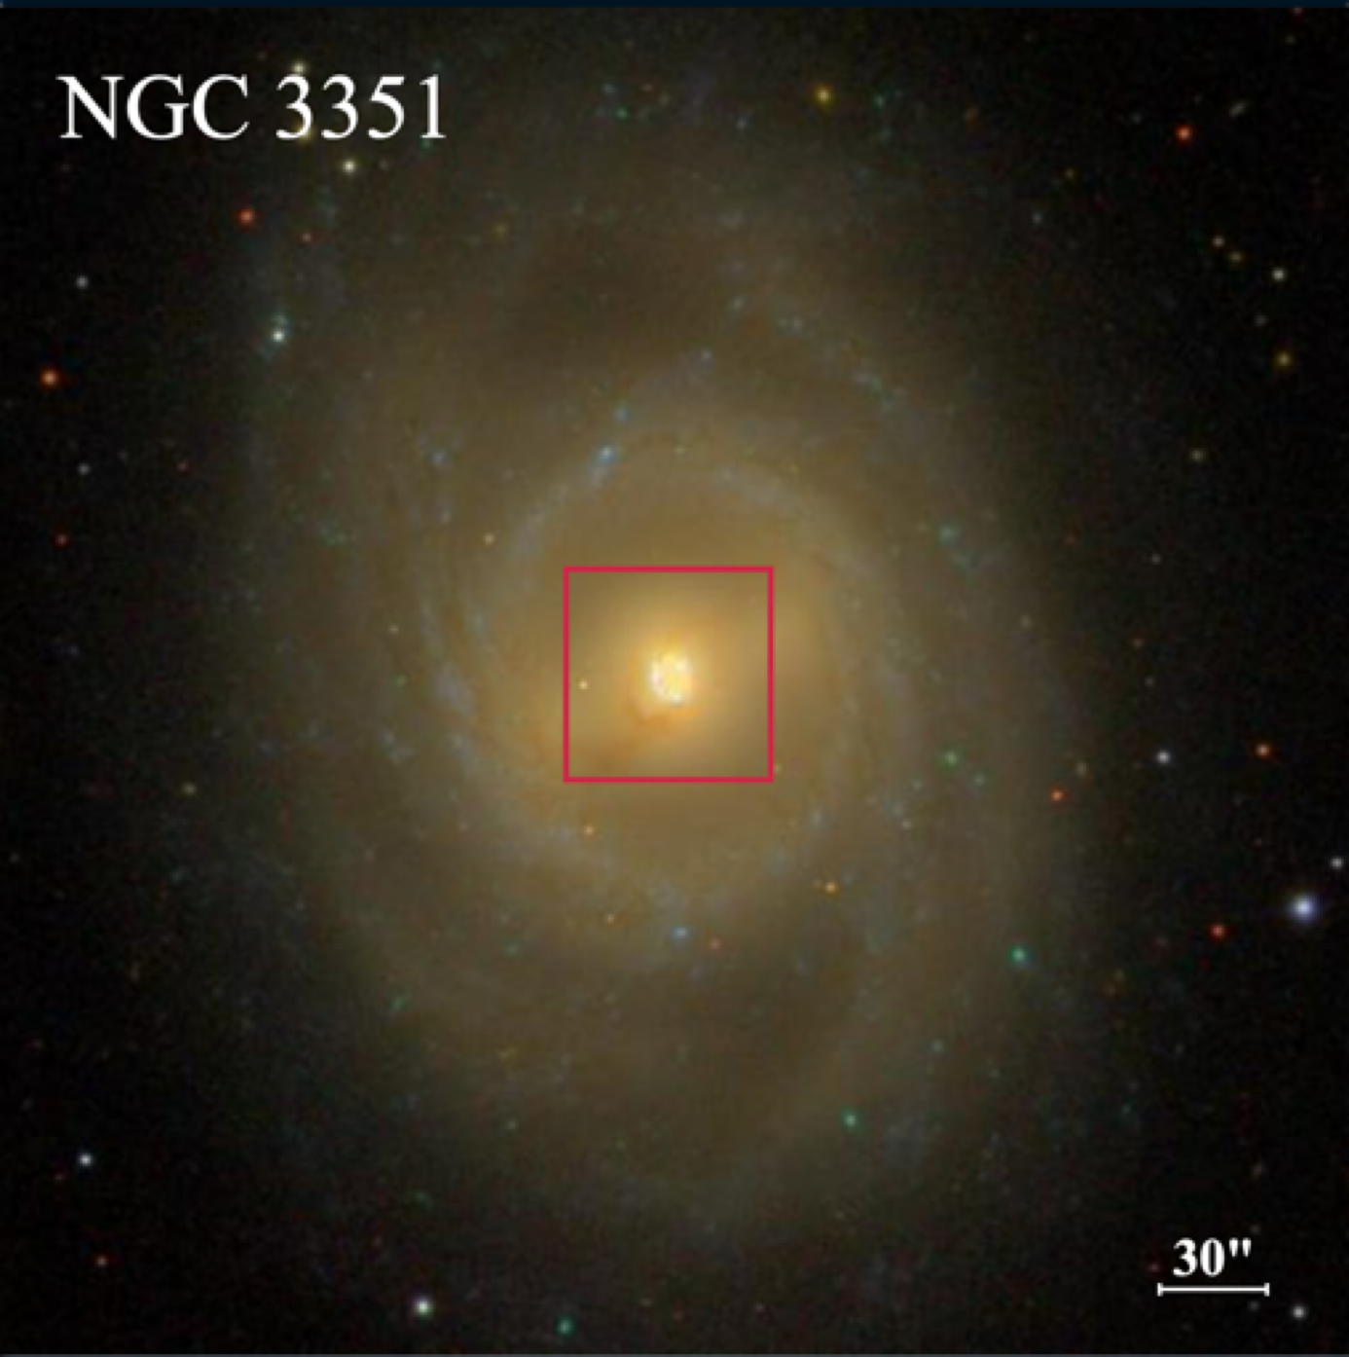
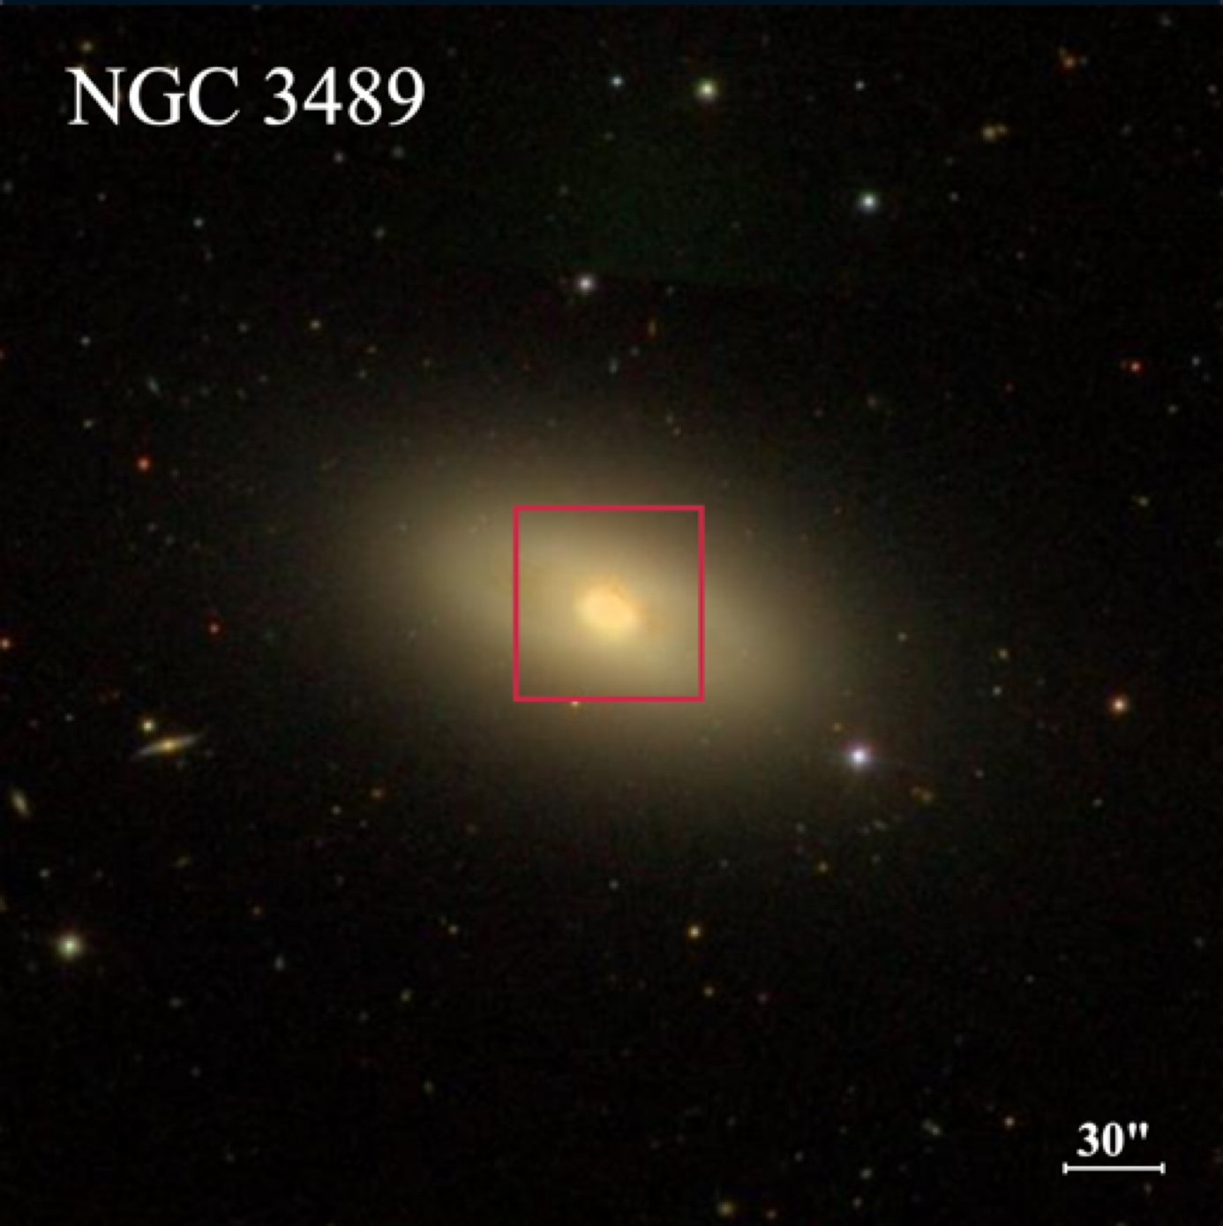
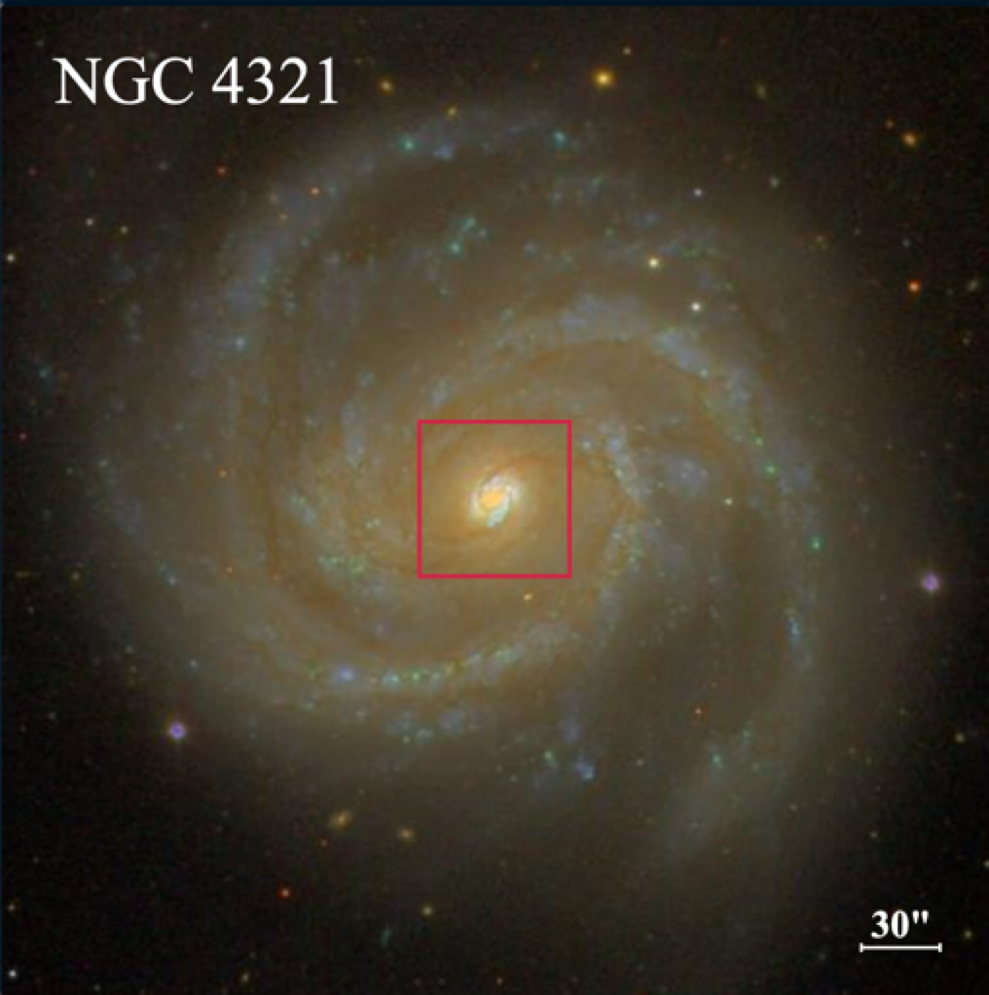
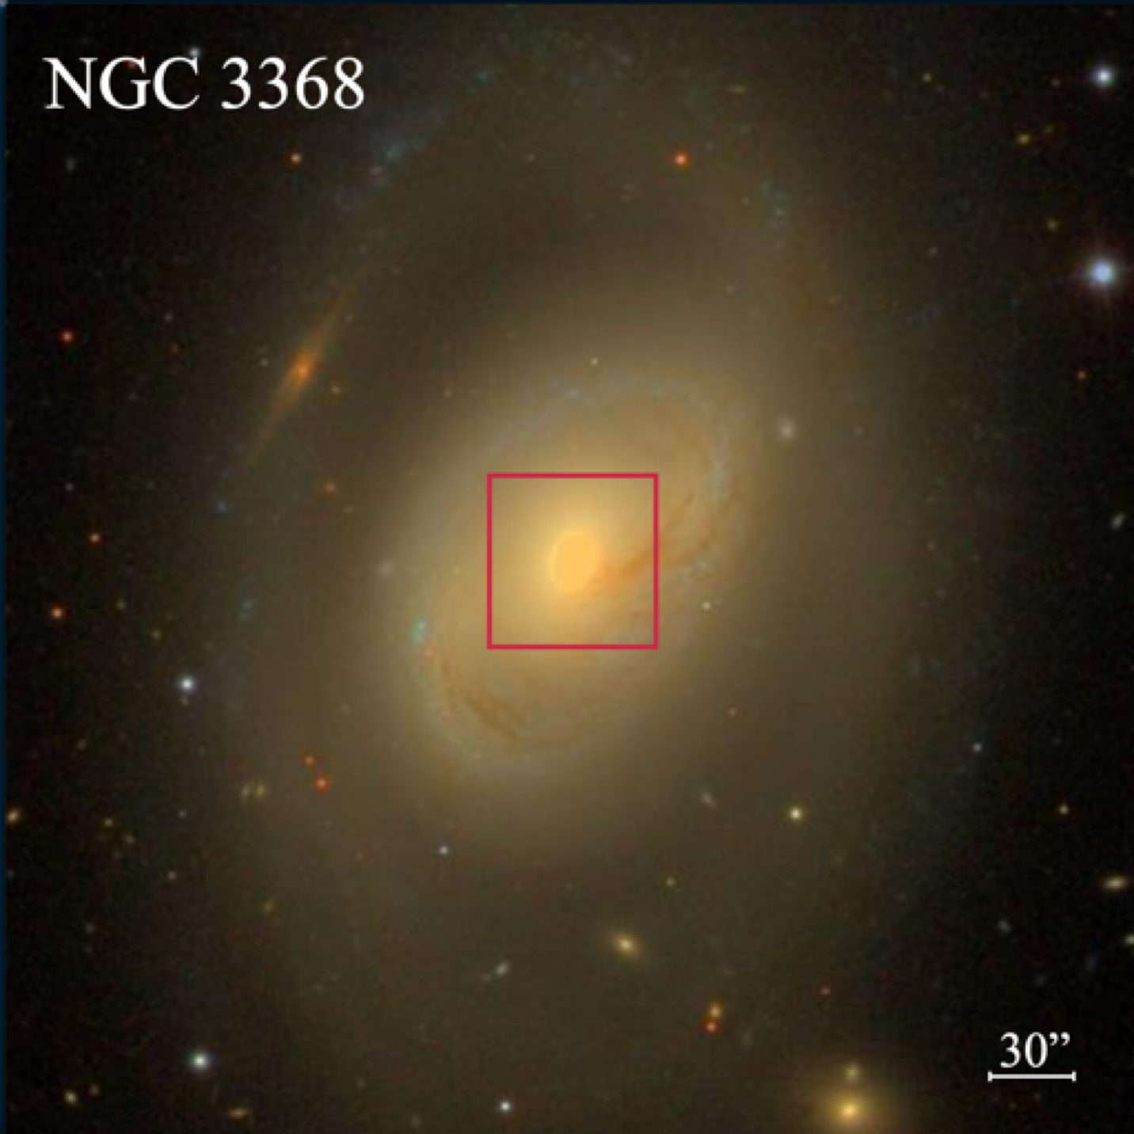
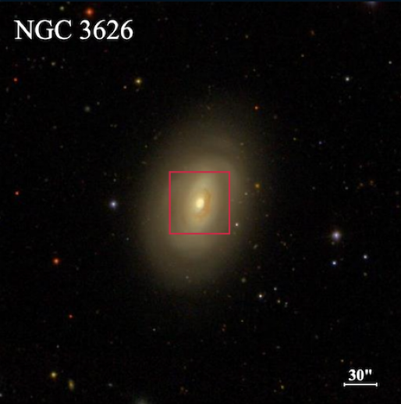
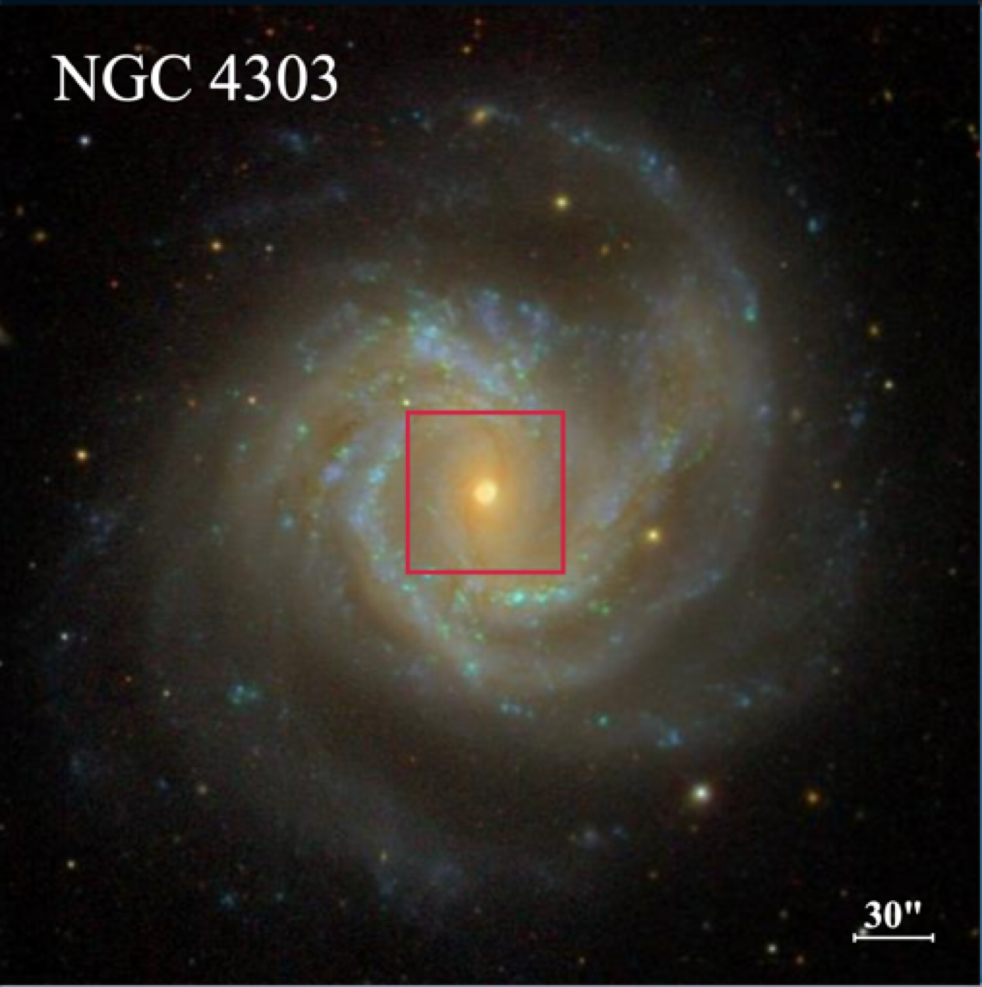
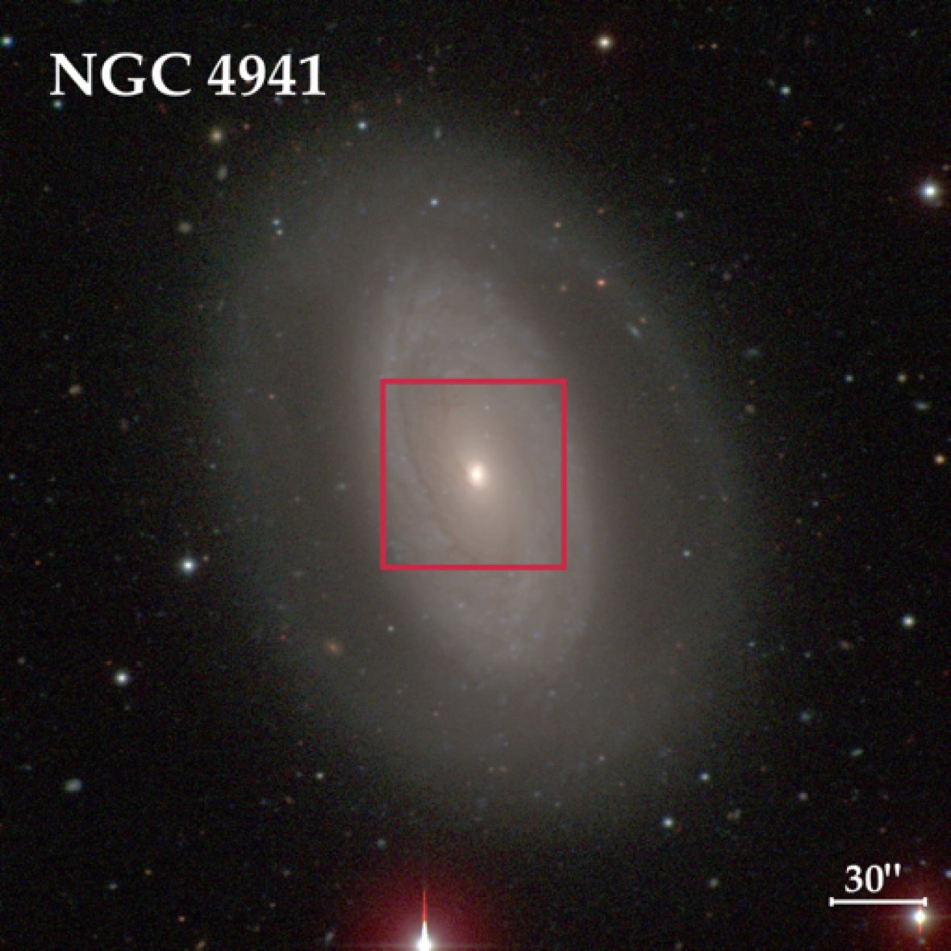
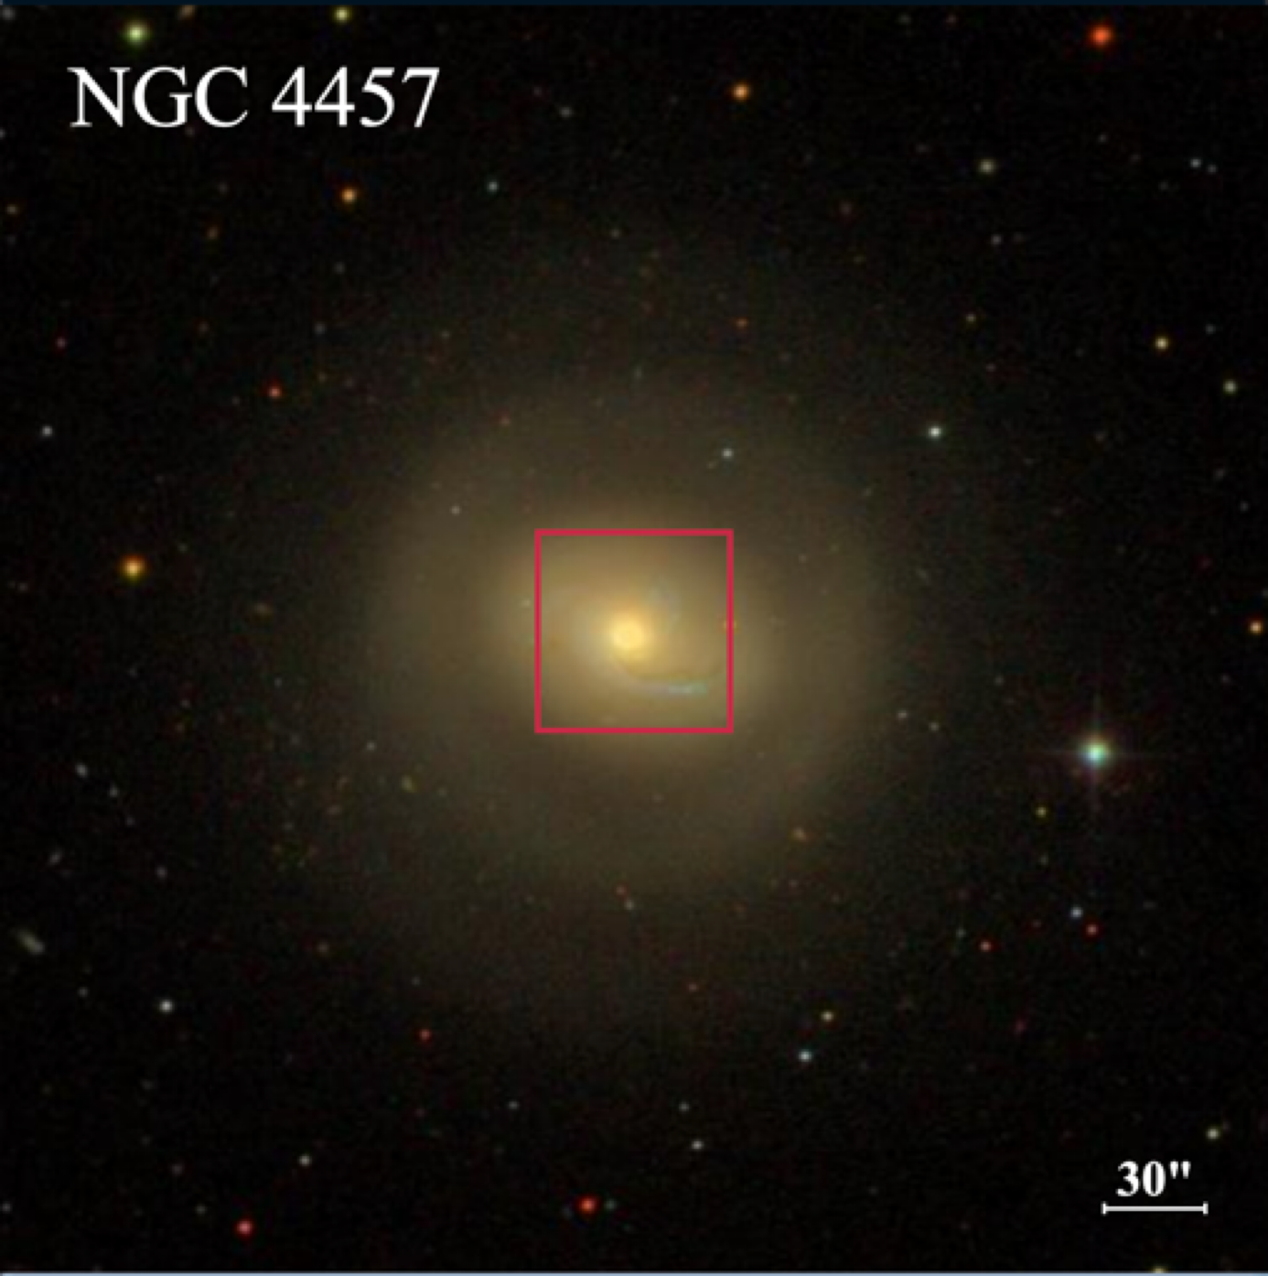
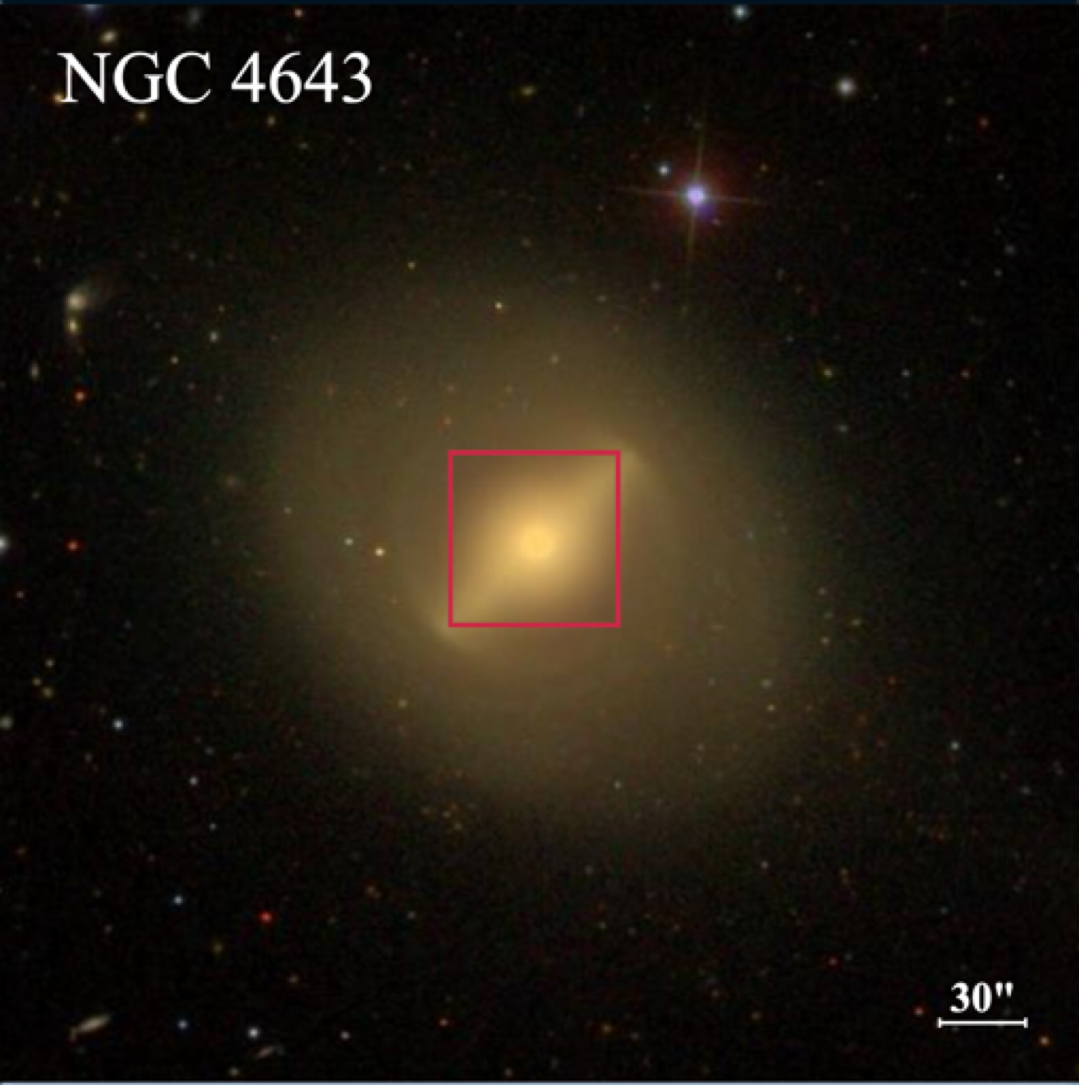
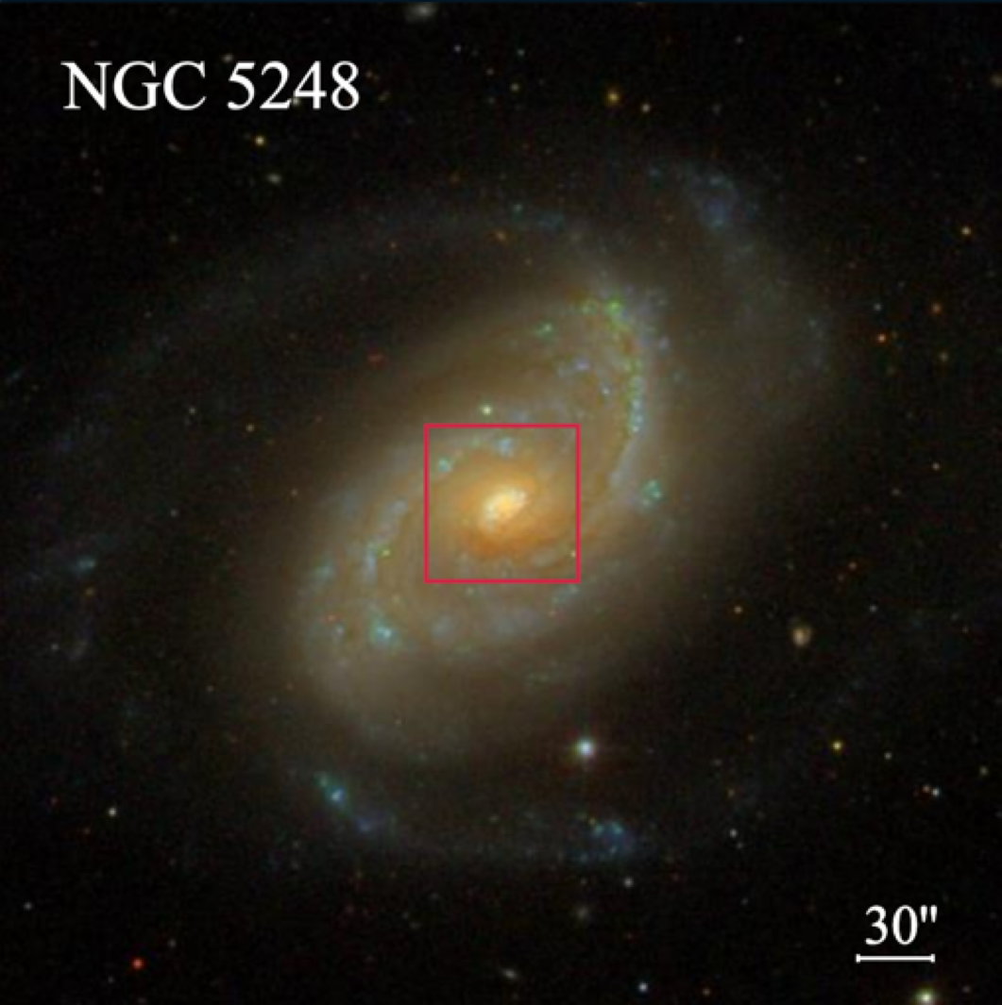
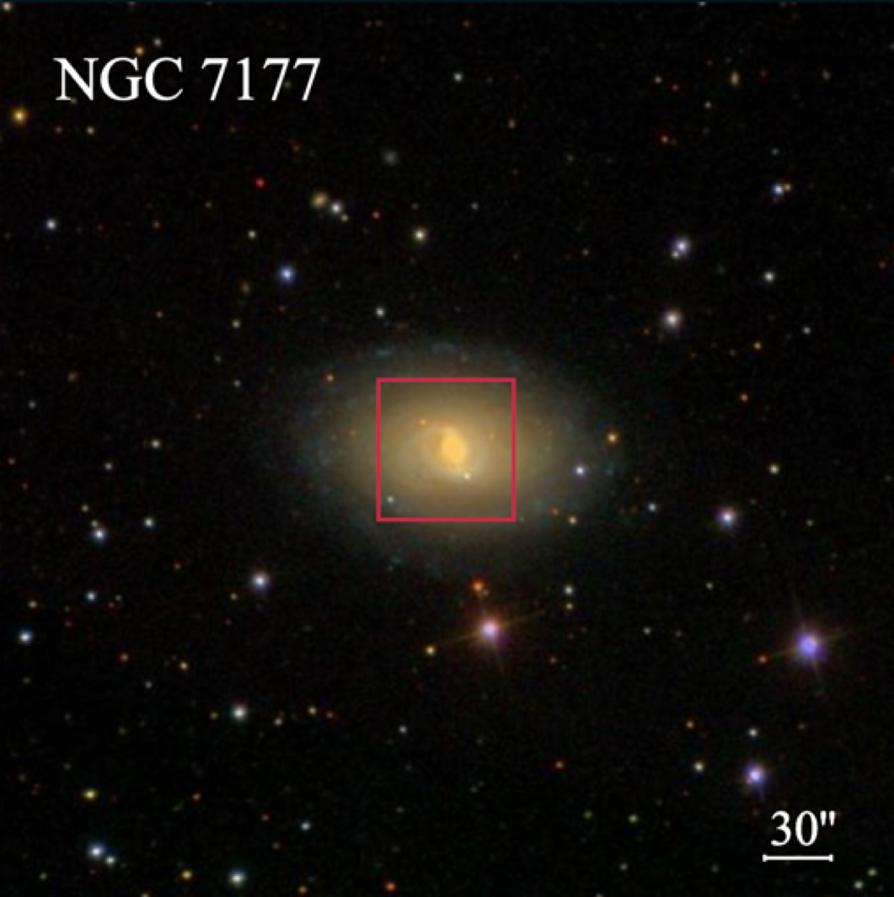
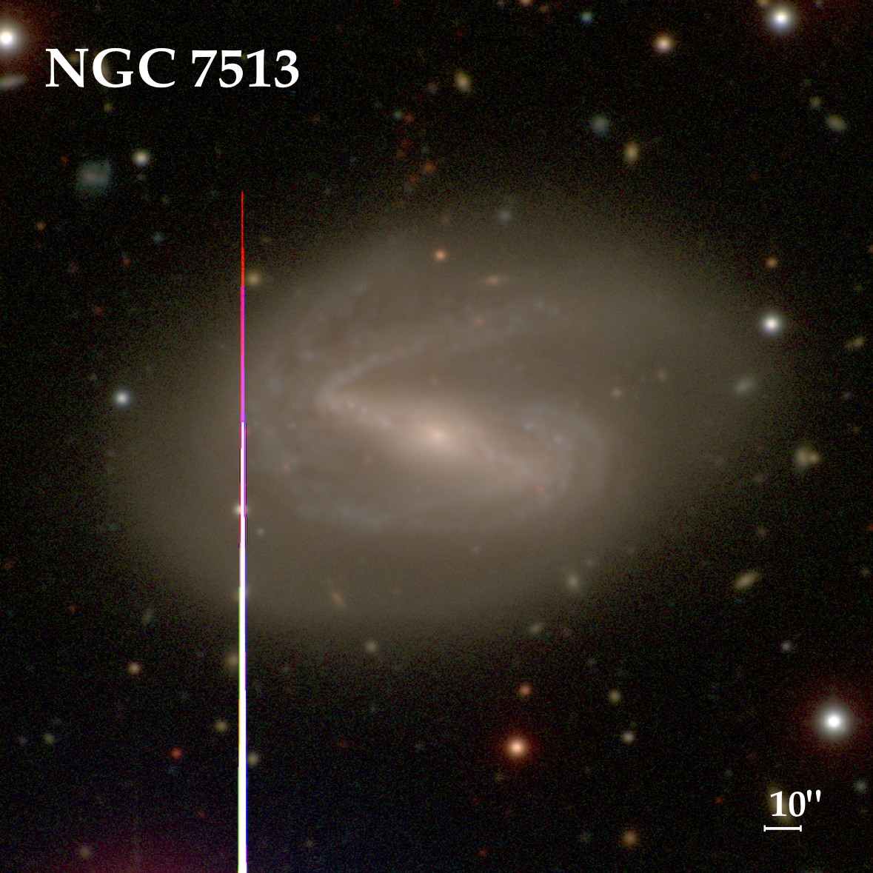
Galaxies from the Composite Bulges Survey (PI: P. Erwin) & TIMER (PI: D. Gadotti)
~20 galaxies with diverse characteristics with and HST observations
NGC1097 as Pilot Target
MUSE
D<20 Mpc
Large scale images: Carnegie-Irvine & SDSS
Kolcu et al. (in prep)
Tutku Kolcu/
Tutku.Kolcu@nottingham.ac.uk
6
Notes:
To make the best out of the MUSE, Prioritising their gas content, good coverage of their central structures, (fraction of the bar, NR/Disks etc.)

Slide 7
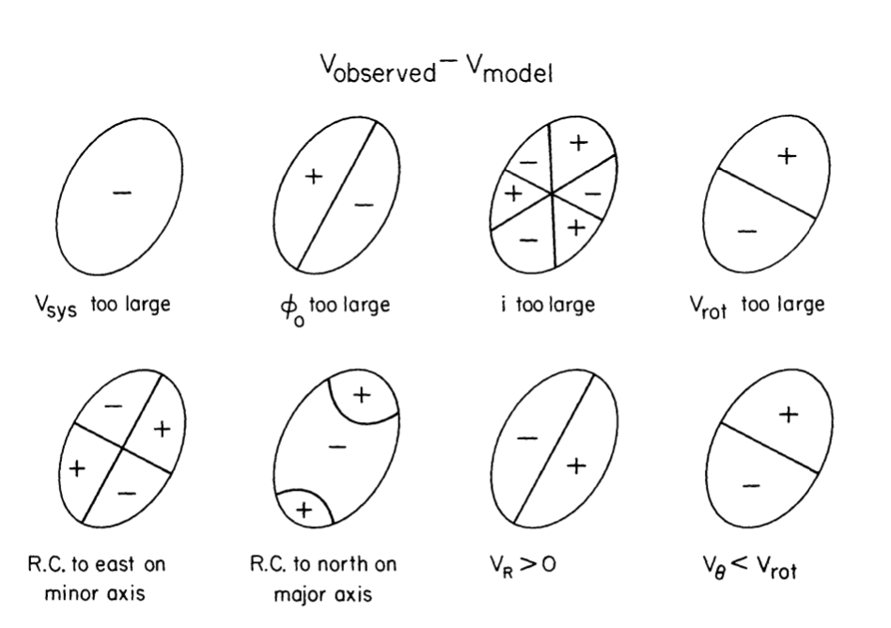
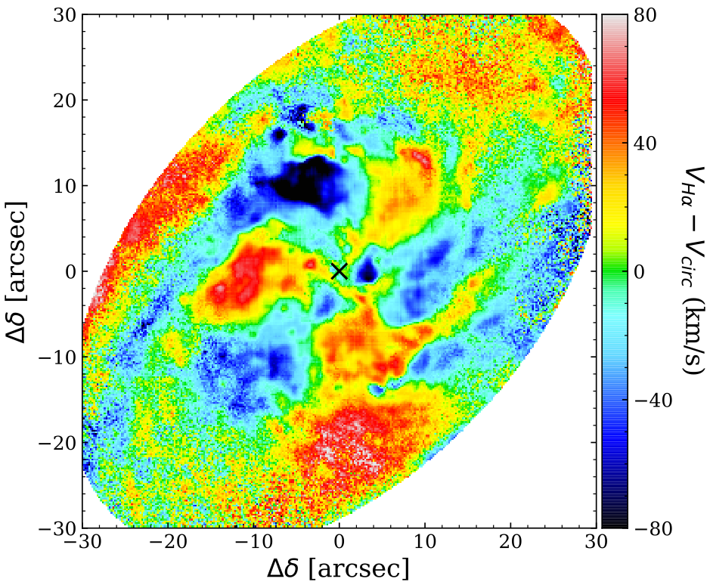
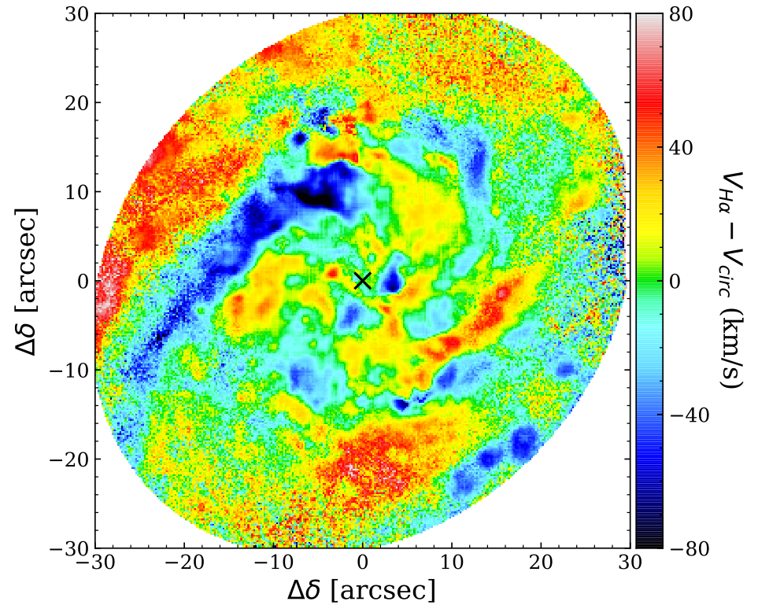
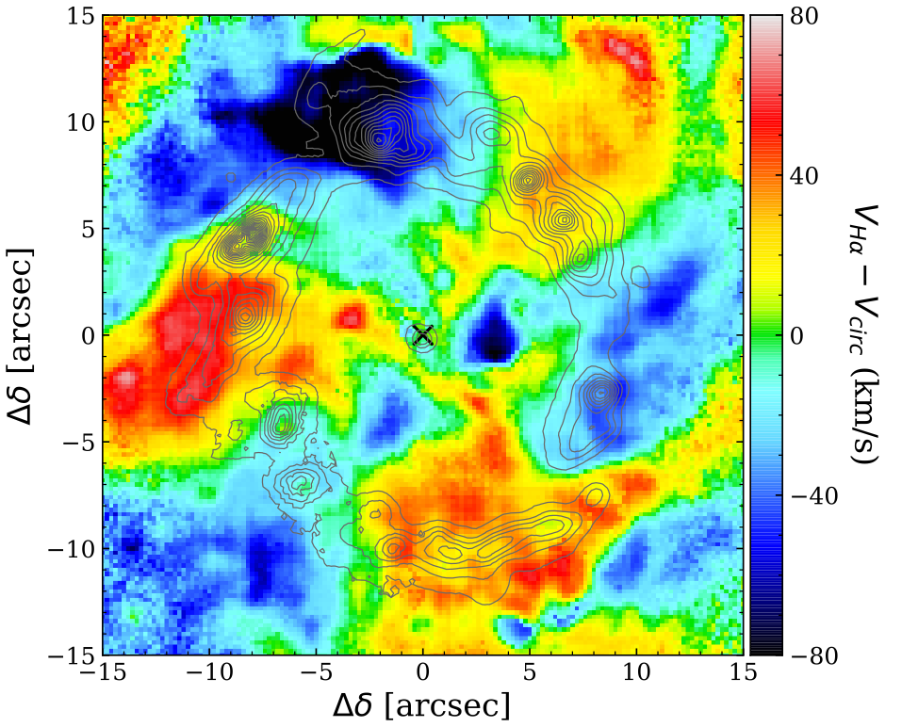
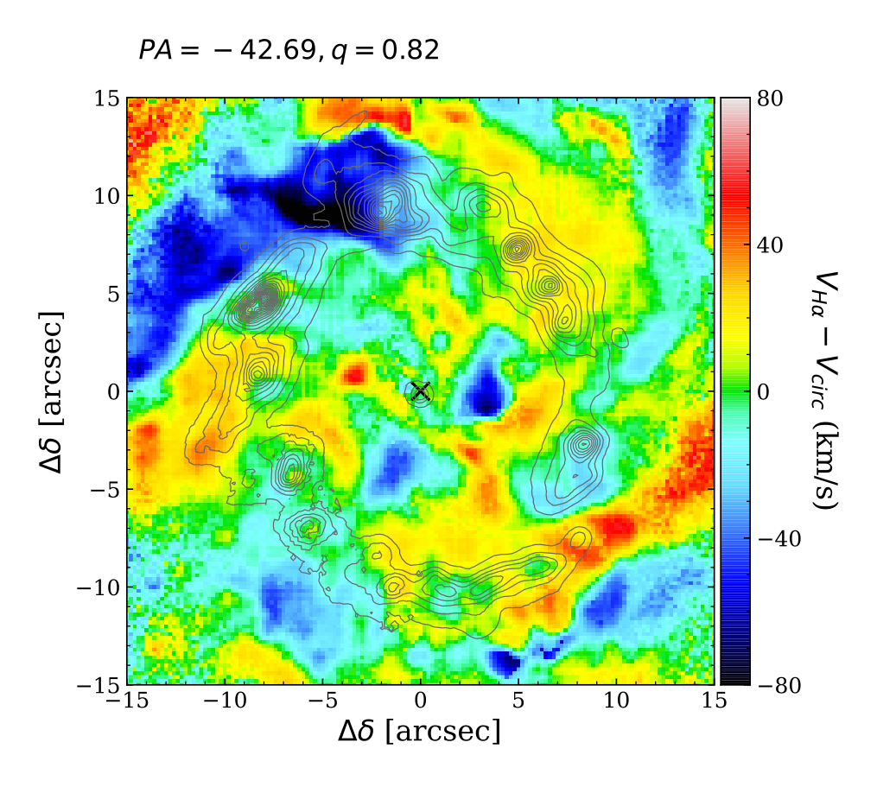
How to identify the large scale shocks in kinematics?
Van Der Kruit - Allen 1978
1) Classical approach: removing the circular rotation of a modelled disk
$$PA={137}^{o},i={35}^{o}$$
VHα
Vcircular
Van Der Kruit - Allen 1978
Residual Velocity Maps ($V_{Hα}−V_{circluar}$)
$$PA={137}^{o},i≈{53}^{o}$$
$$PA={137}^{o},i≈{35}^{o}$$
$$PA={125}^{o},i≈{35}^{o}$$
Pilot Study with NGC 1097
Kolcu et al. 2023
Tutku Kolcu/
Tutku.Kolcu@nottingham.ac.uk
7
Notes:
NII-more common in post shock region, will have different velocity / its velocity is more char. In post shocks

Slide 8
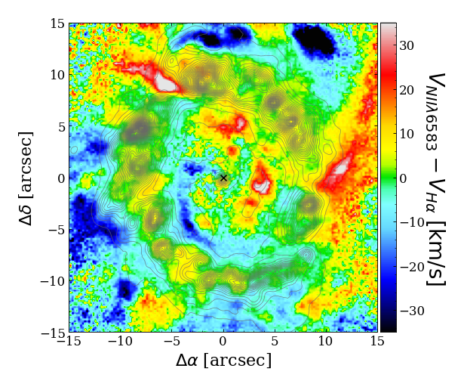
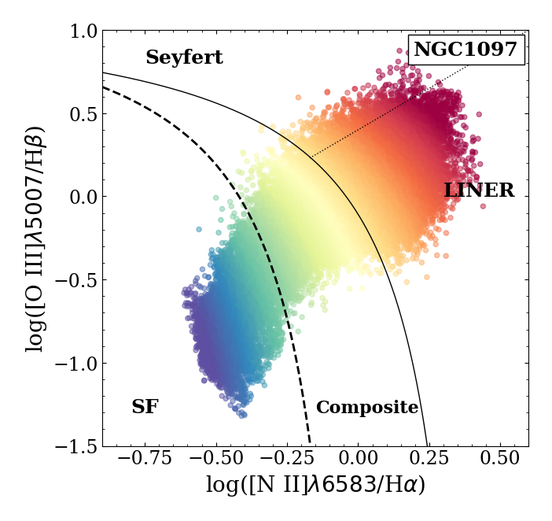
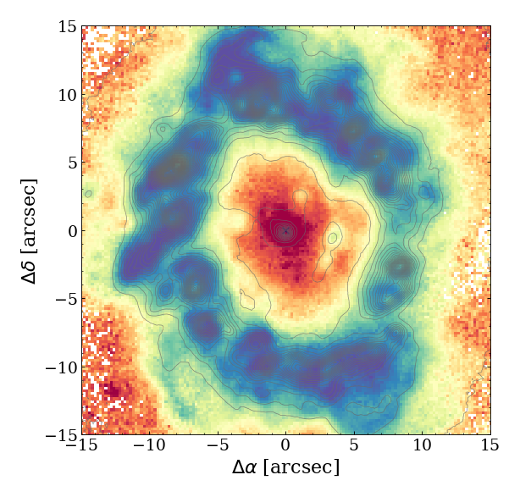
How to identify the large scale shocks in kinematics?
2) Model independent new approach: kinematic differences between $Hα$ and $[NII]λ6583$
Velocity Difference Map
BPT MAP
Pre-shock region: Hα dominates Post-shock region: NII dominates
Limitations: central physical activity (star formation, AGN)
Pilot Study with NGC 1097
Kolcu et al. 2023
Tutku Kolcu/
Tutku.Kolcu@nottingham.ac.uk
8
Notes:
NII-more common in post shock region, will have different velocity / its velocity is more char. In post shocks

Slide 9
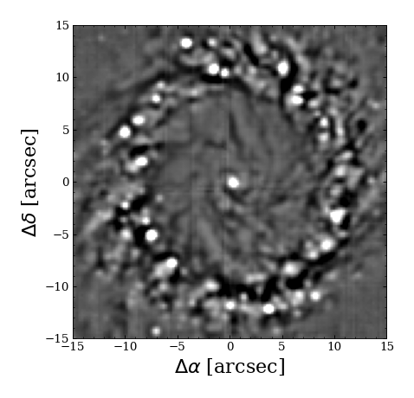
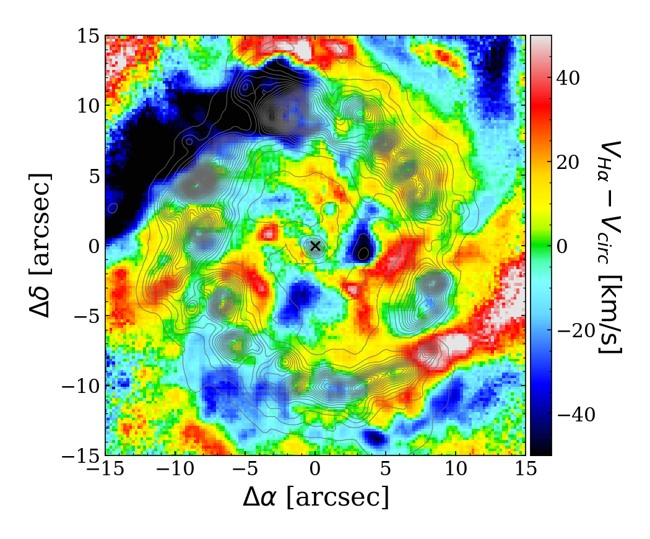
Pilot Study with NGC 1097
How to identify the large scale shocks in kinematics?
Kolcu et al. 2023
We need to combine various methodologies while searching for extended shocks!
Structure Maps
Velocity Residual Map
Velocity Difference Map
BPT MAP
Limitations:
There maybe not much dust to trace
Limitations:
strong dependency on fitting the disk model
Limitations:
central physical activity (star formation, AGN)
Tutku Kolcu/
Tutku Kolcu/
Tutku.Kolcu@nottingham.ac.uk
T.Kolcu@2020.ljmu.ac.uk
9
Notes:
NII-more common in post shock region, will have different velocity / its velocity is more char. In post shocks

Slide 10
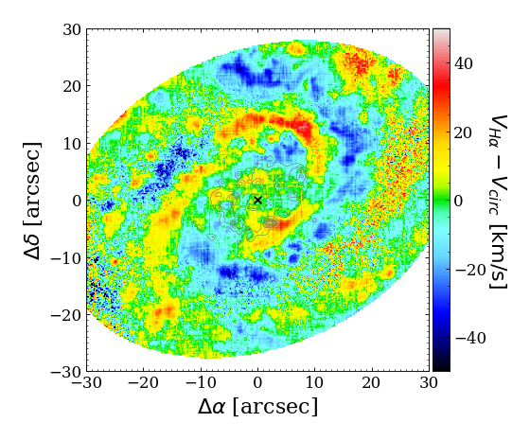
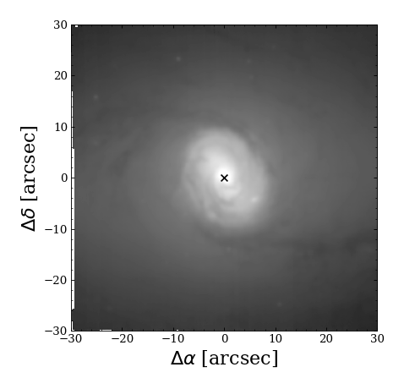
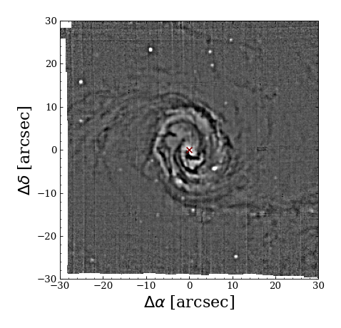
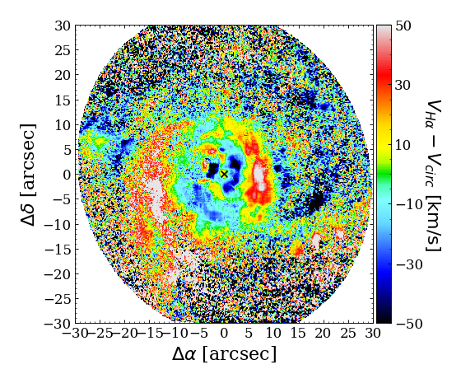
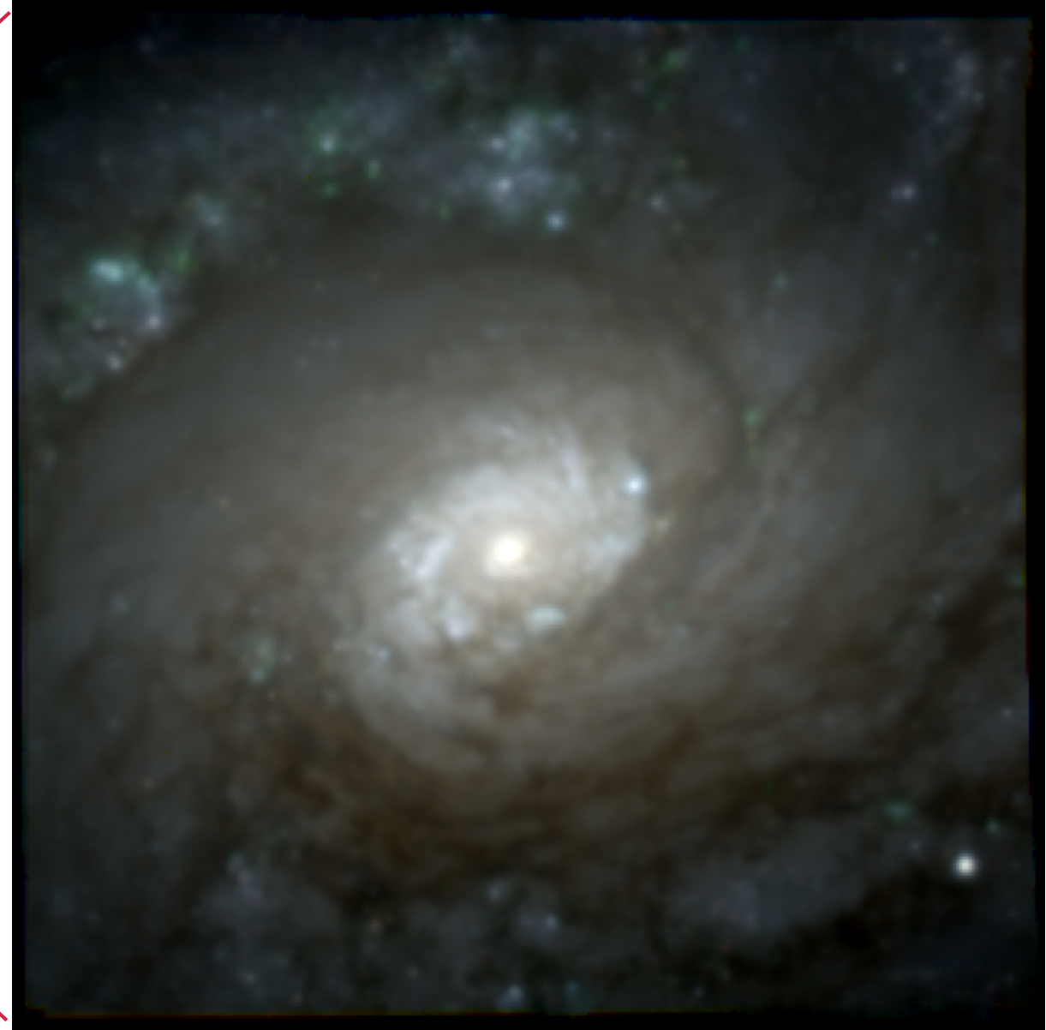
$$Σ_{gas}$$
$$V_{residual}$$
Coherent continuous structures in residual velocity maps, interpreted as spiral shocks propagating to the nucleus
Coherent broken structures in residual velocity maps aligning with dust lanes
NGC 5248
NGC 1433
$$30$$
Davies+09
$$20$$
$$10$$
$$0$$
$$−10$$
$$−20$$
$$−30$$
$$−30$$
$$−20$$
$$−10$$
$$0$$
$$10$$
$$20$$
$$30$$
Tutku Kolcu/
Tutku Kolcu/
Tutku.Kolcu@nottingham.ac.uk
T.Kolcu@2020.ljmu.ac.uk
10
Notes:
The HST images show both nuclear rings, though the outer NR is more like a broad annulus of flocculent-arm star-formation (+ an asymmetric pair of spiral arms making up the inner edge of this zone). The inner NR is harder to make out clearly due to the dust.
SINFONI H+K is present

Slide 11
Coherent continuous structures in residual velocity maps, interpreted as spiral shocks propagating to the nucleus
Coherent broken structures in residual velocity maps aligning with dust lanes
NGC 5248
NGC 1433
$$30$$
$$20$$
$$10$$
$$0$$
$$−10$$
$$−20$$
$$−30$$
$$−30$$
$$−20$$
$$−10$$
$$0$$
$$10$$
$$20$$
$$30$$
Tutku Kolcu/
Tutku Kolcu/
Tutku.Kolcu@nottingham.ac.uk
T.Kolcu@2020.ljmu.ac.uk
11
Notes:
The HST images show both nuclear rings, though the outer NR is more like a broad annulus of flocculent-arm star-formation (+ an asymmetric pair of spiral arms making up the inner edge of this zone). The inner NR is harder to make out clearly due to the dust.
SINFONI H+K is present

Slide 12
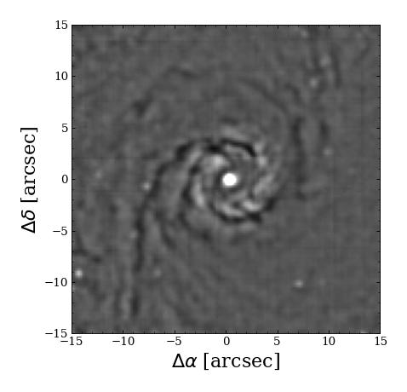
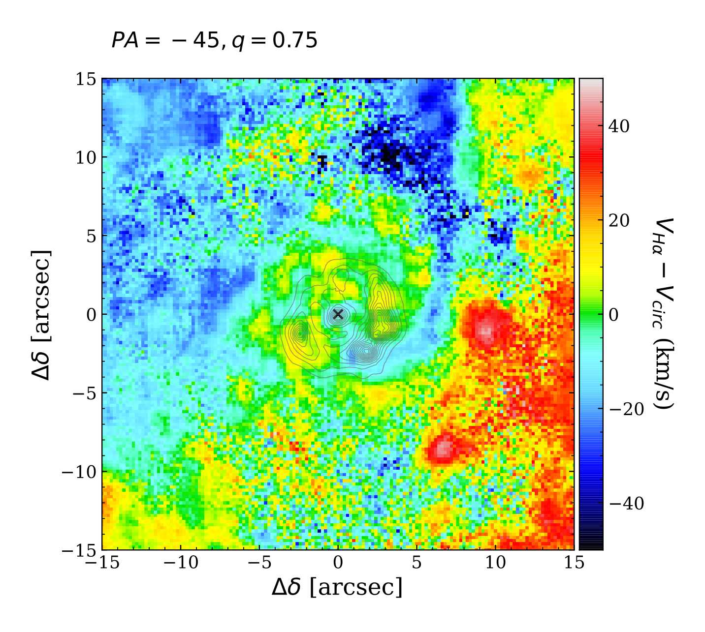
Simultaneous coherent structures can be seen in multiple methodologies
NGC 4303
Structure Maps
Velocity Residual Map
Velocity Difference Map
Tutku Kolcu/
Tutku.Kolcu@nottingham.ac.uk
12
Notes:
Simultaneously occurring,
Depends on geometry, shocks may be clear/unclear
Diff: efficiency of sir is important factor

Slide 13
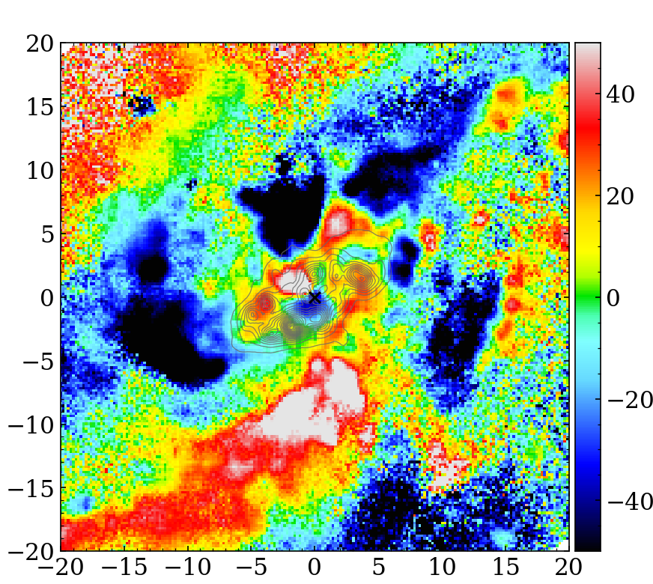
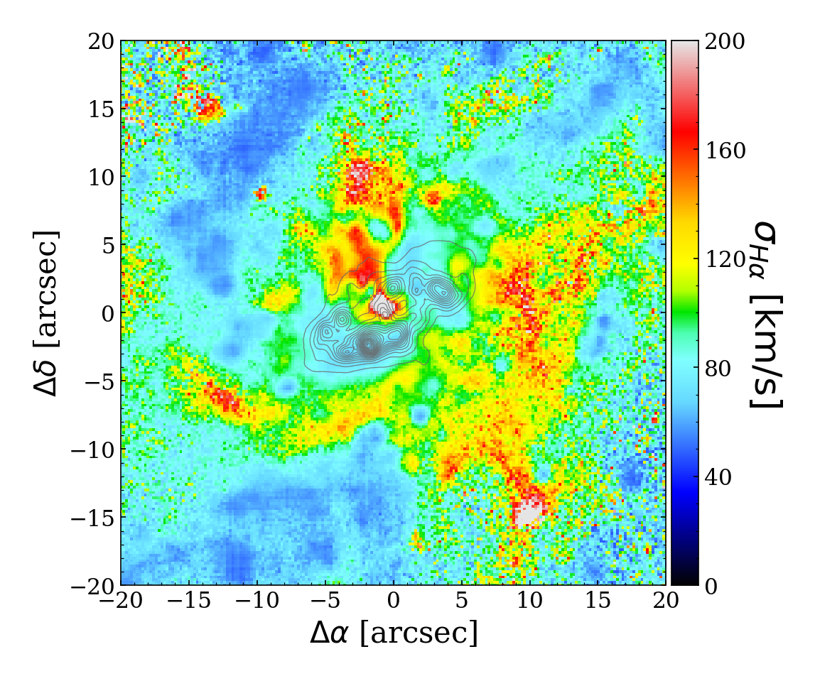
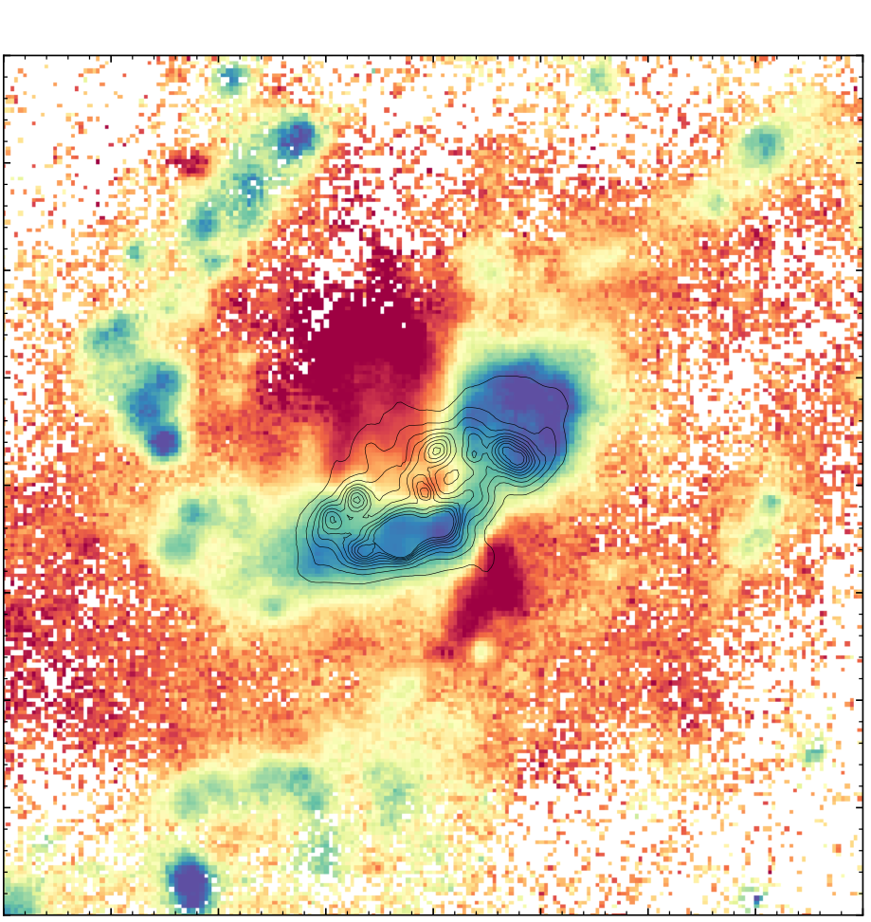
Central physical activity can obscure coherent structures in the kinematic maps
NGC 613
Velocity Residual Map
Velocity Difference Map
Velocity Dispersion Map
BPT Map
check out Silva-Lima et al. 2025 (incl. Kolcu) for a detailed case study of NGC 613!
Tutku Kolcu/
Tutku.Kolcu@nottingham.ac.uk
13

Slide 14
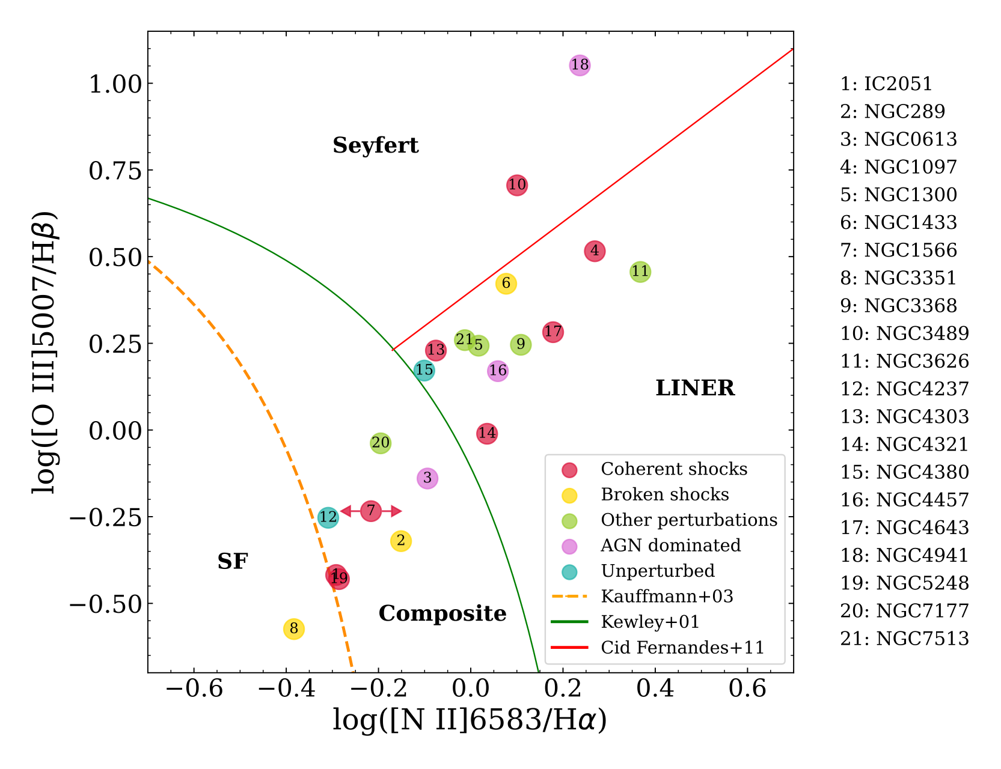
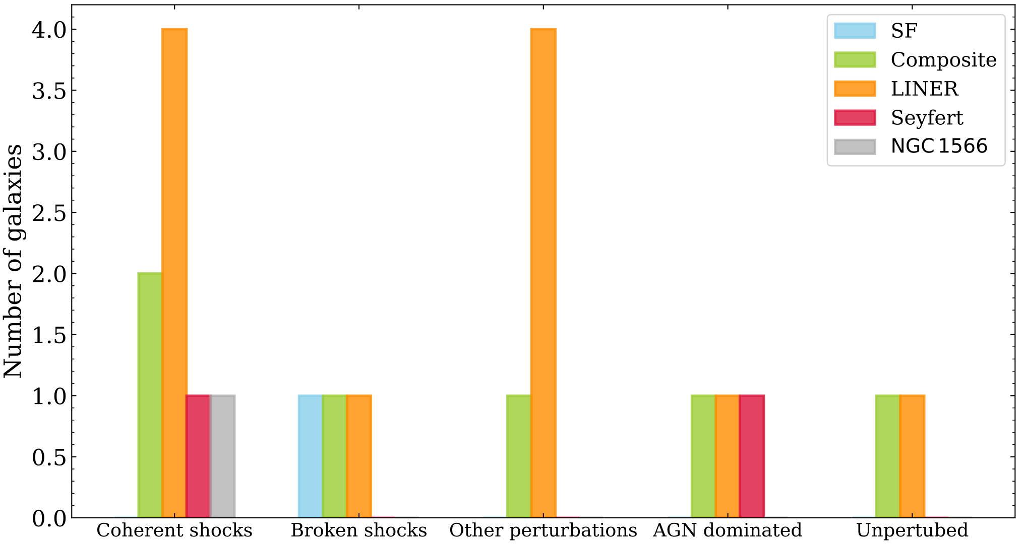
What is driving the kinematics in the inner kpc?
Grouping 1: Type of emission in nuclear regions
Grouping 2: Type of kinematic perturbations seen within inner kpc
—BPT Diagram for the flux integrated over 150pc aperture—
in ~57% (12/21) of galaxies extended shocks dominate the kinematics
in ~14% (3/21) of galaxies AGN outflows dominate and cause obscuration
in ~19% (4/21) of galaxies other kinematic perturbations were dominant
~10% (2/21) of galaxies do not have perturbed kinematics (unbarred galaxies)
Tutku Kolcu/
Tutku.Kolcu@nottingham.ac.uk
14

Slide 15
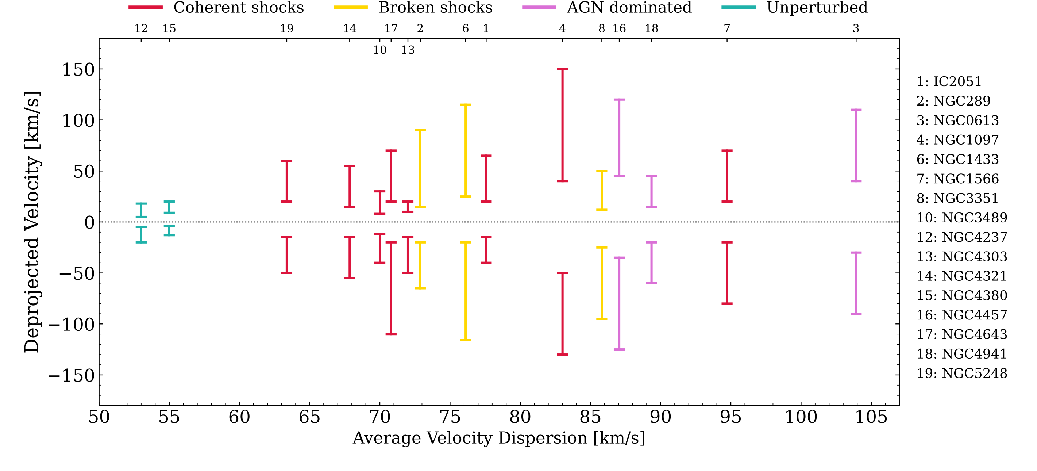
A closer view to global properties along the shock signatures
Larger the velocity ~ Larger the shock strength
Low velocities and velocity dispersions suggest no shock origin. Signatures are due to wave propagation only
Shock signatures with larger velocities are in galaxies in more disturbed systems
Extended shocks are contributing to the overall disturbance within the inner kpc
Tutku Kolcu/
Tutku.Kolcu@nottingham.ac.uk
15

Slide 16
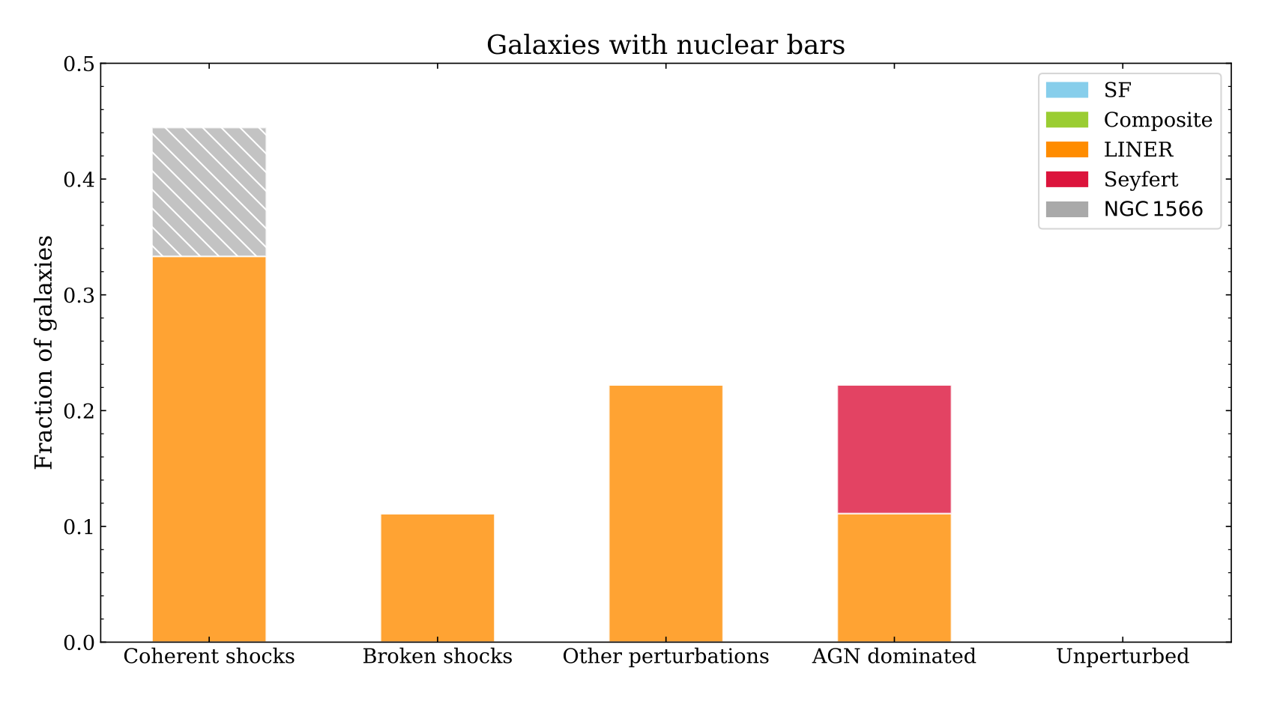
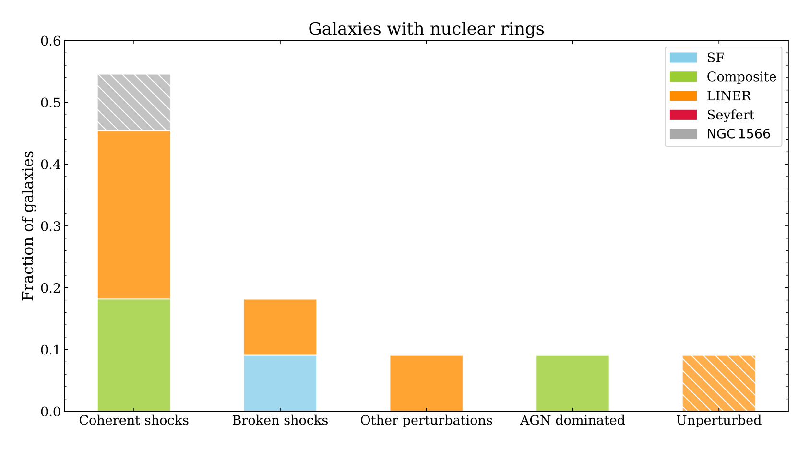
A closer view to central stellar structures and presence of extended shocks
Galaxies with nuclear bars
Galaxies with nuclear rings
Nuclear bars prevent SF activities to dominate within inner kpc of galaxies
~75% of galaxies with nuclear rings exhibit extended shocks
Extended shocks lead inflow to inner kpc, contributing formation of nuclear rings
Galaxies without nuclear bars
Galaxies without nuclear rings
Tutku Kolcu/
Tutku.Kolcu@nottingham.ac.uk
16

Slide 17
Take away messages
Are extended shocks the dominant mechanism driving the gas to nucleus of galaxies?
Pilot Study with NGC 1097 Kolcu et al. 2023, MNRAS, 524, 207
Sample study in prep.
NGC 5248
NGC 1097
in ~57% of galaxies is dominated by extended shocks
Classical and new kinematic methods, together with morphology and dust can unveil large-scale shocks propagating to the nucleus
in ~14% of the galaxies is dominated by AGN outflows
Extended shocks contribute to overall disturbance of the system, and lead formation of nuclear rings due to promoting inflow
T.Kolcu@2020.ljmu.ac.uk

Slide 18
National Astronomy Meeting | 10.07.25
MUSE view of gas inflows in nearby galaxies: Connections to Nuclear Activity and Central Morphology
Dr Tutku Kolcu
Advisors: Witold Maciejewski (LJMU), Dimitri Gadotti (Durham), Francesca Fragkoudi (Durham), Peter Erwin (MPE)
Tutku.Kolcu@nottingham.ac.uk

Slide 19
Shocks along the nuclear bar? Is there a nuclear bar?
NACO J-band
Prieto+05
Pilot Study with NGC 1097
Kolcu et al. 2023, MNRAS, 524, 207.
T.Kolcu@2020.ljmu.ac.uk
Notes:
Limitations: absence of dust, collisional nature, origin independent from shocks

