Slide 3
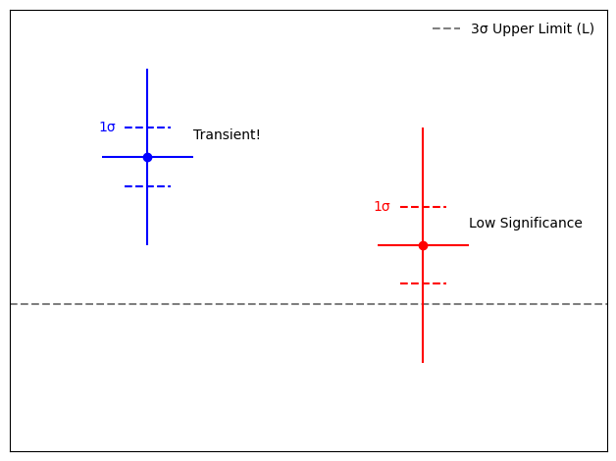
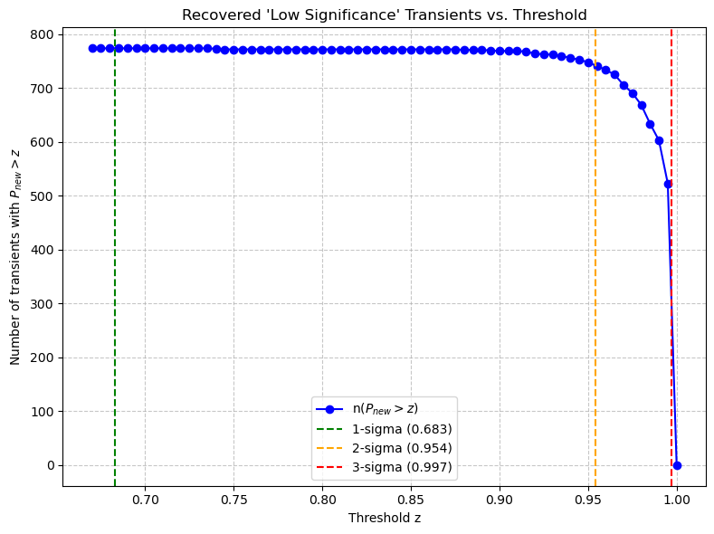


Improving Transient Identification With Swift-XRT
Srijan Srivastava (ss1606@leicester.ac.uk), Dr. Phil Evans
2nd Year PhD Student, University of Leicester
Recovered 523 transients!! (15 times more)
Only 36
Affected by Eddington Bias
>800
Notes:
I am working on improving transient identification with the Living Swift point source catalogue or LSXPS which is a live catalogue updated in “real time”, with a transient search algorithm, so if a new transient is found, we are notified within minutes to hours. But in 3 years only found 36 transients as we threw away faint sources because they might be affected with statistiical biases.
So I used a bayesian approach to correct the bias and we recover 523 new transients (15 time more than the original 36). This approach will be implemented in the live system by us with all the information and new significances. So we can follow through immediately and get more serendiptious discoveries.

